Slide 1
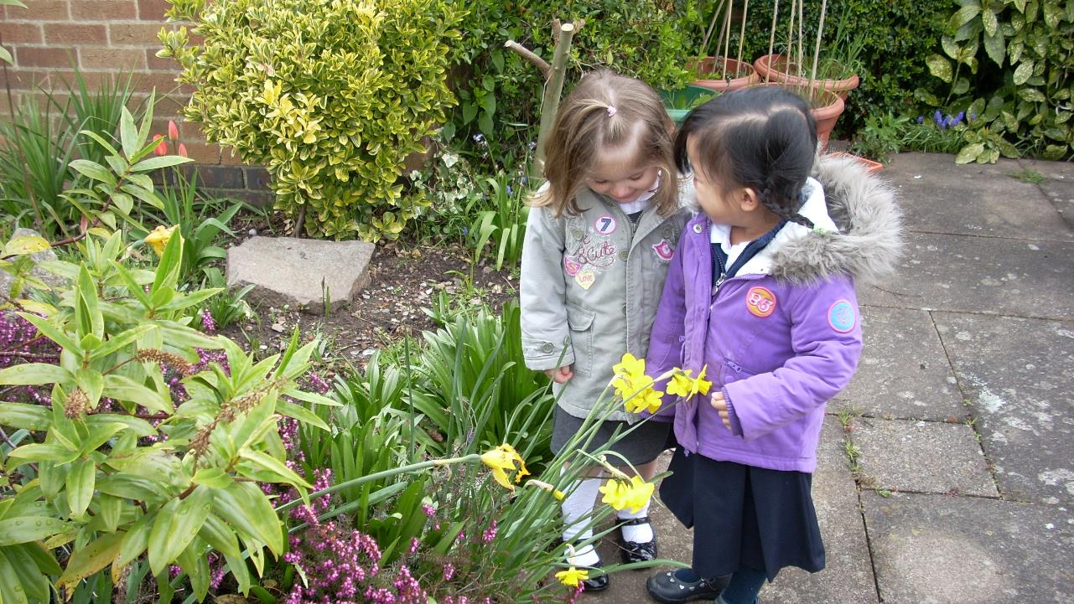
Diocese of Salford
RE in EYFS: dynamic, playful, deep and driven by curiosity, can our RE be more fun, mind opening and thoughtfully creative?

Slide 2
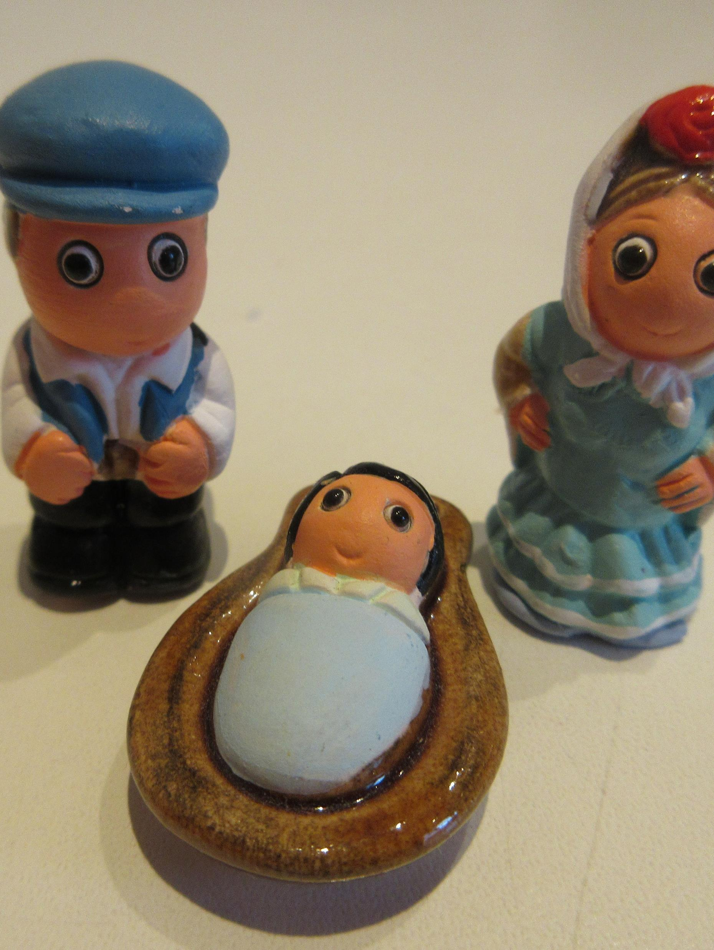
Christmas decorations
(Also: play ‘Kims Game’ with 9 Christmas artefacts, then sort them from 1-9 ‘essential at Christmas’ (Baby Jesus) down to ‘easy to have Christmas without this one (chocolate snowman).

Slide 3
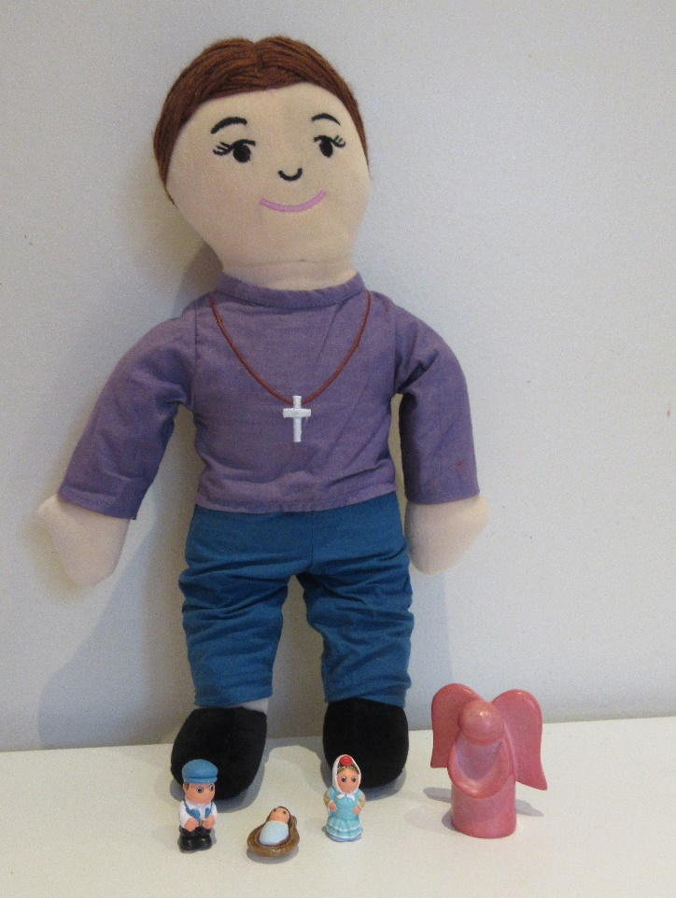
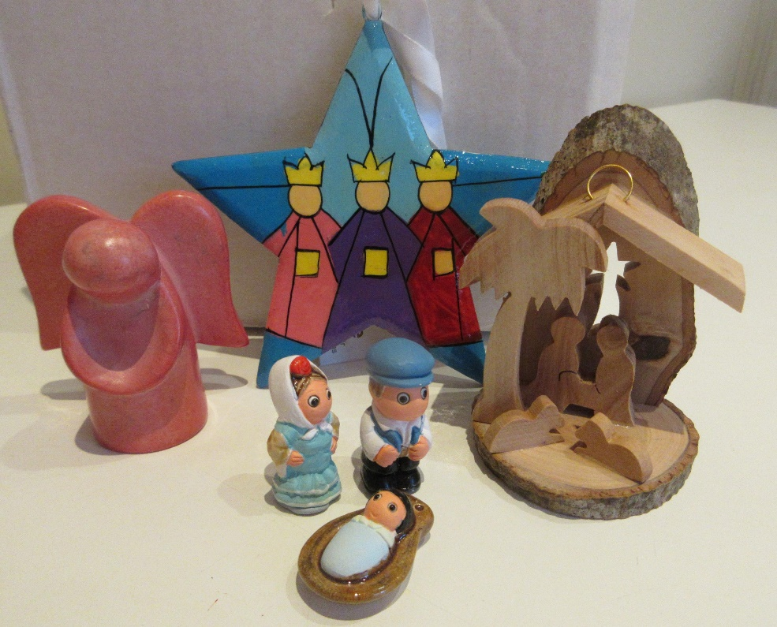
Joanna has 4 favourite Christmas decorations

Slide 4


Which is your favourite?
This one is cute because it would fit in a matchbox
This one has gold in it, but you can’t see it.
This one is made from the wood of a tree from Bethlehem
This one means ‘Peace on Earth, goodwill to all people’

Slide 5

Persona dolls
– a key method in EY RE?
Joanna:
brings things to show the class,
can share a video
can join in singing a song
shares food
tells children what she thinks about a story, an act of worship or an idea
Persona dolls from TTS Religion in Evidence, about £20 (but maybe any doll will do!)

Slide 6
This RE might seek to be…
Playful
Deep
Story based
Active
Child-initiated
Creative
Varied
Thoughtful

Slide 7
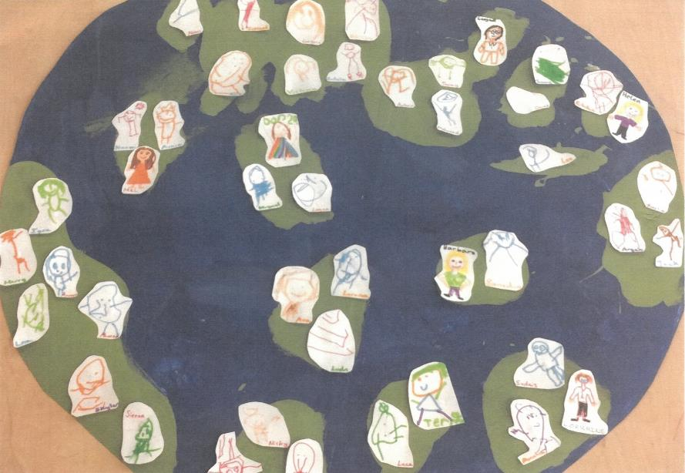
Nursery Class
3-4
Underhill School
United earth, children of one world.
“Our class have joined together to create the Earth, which unites as one! The waters may divide us but we come together with love. Our kind and caring characters help us play in harmony. We may all be unique in our own special way but we create this class filled with joy and happiness!”

Slide 8
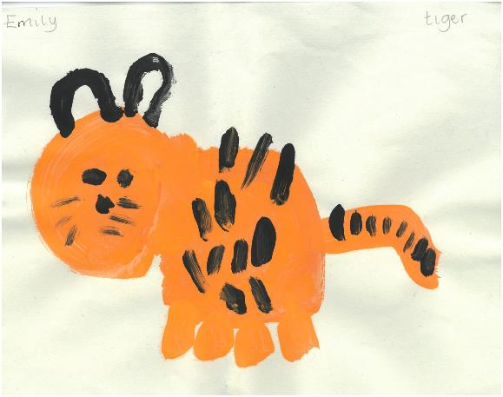
Emily (4)
St Margaret's Primary School
Why do tigers have stripes?

Slide 9
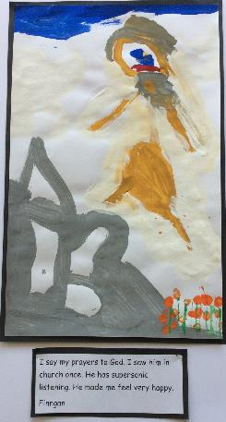
Finnegan, 4
“I say my prayers to God. I saw him in church once. He has supersonic listening. He made me feel very happy.”

Slide 10
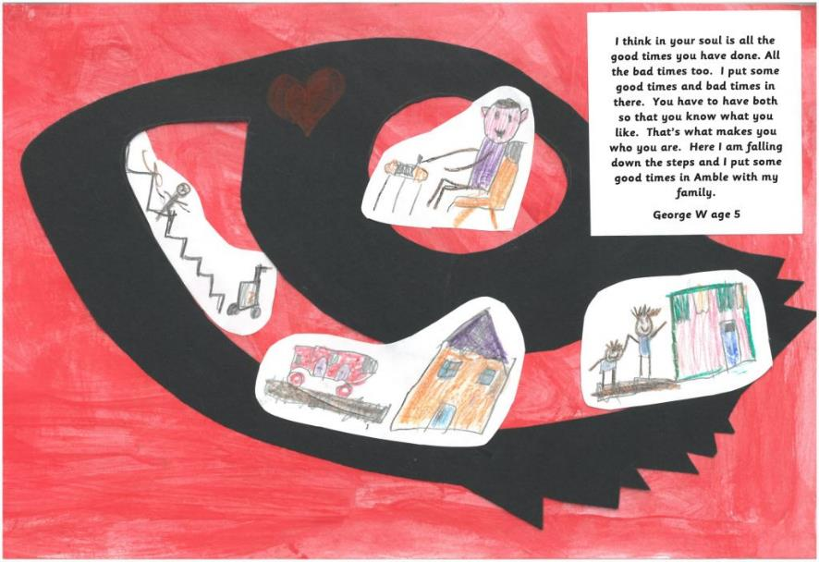
Our children are thinking – deeply.
A danger in RE is that we just teach them little facts – but we must also teach them to think big thoughts.

Slide 11
By the end of the Reception year, we want children to have had opportunities to…
Answer ‘how’ and ‘why’ questions about their experiences and in response to religious stories or events.
Show sensitivity to others’ needs and feelings.
Talk about how they and others show feelings.
Confidently speak in a familiar group and talk about their ideas.
Express themselves effectively, showing awareness of listeners’ needs.
Give their attention to what others say and respond appropriately.
Talk about their own and others’ behaviour and its consequences.
Talk about past and present events in their own lives and in the lives of family members.
Know that other children don’t always enjoy and share the same feelings and are sensitive to this.
By the end of age phase pupils will be able to:
Listen to and talk about religious stories and respond to what they hear with relevant comments.
Sing songs, make music and dance to express religious stories.
Use a variety of materials, tools and techniques, experimenting with colour, design, texture, form and function to express religious stories.
Represent their own ideas, thoughts and feelings about religious stories through design and technology, art, music, dance and role play.
Develop their own narratives and explanations of religious stories by connecting ideas or events to the scripture source used.
Read and understand simple sentences from scripture or from their own religious stories
Share religious stories they have heard and read with others.
Listen, talk about and role play similarities and differences in relation to places they have read or heard about family, church communities and religious stories.
Write simple sentences about religious stories using phrases or words which can be read by themselves and others.
Listen, talk about and role play how people act in a particular way because of their beliefs.
Listen and talk about key figures in the history of the People of God.
Listen, talk about and role play how people behave in the local, national and universal church community.
Listen and talk about religious signs and symbols used in worship, including the celebration of the Sacraments. Use religious signs and symbols in role play.
Decode key religious words appropriate to their age and stage of development.
Use key religious words appropriate to their age and stage of development.

Slide 12
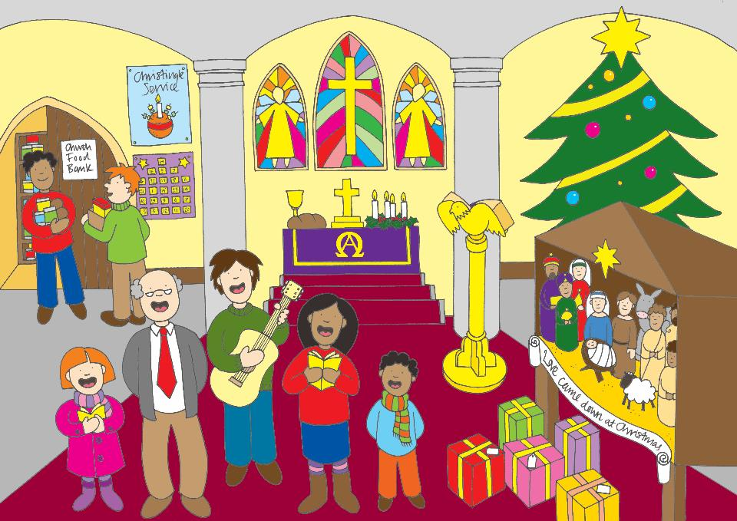
Pointing out, or labelling
Star
Angel
Bible
3 wise men
Bread and wine
Free food
Present
Baby Jesus
Advent Candles
Sharing
Singing
Giving
Remembering
Praising
Kindness
Worship

Slide 13

He came down to Earth from Heaven, who is God and Lord of all
The Angel said ‘Peace on Earth and goodwill to all people with who God is pleased’
The stars in the Bright Sky looked down where he lay, the little Lord Jesus asleep on the hay.
The true light was coming into the world.
Sing to the Lord for he has done wonderful things
Mary laid him in a manger because there was no room for them at the inn

Slide 14
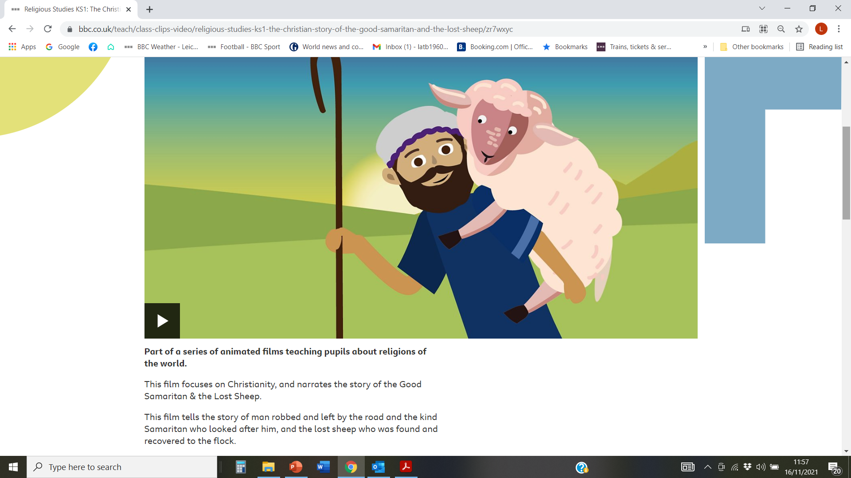
https://www.bbc.co.uk/teach/class-clips-video/religious-studies-ks1-the-christian-story-of-the-good-samaritan-and-the-lost-sheep/zr7wxyc

Slide 15
From the NATRE guidance available to participants in this webinar.

Slide 17

RE in the Nursery: Case study
Emma Pobjoy is Head of Pastures Way School in Luton. She shares some great RE practice from the Nursery
This PowerPoint sequence supports ideas from Summer 2020’s REtoday magazine page 40
This downloadable resource, free to REtoday magazine subscribers and NATRE members, is © RE Today and may be used in your own school. Any other use is by written permission only.
© RE Today, 2017.

Slide 18
Diversity from the very start
“Pastures Way is a nursery school in Luton, a town rich in religious diversity. In a town full of diversity teaching of religious studies is important but even more essential is teaching of acceptance. In the early years these come hand in hand.
We start with a clear message to our youngest children that different people believe different things and that’s OK. This is reinforced through our values curriculum which teaches love, companionship and belief.
Providing opportunities for talk, exploration, experiences, visits, storytelling and creativity the excitement of celebrations and the familiarity of a home religion to children can be an excellent tool in developing learning. Examples of learning can range from learning in the moment to planned specific learning.”
© RE Today, 2017.

Slide 19
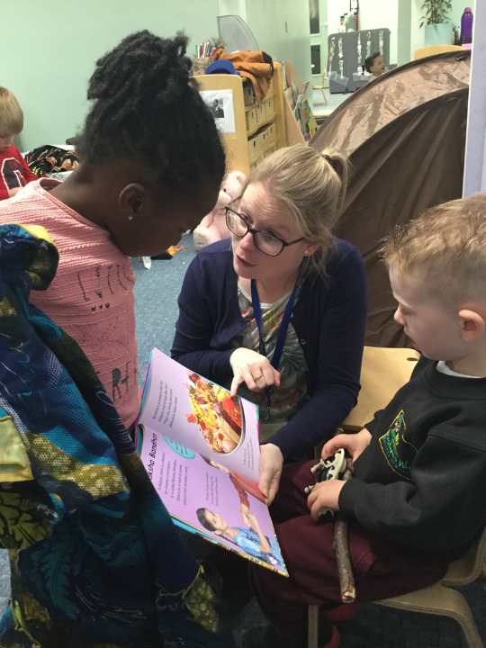
From the beginning of their education at Pastures Way, children learn about diversity in the context of their language and book work.
© RE Today, 2017.

Slide 20
Christian, Muslim, Hindu
Clay, blocks play, links
“Celebrations and festival are a prime time to support learning about religions. At Christmas as well as joining in with all the fun celebrations, story telling is an invaluable tool to learn about Christianity, as it is about Islam and Hindu communities, for example during Diwali the children looked at artefacts from the Hindu religion and then made divas out of clay.
At other times learning can be much more organic. Recently I watched a practitioner playing alongside children in the block play and construction area, a child chose to make a church out of the blocks, this lead to looking at photos of churches, talking about what happens in church and finally leading to a discussion about Christianity and some of the ways of life of Christians - for example one child explained that they go to church every Sunday and what happens there: an important opportunity to link their life at home and school.”
© RE Today, 2017.

Slide 21
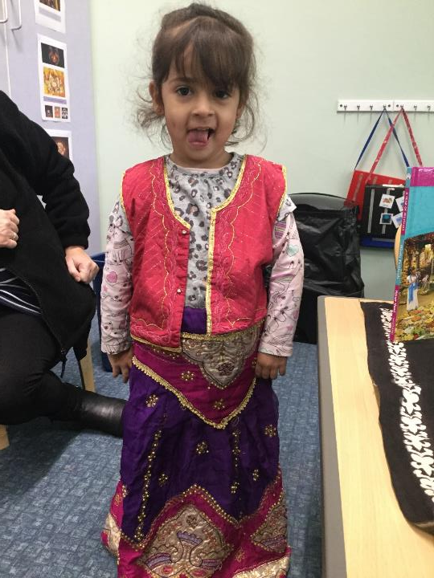
Our children love our multi-religious dress up and fabric box. Note the prayer mat in the display next to this girl’s chosen costumes.

Slide 22
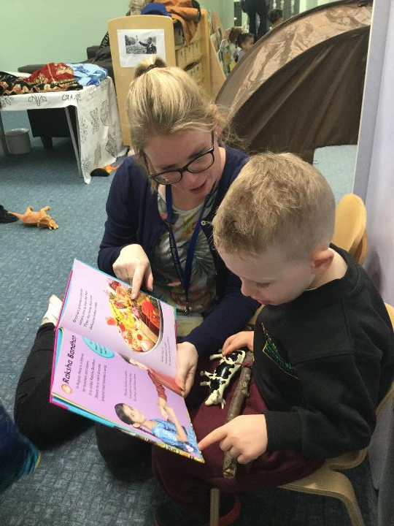
We weave RE and all the early learning goals together in continuous and playful provision.
This boy is beginning to learn about the Hindu festival of Raksha Bandhan from looking at the picture book.

Slide 23
Provocations
Across the nursery there are many ways to integrate RE, our favourite and most effective is through using provocations.
Provocations inspire children and encourage them to engage. The great thing is they are simple and can range from stories, photos or artefacts to do with any religion of choice. The great thing about provocations is that they are open ended and give practitioners opportunity to introduce children to different religions at their pace of exploration.
Our photo record of these kinds of learning opportunities speaks for itself. From books, stories and artefacts to dressing up and playing with puppets, RE can be found in a hundred different ways in early learning.
© RE Today, 2017.

Slide 24
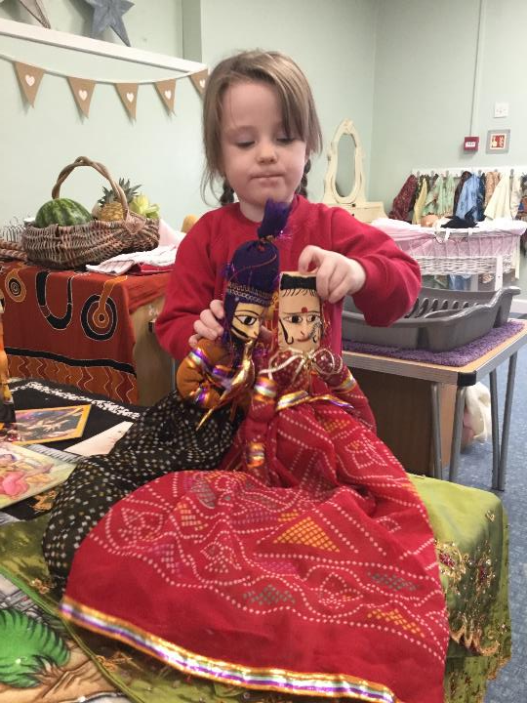
Provocations provide an amazing way to engage children, create language rich experiences and impact learning about specific religions.
Hindu puppets connect to the child’s play and the story the class has heard about Divali

Slide 25
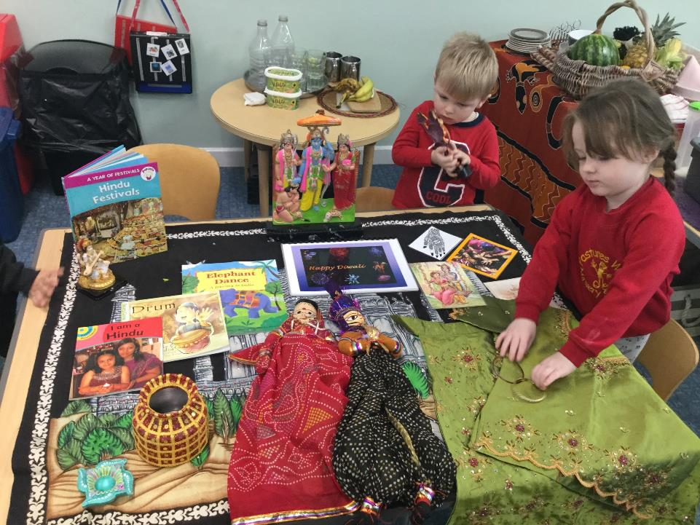
Our photo record of these kinds of learning opportunities speaks for itself. From books, stories and artefacts to dressing up and playing with puppets, RE can be found in a hundred different ways in early learning.

Slide 26
Talking points for
Early Years RE
Look back at what Emma describes. What do you identify some good practice here?
Consider your own practice: is there space for diversity and RE in your Nursery and Reception classes?
Discuss what practical examples from Pasture’s Way your setting could adapt – and what new ideas are sparked off by this article?
© RE Today, 2017.

Slide 27
Fresh Ideas: How to make RE more playful for young learners
Claire Rivers, Head Teacher at St Mark’s School in East Sussex
“Play is a one of the key areas of effective learning for early years and I believe it is through play that children make sense of the world in which they live, starting with the known and moving into exploration of the unknown.
In my teaching and leading of RE I have encouraged that approach regardless of age- to begin with the known and move into the unknown in order to make good connections in learning and to ensure there is understanding.
Play enables multisensory experiences and high quality personalised learning. Through role play children can explore relationships, cultures, faiths and attitudes, key themes in RE.
By playing collaboratively and cooperatively, with expert adult interaction, children will develop respect, a set of values and communication skills.”

Slide 28
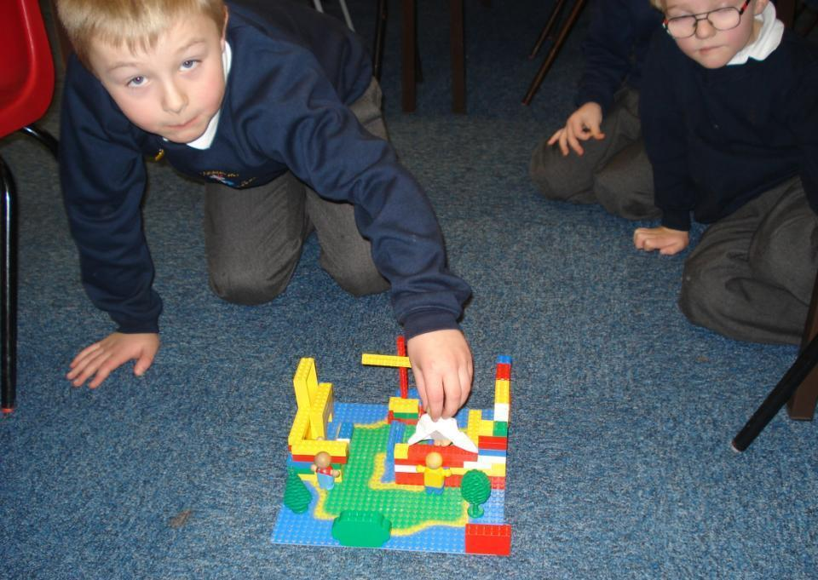
Playful RE needs lego. The boys went to church and played around with the experience when they came back. Natural creativity?

Slide 29
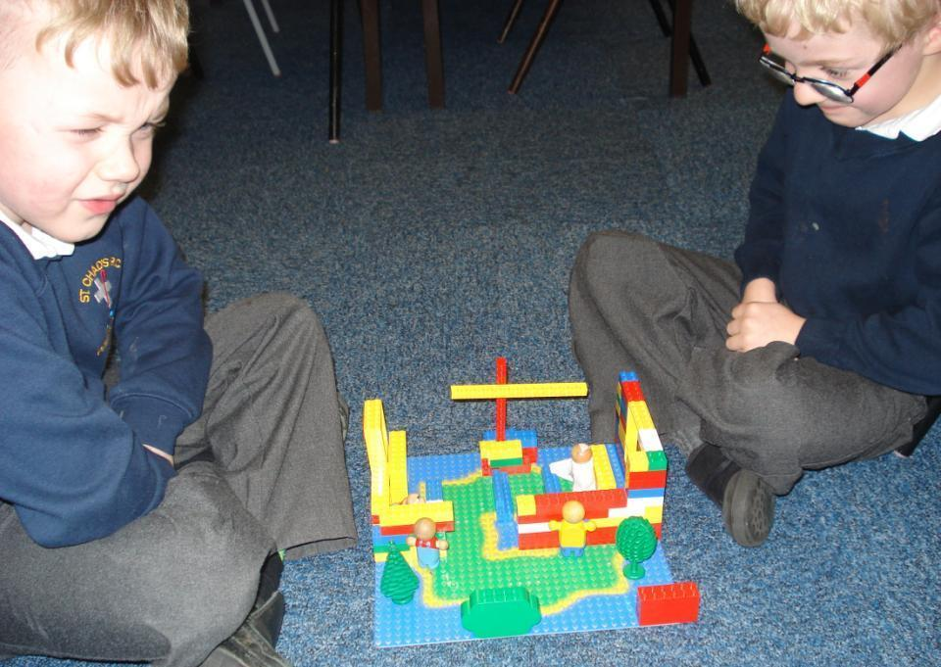
The boys are engaged and busy creating models of some of what they saw on their church visit. See the cross, the priest, the altar? They are beginning to make sense of the Christian community.

Slide 30
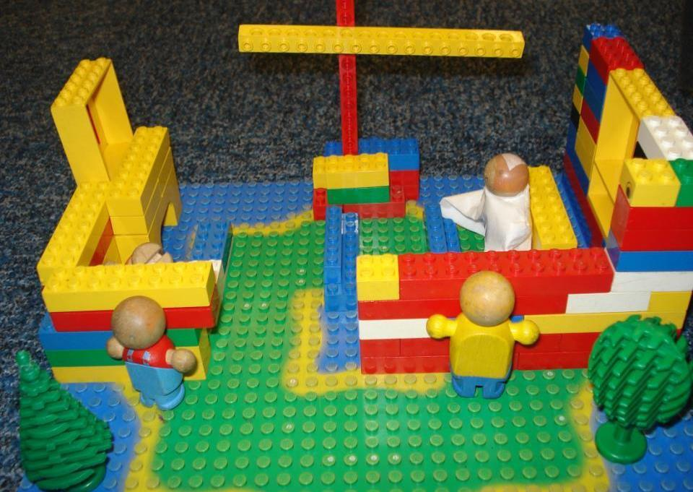
Playful RE: in the close up you can see the Priest, Cross and congregation. Ready for new vocabulary.

Slide 31
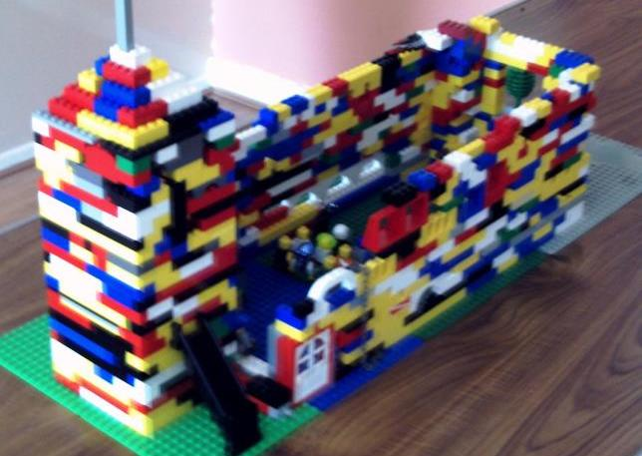
Playful RE
An ambitious recreation of a lego church by some older pupils. Detail is invisible from this angle, but it’s all there.
Including Darth Vader.
The children said “Well. God forgives everyone you know Mr Blaylock”

Slide 32
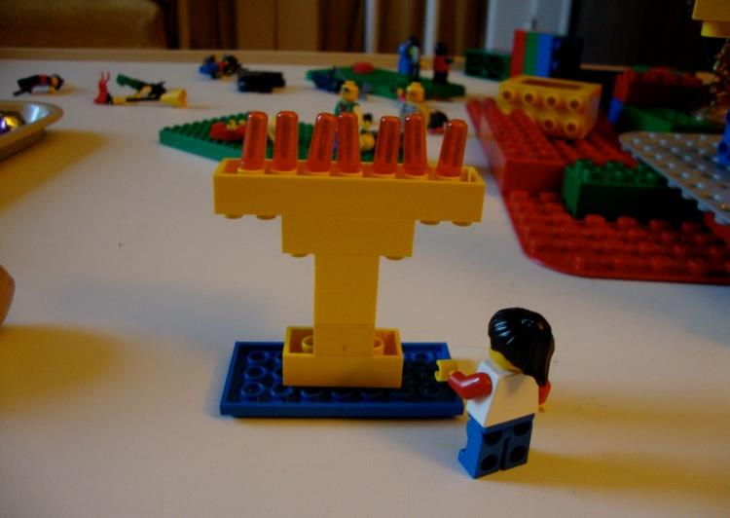
Playful RE: After touch and feel sessions with Jewish artefacts, why not get your pupils to make some artefacts from lego? Here’s a lovely Jewish menorah, complete with seven lightbulbs.

Slide 33
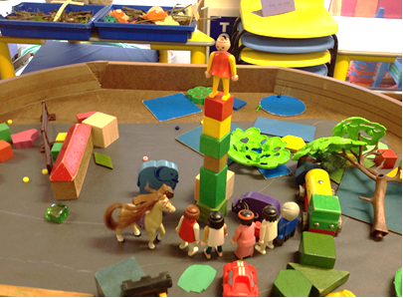
“Everybody came to say a prayer for Jesus when he was on the cross. We put an angel at the top. We could not make a cross so we did a tower.”

Slide 34
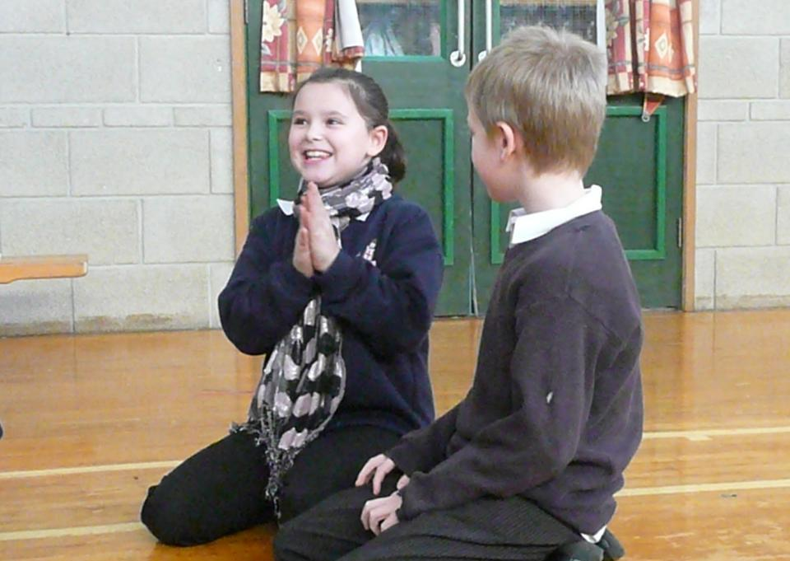
School twinning – pupils sent their own written prayers and reflections for each other to each other from Durham to Tanzania. RE has a local and a global aim and focus. Knowledge and understanding of the world! No less!
They are never too young to be learning that we live in a world and that we may need to share the love all over the world

Slide 35
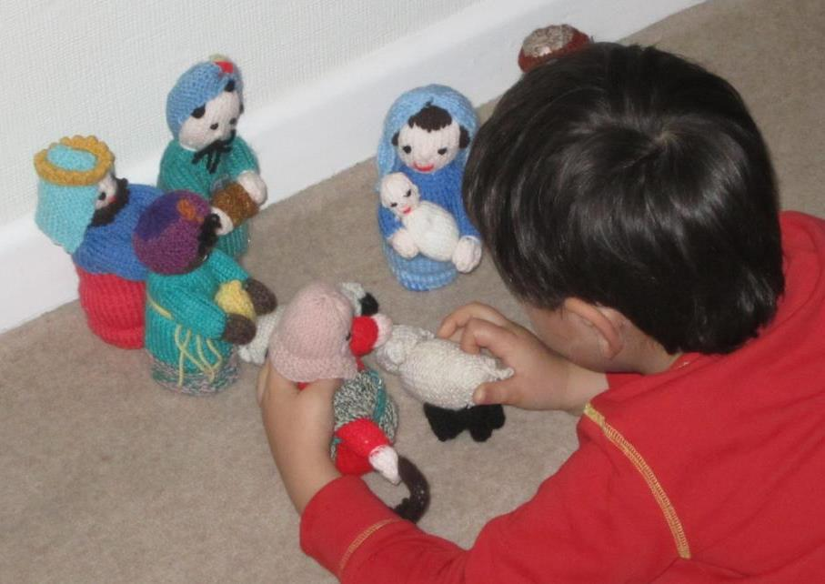
The Small World Nativity
Donna Nagy works at Canon Evans CE Infant School, in Warwickshire. She has been playing around as well...
“Children did a ‘Small World’ play session in a builder's tray, to make the Nativity. Over the years we've used a variety of things for the characters. One year we had Duplo figures for the characters in the story, another time we made dolly pegs into Mary, Joseph, an Innkeeper, Shepherds and wise men, with the children choosing swatches of fabric for the clothes, and drawing faces with sharpie pens. We used sand, gravel and the stones that go in fish tanks for the terrain. The stable was easy to make from some boxes. The children chose to use lollypop sticks for sheep pens!
We regularly do small world for other aspects of the life of Jesus. We have had gospel small world versions of Jesus in the wilderness, Palm Sunday, Good Friday and rising from the dead.”

Slide 36
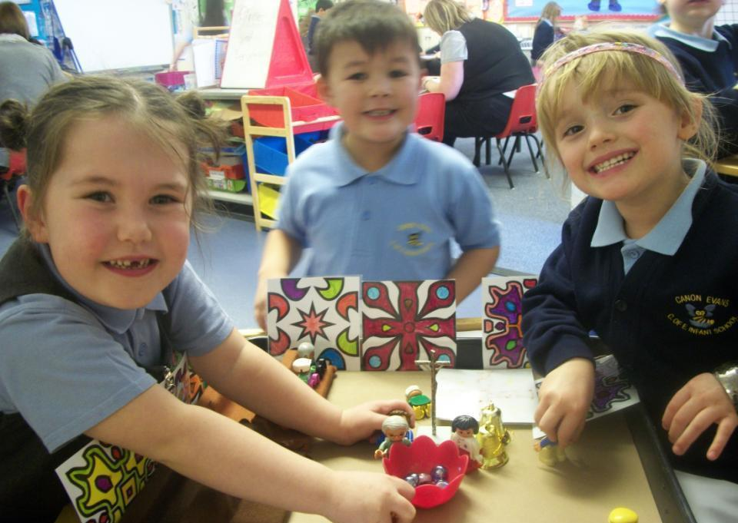
Playful RE: Small world figures of different kinds are great for RE.
This small world church becomes a play area for all the children, and they like the cardboard stained glass removable windows.

Slide 37
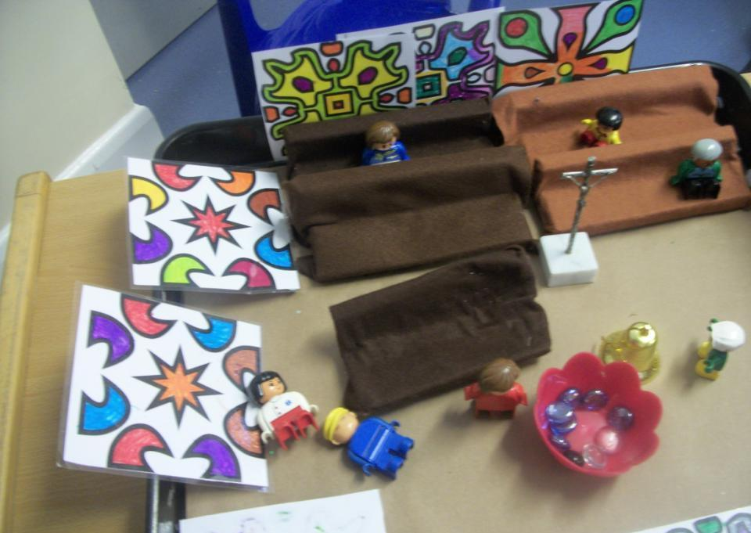
Playful RE
Detail is remembered and incorporated into play.

Slide 38
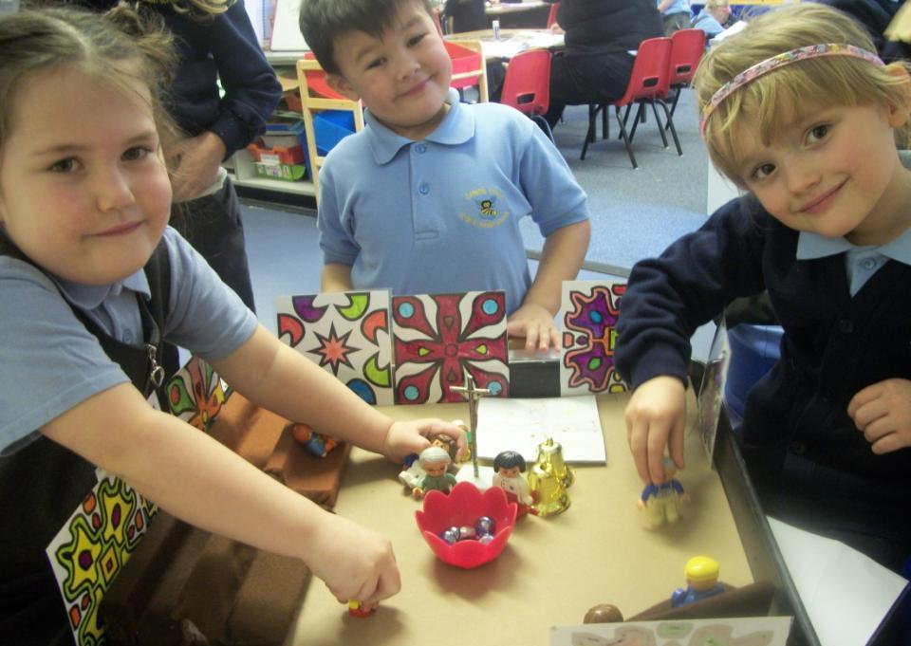
Playful RE
Here comes the Priest to read the Bible

Slide 39
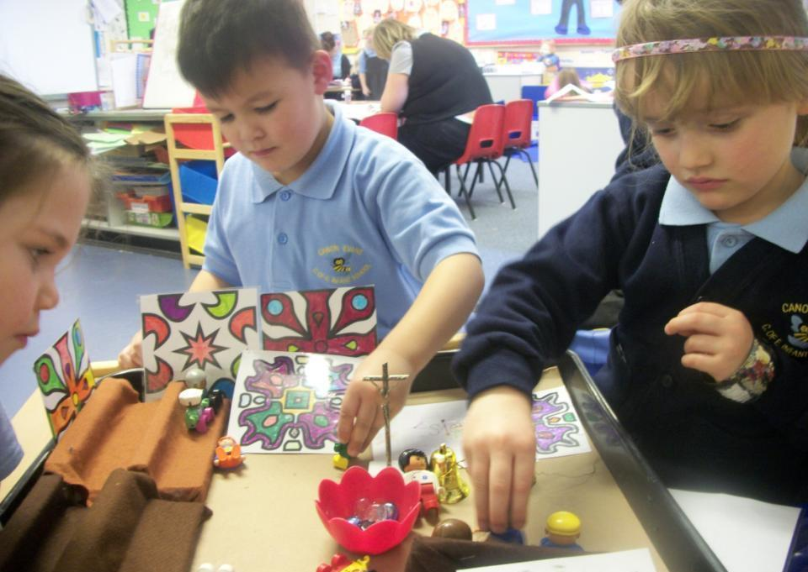
Playful RE
RE needs engagement – you can see it is getting it here.

Slide 40
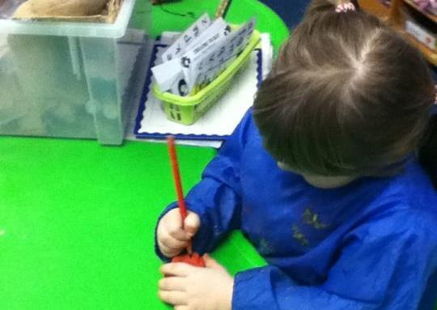
Playful RE
Modelling clay of many kinds has a hundred potential RE experiences in every packet. Get some of them out!

Slide 41
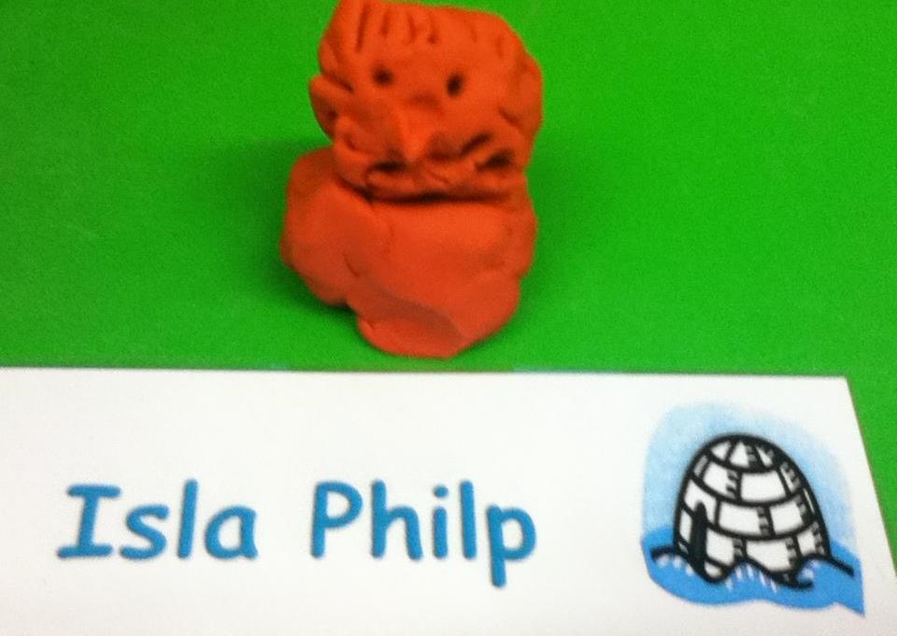
Playful RE: Isla has made a lovely figure of Moses, looking nervous. He has to tell the Pharaoh a message from God

Slide 42
By the end of the Reception year, we want children to have had opportunities to…
Answer ‘how’ and ‘why’ questions about their experiences and in response to religious stories or events.
Show sensitivity to others’ needs and feelings.
Talk about how they and others show feelings.
Confidently speak in a familiar group and talk about their ideas.
Express themselves effectively, showing awareness of listeners’ needs.
Give their attention to what others say and respond appropriately.
Talk about their own and others’ behaviour and its consequences.
Talk about past and present events in their own lives and in the lives of family members.
Know that other children don’t always enjoy and share the same feelings and are sensitive to this.
By the end of age phase pupils will be able to:
Listen to and talk about religious stories and respond to what they hear with relevant comments.
Sing songs, make music and dance to express religious stories.
Use a variety of materials, tools and techniques, experimenting with colour, design, texture, form and function to express religious stories.
Represent their own ideas, thoughts and feelings about religious stories through design and technology, art, music, dance and role play.
Develop their own narratives and explanations of religious stories by connecting ideas or events to the scripture source used.
Read and understand simple sentences from scripture or from their own religious stories
Share religious stories they have heard and read with others.
Listen, talk about and role play similarities and differences in relation to places they have read or heard about family, church communities and religious stories.
Write simple sentences about religious stories using phrases or words which can be read by themselves and others.
Listen, talk about and role play how people act in a particular way because of their beliefs.
Listen and talk about key figures in the history of the People of God.
Listen, talk about and role play how people behave in the local, national and universal church community.
Listen and talk about religious signs and symbols used in worship, including the celebration of the Sacraments. Use religious signs and symbols in role play.
Decode key religious words appropriate to their age and stage of development.
Use key religious words appropriate to their age and stage of development.

Slide 43
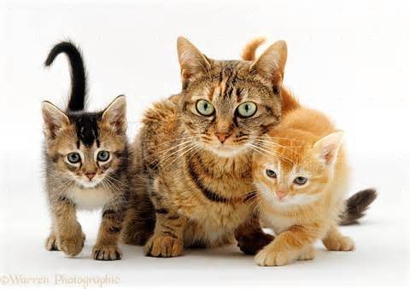

Slide 44
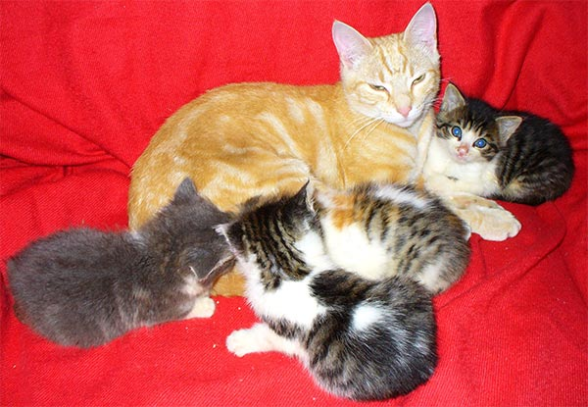
What matters most? Creatures or clothes?

Slide 45
“Believe in God…and out of love for Him, for your relations, for orphans, for the needy, for the traveller, for those who ask… keep on praying, give regularly to charity, keep the promises you have made: be patient in time of suffering and difficulty. Such are the people of the truth, the God fearing.”
Al-Qur’an 2.177

Slide 46
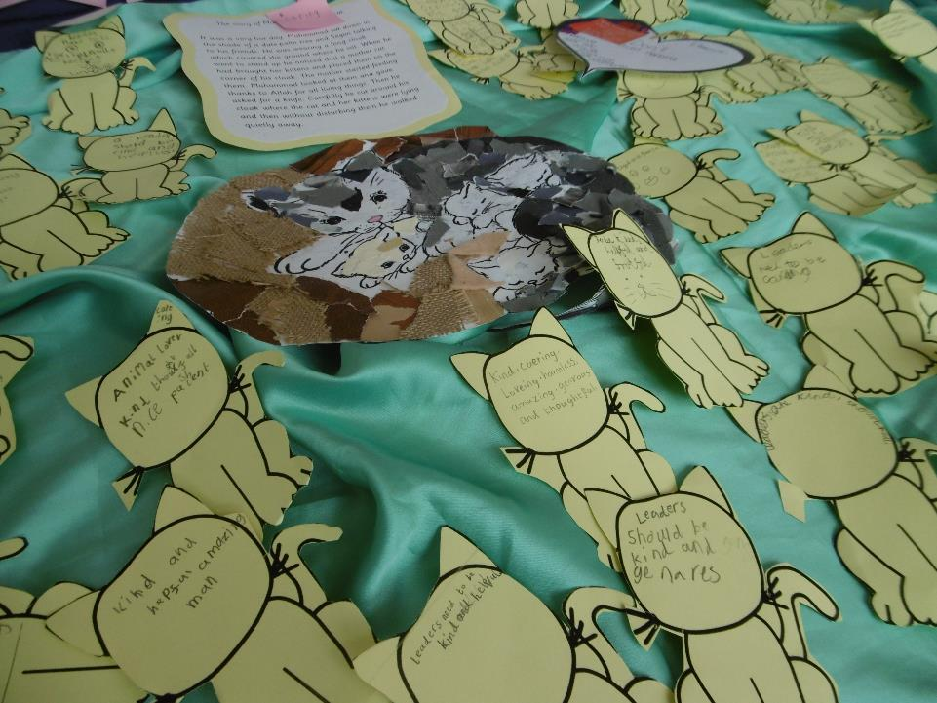

Slide 47
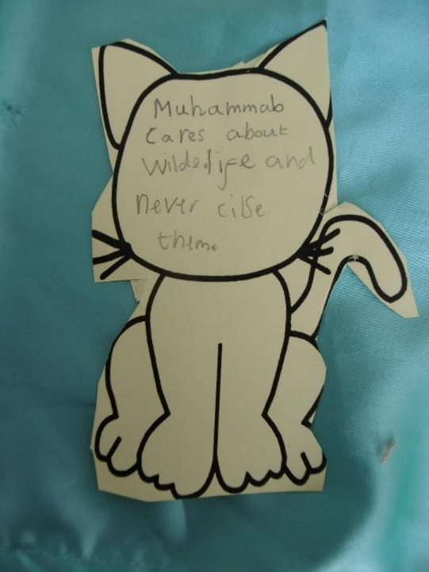
What sort of person was the Prophet?
“Muhammad cares about wildlife and never kills them.”

Slide 48
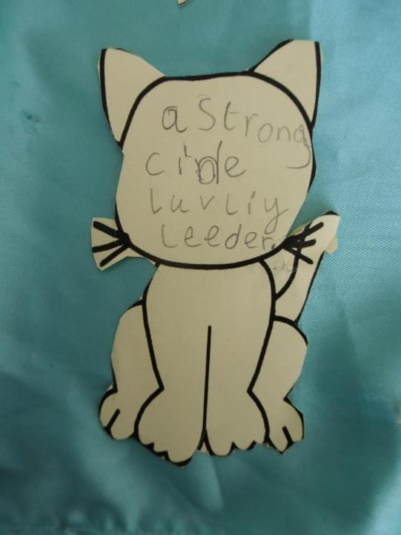
What kind of leader was the Prophet?
“A strong, kind, lovely leader.’

Slide 49
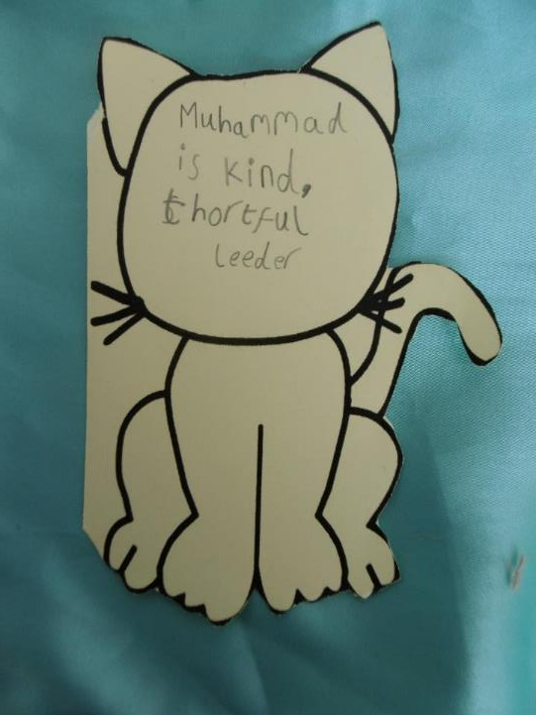
What sort of leader was the Prophet?
“Muhammad is kind, thoughtful leader.”

Slide 50
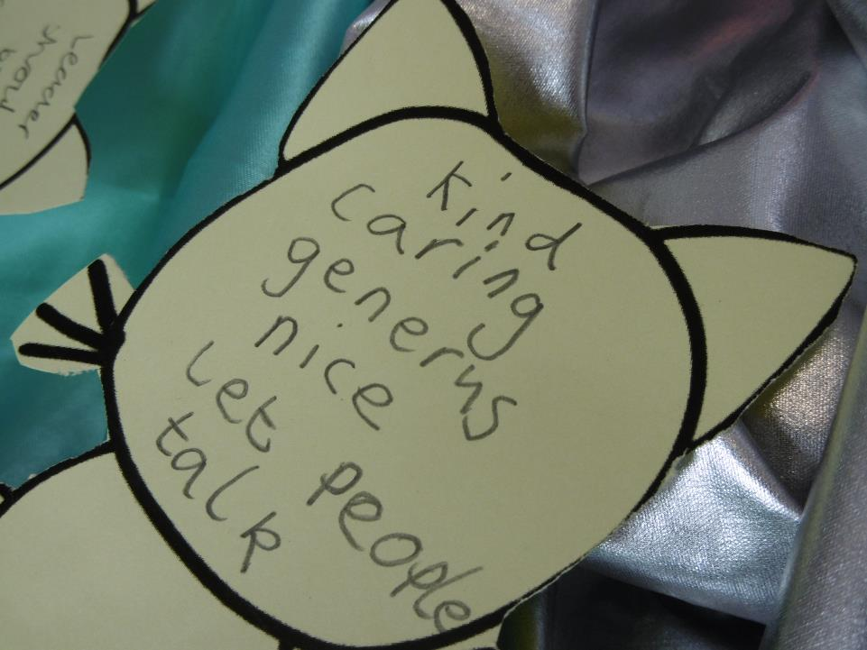
What do you think makes a person a good leader?
“Kind, caring, generous, nice, let people talk.”

Slide 51
EYFS RE and language / literacy
Riverside Primary School expects to use RE stories to develop Reception pupils’ writing and practice their literacy. Stories with animals work well.

Slide 52
Adam is 4. In this RE Focus lesson he is sorting pictures from Jesus’ Story of the Lost Sheep (BBC TV has a simple octonaut style animation). Literacy and RE happen together.

Slide 53
Beth is 4. From the Story of Muhammad and the Kittens she is thinking about kind and unkind ways to play and to treat animals. Literacy and RE both together.

Slide 54
Cam is 4. He has been thinking about the kindness of Prophet Muhammad in a story about 7 kittens. He has two sentences to give examples of times when he is kind.

Slide 55
Daisy is 4. She has been thinking about looking after her friends and she has three examples to share in her sentences. Literacy and RE together.

Slide 56
The theme of worship
What does worship mean?
Worship means singing or praying to God to say ‘thank you’
How do Christians worship?
Where?
  At church, at home, and everywhere they want to.
How?
  Singing, drawing, praying, at Mass – with bread and wine, at Easter or at Christmas
What ideas about worship show us how our 3-5s are thinking about the theme?

Slide 57
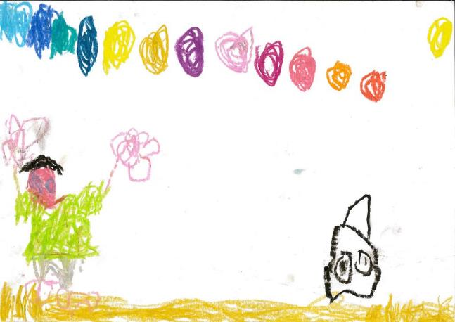
Worship
Where is God?
Elspeth Aitken (5)
“He’s at the beach and there’s light in the sky to show he’s dancing for God.
He’s dancing to be happy!”

Slide 58
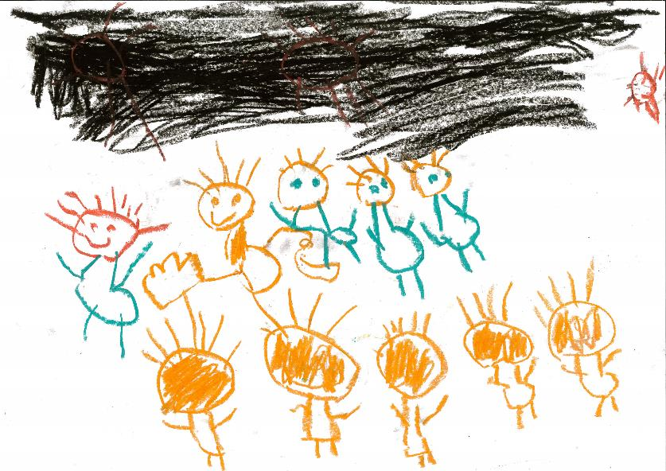
Worship
What do people do at church?
Toby Knight (5)
“they’re having a rock band and they’re worshipping God!”

Slide 59
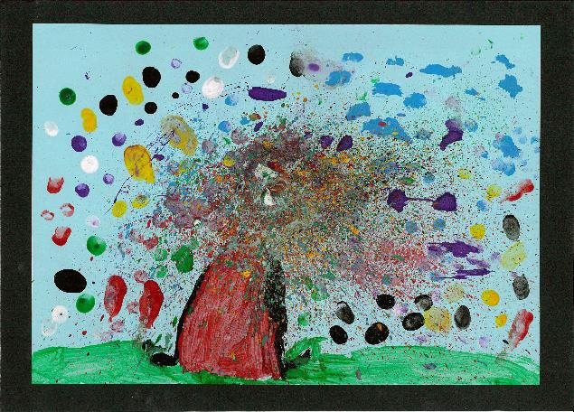
Worship
Genevieve Coulson (5)
“I did the grass and Jesus alive. I used a toothbrush to make all the planets and I put lots of colours on like all the planets and stars that God made.”

Slide 60
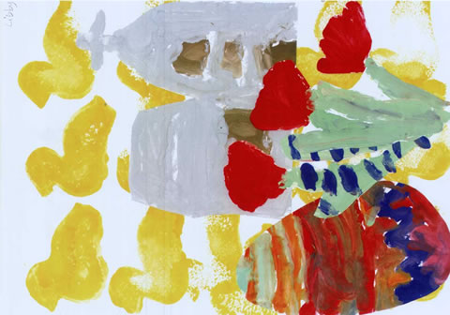
Easter and Jesus
Libby, Yorkshire
Age 5
“Easter is the time when baby animals are born. There are big celebrations about Jesus. He was crucified on a cross and he came back to life!”

Slide 61

Laura (4)
Balderstone St Leonard’s School
Beautiful garden
My holy space is in a beautiful garden. There is a rainbow in the garden

Slide 62
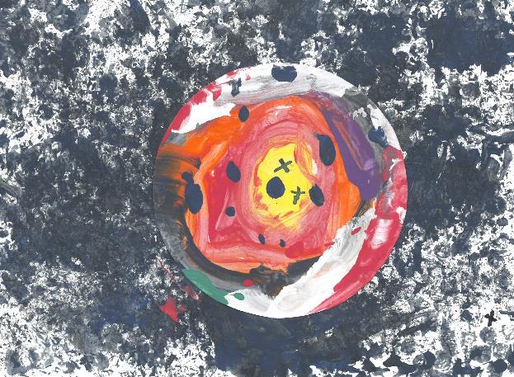
Oliver, 5
St. John the Evangelist Church School
Planet Earth
The title of my picture is called ‘Planet Earth’ because we know about God on earth. Jesus died on the cross and God is in heaven and the clouds – and there are lots of people in heaven. My Granny is meeting God and I will be able to meet her one day.

Slide 63
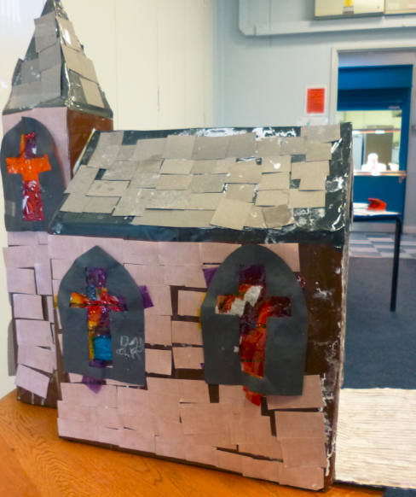
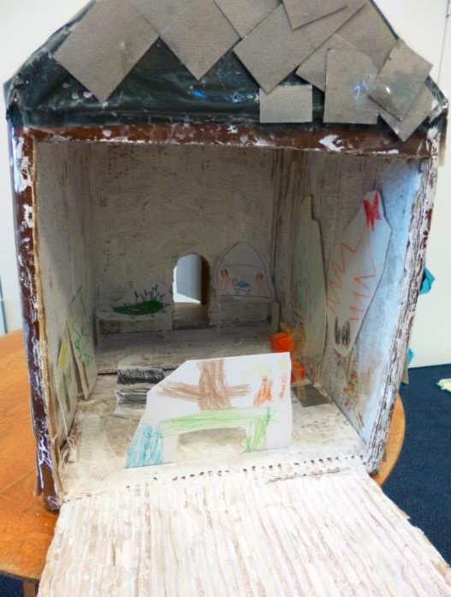

Slide 64
Can you make a picture about worshipping God?

Slide 65
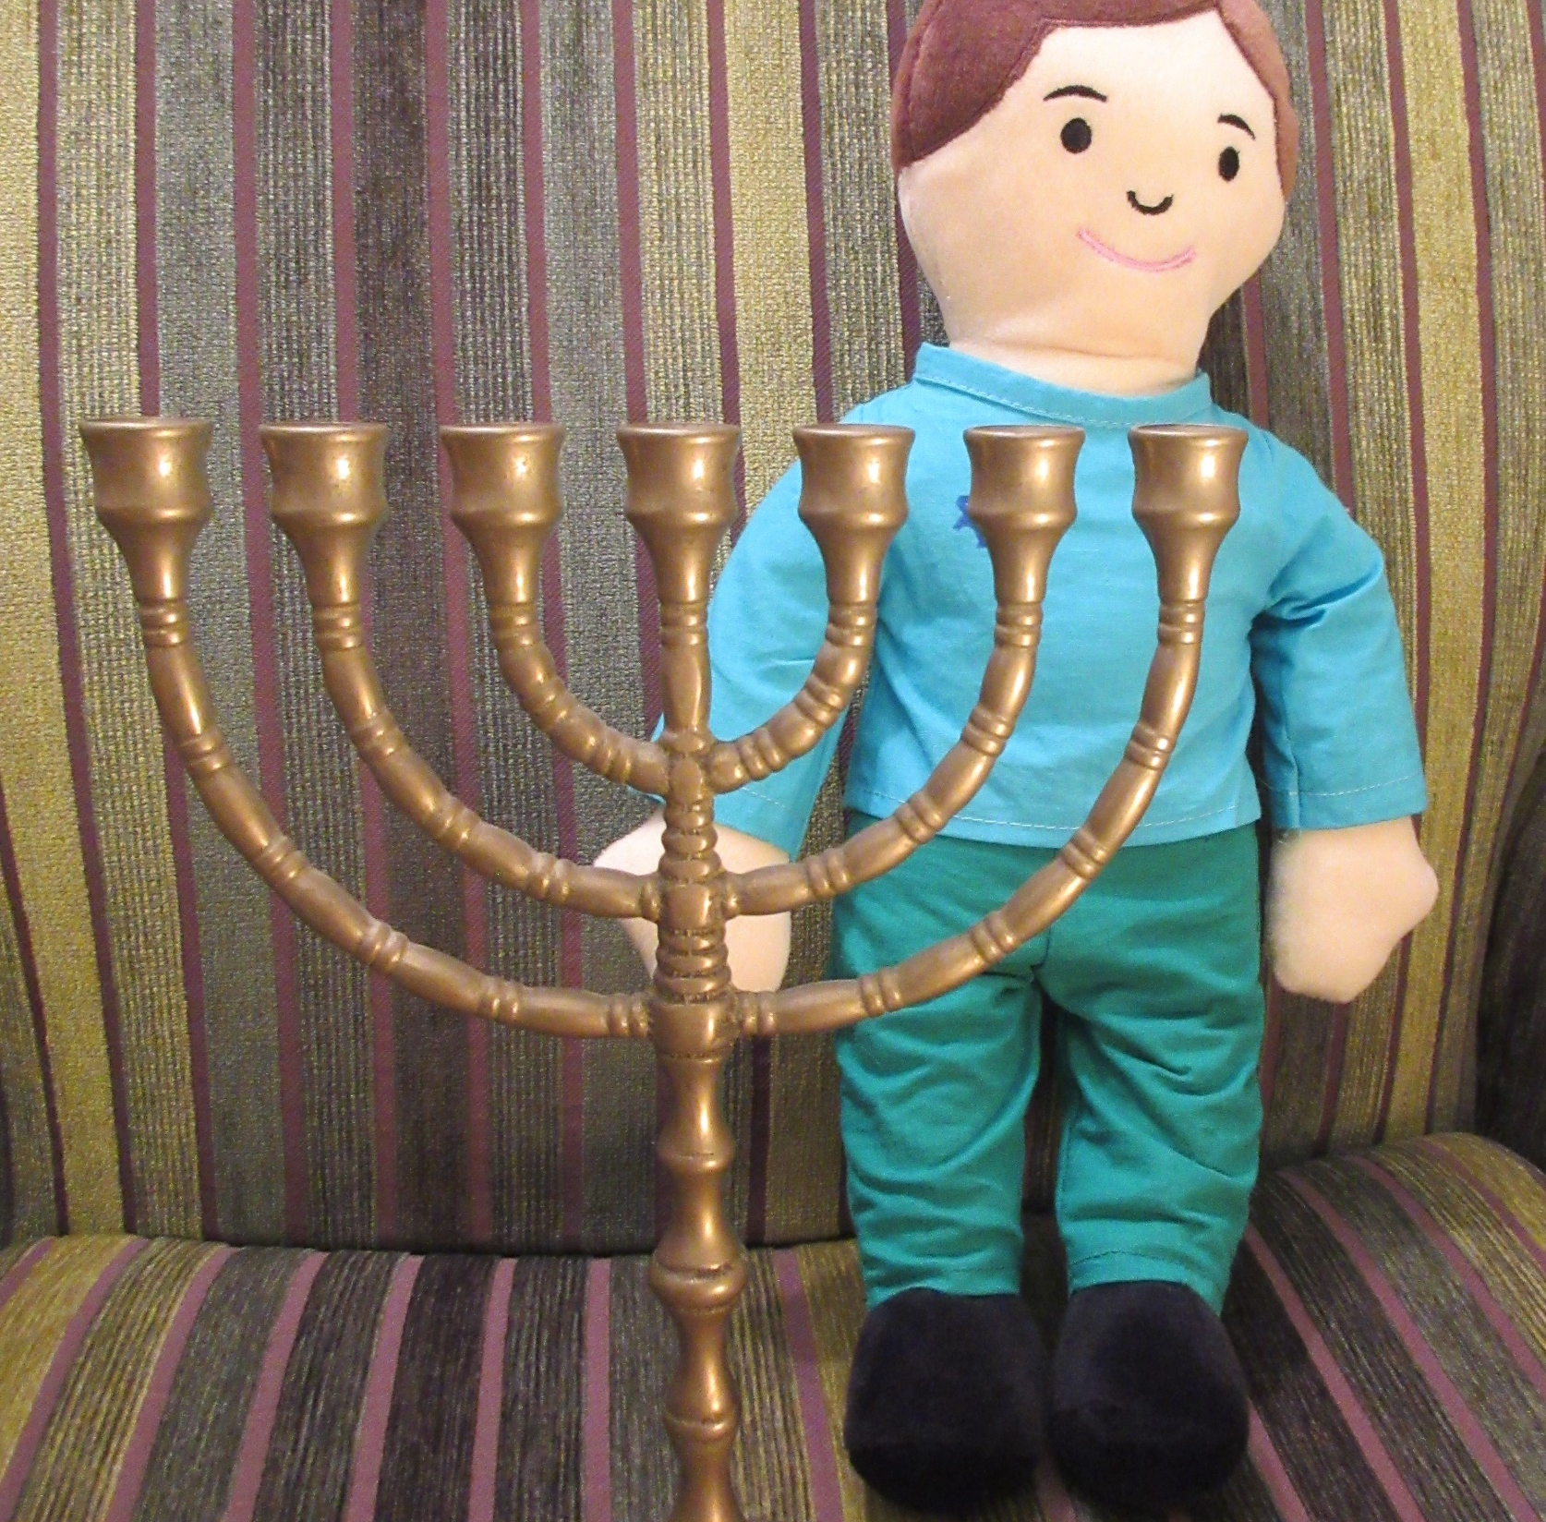

Slide 66
Cutaway pictures
Enquiry learning with visual resources
Thanks to Sophie Hartley, for the rather good cutaways – available as digital and picture cards, ‘What Happens In…?’
20% off £27.50 = £22 from RE Today

Slide 67
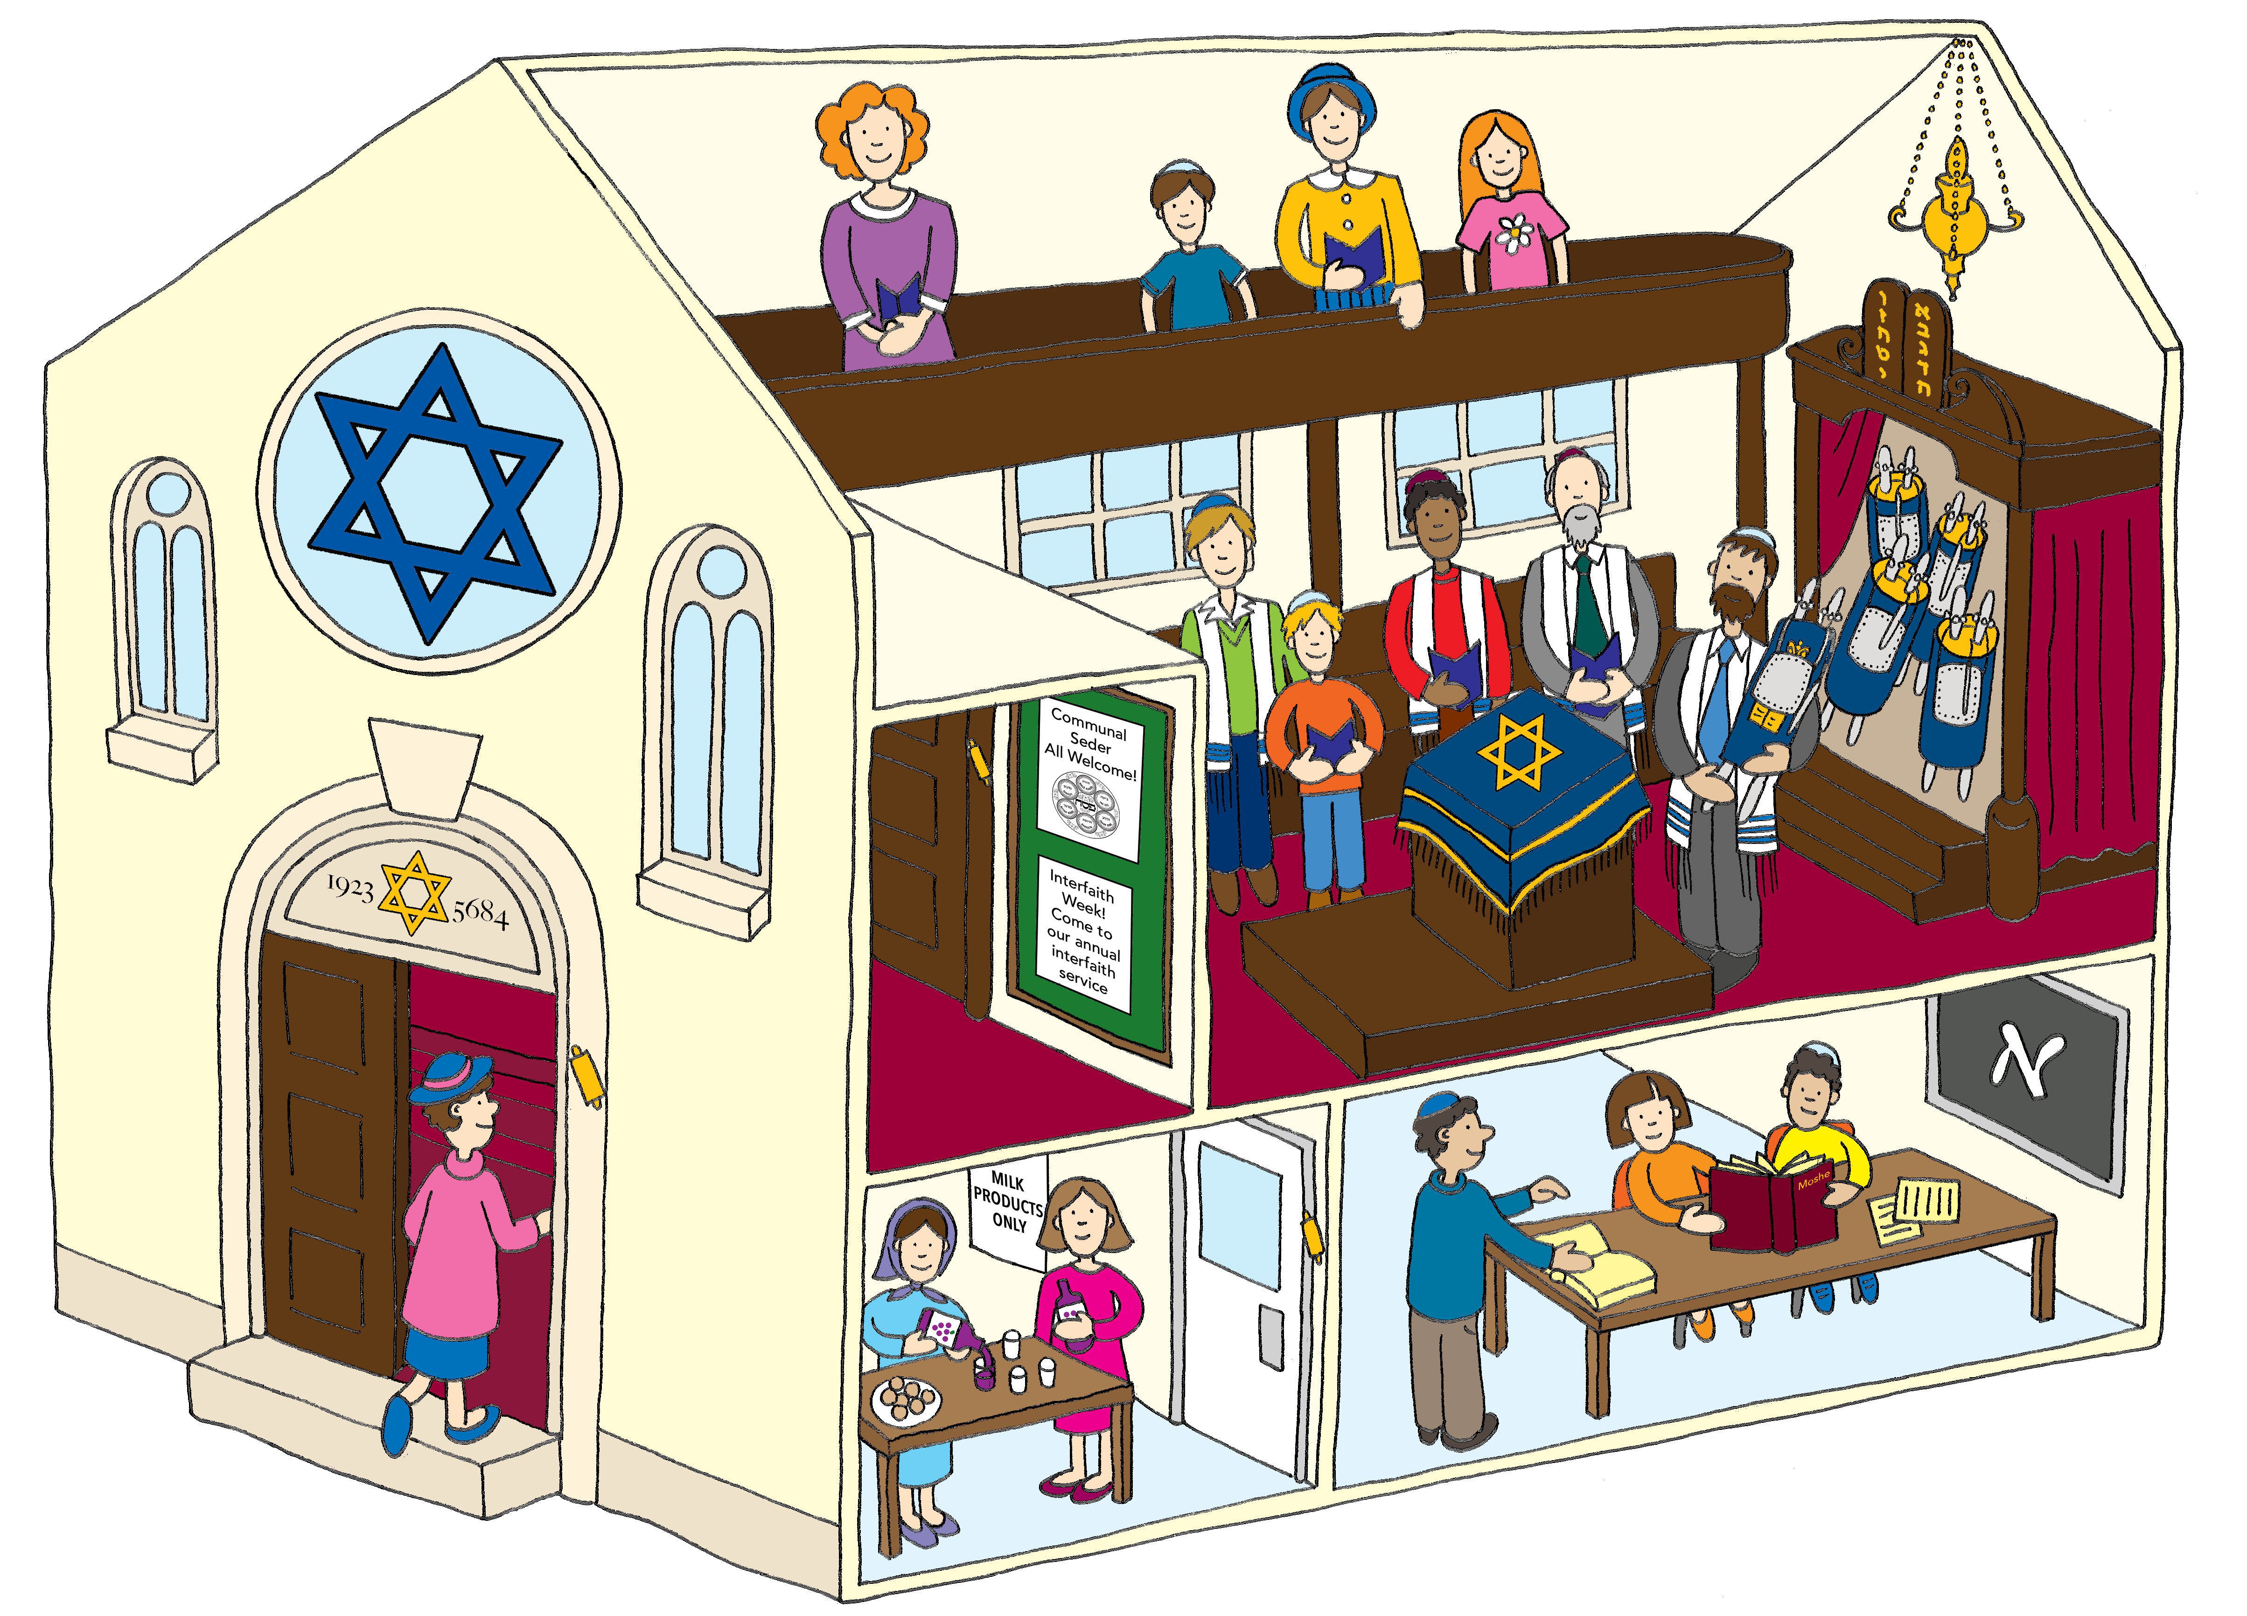

Slide 68
What could you do with this?
Count the people (etc)
Point out:
Can you see a lamp / scroll / six-point star / reading desk?
Who is oldest / youngest / proud / praying / thinking / peaceful / happy / friendly / kind? Use the strategy called ‘picture from memory’
Religions are many – even if God is one
Jesus was Jewish. Our faith, the Christian faith, came from his Jewish faith
‘The church rejects nothing which is good and true in other religions’
What are the people thinking?

Slide 69
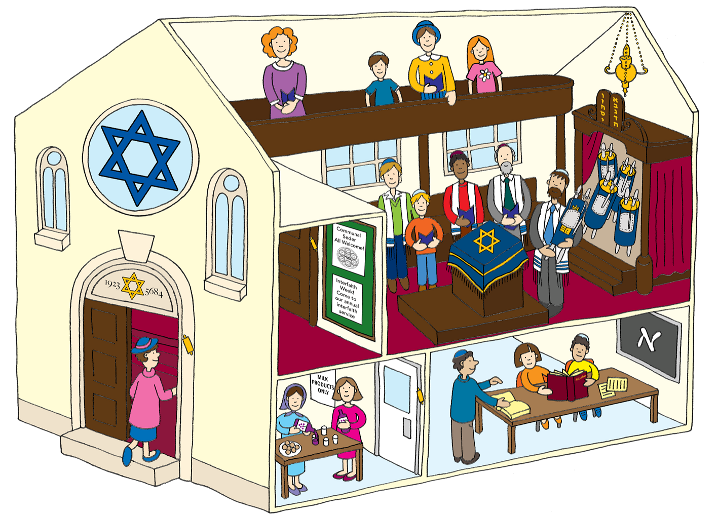
That is my big brother, learning to read out the Jewish holy scroll.
I like being a Rabbi. I can help the young people to learn about God
I am very proud that my boy is growing up in the Jewish faith

Slide 70
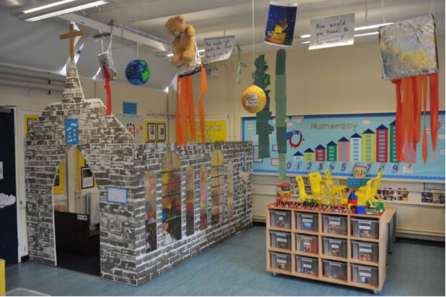
Hallsville School in Newham used similar ideas with the Reception class, creating a church in their classroom for children to play inside.
What do you think the inside looks like?

Slide 71
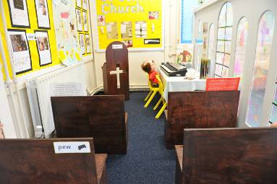
Lots of work for the TA here, but lots of experiential and fun learning for the 4-5 year olds.
Children made the stained glass with sharpies. Photos from their trip to the church on the end wall. Many children tried a ‘play pray’. Have an artefacts table outside the church – they can arrange things inside/
What if you adapted the ideas for older pupils?

Slide 72
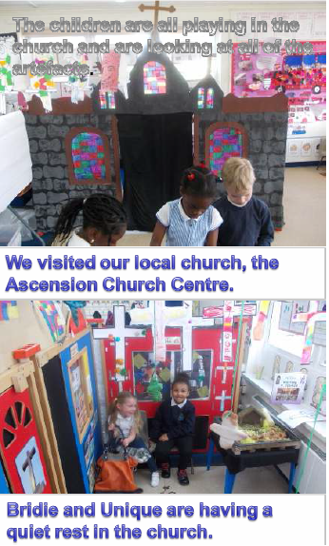
Children from the Reception class at Scott Wilkie Primary School in Newham visited a church, where they had some music lessons and did some singing. They made a small scale version of the church back at school for their play based RE.

Slide 73
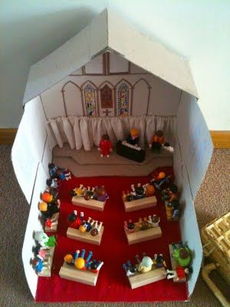
Made by Yr 3, enjoyed in EY

Slide 74






World Faith Jigsaw £7.50
Share a story disc + pack £45
Talking Pictures £33
What happens in… £27.50
Total: £113 discount today of 25% - order price £85
Email lat@retoday.org.uk or sales@retoday.org.uk with school address for firm order using code ‘EYFSOFFER’

Slide 75

Church Visit: a big occasion for RE with some big feelings! Can you walk round outside and guess what’s inside?
Can you sing? Play? Eat and drink? Share a story?
Can you lie on the floor and look up? What can you handle, pass round, touch?
Can you use five senses?
Can you find out?
Photograph? Draw?
Imagine? Create? Be thoughtful? Be friendly? Be quiet? Be aware of God (some people say this)?

Slide 76


Learning some symbols found at worship
Symbols connected to Jesus.
Cross, wine, grapes, wheat, bread, dove, flames, fish, bread
Colours:
White, green, purple, red.
Connections: which colours might you say go with… and why…
Fire, light, joy, sadness, being clean and pure, power, peace, growth, creation, being sorry, food, the Spirit of God.

Slide 77

Playful RE: the children looked at a real Vicar’s Stole in class, and made thier own with symbols of Jesus on it, using sharpie pens and strips of cloth.
They had a table of Christian artefacts and symbols to think about and handle
They took them all to church to show the minister.

Slide 78

Playful RE: can you find a Church minister who understands that play is serious, not irreverent? If so, go to church and do playful RE.
Or mosque. Or synagogue.

Slide 79

Playful RE: ritual and worship can be a foreign country to some children. Dressing up brings it home.
What do the church’s ‘favourite colours’ mean? Purple is sad, red is powerful, green for growth and white for holy and pure.
The real robes are getting their best use of the week here, maybe.
Just look at his face!

Slide 80
Learning some symbols found at worship
Symbols connected to Jesus.
Cross, wine, grapes, wheat, bread, dove, flames, fish, bread
Colours:
White, green, purple, red.
Connections: which colours might you say go with… and why…
Fire, light, joy, sadness, being clean and pure, power, peace, growth, creation, being sorry, food, the Spirit of God.

Slide 81

https://vanpoulles.co.uk/ Lots of fun and imagery to look at and choose from here.

Slide 82




Querks

Slide 83

Playful RE
Beginnings: Enact a Baby Welcoming Ceremony.
Off we go to Church today to welcome Baby Querk to the human race and to human life. to make some promises and say some prayers. The whole class play roles in the Big Day!

Slide 84

Playful RE:
God parents. Who are they? What do they do?
Chosen by mums and dads and carers to look out for the baby all the time and be a special grown up friend – and to pray for the baby.
They promise to care.
What promises would you make to a new baby?

Slide 85

Playful RE: Early learning about rituals
Big days for the family often use food, cards, gifts, songs, getting together, memories, photos and specially chosen words.

Slide 86

Playful RE
Enact a Baby Welcoming Ceremony. At Church Father David asks who is doing what at the Baptism, and gets us all ready. Lots to notice, to think about and to learn. A big experience.

Slide 87


Slide 88

Playful RE
Enact a Baby Welcoming Ceremony.
The whole class play roles in the Big Day!

Slide 89


Slide 90

Playful RE
Back at school, whisper the things you remember about the service – don’t wake the baby.
Can you whisper some kind words, some good promises or some special messages to Baby Querk? Are some of these messages about God?
What other activities might Baby Querk share?

Slide 91

For goodness sake, wherever can you get a donkey?
But can you think of brilliant ways to make RE memorable forever for your class? Surely once a year, the magic of Christmas for example might be worth chasing down a local donkey?

Slide 92
World Faith Jigsaw £7.50
Share a story disc + pack £45
Talking Pictures £33
What happens in… £27.50
Total: £113 discount today of 20%
Email lat@retoday.org.uk or sales@retoday.org.uk with school address for firm order using code ‘EYFSOFFER’

Slide 94
Summary
RE is a requirement for all pupils on school roll
RE is also a great gateway into various aspects of the ELGs and EYFS requirements
Your RE can be a playful centre of learning new vocab and enjoying experience together in the early years
Children can gather a rich knowledge of the place they live – widening from local to national – and connect this to values of friendliness, care, sharing, generosity and more…
The RE syllabus makes space for you to develop best practice.
The NATRE guidance document provides numerous practical possibilities for good RE for your pupils
Include singing, art, music, outdoor RE, story, drama, play alongside short and well planned sessions of direct learning.

