Slide 1
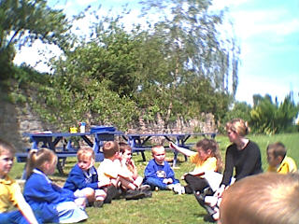
Salford Diocese
RE CPD
Lat Blaylock
Years 1+2:
Practical inspirations

Slide 2
Age related expectations Recognise religious stories Retell, in any form, a narrative that corresponds to the scripture source used. (retell does not mean ‘learn by rote’ – pupils can tell the story in their own words) | Question stems to lead pupils towards the outcomes Can you use the…… to tell the story of……? Could use pictures, role play to tell the story of…. What can you remember about what happens next in…… ? Who are the characters in the parable of……? What do they do….? Are they important in the story and why? What happens in the story? Can you tell me the story about? Who can remember what the character does now?
Recognise key people in the local, national and universal church. Describe different roles of some people in the local, national and universal church. | Who does / says / teaches / follows / leads / is kind / is good / is bad etc? What does… do? What do they do in church? Who’s job is it to….? What else do (they) do in the Church? What do ….. believe about…?
Recognise that people act in a particular way because of their beliefs. Describe some of the actions and choices of believers that arise because of their belief. | What do… do at…..? Christians believe…, so how should they act? Which one of these objects…? What can you tell me about this object?
Recognise key figures in the history of the People of God. Describe the life and work of some key figures in the history of the People of God. | Who is this? Can you name any people who have (worked/ shared/ taught/ lived as..)? Who was…..? What did…..do when they were (living in/ working as/ helping with)?
Recognise religious signs and symbols used in worship, including the celebration of the Sacraments. Describe some religious symbols and the steps involved in religious actions and worship, including the celebration of the Sacraments. | Where we might we find….? Who could use these…..? What happens in the sacrament of baptism? What does………. Say / do?

Slide 3

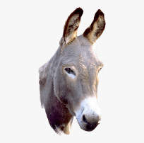
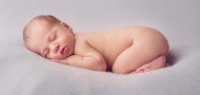
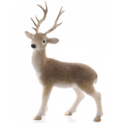
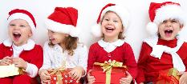
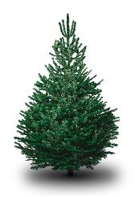
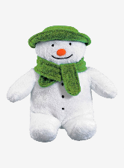
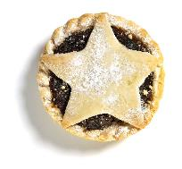
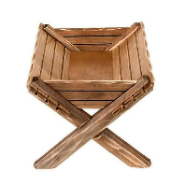
Kim’s game – can you remember…
????

Slide 4




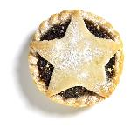



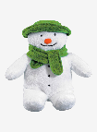
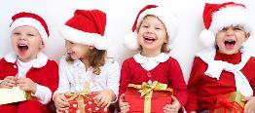
Can you recognise? Describe? Link? Suggest a meaning? Notice? Name? Remember?
Which matters most?
9.
8.
7.
6.
5.
4.
3.
2.
1.
Snowman?
Reindeer?
Tree?
Mince pie?
Donkey?
Manger?
Present?
Children?
Baby Jesus?
Takeaway learning: which of these is not so important at Christmas? Can we manage without a mince pie? Countdown – to the baby.

Slide 5
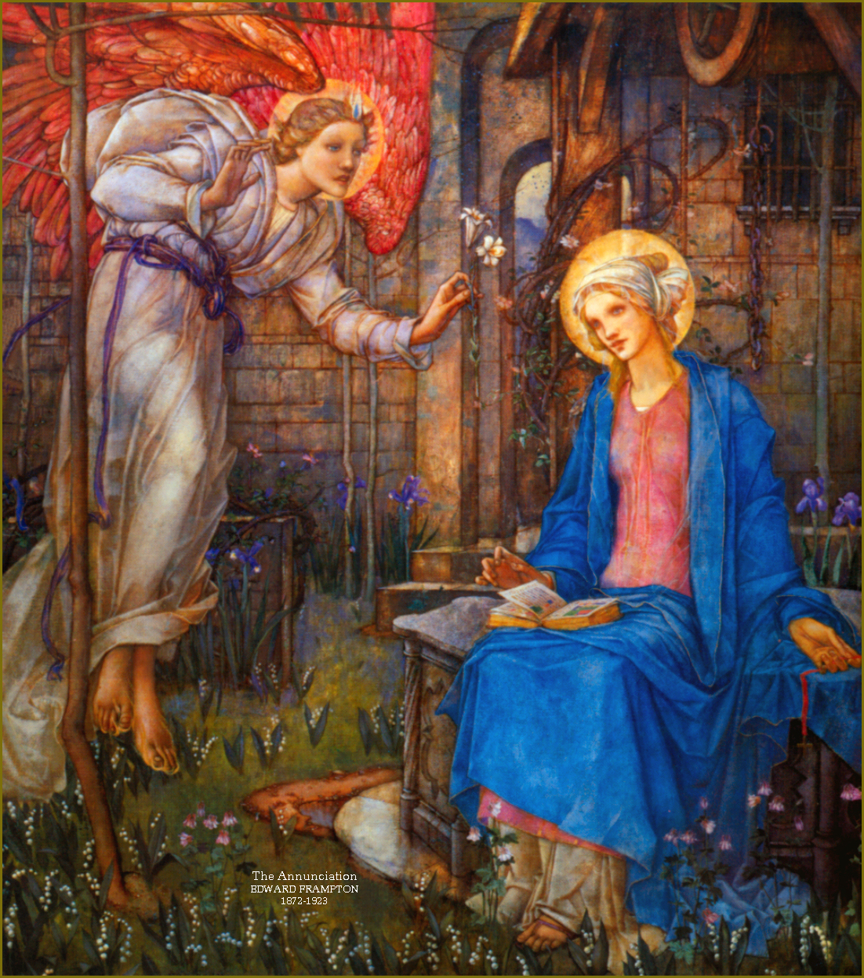
Can you see in the picture how the artist is showing us the importance of what the Angel and Mary said?
Angel:
“Do not be afraid, Mary; you have found favour with God. You will conceive and give birth to a son, and you are to call him Jesus. He will be great and will be called the Son of the Most High. For no word from God will ever fail.”
Mary: “I am the Lord’s servant. May your words to me come true”
More blue or more red?
Can you see bricks? Flowers? A book? Feathers? A flame?
Can you make the hand-shapes of the angel and of Mary?

Slide 6
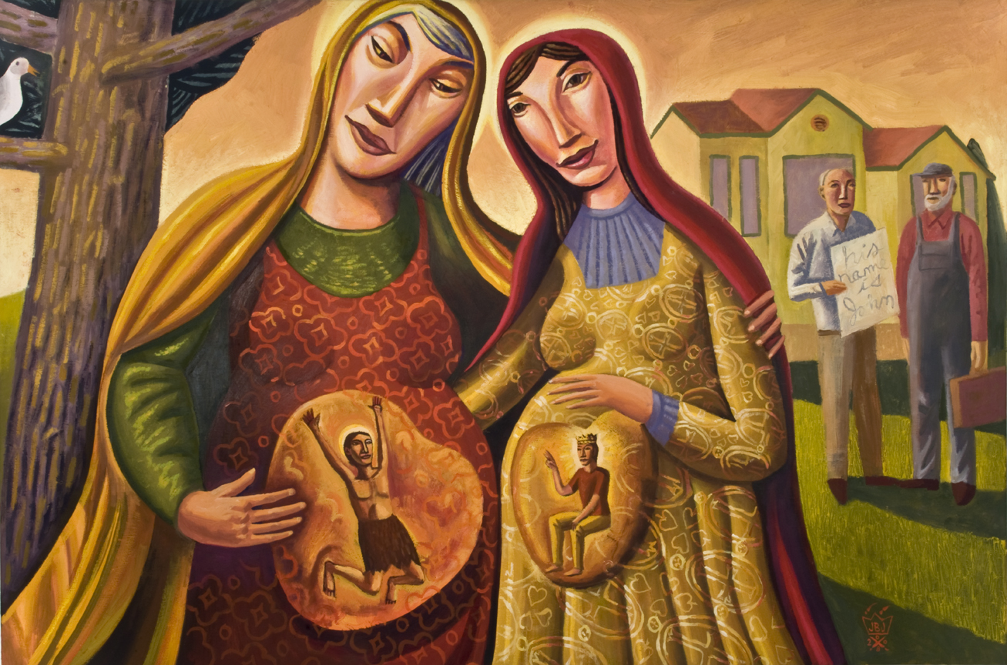
The Visitation, James B Janknegt, 2007, oil on canvas

Slide 7
This kind of capture-sheet for using works of art or photographs has lots of advantages: copy the pic yourself, look really hard, discuss with a talking partner what you are looking at, use your imagination to ‘enter’ the story, raise questions…
“God is going to change the world through these little children. I think that is why the angels have been coming to speak.”
How lovely that my baby will have a little cousin.
Maybe God will work in the lives of these two special babies.

Slide 8
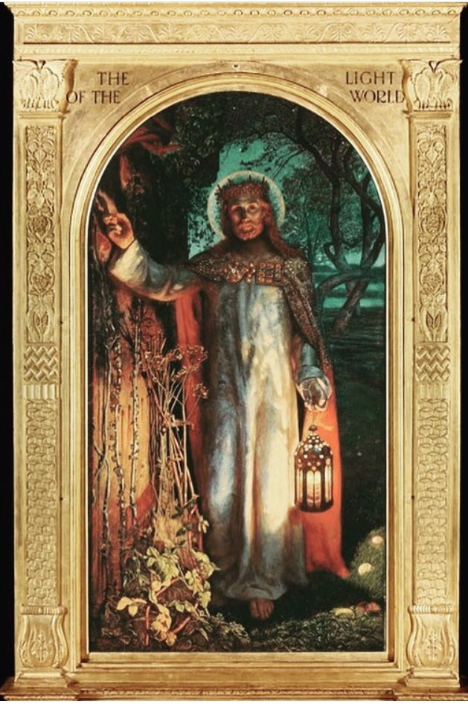
Christingle: maybe a magic moment, and also a big ideas learning opportunity
Nichola Gannon teaches in Lancashire
“Year Two children do a unit of work on Holman Hunt’s famous painting ‘The Light of the World’, using their understanding of Christingle and Christmas to inform their reflections. The lesson aimed to help the children meet the four areas of the Lancashire Agreed Syllabus.
Shared Human Experience: We all have people in our lives that bring us light. The children were asked to consider who those people are and how they change their lives for the better.
Beliefs and Values: Through the Christingle assembly the children learn about the Christian beliefs of a creator God who made a perfect world that he loves. They learn that Christians believe that world was spoiled but Jesus came to make things better. The children were asked to record their understanding of these beliefs on the reverse of their Christingle sheet.
Living Religious Traditions: The children were asked to think about how Christians might share their belief in Jesus as the light of the world with others. We talked about charitable organisations. We watched the Band Aid ‘Do they know it’s Christmas time?’ Children were very moved by this and it inspired the next part of their work.

Slide 9
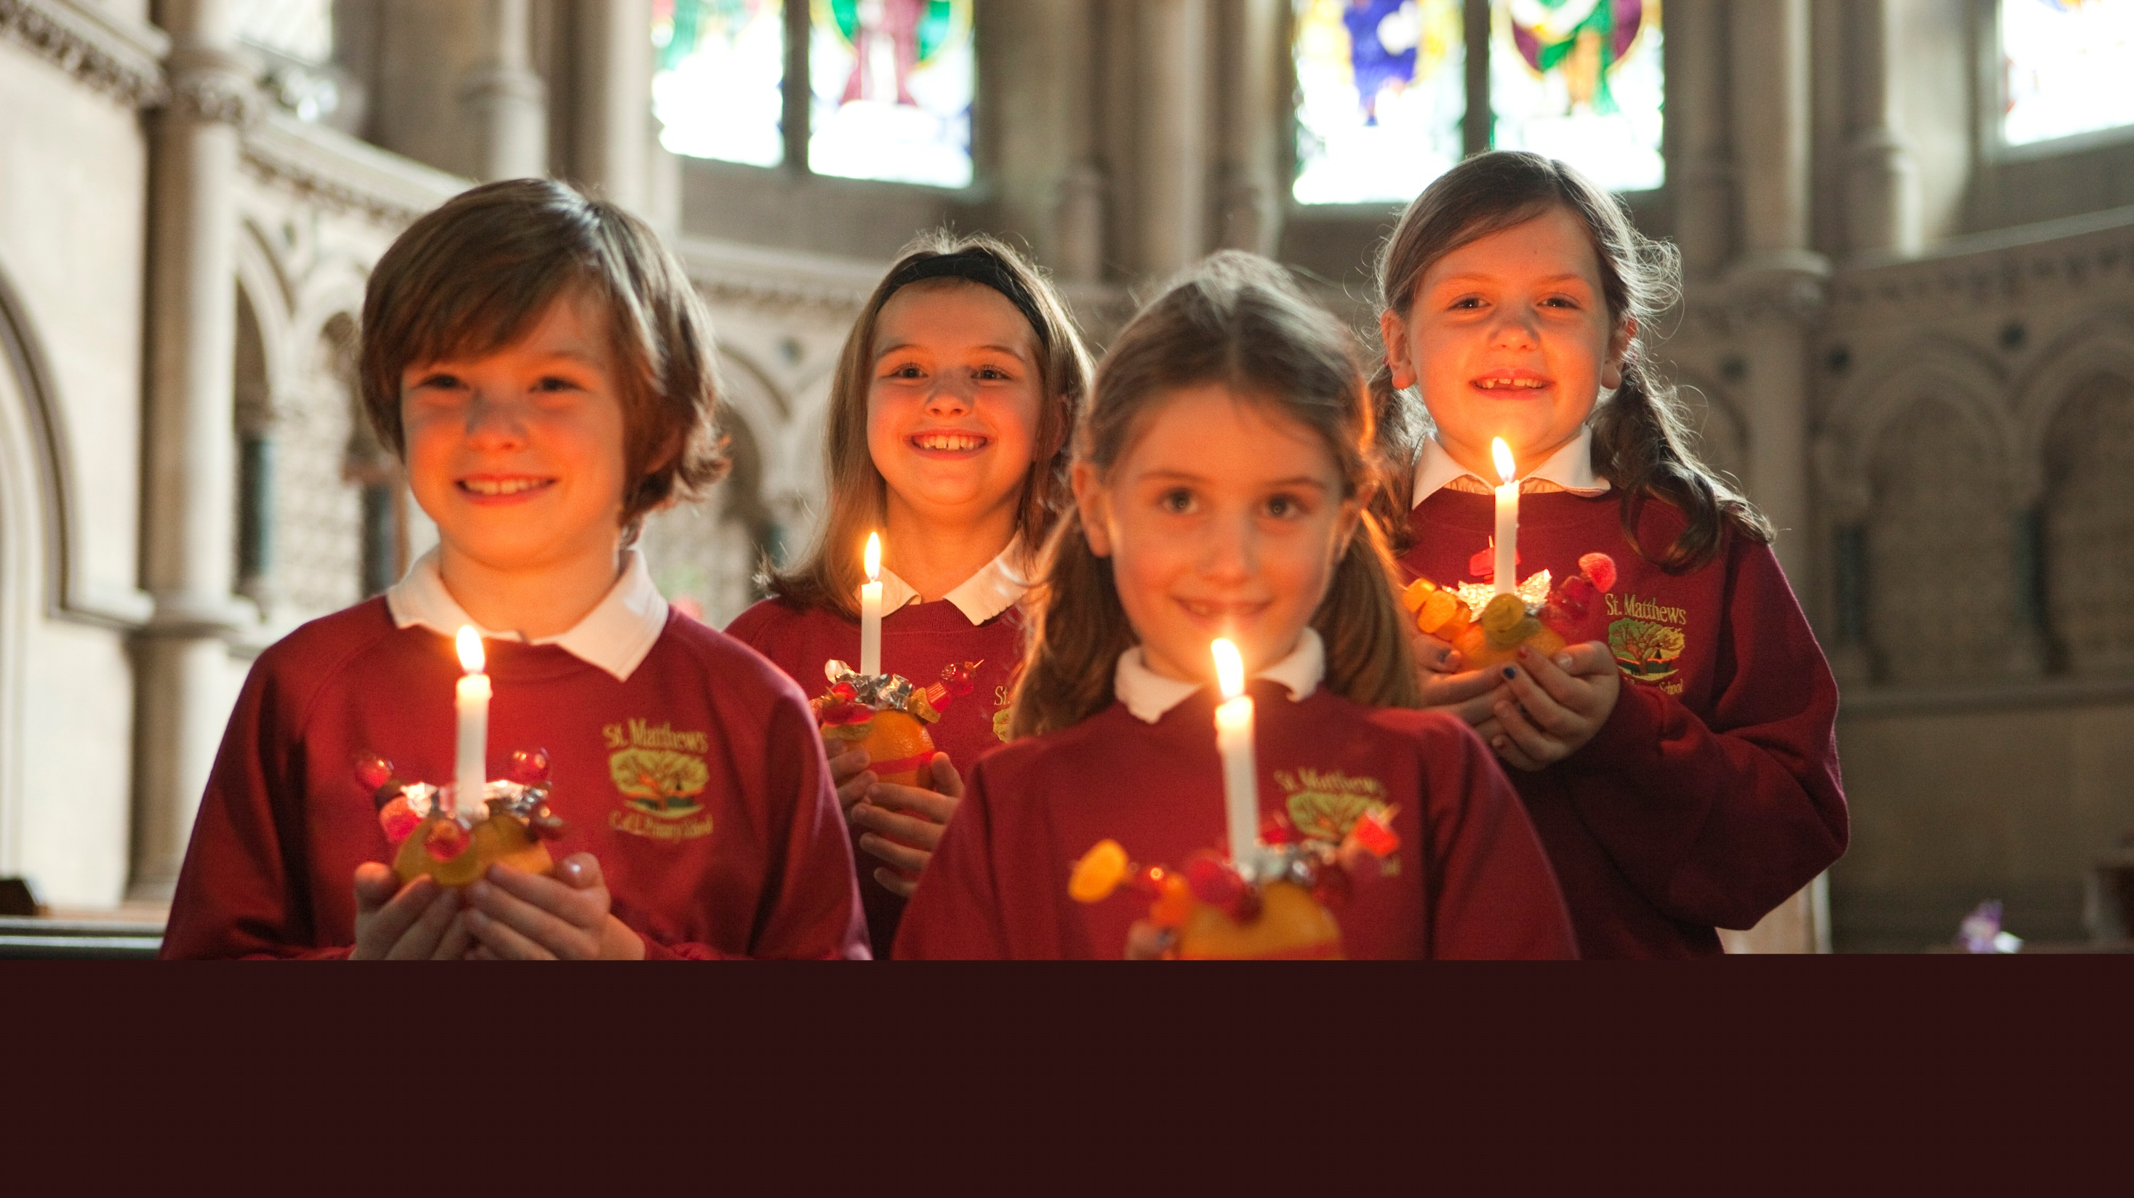

Slide 10
Christingle: maybe a magic moment, and also a big ideas learning opportunity
“The Search for Personal Meaning: As a response to the above learning and the Band Aid video, the children were asked to think of ways in which they could make a difference in the world, bringing their own light to others.
The awe and wonder that the children exude as they enter a candle lit school hall is tangible each year. The children spoke enthusiastically about people who bring light into their lives and were visibly moved by the Band Aid video we showed. They took the task of thinking how they could make a difference in the world very seriously. I was pleased with how the children moved from Shared Human Experience to Search for Personal Meaning by understanding the Christian beliefs, values and traditions surrounding Christingle.
The examples of work are good, but if we develop the ideas next year then rather than providing the children with a writing frame, I would give them the questions included on the frame but invite them to respond in their own way on plain paper. I felt the frame hindered the more able children from recording the full and detailed responses that they had contributed to the class discussion.”
Nichola Gannon, The Cobbs School, Warrington

Slide 11
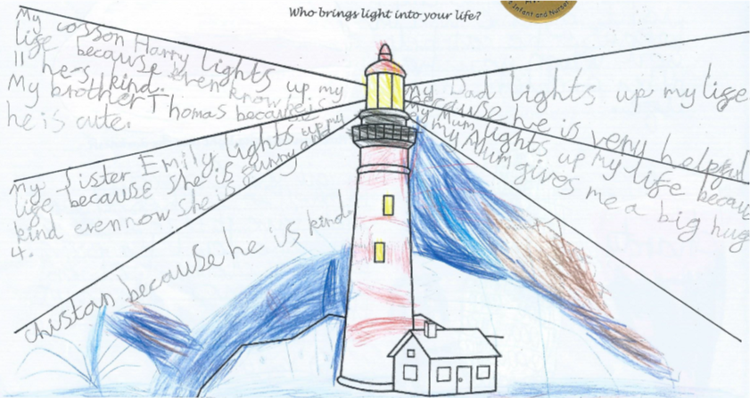
RE that aims for the HOTS (adapt to be a conversation with TA recording it for Y1?

Slide 12
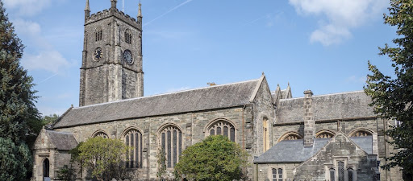
Church Visit: a big occasion for RE with some big feelings! Can you walk round outside and guess what’s inside?
Can you sing? Play? Eat and drink? Share a story?
Can you lie on the floor and look up? What can you handle, pass round, touch?
Can you use five senses?
Can you find out?
Photograph? Draw?
Imagine? Create? Be thoughtful? Be friendly? Be quiet? Be aware of God (some people say this)?

Slide 13
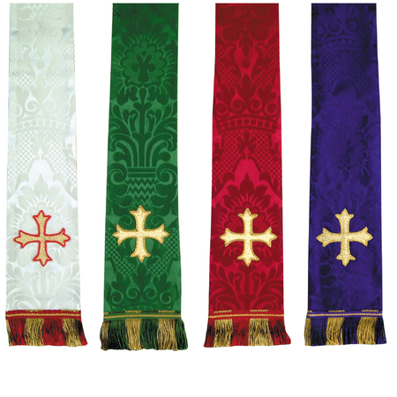
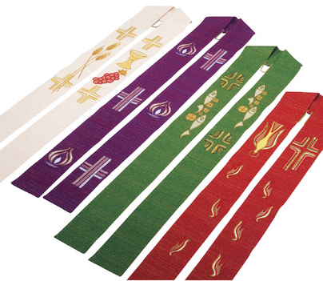
Learning some symbols found at worship
Symbols connected to Jesus.
Cross, wine, grapes, wheat, bread, dove, flames, fish, bread
Colours:
White, green, purple, red.
Connections: which colours might you say go with… and why…
Fire, light, joy, sadness, being clean and pure, power, peace, growth, creation, being sorry, food, the Spirit of God.

Slide 14
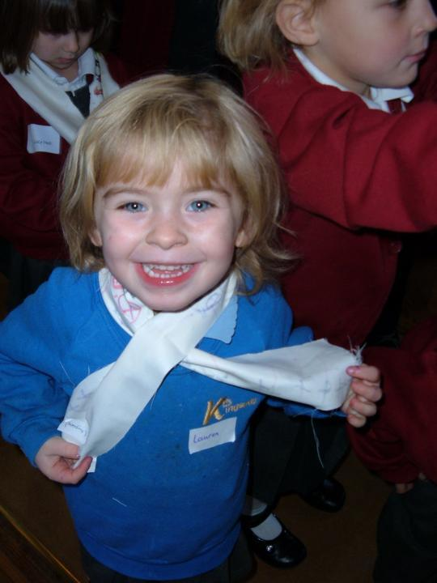
Playful RE:
Younger children know how to learn for themselves.
Emotional depth can come sometimes from a white silk scarf. 4YO Lauren decorated this one with crosses before the Church visit. She got ideas from a Christian artefacts display table in the classroom.

Slide 15
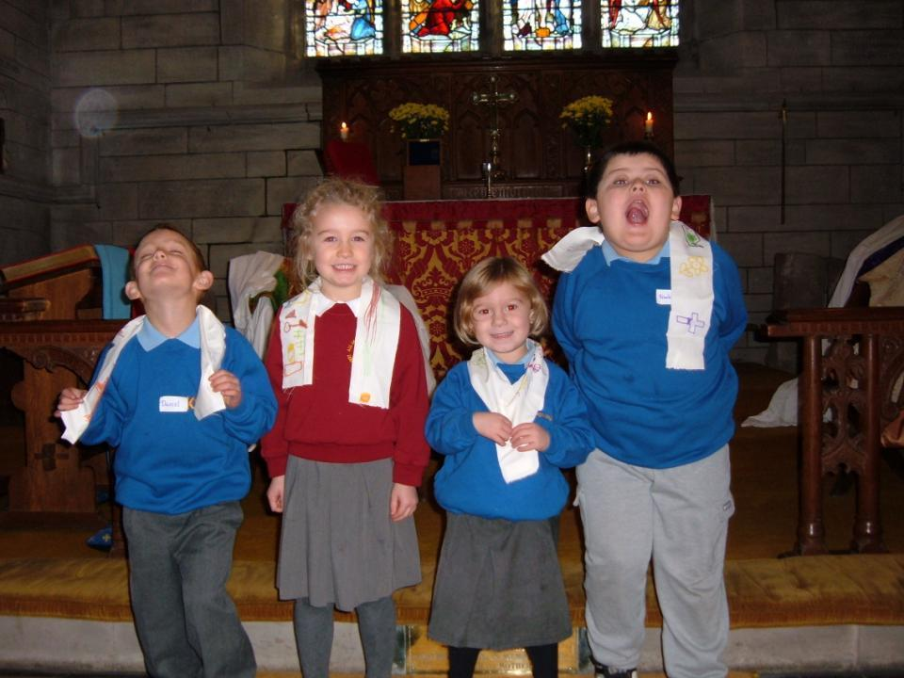
Playful RE: can you find a Church minister who understands that play is serious, not irreverent? If so, go to church and do playful RE.
The children all used artefacts from Christian symbol and worship to design and make their own stoles before going to church.
Or mosque. Or synagogue.

Slide 16
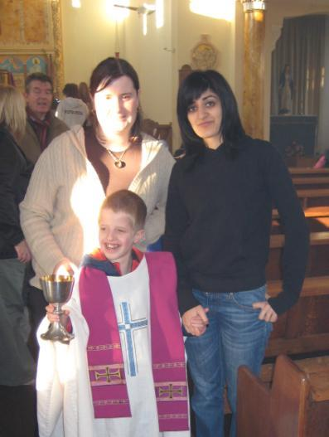
Playful RE: ritual and worship can be a foreign country to some children. Dressing up brings it home.
What do the church’s ‘favourite colours’ mean?
Purple is sad
Red is powerful (like the Holy Spirit. Like fire)
Green is for growth
White is for God’s light: holy and pure
The real robes are getting their best use of the week here, maybe.
Just look at his face!

Slide 17
Learning some symbols found at worship
Symbols connected to Jesus.
Cross, wine, grapes, wheat, bread, dove, flames, fish, bread
Colours:
White, green, purple, red.
Connections: which colours might you say go with… and why…
Fire, light, joy, sadness, being clean and pure, power, peace, growth, creation, being sorry, food, the Spirit of God.

Slide 18
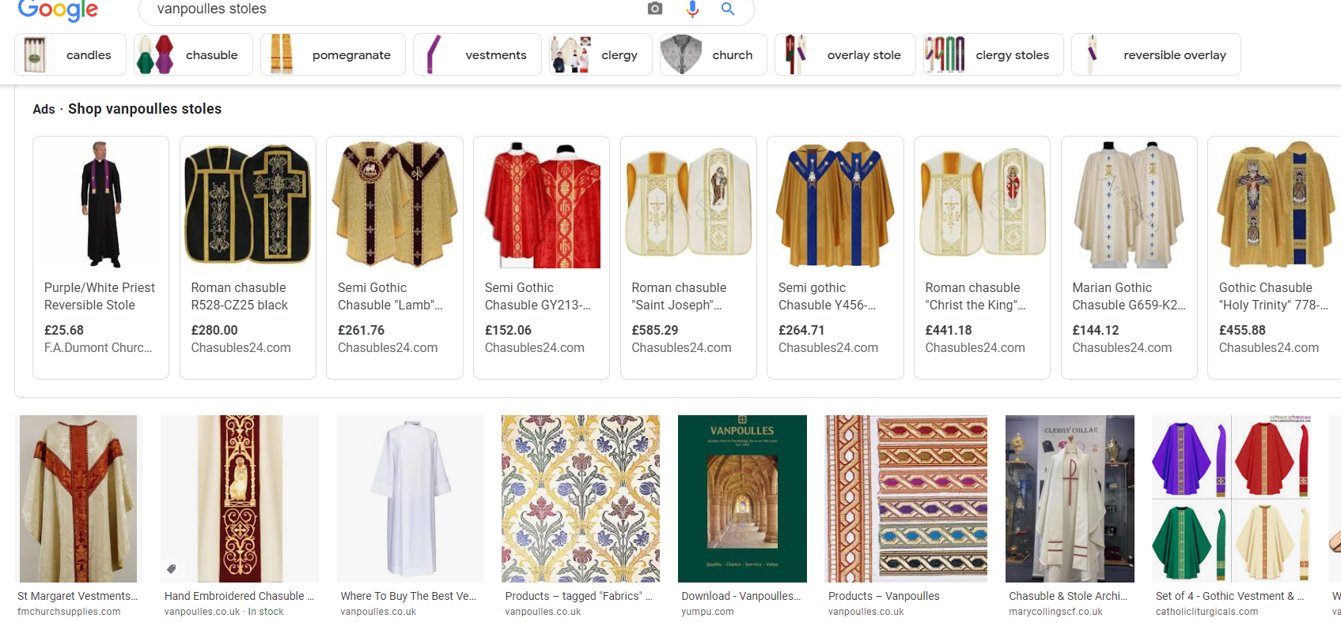
https://vanpoulles.co.uk/ Lots of fun and imagery to look at and choose from here. Computer studies: ‘select thoughtfully from online sources examples that match particular criteria…’

Slide 19
30 bits of the story
Each child does one picture and the whole class creates a book or gallery of the whole story
Can they make sense of their ‘bit’? Can they talk about character, ideas, questions?
(Adapt if you wish for even more simplicity)

Slide 20
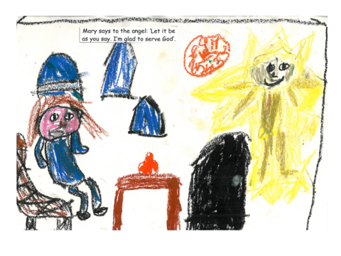
30 Bites: telling the story in class shared art

Slide 21
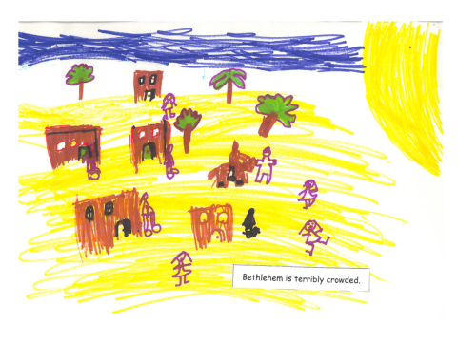

Slide 22
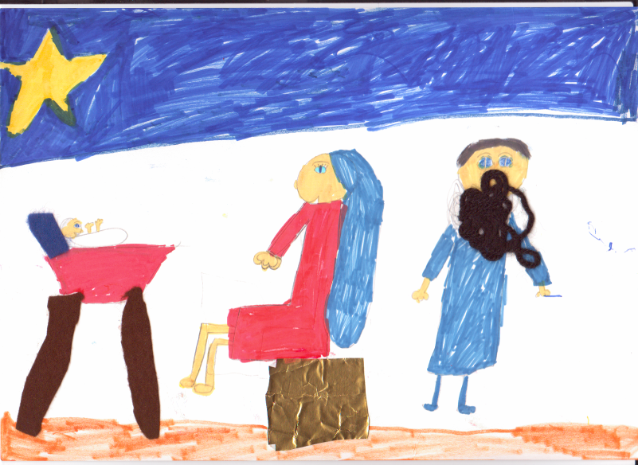
The baby is born.
Mary and Joseph lay him in a manger full of hay.

Slide 23
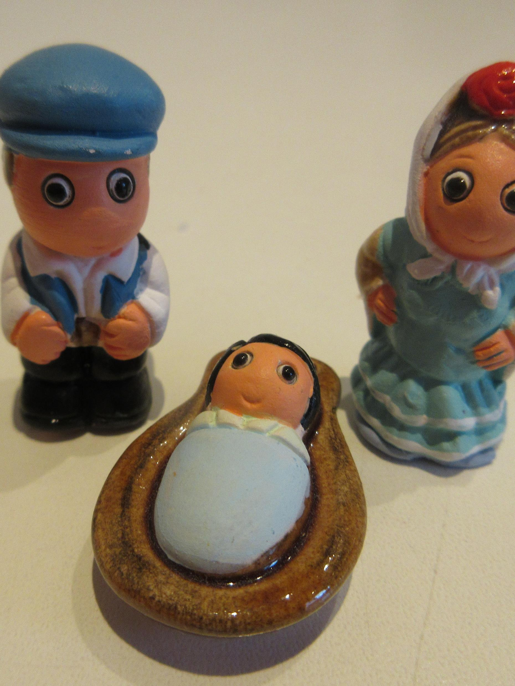
Christmas decorations
Favourites, meanings, decorations
And can you design one and make it yourself?

Slide 24
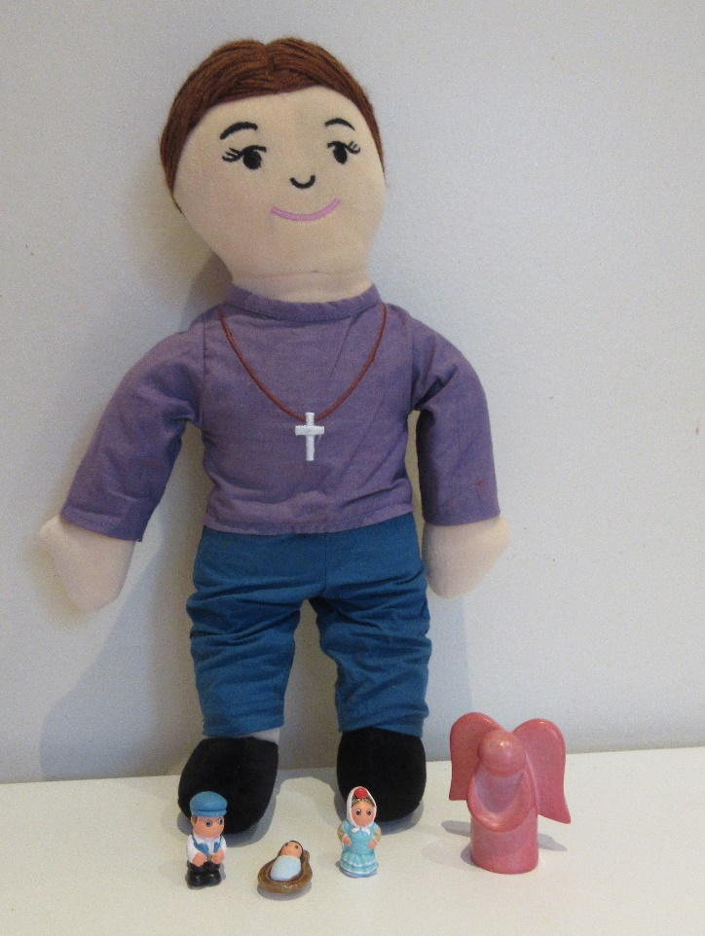
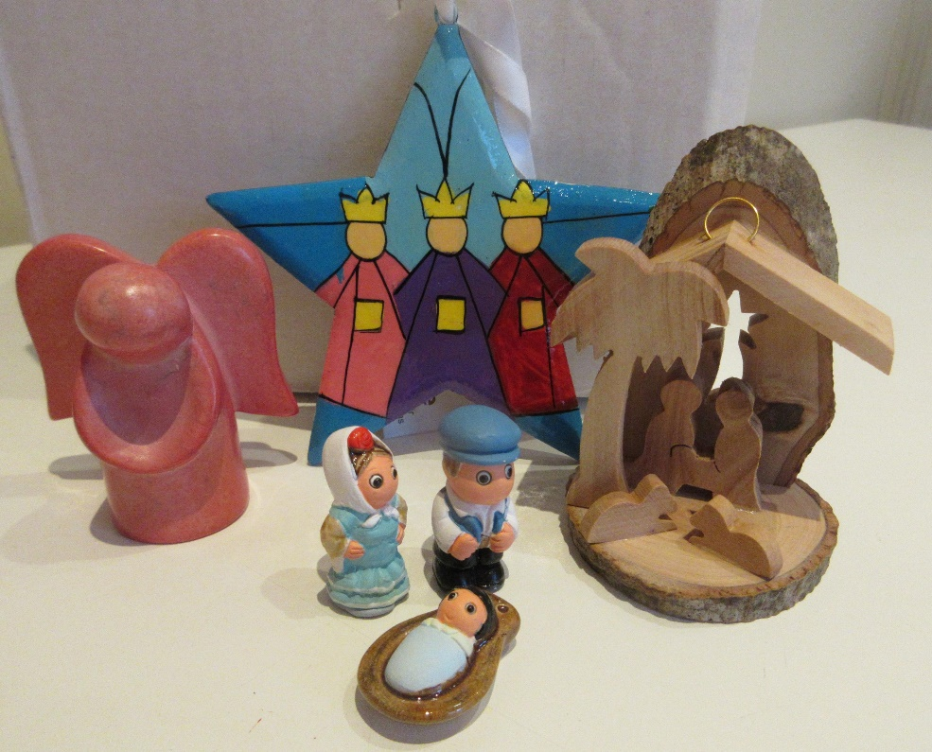
Joanna has 4 favourite Christmas decoarations

Slide 25


Children choose their own favourites and select one that is most about peace / Jesus / gifts / light / God / awe / Mary’s faith / the real meaning of Christmas
This one is cute because it would fit in a matchbox
This one has gold in it, but you can’t see it.
This one is made from the wood of a tree from Bethlehem
This one means ‘Peace on Earth, goodwill to all people’

Slide 26
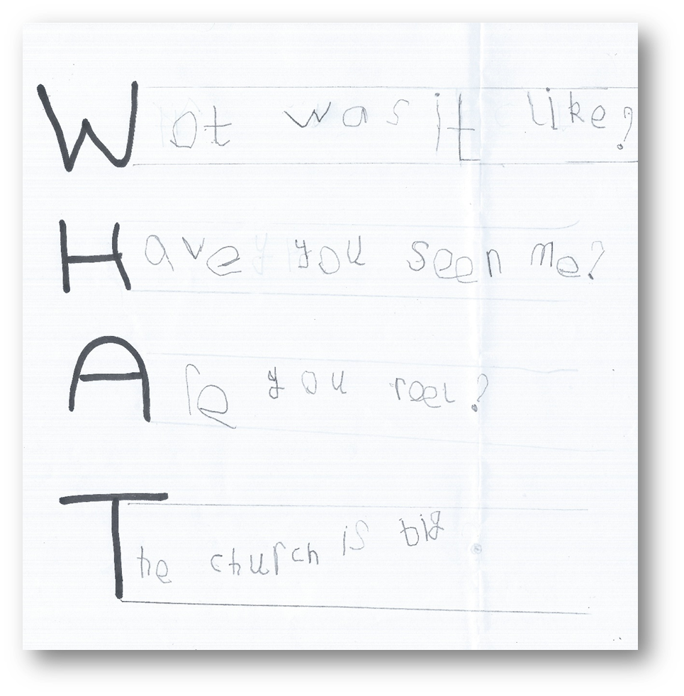
Isaac, age 5
A church visit: three questions for God
This example shows the value of the teacher setting a simple task that is not about recall or remembering a word, but about the pupils’ deeper thinking.
The simple use of an enquiry word – ‘WHAT’ – to make an acrostic enables Isaac to ask God ‘what was it like’. This might be a question about the story of creation the children heard. The next two questions ask ‘Have you seen me?’ and ‘Are you real?’ The pupils shows his deeper thinking by the questions he asks.
The work was part of a planned RE unit about sacred places, which included the church visit. It shows that Isaac is working beyond the expectations of his age because he can ask a variety of questions about religion for himself.
Questions:
How could your school use a task like this to show progress in RE?
Do you give pupils enough opportunities to raise their own questions in RE?
In what ways does this work show good RE in action?
Notes:
Notes: All these examples show only a part of what a pupil is achieving of course, but they have been carefully chosen to illustrate some of RE’s key areas of learning: knowing about religion, understanding the impact of religion and making connections to pupils’ own thinking.

Slide 27
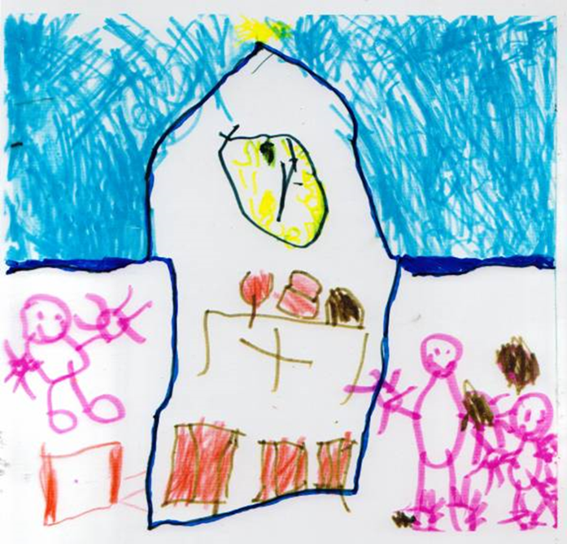
Joshua, age 5
Reflecting on a visit to a church
Children were given time to make a drawing that showed everything they saw and learned from the visit.
Joshua says: “We went to look at the church. In my picture you can see bread and wine on the table, and the holy cross. The chairs were all red. All the people are coming to church to see Jesus. We saw the vicar.”
This example shows that the learner can recall and express his own learning from a visit to a place of worship. His comment on his picture lists some details, and his work shows he has begun to understand what the Church is a sacred place for Christians.
This piece of work came from a classroom where pupils’ RE included walking to church to hear a story, sing a song and meet the Vicar. Back in school, they were asked to make a picture of all they had found out. They had some photos to remind them of the visit. This was the first RE lesson in the Year 1 class.
The planned unit of work around this gave children lots of opportunities to play, integrated with their learning about a church building. The unit was called ‘What makes some places sacred to believers.
Questions:
How could your school use a task like this to show progress in RE?
Does Joshua’s work show achievement in language and communication as well as in RE?
In what ways does this work show good RE in action?
Notes:
Notes: All these examples show only a part of what a pupil is achieving of course, but they have been carefully chosen to illustrate some of RE’s key areas of learning: knowing about religion, understanding the impact of religion and making connections to pupils’ own thinking.

Slide 28
Saint Paul wrote, in the Bible:
“A person’s body has more than one part. It has many parts. ¹⁵ The foot might say, “I am not a hand. So I am not part of the body.” But saying this would not stop the foot from being a part of the body. ¹⁶ The ear might say, “I am not an eye. So I am not part of the body.” But saying this would not make the ear stop being a part of the body. ¹⁷ If the whole body were an eye, the body would not be able to hear. If the whole body were an ear, the body would not be able to smell anything…
Truly God put the parts in the body as he wanted them. He made a place for each one of them. ²⁰ And so there are many parts, but only one body.
The eye cannot say to the hand, “I don’t need you!” And the head cannot say to the foot, “I don’t need you!” ²² No! Those parts of the body that seem to be weaker are really very important… God wanted the different parts to care the same for each other. ²⁶ If one part of the body suffers, then all the other parts suffer with it.
²⁷ All of you together are the body of Christ. Each one of you is a part of that body.”
1 Corinthians 12

Slide 29
Team church
Team A: Here’s the church... Build a cardboard box church. Provide the children with a huge box, and tell them it is going to be turned into a church. Talk a lot before this starts! | Team B: Here’s the steeple... A Tower and a bell This team are also going to do some big scale box modelling. Get them to look at some pictures of a church tower or spire, and tell them their challenge is to make one
Team C: Lego furniture Talk to this team about the things they find inside church. There might need to be an altar for the sacrament, and a font to welcome new babies, some images and statues of saints or of the Blessed Virgin Mary | Team D: Making Windows from stories of Jesus Give the team members an outline on paper of a blank church window, and tell them that we are making some windows for our class’s team built church. Ask what pictures
Team E: Open the door and here’s all the people Tell this team that their challenge is to create the congregation for the church. | Team F: All around the church Ask this team to decide how the whole model church can be put into a churchyard or garden.

Slide 30
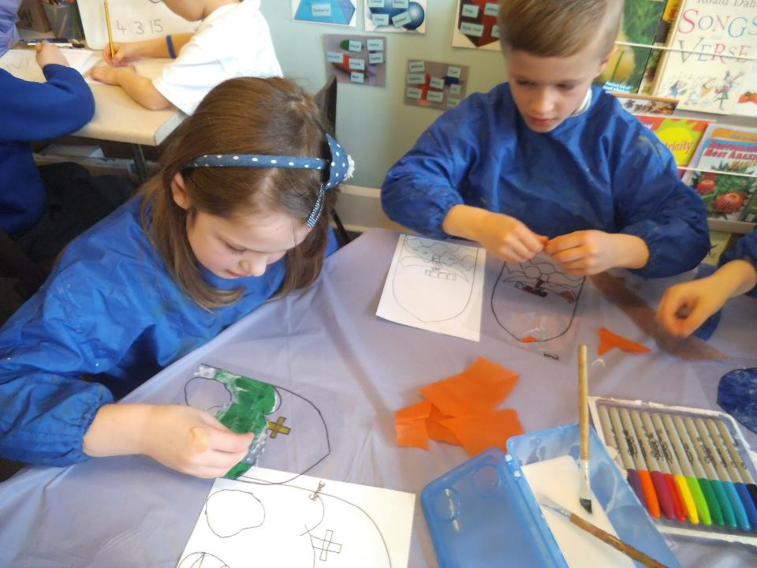
Worth taking time and trouble with the stained glass pictures.

Slide 31
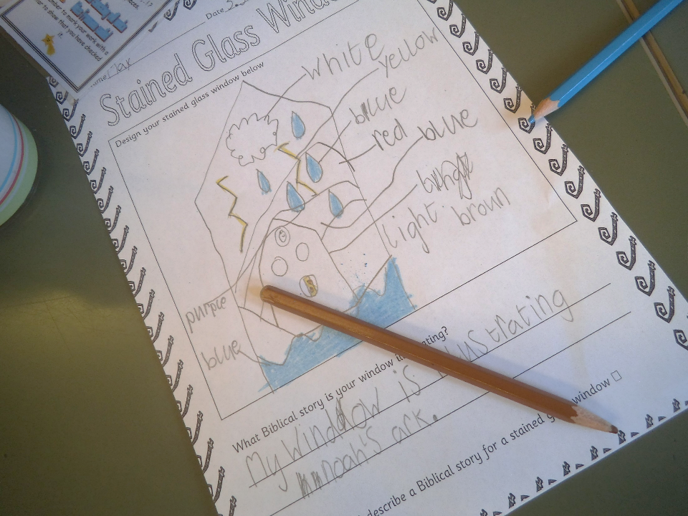

Slide 32
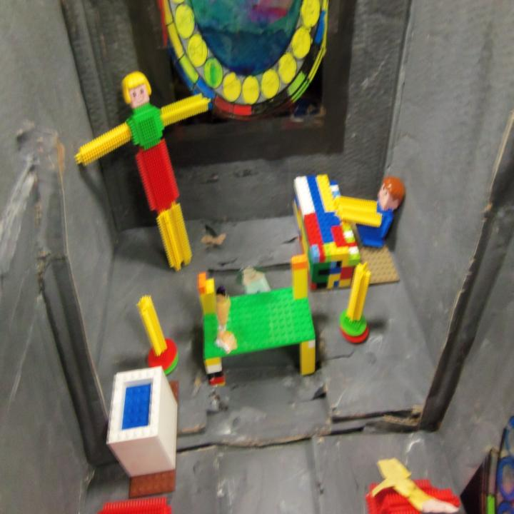
Here you can see an acetate stained glass window, a stickle brick crucifix, two candles, an altar, font and organ. What will it look like if you move the camera up a bit?
Notes:
Children might learn some key words: altar, font, church, crucifix, stained glass, and use these in their work.

Slide 33
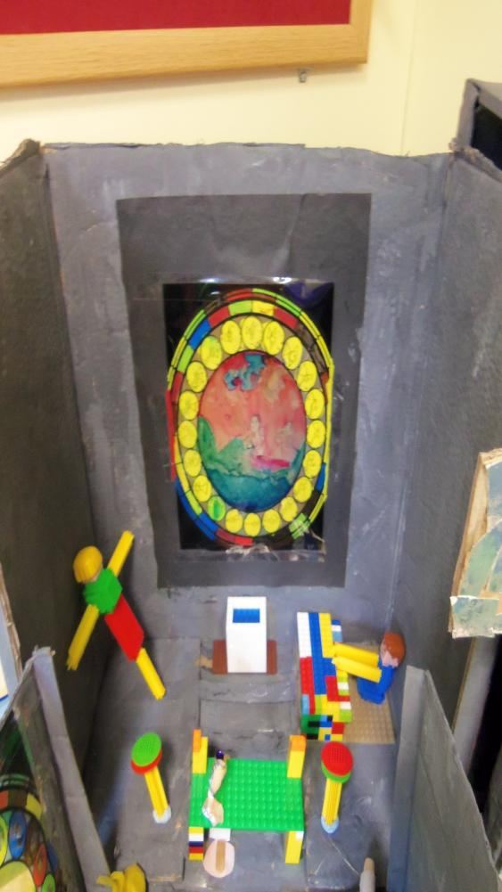
Jesus the good shepherd saving a sheep (smudged)!
The stained glass window was done with sharpie pens. It works better to do the windows on plain paper, then photocopy them onto acetate.
Imagine what you see when you turn around and look down the church.
Notes:
You might give your pupils a particular story to illustrate in their stained glass pictures: the Lost Sheep, or Jesus Birth?

Slide 34
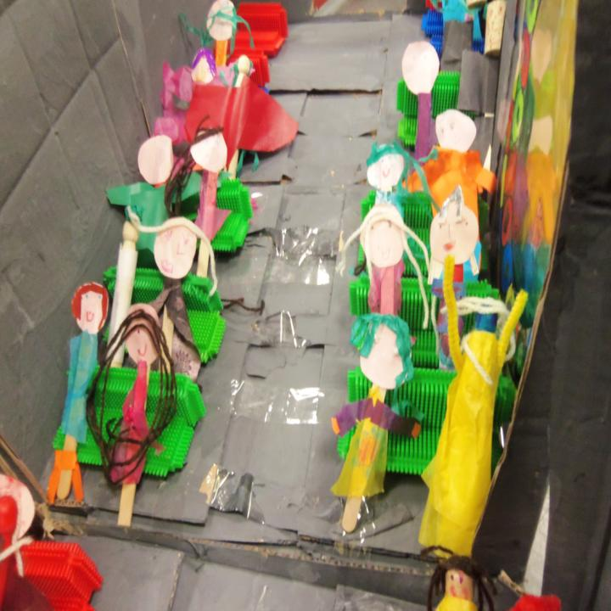
“Open the doors and here’s all the people”
What will it look like if you move the camera back to see the whole church?
Notes:
These little people were made from lolly sticks dressed in tissue, with individual cardboard faces. The team made nearly twenty of them.

Slide 35
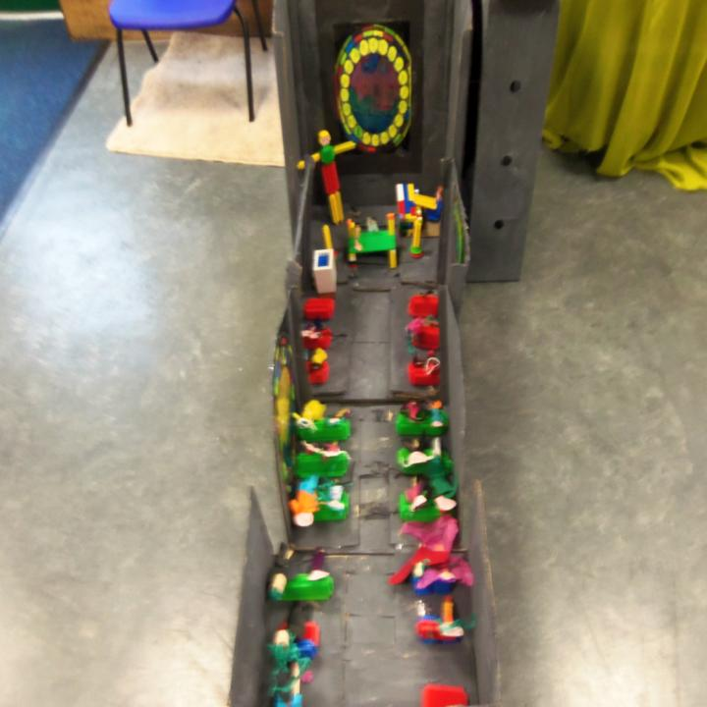
The tower building team did a fine job.
Can children write about their work, using, for example, labels, lists and captions?
Notes:
This class did not have a team to make a church yard – a big piece of green cloth is a good start, but a walk in the school grounds for twigs to be trees and stones to be rocks is good.

Slide 36
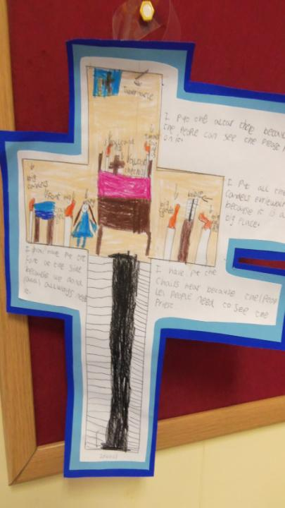
Julie got her pupils to make a plan of the church and draw some of the things they had learned about in their plan.
Some pupils wrote about the drawings as well.
Notes:
This follow up work linked well to literacy objectives and cemented the learning effectively.

Slide 37
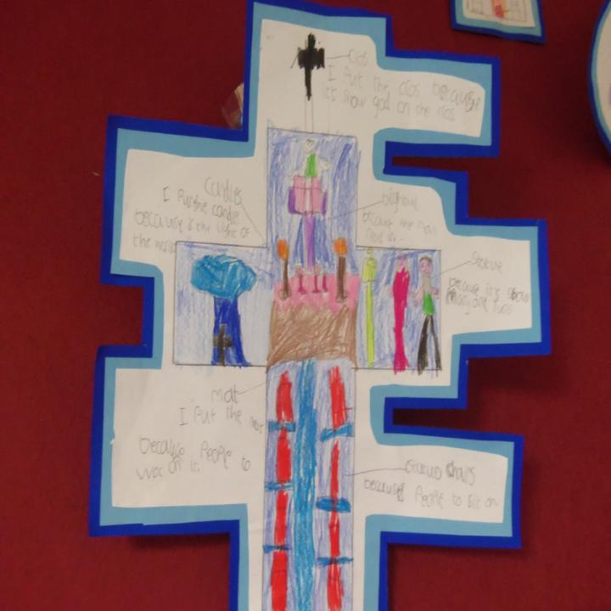
It’s good thinking and creative energy that makes this team task into good RE
I put the cross because I saw Jesus or God on the cross
I put a candle because Jesus is the light of the world
Notes:
This child is beginning to make sense of the symbols of the church.

Slide 38
Get each team to share its work with the others.
Remind children that the Bible compares the church to a body, where the hands do one thing and the feet another, the tummy matters and so does the tongue.
Tell the children that their teamwork is like the church itself, in one way. Christians believe God is pleased when we all co-operate, when we all do our bit.
Can they see the links? Ask them to express their ideas. What do they liker about teamwork? Co-operation? Being ‘one body’?
Extensions into the syllabus: ask the children to make up some prayers or meditations, and to practice a song for the ‘opening’ of the church, and have a little ceremony.
Can some of your writers make a poster inviting people to come?
Ask children to take and use photos of the teams working to show how the church is built. Link community and activity together as a way to learn what it means to belong to the church.

Slide 39
Saint Paul wrote, in the Bible:
“A person’s body has more than one part. It has many parts. ¹⁵ The foot might say, “I am not a hand. So I am not part of the body.” But saying this would not stop the foot from being a part of the body. ¹⁶ The ear might say, “I am not an eye. So I am not part of the body.” But saying this would not make the ear stop being a part of the body. ¹⁷ If the whole body were an eye, the body would not be able to hear. If the whole body were an ear, the body would not be able to smell anything…
Truly God put the parts in the body as he wanted them. He made a place for each one of them. ²⁰ And so there are many parts, but only one body.
The eye cannot say to the hand, “I don’t need you!” And the head cannot say to the foot, “I don’t need you!” ²² No! Those parts of the body that seem to be weaker are really very important… God wanted the different parts to care the same for each other. ²⁶ If one part of the body suffers, then all the other parts suffer with it.
²⁷ All of you together are the body of Christ. Each one of you is a part of that body.”
1 Corinthians 12

Slide 40
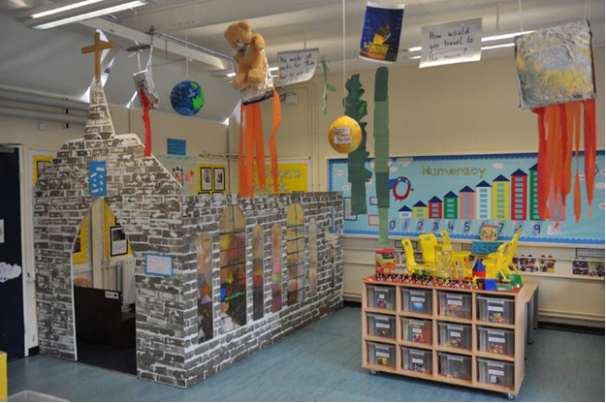
Hallsville School in Newham used similar ideas with the Reception class, creating a church in their classroom for children to play inside.
What do you think the inside looks like?

Slide 41
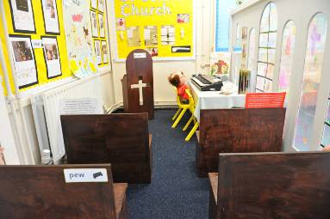
Lots of work for the TA here, but lots of experiential and fun learning for the 4-5 year olds.
What if you adapted the ideas for older pupils?

Slide 42
Team Church for 7-11s
Older pupils might try…
Designing and making two faith community buildings, from different religions, and considering similarities and differences. They could invite the 4-6 year olds to come and see their work
Developing ideas for a ‘shared sacred space’ – e.g. a chapel for an airport, hospital, prison or shopping centre: how could this be made to work for Christians, Jews, Muslims and Hindus? What about non-religious people?
Notes:
Making this task more thoughtful is the focus of these ideas: it is RE, not just design or technology.

Slide 43
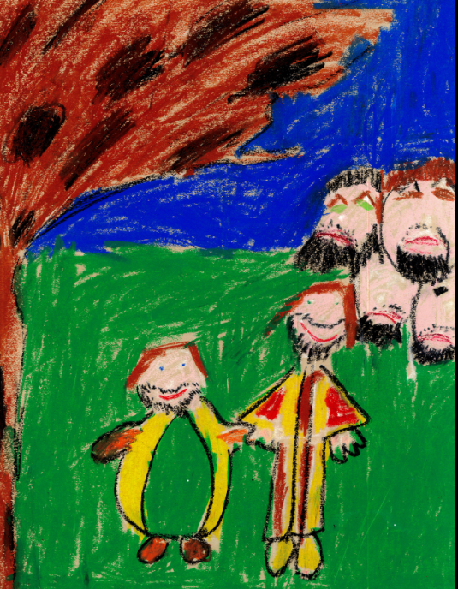
Tony, only 7 (!), created this amazingly expressive image of the story of Zacchaeus. This traitorous, Roman~ collaborating tax collector persuaded by Jesus to repent of his selfish and avaricious way of life. Tony said:
“My picture is made with wax crayons. I did Jesus and Zack looking happy at the end of the story. The other people were cross with Jesus for being friends with him. No one liked him except Jesus. At the end he gave all his money away, so Jesus changed his life.”
The disdainful jealousy of the onlookers is particularly well expressed in their wax crayon faces.

Slide 44
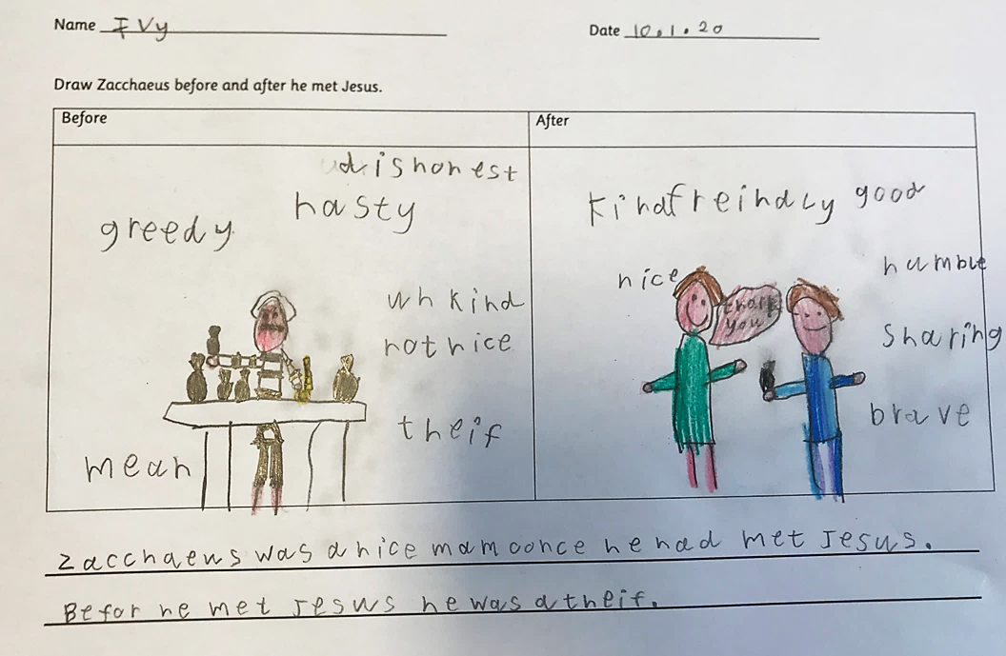
Ivy, age 7
The story of Jesus meeting Zacchaeus and changing his life from greed and loneliness to generosity and community
This example shows that pupils can make sense of religious story for themselves if they are set well structured tasks. Ivy chooses 6 ideas about the kind of person Zacchaeus was at the start of the story, and 7 words to describe how he changed. The work is focused on the way an encounter with Jesus transformed his life – a big idea about religion’s power to change people’s lives.
Regarding age related expectations, this work shows that Ivy can give examples of how stories show what difference faith makes, and think, talk and ask questions about the story using her own ideas about values.
Questions:
How could your school use a task like this to show progress
in RE?
The task has several layers – to draw, to select words, to write a sentence summarising the story. Do you use layered tasks enough, to deepen pupil responses in RE?
In what ways does this work show good RE in action?

Slide 45
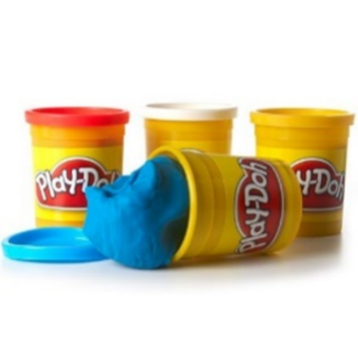
Creation Play Doh
Put the class into 6 teams and ask them to think about how their team could make one of the ‘days’ of creation from pay doh (the sixth day is very much harder than the others – maybe two teams on this?)
Give each team a tray or board to work on, and 4-6 pots of different coloured play doh.
Ask them to make everything they can that goes with their ‘day’ on a tray, and line up the six trays, to show the whole story
On a seventh tray, ask children to make a picture of ‘rest’ out of play doh. Can pupils who finish early also make a play doh image of LIFE / LIGHT / GOD?
Arrange them all in order, as an exhibition

Slide 46
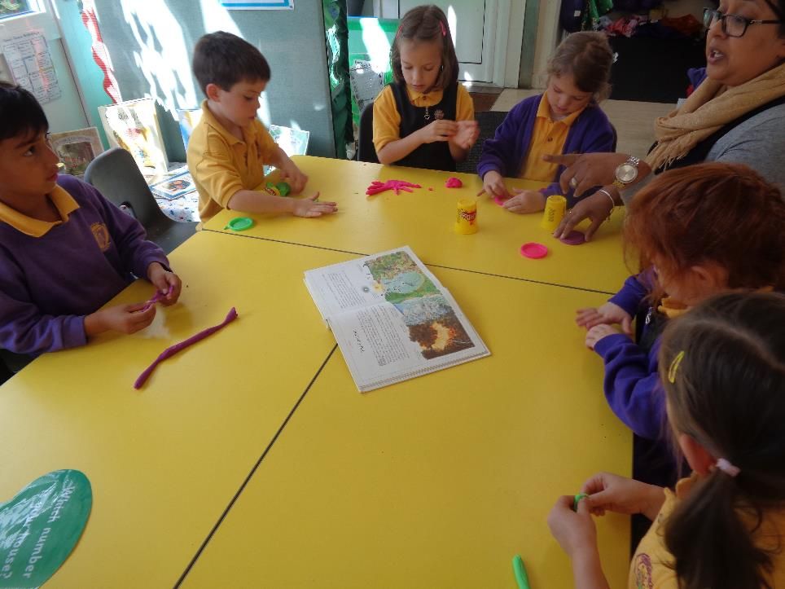
Year 1 groups used a picture-Bible to guide their making of the days of the story of creation.

Slide 47
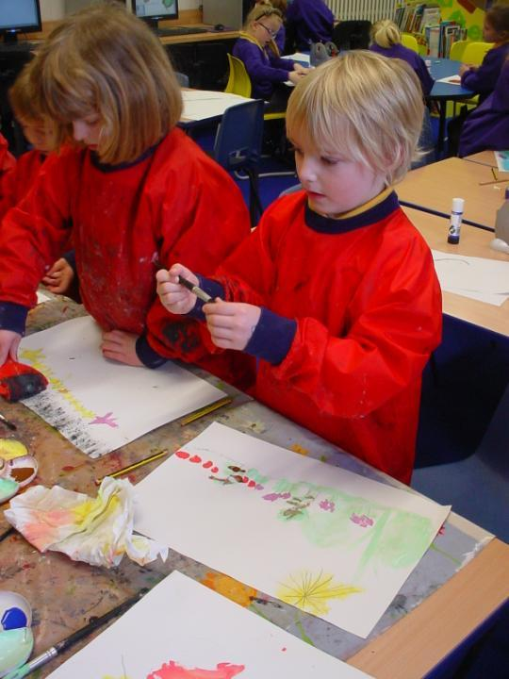
“I gave the children a choice which group they joined, which aspect of the Genesis creation stories they wanted to make.
Pupils in reception class worked on the background, producing different days between them.
The Year 1 and 2 pupils created animals, plants, stars, waterfalls, rivers and so on to depict God’s creation on each day of the story. This resulted in a busy, vibrant and wonderful display to which the whole school had contributed.
Alongside this work were individual pieces of work which addressed associated ideas with creation, such as ordering the days of creation, selecting their favourite thing in the creation, thinking about what might have made God proud.”

Slide 48
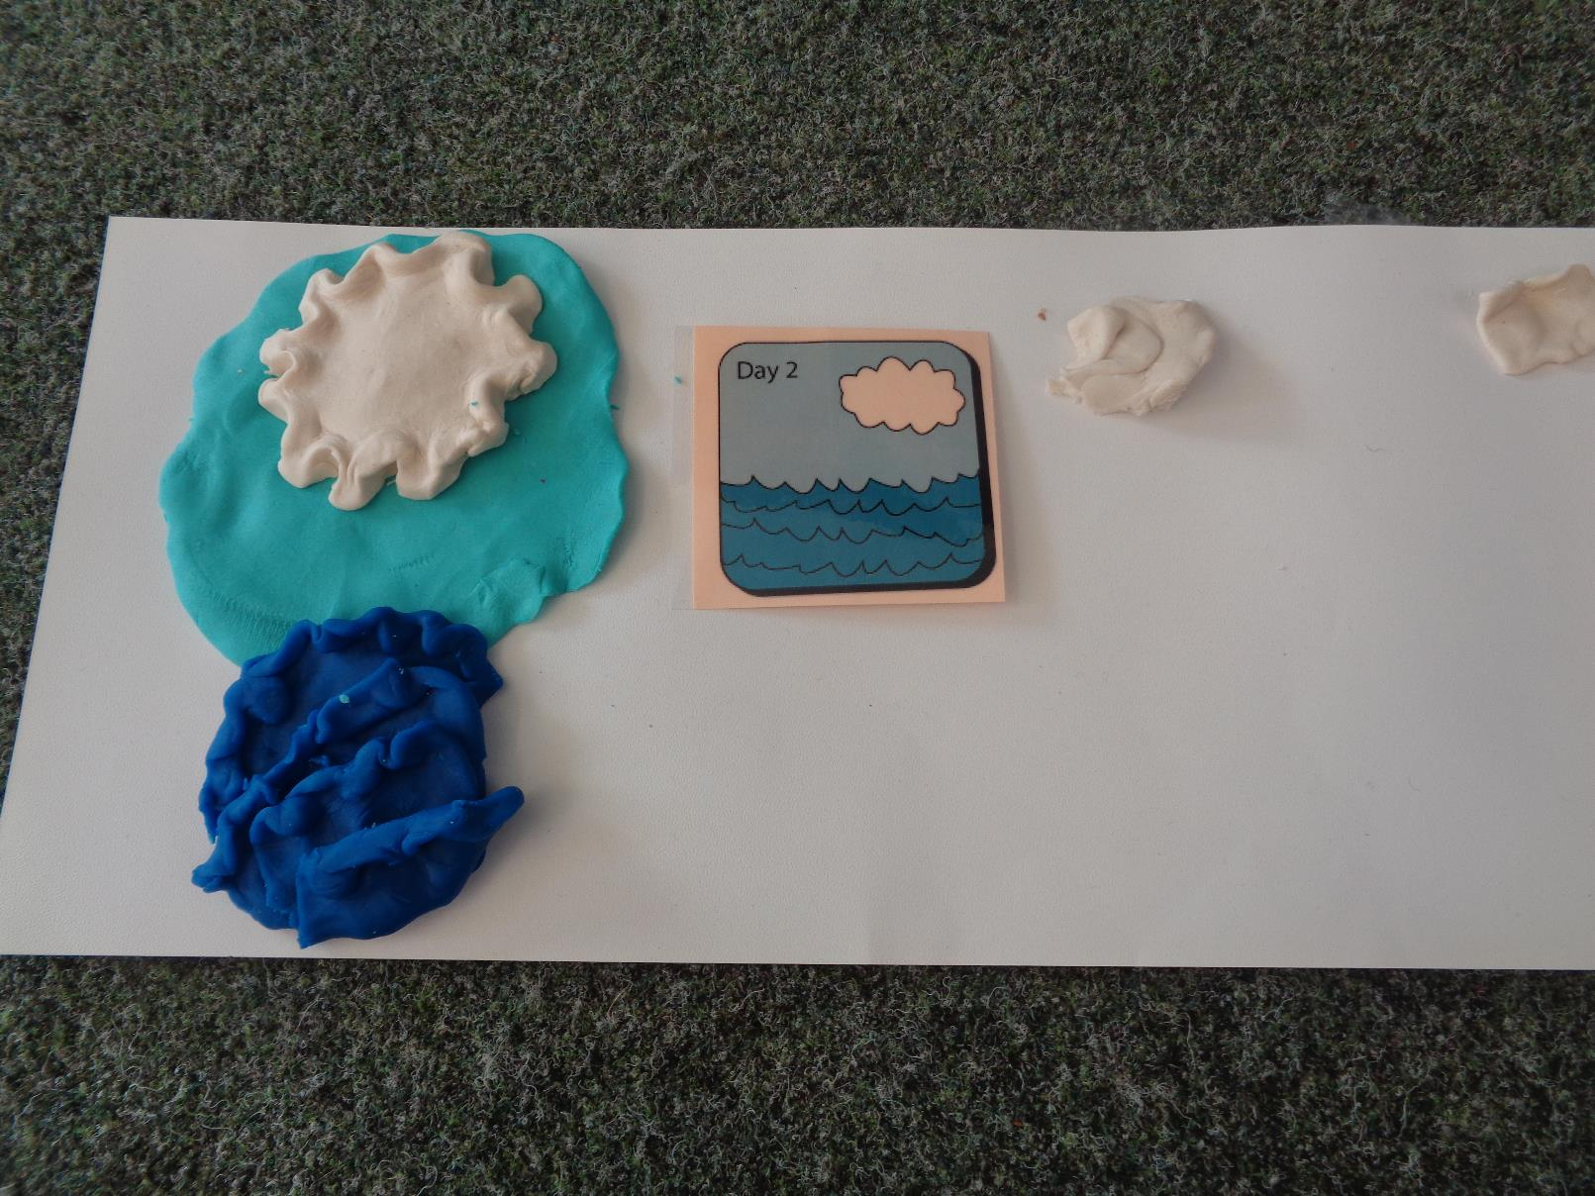
Simple pictures reminded children of the story they were learning, and enabled creativity and imagination- also sequencing!

Slide 49
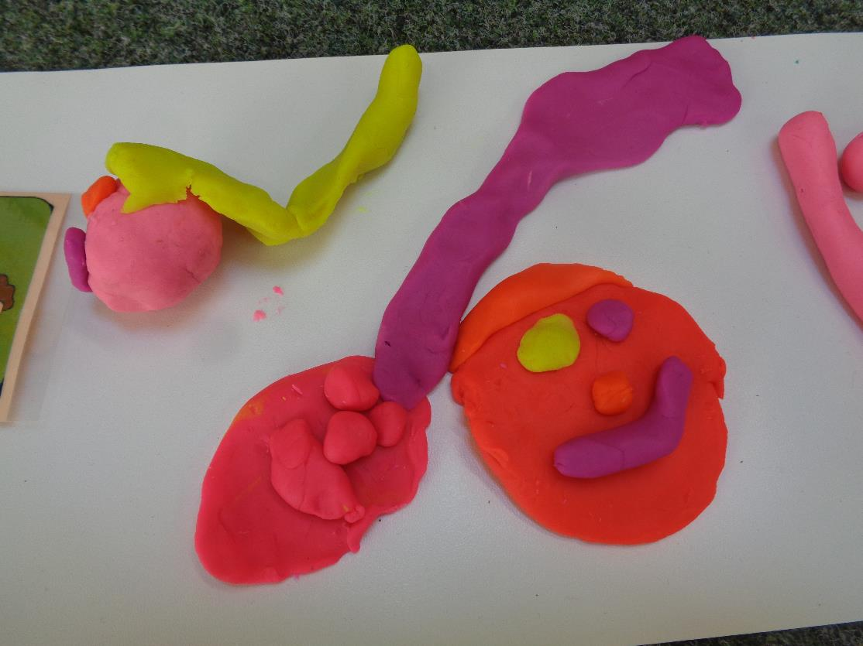
Day Six: the creation of humanity

Slide 50
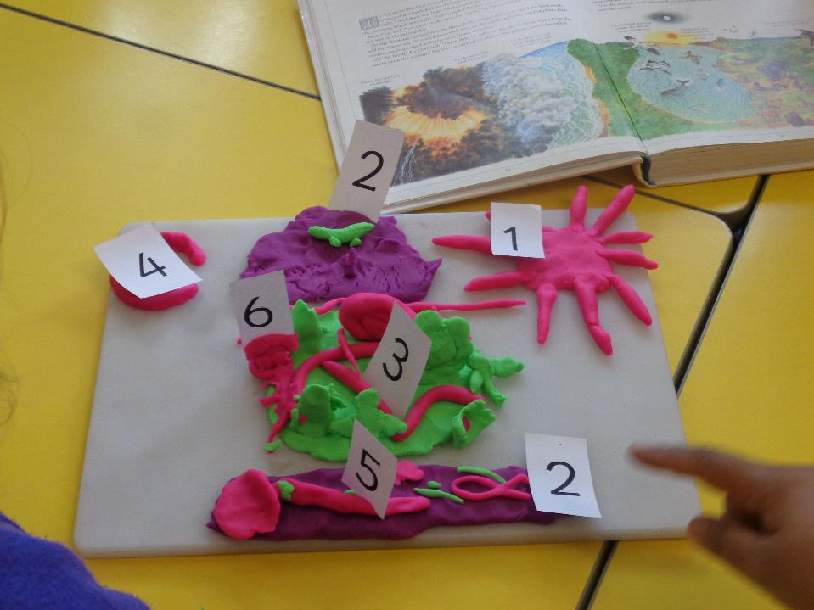
Pupils used number cards to label their ‘creations’, as the story goes.

Slide 51

7 Creations:
Number three pages on your table. Make from your play doh something for each of those three (afterwards, put it back please)
Night and Day
Sky and Sea
Land, Trees, Vegetation
Sun, Moon and Stars
Birds and Fish
Every creeping thing, animals of the field, wild creatures, humans
Rest.

Slide 52

Year 1: Seven in a Row
This photograph shows a whole class product, reflecting on the first Creation story of the Bible
Every child has achieved.
Can they identify, name, describe, suggest a meaning, recall, remember, talk about, make a link?

Slide 53

Variations: lego days. Izzy has contributed to day three, the creation of the trees.

Slide 54



Slide 55

This task, to ask the questions you’d like to of ‘the person who knows everything’ is versatile across many levels.
Aaron is able to ask his own questions about creation and the world. In the RE context, he asks questions about things that matter to him. This is a high achievement for Aaron, who is in Year 1.

Slide 56

Creation Play Doh Outcomes
4-5YOs
Children listen with enjoyment to stories, songs and poems from different communities, responding with relevant comments and questions. They use talk to organise, sequence and clarify thinking and events [ELG C+L]
7YOs
Retell a Bible story of creation in simple sculpture + suggest what the story means
Describe what happens in the story. Identify a key moment or a big question.
Ask and respond to questions about God as the Maker. Realise that some of these questions are difficult to answer.

Slide 57

This class display followed several lessons of work, arising from Genesis 3. The pupils in Year 2 had lots of discussion, saw different versions of the story, and thought about the ‘big ideas’.
Their extended writing is a good example of the ways RE and English skills should and can connect.
The skills of thinking about meaning are very clearly evidenced here. The children dhow this by asking questions, noticing details in the stories and responding to teacher-led questioning with insights and thoughts of their own.
“We wrote questions for the characters in the story and hot seated different people to play their roles.”
“We have been thinking about the ideas in the story, such as choice, innocence”
“We wrote in character as Adam, Eve or the Snake”

Slide 58

What can we remember?
Who talks?
God, Adam, Eve, the snake
What was the rule?
Why did Adam and Eve break the rule?
Do we all get tempted sometimes?
Does a ‘little voice inside us’ do the tempting?

Slide 59

Freeze the frame (here Adam takes a bite and the snake is delighted)
Put the pictures in the right order
Take turns to tell the next bit of the story

Slide 60

What are the most important words in the story?
Garden
God
Temptation
Snake
Adam
Eve
Fruit
Rule
Broken
Choice
Innocent

Slide 61

The snake in the hot seat:
Why did you do it?
Are you sorry?
Are you cross with God?
How will you live without your legs?
Are you evil?

Slide 62

Eve in the hot seat:
Are you unhappy now?
Did Adam join in with you?
Whose fault do you think it was?
Are you sorry now you are thrown out of the garden?
Do you think God has been fair?

Slide 63


Slide 64



What do Christians believe about God?
By the end of this unit pupils should know that many Christians believe:
in one God, who created and loves the Earth and all people
God is ‘beside, behind and ahead’ – with people all the time
the Spirit of God is invisible, but with people always, so they can pray to God any time and in any place
Jesus shows what God is like
BIG QUESTIONS BIG ANSWERS – Investigating God Editor: Fiona Moss © RE Today 2021
Notes:
In order to access the learning in this unit, pupils should have learnt about:
the idea that some people believe God is the creator of the Earth
the idea that Christianity is one of many religions

Slide 65

Key words to learn
God
Creator
Father
Trinity
Holy spirit
Jesus
BIG QUESTIONS BIG ANSWERS – Investigating God Editor: Fiona Moss © RE Today 2021
Notes:
Expected outcomes (based on the Early Learning Goals for England 2020)
Children answer ‘how’ and ‘why’ questions about their experiences.
Children express themselves effectively, showing awareness of listeners’ needs.
They develop their own narratives and explanations by connecting ideas or events.
They know about similarities and differences between themselves and others, and among families, communities and traditions.
They represent their own ideas, thoughts and feelings through art and music.
This unit helps pupils in Scotland to achieve RME 0-01a and 1-01c.

Slide 66

BIG QUESTIONS BIG ANSWERS – Investigating God Editor: Fiona Moss © RE Today 2021
Notes:
Activity 1
Show children the three-letter word on p. 6, and have a conversation with the class about this ‘big little word’ – it may only have three letters, but it is very important for some people. You could use some Christian artefacts or art works such as those from the Spirited Arts competition (see eResources) connected to the idea of God, and ask children to talk about God. One way to do this is to suggest what for some people the three letters might stand for:
• G is for Goodness.
• O is for Over all people.
• D is for Divine.
Give each pupil an outline of the three letters copied from p. 6 (Resource 2.1) and ask them to draw inside the letters anything they would like to which is to do with God. After the children have made their pictures, arrange for them to share their ideas in small talking groups of three or four and in a whole-class talking circle.

Slide 67

Lots of children gave ideas from prior learning about God.
Every child tackled this task differently.
BIG QUESTIONS BIG ANSWERS – Investigating God Editor: Fiona Moss © RE Today 2021

Slide 68


Leighton, 6, thought of things to thank God for, including tractors, stars, sun and moon, spaceships… He drew them all into his letter-outline.
BIG QUESTIONS BIG ANSWERS – Investigating God Editor: Fiona Moss © RE Today 2021

Slide 69


Children are invited to think of the words they link to God, and draw them into the letters
It is important to note this is to link to the idea of God- this is not about them believing in God.
How do you know the wind is there?
BIG QUESTIONS BIG ANSWERS – Investigating God Editor: Fiona Moss © RE Today 2021

Slide 70


The activity gives children the chance to think about the meanings of the word ‘God’ for themselves. Teachers may need to explain different words to the class.
BIG QUESTIONS BIG ANSWERS – Investigating God Editor: Fiona Moss © RE Today 2021

Slide 71




Show these examples to your class, but then ask them to work from their own thoughts, not to copy what others have done. Good modelling encourages thinking, not copying, in RE.
BIG QUESTIONS BIG ANSWERS – Investigating God Editor: Fiona Moss © RE Today 2021

Slide 72
Hi, I’m Grace. I’m a Christian. What can you see that I am wearing that is a clue to my religion? I have got 5 thoughts about God. The first is that God is amazing because he made the world, including cats. I like cats best of all the animals.
BIG QUESTIONS BIG ANSWERS – Investigating God Editor: Fiona Moss © RE Today 2021
Notes:
Activity 2
Introduce the children to Grace. Read aloud the five things she has to say about God. Fix this in children’s understanding by repeating that Grace is a Christian, and that there are other religions who say different things about God. Some people have no religion, and don’t believe in God at all. Depending on the children’s prior learning, you might explore the beliefs about God of someone from another religion.

Slide 73
My second thought about God is that God loves us. I think that is why we have Christmas. It reminds us that God came to Earth to show love.
BIG QUESTIONS BIG ANSWERS – Investigating God Editor: Fiona Moss © RE Today 2021
Notes:
Activity 2
Introduce the children to Grace. Read aloud the five things she has to say about God. Fix this in children’s understanding by repeating that Grace is a Christian, and that there are other religions who say different things about God. Some people have no religion, and don’t believe in God at all. Depending on the children’s prior learning, you might explore the beliefs about God of someone from another religion.

Slide 74
I also think it is really good that we can pray to God any time and anywhere, and God listens to our prayers (even though he does not always give us what we ask for).
BIG QUESTIONS BIG ANSWERS – Investigating God Editor: Fiona Moss © RE Today 2021
Notes:
Activity 2
Introduce the children to Grace. Read aloud the five things she has to say about God. Fix this in children’s understanding by repeating that Grace is a Christian, and that there are other religions who say different things about God. Some people have no religion, and don’t believe in God at all. Depending on the children’s prior learning, you might explore the beliefs about God of someone from another religion.

Slide 75
And I think that sometimes people can feel close to God. I sometimes feel God is close when I sing a ‘thank you’ song at church. And also when my cat is sleeping on my lap.
BIG QUESTIONS BIG ANSWERS – Investigating God Editor: Fiona Moss © RE Today 2021
Notes:
Activity 2
Introduce the children to Grace. Read aloud the five things she has to say about God. Fix this in children’s understanding by repeating that Grace is a Christian, and that there are other religions who say different things about God. Some people have no religion, and don’t believe in God at all. Depending on the children’s prior learning, you might explore the beliefs about God of someone from another religion.

Slide 76
My fifth thought is that God is a mystery. We don’t know what God looks like, and we can’t see – God is invisible. I hope I learn more about God when I am older.
BIG QUESTIONS BIG ANSWERS – Investigating God Editor: Fiona Moss © RE Today 2021
Notes:
Activity 2
Introduce the children to Grace. Read aloud the five things she has to say about God. Fix this in children’s understanding by repeating that Grace is a Christian, and that there are other religions who say different things about God. Some people have no religion, and don’t believe in God at all. Depending on the children’s prior learning, you might explore the beliefs about God of someone from another religion.

Slide 77

Do you think God made the world? What do you like
about the animals of the Earth?
Grace thinks God loves us. What do you think? What do you think Christmas is all about?
Grace says, ‘God is a mystery’. What do you think about the mystery of God?
Do you agree with Grace about prayer? What are your thoughts about talking to God?
What makes Grace feel close to God? Does anything make you feel close to God, or not?
BIG QUESTIONS BIG ANSWERS – Investigating God Editor: Fiona Moss © RE Today 2021
Notes:
Activity 2
Along with your introduction to what Grace has to say, ask the children some questions about their ideas too.
Here are some examples. They look challenging, but our 4–6s often have surprisingly deep answers to these big questions.

Slide 78



Pupils learn from Grace’s ideas, and think about her identity: she is a Christian. Then they are invited to suggest five of their own thoughts about God. These could include not there!
BIG QUESTIONS BIG ANSWERS – Investigating God Editor: Fiona Moss © RE Today 2021

Slide 79



Learning is focused by the request for five ideas: this enables children to do work that is particular to their own ideas.
BIG QUESTIONS BIG ANSWERS – Investigating God Editor: Fiona Moss © RE Today 2021

Slide 80



Children’s ideas come from what they have heard in home or school settings. Some children learn about God at a place of worship.
BIG QUESTIONS BIG ANSWERS – Investigating God Editor: Fiona Moss © RE Today 2021

Slide 81


Ideas are many, and varied: all are welcome and open to discussion. Ask: What do we mean by…?
BIG QUESTIONS BIG ANSWERS – Investigating God Editor: Fiona Moss © RE Today 2021

Slide 82
My name is
My first thought about God is
Here is a picture of me.
My second thought about God is
I also think
And I think
My fifth thought is that God is
BIG QUESTIONS BIG ANSWERS – Investigating God Editor: Fiona Moss © RE Today 2021
Notes:
Activity 3
Give each child a copy of p. 8 (Resource 2.3). Ask them to draw a picture of themselves on the left-hand side, and then complete the sheet using pictures, single words or sentences (perhaps using an amanuensis, maybe from an older age group – it is a good RE activity to get 7–9s to come and talk with 4–6s about this topic).
The aim of this work is to share their own big ideas about God and to realise that different people have different ideas about God.

Slide 83

Song: God behind, God beside, God ahead
Listen to the song by Stephen from Fischy Music
It’s a song for Christian children, but anyone can sing along if they want to. You don’t have to, of course
What does Stephen believe about God?
(To start the song, click on the speaker on the next slide)
Can children draw one of the times when Stephen feels close to God? Breakfast? Christmas?
BIG QUESTIONS BIG ANSWERS – Investigating God Editor: Fiona Moss © RE Today 2021
Notes:
Activity 4
‘God beside, God behind, God ahead’
This song by Stephen Fischbacher of Fischy Music is used here by kind permission. It expresses the Christian view that God is everywhere and that people can communicate with God by praying, ‘any time, any place’.
Play the song to your class, and use the questions on p. 9 to consider these Christian ideas and share the pupils’ thoughts about the words of the song.
A sample of the song being sung with actions can be viewed on YouTube (see eResources).

Slide 84

When I wake up in the morning, in my bed
God behind, God beside, God ahead
When I’m eating up my breakfast - bacon and egg
God behind, God beside, God ahead
When I’m going on a summer holiday
God behind, God beside, God ahead
When I’m opening my presents, Christmas day
God behind, God beside, God ahead
In the sunshine (Aaah!)
And the rain (Aw!)
In the laughter (Ha Ha Ha!)
And in the pain (Ouch!)
With us in the morning, with us in the day
With us in the evening, always, always, always, always
When it feels like you’ve been left out, on your own
God behind, God beside, God ahead
When there are no cards or letters, no-one phones
God behind, God beside, God ahead
When you fall out with your friends… feeling sad
God behind, God beside, God ahead
When somebody in your family drives you mad
God behind, God beside, God ahead
In the sunshine - and the rain
In the laughter - and in the pain
With us in the morning, with us in the day
With us in the evening, always, always, always, always…
BIG QUESTIONS BIG ANSWERS – Investigating God Editor: Fiona Moss © RE Today 2021
Notes:
Activity 4
‘God beside, God behind, God ahead’
This song by Stephen Fischbacher of Fischy Music is used here by kind permission. It expresses the Christian view that God is everywhere and that people can communicate with God by praying, ‘any time, any place’.
Play the song to your class, and use the questions on p. 9 to consider these Christian ideas and share the pupils’ thoughts about the words of the song.
A sample of the song being sung with actions can be viewed on YouTube (see eResources).

Slide 85

Stephen wrote this song. What does he believe about God?
If somebody thinks God is always with them, how would that make them feel?
Christians believe that God always listens when they pray. How do you think they might feel about that?
Christians sometimes pray prayers that start like these. Can you finish off the prayers? Which ones do you like best and why?
  ‘Dear God, please help me not to be scared of…’
  ‘God, please help me to be kind to…’
  ‘Jesus, you were always friendly, but I sometimes feel unfriendly. Help me to…’
  ‘Please God, help me to…’
  ‘Dear God, I am sorry for doing a bad thing…’
Some people don’t believe in praying, but they do believe in reflecting or meditating. Do you like to pray, or to reflect, or to meditate? Or is that something that you don’t do?
BIG QUESTIONS BIG ANSWERS – Investigating God Editor: Fiona Moss © RE Today 2021
Notes:
Activity 4
‘God beside, God behind, God ahead’
This song by Stephen Fischbacher of Fischy Music is used here by kind permission. It expresses the Christian view that God is everywhere and that people can communicate with God by praying, ‘any time, any place’.
Play the song to your class, and use the questions on p. 9 to consider these Christian ideas and share the pupils’ thoughts about the words of the song.
A sample of the song being sung with actions can be viewed on YouTube (see eResources).

Slide 86


Here are some thoughts about praying. Don’t ask children to pray in RE: many come from families who don’t believe in praying. Talk to children about how we are all different.
Instead, in this activity, children are invited to show that they understand the kind of things Christians might pray.
BIG QUESTIONS BIG ANSWERS – Investigating God Editor: Fiona Moss © RE Today 2021

Slide 87

What might a Christian child pray?
“Dear God, please help me not to be scared of the dark. Please help me to be kind to Kingston... Help me to wave and smile… Help me do my work… I am sorry for messing around…”
BIG QUESTIONS BIG ANSWERS – Investigating God Editor: Fiona Moss © RE Today 2021

Slide 88


BIG QUESTIONS BIG ANSWERS – Investigating God Editor: Fiona Moss © RE Today 2021

Slide 89

Key words: can you explain these words?
God
Creator
Father
Trinity
Holy spirit
Jesus
BIG QUESTIONS BIG ANSWERS – Investigating God Editor: Fiona Moss © RE Today 2021
Notes:
Expected outcomes (based on the Early Learning Goals for England 2020)
Children answer ‘how’ and ‘why’ questions about their experiences.
Children express themselves effectively, showing awareness of listeners’ needs.
They develop their own narratives and explanations by connecting ideas or events.
They know about similarities and differences between themselves and others, and among families, communities and traditions.
They represent their own ideas, thoughts and feelings through art and music.
This unit helps pupils in Scotland to achieve RME 0-01a and 1-01c.

Slide 90

Our Father…
This PowerPoint sequence supports ideas about how to teach the Lord’s Prayer. Grateful thanks to Sophie Hardwicke for her excellent visual learning materials.
This downloadable resource, free to REtoday magazine subscribers and NATRE members, is © RE Today and may be used in your own school. Any other use is by written permission only.
© RE Today, 2017.

Slide 91
Essential Knowledge for the pupil
Pupils will know:
The Lord’s Prayer was first taught by Jesus to his first followers, his Disciples.
The Lord’s Prayer calls God ‘Our Father’ because Christians think God is like our parents, and loves and cares for us.
The Lord’s Prayer is quite difficult for infants, but thinking carefully helps us to understand the meaning of each line in the prayer.
The Lord’s Prayer is about what God wants people to do as well as about what people want God to do for us. It is a prayer to help Christian people to be kind, to care, not to do wrong and to worship God.

Slide 92
How many people in the picture?
Who is the youngest?
Who is the oldest?
Can you see some bad behaviour? A bully? A greedy person? A fight? Someone stealing? Someone cheating at football? Who is the worst?
Can you see some good behaviour? Sharing? Kindness? Generosity? Peace? Respect? Forgiveness? Saying sorry? Co-operating? Who is the best?
Can you connect: here are some of the words from the Lord’s Prayer. Can you point to something in the picture that is to do with these words? Father / Holy / Heaven / Food / Forgive / Sin / Temptation / Evil / Power.

Slide 93
The picture was drawn to show the meaning of the Lord’s Prayer. Can you see a picture that shows:
  A family and a symbol of God, Father, Son and Holy Spirit?
  People making peace and stopping war? A dustbin full of weapons?
  People enjoying their ‘daily bread’ or ‘daily food’ together?
  The difference between hogging things greedily for myself and planning to share money with people who are poor?
  An idea about heaven (Can you see the Tree of Life? Can you see the River of Life? Can you see where the lion and the lamb are friends, while people make sweet music)?
  A mum stopping her children from fighting?
Read each line from the Lord’s Prayer – it is quite hard to understand it all. Can pupils point to the part of the picture that links to each line as the lines are read out, and talk about the links?

Slide 95

Our Father, who lives in heaven
May your name be kept holy

Slide 96

Your kingdom come, your will be done on Earth as it is in Heaven

Slide 97



Give us today the food we need

Slide 98



And forgive us our sins, just as we forgive those who sin against us

Slide 99

Do not lead us into temptation, but free us from evil

Slide 100

Do not lead us into temptation, but free us from evil

Slide 101

Do not lead us into temptation, but free us from evil

Slide 102

For the kingdom, the power and the glory belong to you forever and ever
Amen

Slide 103

For the kingdom, the power and the glory belong to you forever and ever
Amen

Slide 105
Questions for thinking
Is God like our mums and dads? Does God care for us?
Can everyone on earth have enough food? Do we all need to share more fairly?
Can we bring peace to our world instead of war?
Can we make Earth more like Heaven?
Can we be freed from temptations? How?
Why is forgiveness difficult? Who can help people to forgive?

Slide 106
Our Father, who lives in heaven
May your name be kept holy
Your kingdom come, your will be done on Earth as it is in Heaven
Give us today the food we need
And forgive us our sins, just as we forgive those who sin against us
Do not lead us into temptation, but free us from evil
For the kingdom, the power and the glory belong to you forever and ever
Amen

Slide 107
Next Steps in Learning
To extend pupils’ achievement from this work, or to use the visual learning with older pupils, you might ask pupils to create a picture book of the Lord’s Prayer.
Give them an 8 page booklet to complete (there is one on the RE Today Website ready to use).
This booklet asks for the pupils’ own questions and explanations of the lines of the prayer: a challenging task that some adult Christians find difficult!

Slide 108
The Lord’s Prayer is also a song!
Watch some sung versions of the Lord’s Prayer.
Learn a lot by comparing the versions, which are all slightly different. Which one do you like best and why?
A children’s choir: https://www.youtube.com/watch?v=e6STLRycSnE
A Canadian modern version: https://www.youtube.com/watch?v=w2vSnQ3JASk
A line-by-line call and response teaching version: https://www.youtube.com/watch?v=kP29O6rILWc

Slide 109
Outcomes to work on the Lord’s Prayer
Emerging
Notice and talk about the Lord’s Prayer and its meaning
Recognise simple links between some lines and phrases in the prayer and things Christians believe or do, using pictures.
Expected
Making sense of the text: talk about the meaning of three or more of the phrases in the Lord’s Prayer
Understanding the impact: Choose and talk about the lines of the prayer they think are most important, most difficult to understand or most difficult to do.
Understanding the impact: select and discuss pictures of aspects of the Lord’s Prayer
Making connections: link up thoughts about prayer to thoughts about what people should do.
Exceeding
Explain the meaning of the Lord’s Prayer for younger children, simply
Raise and discuss questions about prayer for themselves.

Slide 110




Slide 111
© RE Today 2021​

Slide 112

Joanna is a Christian. She is 6. Her festival is Christmas. Her church has four ideas for a greener festival. What do you think of them?
“Everyone likes a Christmas tree. But it means millions of trees grow for a few years, sit in a house for a few weeks and then get thrown away. We’re going to use artificial trees that can last ten years, and make some decorations of our own instead of buying ones made in China!”
“We think that too much money is spent on presents and cards, which maybe people don’t even like. We are going to make half our presents and cards ourselves this year. We think it will be fun.”
“Wrapping paper is a bit of a waste. We are going to use recycled gift wrap for all our presents this year.”
“At church, we have hundreds of Christingles made of oranges for a special service. Lots of the oranges are thrown away, so this year we will collect them – and make marmalade. They get boiled, so it will be quite safe, and everyone can get yummy marmalade for New Year.”
Which for these four ideas do you think will make a big difference?
© RE Today 2021​

Slide 113

Joanna is a Christian. She asked her Pastor at church: can Christians do more to help save the planet? What does the Bible teach about this? Here is what the minister said:
“Yes, Christians can do lots more to save the planet, and we must. We haven’t been very good at this in the past! The Bible says that God made the Earth good (Genesis 1), but we have often spoiled it.”
“I think Jesus loved the world of nature – he noticed sparrows, and doves, pigeons, hens, foxes, flowers and fruit trees. We should follow Jesus and care for the earth too. Some Christians teach that we are God’s Stewards.”
“It is God who owns the earth, which he made, and loves, and saves. God gives us the task of caring for the planet. In the Psalms, one song says ‘The earth is the Lord’s and everything in it, the world and its inhabitants too, because God is the one who established it on the seas; God set it firmly on the waters.’ (Psalm 24:1-2).”
“God is pleased, I believe, when humans love the Earth and care for it and protect it.”
© RE Today 2021​

Slide 114
Age related expectations Recognise religious stories Retell, in any form, a narrative that corresponds to the scripture source used. (retell does not mean ‘learn by rote’ – pupils can tell the story in their own words) | Question stems to lead pupils towards the outcomes Can you use the…… to tell the story of……? Could use pictures, role play to tell the story of…. What can you remember about what happens next in…… ? Who are the characters in the parable of……? What do they do….? Are they important in the story and why? What happens in the story? Can you tell me the story about? Who can remember what the character does now?
Recognise key people in the local, national and universal church. Describe different roles of some people in the local, national and universal church. | Who does / says / teaches / follows / leads / is kind / is good / is bad etc? What does… do? What do they do in church? Who’s job is it to….? What else do (they) do in the Church? What do ….. believe about…?
Recognise that people act in a particular way because of their beliefs. Describe some of the actions and choices of believers that arise because of their belief. | What do… do at…..? Christians believe…, so how should they act? Which one of these objects…? What can you tell me about this object?
Recognise key figures in the history of the People of God. Describe the life and work of some key figures in the history of the People of God. | Who is this? Can you name any people who have (worked/ shared/ taught/ lived as..)? Who was…..? What did…..do when they were (living in/ working as/ helping with)?
Recognise religious signs and symbols used in worship, including the celebration of the Sacraments. Describe some religious symbols and the steps involved in religious actions and worship, including the celebration of the Sacraments. | Where we might we find….? Who could use these…..? What happens in the sacrament of baptism? What does………. Say / do?

Slide 115

Julia (3)
Where is God?
He’s in the church and the sky.

Slide 116

Maddie (5)
Where is God?
God is in the clouds having a rest because he is poorly after making everything. God is the gold glitter

Slide 117

Orla (5)
Rainbow promise
My Picture is of myself and Morgan and a rainbow because I can see God in us because He loves us. God will not send a flood again, the rainbow will be his promise.

Slide 118

Archie (6)
God my protector
This picture is inspired by the Celtic prayer ‘The sea is so vast, my boat is so small, dear Lord protect me.’ God looks after me when I’m scared.

Slide 119

Reception Class
St. Mark's CE Primary School
God is in our hearts
To explore this theme, the children looked at where God might be found. They discussed that ‘He is in the Mosque, keeping us safe’ and also ‘In space, in a castle!’ but mostly the children agreed that ‘God is in our hearts’. To make the work, the children created clouds using cellophane, planets using paint and paper plates and every child also created a handprint around a world-heart.
Lat: One good thing about this work is the engagement of every child in a big question. Another is that it’s beautiful. Another is that it recognises there are different answers to the big question.

Slide 120




Choose a favourite.
RE is interested in big questions and ideas. Also in every child developing their personal perspective. How shall we do this?

