Slide 1
Diocese of Salford Years 3 and 4: RE with creative, spiritual and thoughtful focus
Examples of topical RE will be used to show how RE has an impact, both in terms of age-related standards and in pupils’ own deep thinking and developing attitudes and values. Some features of excellence here include using different method of study to enable increasingly high levels of understanding of religion
Barnabas, Saul / Paul and Encouragement
Sacrament, symbol, meanings, journey of life
“Our Father…” Meanings, questions and big ideas
Father David: What’s in the diary?
The Baptism of Jesus
Exploring ideas about God and the Earth
Exemplar tasks and outcomes from Y3 and 4 on Christianity Key Topics

Slide 2
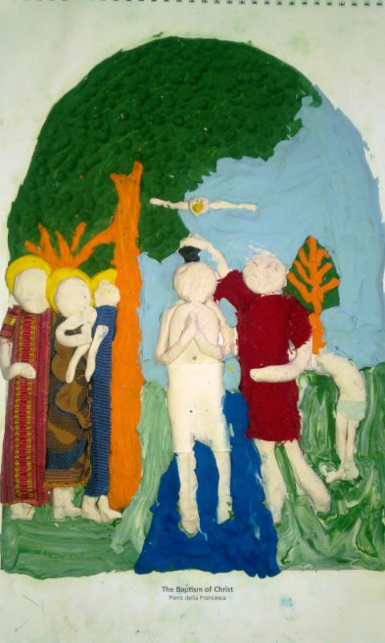
This picture is a material collage, based on a famous work of art by Piero della Francesca, over 550 years old. Made by three pupils in Year 4 as an art and RE project.
It shows Saint John the Baptist baptising Jesus in the River Jordan. God’s Holy Spirit, like a dove, hovers above Jesus.
Christians believe that God Almighty came to earth in Jesus to save humanity from all our ills and evils. They believe the Spirit of God is still alive and active in the world today.

Slide 3
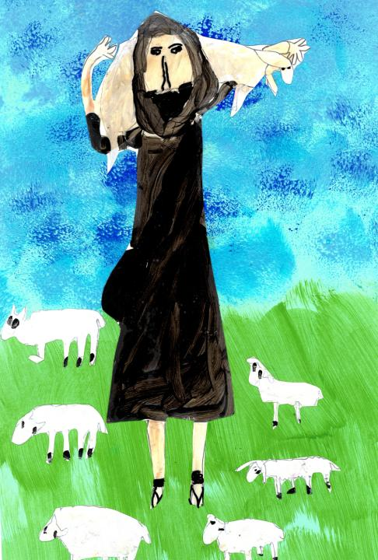
This picture shows Jesus the Good Shepherd. In Saint John’s gospel, Jesus describes himself like this. In Saint Luke’s gospel he tells the story of the lost sheep. Just as the shepherd is delighted to find his lost sheep, so Jesus said: “There is more joy in heaven over one sinful person who turns to God than over 99 who don’t need to repent (to turn back to God).’
Salvation is for bad people! Archbishop Justin Welby says: “The church is not a place where good people go. It's a place where bad people go to meet God.”

Slide 4
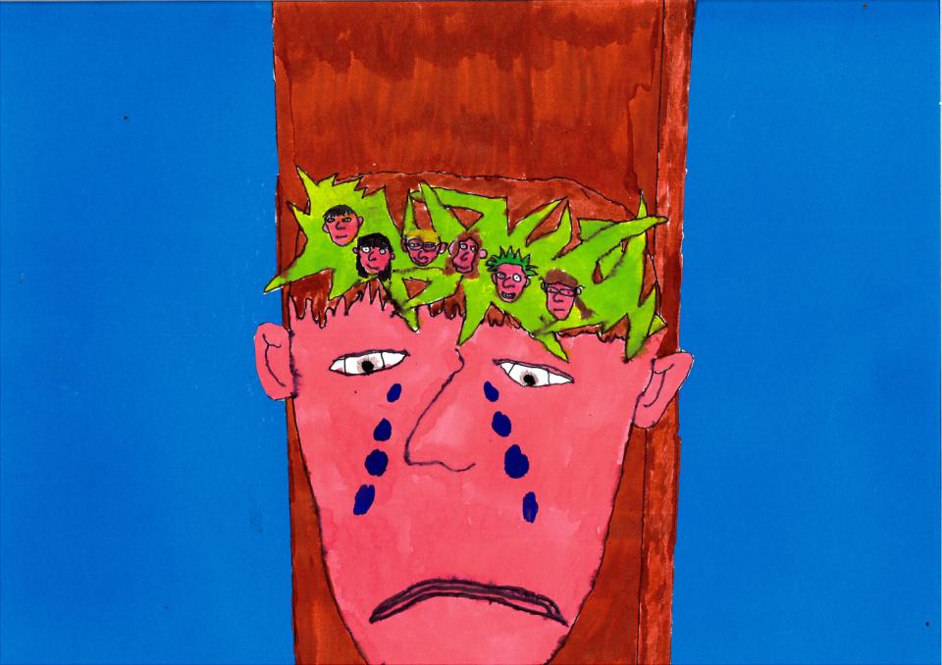
This picture was made by an 8 year old, who chose the title ‘Crucified, he thought of you.’
“One of the thieves crucified with Jesus said to him ‘Remember me, when you come into your kingdom’. Jesus replied: ‘Today, you will be with me in Paradise.’ I imagine Jesus thinking about all the people when he was killed, even us.”
Christians believe that Jesus’s death was not just a sad tragedy, but something bigger.
He forgave those who killed him. He loved to the very end. He showed that love was stronger than death. This death brings salvation to humanity.

Slide 5
Driver Words:7-9
Retell – Tell a religious story again in any form. Verbs: retell, recall, reproduce, recount, repeat, recite, tell, sequence, narrate.
Describe – Give an accurate account in any form of the role of person, a religious rite or symbol. Verbs – describe, report, make clear, write up.
Retell a narrative that is accurate in its sequence and details that corresponds to the scripture source used. | What happens in the parable of the Lost son in Luke’s Gospel? Who are the characters in the Good Samaritan? What do they do? What does the Jesus do once Zacchaeus comes down from the tree? Why were the Disciples with Jesus in the upper room at the Feast of Passover, explain what happened? Which (disciple / person) (said/ helped/ accompanied……..) to?
Describe with increasing details and accuracy…. | a range of religious beliefs the life and work of some key figures in the history of the People of God. different roles of some people in the local, national and universal church. religious symbols and the steps involved in religious actions and worship, including the celebration of the Sacraments. those actions of believers which arise as a consequence of their beliefs. Questions relating to these standards must focus on increasing the details and accuracy in pupil work.
Make links between; beliefs and sources, giving reasons for beliefs. beliefs and worship, giving reasons for actions and symbols. beliefs and life, giving reasons for actions and choices. | What might we learn from the parable of the Lost Son? What did Jesus telling the parable of the sower help us to know? Can you see connections between the …….(bible story)…. what we believe? Does the Jesse tree have a meaning? What does it express? Why do people use a Jesse Tree? Why is it important to some Christians? The priest uses a / does….. Why does he do that? When we do / say….we are showing that we believe……. Why do we bless ourselves with holy water when we enter church? What does it show? In our school we believe that God loves everyone in the whole world and so we try to love everyone too! Can you think of ways we take care of each other in our class? School? We believe that we are called to care for the earth. What could we do as a class/ school / family to ensure that things are not wasted? How does our school show its love of our ‘neighbours’?

Slide 6

Driver Words:7-9
Retell – Tell a religious story again in any form. Verbs: retell, recall, reproduce, recount, repeat, recite, tell, sequence, narrate.
Describe – Give an accurate account in any form of the role of person, a religious rite or symbol. Verbs – describe, report, make clear, write up.
Ask and respond to questions about their own and others’ experiences | What happened to you… how did you feel when… have you had something like this happen to you… who do you know who has…
Use a given source to support a view point. | Can you use….. To support…. Point of view?
Express a point of view | Who do you agree with? Which do you think is correct? Better ? Fairer?
Express a preference | Which do you prefer? Which is better? Which is the best way to? Which would you choose?
Retell, describe, make links, use sources to support viewpoints, express a point of view, express a preference…

Slide 7
Email me on lat@retoday.org.uk to buy the bundle for £111. We will send you a fat parcel (with a slim invoice).
You are already having this webinar – but if your school would like some bespoke RE training that is possible.

Slide 8

Adverts: email me on lat@retoday.org.uk with ‘Salford’ in the title to take advantage…
Subscribe
NATRE membership
£80 the year
3 x RE Today, 3 books, 1400 downloads, discounts on webinars, training and publications, monthly email to update…
Schools in need can check eligibility to join our subsidised scheme, ‘Primary £1000’. £55 for two years.
Buy
Relevant to todays’ work:
101 Great Ideas for Spiritual and Moral RE - £26.50
Picturing Jesus Fresh Ideas - £31
RE in Action – 40+ examples of great RE. £25
Series of 9 books: Inspiring RE £80 (usually £10 each)
You can have 20% off because you are here today
Would you like me to give your staff a webinar? Ask me for prices….
www.natre.org.uk/shop
All our great RE stuff available here.

Slide 9
Working with pupils who have wellbeing needs
Barnabas rescued Paul from feeling depressed.
Then Paul wrote 13 books of the Bible and started 22 churches! Paul wrote:
Philippians 4 verses 4-9
“Always be glad because of the Lord! I will say it again: Be glad. Always be gentle with others. The Lord will soon be here. Don’t worry about anything, but pray about everything. With thankful hearts offer up your prayers and requests to God. Then, because you belong to Christ Jesus, God will bless you with peace that no one can completely understand. And this peace will control the way you think and feel.
Finally, my friends, keep your minds on whatever is true, pure, right, holy, friendly, and proper. Don’t ever stop thinking about what is truly worthwhile and worthy of praise. You know the teachings I gave you, and you know what you heard me say and saw me do. So follow my example. And God, who gives peace, will be with you.”

Slide 10
Choose your favourite sentence that Paul wrote from these 8 examples.
“Always be glad because of the Lord!”
“Always be gentle with others.”
“Don’t worry about anything, but pray about everything.”
“With thankful hearts offer up your prayers and requests to God.”
“Because you belong to Christ Jesus, God will bless you with peace”
“Friends, keep your minds on whatever is true, pure, right, holy, friendly…”
“Don’t stop thinking about what is truly worthwhile”
“God, who gives peace, will be with you.”

Slide 11

“We all need encouragement”

Slide 12
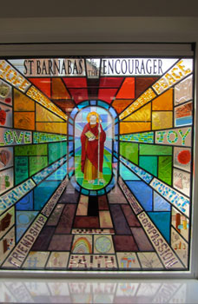
Stained glass window from St Barnabas School in Leicester, showing the school’s values, connected to the idea of encouragement. How can we all encourage each other at the moment?

Slide 13
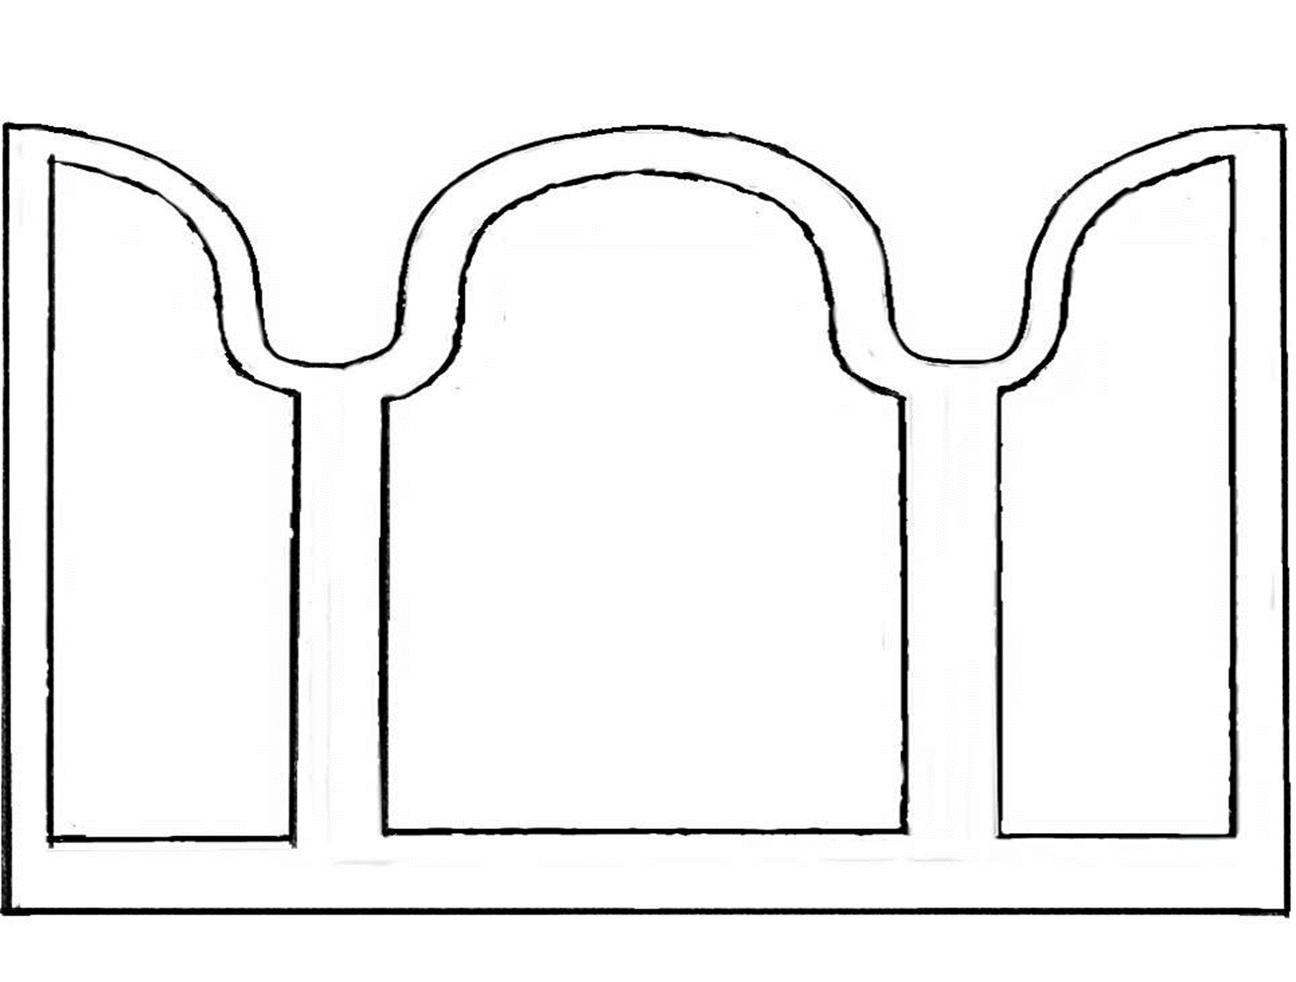
Can you make a triptych? Include the sentence you chose from Saint Paul, and a picture of Saint Barnabas the encourager, and a picture that shows you encouraging other people as well. Make this on card, and fold it so that it will stand up by itself – together with others from the class.

Slide 14
Retell, describe, make links, use sources to support viewpoints, express a point of view, express a preference…

Slide 15
Join NATRE Today (I’ll give you a free book)
1400+ free downloads
96 page mag, termly
3 new books every year
Discounts on RE Today and NATRE stuff
£80 the year (£6.65 the month, cash / card / school)
Art in Heaven comp: £1000 in prizes

Slide 16
https://www.bbc.co.uk/teach/class-clips-video/religious-studies-ks2-holy-communion/z7xhy9q
KEYWORDS | Holy Communion, symbol, Last Supper, disciple, body of Christ, Mass, First Communion, sacrament
Key Stage 2: Idea 1: Bread, wine, what can they mean? Before you show the clip, have a little tasting session: bring some different kinds of fresh bread to the class (e.g. pitta, a French stick, some croissants, wholemeal bread, a fruity naan or whatever is easy to get from your local store – remember to check for allergies). Ask pupils to taste a little bit of each kind of bread and then discuss and make a list of all the people who you could thank for this bread – can they think of 5 ‘thank yous’ for each kind of bread? A bit of a challenge. What does the bread of Holy Communion mean to these young Christians? What do they remember when they receive this bread? Communion is a way for Christians to say ‘thank you’ to God for Jesus’ life and death. Ask children to sum up what they have learned by writing into a line drawing of a loaf of bread and a wine cup what these two symbols mean for Christian children.
Key Stage 2: Raising questions: exploring something mysterious together An alternative to the above task would be to show the clip and ask pupils to raise questions in pairs about what they have seen. Each pair could go for three factual questions and three mysterious questions. This enables them to explore the mysterious nature of this topic through their own questions. Collect, display and categorise the questions: which are most important? Which are hardest to answer? To make this work smoothly, you might give some examples: what does the symbol on Santos’ tie mean? Are the wine cups real silver? What does it mean when the priest says ‘Jesus will come into your life?’ Why is Holy Communion such an important thing for Christians in over 200 countries of the world?

Slide 17
Life is like a journey
The journey of life May be easy, may be hard,
There’ll be danger on the way;
With Christ at my side I’ll do battle as I ride,
‘Gainst the foe that would lead me astray;
Will you ride, ride, ride With the King of Kings,
Will you follow my leader true; Will you shout Hosanna
To the lowly Son of God, Who died for me and you?
My burden is light And a song is in my heart
As I travel on life’s way; For Christ is my Lord
And he’s given me his word That by my side he’ll stay;
Words and Music: Valerie Collison
Connections: learning to trust, the sacraments, Christmas journeys, meaning and purpose in life

Slide 18
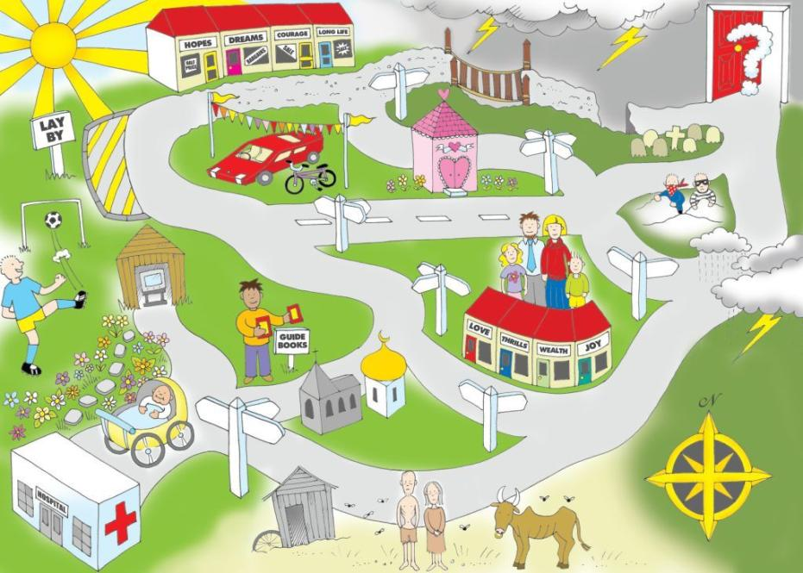

Slide 19
Pick a route: Notice the starting point – the baby in the pram leaving the hospital. The baby is setting out on her life journey. If you could choose the route for her – where would she go? What would you include and what would you avoid? Why have you picked this route? Does a good life mean no suffering or do we need the stormy times too?
Guidebook for the journey of life: Notice the man selling guidebooks. These might be guidebooks for the journey of life. If you were asked to write the first page of the guidebook for the journey – what would you say? What advice would you give?
Buildings and shops: Notice the buildings on the journey. 8 shops, 2 sheds, religious buildings, a wedding chapel, a hospital – if you could take one thing from each building to help you on your journey of life, what would it be and why? If you could choose something from only four of the shops to help you on your journey of life which would you choose and why? Put these four in order. Which matters most of all to you? Can you say why? Now think about someone who is a Christian, Muslim, Jew or another religion: what would they choose and why?
Before and after: This map shows the journey of life – but what about what happens before we are born and after we die? Show your ideas using pictures / symbols / colours and words. Fold a sheet of paper diagonally. Bottom left: what you think came before this life? Top right: show what you think / believe happens after this life. Do the same for a Hindu or Christian.

Slide 20
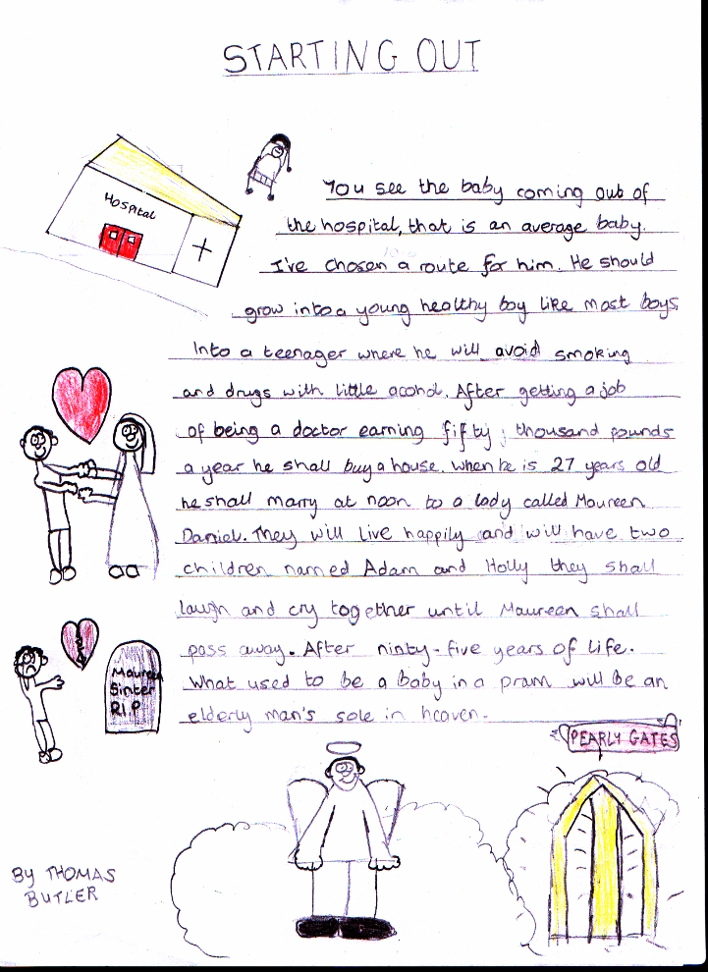
Thomas Butler has charted life’s journey as he sees it. Can he consider reflectively and sensitively some questions about life as a journey? Can he use the metaphor and apply the idea himself? Expectations for 11 year olds!

Slide 21
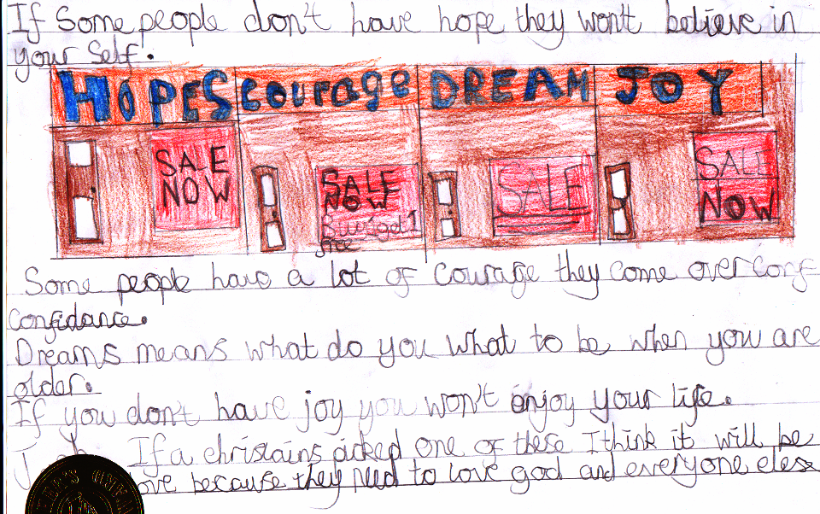
Jack, 9, from Hartpury School has recognised the different ways people have of approaching life’s challenges. He’s also made a link to his understanding of Christian faith.

Slide 22
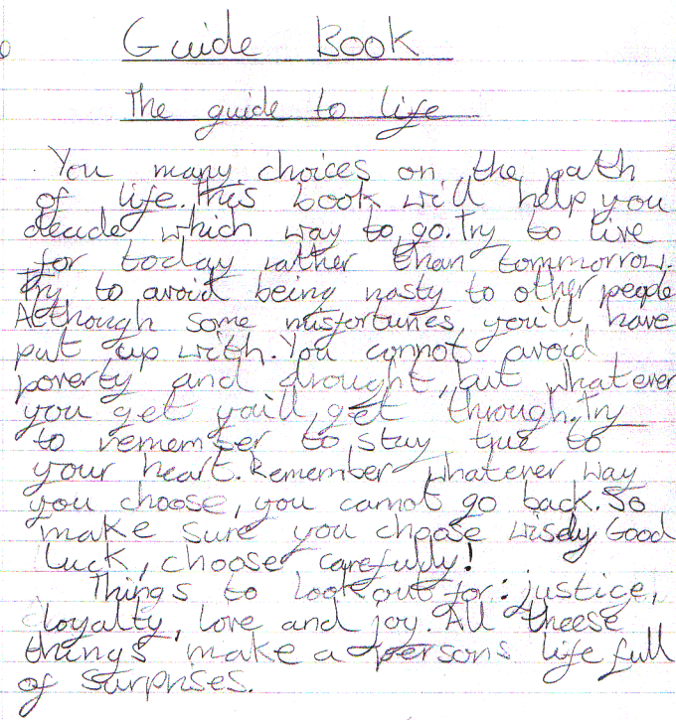
10 year old Catherine from Meadowside PS gives her introduction to the guidebook to life.

Slide 23
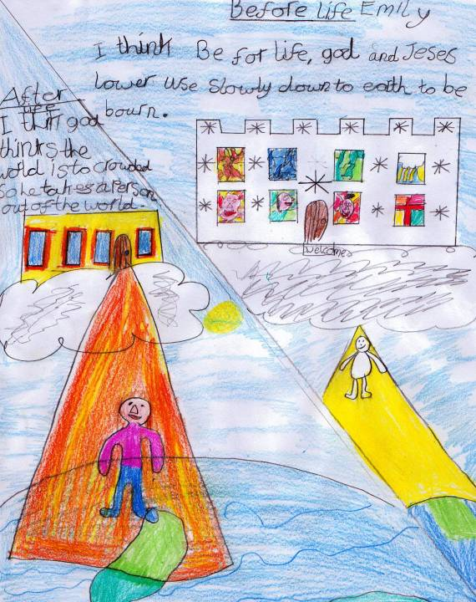
Emily, 7, has given us two great ideas about life before birth and life after death.
The scaffolded structure enables her to put the ideas down in a controlled way.
This shows some of the value of creative thinking in RE
Links:
The Bible, guide to life.
Journeys: walking with God
Milestones: the sacraments

Slide 24
The Journey of Life
How can the sacraments mark the turning points in life’s journey?
Thanks to Gerri Yates and her talented pupils at Our Lady Queen of Martyrs RC Primary in Durham

Slide 25
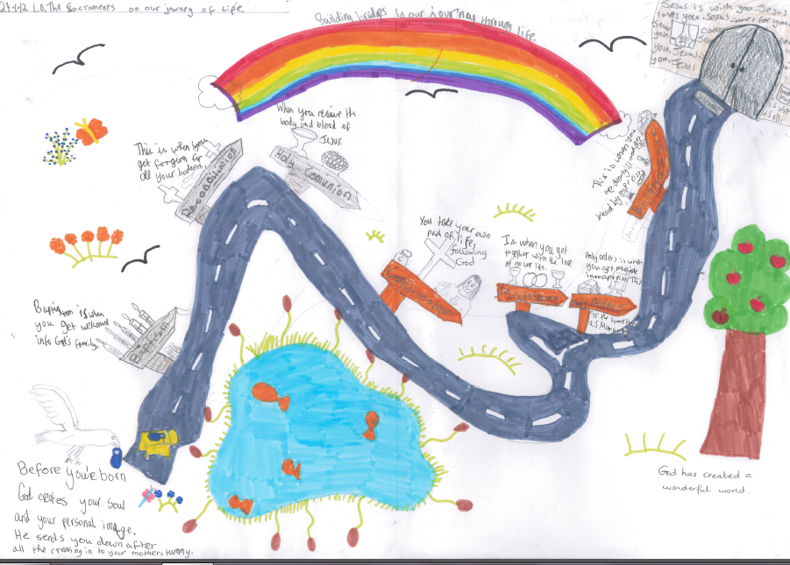

Slide 26
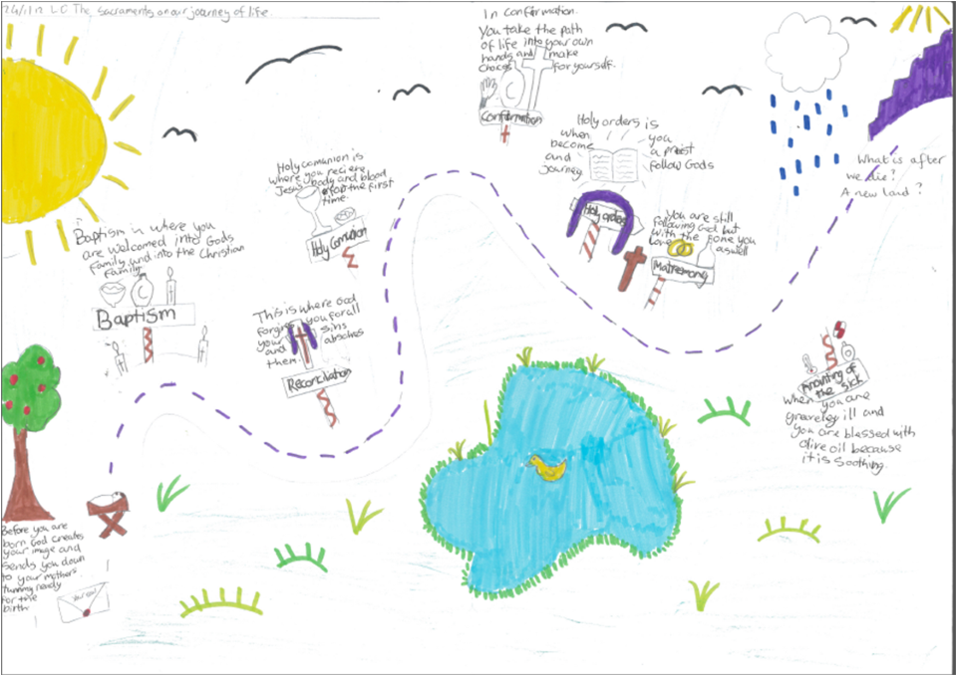

Slide 27
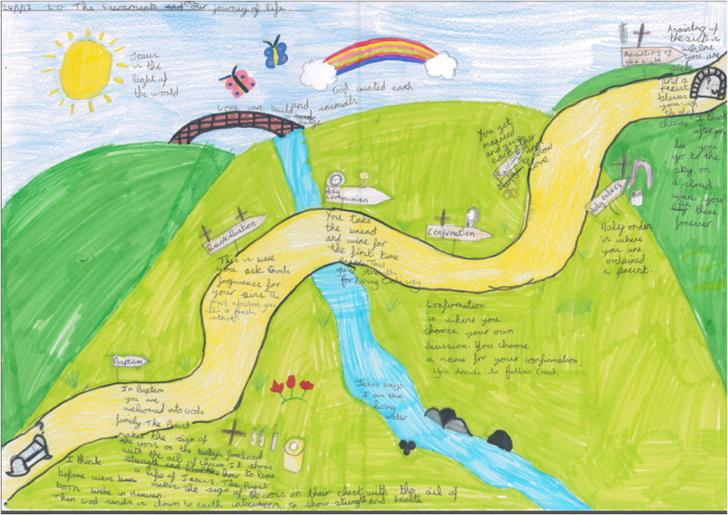
Retell, describe, make links, use sources to support viewpoints, express a point of view, express a preference…

Slide 28
Breakout room discussions
Which of these ideas do you like? Dislike? Which will you use? Which give you some fresh ideas of your own?
How do the ideas connect to the driver words and the outcomes?
Retell, describe, make links, use sources to support viewpoints, express a point of view, express a preference…

Slide 29
Prayer: how and why do people find praying helps them?
Talk with the children about praying in school, and in church or mosque.
Consider these comments (flashcards on the floor?):
  ‘I pray because it helps me remember God is with me always.’
  ‘I don’t know much about prayer.’
  ‘When I pray, I feel calmer and more peaceful.’
  ‘I thank God for the good things in life. It helps me.’
  ‘When I pray, I feel God close to me.’
  ‘I would like to know more about praying because I have lots of questions.’
  ‘I am not sure if my prayers are answered, or even if God hears me.’
  ‘I like to pray with other people in school better than on my own.’
Ask the children what they would like to ask about prayer, and record all their questions. Would a Christian visitor come to school to share their thoughts?

Slide 30

Our Father…
This PowerPoint sequence supports ideas about how to teach the Lord’s Prayer. Grateful thanks to Sophie Hardwicke for her excellent visual learning materials.
This downloadable resource, free to REtoday magazine subscribers and NATRE members, is © RE Today and may be used in your own school. Any other use is by written permission only.
© RE Today, 2017.

Slide 31
Essential Knowledge for the pupil
Pupils will know:
The Lord’s Prayer was first taught by Jesus to his first followers, his Disciples.
The Lord’s Prayer calls God ‘Our Father’ because Christians think God is like our parents, and loves and cares for us.
The Lord’s Prayer is quite a difficult text for 7-9s, but thinking carefully helps us to understand the meaning of each line in the prayer. Even adults are still learning what it means.
The Lord’s Prayer is about what God wants people to do as well as about what people want God to do for us. It is a prayer to help Christian people to be kind, to care, not to do wrong and to worship God.

Slide 32
How many people in the picture?
Who is the youngest?
Who is the oldest?
Can you see some bad behaviour? A bully? A greedy person? A fight? Someone stealing? Someone cheating at football? Who is the worst?
Can you see some good behaviour? Sharing? Kindness? Generosity? Peace? Respect? Forgiveness? Saying sorry? Co-operating? Who is the best?
Can you connect: here are some of the words from the Lord’s Prayer. Can you point to something in the picture that is to do with these words? Father / Holy / Heaven / Food / Forgive / Sin / Temptation / Evil / Power.

Slide 34
The picture was drawn to show the meaning of the Lord’s Prayer. Can you see a picture that shows:
  A family and a symbol of God, Father, Son and Holy Spirit?
  People making peace and stopping war? A dustbin full of weapons?
  People enjoying their ‘daily bread’ or ‘daily food’ together?
  The difference between hogging things greedily for myself and planning to share money with people who are poor?
  An idea about heaven (Can you see the Tree of Life? Can you see the River of Life? Can you see where the lion and the lamb are friends, while people make sweet music)?
  A mum stopping her children from fighting?
Read each line from the Lord’s Prayer – it is quite hard to understand it all. Can pupils point to the part of the picture that links to each line as the lines are read out, and talk about the links?

Slide 36
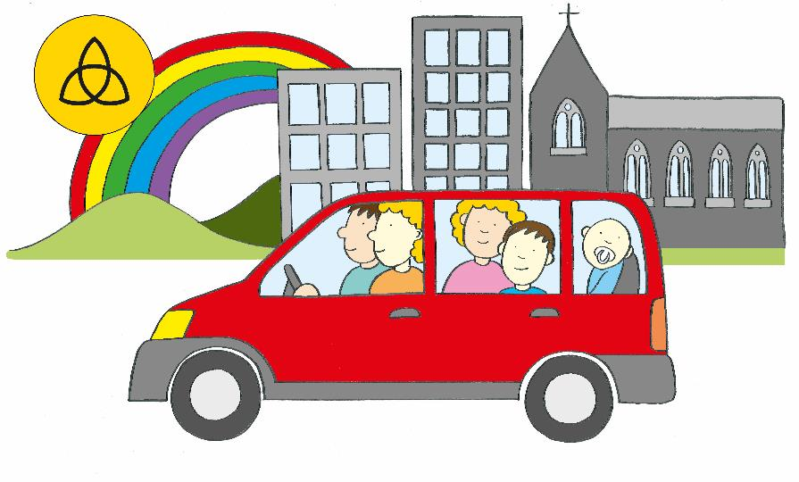
Our Father, who lives in heaven
May your name be kept holy

Slide 37
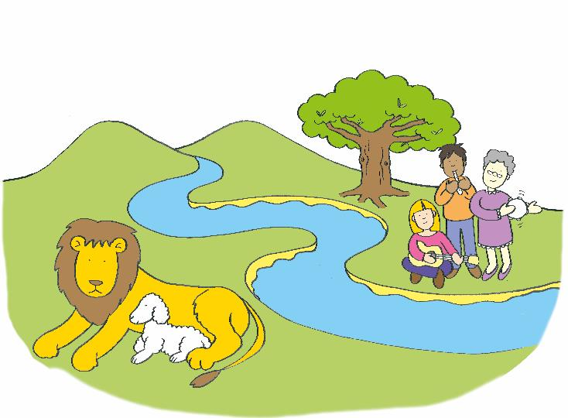
Your kingdom come, your will be done on Earth as it is in Heaven

Slide 38
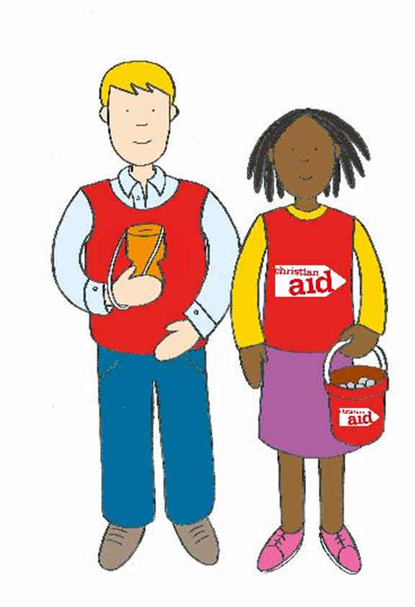
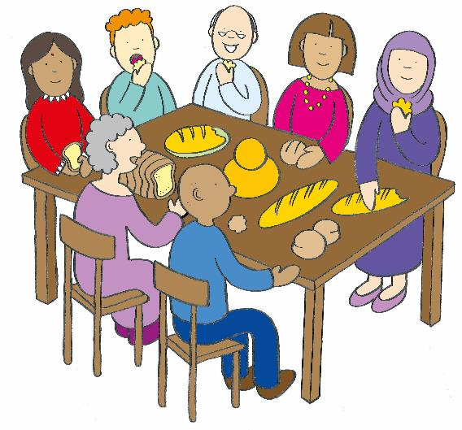
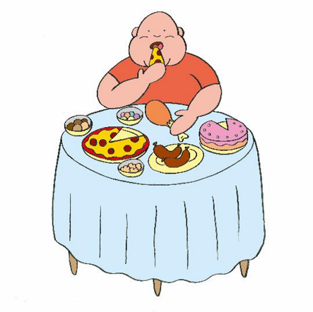
Give us today the food we need

Slide 39
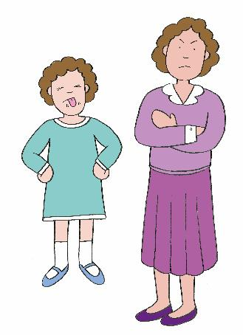
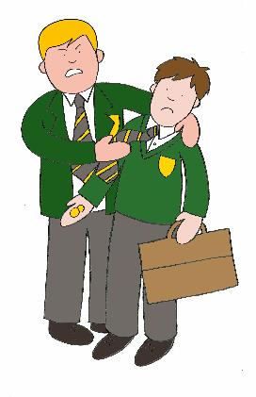
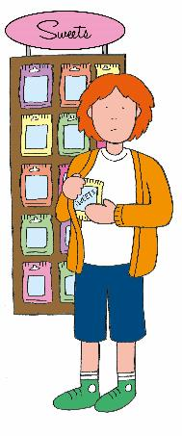
And forgive us our sins, just as we forgive those who sin against us

Slide 40
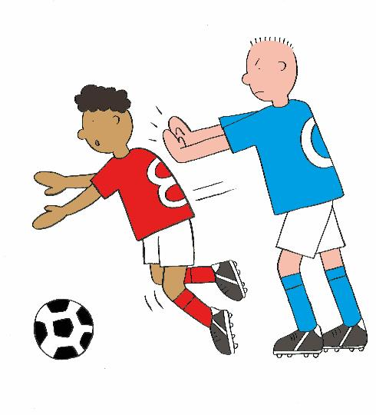
Do not lead us into temptation, but free us from evil

Slide 41
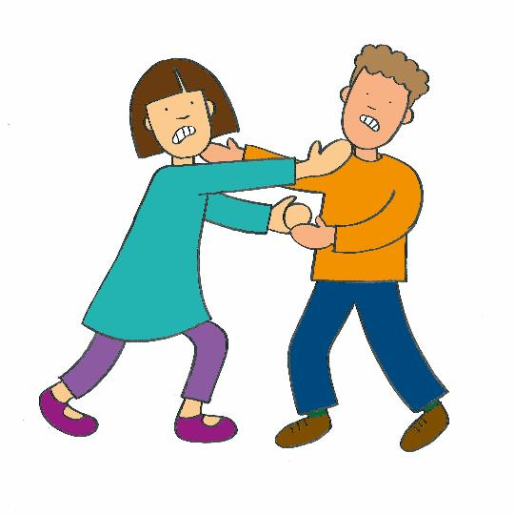

Slide 42
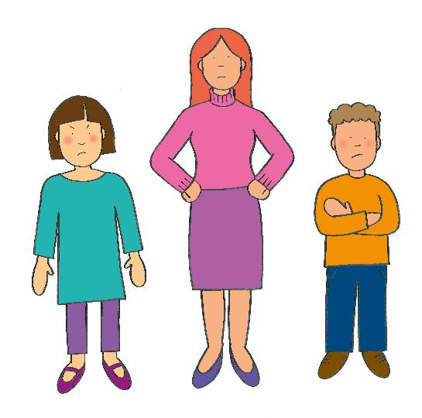
Do not lead us into temptation, but free us from evil

Slide 43
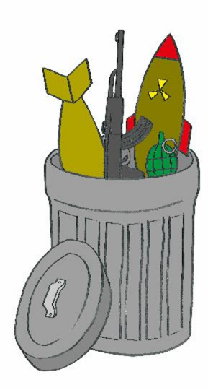
For the kingdom, the power and the glory belong to you forever and ever
Amen

Slide 44
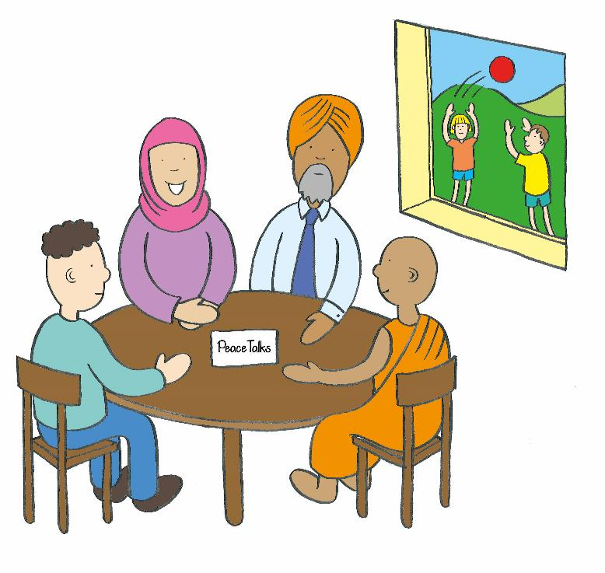
For the kingdom, the power and the glory belong to you forever and ever
Amen

Slide 46
Questions for thinking
Is God like our mums and dads? Does God care for us?
Can everyone on earth have enough food? Do we all need to share more fairly?
Can we bring peace to our world instead of war?
Can we make Earth more like Heaven?
Can we be freed from temptations? How?
Why is forgiveness difficult? Who can help people to forgive?

Slide 47
Our Father, who lives in heaven
May your name be kept holy
Your kingdom come, your will be done on Earth as it is in Heaven
Give us today the food we need
And forgive us our sins, just as we forgive those who sin against us
Do not lead us into temptation, but free us from evil
For the kingdom, the power and the glory belong to you forever and ever
Amen

Slide 49
Next Steps in Learning
To extend pupils’ achievement from this work, or to use the visual learning with older pupils, you might ask pupils to create a picture book of the Lord’s Prayer.
Give them an 8 page booklet to complete (there is one on the RE Today Website ready to use).
This booklet asks for the pupils’ own questions and explanations of the lines of the prayer: a challenging task that some adult Christians find difficult!

Slide 50
The Lord’s Prayer is also a song!
Watch some sung versions of the Lord’s Prayer.
Learn a lot by comparing the versions, which are all slightly different. Which one do you like best and why?
A children’s choir: https://www.youtube.com/watch?v=e6STLRycSnE
A Canadian modern version: https://www.youtube.com/watch?v=w2vSnQ3JASk
A line-by-line call and response teaching version: https://www.youtube.com/watch?v=kP29O6rILWc

Slide 51
Outcomes to work on the Lord’s Prayer
Emerging
Notice and talk about the Lord’s Prayer and its meaning
Make simple links between some lines and phrases in the prayer and things Christians believe or do, using pictures.
Expected
Making sense of the text: talk about the meaning of three or more of the phrases in the Lord’s Prayer
Understanding the impact: Choose and talk about the lines of the prayer they think are most important, most difficult to understand or most difficult to do.
Understanding the impact: select and discuss pictures of aspects of the Lord’s Prayer, use quotations to make a point or express a view
Making connections: link up thoughts about prayer to thoughts about what people should do.
Exceeding
Use lines fo the prayer to talk about what God is like and why prayer is important for Catholics
Explain the meaning of the Lord’s Prayer for younger children, simply
Raise and discuss questions about prayer for themselves.
Retell, describe, make links, use sources to support viewpoints, express a point of view, express a preference…

Slide 52
Prayer-art
A long and deep Christian tradition of using art as prayer
Every child’s creativity
Looking at some prayers which are used in school, thinking about personal prayer and making up some prayer lines of their own
Learning ‘Our Father’ and applying it.

Slide 53
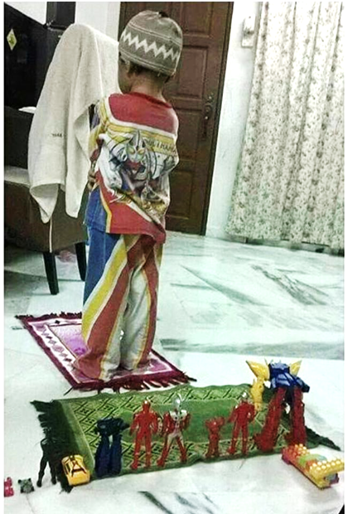
Children’s play is often constructed around what is significant in their family and community.
Is it good to encourage playful engagement with the ‘stuff’ of religion and belief?
How would RE change if play and imagination were more fully embraced?

Slide 54
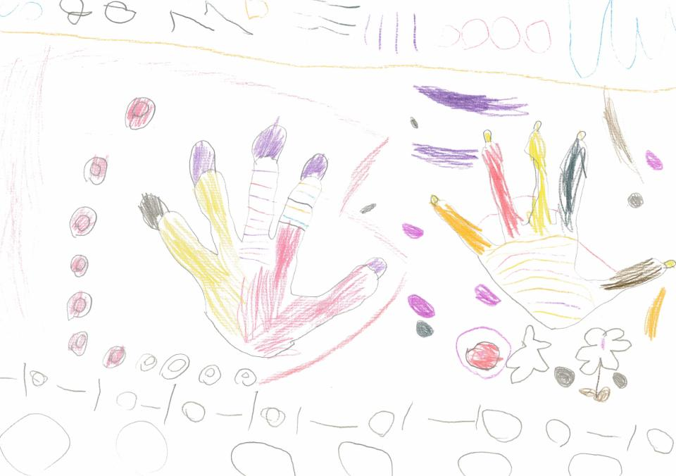
Imogen and Bethany, both 5 said: “God listens to all languages”
“Our work shows our hands praying. The patterns are different languages because God listens to all languages.”
Do you think God hears all the prayers of people from all the languages in the world?

Slide 55
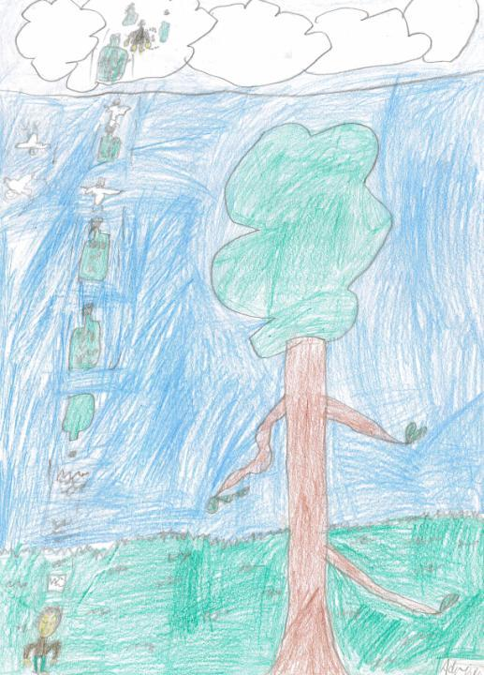
Adriana Jahja, 7.
Trees
“I wrote a prayer about the trees on our school playground. They give us shade and are where lots of insects and birds live. In my picture I was praying that the trees stay safe and aren’t harmed by people picking the leaves or pulling the branches off. I chose a bottle to carry my prayers up to God because it had a lid and my prayers wouldn’t come out. God can take off the lid when he is ready to hear my prayer. When the doves have delivered my prayers the bottles can be used again. Mrs Cowdery says we should recycle to help save resources so I think this is a good idea. I chose green for the colour of my prayer because it is the colour of the trees that I am praying about.”
Do you think we should pray more about our environment?

Slide 56
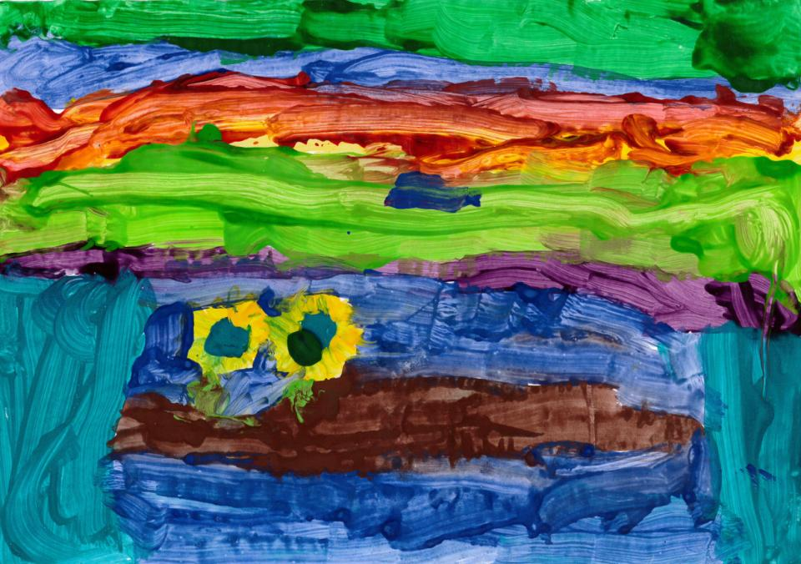
Isobel age 6 His favourite place
“I painted the jetty. We throw flowers in the water there because my granddad died. It was his favourite place. We think about him - daddy, granny, Stella, Hope and me. We pray for him, and say ‘I miss you…’ ”
Isobel is sad about her grandad. But do you think praying at the jetty helps her? Does God comfort people when we pray?
.

Slide 57
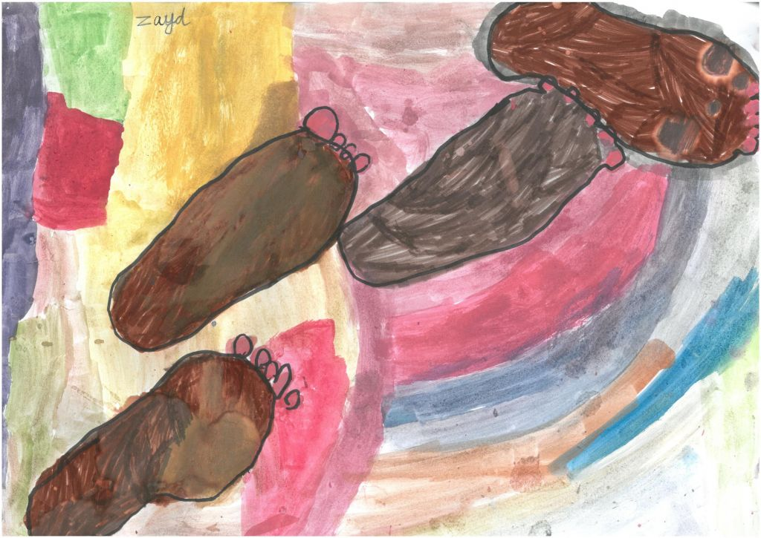
Zayd (7) Footprints
“These footprints mean God is walking with me wherever I go. This picture shows that God is always walking with me even when I am running, he will still be beside me. Even when I am bad God is walking with me and when I am good, he is still next to me, he never leaves me.”

Slide 58
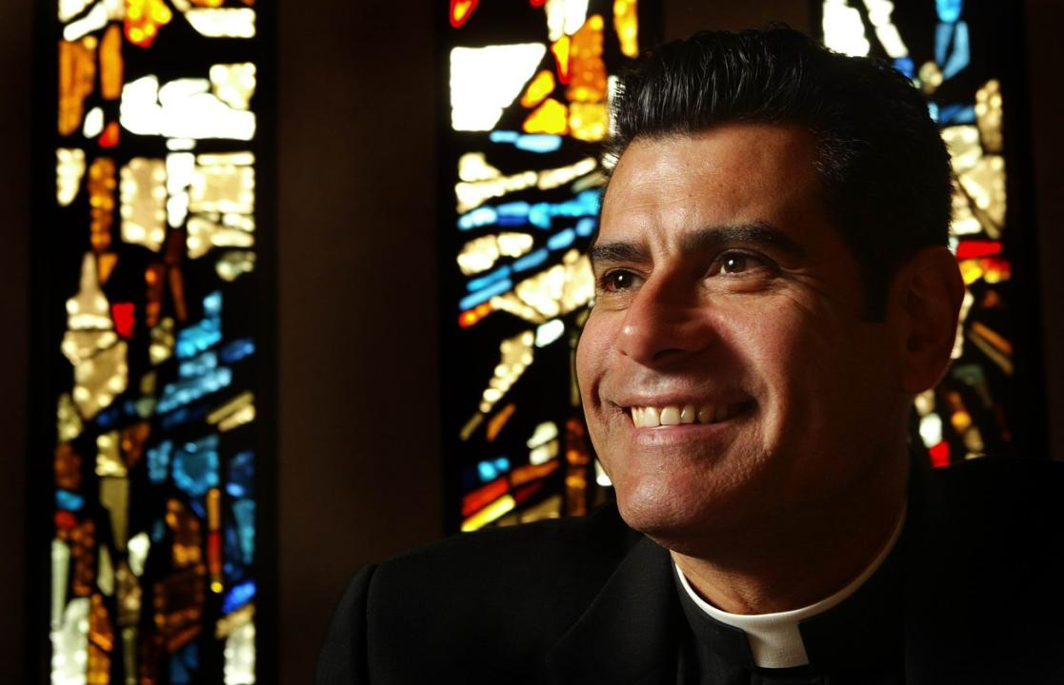
Father David: What’s in the
diary?

Slide 59
Father David’s Diary
Monday: Assembly at the Infants
Tuesday: Baptising Baby Joe
Wednesday: Wedding for Kerry and John
Thursday: Funeral for Mr Jones
Friday: Messy Church with the 5-11s

Slide 60
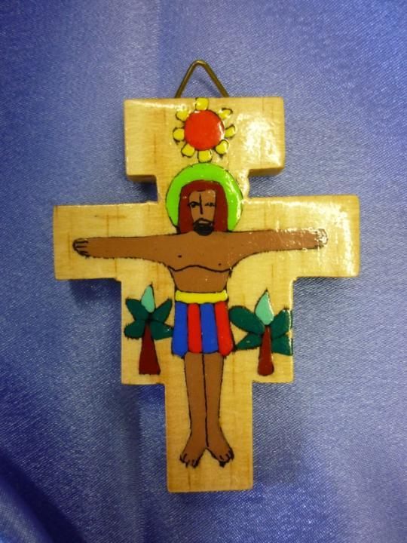

Slide 61
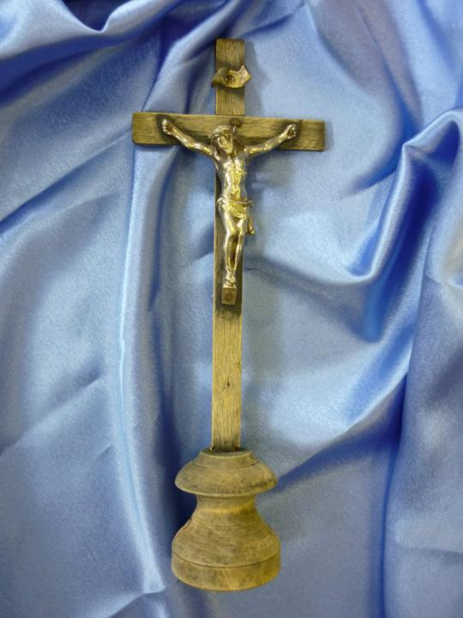

Slide 62
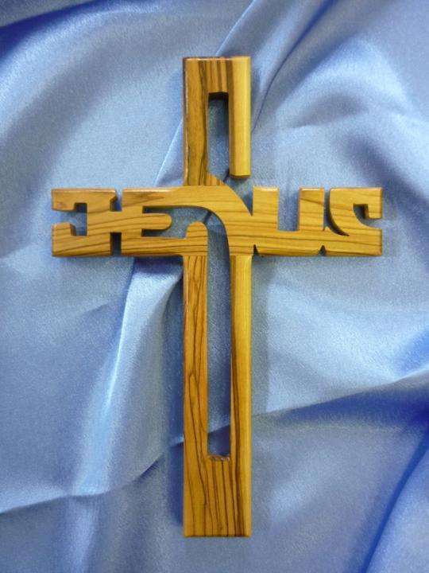

Slide 63
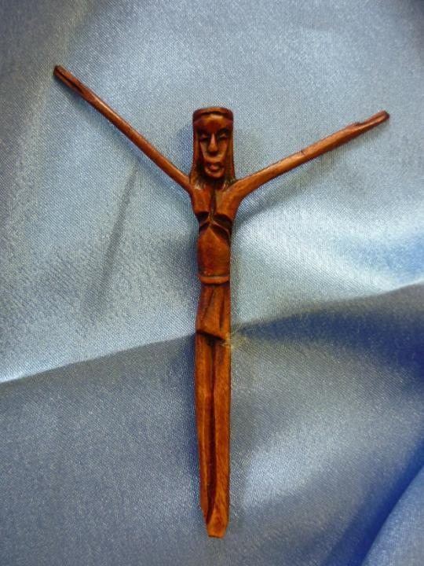

Slide 64
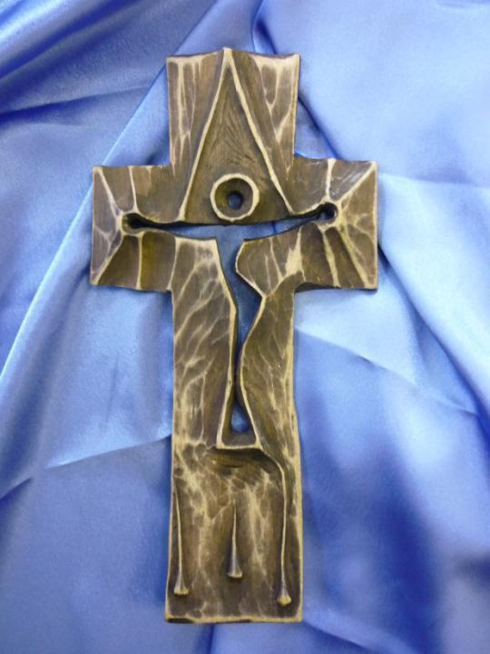

Slide 65
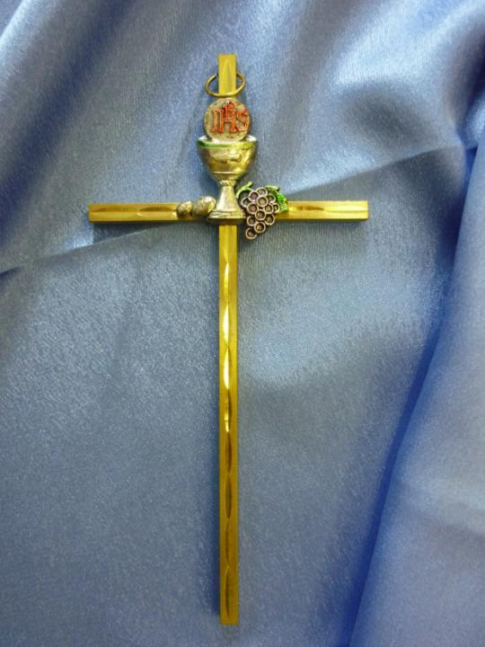

Slide 66
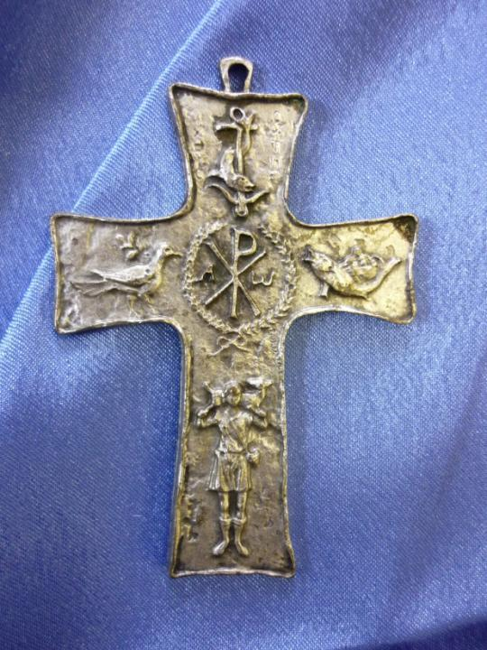

Slide 67
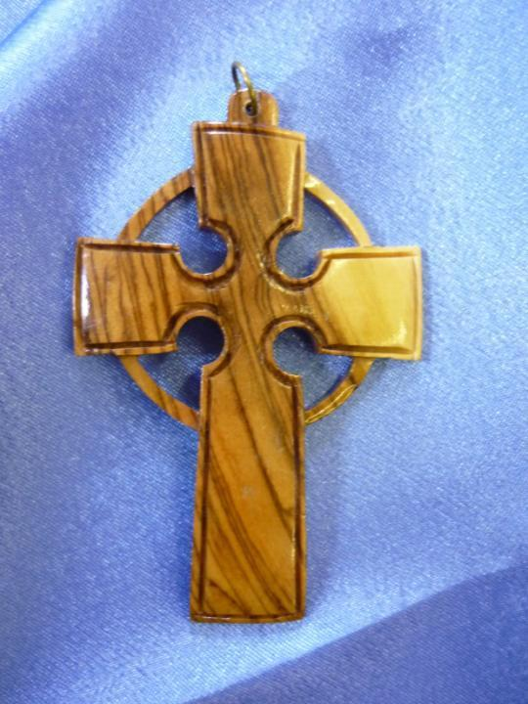

Slide 68
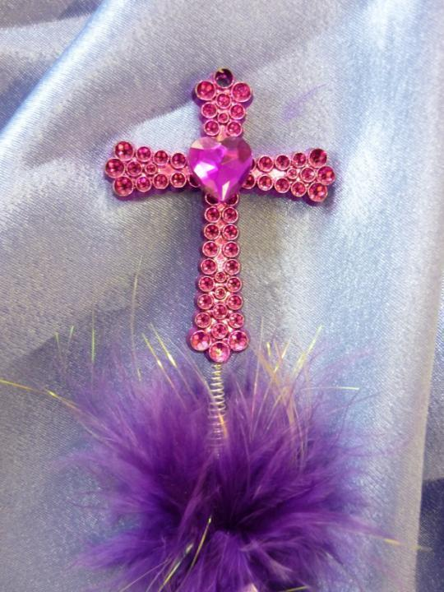

Slide 69
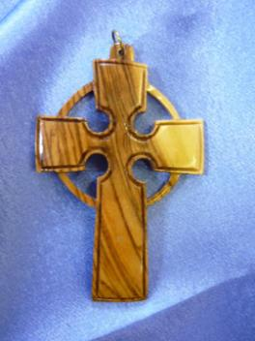


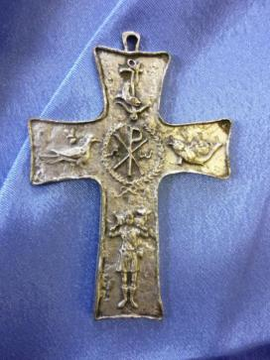






Slide 70
Which of the crosses would be good for each of the people?
Choose a cross for the Infant School, the Baptism, the Wedding and the Funeral
If you went to the Messy Church and Father David told you about his week, then asked you to design and make a cross, which occasion would you choose? What would your Cross design be like?
Lat Blaylock, RE Today

Slide 71
Father David: What’s in the
diary?

Slide 72
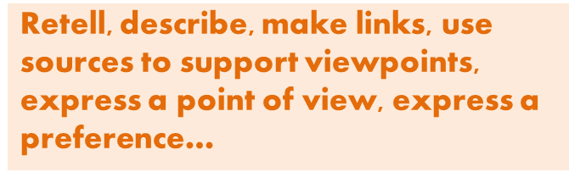
Father David’s Diary
Monday: Assembly at the Infants
Tuesday: Baptising Baby Joe
Wednesday: Wedding for Kerry and John
Thursday: Funeral for Mr Jones
Friday: Messy Church with the 7-11s

Slide 73
Exploring the Cross
Think about the cross of Jesus and its meanings.
This presentation provides an idea for you to use as a project in art and RE for pupils 7-11.
These collage crosses were devised and created by 7-11s making some collaged crosses, to help understand the cross of Jesus and the festival of Easter.

Slide 74
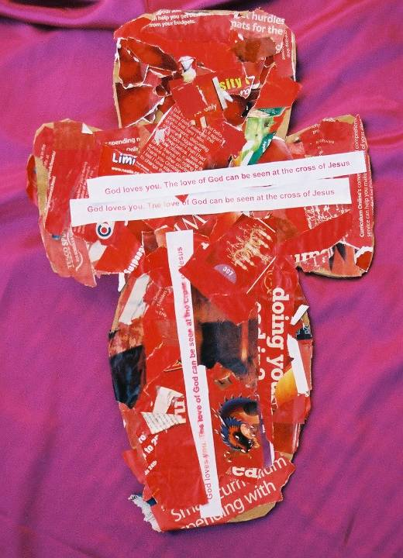
“Our red cross is about the love of God. Christians believe Jesus died to show God’s love on the cross. Our red cross means that we are all loved.”

Slide 75
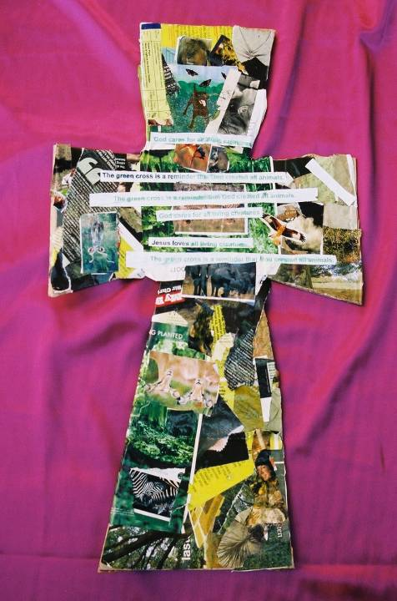
“The green cross is covered in all of our favourite animals and wild creatures.
Save the world!”

Slide 76
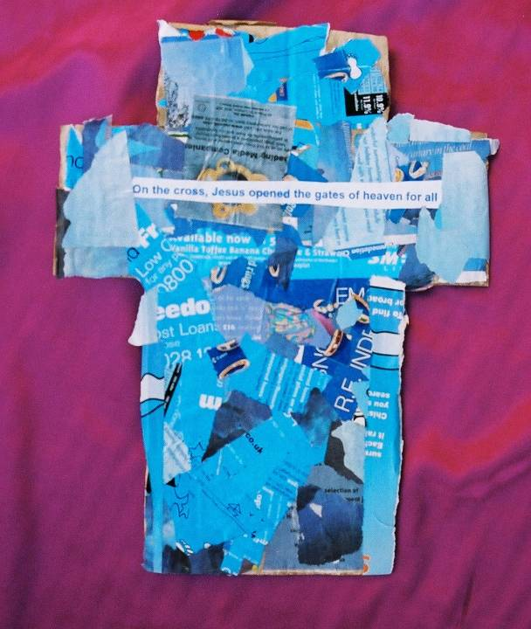
“This sky blue cross is for heaven. Blue sky – heaven is beyond it
Some of us have a friend or a person in our families who has died.
Some of us believe in heaven.”

Slide 77
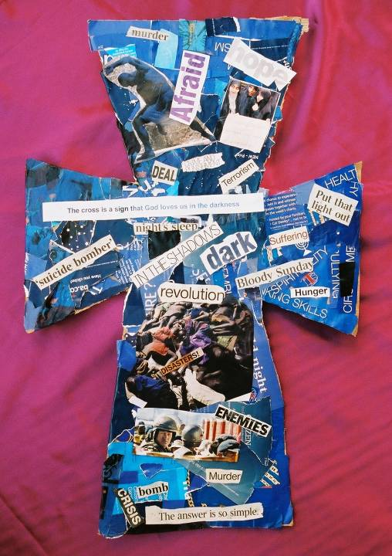
“This dark blue cross is a reminder that Christians believe God is with us in the darkness.
They say: “When we are afraid, or when enemies attack us, we don’t have to be scared.
God’s there.”

Slide 78
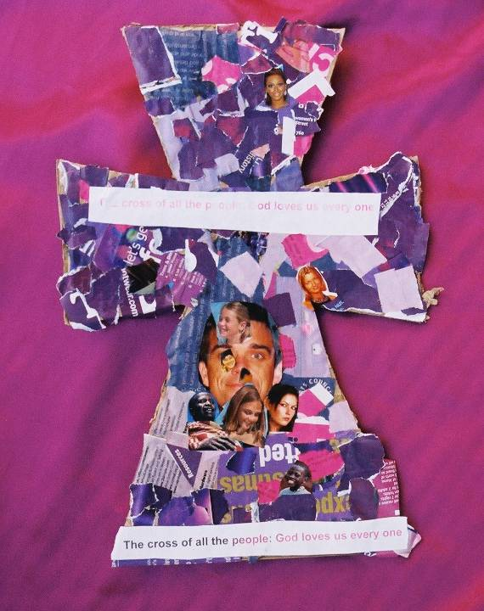
“Our purple cross is to remind us that Christians believe God loves everyone.
No matter what you look like, and no matter what you’ve done.”

Slide 79
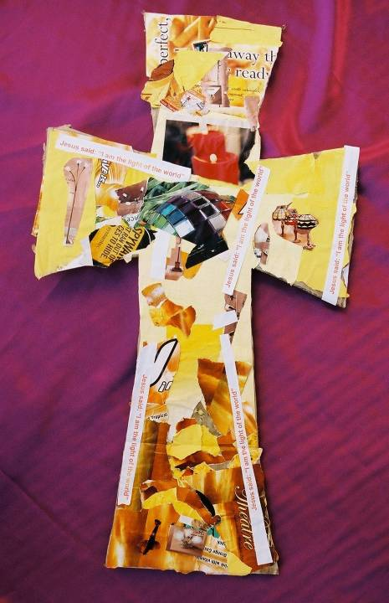
“Jesus said ‘I am the light of the world’. We made a yellow cross of lights to show all kinds of lights.
There are candles, torches and table lamps and a disco ball. Jesus also said Christians are to shine like lights in the dark world. Be like torches for Jesus.”

Slide 80
In the classroom:
Ask pupils to review the six crosses and choose their two favourites. Ask them to say why.
Ask pupils to design and make a big cross (these 6 are about 1.2 metres tall)
Select symbols, imagery and a few words to express some ‘what really, really matters’ ideas
Look at scripture: read about the Cross from Mark 15 and ask children to connect it up to the images
Write some prayers or reflections to go with the images.
Lat Blaylock

Slide 81


Slide 82


Slide 83


Slide 84
Incarnation / God / Trinity
Resource Sheet
Almighty
Breath
Comforter
Creator
Dove
Fire
Fortress
Holy
King
Prince of Peace
Prophet
Rabbi (Teacher)
Rock
Saviour
Shepherd
Water
Wind
Words used to describe Father, Son and Holy Spirit in the Bible.
Can you sort them?
Father
Holy Spirit
Son
Notes:
Delegates to do using paper on table to draw venn diagram and scribble in words – discussing why these words are used

Slide 85
Father
Holy Spirit
Son
Almighty
Creator
Fortress
Rock
King
Prince of Peace
Prophet
Rabbi (Teacher)
Saviour
Shepherd
Breath
Comforter
Dove
Fire
Holy
Water
Wind
Notes:
Delegates to do using paper on table to draw venn diagram and scribble in words – discussing why these words are used

Slide 86

Notes:
Introduce what next steps would be- describeb the sort of activities you can do with a poem like this
Connections: Explore Trinity in art and pupils’ own attempts to express mystery.

Slide 87
Incarnation: the big idea of God coming to earth
Text, Impact, Connections

Slide 88
Matthew’s Gospel says:
¹³ Then Jesus came from Galilee to the Jordan to be baptized by John. ¹⁴ But John tried to deter him, saying, “I need to be baptized by you, and do you come to me?”
¹⁵ Jesus replied, “Let it be so now; it is proper for us to do this to fulfil all righteousness.” Then John consented.
¹⁶ As soon as Jesus was baptized, he went up out of the water. At that moment heaven was opened, and he saw the Spirit of God descending like a dove and alighting on him. ¹⁷ And a voice from heaven said, “This is my Son, whom I love; with him I am well pleased.

Slide 89

Jesus, baptised by his cousin at the start of his public life, centres himself on his mission.
African American artist Pheoris West paints a black Christ, three faces looking back, centering and looking ahead? The dove, symbolically, flies in from the left. Jesus’ hand reaches down the edge of the canvas and connects – to John’s hand? Ours? What’s that expression on his face? Peace or determination?
Jesus’ first disciples joined him from John the Baptist’s circle. How did they feel at this moment?

Slide 90

Daniel Bonnell
I like the way the figure of Jesus ‘dives’. Like Jesus diving into human life, his mission. I also like the way the image calls to mind a crucifixion image. The dove, very natural, seems to emerge from the splash.

Slide 91

Chinese Christian artist He Qi has an amazing conversion story. Check it out.
Here St John the Baptist gives him the blessings of baptism, the angelic music is close at hand, the Holy Spirit descends in a luminous triangle. Jesus’ own body language flows like the river as he immerses himself in human life.

Slide 92
Blue background
You can see his face
Jesus is ‘looking ahead’
The dove
The water
They are mysterious
It’s a crucifixion as well as a baptism
Jesus is alone
It’s a Chinese Jesus
There is an angel
There is music

Slide 93



Which of the pictures expresses the story best? What in the art work links to ideas about God, Spirit, Incarnation, Trinity?
How would you respond to a commission to paint this scripture, or design this as a stained glass window?

Slide 94

Connect the starts and ends of these sentences
Christians believe God made the world / so they care for the earth
Christians believe God was at the beginning of time / so they trust God because he is great.
Christians believe God is full of love / so they trust in God for forgiveness
Christians believe God came to earth as Jesus / so they celebrate Christmas day
Christians believe Jesus was on a rescue mission to save humanity / so they always remember his death and his resurrection
Christians believe God gives life to every person / so they thank God for the Spirit
Christians believe God is an amazing mystery / so they keep making sculptures, paintings, songs and churches to try to get their idea of God clearer
Christians believe God wants people to live for justice / so they try to follow what the Word of God says.

Slide 96


Slide 97
Amy, 10.
Awful sea of plastic.
“The girl’s head is full of an overheated world – is this real, or just imagination? At the moment it might still be imagination, but in 10 years, it is real.
The sea, full of plastic and dead fish, is rising around her shoulders. We haven’t just ruined it all for the fish, but will ruin the earth for ourselves to. We are literally drowning in our own stupidity. God help us!”
Notes:
Ask your pupils to plan their own entries, never copying others, but seeing from this set of pieces what kinds of responses others have made: the high bar of high standards is certainly set here.

Slide 98



Slide 99
Notes:
Look at the entries and see the progression, passion and spiritual engagement which they evidence. This is by a pupil aged 7.

Slide 100


10-year-old Niyati from Church Hill CofE Junior School says:
I feel that God is everywhere that's why I have drawn rivers, mountains, greens, the moon and sun and the most important part is he is in my heart and he supports everyone in the world. The colours represent calm and peace around God and that he makes peace in the world.
Notes:
Pupils often evidence connections in their thinking between God, humanity and nature in many forms.

Slide 101


Isabelle, Charlotte and Astrid (all age 12) entered a group piece of artwork titled ‘Mother Earth’.
The religions that inspired our work were Hinduism and Paganism. Hinduism inspired us because of the Hindu belief that Brahman, the Hindu God, is in everything and is. But the original idea of Mother Earth came from the Pagan religion, based on the worshipping of nature and that God is like a mother because she has given us life and continues to sustain us.
This work is spiritual because it may remind people that the earth is a gift to us, we belong it and should look after it. This, therefore, is very relevant at the moment because humans are at a stage in their existence in which they really need to start caring and putting the earth and others before their own desires.
Notes:
Good plural RE: in this sample of pieces of work pupils draw upon all kinds of religious sources, Hindu, Buddhist, Muslim, Jewish, Sikhi, Christian, Pagan and more. Good.

Slide 102
Examples of work that shows standards and progress

Slide 103

Ivy , age 7
The story of Jesus meeting Zacchaeus and changing his life from greed and loneliness to generosity and community
This example shows that pupils can make sense of religious story for themselves if they are set well structured tasks. Ivy chooses 6 ideas about the kind of person Zacchaeus was at the start of the story, and 7 words to describe how he changed. The work is focused on the way an encounter with Jesus transformed his life – a big idea about religion’s power to change people’s lives.
Regarding age related expectations, this work shows that Ivy can give examples of how stories show what difference faith makes, and think, talk and ask questions about the story using her own ideas about values.
Questions:
How could your school use a task like this to show progress
in RE?
The task has several layers – to draw, to select words, to write a sentence summarising the story. Do you use layered tasks enough, to deepen pupil responses in RE?
In what ways does this work show good RE in action?

Slide 104
Finlay, age 7
The story of Easter: what does it say to Christians and what questions does Finlay have?
This school expects high standards in RE just as it does in English. This was part of learning on The story of Easter and what it means to Christians.
Finlay knows that for Christians, believing in God should be more than a belief: it should affect how Christians choose to live their lives.
Cleverly, Finlay leaves questions hanging for the reader to consider. His ideas about the story show he is working beyond age-related expectations.
Questions:
How could your school use a task like this to show progress in RE?
In what ways does this work show good RE in action?
Are standards in RE the same as standards in English in your school?

Slide 105




Harley, age 7, and other pupils
Treasure and Money
The children used a story of the Prophet to think about this Hadith: ‘Generosity is near to Allah, near to Paradise, near to the people … Miserliness is far from Allah, far from Paradise, far from the people.’¹ They heard a story of Jesus and thought about his sayings: ‘Give expecting nothing in return’ and ‘Sell what you have and give to the poor and come and follow me.’
This is an example of good, independent thinking around two texts – one from Islam and one from Christianity.
The teacher emphasised the importance of pupils using the ‘box fill in’ sheet to express their own thoughts around whether there are things which are more valuable than money and the work is evidence that 6-7-year-olds can engage with some very big questions and formulate their own ideas.
Questions:
How could your school use a task like this to show progress in RE?
In what ways does this work show good RE in action?
What opportunities are there in your setting for younger children to develop their own responses to key passages from sacred texts?
¹ Al-Tirmidhī

Slide 106


Harry, age 8
Key Christian beliefs about Advent and Christmas
Harry has a clear understanding of the meaning of the period of Advent for Christians as a time of preparing, waiting and anticipating what is to come.
A key quality of this work is the depth of knowledge and understanding of Christian beliefs shown by the pupil; for example, that Jesus is considered by Christians to be a king and the Son of God.
This work describes how Christians show their beliefs and use scripture as they mark, celebrate and worship at Advent and Christmas, Harry achieving well for his age.
Questions:
How could your school use a task like this to show progress in RE?
Do your pupils have clear knowledge like this about the Christian celebration of Christmas?
In what ways does this work show good RE in action?
The 24 doors all have different facts and quotes about advent behind them, adding up to rich knowledge of the season.

Slide 107


Puja, age 9
Wanted Messiah!
Excellent use of Theological terms
Puja explains the core Christian concept of Messiah using examples from the Bible and can make connections between beliefs and practices.
Prior learning is key- previously, pupils had found out about the concept of the ‘people of God’ in the Old Testament and looked at some of the prophecies that many Christians believe are found in the Book of Isaiah. This work built on their understanding of incarnation.
One key quality of this work is her clear understanding of the biblical texts she has explored.
Questions:
How could your school use a task like this to show progress in RE?
Can your pupils explain key theological terms this clearly?
In what ways does this work show good RE in action?

Slide 108
Email me on lat@retoday.org.uk to buy the bundle for £111. We will send you a fat parcel (with a slim invoice).
You are already having this webinar – but if your school would like some bespoke RE training that is possible.

Slide 109
Diocese of Salford Years 3 and 4: RE with creative, spiritual and thoughtful focus
Examples of topical RE will be used to show how RE has an impact, both in terms of age-related standards and in pupils’ own deep thinking and developing attitudes and values. Some features of excellence here include using different method of study to enable increasingly high levels of understanding of religion
Barnabas, Saul / Paul and Encouragement
Sacrament, symbol, meanings, journey of life
“Our Father…” Meanings, questions and big ideas
Father David: What’s in the diary?
The Baptism of Jesus
Exploring ideas about God and the Earth
Exemplar tasks and outcomes from Y3 and 4 on Christianity Key Topics

