Slide 1
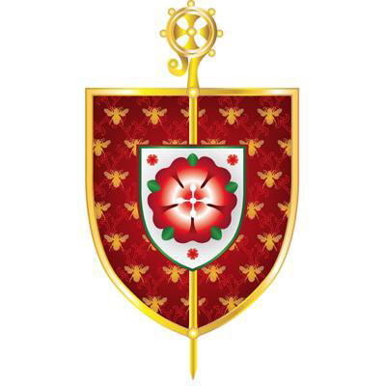
A quick guide for Governors: Who is Catholic and why Roman?
www.dioceseofsalford.org.uk/education
December 2020

Slide 2
A quick history of Roman usage
Roman was a derogatory term used by the Established Church of England; usage began some time before the restoration of the hierarchy in 1850
Anglicans also claimed to be Catholic, so the term Roman was adopted to distinguish between the two. The term papists had fallen out of use
The Church of England see themselves as part of the Universal Church – they use the same creed: “I believe in one, holy Catholic and apostolic Church”
So we did not choose this term for ourselves; we are simply the Catholic Church elsewhere in the world

Slide 3
Other Catholic churches
Latin Rite or
Roman Rite
There are 24 churches sui iuris (with their own law) in Communion with the Pope
Divided into 6 liturgical traditions
Syro-Malabar
Ukrainian
Eastern Catholic Churches

Slide 4
‘In communion’ with the Bishop of Rome
This term constitutes a common sacramental sharing between the Eastern Catholic Church and the Latin Rite, including Eucharistic intercommunion
There are only two established hierarchies: Ukrainian and Syro-Malabar
The care of Catholics in other Eastern Catholic Churches is given to the care of the Latin Rite bishop (except for one)
England and Wales

Slide 5
So to our own Roman Catholic schools today
Some dioceses have ceased to use the term Roman
In the diocese of Salford, the bishop of the day decided against this, as some clergy and the lay faithful felt part of their history was being cast aside
Where retained in policies and practice, the term should be understood to mean Latin (Roman) Rite and and also the 24 Eastern Catholic Churches in communion with the Pope as Bishop of Rome
Where Roman is not retained and just termed Catholic, it means Roman Catholic, in England and Wales (and in Great Britain and Northern Ireland)
Baptised members of the Eastern Catholic Churches therefore have equal admission rights as members of the Latin (Roman) Church to Salford’s Roman Catholic schools

Slide 6
Available on the governance section of the website
www.dioceseofsalford.org.uk/education

