Slide 1







Encouraging Young People to take an active role in the Parish
Elizabeth Gibbons – e.gibbons@st-ambrose.Manchester.sch.uk
Rob Jordan – r.Jordan@sacredheart-jun.Manchester.sch.uk
Lorraine Leonard – Lorraine.Leonard@dioceseofsalford.org.uk
Notes:
Introduce ourselves and our roles.
3 workshops today based on:
Relationship between the Parish Priest and Headteacher
Young people becoming Beacons of Hope
Encouraging YP to take an active roles in the parish
Brief overview of Hope in the Future Working Party (next 2 slides)

Slide 2
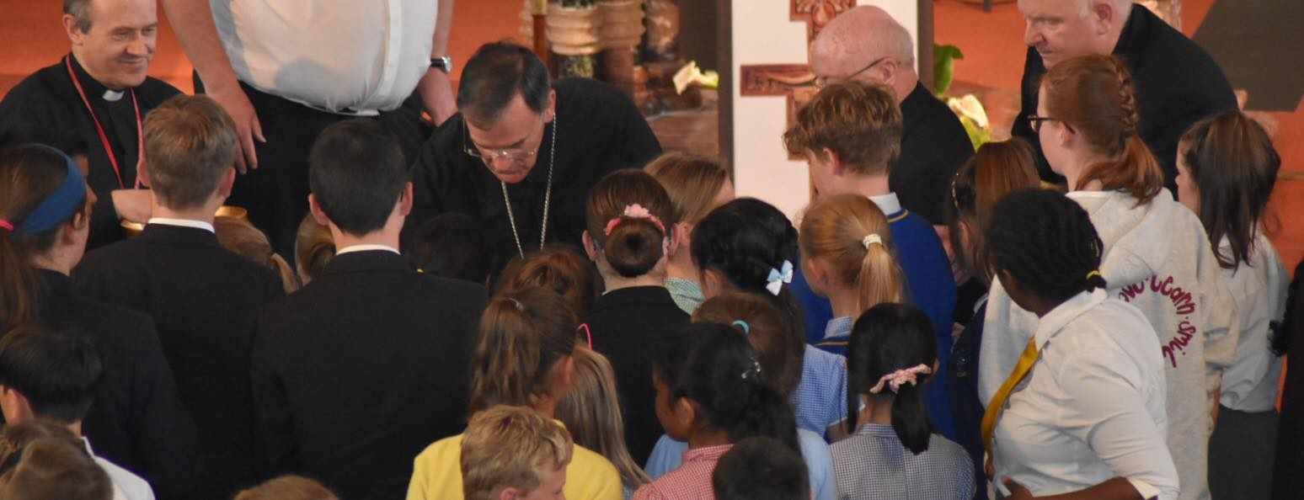

Hope in the Future for Schools
Notes:
Hope in the Future for schools was launch in June last year.
Each school was presented with a San Damiano Cross

Slide 3
Hope in the Future Schools Group
Strengthen, establish and develop school parish links.
Share resources and ideas in order to develop links between school and parish.
Use the 7 steps (in any order) to develop links between school and parish
Notes:
Explain the background to the group.

Slide 4
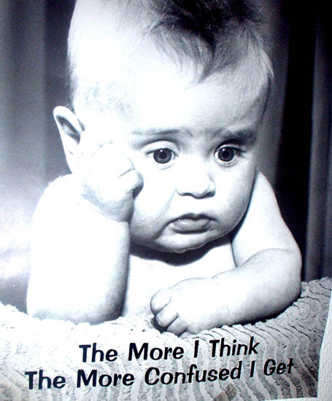
“Dear young people...............
………….you are the future!”
Notes:
How many times have we heard this saying?
Young people are not just the future, they are the here and now – THE PRESENT!
Young people want to get involved, sometimes they are not asked!

Slide 5
GIFT Chaplaincy Teams
Mini Vinnies
Caritas Ambassadors
Faith Leaders
Liturgy Leaders
SVP
Notes:
This is just to name a few.
These group are already established in your schools.

Slide 6
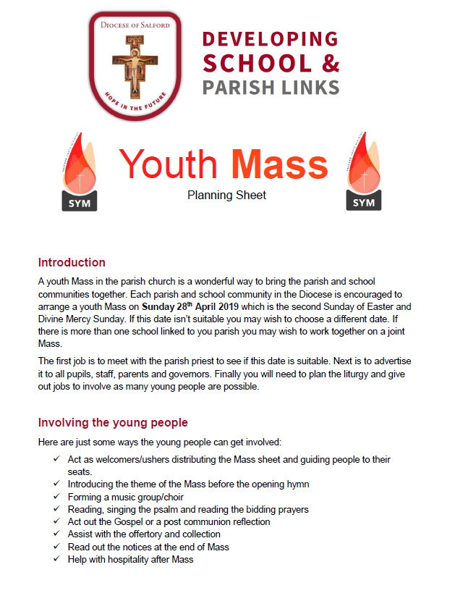

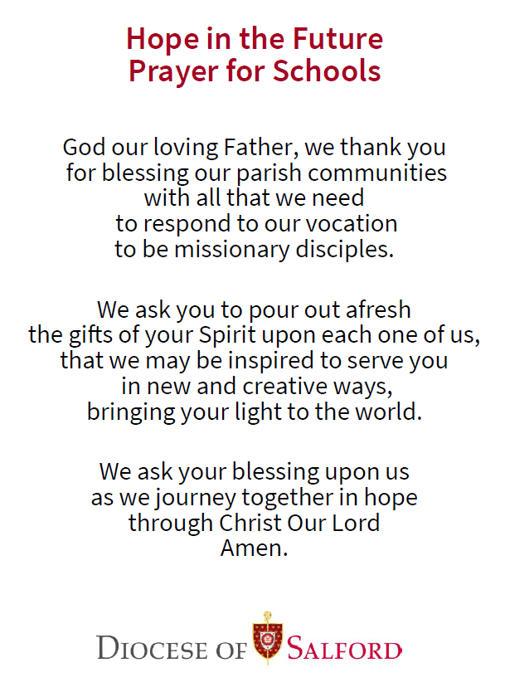
Resources sent out
14th January 2019
Next Resources: w/c 25th March 2019
www.dioceseofsalford.org.uk/parishes/school-links/

Slide 7
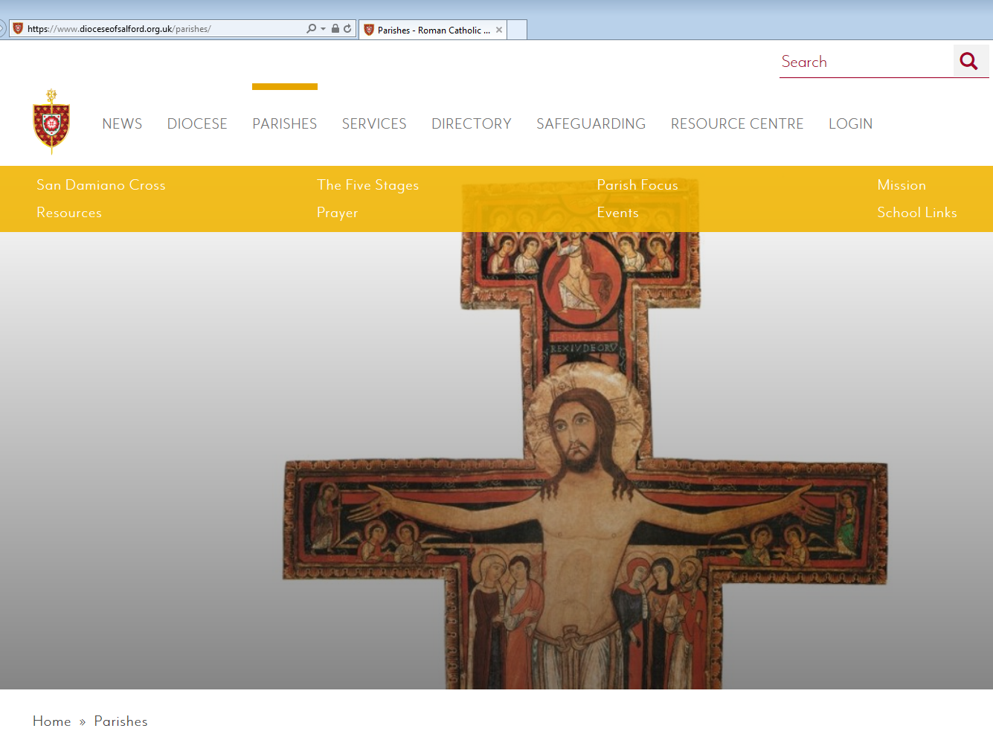
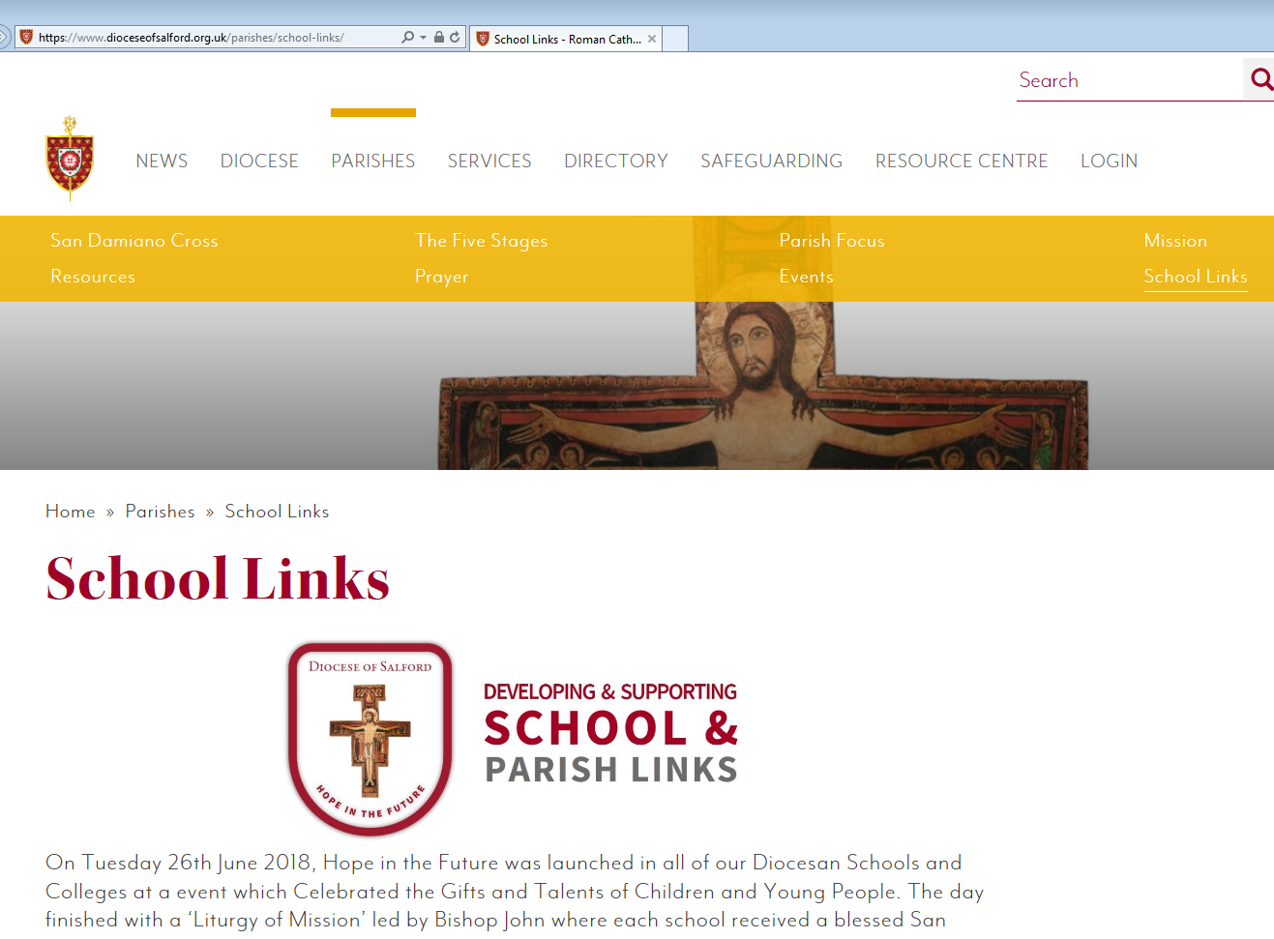
1
2
www.dioceseofsalford.org.uk/parishes/school-links/

Slide 8
Suggested Practical Ideas
Hope in the Future Rep – RE LEAD
Invitation
Youth Group
Mass and Liturgies in the Church – Young people to Lead
Welcomers/Readers
Chaplaincy Teams in schools – Notice board in Church
School/Church shares news/events
Rep from the school to be on the Parish HITF Team.

Slide 9

Faith in Action Award

Slide 10
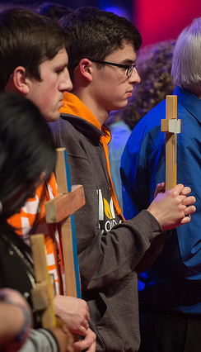
Who is it for?
Y6 - Y13
Primary School
Secondary School
Parish Youth Groups
Pre/Post Confirmation Groups

Slide 11
Benefits
To strengthen links between individuals, communities and organisations to explore the universal call to holiness.
Encourages school/parish/community links.
Completely inclusive - accessible by all participants.
Simple and powerful way of reflecting on active faith.
Enables outreach and inspires action.
Motivation for young people to do more

Slide 12

Faith in Action Award

Slide 13
Thank you for listening, any questions please?

