Slide 1


How can help us to become Beacons of
Notes:
Welcome everybody.
Introduce myself & background.
Invite parish groups to introduce themselves.

Slide 2

Aims of this workshop
To remind ourselves of the main themes of CST.
To remind ourselves where CST comes from.
To have a flavour of how CST is embedded in our Catholic schools with particular focus on Caritas Ambassador Teams.
To consider which aspects of CST your parish is focussing on or wants to focus on.
To consider how the themes of CST can help you to engage with your local schools and young people in your parish to become BEACONS OF HOPE.
Notes:
Acknowledge people’s differing levels of knowledge and experience.
Run through the aims of the workshop.

Slide 3

What is Catholic Social Teaching?
Dignity of the Human Person.
Family & Community.
Solidarity and the Common Good.
Option for the Poor and Vulnerable.
Rights and Responsibilities.
6. Dignity of Work.
7. Stewardship.
https://www.youtube.com/watch?v=ELyLdMlFdzA
Notes:
CST is often referred to as “the Catholic Church’s best kept secret”.
The themes can be grouped in various ways with slightly different headings but I want you to see the themes as they are presented in school.
If there is time, show short film What IS CST?
https://www.youtube.com/watch?v=ELyLdMlFdzA

Slide 4


Slide 5
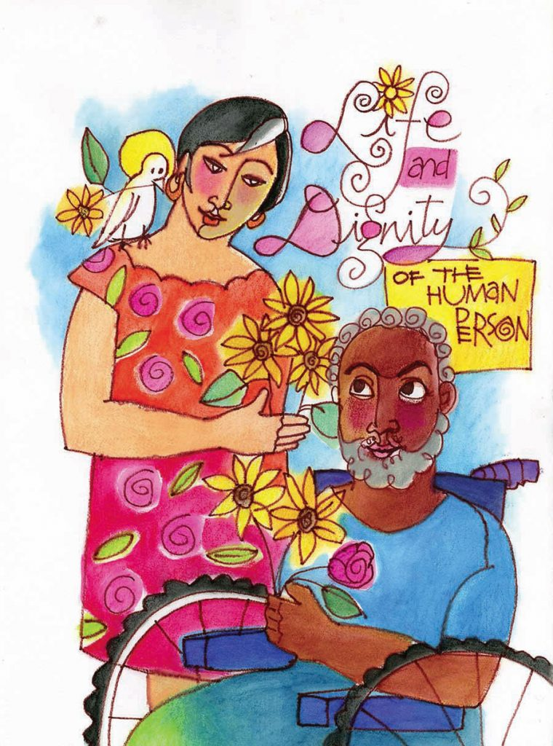
Dignity of the Human Person

Slide 6
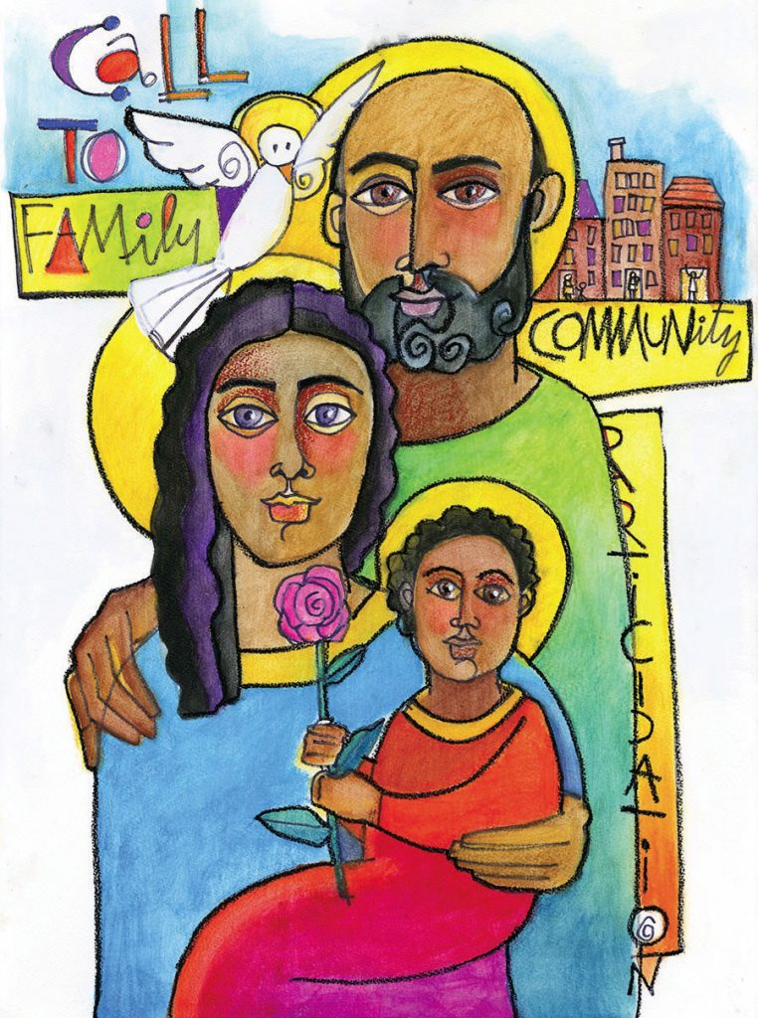
Family & Community

Slide 7
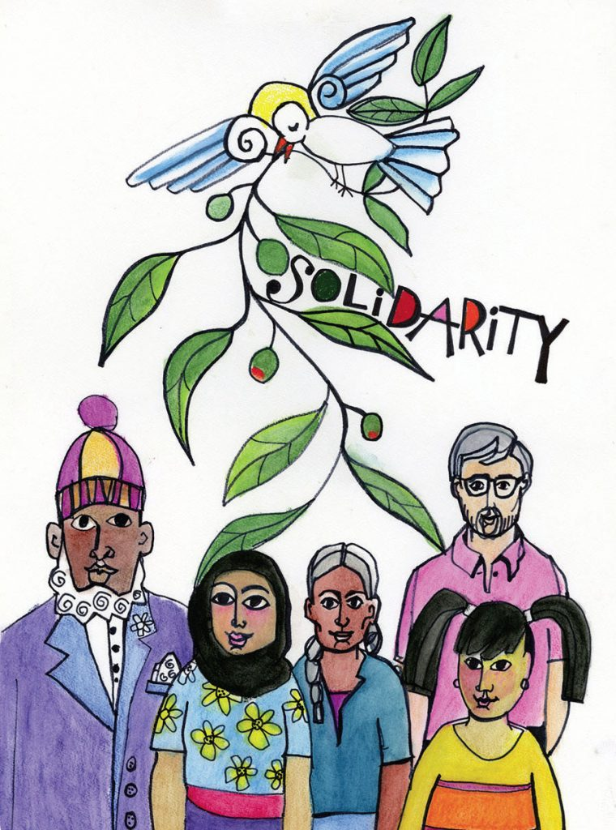
Solidarity & the Common Good

Slide 8

Rights & Responsibilities

Slide 9
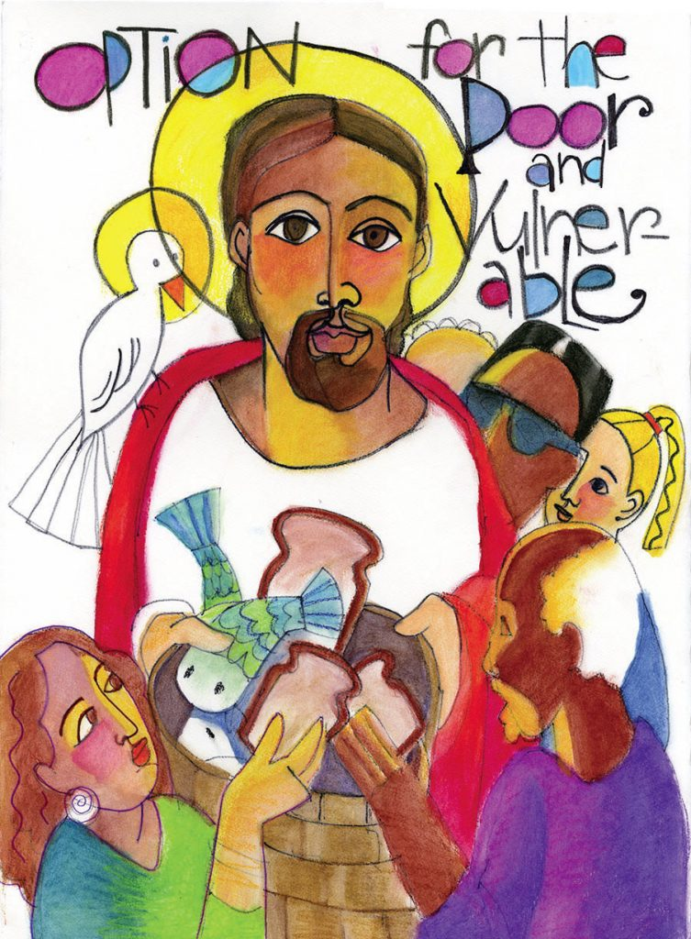
Option for the Poor & Vulnerable

Slide 10
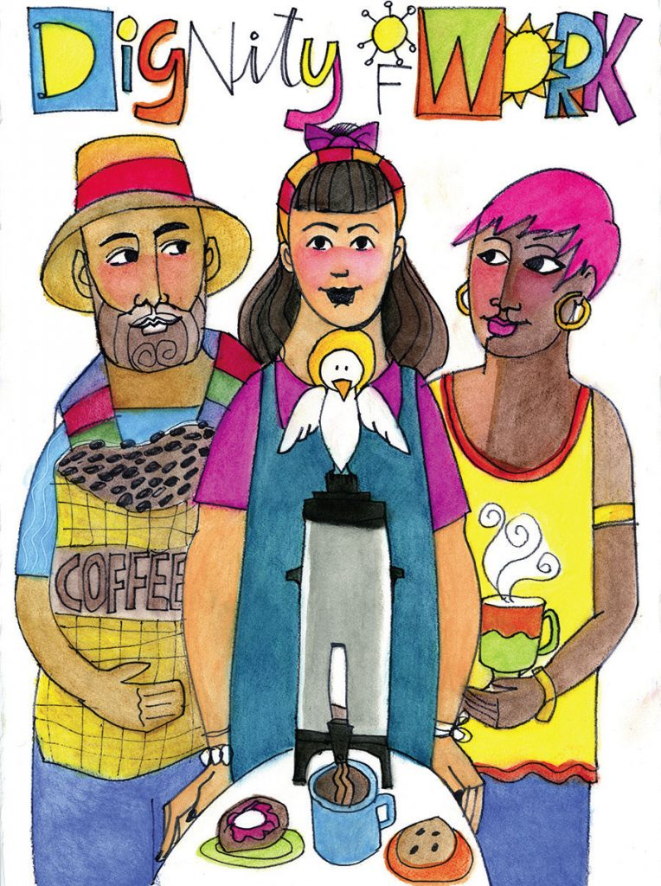
Dignity of Work

Slide 11

Stewardship
Notes:
Laudato Si.
Bishop John’s letter to schools & parishes last weekend.

Slide 12
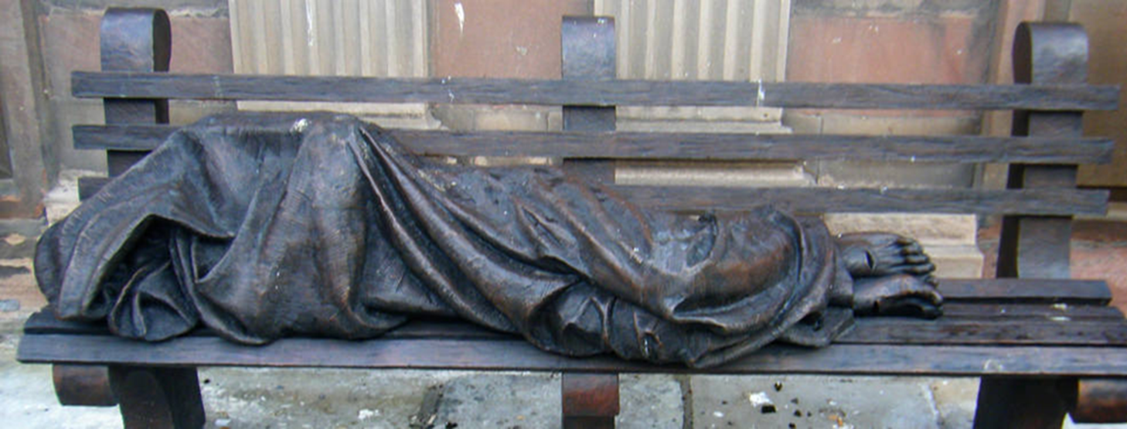
Notes:
For me this image captures several of the themes of CST in our modern world.
Ask group if they recognise the sculpture.
Talk about it’s location, impact and significance.

Slide 13
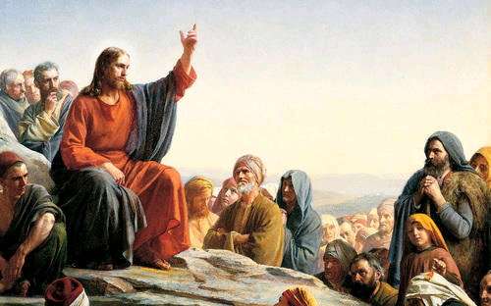

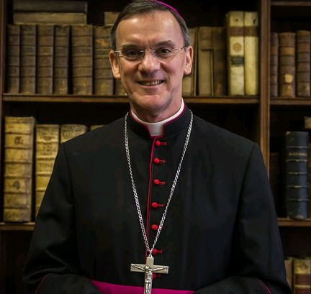

Where does CST come from?
https://www.youtube.com/watch?v=3p2vnOM5xZU
Notes:
CST comes to us through the Word of Jesus.
Through Holy Scripture.
Through papal documents & encyclicals.
Through Bishops’ pastoral letters.
NB: Make particular reference to Bishop John’s Pastoral Letter to parishes and schools last weekend.
Show clip of Bishop John’s message to schools Feb 2019.
https://www.youtube.com/watch?v=3p2vnOM5xZU

Slide 14
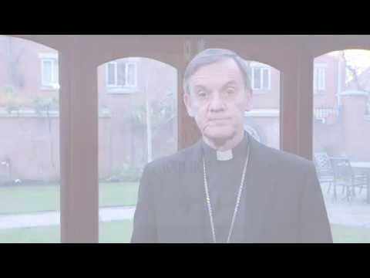

Slide 15
How are the themes of CST embedded in our R.C schools?
It’s how we do things.
It’s how we treat people.
The 5 Ws: Welcome; Worship; Welfare; Word; Witness.
Through Liturgy.
Through Sacramental Programme.
Through RE lessons.
Supported by the family*, the parish & wider community including the Diocese.
BY PUTTING FAITH INTO ACTION!

Slide 16
Faith In Action in schools
Pupil Chaplains & GIFT Teams.
Caritas Ambassadors.
CAFOD team.
IMPACT Teams.*
Mini Vinnies.
Justice & Peace teams.
Advent & Lent fund-raising.
St Joseph’s Penny.
The Little Sleep Out.
Notes:
Talk through list which gives examples of just some of the ways our schools put their faith into action.
Explain how some fit perfectly with parish group equivalents but that is not essential.

Slide 17
Caritas Ambassadors
https://www.youtube.com/watch?v=MQGSHDKA180
Are trained and commissioned by the Diocese.
They do not need to be practicing Catholics but need to be passionate about social justice.
Training is based on the 7 themes of Catholic Social Teaching.
They plan and promote social action projects.
They are the face of Caritas & help raise awareness for the projects of Caritas.
They lead fund-raising activities eg, St Joseph’s Penny during Lent.
Help schools to put faith into action.
Develops confident future leaders.
Can be nominated for prestigious Bishop’s CA Award.
Aids transition from primary school to high school.
Provides meaningful opportunities to link with parishes.
Notes:
Ask if anyone knows what the word Caritas means.
Explain it is the official “home” charity of the Diocese.
Ask if there are any Parish Caritas Reps in the room.
Show film clip from CA Festival. https://www.youtube.com/watch?v=MQGSHDKA180
Explain the role of Caritas Ambassadors in School.
Explain how they are trained.
Refer to Caritas In Action resource.

Slide 18
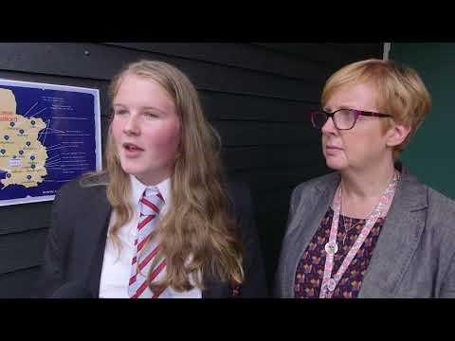

Slide 19
Food for Thought…
Some of the young people who attend Mass in your parish may not be attending a Catholic School so don’t have the opportunity to be a Caritas Ambassador…is this something you could offer them through your parish instead??
Anyone wish to pilot this?

Slide 20
What is happening already?
Talk for 5 mins in your parish groups
What is happening at the moment in your parish to put the principles of CST into direct action? Discuss.
What else could you do? Make a list.
How could that involve your local schools and young people in your parish? Explore.
Notes:
Stop discussion after 5 mins.
Ask for feedback if there is time.
If not, go straight onto next slide activity.

Slide 21
What WILL you do?
What WILL you do?
How are you going to do it?
What is the first step?
When can you start?
What will stop you?
How can you get round this?
What will the benefits be?
Notes:
Handout a template to parish groups.
5 mins to identify some actions.
Time permitting, ask groups to share their action plans.

Slide 22
Aims of this workshop
To remind ourselves of the main themes of CST.
To remind ourselves where CST comes from.
To have a flavour of how CST is embedded in our Catholic schools with particular focus on Caritas Ambassador Teams.
To consider which aspects of CST your parish is focussing on or wants to focus on.
To plan how the themes of CST can help you to engage with your local schools and young people in your parish TO BECOME BEACONS OF HOPE.
Notes:
Run through the aims of the workshop & ask group how far we have achieved them.
Give out CA & CIA leaflets.
Give out sheet with CST themes & suggested reading.

