Slide 1
CAMINO
Making the Journey…
Making the journey as a pilgrim to Holy Island

Slide 2
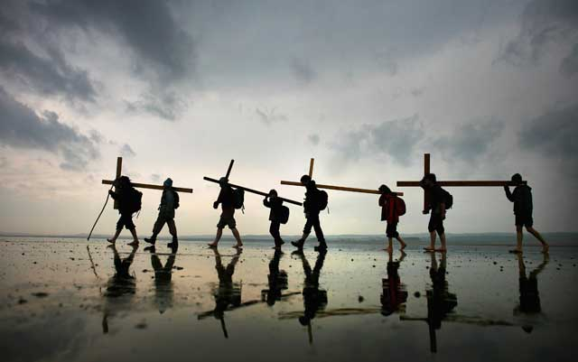
Introduction
With all of the holy islands that lie just off our shores, there is an element of risk in getting there. Lindisfarne, only truly an island twice a day, is no different. Dicing with the tides has always been and remains an essential part of the allure – whether you are slipping and sliding in bare feet across the traditional Pilgrims' Way or motoring on the more recent road, which comes complete with elaborate warning signs depicting a car sinking beneath the waves having misread the tide timetable. You have to step beyond what is normal and comfortable to get to Lindisfarne. The quid pro quo is that by making yourself vulnerable, and, please God, surviving, you are somehow laying yourself open to seeing things in a different way when you get to this island with its history of saintly monks and miracle cures. Your guard is down.

Slide 3
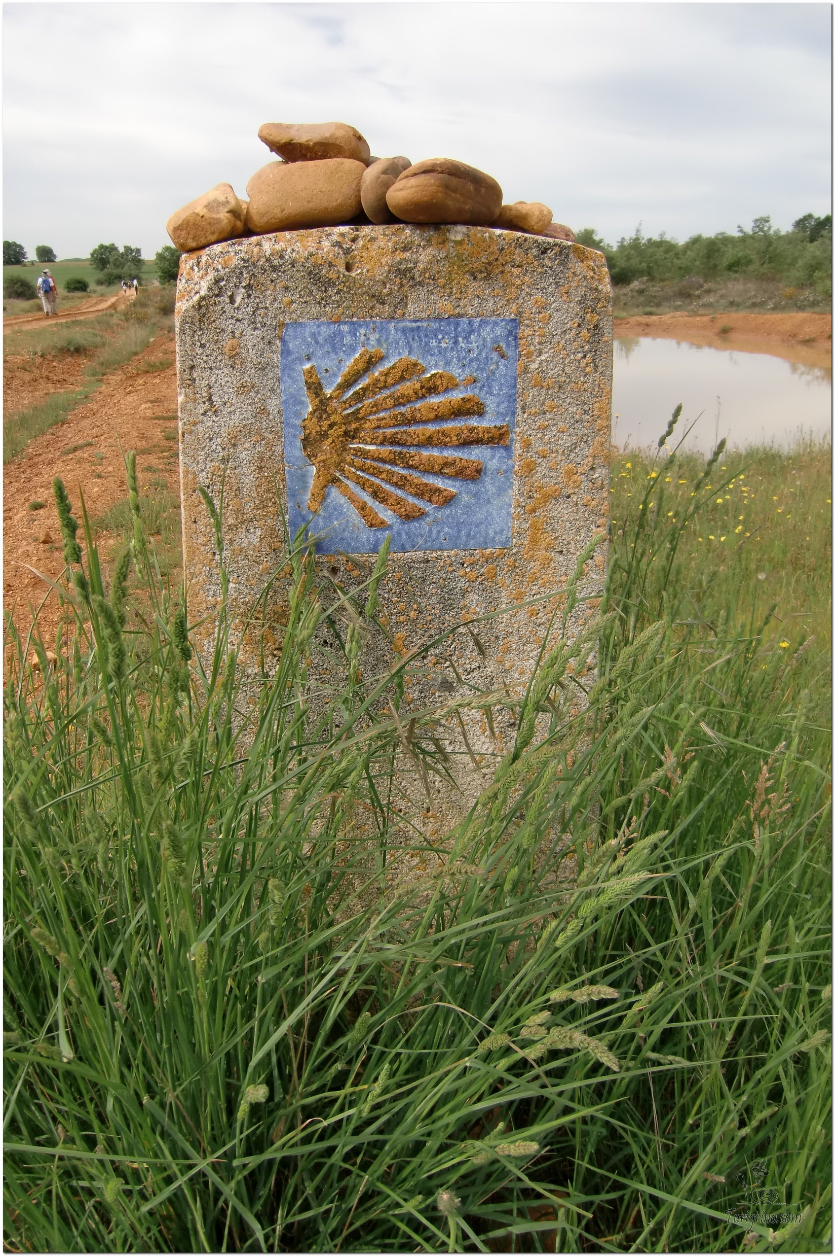
Opening Prayer
The Camino Prayer (adapted)
O God, who brought your servant Abraham out of the land of the Chaldeans, protecting him in his wanderings, who guided the Hebrew people across the desert, we ask that you watch over us, your servants, as we walk in the love of your name.
Be for us our companion on the journey,
Our guide at the crossroads, Our breath in our weariness,
Our protection in danger, our albergue on the Camino,
Our shade in the heat, Our light in the darkness,
Our consolation in our discouragements,
And our strength in our intentions.
So that with your guidance we may arrive safe and sound at the end of the road and enriched with grace and virtue we return safely to our homes filled with joy.
In the name of Jesus Christ our Lord, Amen. Apostle Santiago, pray for us. Santa Maria, pray for us.

Slide 4
Catholicism in a Hundred Objects
This video is 17 minutes long so watch as much or as little as you like
The Cross

Slide 5
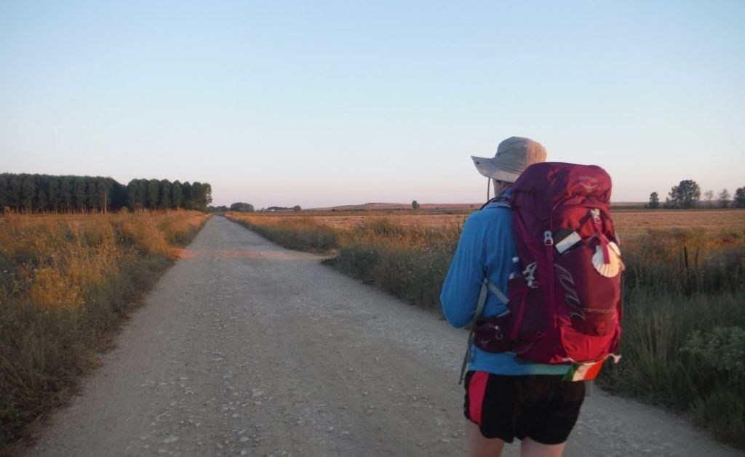
Rucksack Prayer – Part 1

Slide 6
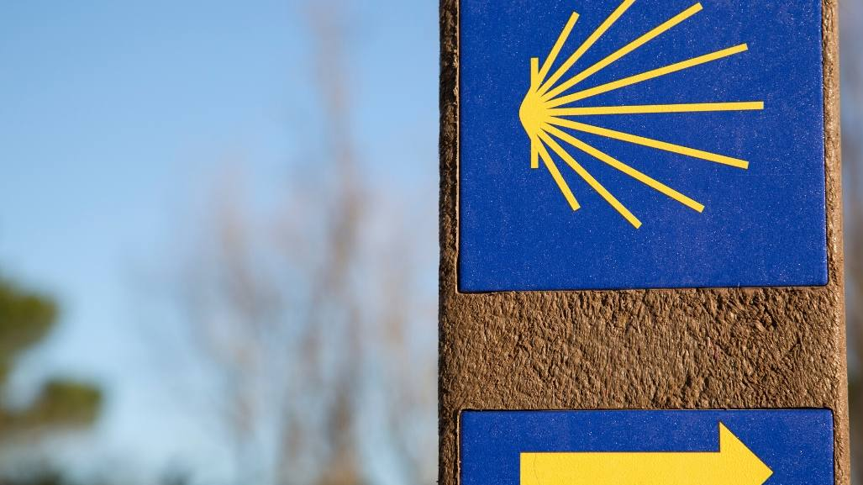
Making the journey to Holy Island

Slide 7
Scripture Reading - 1 Corinthians 9:16-23
If I proclaim the gospel, this gives me no ground for boasting, for an obligation is laid on me, and woe to me if I do not proclaim the gospel! For if I do this of my own will, I have a reward; but if not of my own will, I am entrusted with a commission. What then is my reward? Just this: that in my proclamation I may make the gospel free of charge, so as not to make full use of my rights in the Gospel.
For though I am free with respect to all, I have made myself a slave to all, so that I might win more of them. To the Jews I became as a Jew, in order to win Jews. To those under the law I became as one under the law (though I myself am not under the law) so that I might win those under the law. To those outside the law I became as one outside the law (though I am not free from God's law but am under Christ's law) so that I might win those outside the law. To the weak I became weak, so that I might win the weak. I have become all things to all people, that I might by all means save some. I do it all for the sake of the gospel, so that I may share in its blessings.

Slide 8
From what you have heard so far…
…what are your Initial thoughts, reactions, questions that come to mind?
We can discuss these later…

Slide 9
Main Input
Leave me alone with God as much as may be. As the tide draws the waters close in upon the shore, Make me an island, set apart, alone with you, God, holy to you.
Then with the turning of the tide prepare me to carry your presence to the busy world beyond, the world that rushes in on me till the waters come again and fold me back to you.

Slide 10
Reflection
‘Make me an island, set apart, alone with you, God, holy to you’.

Slide 11
Testimony
‘And whatever you do, in word or deed, do everything in the name of the Lord Jesus, giving thanks to God the Father through him’. Colossians 3:17

Slide 12
Catechism of the Catholic Church
315 In the creation of the world and of man, God gave the first and universal witness to his almighty love and his wisdom, the first proclamation of the "plan of his loving goodness", which finds its goal in the new creation in Christ.
316 Though the work of creation is attributed to the Father in particular, it is equally a truth of faith that the Father, Son and Holy Spirit together are the one, indivisible principle of creation.
317 God alone created the universe, freely, directly and without any help.
318 No creature has the infinite power necessary to "create" in the proper sense of the word, that is, to produce and give being to that which had in no way possessed it (to call into existence "out of nothing") (cf DS 3624).
319 God created the world to show forth and communicate his glory. That his creatures should share in his truth, goodness and beauty - this is the glory for which God created them.
320 God created the universe and keeps it in existence by his Word, the Son "upholding the universe by his word of power" (Heb 1:3), and by his Creator Spirit, the giver of life.
323 Divine providence works also through the actions of creatures. To human beings God grants the ability to cooperate freely with his plans.

Slide 13
Question
Why would I go on pilgrimage?

Slide 14
Discussion
Why might we feel closer to God at places of Pilgrimage?
Discuss this is two’s & three’s then feedback to the main group

Slide 15
Internet Corner - Where to find out more…
www.lindisfarne.org.uk/
www.catholicexchange.com/five-things-to-know-about-st-aidan-of-lindisfarne
www.lindisfarne.org.uk/general/relhist.htm

Slide 16
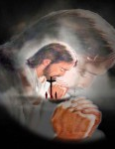
Conversation with Jesus
Focus on this image of Jesus and open your heart to Him now.
Take this opportunity to talk to him in your mind and heart.
Listen and be aware of his presence with you.
You may want to use this hymn to help you pray

Slide 17
Spiritual Journal
You may want to write down what has been important for you during this time together

Slide 18
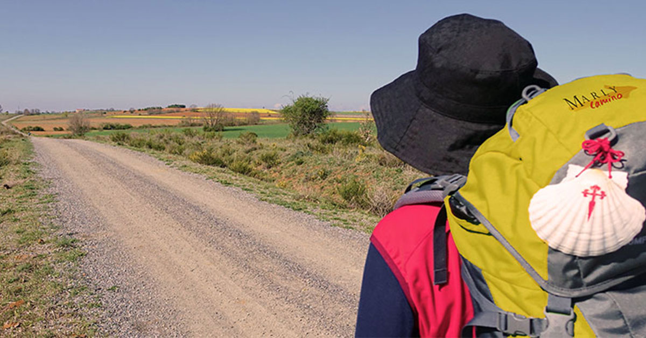
Rucksack Prayer – Part 2

Slide 19
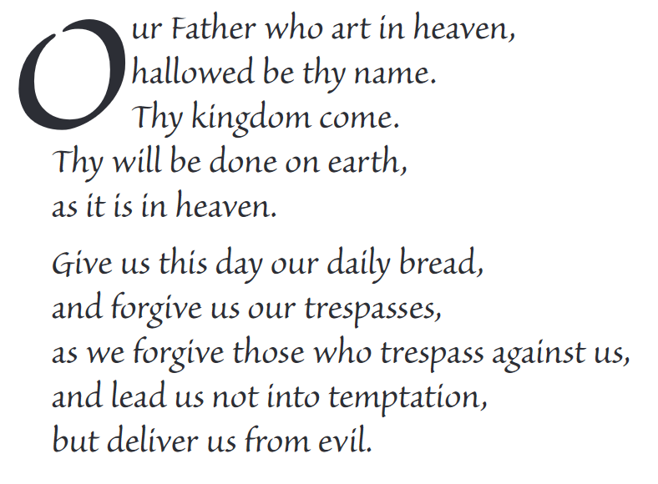
The Lord’s Prayer

Slide 20
Final pilgrim blessing for the week ahead
God of our pilgrimage,
you have given us a desire
to take the questing way
and set out on our journey.
Help us to keep our eyes fixed on Jesus,
that whatever we encounter as we travel,
we may seek to glorify you by the way we live.
You call us, Lord,
to leave familiar things and to leave our “comfort zone”.
May we open our eyes to new experiences,
may we open our ears to hear you speaking to us
and may we open our hearts to your love.
Grant that this time spent on pilgrimage
may help us to see ourselves as we really are
and may we strive to become the people you would have us be. Amen
… continued on next slide

Slide 21
Final pilgrim blessing for the week ahead
Lord, you know our beginning and our end.
Help us to realise we are only pilgrims on this earth
and save us from being too attached to worldly possessions.
May we experience the freedom to wander,
the freedom to hope and the freedom to love as we journey. Amen
Creator God, you are the source of all life and motivation.
May we journey in faith and love, rejoicing and eager to serve you.
Grant us a glimpse of your glory as we seek to follow you –
the Way, the Truth and the Life. Amen
May God the Father who created you, guide your footsteps,
May God the Son who redeemed you, share your journey,
May God the Holy Spirit who sanctifies you, lead you on life’s pilgrimage,
and the blessing of God, Father, Son and Holy Spirit
be with you wherever you may go. Amen.

Slide 22
CAMINO
Making the Journey…
Making the journey as a pilgrim to Holy Island

