Slide 1
CAMINO
Making the Journey…
Making the journey as a pilgrim to Rome

Slide 2
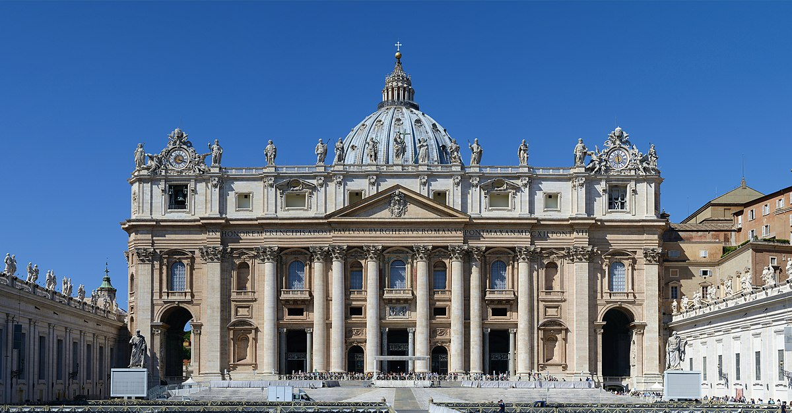
Introduction
Rome is an important place of pilgrimage, particularly for Roman Catholics. The Vatican is the home of the Pope, the spiritual head of the Roman Catholic Church.
Roman Catholics believe that Jesus appointed Peter as the leader of his disciples.
In ancient Greek the name 'Peter' is the same word as 'rock'. Tradition says that after Pentecost and time spent in Jerusalem, Peter went to Rome.
Peter is seen as the first Bishop of Rome and many Christians believe that he was executed and buried on Vatican Hill in Rome. The Head of the Roman Catholic Church, the Pope, is the direct successor to Peter.
Pilgrims visit the Vatican to hear the Pope speak publicly on Wednesdays in Saint Peter's Square, or attend mass led by the Pope during the year.

Slide 3
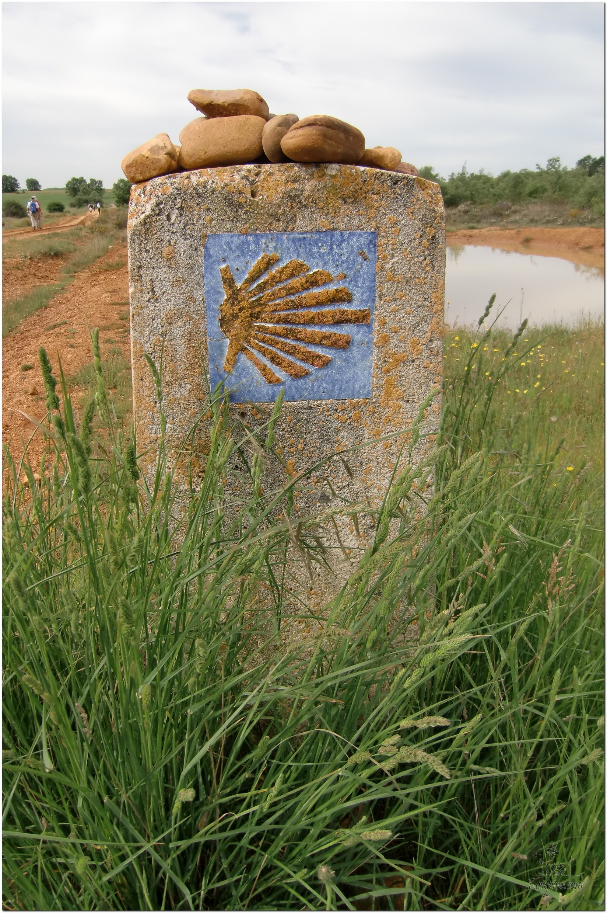
Opening Prayer
The Camino Prayer (adapted)
O God, who brought your servant Abraham out of the land of the Chaldeans, protecting him in his wanderings, who guided the Hebrew people across the desert, we ask that you watch over us, your servants, as we walk in the love of your name.
Be for us our companion on the journey,
Our guide at the crossroads, Our breath in our weariness,
Our protection in danger, our albergue on the Camino,
Our shade in the heat, Our light in the darkness,
Our consolation in our discouragements,
And our strength in our intentions.
So that with your guidance we may arrive safe and sound at the end of the road and enriched with grace and virtue we return safely to our homes filled with joy.
In the name of Jesus Christ our Lord, Amen. Apostle Santiago, pray for us. Santa Maria, pray for us.

Slide 4
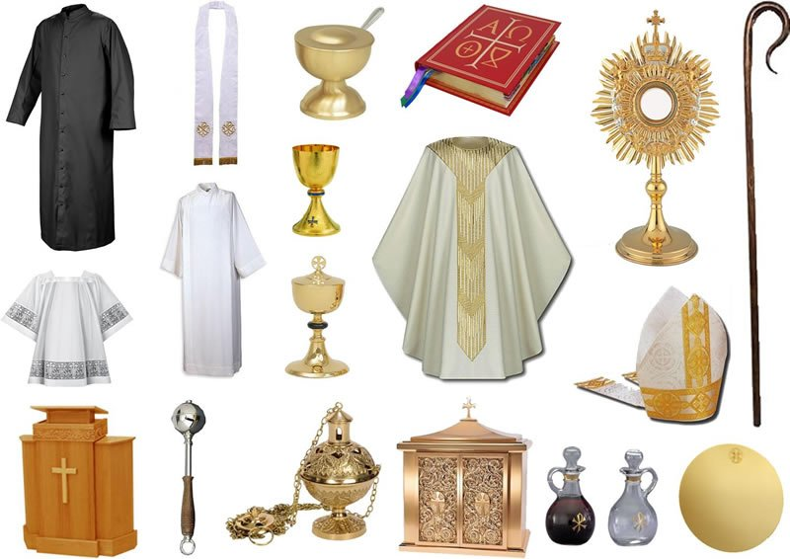
Catholicism in a Hundred Objects
This video is 25 minutes long so watch as much or as little as you like
Objects in Catholic Churches

Slide 5
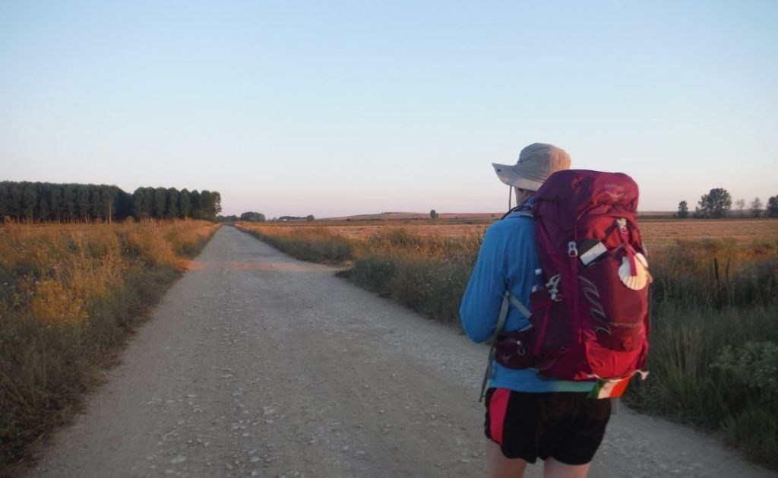
Rucksack Prayer – Part 1

Slide 6
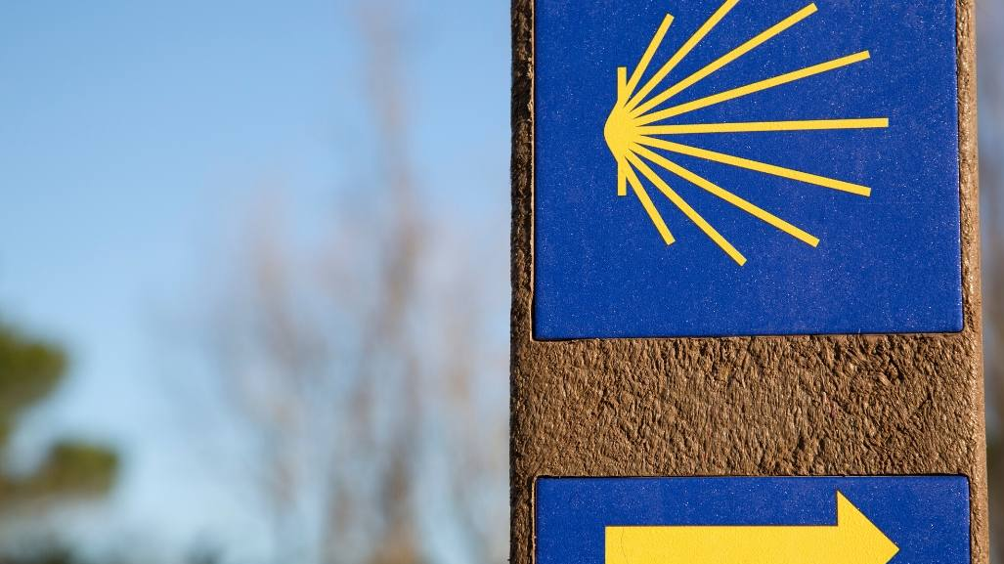
A Journey to Rome

Slide 7
Scripture Reading - Romans 13:8-10
St Paul writing to the Church of Rome
Avoid getting into debt, except the debt of mutual love. If you love your fellow men you have carried out your obligations. All the commandments: You shall not commit adultery, you shall not kill, you shall not steal, you shall not covet, and so on, are summed up in this single command: You must love your neighbour as yourself. Love is the one thing that cannot hurt your neighbour; that is why it is the answer to every one of the commandments.

Slide 8
From what you have heard so far…
…what are your Initial thoughts, reactions, questions that come to mind?
We can discuss these later…

Slide 10
Virtual tours of St. Peter's Basilica and the Sistine Chapel

Slide 11
Reflection

Slide 12
Catechism of the Catholic Church
866 The Church is one: she acknowledges one Lord, confesses one faith, is born of one Baptism, forms only one Body, is given life by the one Spirit, for the sake of one hope (cf. Eph 4:3-5), at whose fulfillment all divisions will be overcome.
867 The Church is holy: the Most Holy God is her author; Christ, her bridegroom, gave himself up to make her holy; the Spirit of holiness gives her life. Since she still includes sinners, she is "the sinless one made up of sinners." Her holiness shines in the saints; in Mary she is already all-holy.
868 The Church is catholic: she proclaims the fullness of the faith. She bears in herself and administers the totality of the means of salvation. She is sent out to all peoples. She speaks to all men. She encompasses all times. She is "missionary of her very nature" (AG 2).
869 The Church is apostolic. She is built on a lasting foundation: "the twelve apostles of the Lamb" (Rev 21:14). She is indestructible (cf. Mt 16:18). She is upheld infallibly in the truth: Christ governs her through Peter and the other apostles, who are present in their successors, the Pope and the college of bishops.
870 "The sole Church of Christ which in the Creed we profess to be one, holy, catholic, and apostolic, . . . subsists in the Catholic Church, which is governed by the successor of Peter and by the bishops in communion with him. Nevertheless, many elements of sanctification and of truth are found outside its visible confines"(LG 8).

Slide 13
Question
What are the marks of the Catholic Church?

Slide 14
Discussion
Has anyone been to the Vatican?
Discuss this is two’s & three’s then feedback to the main group

Slide 15
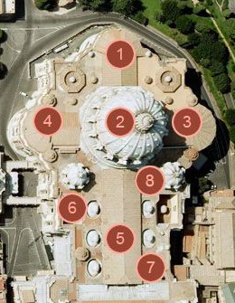
Internet Corner - Where to find out more…
The Holy See
www.vatican.va/content/vatican/en.html
Virtual Tours of St Peter’s www.vatican.va/various/basiliche/san_pietro/vr_tour/index-en.html

Slide 16
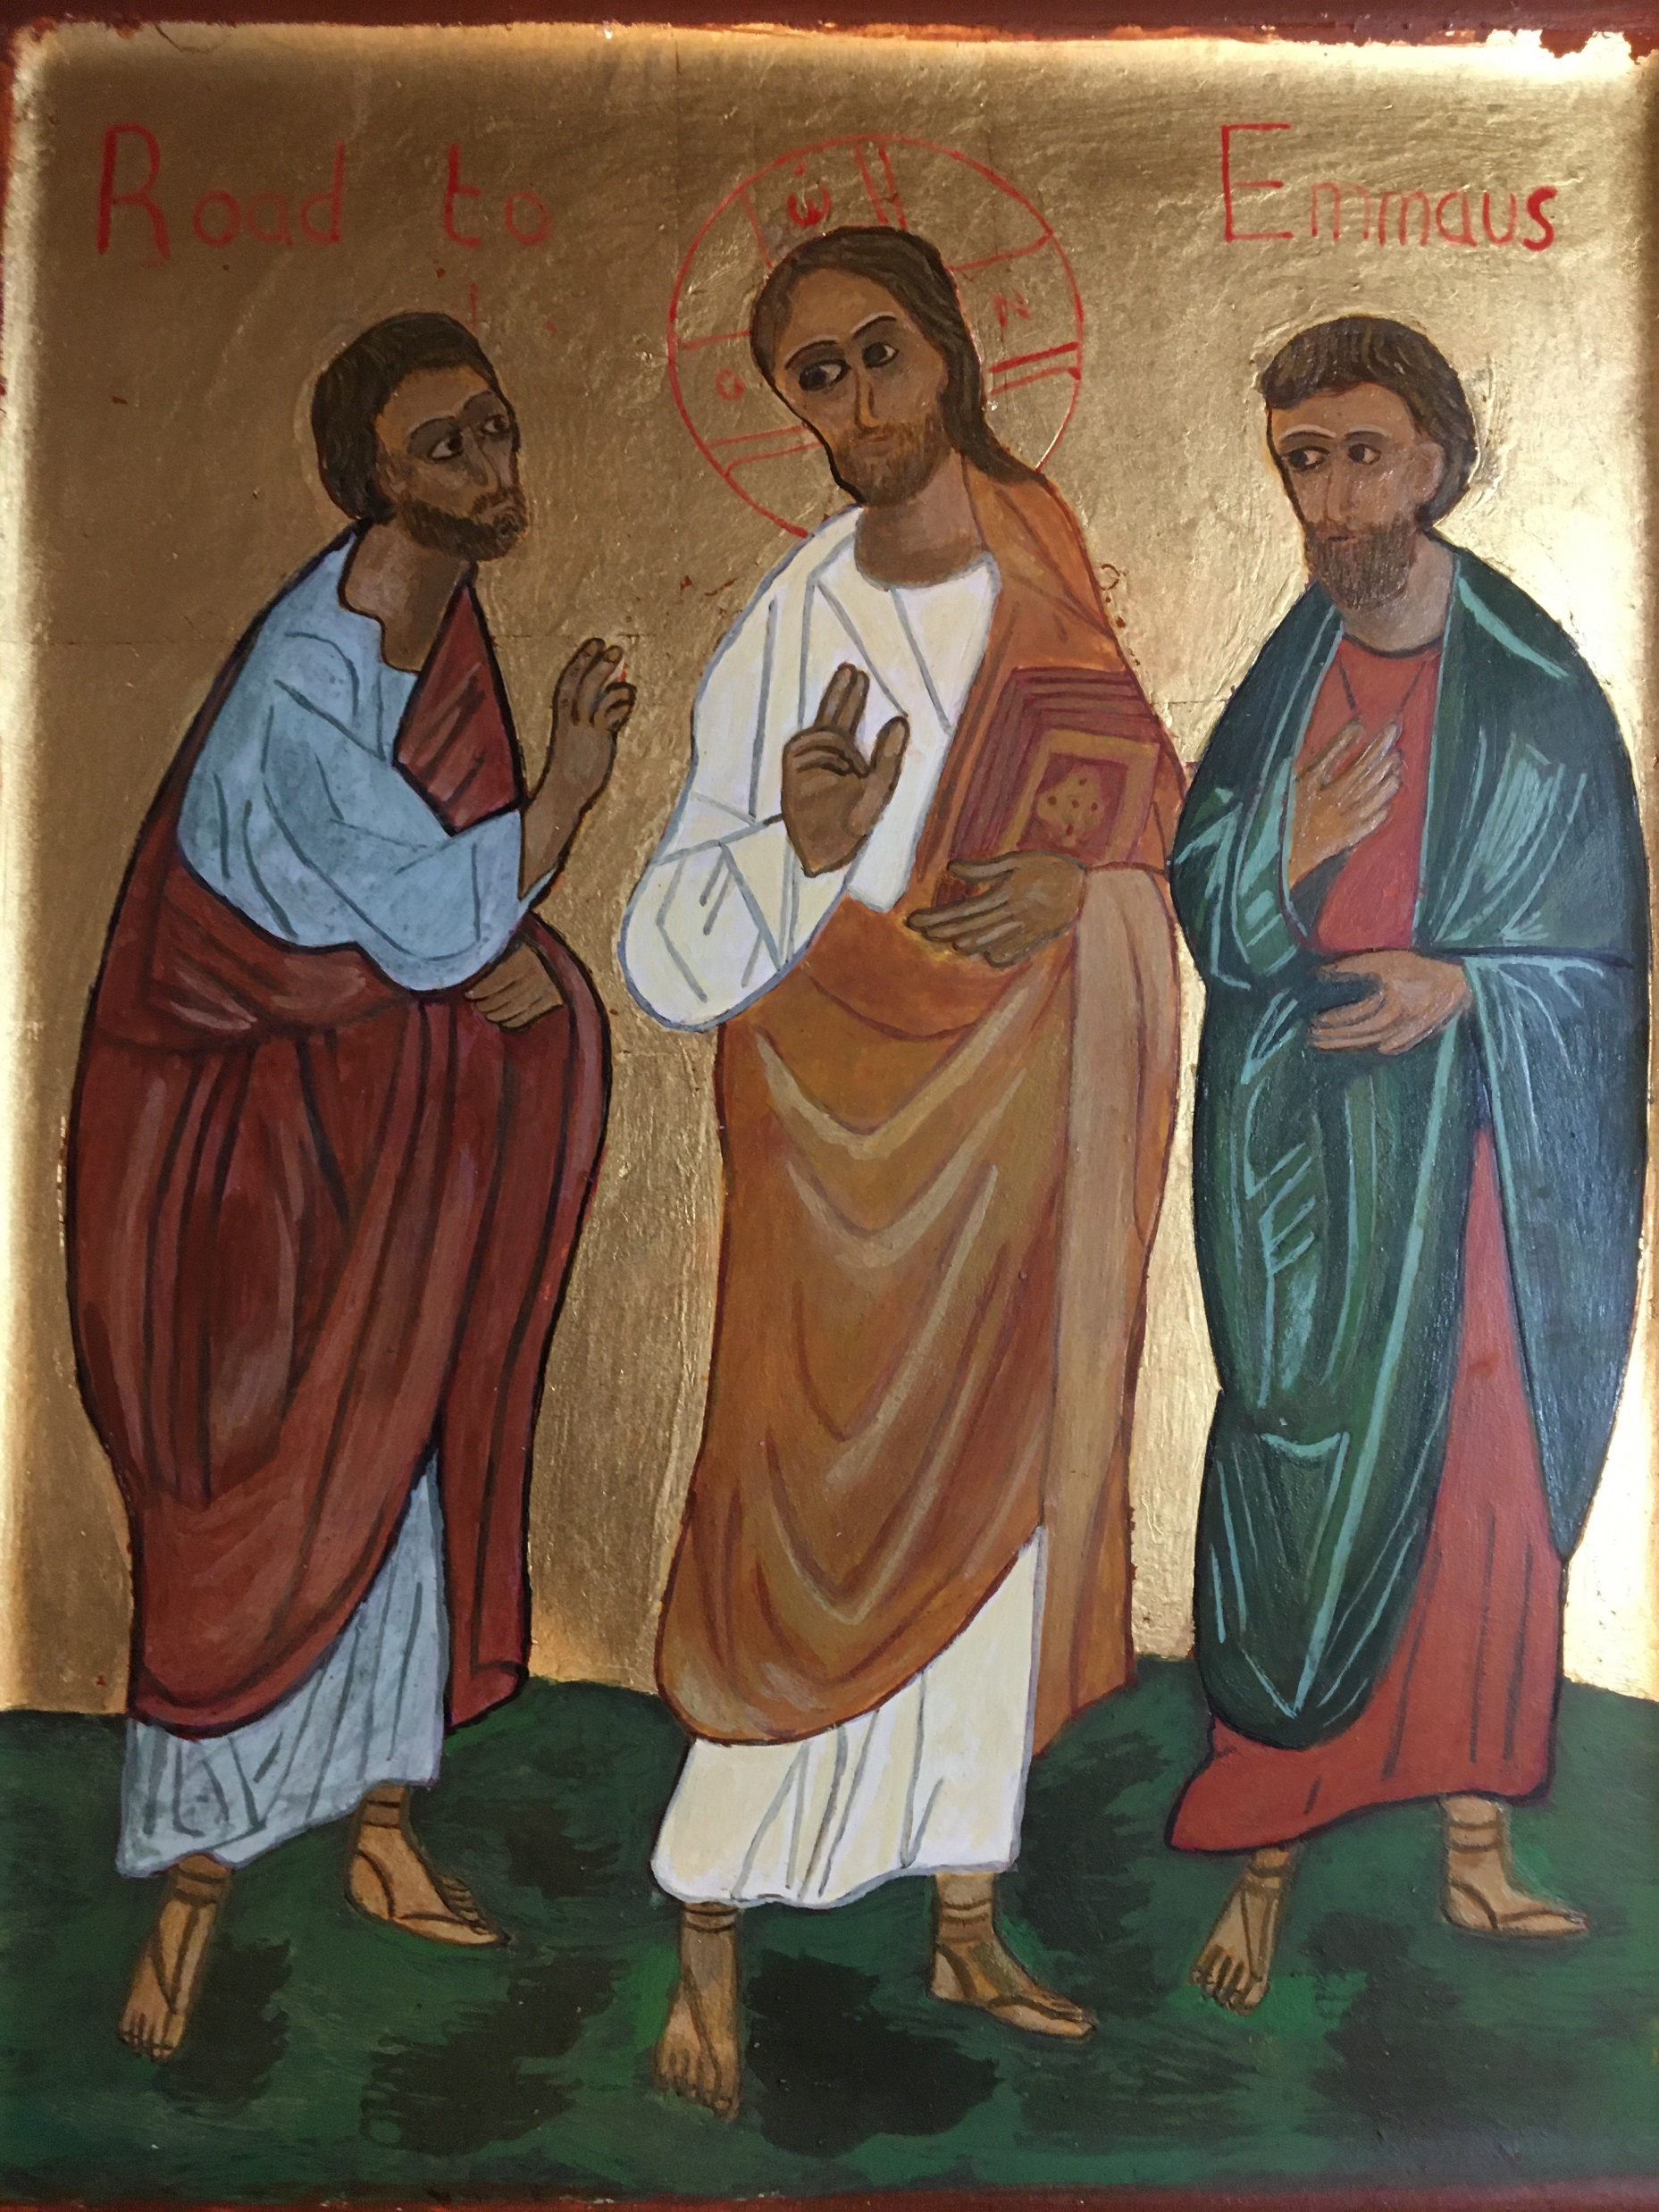
Conversation with Jesus
Focus on this image of Jesus and open your heart to Him now.
Take this opportunity to talk to him in your mind and heart.
Listen and be aware of his presence with you.
You may want to use this hymn to help you pray

Slide 17
Spiritual Journal
You may want to write down what has been important for you during this time together

Slide 18
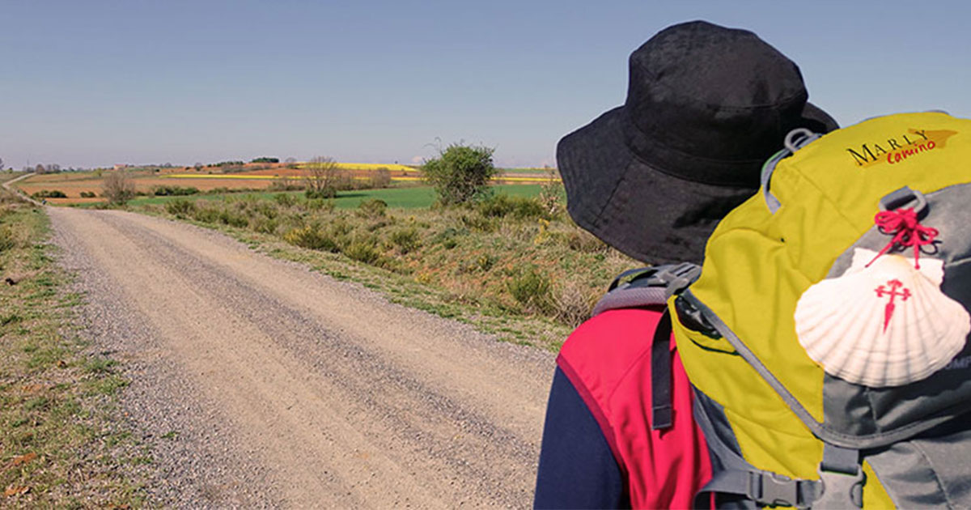
Rucksack Prayer – Part 2

Slide 19
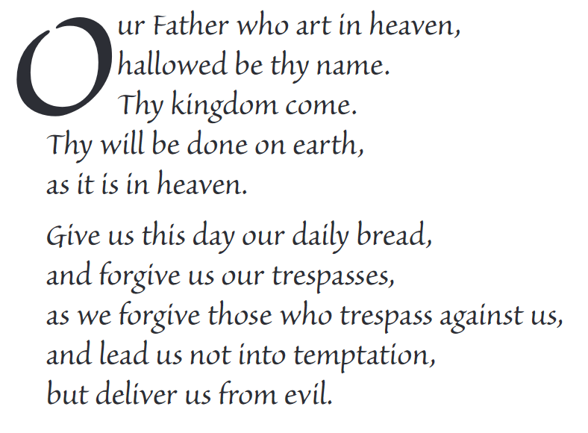
The Lord’s Prayer

Slide 20
Final pilgrim blessing for the week ahead
God of our pilgrimage,
you have given us a desire
to take the questing way
and set out on our journey.
Help us to keep our eyes fixed on Jesus,
that whatever we encounter as we travel,
we may seek to glorify you by the way we live.
You call us, Lord,
to leave familiar things and to leave our “comfort zone”.
May we open our eyes to new experiences,
may we open our ears to hear you speaking to us
and may we open our hearts to your love.
Grant that this time spent on pilgrimage
may help us to see ourselves as we really are
and may we strive to become the people you would have us be. Amen
… continued on next slide

Slide 21
Final pilgrim blessing for the week ahead
Lord, you know our beginning and our end.
Help us to realise we are only pilgrims on this earth
and save us from being too attached to worldly possessions.
May we experience the freedom to wander,
the freedom to hope and the freedom to love as we journey. Amen
Creator God, you are the source of all life and motivation.
May we journey in faith and love, rejoicing and eager to serve you.
Grant us a glimpse of your glory as we seek to follow you –
the Way, the Truth and the Life. Amen
May God the Father who created you, guide your footsteps,
May God the Son who redeemed you, share your journey,
May God the Holy Spirit who sanctifies you, lead you on life’s pilgrimage,
and the blessing of God, Father, Son and Holy Spirit
be with you wherever you may go. Amen.

Slide 22
CAMINO
Making the Journey…
Making the journey as a pilgrim to Rome

