Slide 1
CAMINO
Making the Journey…
Making the journey as a pilgrim to Santiago de Compostela

Slide 2
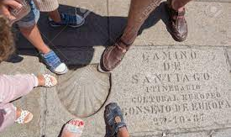
Introduction
Every journey is made up of different parts. The traveller’s path is determined by milestones, where progress can be measured. This can also apply to our spiritual life.
Before we undertake a journey, we must prepare for it. To set out on our journey to God, the only true goal of our life, we must first, look into ourselves and reflect on the truth that God penetrates every part of our being. Unfortunately, this truth escapes us at certain times in our daily lives. God is always present to us, but we are not present to Him. To make ourselves present to Him requires a spiritual journey, a journey of awakening, a journey of love to Love.

Slide 3
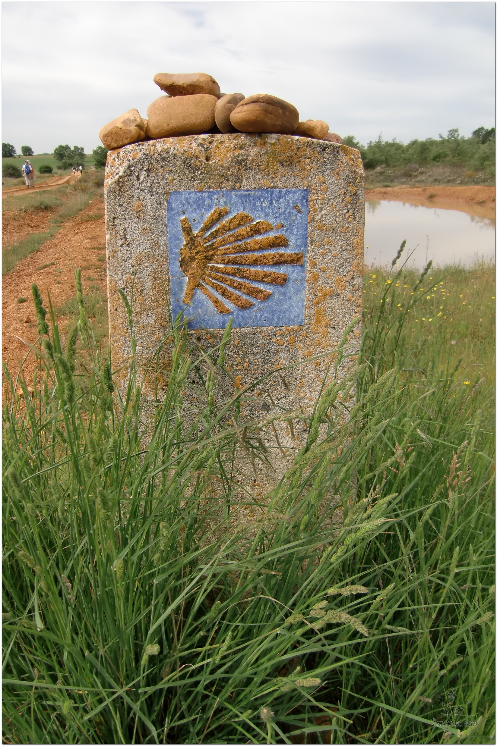
Opening Prayer
The Camino Prayer (adapted)
O God, who brought your servant Abraham out of the land of the Chaldeans, protecting him in his wanderings, who guided the Hebrew people across the desert, we ask that you watch over us, your servants, as we walk in the love of your name.
Be for us our companion on the journey,
Our guide at the crossroads, Our breath in our weariness,
Our protection in danger, our albergue on the Camino,
Our shade in the heat, Our light in the darkness,
Our consolation in our discouragements,
And our strength in our intentions.
So that with your guidance we may arrive safe and sound at the end of the road and enriched with grace and virtue we return safely to our homes filled with joy.
In the name of Jesus Christ our Lord, Amen. Apostle Santiago, pray for us. Santa Maria, pray for us.

Slide 4
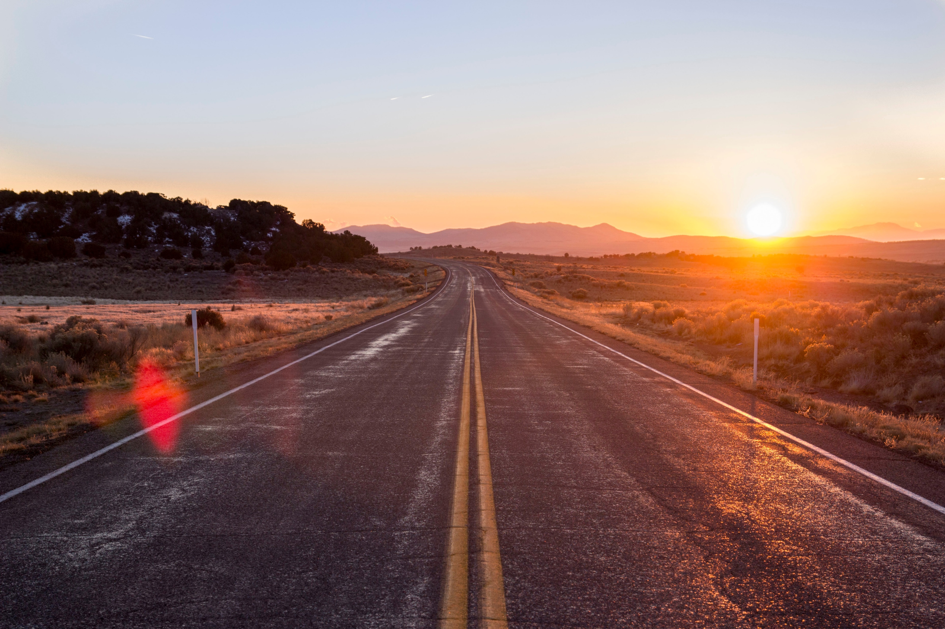
Catholicism in a Hundred Objects
This video is 20 minutes long so watch as much or as little as you like

Slide 5
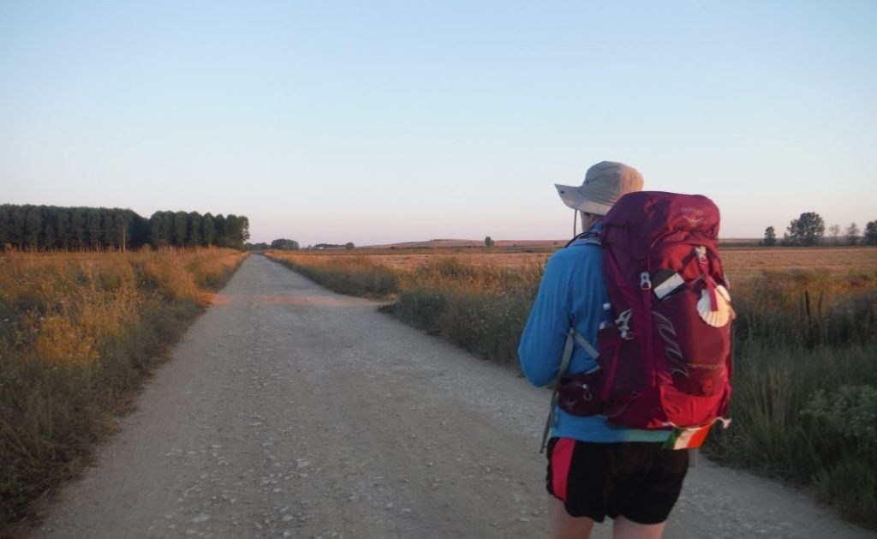
Rucksack Prayer – Part 1

Slide 6
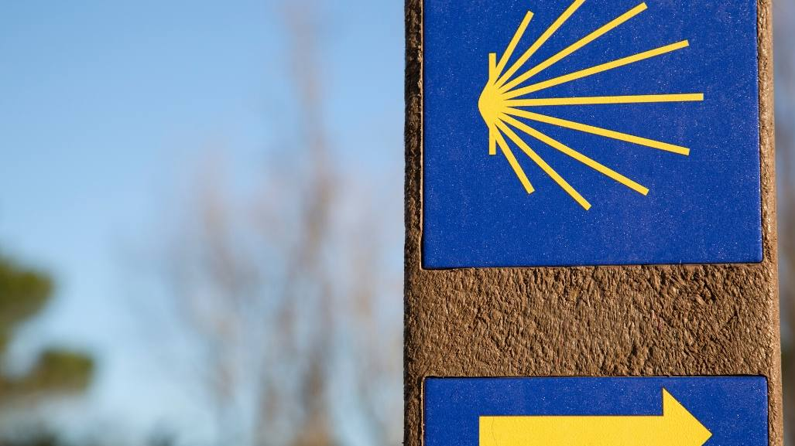
A Journey to Santiago de Compostela

Slide 7
Scripture Reading - Exhortations to Seek Wisdom and Walk with the Lord – Proverbs 3 1:12
My child, do not forget my teaching, but let your heart keep my commandments, for they will provide a long and full life, and well-being for you. Do not let mercy and truth leave you; bind them around your neck, write them on the tablet of your heart. Then you will find favour and good understanding, in the sight of God and people. Trust in the Lord with all your heart, and do not rely on your own understanding. Acknowledge him in all your ways, and he will make your paths straight. Do not be wise in your own estimation; fear the Lord and turn away from evil. This will bring healing to your body, and refreshment to your inner self. Honour the Lord from your wealth and from the first fruits of all your crops; then your barns will be filled completely, and your vats will overflow with new wine. My child, do not despise discipline from the Lord, and do not loathe his rebuke. For the Lord disciplines those he loves, just as a father disciplines the son in whom he delights.

Slide 8
From what you have heard so far…
…what are your Initial thoughts, reactions, questions that come to mind?
We can discuss these later…

Slide 9
Main Input
This video is 59 minutes long so watch as much or as little as you like
The early history of Christian Pilgrimage

Slide 10
Reflection
“God walks with us”

Slide 11
Testimony
Lessons Learned On The Camino de Santiago

Slide 12
Catechism of the Catholic Church
God's promise and the prayer of Faith
2570 When God calls him, Abraham goes forth "as the Lord had told him";⁸ Abraham's heart is entirely submissive to the Word and so he obeys. Such attentiveness of the heart, whose decisions are made according to God's will, is essential to prayer, while the words used count only in relation to it. Abraham's prayer is expressed first by deeds: a man of silence, he constructs an altar to the Lord at each stage of his journey. Only later does Abraham's first prayer in words appear: a veiled complaint reminding God of his promises which seem unfulfilled.⁹ Thus one aspect of the drama of prayer appears from the beginning: the test of faith in the fidelity of God.
2571 Because Abraham believed in God and walked in his presence and in covenant with him,¹⁰ the patriarch is ready to welcome a mysterious Guest into his tent. Abraham's remarkable hospitality at Mamre foreshadows the annunciation of the true Son of the promise.¹¹ After that, once God had confided his plan, Abraham's heart is attuned to his Lord's compassion for men and he dares to intercede for them with bold confidence.¹²
2572 As a final stage in the purification of his faith, Abraham, "who had received the promises,"¹³ is asked to sacrifice the son God had given him. Abraham's faith does not weaken ("God himself will provide the lamb for a burnt offering."), for he "considered that God was able to raise men even from the dead."¹⁴ And so the father of believers is conformed to the likeness of the Father who will not spare his own Son but will deliver him up for us all.¹⁵ Prayer restores man to God's likeness and enables him to share in the power of God's love that saves the multitude.¹⁶
2573 God renews his promise to Jacob, the ancestor of the twelve tribes of Israel.¹⁷ Before confronting his elder brother Esau, Jacob wrestles all night with a mysterious figure who refuses to reveal his name, but he blesses him before leaving him at dawn. From this account, the spiritual tradition of the Church has retained the symbol of prayer as a battle of faith and as the triumph of perseverance.¹

Slide 13
Question
Who/What is the Holy Spirit?

Slide 14
Discussion
What is the journey of faith?
Discuss this is two’s & three’s then feedback to the main group

Slide 15
Internet Corner - Where to find out more…
https://vivecamino.com/en/
http://catedraldesantiago.es/en/
Camino times two
walking together on the way of Saint James
https://caminotimestwo.com

Slide 16
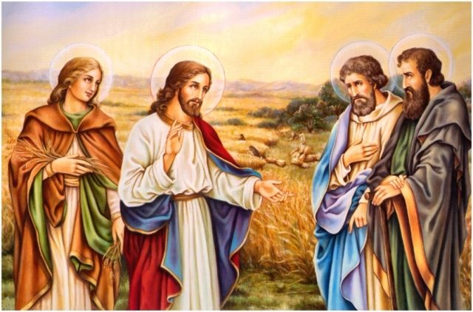
Conversation with Jesus
Focus on this image of Jesus and open your heart to Him now.
Take this opportunity to talk to him in your mind and heart.
Listen and be aware of his presence with you.
You may want to use this hymn to help you pray

Slide 17
Spiritual Journal
You may want to write down what has been important for you during this time together

Slide 18
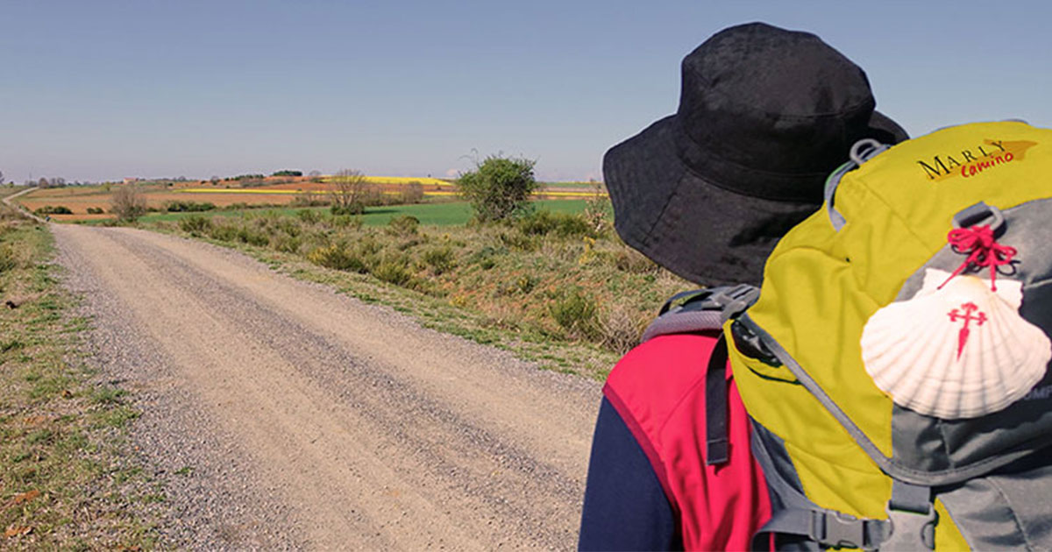
Rucksack Prayer – Part 2

Slide 19
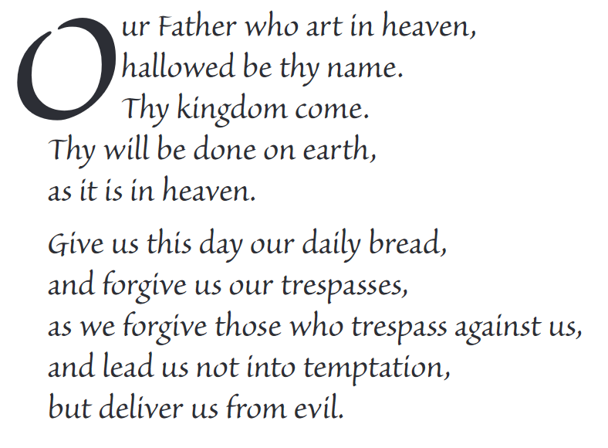
The Lord’s Prayer

Slide 20
Final pilgrim blessing for the week ahead
God of our pilgrimage,
you have given us a desire
to take the questing way
and set out on our journey.
Help us to keep our eyes fixed on Jesus,
that whatever we encounter as we travel,
we may seek to glorify you by the way we live.
You call us, Lord,
to leave familiar things and to leave our “comfort zone”.
May we open our eyes to new experiences,
may we open our ears to hear you speaking to us
and may we open our hearts to your love.
Grant that this time spent on pilgrimage
may help us to see ourselves as we really are
and may we strive to become the people you would have us be. Amen
… continued on next slide

Slide 21
Final pilgrim blessing for the week ahead
Lord, you know our beginning and our end.
Help us to realise we are only pilgrims on this earth
and save us from being too attached to worldly possessions.
May we experience the freedom to wander,
the freedom to hope and the freedom to love as we journey. Amen
Creator God, you are the source of all life and motivation.
May we journey in faith and love, rejoicing and eager to serve you.
Grant us a glimpse of your glory as we seek to follow you –
the Way, the Truth and the Life. Amen
May God the Father who created you, guide your footsteps,
May God the Son who redeemed you, share your journey,
May God the Holy Spirit who sanctifies you, lead you on life’s pilgrimage,
and the blessing of God, Father, Son and Holy Spirit
be with you wherever you may go. Amen.

Slide 22
CAMINO
Making the Journey…
Making the journey as a pilgrim to Santiago de Compostela

