Slide 1
CAMINO
Making the Journey…
Making the journey as a pilgrim to Walsingham

Slide 2
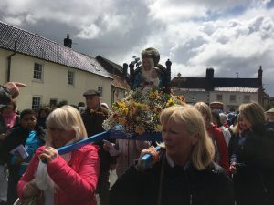
Introduction
At Walsingham, we share the journey that our Blessed Mother experienced at the Annunciation.
Walsingham is all about joy! The Pynson Ballad reminds us that the Virgin Mary wanted the Holy House to be built as a reminder of the joy she felt at the Annunciation when Christ became incarnate. This is what she desires for us: the fullness of joy that only God can give. A joy rooted in the Paschal Mystery, a joy that deepens as we die to self and live for Christ, thus allowing him to breath, speak, work, move and animate our whole being. A joy rooted in an authenticity of being as Christ becomes more and more incarnate in us.

Slide 3
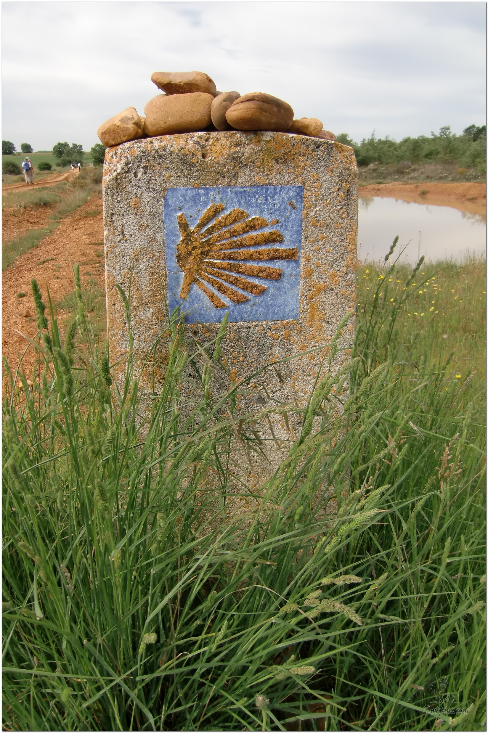
Opening Prayer
The Camino Prayer (adapted)
O God, who brought your servant Abraham out of the land of the Chaldeans, protecting him in his wanderings, who guided the Hebrew people across the desert, we ask that you watch over us, your servants, as we walk in the love of your name.
Be for us our companion on the journey,
Our guide at the crossroads, Our breath in our weariness,
Our protection in danger, our albergue on the Camino,
Our shade in the heat, Our light in the darkness,
Our consolation in our discouragements,
And our strength in our intentions.
So that with your guidance we may arrive safe and sound at the end of the road and enriched with grace and virtue we return safely to our homes filled with joy.
In the name of Jesus Christ our Lord, Amen. Apostle Santiago, pray for us. Santa Maria, pray for us.

Slide 4
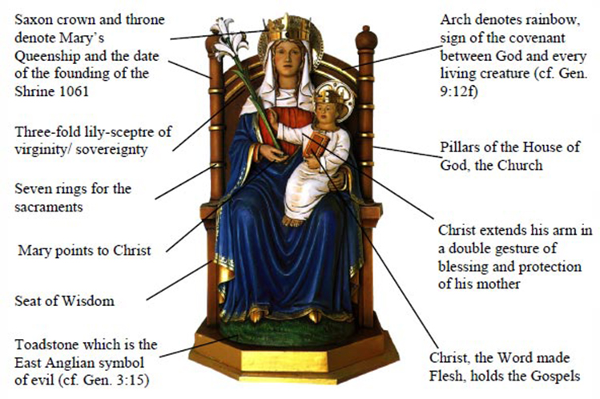
Catholicism in a Hundred Objects
This video is 11 minutes long so watch as much or as little as you like

Slide 5
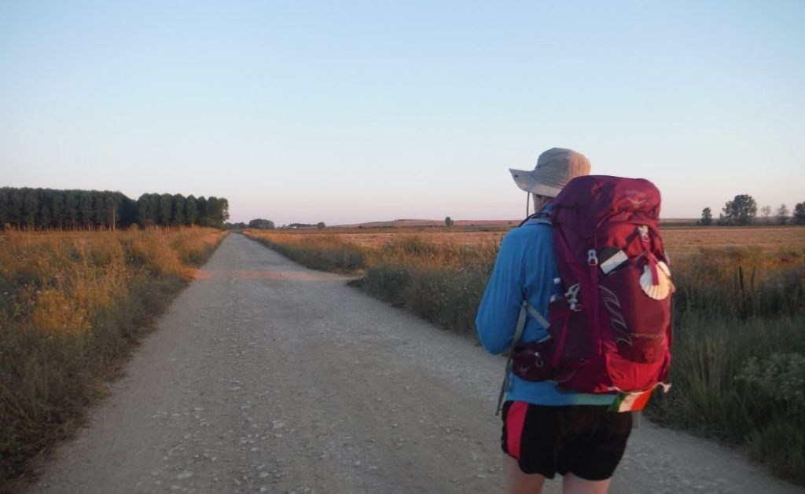
Rucksack Prayer – Part 1

Slide 6
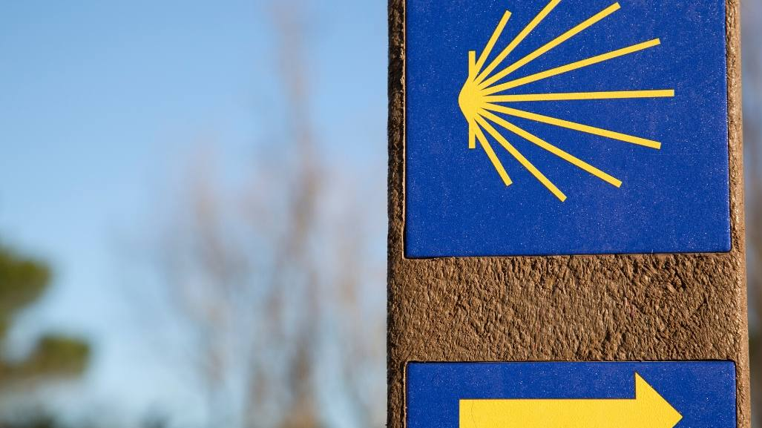
A Journey to Walsingham…

Slide 7
Scripture Reading - The Annunciation - Luke 1:26-38
In the sixth month the angel Gabriel was sent by God to a town in Galilee called Nazareth, to a virgin engaged to a man whose name was Joseph, of the house of David. The virgin's name was Mary. And he came to her and said, "Greetings, favoured one! The Lord is with you." But she was much perplexed by his words and pondered what sort of greeting this might be. The angel said to her, "Do not be afraid, Mary, for you have found favour with God. And now, you will conceive in your womb and bear a son, and you will name him Jesus. He will be great, and will be called the Son of the Most High, and the Lord God will give to him the throne of his ancestor David. He will reign over the house of Jacob forever, and of his kingdom there will be no end." Mary said to the angel, "How can this be, since I am a virgin?" The angel said to her, "The Holy Spirit will come upon you, and the power of the Most High will overshadow you; therefore the child to be born will be holy; he will be called Son of God. And now, your relative Elizabeth in her old age has also conceived a son; and this is the sixth month for her who was said to be barren. For nothing will be impossible with God." Then Mary said, "Here am I, the servant of the Lord; let it be with me according to your word." Then the angel departed from her.

Slide 8
From what you have heard so far…
…what are your Initial thoughts, reactions, questions that come to mind?
We can discuss these later…

Slide 9
Main Input
‘The Walsingham Way’ - Mgr John Armitage

Slide 10
Reflection
“All who are in any way distressed or in need, let them seek me there in that little house you have made in Walsingham. To all that seek me there shall be given help.”

Slide 11
Testimony
Abandon yourself in the hands of Mary. She will take care of you.

Slide 12
Catechism of the Catholic Church
967 By her complete adherence to the Father's will, to his Son's redemptive work, and to every prompting of the Holy Spirit, the Virgin Mary is the Church's model of faith and charity. Thus she is a "preeminent and … wholly unique member of the Church"; indeed, she is the "exemplary realization" (typus) of the Church. 968 Her role in relation to the Church and to all humanity goes still further. "In a wholly singular way she cooperated by her obedience, faith, hope, and burning charity in the Saviour's work of restoring supernatural life to souls. For this reason she is a mother to us in the order of grace." 969 "This motherhood of Mary in the order of grace continues uninterruptedly from the consent which she loyally gave at the Annunciation and which she sustained without wavering beneath the cross, until the eternal fulfillment of all the elect. Taken up to heaven she did not lay aside this saving office but by her manifold intercession continues to bring us the gifts of eternal salvation … Therefore the Blessed Virgin is invoked in the Church under the titles of Advocate, Helper, Benefactress, and Mediatrix." 970 "Mary's function as mother of men in no way obscures or diminishes this unique mediation of Christ, but rather shows its power. But the Blessed Virgin's salutary influence on men … flows forth from the superabundance of the merits of Christ, rests on his mediation, depends entirely on it, and draws all its power from it. "No creature could ever be counted along with the Incarnate Word and Redeemer; but just as the priesthood of Christ is shared in various ways both by his ministers and the faithful, and as the one goodness of God is radiated in different ways among his creatures, so also the unique mediation of the Redeemer does not exclude but rather gives rise to a manifold cooperation which is but a sharing in this one source."

Slide 13
Question
Why do Catholics call Mary their mother?

Slide 14
Discussion
What is the importance of pilgrimage?
Discuss this is two’s & three’s then feedback to the main group

Slide 15
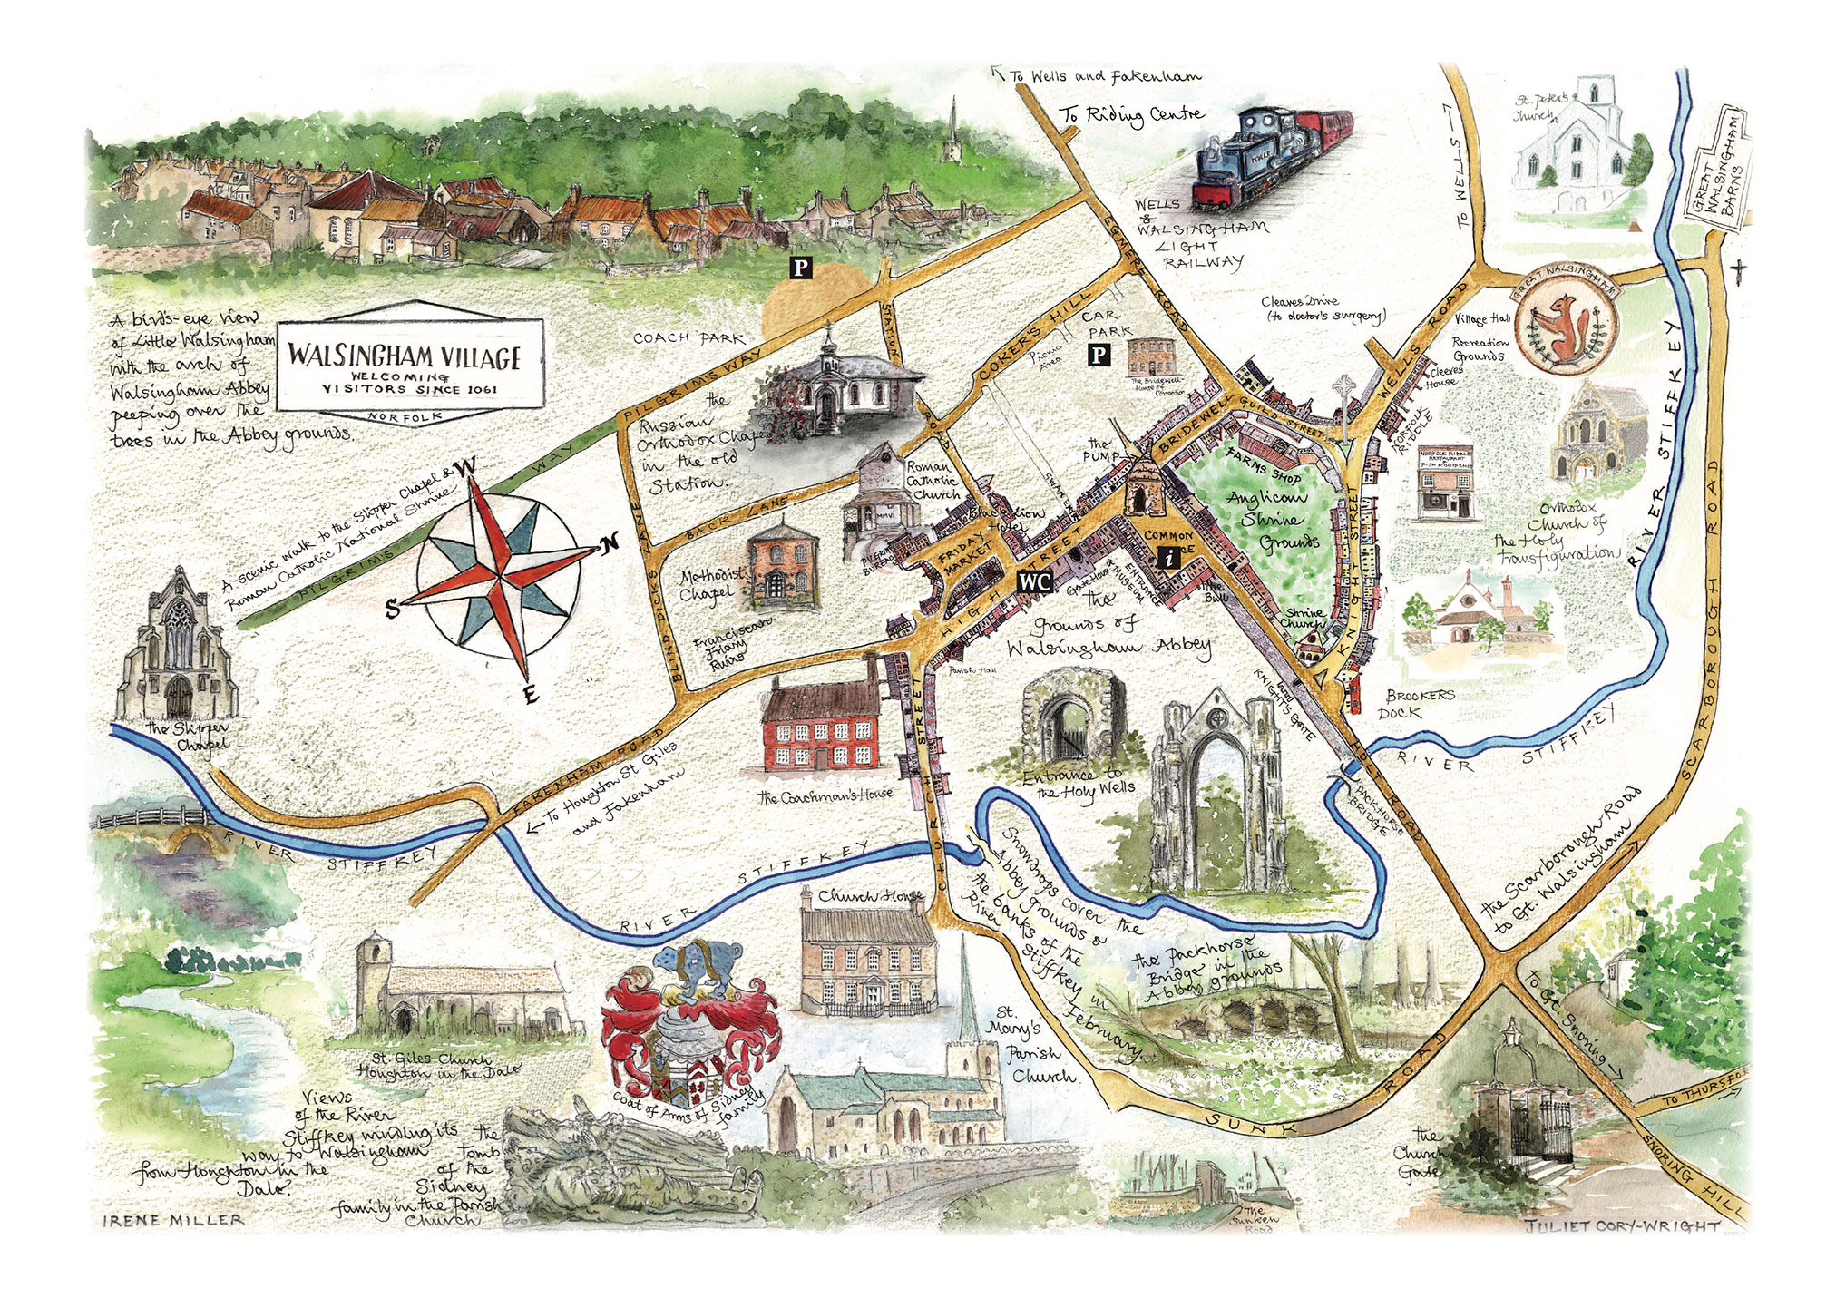
Internet Corner - Where to find out more…
www.walsingham.org.uk/
www.walsinghamway.blog/
www.walsinghamvillage.org/about/history-of-walsingham/

Slide 16
Conversation with Jesus
Focus on this image of Jesus and open your heart to Him now.
Take this opportunity to talk to him in your mind and heart.
Listen and be aware of his presence with you.
You may want to use this hymn to help you pray

Slide 17
Spiritual Journal
You may want to write down what has been important for you during this time together

Slide 18
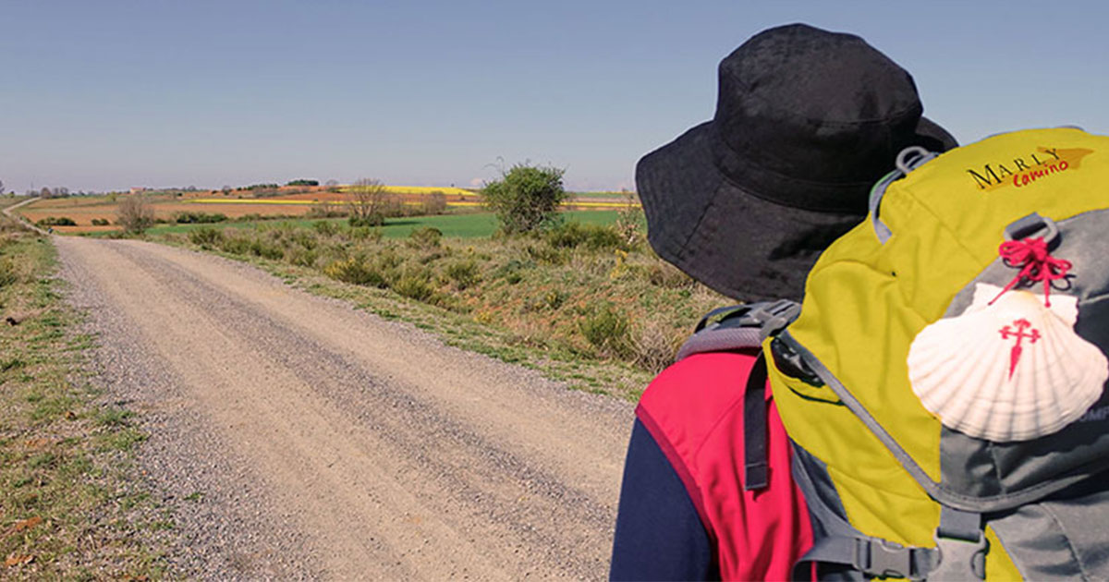
Rucksack Prayer – Part 2

Slide 19
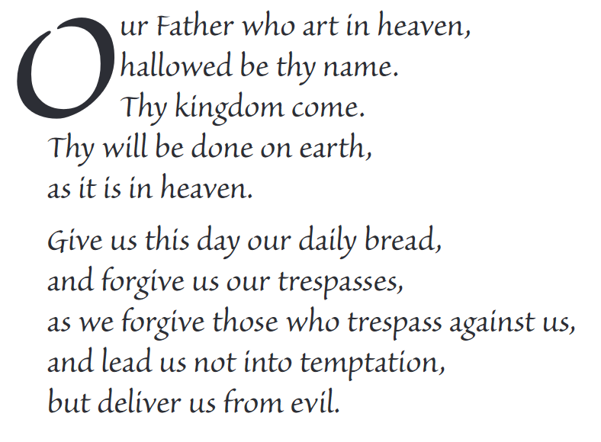
The Lord’s Prayer

Slide 20
Final pilgrim blessing for the week ahead
God of our pilgrimage,
you have given us a desire
to take the questing way
and set out on our journey.
Help us to keep our eyes fixed on Jesus,
that whatever we encounter as we travel,
we may seek to glorify you by the way we live.
You call us, Lord,
to leave familiar things and to leave our “comfort zone”.
May we open our eyes to new experiences,
may we open our ears to hear you speaking to us
and may we open our hearts to your love.
Grant that this time spent on pilgrimage
may help us to see ourselves as we really are
and may we strive to become the people you would have us be. Amen
… continued on next slide

Slide 21
Final pilgrim blessing for the week ahead
Lord, you know our beginning and our end.
Help us to realise we are only pilgrims on this earth
and save us from being too attached to worldly possessions.
May we experience the freedom to wander,
the freedom to hope and the freedom to love as we journey. Amen
Creator God, you are the source of all life and motivation.
May we journey in faith and love, rejoicing and eager to serve you.
Grant us a glimpse of your glory as we seek to follow you –
the Way, the Truth and the Life. Amen
May God the Father who created you, guide your footsteps,
May God the Son who redeemed you, share your journey,
May God the Holy Spirit who sanctifies you, lead you on life’s pilgrimage,
and the blessing of God, Father, Son and Holy Spirit
be with you wherever you may go. Amen.

Slide 22
CAMINO
Making the Journey…
Making the journey as a pilgrim to Walsingham

