Slide 1
CAMINO
Making the Journey…
Making the journey as a pilgrim to the Holy Land

Slide 2
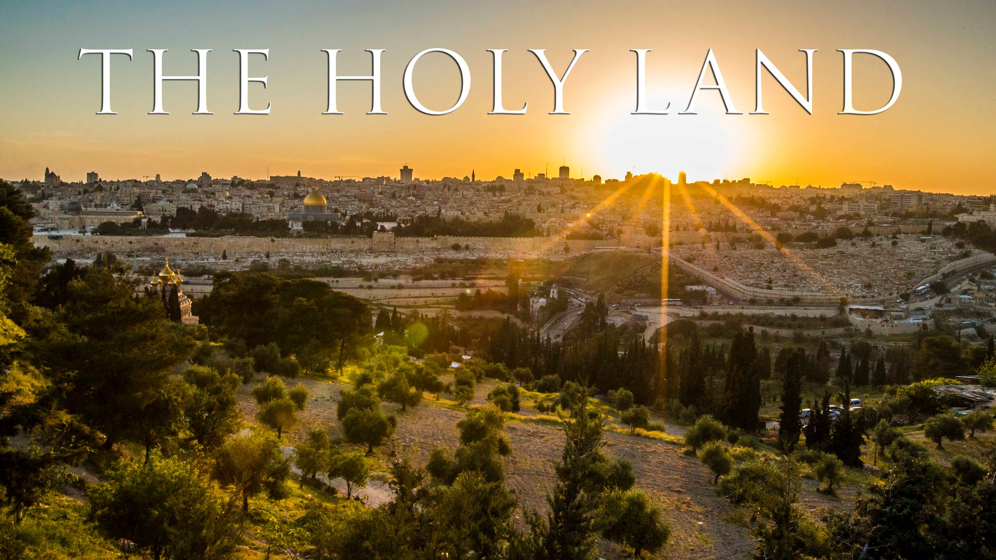
Introduction
Our Lord Jesus Christ was a pilgrim in the Holy Land. Now we ask him to lead and guide us in our lives.
We pray for the grace to keep our eyes focused on his will.
Lord, open our hearts, that we may find God in all we see and do and in each other. Let your words be alive within us and your Gospel in our hearts.
Give us a spirit of prayer, grace and love as we journey through life. Amen.

Slide 3
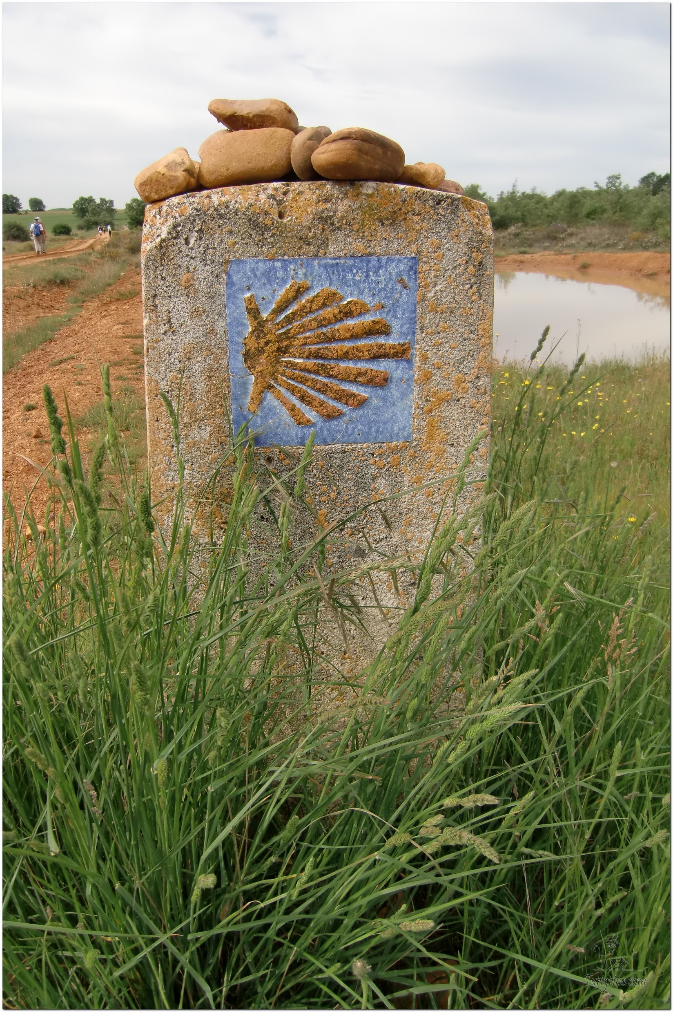
Opening Prayer
The Camino Prayer (adapted)
O God, who brought your servant Abraham out of the land of the Chaldeans, protecting him in his wanderings, who guided the Hebrew people across the desert, we ask that you watch over us, your servants, as we walk in the love of your name.
Be for us our companion on the journey,
Our guide at the crossroads, Our breath in our weariness,
Our protection in danger, our albergue on the Camino,
Our shade in the heat, Our light in the darkness,
Our consolation in our discouragements,
And our strength in our intentions.
So that with your guidance we may arrive safe and sound at the end of the road and enriched with grace and virtue we return safely to our homes filled with joy.
In the name of Jesus Christ our Lord, Amen. Apostle Santiago, pray for us. Santa Maria, pray for us.

Slide 4
Catholicism in a Hundred Objects
This Photo by Unknown Author is licensed under CC BY-NC

Slide 5
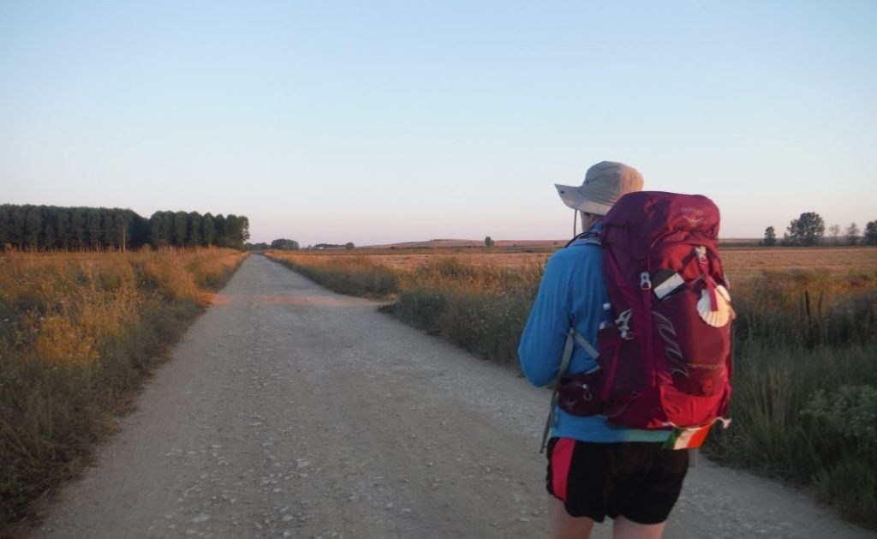
Rucksack Prayer – Part 1

Slide 6
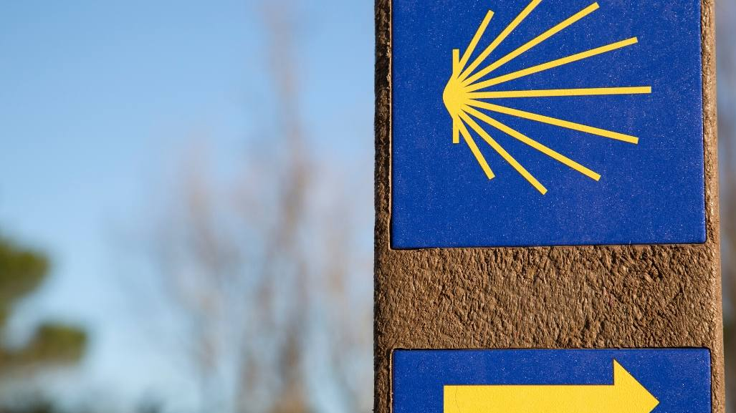
Making the journey to the Holy Land
Intro video here

Slide 7
Scripture Reading – John 21:1-14
Afterward Jesus appeared again to his disciples, by the Sea of Galilee. It happened this way: Simon Peter, Thomas (also known as Didymus ), Nathanael from Cana in Galilee, the sons of Zebedee, and two other disciples were together. “I’m going out to fish,” Simon Peter told them, and they said, “We’ll go with you.” So they went out and got into the boat, but that night they caught nothing. Early in the morning, Jesus stood on the shore, but the disciples did not realize that it was Jesus. He called out to them, “Friends, haven’t you any fish?” “No,” they answered. He said, “Throw your net on the right side of the boat and you will find some.” When they did, they were unable to haul the net in because of the large number of fish. Then the disciple whom Jesus loved said to Peter, “It is the Lord!” As soon as Simon Peter heard him say, “It is the Lord,” he wrapped his outer garment around him (for he had taken it off) and jumped into the water. The other disciples followed in the boat, towing the net full of fish, for they were not far from shore, about a hundred yards. When they landed, they saw a fire of burning coals there with fish on it, and some bread. Jesus said to them, “Bring some of the fish you have just caught.” So Simon Peter climbed back into the boat and dragged the net ashore. It was full of large fish, 153, but even with so many the net was not torn. Jesus said to them, “Come and have breakfast.” None of the disciples dared ask him, “Who are you?” They knew it was the Lord. Jesus came, took the bread and gave it to them, and did the same with the fish. This was now the third time Jesus appeared to his disciples after he was raised from the dead.

Slide 8
From what you have heard so far…
…what are your Initial thoughts, reactions, questions that come to mind?
We can discuss these later…

Slide 9
Main Input

Slide 10
Reflection
“In the wilderness prepare the way of the Lord; make straight in the desert a highway for our God.” Isaiah 40:3

Slide 11
What is a pilgrimage?

Slide 12
Catechism of the Catholic Church
574 From the beginning of Jesus' public ministry, certain Pharisees and partisans of Herod together with priests and scribes agreed together to destroy him. Because of certain acts of his expelling demons, forgiving sins, healing on the sabbath day, his novel interpretation of the precepts of the Law regarding purity, and his familiarity with tax collectors and public sinners--some ill-intentioned persons suspected Jesus of demonic possession. He is accused of blasphemy and false prophecy, religious crimes which the Law punished with death by stoning.
575 Many of Jesus' deeds and words constituted a "sign of contradiction", but more so for the religious authorities in Jerusalem, whom the Gospel according to John often calls simply "the Jews", than for the ordinary People of God. To be sure, Christ's relations with the Pharisees were not exclusively polemical. Some Pharisees warn him of the danger he was courting; Jesus praises some of them, like the scribe of Mark 12:34, and dines several times at their homes. Jesus endorses some of the teachings imparted by this religious elite of God's people: the resurrection of the dead, certain forms of piety (almsgiving, fasting and prayer), The custom of addressing God as Father, and the centrality of the commandment to love God and neighbour.
576 In the eyes of many in Israel, Jesus seems to be acting against essential institutions of the Chosen People: - submission to the whole of the Law in its written commandments and, for the Pharisees, in the interpretation of oral tradition; - the centrality of the Temple at Jerusalem as the holy place where God's presence dwells in a special way; - faith in the one God whose glory no man can share.

Slide 13
Discussion
What is the importance of the Holy Land to us as Christians?
Discuss this is two’s & three’s then feedback to the main group

Slide 14
Internet Corner - Where to find out more…
thecatholictravelguide.com/destinations/holy-land/
cnewa.org/magazine/early-christianity-in-the-holy-land-an-emerging-view-30502/

Slide 15
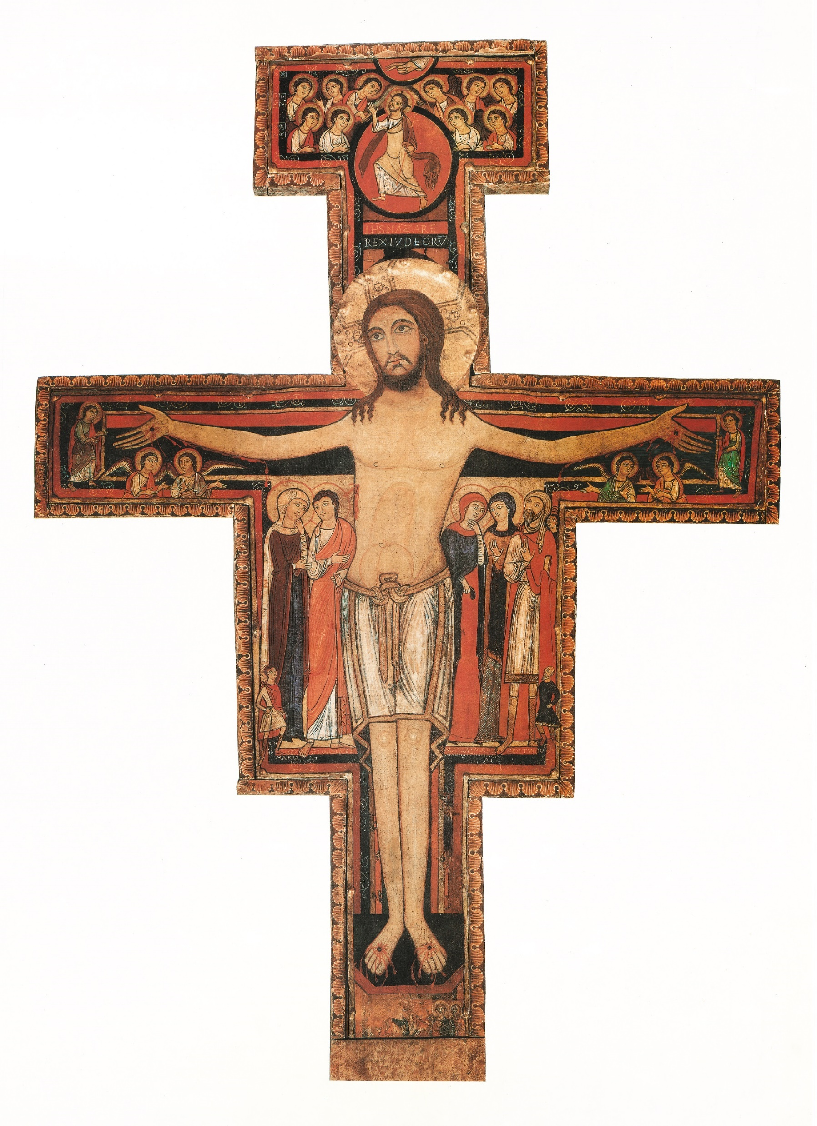
Conversation with Jesus
Focus on this image of Jesus and open your heart to Him now.
Take this opportunity to talk to him in your mind and heart.
Listen and be aware of his presence with you.
You may want to use this hymn to help you pray

Slide 16
Spiritual Journal
You may want to write down what has been important for you during this time together

Slide 17
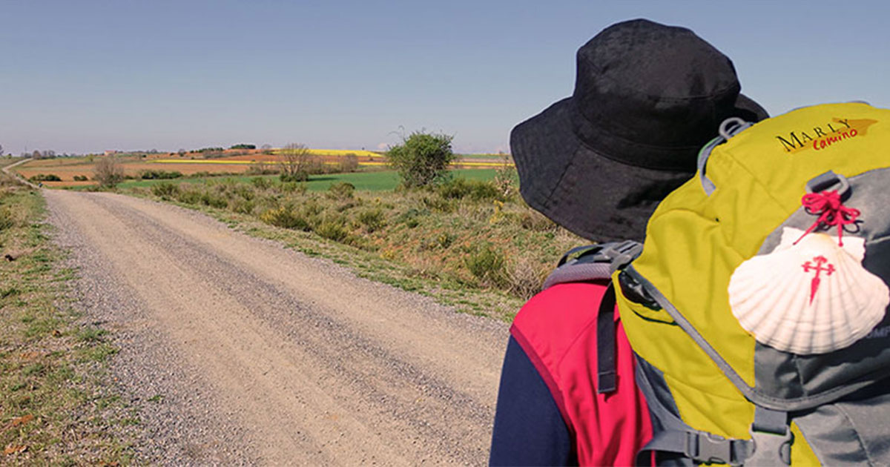
Rucksack Prayer – Part 2

Slide 18
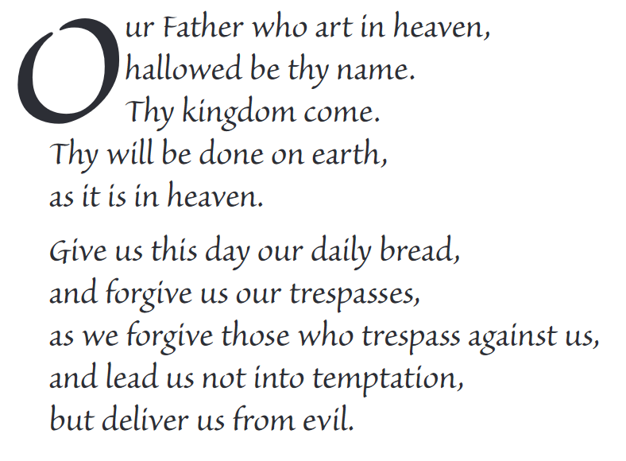
The Lord’s Prayer

Slide 19
Final pilgrim blessing for the week ahead
God of our pilgrimage,
you have given us a desire
to take the questing way
and set out on our journey.
Help us to keep our eyes fixed on Jesus,
that whatever we encounter as we travel,
we may seek to glorify you by the way we live.
You call us, Lord,
to leave familiar things and to leave our “comfort zone”.
May we open our eyes to new experiences,
may we open our ears to hear you speaking to us
and may we open our hearts to your love.
Grant that this time spent on pilgrimage
may help us to see ourselves as we really are
and may we strive to become the people you would have us be. Amen
… continued on next slide

Slide 20
Final pilgrim blessing for the week ahead
Lord, you know our beginning and our end.
Help us to realise we are only pilgrims on this earth
and save us from being too attached to worldly possessions.
May we experience the freedom to wander,
the freedom to hope and the freedom to love as we journey. Amen
Creator God, you are the source of all life and motivation.
May we journey in faith and love, rejoicing and eager to serve you.
Grant us a glimpse of your glory as we seek to follow you –
the Way, the Truth and the Life. Amen
May God the Father who created you, guide your footsteps,
May God the Son who redeemed you, share your journey,
May God the Holy Spirit who sanctifies you, lead you on life’s pilgrimage,
and the blessing of God, Father, Son and Holy Spirit
be with you wherever you may go. Amen.

Slide 21
CAMINO
Making the Journey…
Making the journey as a pilgrim to the Holy Land

