Slide 1
CAMINO
Making the Journey…
Making the journey as a pilgrim to Lourdes

Slide 2
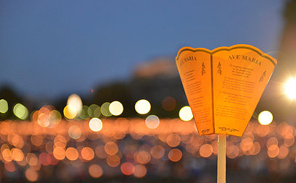
Introduction
The Virgin Mary appeared in a series of 18 apparitions to Bernadette Soubirous beginning in 1858.
Since then, pilgrims have visited Lourdes on pilgrimage, to renew and strengthen faith, gain a sense of purpose and think about their lives, to seek solutions or gain strength and guidance in times of difficulty or distress.
Many sick pilgrims bathe in the healing waters of the spring and find peace with their prognosis rather than to seek a miraculous cure.
‘Lourdes brings people together, young and old, disabled or able-bodied, rich and poor, with a shared experience of faith where everyone is accepted.’

Slide 3
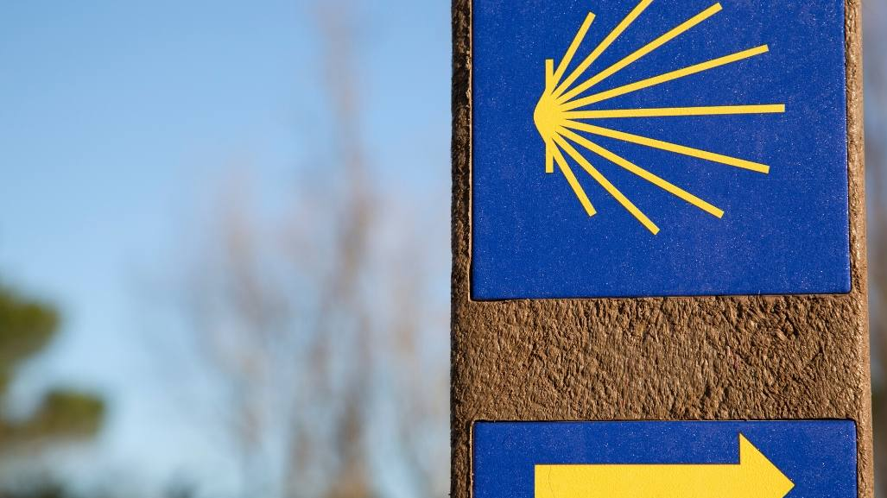
Introduction

Slide 4
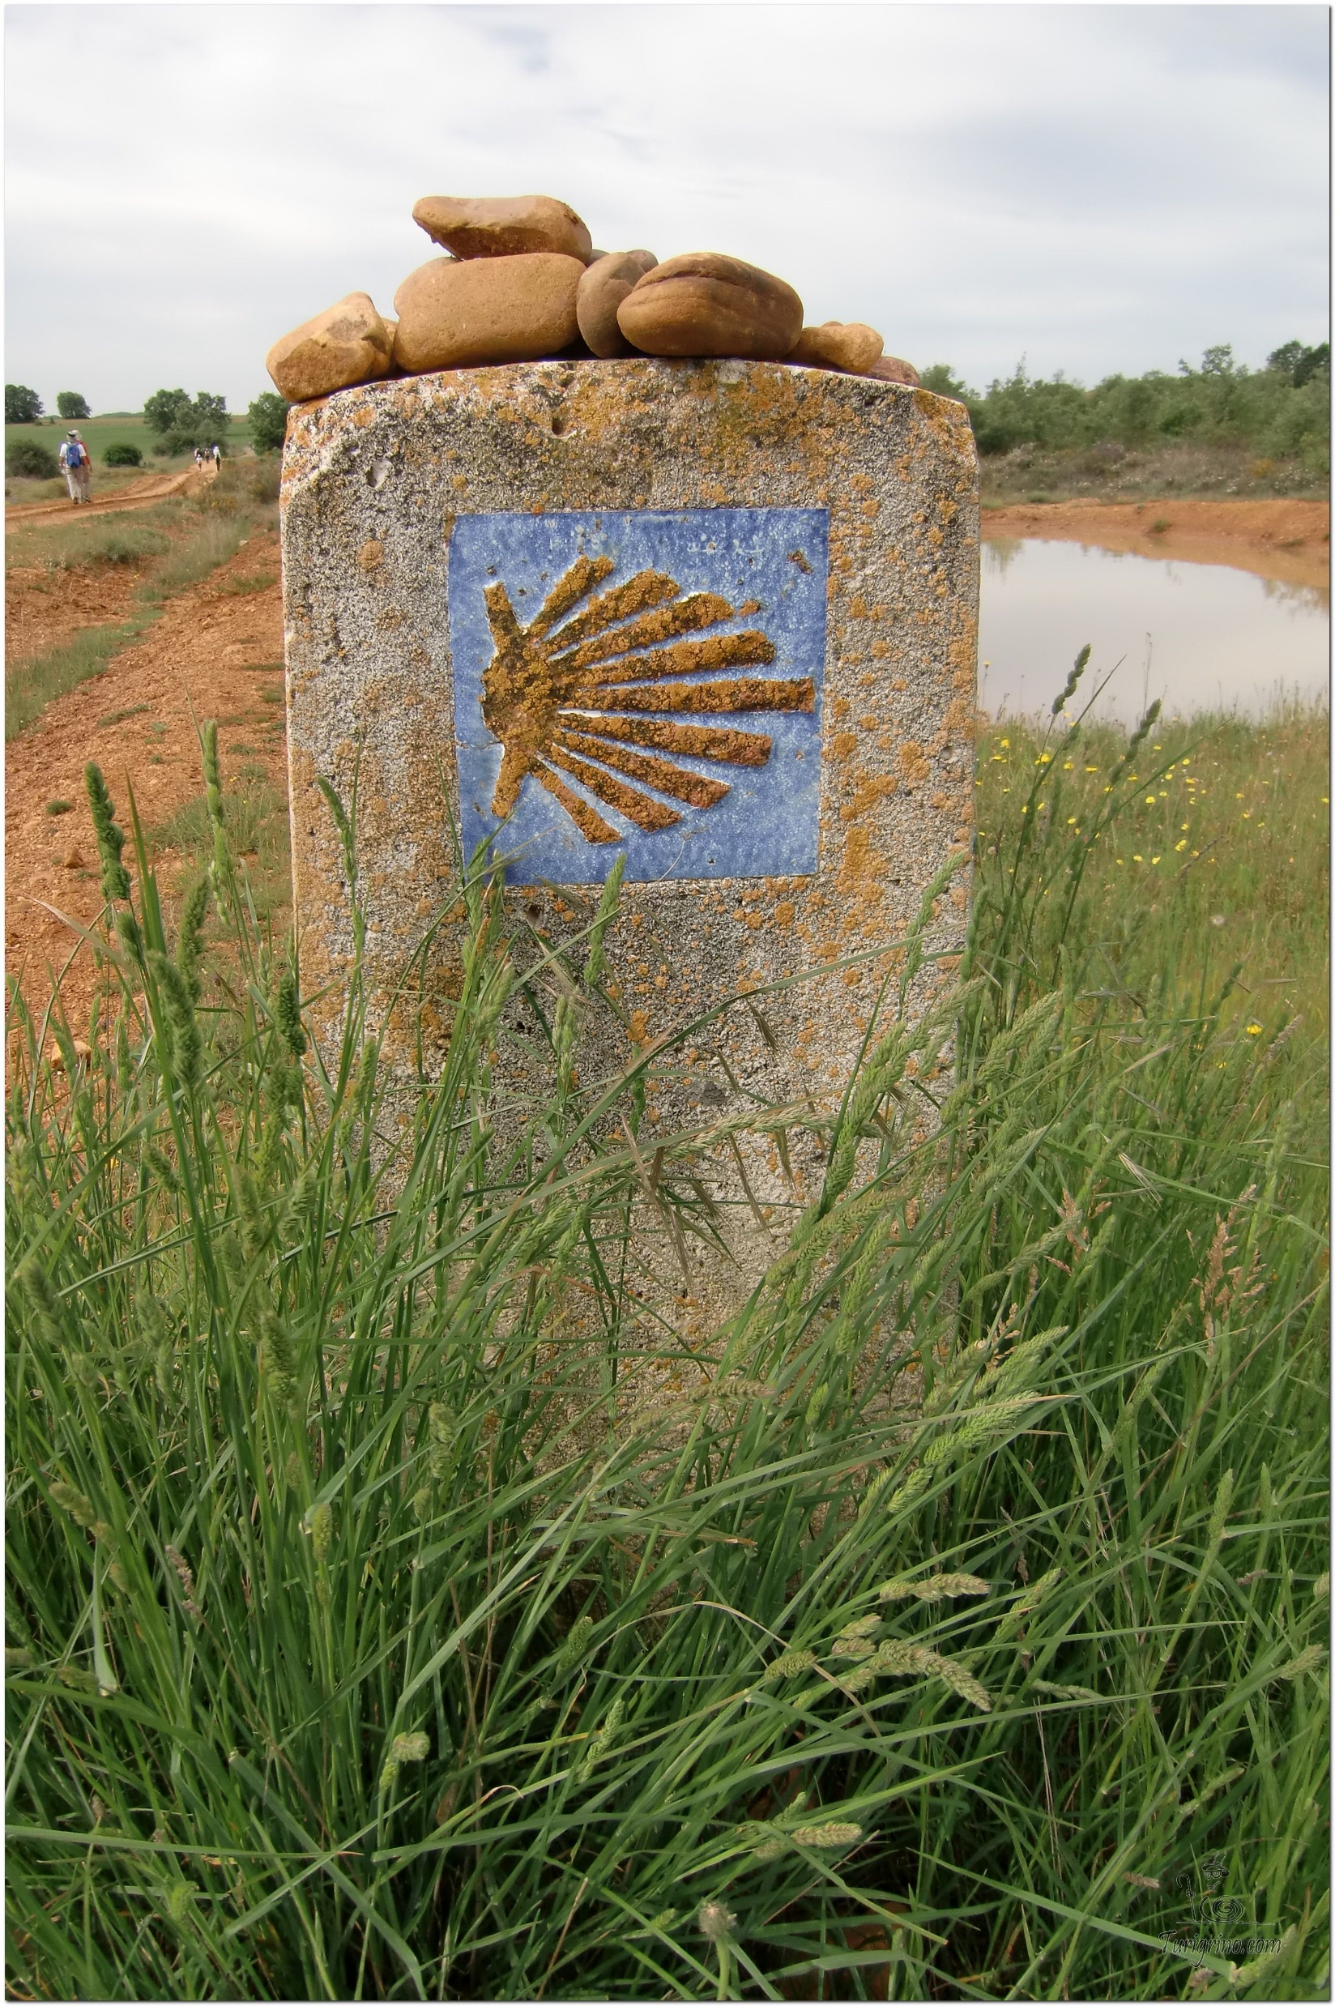
Opening Prayer
Prayer to Our Lady of Lourdes (adapted)
Oh ever immaculate Virgin, Mother of Mercy, Health of the Sick, Refuge of Sinners, Comforter of the Afflicted, you know my wants, my troubles, my sufferings. Look upon me with mercy.
When you appeared in the grotto of Lourdes, you made it a privileged Sanctuary where you dispense your favours, and where many sufferers have obtained the cure of their infirmities, both spiritual and physical.
I come, therefore, with unbounded confidence to implore your maternal intercession. My loving Mother, obtain my request. I will try to imitate your virtues so that I may one day share your company and bless you in eternity. Amen.
Our Lady of Lourdes, pray for us.
Saint Bernadette, pray for us.

Slide 5
True or False?
Was Mary preserved from the stain of original sin?

Slide 6
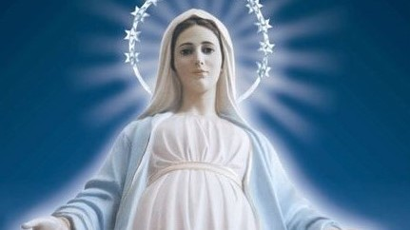
True!
‘The Immaculate Conception means that from the first moment of her existence, Mary's soul was preserved from the effects of the fall of Adam and Eve. As a result, she was "full of grace" right from the start. This special gift was given to her on the basis of the merits of the life, death, and Resurrection of Jesus Christ. Since God exists beyond all time, and all times are present before Him, He can apply the graces of Christ's redemptive work to people living at any time in human history. It was on this basis that He poured out graces upon the patriarchs and prophets even before the coming of the Saviour. He did so for Mary, too, but uniquely, in her case, right from the first moment of her existence’. Father Adolf Faroni

Slide 7
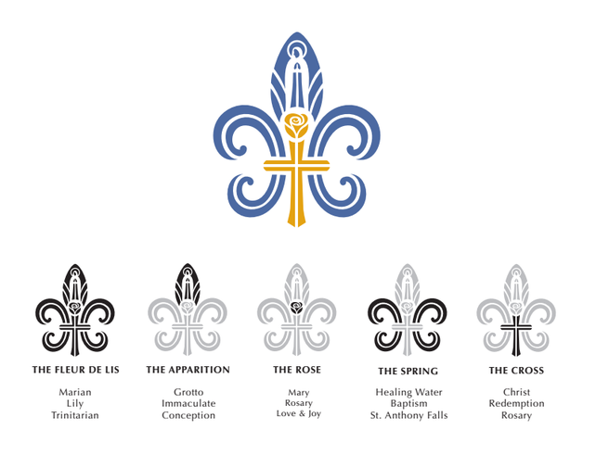
Catholicism in a Hundred Objects
The Fleur de Lis – the symbol for Mary the Mother of God

Slide 8
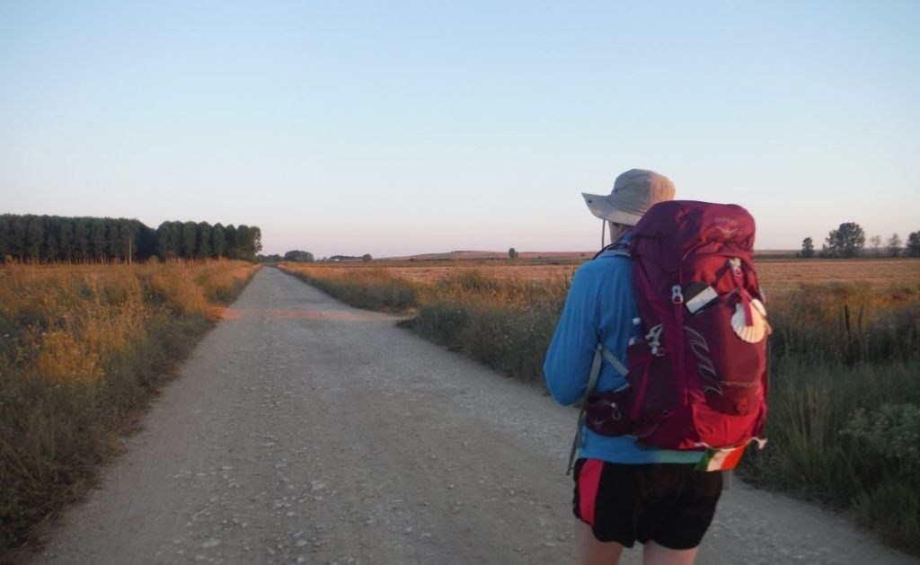
Rucksack Prayer – Part 1

Slide 9
Scripture Reading - - Luke 1:26-38
In the sixth month, the angel Gabriel was sent by God to a town in Galilee called Nazareth, to a virgin engaged to a man whose name was Joseph, of the house of David.
The virgin's name was Mary. And he came to her and said, "Greetings, favoured one! The Lord is with you." But she was much perplexed by his words and pondered what sort of greeting this might be. The angel said to her, "Do not be afraid, Mary, for you have found favour with God. And now, you will conceive in your womb and bear a son, and you will name him Jesus. He will be great, and will be called the Son of the Most High, and the Lord God will give to him the throne of his ancestor David. He will reign over the house of Jacob forever, and of his kingdom there will be no end."
Mary said to the angel, "How can this be, since I am a virgin?" The angel said to her, "The Holy Spirit will come upon you, and the power of the Most High will overshadow you; therefore the child to be born will be holy; he will be called Son of God. And now, your relative Elizabeth in her old age has also conceived a son; and this is the sixth month for her who was said to be barren. For nothing will be impossible with God."
Then Mary said, "Here am I, the servant of the Lord; let it be with me according to your word." Then the angel departed from her.

Slide 10
From what you have heard so far…
…what are your Initial thoughts, reactions, questions that come to mind?
We can discuss these later…

Slide 11
Lourdes and the Immaculate Conception
"If one dream should fall and break into a thousand pieces... never be afraid to pick one of those pieces up and begin again. That's the beauty of being alive... We can always start all over again. Enjoy God's amazing opportunities bestowed on us. Have faith in Him always."
St Bernadette Soubirous (Lourdes)

Slide 12
Reflection
As you listen to this song of praise, you may like to reflect on the promise made by Our Lady of Lourdes, to Bernadette.
“I do not promise to make you happy in this world, but in the other”.

Slide 13
Testimony
Salford Diocesan Pilgrims and volunteers

Slide 14
Catechism of the Catholic Church
508 From among the descendants of Eve, God chose the Virgin Mary to be the mother of his Son. "Full of grace," Mary is "the most excellent fruit of redemption" (SC 103): from the first instant of her conception, she was totally preserved from the stain of original sin and she remained pure from all personal sin throughout her life. 509 Mary is truly "Mother of God" since she is the mother of the eternal Son of God made man, who is God himself. 510 Mary "remained a virgin in conceiving her Son, a virgin in giving birth to him, a virgin in carrying him, a virgin in nursing him at her breast, always a virgin" (St. Augustine, Serm. 186, 1: PL 38, 999): with her whole being she is "the handmaid of the Lord" (Lk 1:38). 511 The Virgin Mary "cooperated through free faith and obedience in human salvation" (LG 56). She uttered her yes "in the name of all human nature" (St. Thomas Aquinas, Sth III, 30, 1). By her obedience she became the new Eve, mother of the living.

Slide 15
Why does Mary have so many titles?

Slide 16
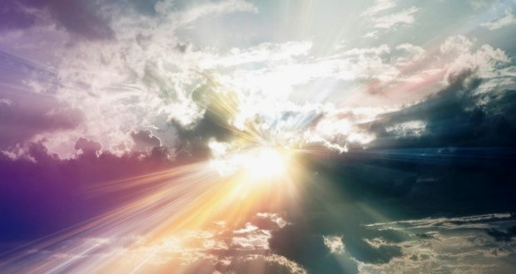
Discussion
Our Lady of Lourdes spoke to St. Bernadette about the next world. Do I prioritize the things of this world or the next? What is most important to me in my life?
Discuss this is two’s & three’s then feedback to the main group

Slide 17
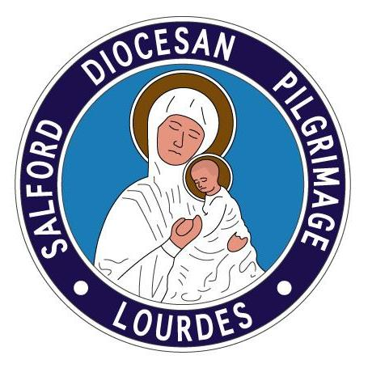
Internet Corner - Where to find out more…
www.lourdes-france.org/en/
www.salfordlourdes.co.uk/
www.en.lourdes-infotourisme.com/

Slide 18
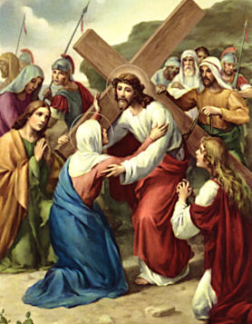
Conversation with Jesus
Focus on this image of Jesus and open your heart to Him now.
Take this opportunity to talk to him in your mind and heart.
Listen and be aware of his presence with you.
You may want to use this hymn to help you pray

Slide 19
Spiritual Journal
You may want to write down what has been important for you during this time together

Slide 20
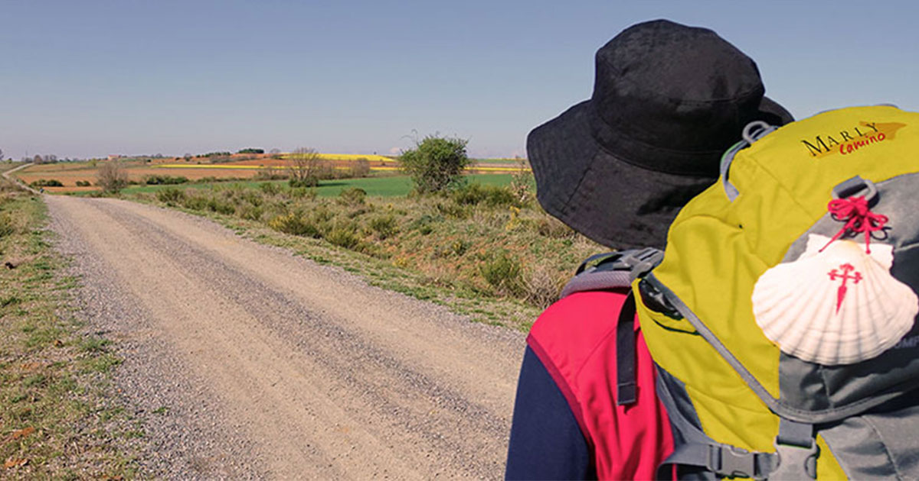
Rucksack Prayer – Part 2

Slide 21
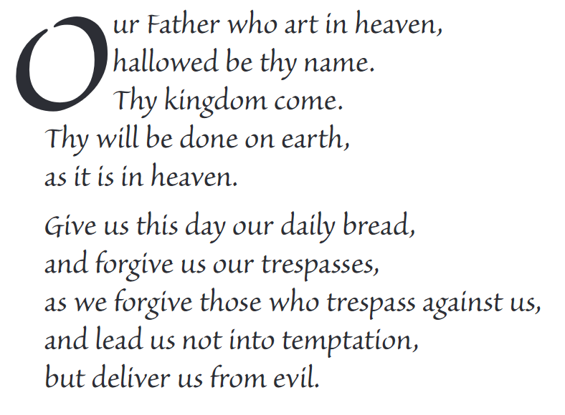
The Lord’s Prayer

Slide 22
Final pilgrim blessing for the week ahead
God of our pilgrimage,
you have given us a desire
to take the questing way
and set out on our journey.
Help us to keep our eyes fixed on Jesus,
that whatever we encounter as we travel,
we may seek to glorify you by the way we live.
You call us, Lord,
to leave familiar things and to leave our “comfort zone”.
May we open our eyes to new experiences,
may we open our ears to hear you speaking to us
and may we open our hearts to your love.
Grant that this time spent on pilgrimage
may help us to see ourselves as we really are
and may we strive to become the people you would have us be. Amen
… continued on next slide

Slide 23
Final pilgrim blessing for the week ahead
Lord, you know our beginning and our end.
Help us to realise we are only pilgrims on this earth
and save us from being too attached to worldly possessions.
May we experience the freedom to wander,
the freedom to hope and the freedom to love as we journey. Amen
Creator God, you are the source of all life and motivation.
May we journey in faith and love, rejoicing and eager to serve you.
Grant us a glimpse of your glory as we seek to follow you –
the Way, the Truth and the Life. Amen
May God the Father who created you, guide your footsteps,
May God the Son who redeemed you, share your journey,
May God the Holy Spirit who sanctifies you, lead you on life’s pilgrimage,
and the blessing of God, Father, Son and Holy Spirit
be with you wherever you may go. Amen.

Slide 24
CAMINO
Making the Journey…
Making the journey as a pilgrim to Lourdes

