Slide 1
CAMINO
Making the Journey…
Session 1
Making the journey as a pilgrim - Creation

Slide 2
Introduction
This first step is an opportunity to understand yourself and everything in the World as part of God’s creation. This contrasts with a view of a random universe with no meaning and purpose in it. It doesn’t dismiss science but rather sees it as a way of understanding God’s creation. If we see ourselves as created by God it gives us a sense of purpose and belonging and allows us to see life itself as a pilgrimage.

Slide 3
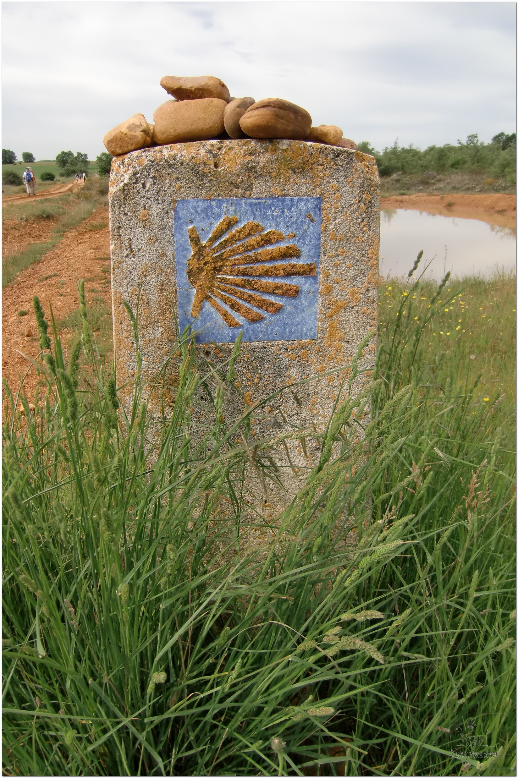
Opening Prayer
The Camino Prayer (adapted)
O God, who brought your servant Abraham out of the land of the Chaldeans, protecting him in his wanderings, who guided the Hebrew people across the desert, we ask that you watch over us, your servants, as we walk in the love of your name.
Be for us our companion on the journey,
Our guide at the crossroads, Our breath in our weariness,
Our protection in danger, our albergue on the Camino,
Our shade in the heat, Our light in the darkness,
Our consolation in our discouragements,
And our strength in our intentions.
So that with your guidance we may arrive safe and sound at the end of the road and enriched with grace and virtue we return safely to our homes filled with joy.
In the name of Jesus Christ our Lord, Amen. Apostle Santiago, pray for us. Santa Maria, pray for us.

Slide 4
True or False?
A Catholic priest came up with the ‘Big Bang’ theory

Slide 5
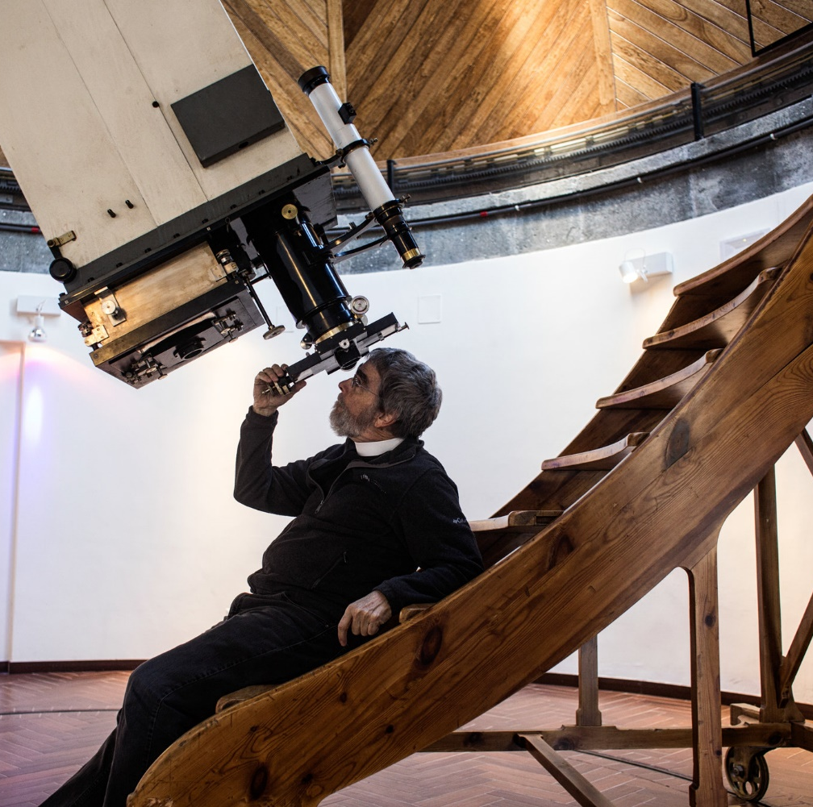
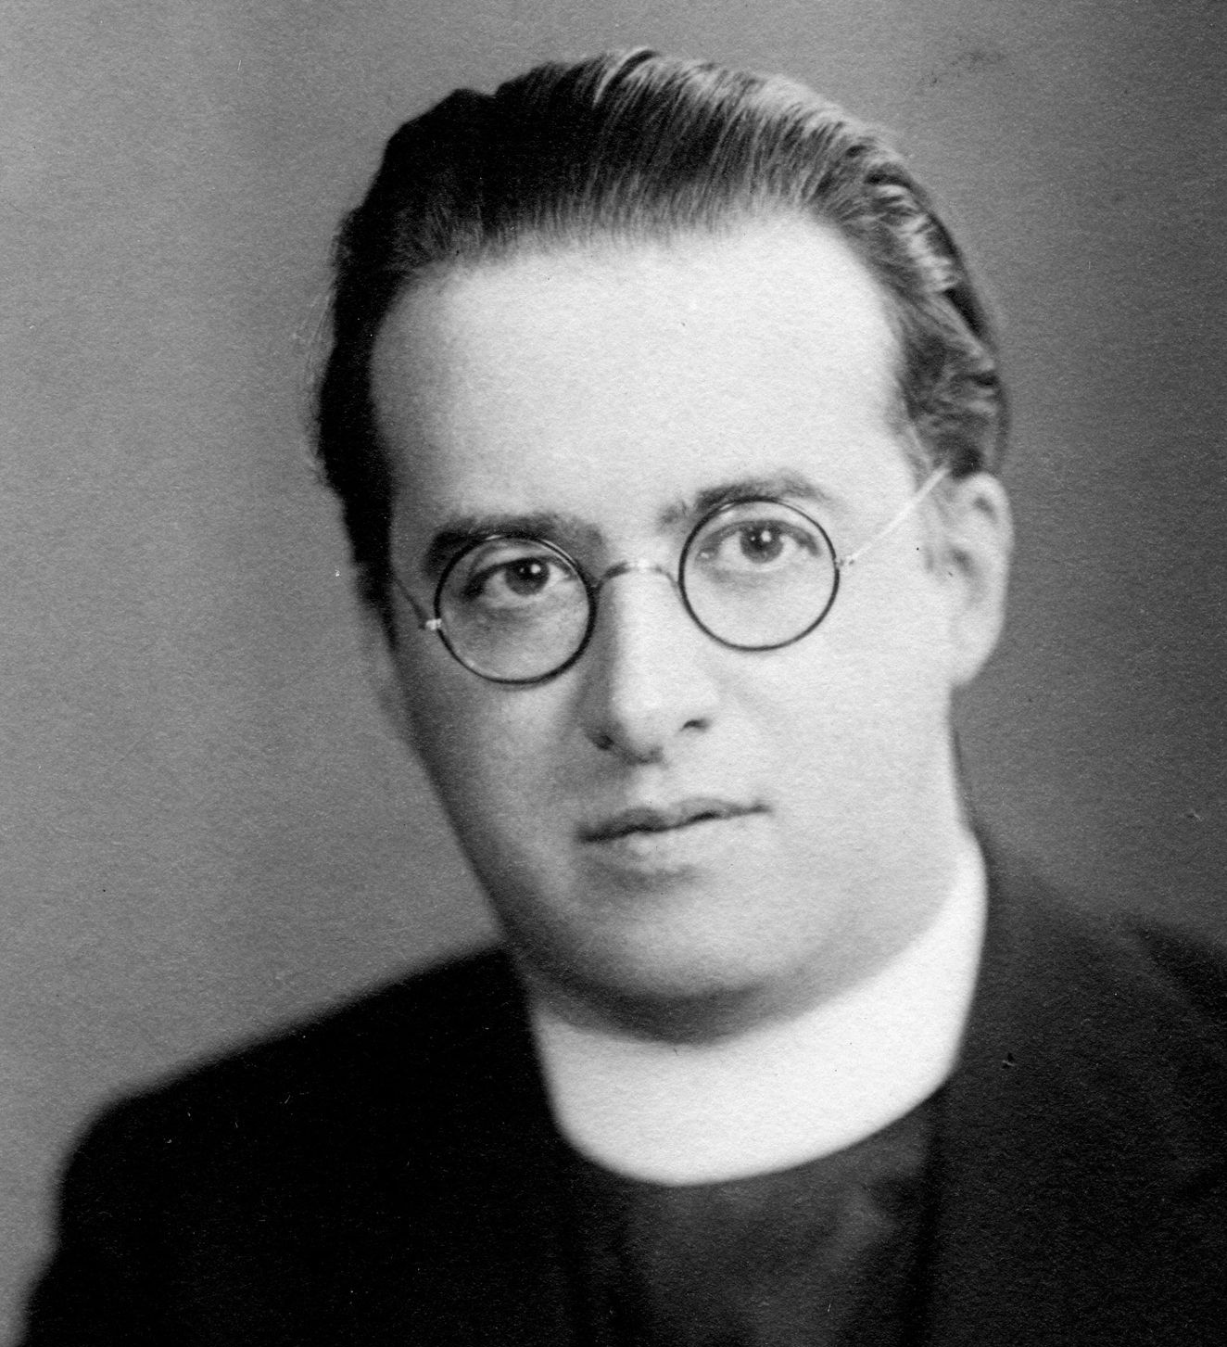
True!
This startling idea first appeared in scientific form in 1931, in a paper by Fr Georges Lemaître, a Belgian cosmologist and Catholic priest. The theory, accepted by nearly all astronomers today, was a radical departure from scientific orthodoxy in the 1930s. In fact, the Vatican has had it’s head in the stars for years with it’s own astronomy telescope.

Slide 6
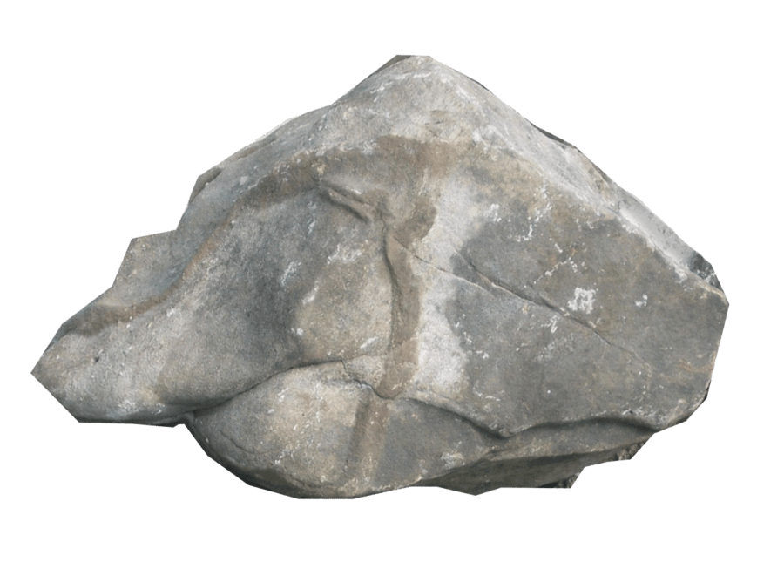
Catholicism in a Hundred Objects
This video is 25 minutes long so watch as much or as little as you like
Object 1 – A Rock symbolising God’s creation

Slide 7
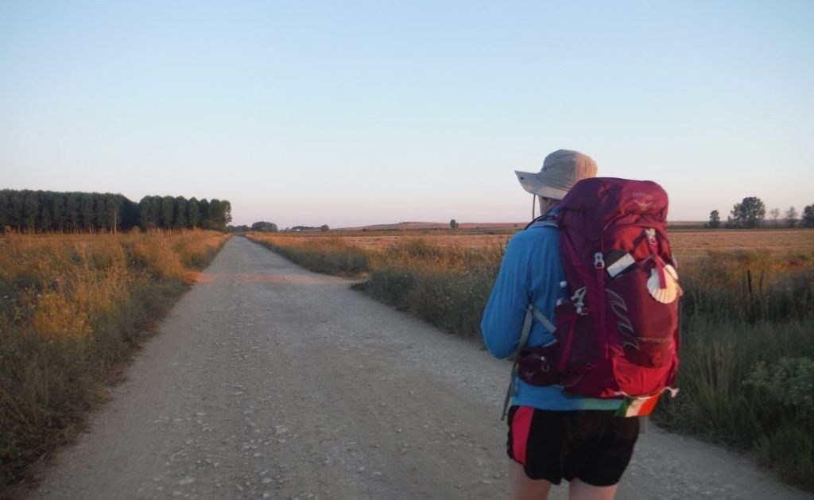
Rucksack Prayer – Part 1

Slide 8
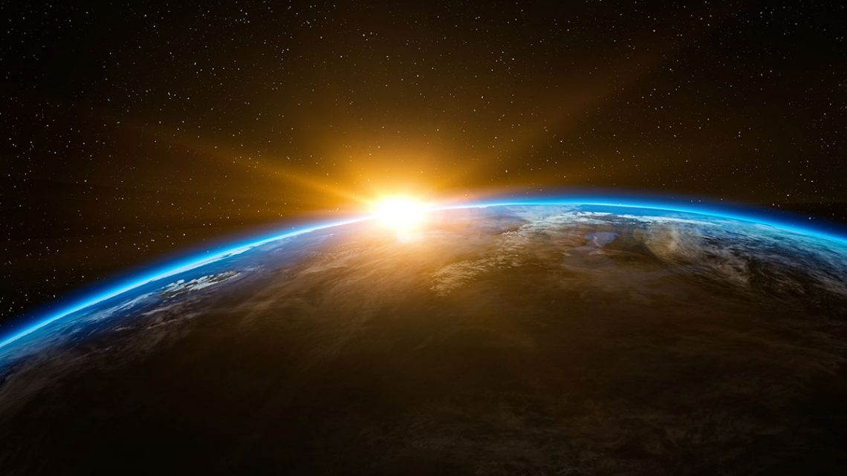
Scripture Reading – Story of Creation - Genesis 1:1-2:2
In the beginning God created the heavens and the earth. Now the earth was a formless void, there was darkness over the deep, and God’s spirit hovered over the water.
God said, ‘Let there be light’, and there was light. God saw that light was good, and God divided light from darkness. God called light ‘day’, and darkness he called ‘night.’ Evening came and morning came: the first day.
God said, ‘Let there be a vault in the waters to divide the waters in two.’ And so it was. God made the vault, and it divided the waters above the vault from the waters under the vault. God called the vault ‘heaven.’ Evening came and morning came: the second day.
God said, ‘Let the waters under heaven come together into a single mass, and let dry land appear.’ And so it was. God called the dry land ‘earth’ and the mass of waters ‘seas’, and God saw that it was good.
God said, ‘Let the earth produce vegetation: seed-bearing plants, and fruit trees bearing fruit with their seed inside, on the earth.’ And so it was. The earth produced vegetation: plants bearing seed in their several kinds, and trees bearing fruit with their seed inside in their several kinds. God saw that it was good. Evening came and morning came: the third day.
God said, ‘Let there be lights in the vault of heaven to divide day from night, and let them indicate festivals, days and years. Let them be lights in the vault of heaven to shine on the earth.’ And so it was. God made the two great lights: the greater light to govern the day, the smaller light to govern the night, and the stars. God set them in the vault of heaven to shine on the earth, to govern the day and the night and to divide light from darkness. God saw that it was good. Evening came and morning came: the fourth day.
God said, ‘Let the waters teem with living creatures, and let birds fly above the earth within the vault of heaven.’ And so it was. God created great sea-serpents and every kind of living creature with which the waters teem, and every kind of winged creature. God saw that it was good. God blessed them, saying, ‘Be fruitful, multiply, and fill the waters of the seas; and let the birds multiply upon the earth.’
… continued on next slide

Slide 9
Evening came and morning came: the fifth day.
God said, ‘Let the earth produce every kind of living creature: cattle, reptiles, and every kind of wild beast.’ And so it was. God made every kind of wild beast, every kind of cattle, and every kind of land reptile. God saw that it was good.
God said, ‘Let us make man in our own image, in the likeness of ourselves, and let them be masters of the fish of the sea, the birds of heaven, the cattle, all the wild beasts and all the reptiles that crawl upon the earth.’
God created man in the image of himself,
in the image of God he created him,
male and female he created them.
God blessed them, saying to them, ‘Be fruitful, multiply, fill the earth and conquer it. Be masters of the fish of the sea, the birds of heaven and all living animals on the earth.’ God said, ‘See, I give you all the seed-bearing plants that are upon the whole earth, and all the trees with seed-bearing fruit; this shall be your food. To all wild beasts, all birds of heaven and all living reptiles on the earth I give all the foliage of plants for food.’ And so it was. God saw all he had made, and indeed it was very good. Evening came and morning came: the sixth day.
Thus heaven and earth were completed with all their array. On the seventh day God completed the work he had been doing. He rested on the seventh day after all the work he had been doing.

Slide 10
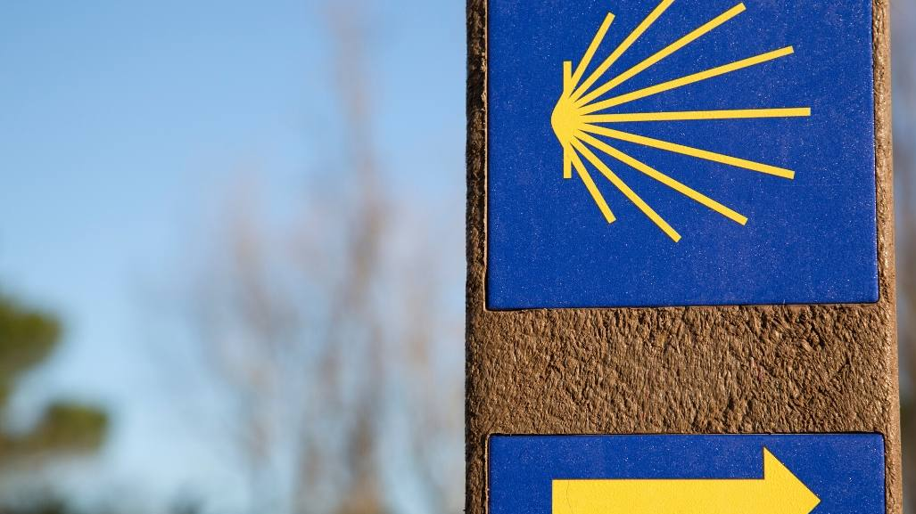
Introduction

Slide 11
From what you have heard so far…
…what are your Initial thoughts, reactions, questions that come to mind?
We can discuss these later…

Slide 12
God’s creation and our part in it
‘Before the mountains were born or you brought forth the whole world, from everlasting to everlasting you are God’
Psalm 90:2

Slide 13
Reflection
As you listen to this praise song, ‘So will I’ from Hillsong, you may like to reflect on the wonder of God’s creation and your response to the Creator.

Slide 14
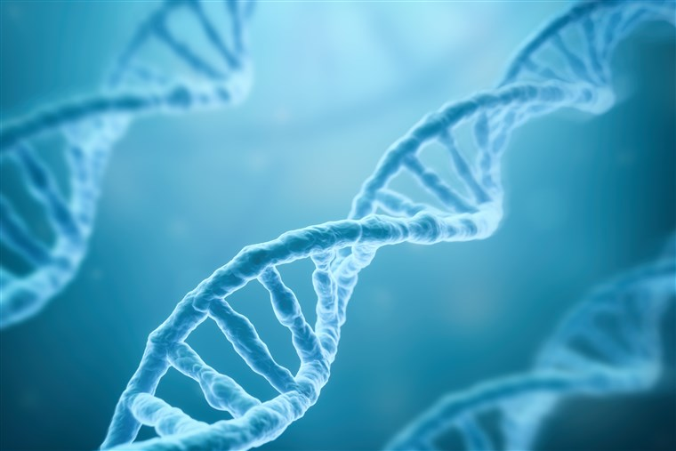
Testimony
Francis Collins – Director of the Human Genome Project

Slide 15
Catechism of the Catholic Church
315 In the creation of the world and of man, God gave the first and universal witness to his almighty love and his wisdom, the first proclamation of the "plan of his loving goodness", which finds its goal in the new creation in Christ.
316 Though the work of creation is attributed to the Father in particular, it is equally a truth of faith that the Father, Son and Holy Spirit together are the one, indivisible principle of creation.
317 God alone created the universe, freely, directly and without any help.
318 No creature has the infinite power necessary to "create" in the proper sense of the word, that is, to produce and give being to that which had in no way possessed it (to call into existence "out of nothing") (cf DS 3624).
319 God created the world to show forth and communicate his glory. That his creatures should share in his truth, goodness and beauty - this is the glory for which God created them.
320 God created the universe and keeps it in existence by his Word, the Son "upholding the universe by his word of power" (Heb 1:3), and by his Creator Spirit, the giver of life.
323 Divine providence works also through the actions of creatures. To human beings God grants the ability to cooperate freely with his plans.

Slide 16
What about Evolution?

Slide 17
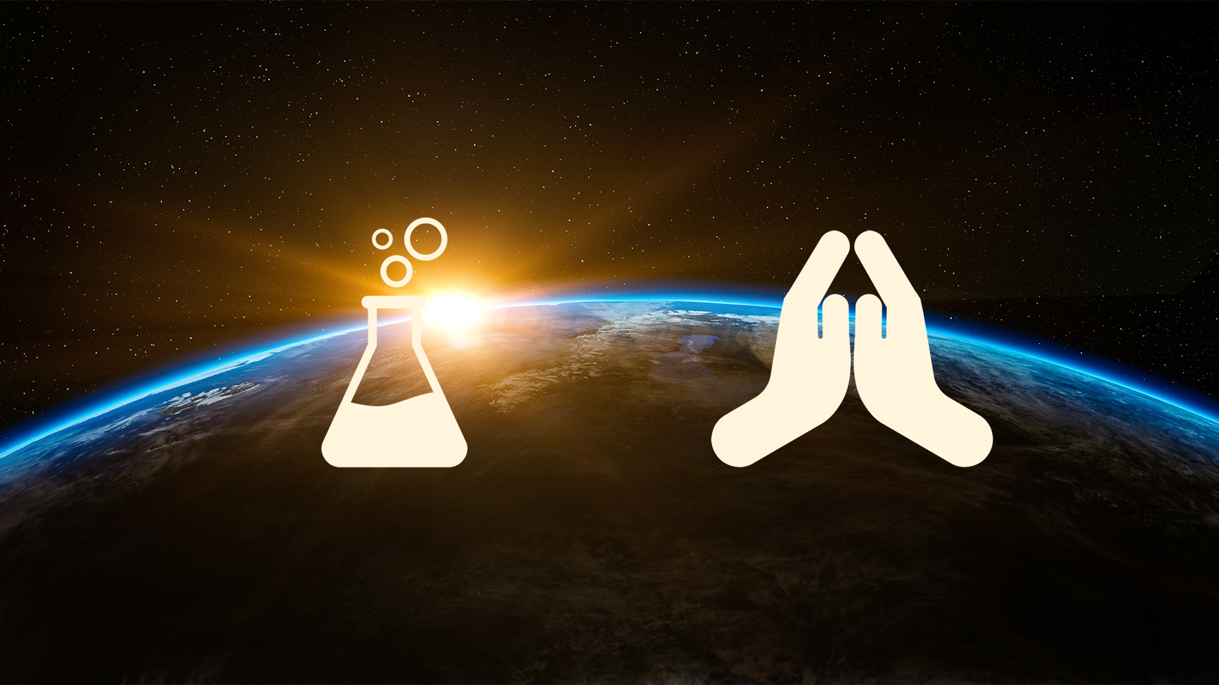
Discussion
What do you find challenging in relation to faith and science?
Discuss this is two’s & three’s then feedback to the main group

Slide 18
Internet Corner - Where to find out more…
reasonfaithscience.com/
alpha.org/
Sycamore.fm/

Slide 19
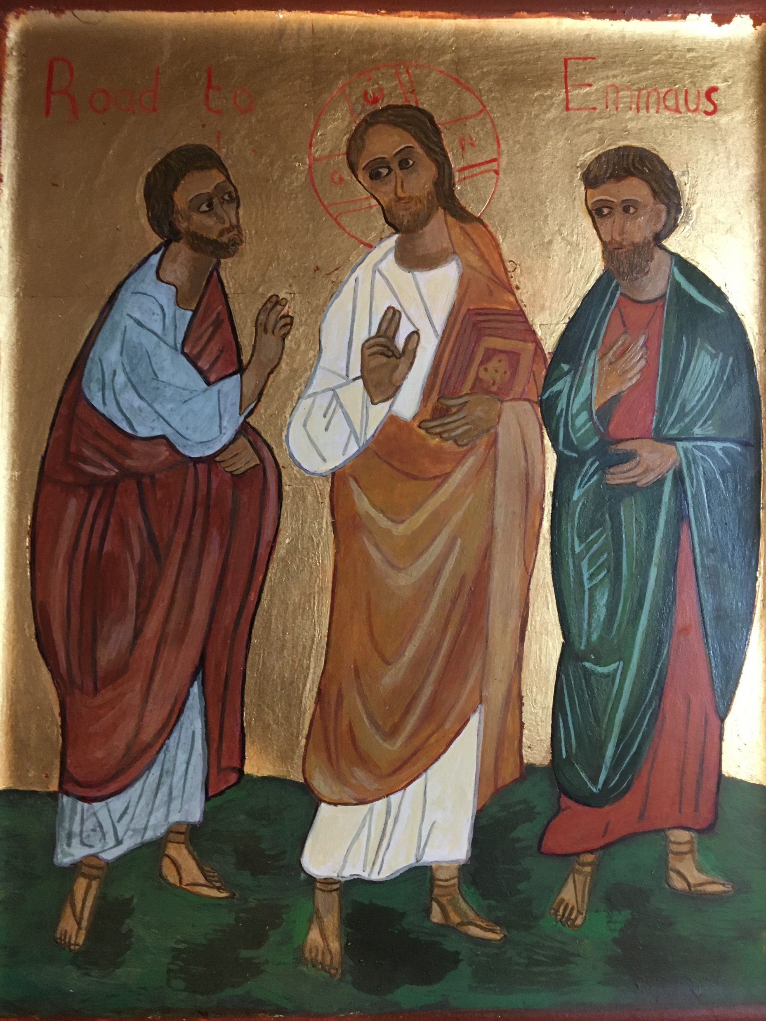
Conversation with Jesus
Focus on this image of Jesus and open your heart to Him now.
Take this opportunity to talk to him in your mind and heart.
Listen and be aware of his presence with you.
You may want to use this hymn to help you pray

Slide 20
Spiritual Journal
You may want to write down what has been important for you during this time together

Slide 21
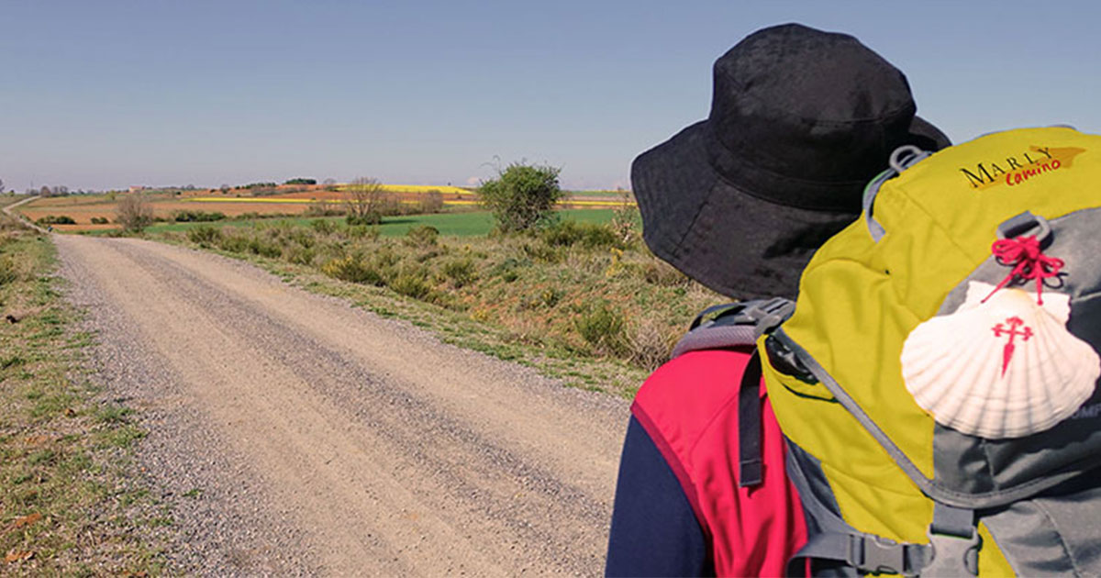
Rucksack Prayer – Part 2

Slide 22
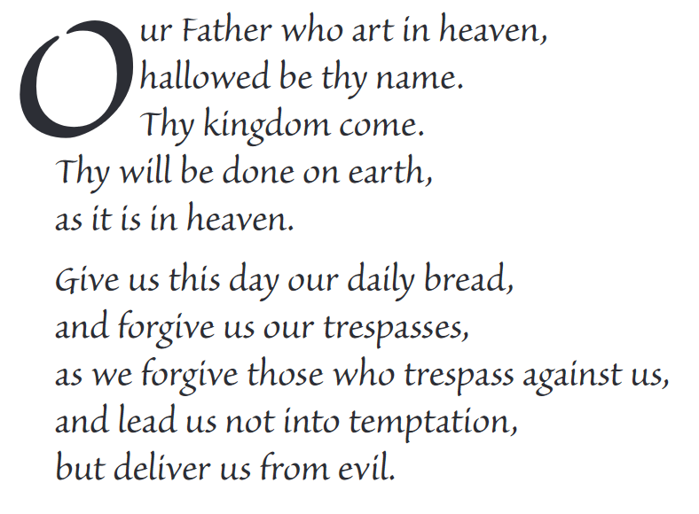
The Lord’s Prayer

Slide 23
Final pilgrim blessing for the week ahead
God of our pilgrimage,
you have given us a desire
to take the questing way
and set out on our journey.
Help us to keep our eyes fixed on Jesus,
that whatever we encounter as we travel,
we may seek to glorify you by the way we live.
You call us, Lord,
to leave familiar things and to leave our “comfort zone”.
May we open our eyes to new experiences,
may we open our ears to hear you speaking to us
and may we open our hearts to your love.
Grant that this time spent on pilgrimage
may help us to see ourselves as we really are
and may we strive to become the people you would have us be. Amen
… continued on next slide

Slide 24
Final pilgrim blessing for the week ahead
Lord, you know our beginning and our end.
Help us to realise we are only pilgrims on this earth
and save us from being too attached to worldly possessions.
May we experience the freedom to wander,
the freedom to hope and the freedom to love as we journey. Amen
Creator God, you are the source of all life and motivation.
May we journey in faith and love, rejoicing and eager to serve you.
Grant us a glimpse of your glory as we seek to follow you –
the Way, the Truth and the Life. Amen
May God the Father who created you, guide your footsteps,
May God the Son who redeemed you, share your journey,
May God the Holy Spirit who sanctifies you, lead you on life’s pilgrimage,
and the blessing of God, Father, Son and Holy Spirit
be with you wherever you may go. Amen.

Slide 25
CAMINO
Making the Journey…
Session 1
Making the journey as a pilgrim - Creation

