Slide 1
CAMINO
Making the Journey…
Session 10
Making the journey with the Church – as pilgrim people of God

Slide 2
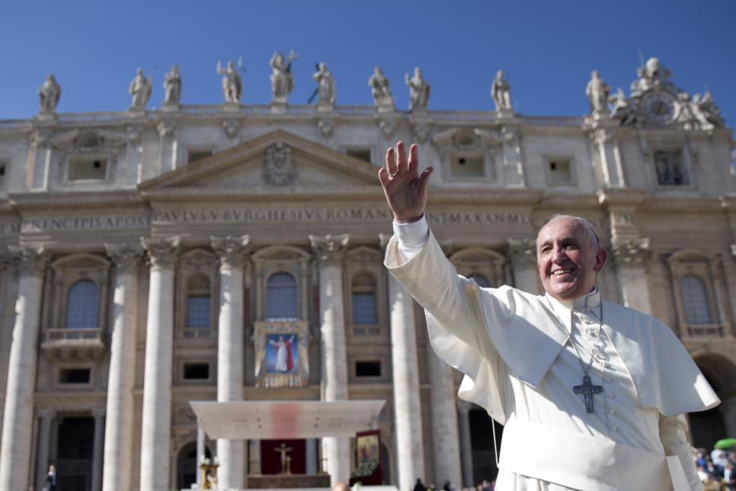
Introduction
Jesus gave us the Church to help us on our pilgrim way. The Church is one, Holy, Catholic and apostolic and we are united around the successor of St Peter. The Church helps us navigate our way along the journey of life and is itself the pilgrim people of God. Despite human sinfulness and imperfections in the Church throughout history and still today, being part of the Church means we do not have to make this journey on our own. This time together is to help us understand the teaching authority of the Church and the relationship between scripture and tradition in the Roman Catholic Church. In the Church we encounter Christ in a number of ways.

Slide 3
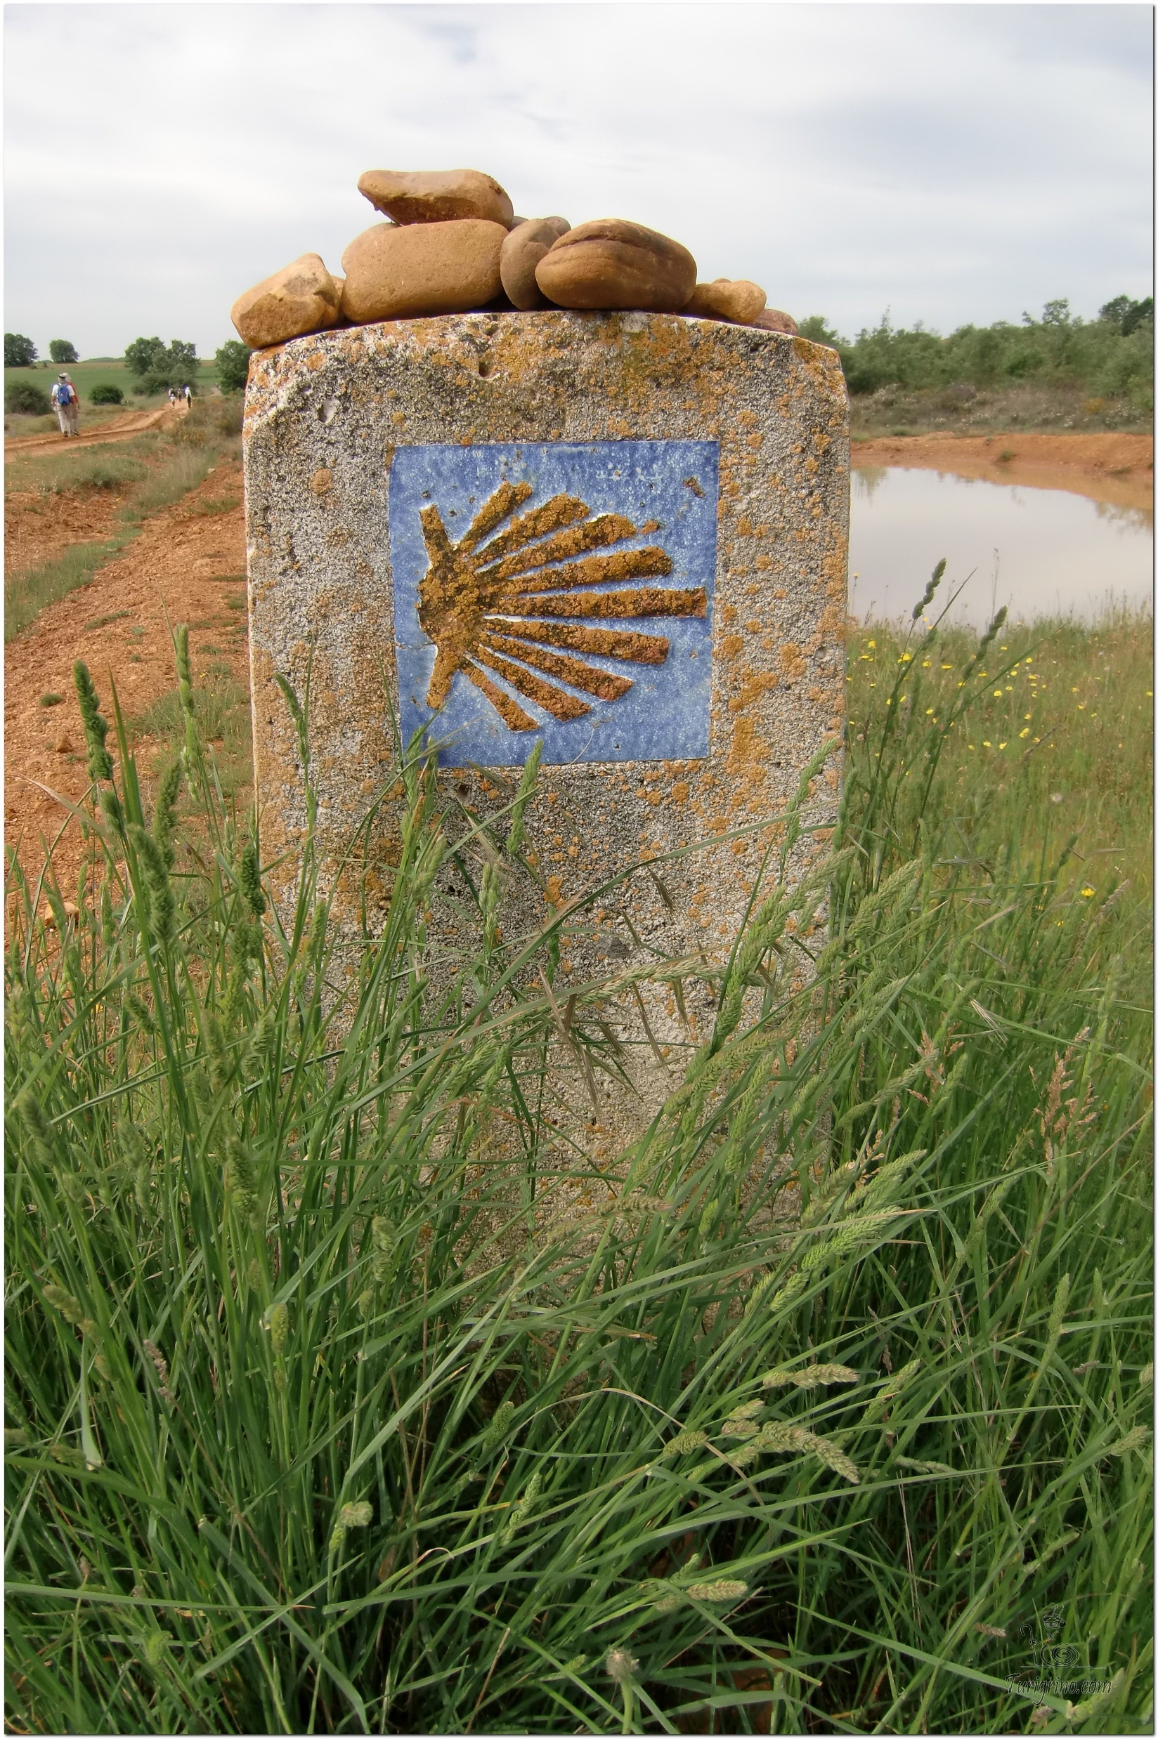
Opening Prayer
The Camino Prayer (adapted)
O God, who brought your servant Abraham out of the land of the Chaldeans, protecting him in his wanderings, who guided the Hebrew people across the desert, we ask that you watch over us, your servants, as we walk in the love of your name.
Be for us our companion on the journey,
Our guide at the crossroads, Our breath in our weariness,
Our protection in danger, our albergue on the Camino,
Our shade in the heat, Our light in the darkness,
Our consolation in our discouragements,
And our strength in our intentions.
So that with your guidance we may arrive safe and sound at the end of the road and enriched with grace and virtue we return safely to our homes filled with joy.
In the name of Jesus Christ our Lord, Amen. Apostle Santiago, pray for us. Santa Maria, pray for us.

Slide 4
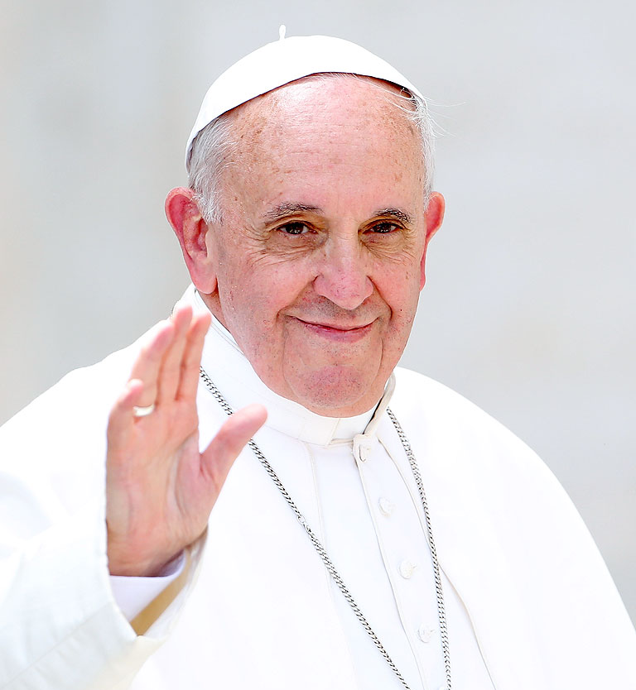
Icebreaker
Who is this and what do you know about him?

Slide 5
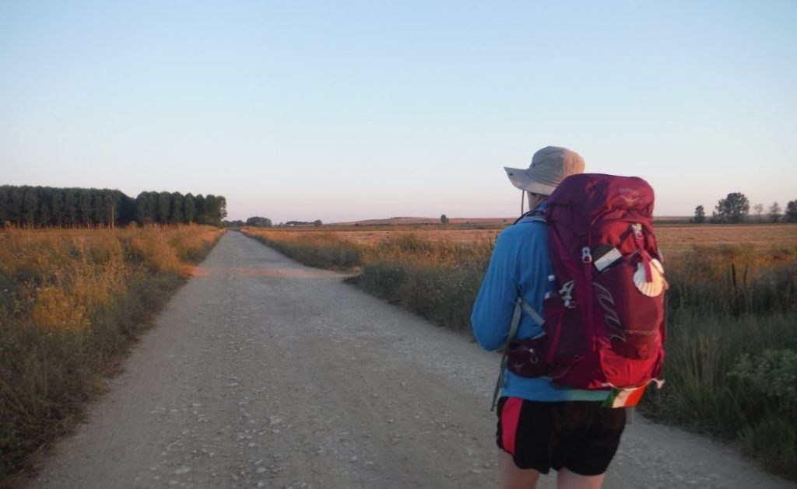
Rucksack Prayer – Part 1

Slide 6
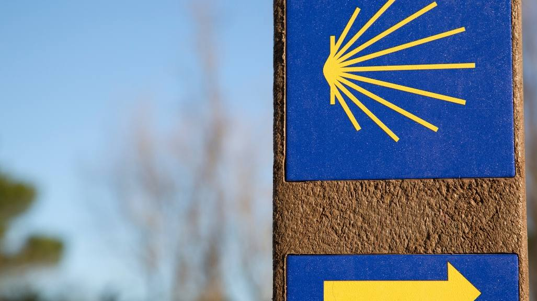
A Journey with
The Church

Slide 7
Scripture Reading – Matthew 16:13-21
When Jesus came to the region of Caesarea Philippi, he asked his disciples, “Who do people say the Son of Man is?”
They replied, “Some say John the Baptist; others say Elijah; and still others, Jeremiah or one of the prophets.”
“But what about you?” he asked. “Who do you say I am?” Simon Peter answered, "You are the Christ, the Son of the living God."
Jesus replied, "Blessed are you, Simon son of Jonah, for this was not revealed to you by man, but by my Father in heaven.
And I tell you that you are Peter, and on this rock I will build my church,
and the gates of Hades will not overcome it.
I will give you the keys of the kingdom of heaven; whatever you bind on earth will be bound in heaven, and whatever you loose on earth will be loosed in heaven."
Then he warned his disciples not to tell anyone that he was the Christ.
From that time on Jesus began to explain to his disciples that he must go to Jerusalem and suffer many things at the hands of the elders, chief priests and teachers of the law, and that he must be killed and on the third day be raised to life.

Slide 8
From what you have heard so far…
…what are your Initial thoughts, reactions, questions that come to mind?
We can discuss these later…

Slide 9
So what is the Church?
Fr Stephen explores The special place of the Catholic Church

Slide 10
And why do we need it?
Fr Stephen explores Why do we need the Church

Slide 11
Reflection
The Church is One Foundation Hymn

Slide 12
Get involved in the Local Church
Find out about the Diocese of Salford’s renewal programme ‘Hope in the Future’ and how you can help Rebuild His Church.

Slide 13
Catechism of the Catholic Church
777 The word "Church" means "convocation." It designates the assembly of those whom God's Word "convokes," i.e., gathers together to form the People of God, and who themselves, nourished with the Body of Christ, become the Body of Christ.
778 The Church is both the means and the goal of God's plan: prefigured in creation, prepared for in the Old Covenant, founded by the words and actions of Jesus Christ, fulfilled by his redeeming cross and his Resurrection, the Church has been manifested as the mystery of salvation by the outpouring of the Holy Spirit. She will be perfected in the glory of heaven as the assembly of all the redeemed of the earth (cf Rev 14:4).
779 The Church is both visible and spiritual, a hierarchical society and the Mystical Body of Christ. She is one, yet formed of two components, human and divine. That is her mystery, which only faith can accept.
780 The Church in this world is the sacrament of salvation, the sign and the instrument of the communion of God and men.

Slide 14
Why be Catholic?

Slide 15
Discussion
What drew you towards the Catholic Church?
Discuss this is two’s & three’s then feedback to the main group

Slide 16
Internet Corner - Where to find out more…
The Holy See www.vatican.va/content/vatican/en.html
The Catholic Bishop’s Conference for England & Wales
www.cbcew.org.uk
Diocese of Salford
www.dioceseofsalford.org.uk

Slide 17
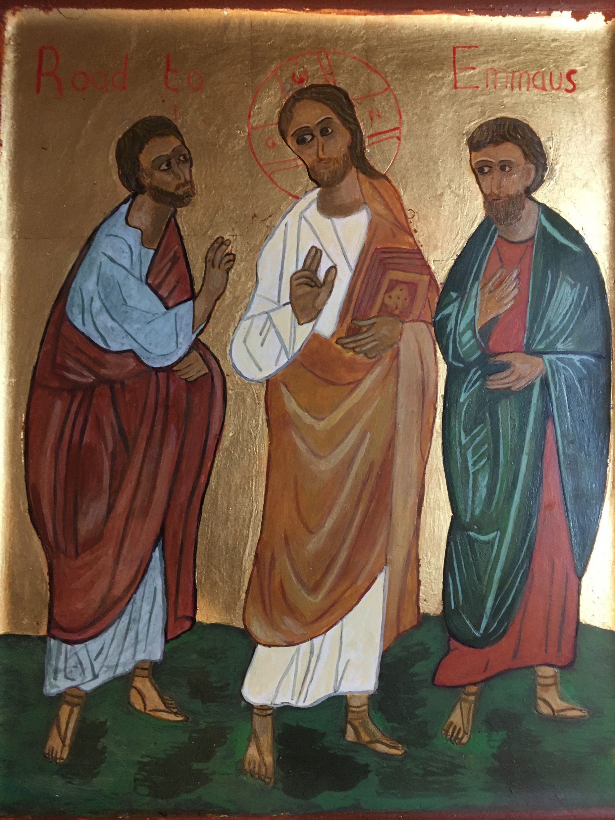
Conversation with Jesus
Focus on this image of Jesus and open your heart to Him now.
Take this opportunity to talk to him in your mind and heart.
Listen and be aware of his presence with you.
You may want to use this hymn to help you pray

Slide 18
Spiritual Journal
You may want to write down what has been important for you during this time together

Slide 19
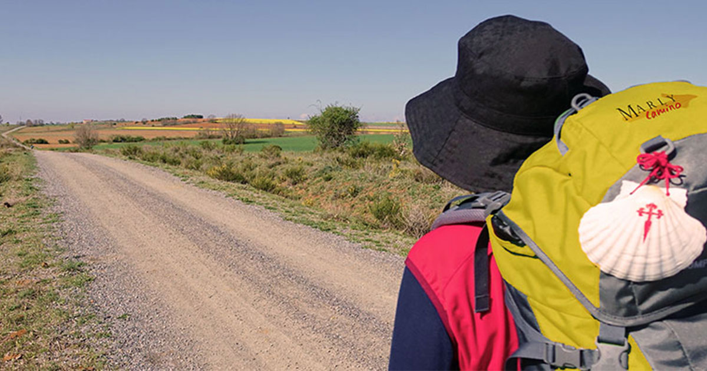
Rucksack Prayer – Part 2

Slide 20
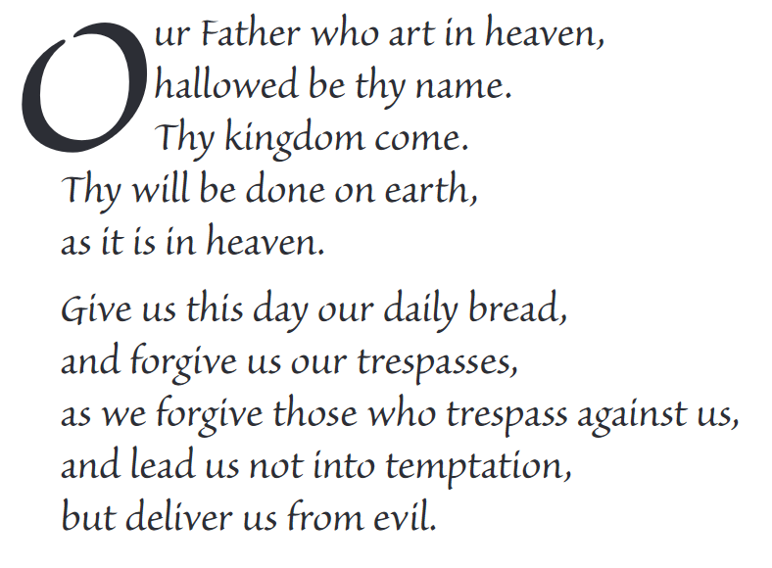
The Lord’s Prayer

Slide 21
Final pilgrim blessing for the week ahead
God of our pilgrimage,
you have given us a desire
to take the questing way
and set out on our journey.
Help us to keep our eyes fixed on Jesus,
that whatever we encounter as we travel,
we may seek to glorify you by the way we live.
You call us, Lord,
to leave familiar things and to leave our “comfort zone”.
May we open our eyes to new experiences,
may we open our ears to hear you speaking to us
and may we open our hearts to your love.
Grant that this time spent on pilgrimage
may help us to see ourselves as we really are
and may we strive to become the people you would have us be. Amen
… continued on next slide

Slide 22
Final pilgrim blessing for the week ahead
Lord, you know our beginning and our end.
Help us to realise we are only pilgrims on this earth
and save us from being too attached to worldly possessions.
May we experience the freedom to wander,
the freedom to hope and the freedom to love as we journey. Amen
Creator God, you are the source of all life and motivation.
May we journey in faith and love, rejoicing and eager to serve you.
Grant us a glimpse of your glory as we seek to follow you –
the Way, the Truth and the Life. Amen
May God the Father who created you, guide your footsteps,
May God the Son who redeemed you, share your journey,
May God the Holy Spirit who sanctifies you, lead you on life’s pilgrimage,
and the blessing of God, Father, Son and Holy Spirit
be with you wherever you may go. Amen.

Slide 23
CAMINO
Making the Journey…
Session 10
Making the journey with the Church – as pilgrim people of God

