Slide 1
CAMINO
Making the Journey…
Session 11
Making the journey with Mary

Slide 2
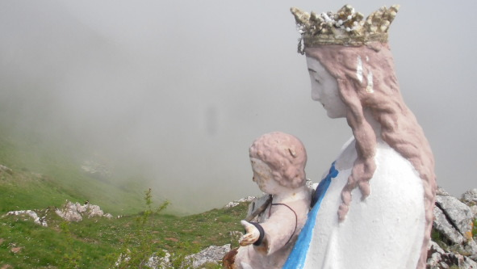
Introduction
The journey of life is long and arduous, and Mary’s intercession empowers those who walk it to discover and learn more about themselves and about life.
Mary knows the difficulties and adversities we face in life and that is why we pray the Memorare, which teaches us, ‘never has it been known that anyone who has sought Mary’s help has been left unaided.’
Through it all, “as a true mother, she walks at our side, she shares our struggles and she constantly surrounds us with God’s love,” Pope Francis.

Slide 3
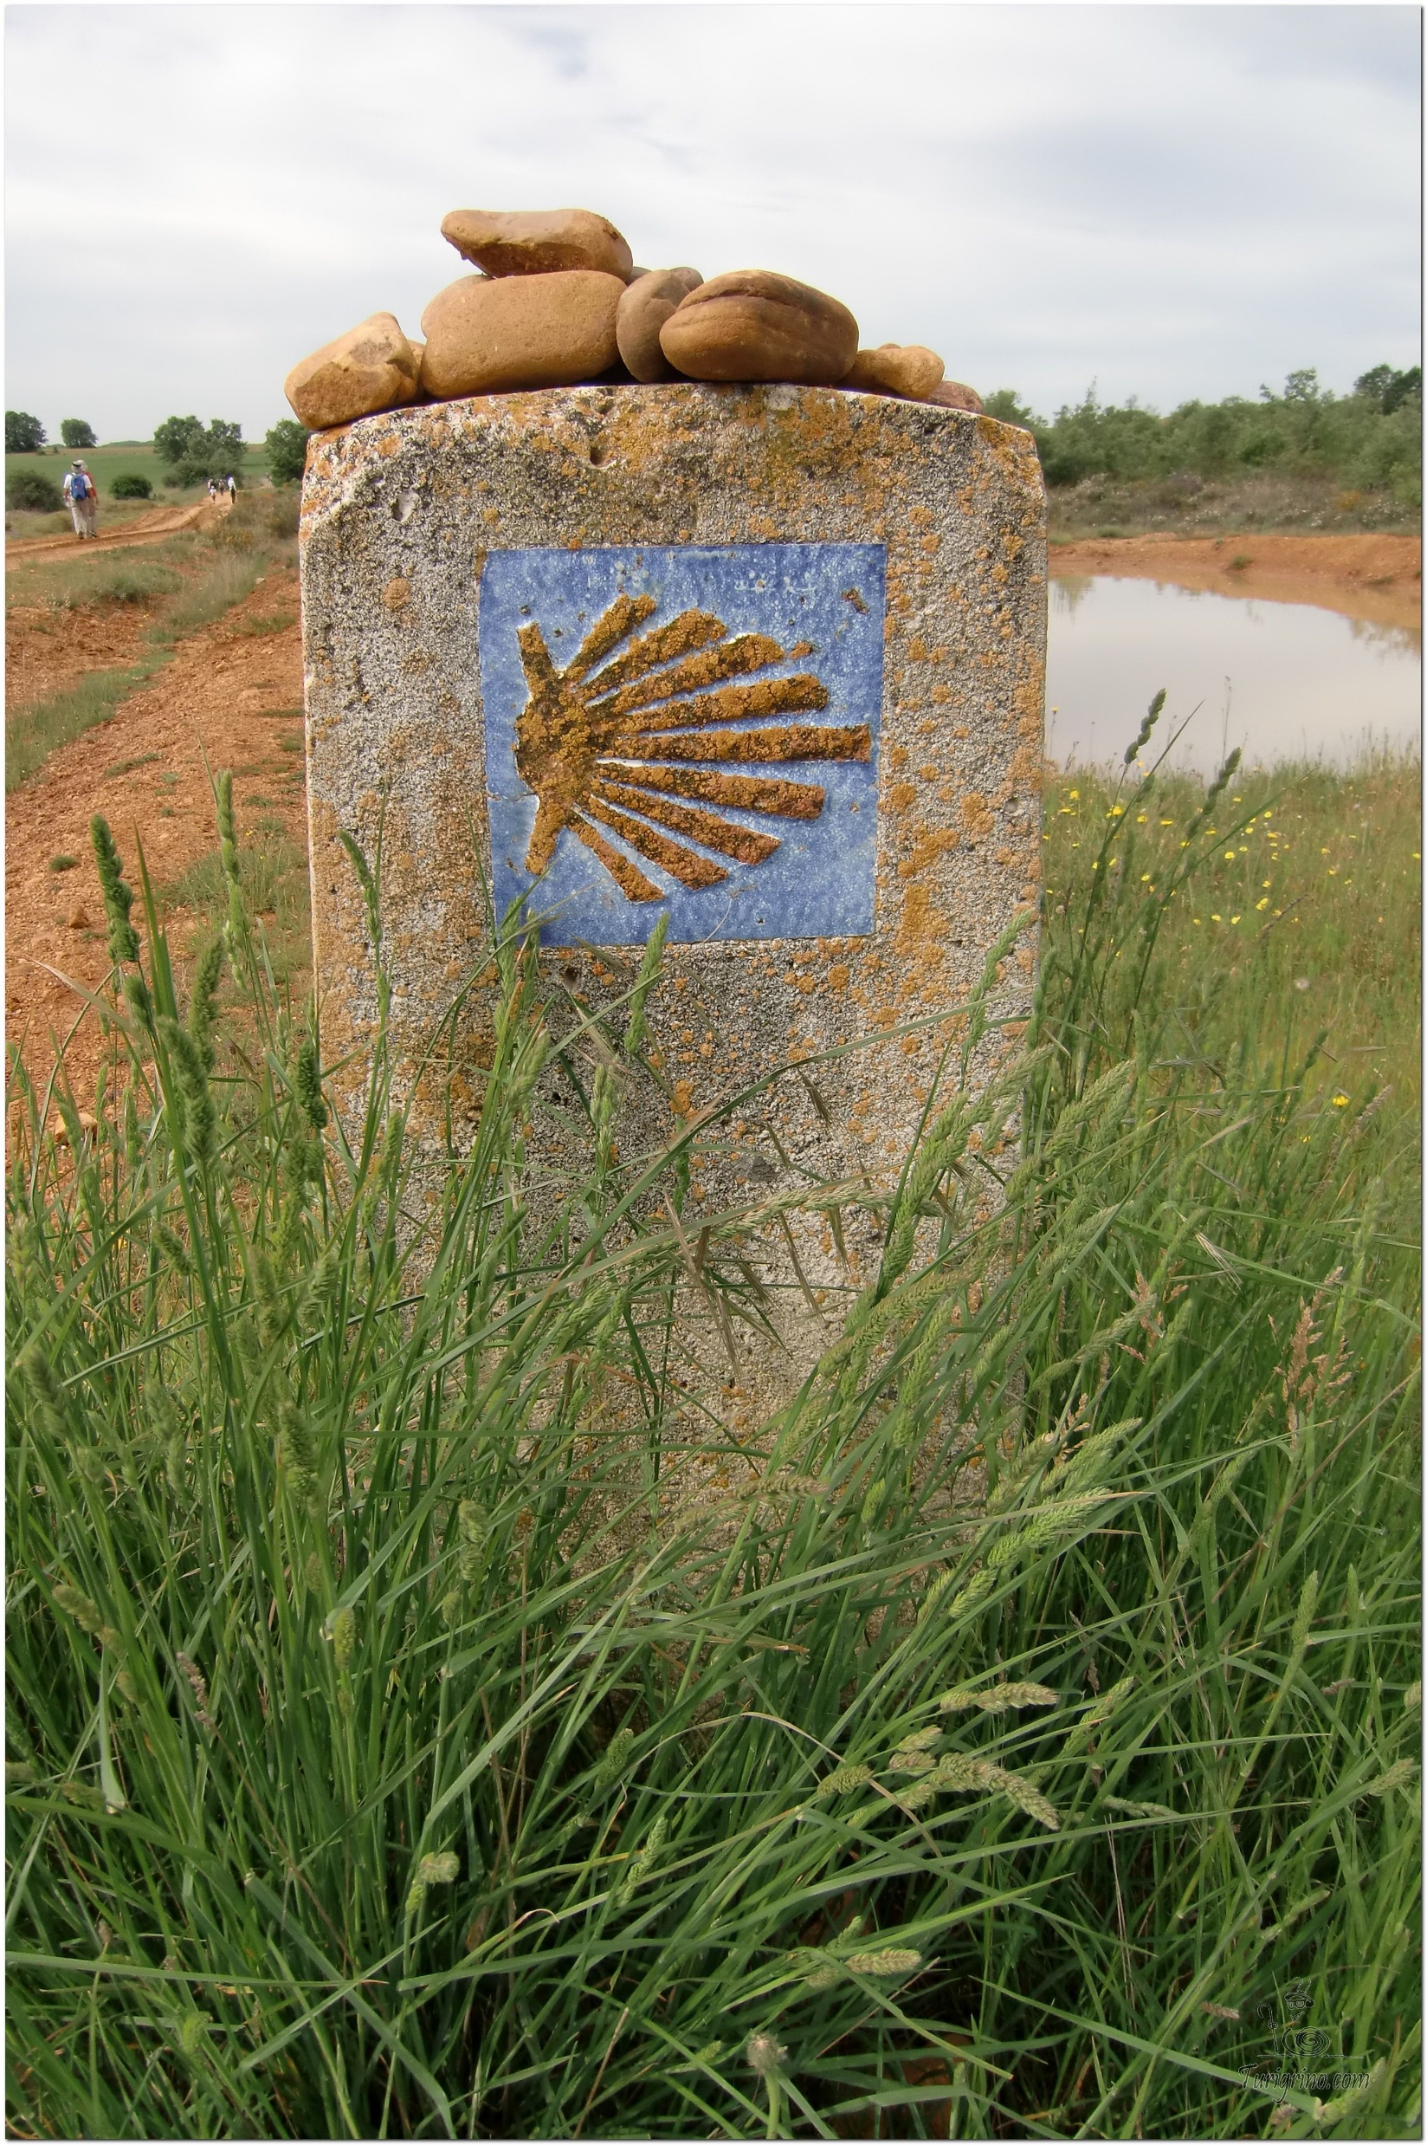
Opening Prayer
The Camino Prayer (adapted)
O God, who brought your servant Abraham out of the land of the Chaldeans, protecting him in his wanderings, who guided the Hebrew people across the desert, we ask that you watch over us, your servants, as we walk in the love of your name.
Be for us our companion on the journey,
Our guide at the crossroads, Our breath in our weariness,
Our protection in danger, our albergue on the Camino,
Our shade in the heat, Our light in the darkness,
Our consolation in our discouragements,
And our strength in our intentions.
So that with your guidance we may arrive safe and sound at the end of the road and enriched with grace and virtue we return safely to our homes filled with joy.
In the name of Jesus Christ our Lord, Amen. Apostle Santiago, pray for us. Santa Maria, pray for us.

Slide 4
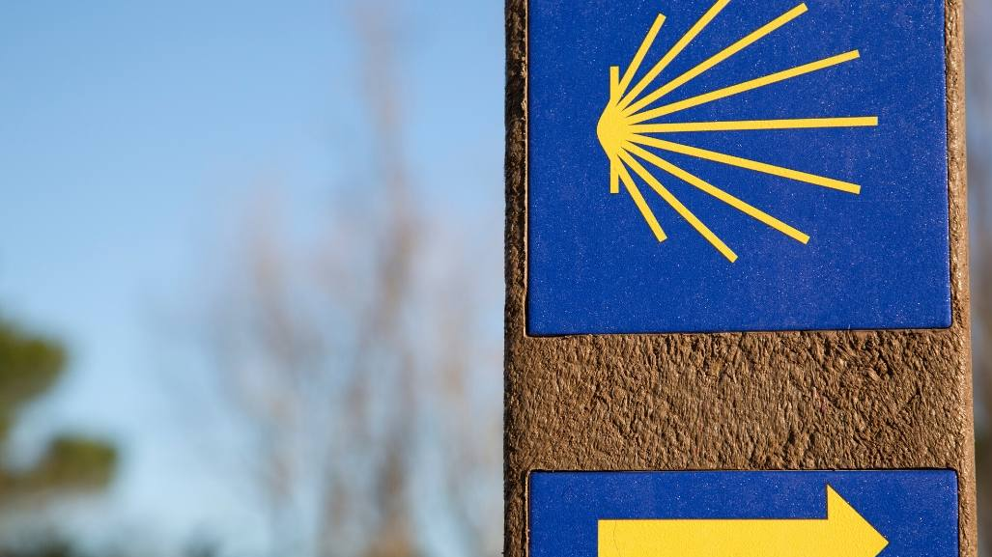
A Journey with Mary…
We should entrust each soul we pray for to God's mercy and ask for Mary's intercession, because we know Jesus not only won't, but can't refuse to give her anything she asks for. ... “Mary is neither wanting in the power nor the will to save us”.

Slide 5
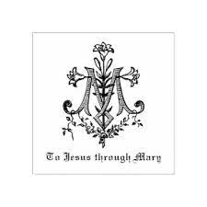
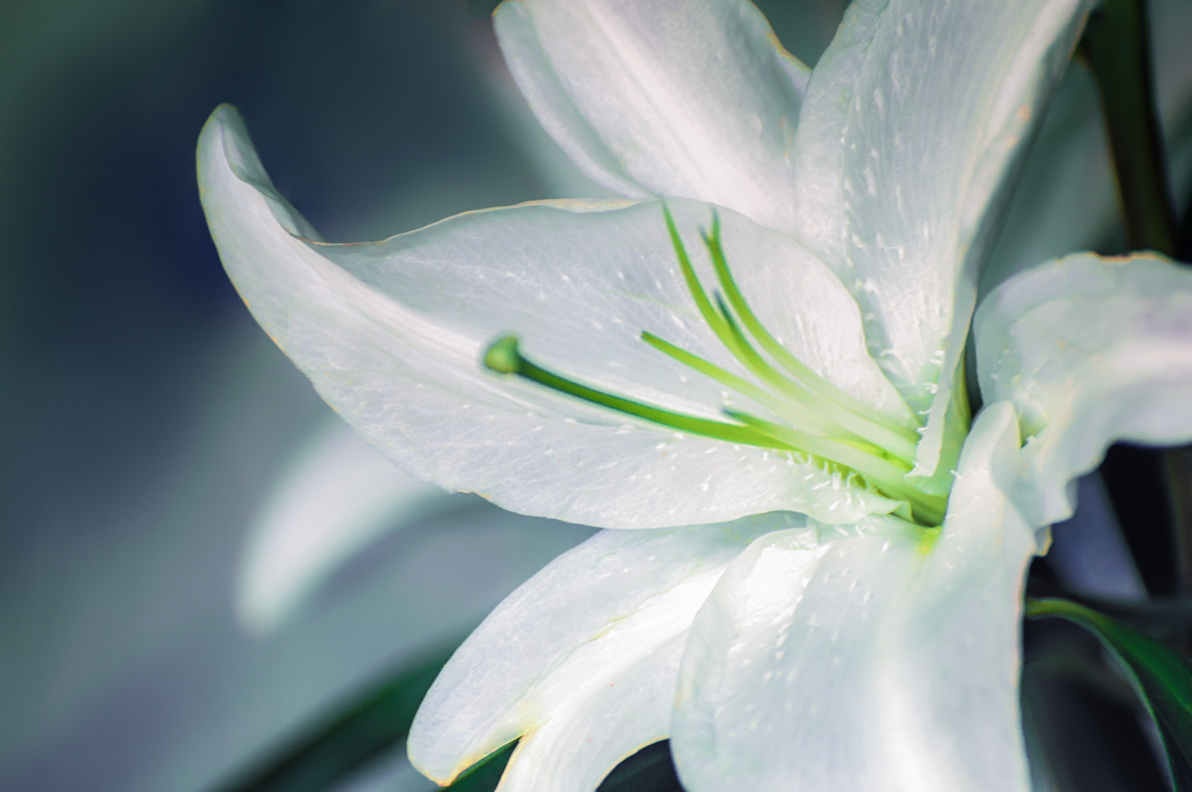
Symbols of Our Lady
This video is 5 minutes long so watch as much or as little as you like

Slide 6
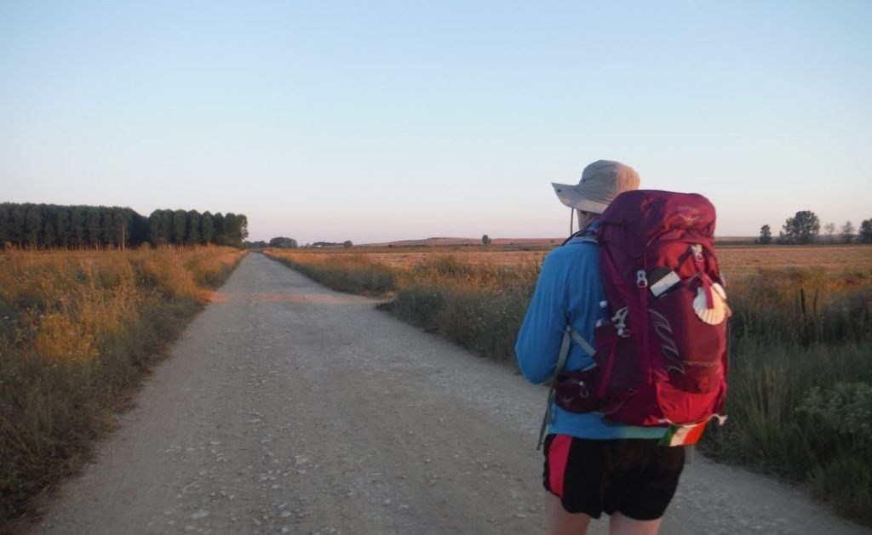
Rucksack Prayer – Part 1

Slide 7
The Annunciation - Luke 1:26-38
In the sixth month the angel Gabriel was sent by God to a town in Galilee called Nazareth, to a virgin engaged to a man whose name was Joseph, of the house of David. The virgin's name was Mary. And he came to her and said, "Greetings, favoured one! The Lord is with you." But she was much perplexed by his words and pondered what sort of greeting this might be. The angel said to her, "Do not be afraid, Mary, for you have found favour with God. And now, you will conceive in your womb and bear a son, and you will name him Jesus. He will be great, and will be called the Son of the Most High, and the Lord God will give to him the throne of his ancestor David. He will reign over the house of Jacob forever, and of his kingdom there will be no end."
Mary said to the angel, "How can this be, since I am a virgin?" The angel said to her, "The Holy Spirit will come upon you, and the power of the Most High will overshadow you; therefore the child to be born will be holy; he will be called Son of God. And now, your relative Elizabeth in her old age has also conceived a son; and this is the sixth month for her who was said to be barren. For nothing will be impossible with God." Then Mary said, "Here am I, the servant of the Lord; let it be with me according to your word." Then the angel departed from her.

Slide 8
From what you have heard so far…
…what are your Initial thoughts, reactions, questions that come to mind?
We can discuss these later…

Slide 9
Main Input
Mary and the Saints

Slide 10
Reflection
Hail Queen of Heaven
This video is 3 minutes long so watch as much or as little as you like
We can learn from Mary, who was immaculate in love, to be like her, strong, faithful, unwavering in determination, and imbued with unfailing hope in the midst of earthly chaos.

Slide 11
Testimony
This video is 7 minutes long
In this video, Fr Mike Schmitz explains that if we want to be holy, the Virgin Mary should have an integral role in our spiritual life and how we can relate to the Blessed Mother.

Slide 12
Catechism of the Catholic Church
484 The Annunciation to Mary inaugurates "the fullness of time," the time of the fulfilment of God's promises and preparations. Mary was invited to conceive him in whom the "whole fullness of deity" would dwell "bodily." The divine response to her question, "How can this be, since I know not man?," was given by the power of the Spirit: "The Holy Spirit will come upon you." 485 The mission of the Holy Spirit is always conjoined and ordered to that of the Son. The Holy Spirit, "the Lord, the giver of Life," is sent to sanctify the womb of the Virgin Mary and divinely fecundate it, causing her to conceive the eternal Son of the Father in a humanity drawn from her own. 486 The Father's only Son, conceived as man in the womb of the Virgin Mary, is "Christ," that is to say, anointed by the Holy Spirit, from the beginning of his human existence, though the manifestation of this fact takes place only progressively: to the shepherds, to the magi, to John the Baptist, to the disciples. Thus the whole life of Jesus Christ will make manifest "how God anointed Jesus of Nazareth with the Holy Spirit and with power." 487 What the Catholic faith believes about Mary is based on what it believes about Christ, and what it teaches about Mary illumines in turn its faith in Christ.
Notes:
IN BRIEF
508 From among the descendants of Eve, God chose the Virgin Mary to be the mother of his Son. "Full of grace", Mary is "the most excellent fruit of redemption" (SC 103): from the first instant of her conception, she was totally preserved from the stain of original sin and she remained pure from all personal sin throughout her life.
509 Mary is truly "Mother of God" since she is the mother of the eternal Son of God made man, who is God himself.
510 Mary "remained a virgin in conceiving her Son, a virgin in giving birth to him, a virgin in carrying him, a virgin in nursing him at her breast, always a virgin" (St. Augustine, Serm. 186, 1: PL 38, 999): with her whole being she is "the handmaid of the Lord" (Lk 1:38).
511 The Virgin Mary "cooperated through free faith and obedience in human salvation" (LG 56). She uttered her yes "in the name of all human nature" (St. Thomas Aquinas, STh III, 30, 1). By her obedience she became the new Eve, mother of the living.

Slide 13
Question
Do Catholics worship Mary?

Slide 14
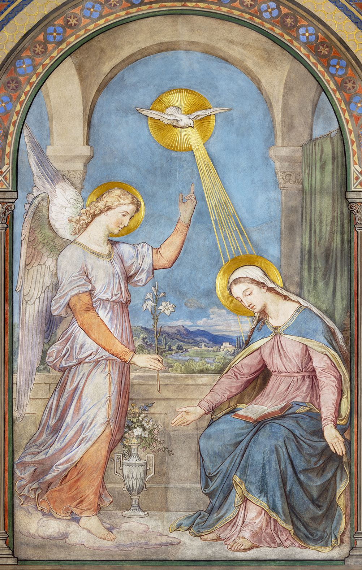
Discussion
Consider the role of Mary in the story of Salvation and the dogmas abut her in this context.
Consider, also the intercessory nature of our devotion to Mary that always points beyond to Christ, just as she did herself at the wedding feast at Cana.
What are the myths and misconceptions about the role of our devotion to Our Lady in mainstream Roman Catholicism? Consider how our devotion to her is another way to deepen our relationship with Jesus, himself.
Discuss this in two’s & three’s then feedback to the main group

Slide 15
Internet Corner - Where to find out more…
The importance of Mary
https://youtu.be/sCTC9yjSKM0
Our Blessed Mother https://youtu.be/__dYY4ygPN8

Slide 16
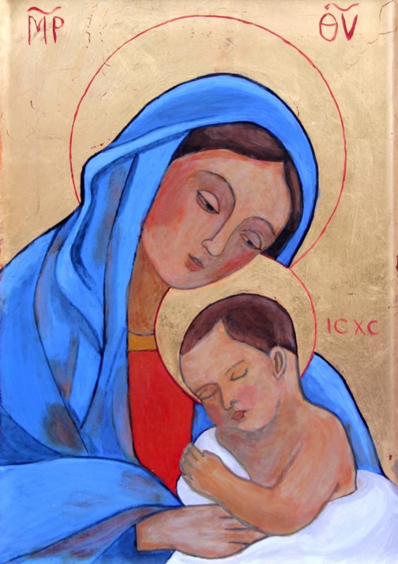
Conversation with Jesus & Mary
Focus on this image of Jesus and Mary and open your heart to them now.
Take this opportunity to talk to them in your mind and heart.
Listen and be aware of their presence with you.
You may want to use this hymn to help you pray

Slide 17
Spiritual Journal
You may want to write down what has been important for you during this time together

Slide 18
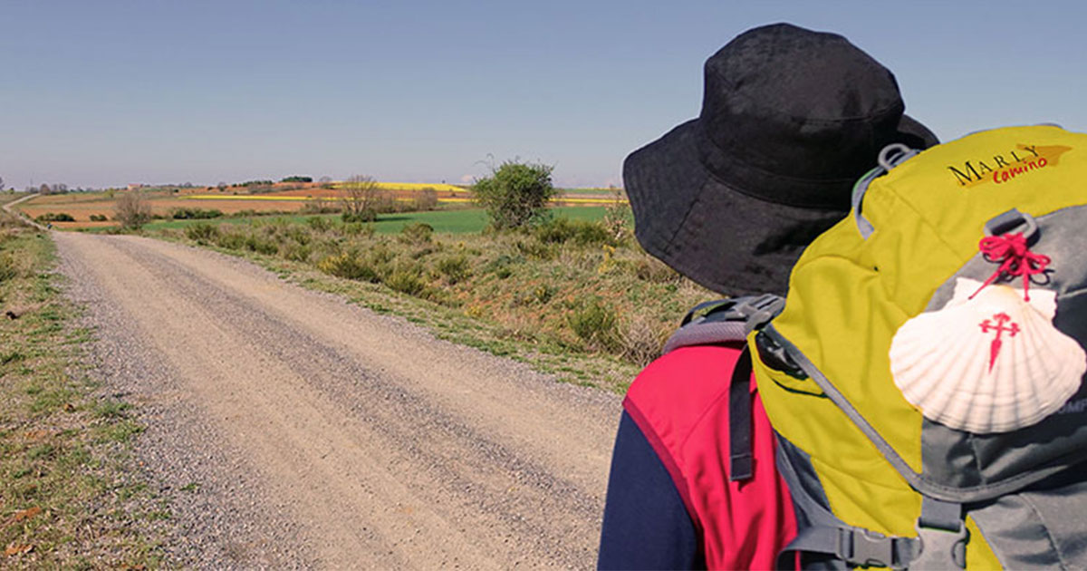
Rucksack Prayer – Part 2

Slide 19
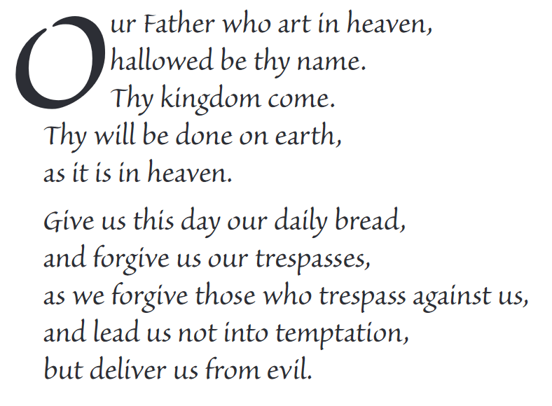
The Lord’s Prayer

Slide 20
Final pilgrim blessing for the week ahead
God of our pilgrimage,
you have given us a desire
to take the questing way
and set out on our journey.
Help us to keep our eyes fixed on Jesus,
that whatever we encounter as we travel,
we may seek to glorify you by the way we live.
You call us, Lord,
to leave familiar things and to leave our “comfort zone”.
May we open our eyes to new experiences,
may we open our ears to hear you speaking to us
and may we open our hearts to your love.
Grant that this time spent on pilgrimage
may help us to see ourselves as we really are
and may we strive to become the people you would have us be. Amen
… continued on next slide

Slide 21
Final pilgrim blessing for the week ahead
Lord, you know our beginning and our end.
Help us to realise we are only pilgrims on this earth
and save us from being too attached to worldly possessions.
May we experience the freedom to wander,
the freedom to hope and the freedom to love as we journey. Amen
Creator God, you are the source of all life and motivation.
May we journey in faith and love, rejoicing and eager to serve you.
Grant us a glimpse of your glory as we seek to follow you –
the Way, the Truth and the Life. Amen
May God the Father who created you, guide your footsteps,
May God the Son who redeemed you, share your journey,
May God the Holy Spirit who sanctifies you, lead you on life’s pilgrimage,
and the blessing of God, Father, Son and Holy Spirit
be with you wherever you may go. Amen.

Slide 22
CAMINO
Making the Journey…
Session 11
Making the journey with Mary

