Slide 1
CAMINO
Making the Journey…
Session 12
Making the journey with the Saints

Slide 2
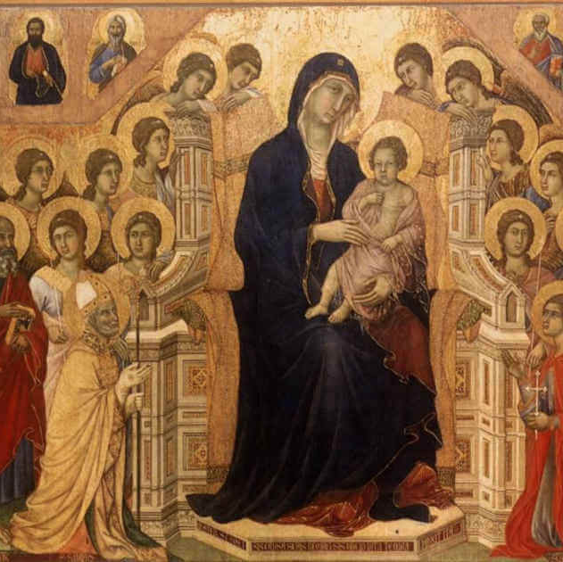
Introduction
We are pilgrims on the way through life and we have the saints who have walked this path before us to help us on our way. The call to be a pilgrim is part of the universal call to holiness. The lives of the saints have left their footprints on this earth to give us the confidence that we are on the right path. Devotion to the saints on the Roman Catholic tradition is a way of recognising this and such devotion should always point beyond the saints to Christ himself. The Church canonises people to give us good examples to follow on our own faith journey and to inspire us. The saints themselves have followed in the footsteps of Christ. You are encouraged to find out more about the saints as each of us will be drawn to different saints as a fellow pilgrim to encourage us on the Way.

Slide 3
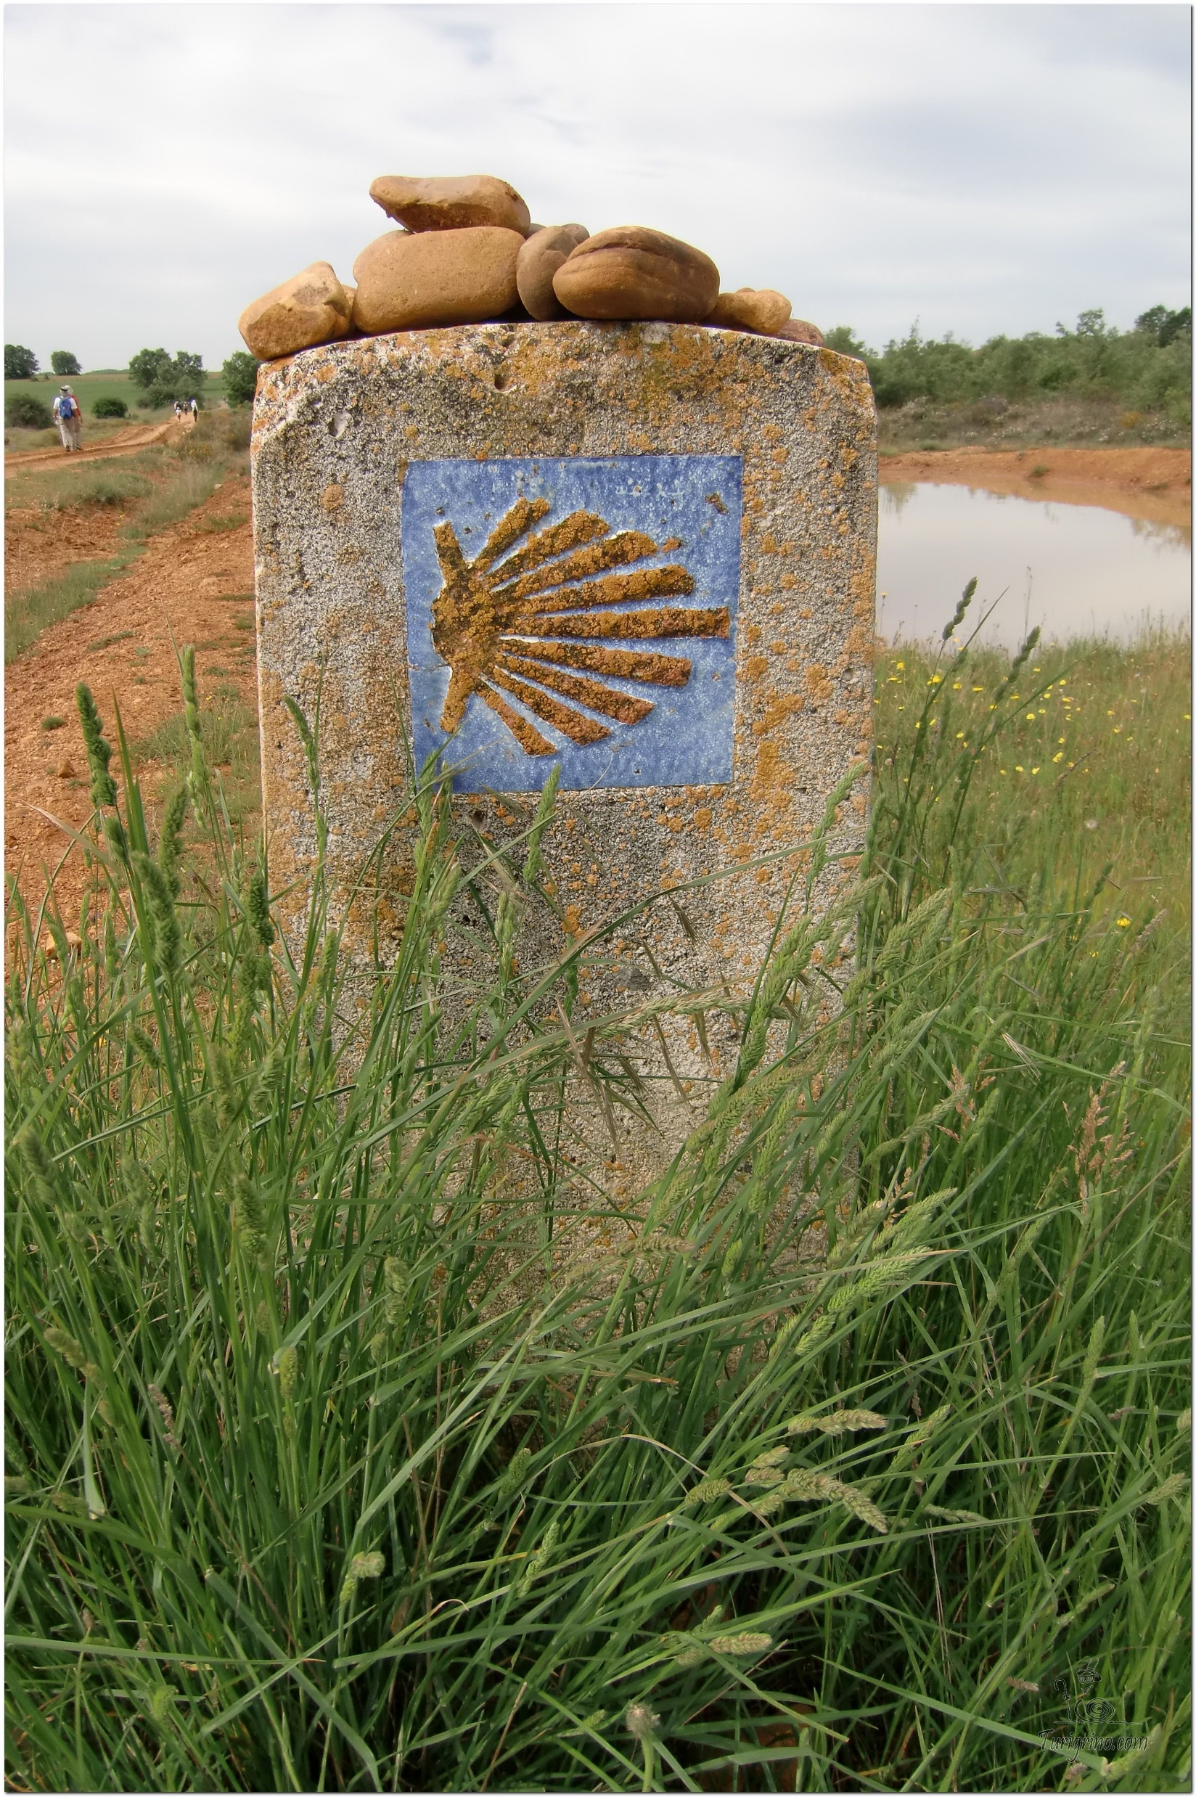
Opening Prayer
The Camino Prayer (adapted)
O God, who brought your servant Abraham out of the land of the Chaldeans, protecting him in his wanderings, who guided the Hebrew people across the desert, we ask that you watch over us, your servants, as we walk in the love of your name.
Be for us our companion on the journey,
Our guide at the crossroads, Our breath in our weariness,
Our protection in danger, our albergue on the Camino,
Our shade in the heat, Our light in the darkness,
Our consolation in our discouragements,
And our strength in our intentions.
So that with your guidance we may arrive safe and sound at the end of the road and enriched with grace and virtue we return safely to our homes filled with joy.
In the name of Jesus Christ our Lord, Amen. Apostle Santiago, pray for us. Santa Maria, pray for us.

Slide 4
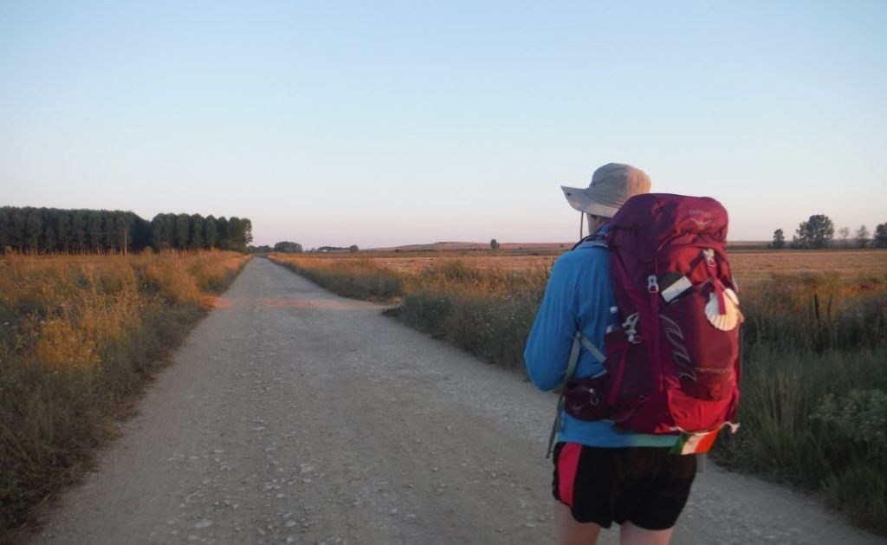
Rucksack Prayer – Part 1

Slide 5
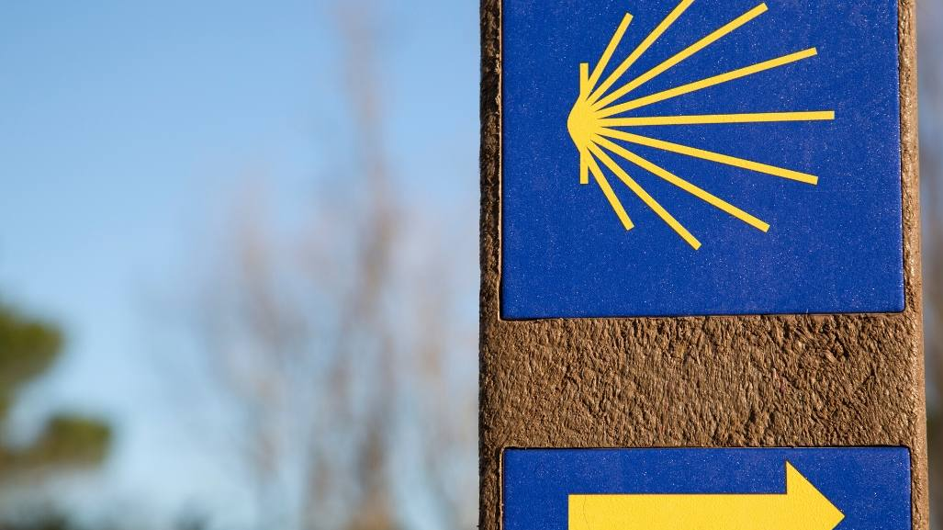
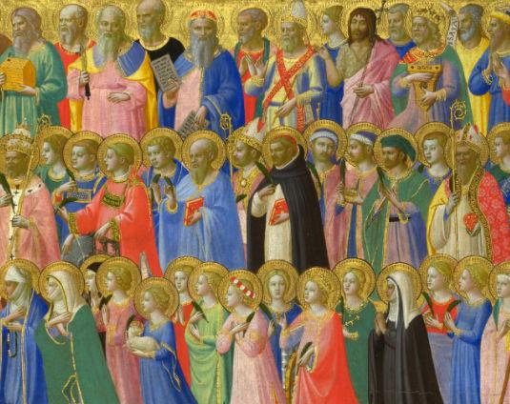
A Journey with the Saints

Slide 6
Scripture Reading – 1 Corinthians 1: 2
To the Church of God in Corinth, to those who have been consecrated in Christ Jesus and called to be God’s holy people, with all those everywhere who call on the name of our Lord Jesus Christ, their Lord as well as ours.

Slide 7
From what you have heard so far…
…what are your Initial thoughts, reactions, questions that come to mind?
We can discuss these later…

Slide 8
Main Input – What is a Saint?

Slide 10
Catechism of the Catholic Church
The Church is a ‘communion of saints’: this expression refers first to the ‘holy things’ (sancta), above all the Eucharist, by which ‘the unity of believers, who form one body in Christ, is both represented and brought about’ (LG3).
The term ‘communion of saints’ refers also to the communion of ‘holy persons’ (sancti) in Christ who ‘died for all’, so that what each one does or suffers in and for Christ bears fruit for all.
‘We believe in the communion of all the faithful of Christ, those who are pilgrims on earth, the dead who are being purified, and the blessed in heaven, all together forming one Church; and we believe that in this communion, the merciful love of God and his saints is always [attentive] to our prayers’ (Paul VI, CPG)

Slide 11
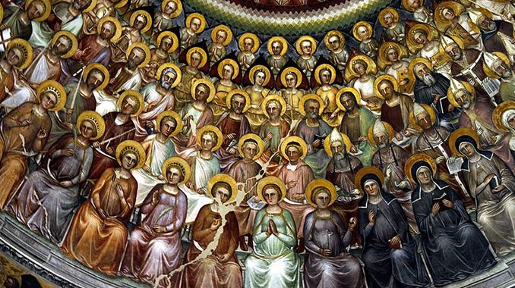
Discussion
How are we all called to be Saints?
Can you name a couple of Saints; why might people say why they are Saints?
Discuss this is two’s & three’s then feedback to the main group

Slide 12
Internet Corner - Where to find out more…
www.wordonfire.org/resources/browse/saint/
www.catholic.org/saints/

Slide 13
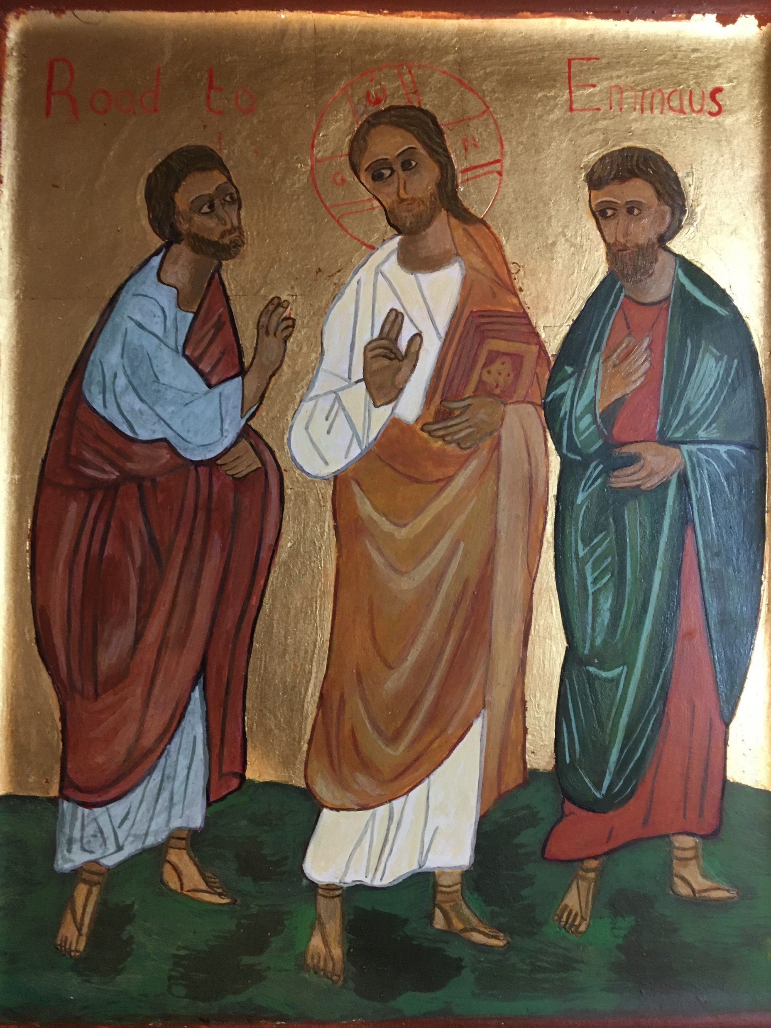
Conversation with Jesus
Focus on this image of Jesus and open your heart to Him now.
Take this opportunity to talk to him in your mind and heart.
Listen and be aware of his presence with you.
You may want to use this hymn to help you pray

Slide 14
Spiritual Journal
You may want to write down what has been important for you during this time together

Slide 15
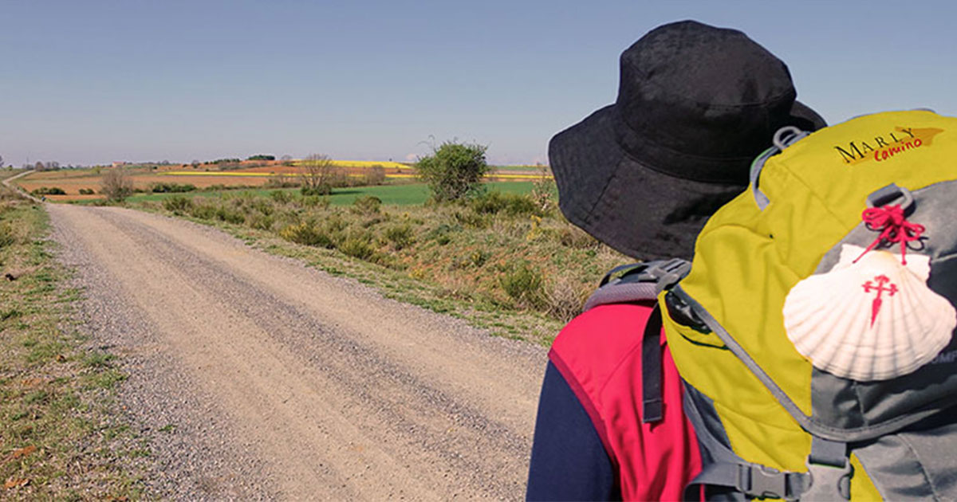
Rucksack Prayer – Part 2

Slide 16
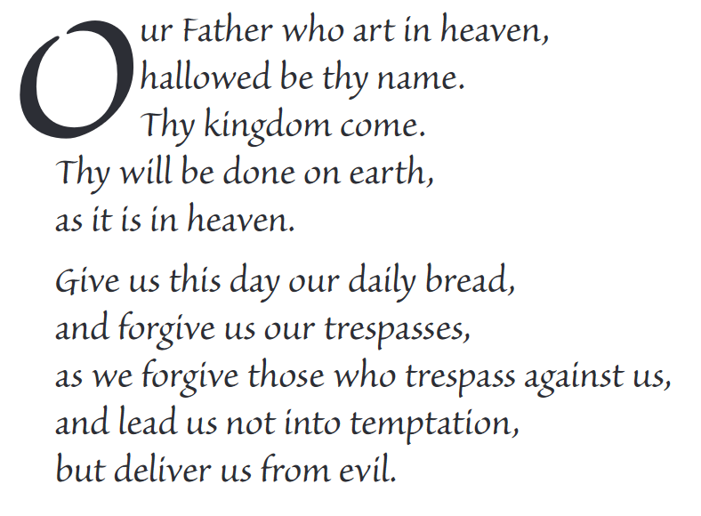
The Lord’s Prayer

Slide 17
Final pilgrim blessing for the week ahead
God of our pilgrimage,
you have given us a desire
to take the questing way
and set out on our journey.
Help us to keep our eyes fixed on Jesus,
that whatever we encounter as we travel,
we may seek to glorify you by the way we live.
You call us, Lord,
to leave familiar things and to leave our “comfort zone”.
May we open our eyes to new experiences,
may we open our ears to hear you speaking to us
and may we open our hearts to your love.
Grant that this time spent on pilgrimage
may help us to see ourselves as we really are
and may we strive to become the people you would have us be. Amen
… continued on next slide

Slide 18
Final pilgrim blessing for the week ahead
Lord, you know our beginning and our end.
Help us to realise we are only pilgrims on this earth
and save us from being too attached to worldly possessions.
May we experience the freedom to wander,
the freedom to hope and the freedom to love as we journey. Amen
Creator God, you are the source of all life and motivation.
May we journey in faith and love, rejoicing and eager to serve you.
Grant us a glimpse of your glory as we seek to follow you –
the Way, the Truth and the Life. Amen
May God the Father who created you, guide your footsteps,
May God the Son who redeemed you, share your journey,
May God the Holy Spirit who sanctifies you, lead you on life’s pilgrimage,
and the blessing of God, Father, Son and Holy Spirit
be with you wherever you may go. Amen.

Slide 19
CAMINO
Making the Journey…
Session 12
Making the journey with the Saints

