Slide 1
CAMINO
Making the Journey…
Session 13
Making the journey with the Sacraments

Slide 2
Introduction
The sacraments are a rich treasure and a very important part of the Roman Catholic Church and its identity. The sacraments are ensured encounters with Christ to help us on our pilgrim journey on this earth. They are to strengthen us in our Christian life and heal us when we need healing so that we can proclaim the Gospel. Consider the different sacraments as encounters with Jesus in a very special way and how they strengthen us on our pilgrim journey. The sacraments are a great gift from God that confirm the abiding presence of Christ amongst us. When we receive the sacraments, it is Christ himself that we are receiving more fully into our lives. This helps us on the Way.

Slide 3
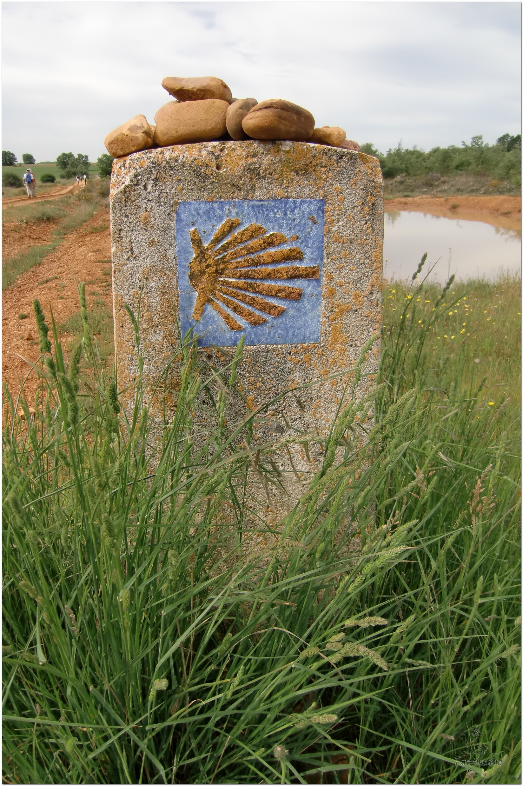
Opening Prayer
The Camino Prayer (adapted)
O God, who brought your servant Abraham out of the land of the Chaldeans, protecting him in his wanderings, who guided the Hebrew people across the desert, we ask that you watch over us, your servants, as we walk in the love of your name.
Be for us our companion on the journey,
Our guide at the crossroads, Our breath in our weariness,
Our protection in danger, our albergue on the Camino,
Our shade in the heat, Our light in the darkness,
Our consolation in our discouragements,
And our strength in our intentions.
So that with your guidance we may arrive safe and sound at the end of the road and enriched with grace and virtue we return safely to our homes filled with joy.
In the name of Jesus Christ our Lord, Amen. Apostle Santiago, pray for us. Santa Maria, pray for us.

Slide 4
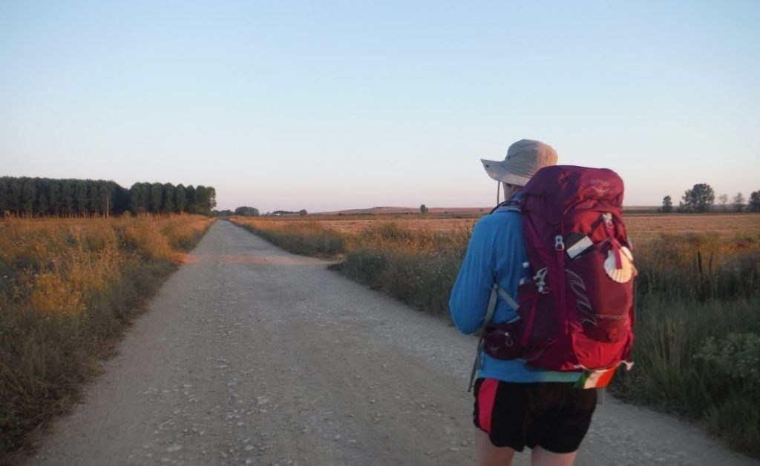
Rucksack Prayer – Part 1

Slide 5
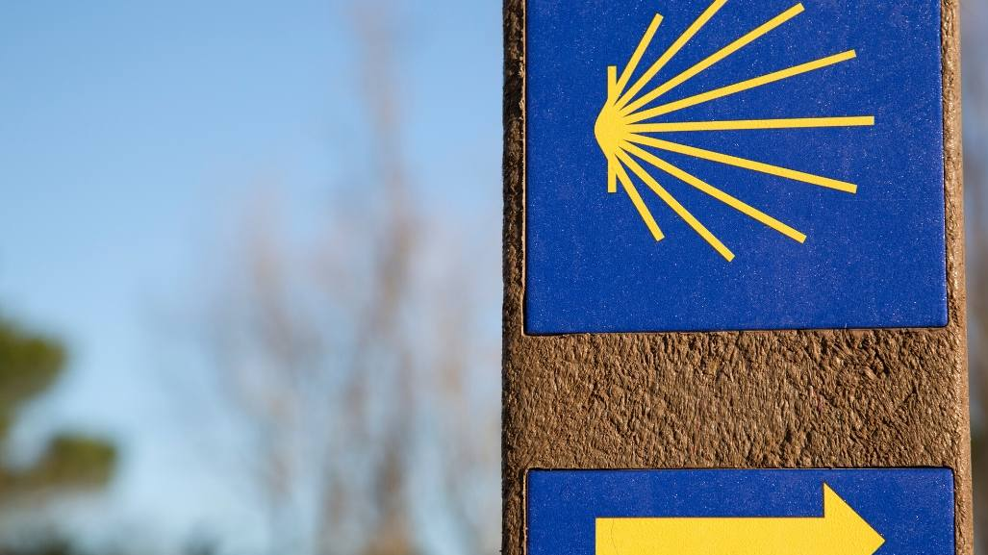
A Journey with
The Sacraments

Slide 6
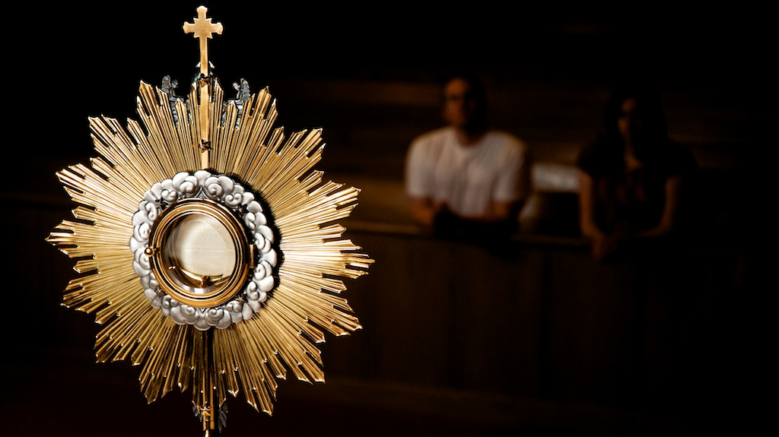
Scripture Reading – Matthew 28:16-20
Now the eleven disciples went to Galilee, to the mountain to which Jesus had directed them. And when they saw him they worshiped him, but some doubted. And Jesus came and said to them, “All authority in heaven and on earth has been given to me. Go therefore and make disciples of all nations, baptising them in the name of the Father and of the Son and of the Holy Spirit, teaching them to observe all that I have commanded you. And know,
I am with you always, to the end of time.”

Slide 7
From what you have heard so far…
…what are your Initial thoughts, reactions, questions that come to mind?
We can discuss these later…

Slide 8
What are the Sacraments and why do we need them?
We are a physical people. We like to be able to touch, smell, taste and see things. God knew this when He gave us the Sacraments. They are a outward sign of an inward reality and help us to think about things we can’t see.

Slide 9
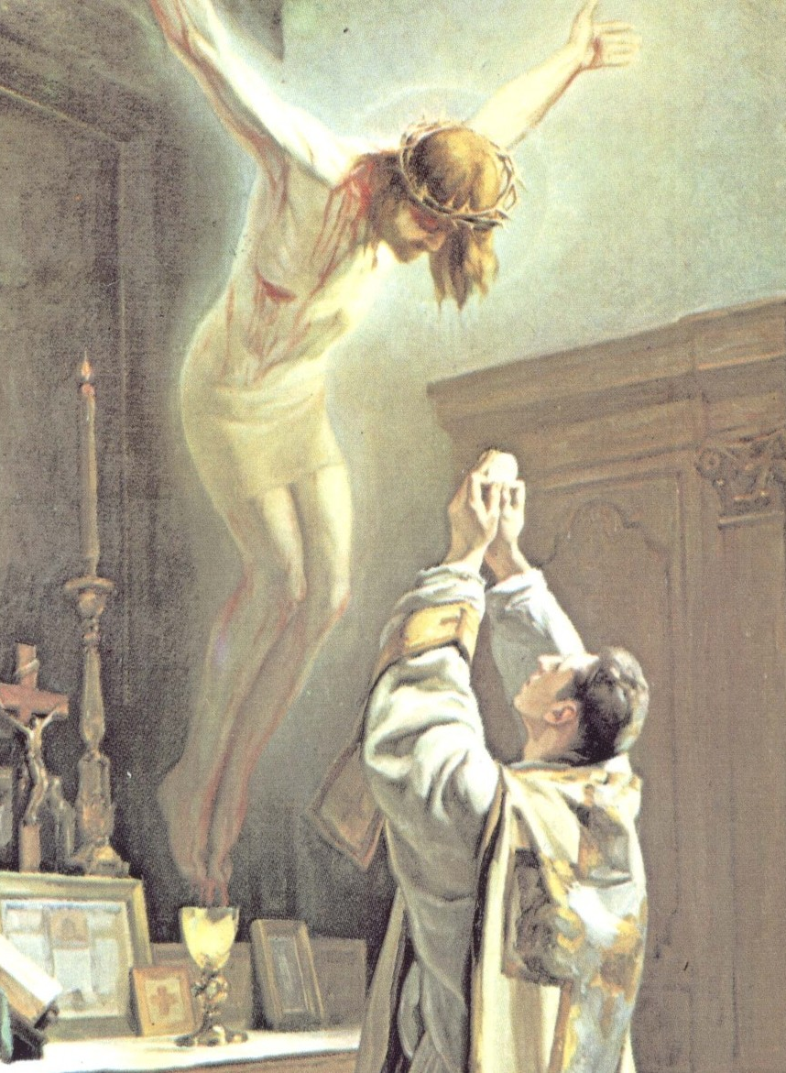
The Holy Mass – the source & summit of our Faith
“I am the bread of life. Those who come to me shall never hunger and whoever believes in me will never thirst”
John 3:35

Slide 10
Jesus comes to meet us
“You didn’t want Heaven without us so Jesus you brought Heaven down”

Slide 11
Discussion
SACRAMENT
The word Sacrament. What does this mean to you?
Discuss this is two’s & three’s then feedback to the main group

Slide 12
Catechism of the Catholic Church
1131 The sacraments are efficacious signs of grace, instituted by Christ and entrusted to the Church, by which divine life is dispensed to us. the visible rites by which the sacraments are celebrated signify and make present the graces proper to each sacrament. They bear fruit in those who receive them with the required dispositions.
1132 The Church celebrates the sacraments as a priestly community structured by the baptismal priesthood and the priesthood of ordained ministers.
1133 The Holy Spirit prepares the faithful for the sacraments by the Word of God and the faith which welcomes that word in well-disposed hearts. Thus the sacraments strengthen faith and express it.
1134 The fruit of sacramental life is both personal and ecclesial. For every one of the faithful an the one hand, this fruit is life for God in Christ Jesus; for the Church, on the other, it is an increase in charity and in her mission of witness.

Slide 13
Question
What are the Sacraments?

Slide 14
Internet Corner - Where to find out more…
Sycamore video on the Sacraments
Mass Readings & Prayers of the Church
universalis.com/

Slide 15
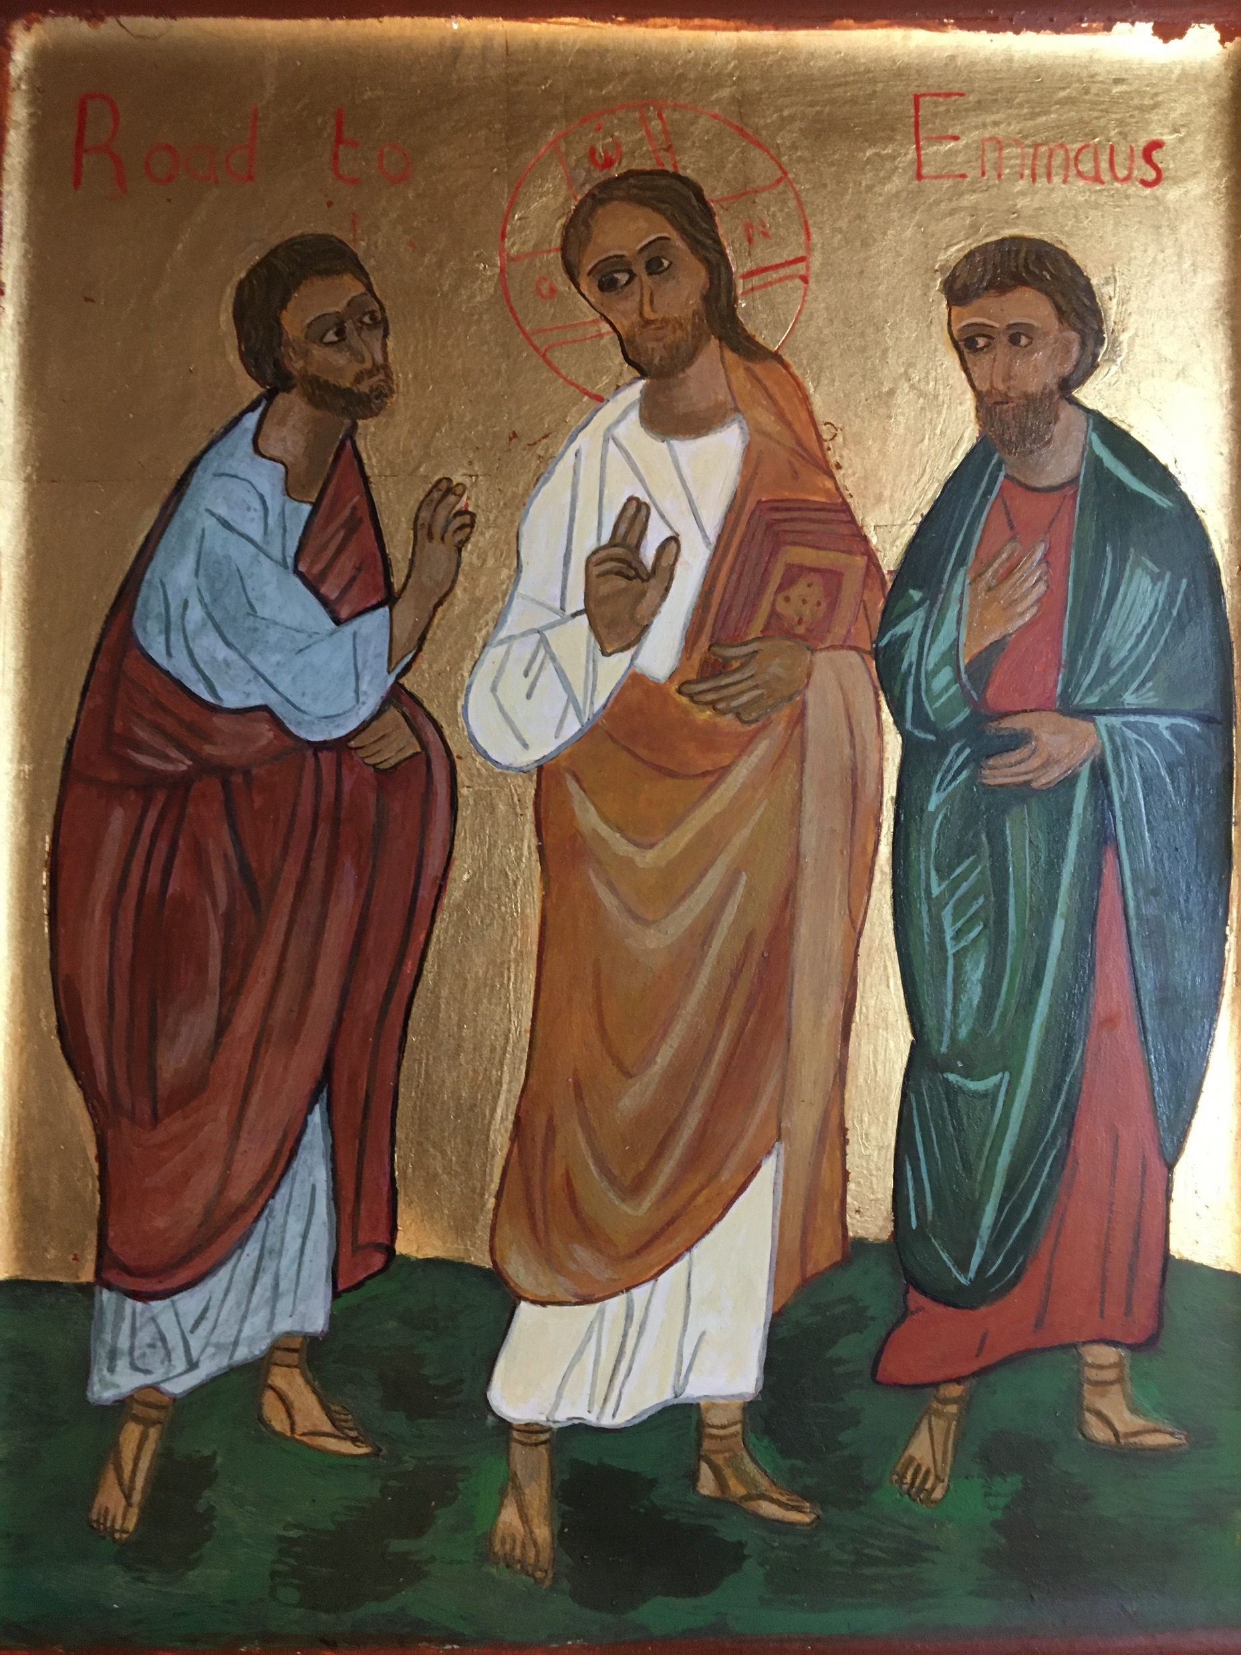
Conversation with Jesus
Focus on this image of Jesus and open your heart to Him now.
Take this opportunity to talk to him in your mind and heart.
Listen and be aware of his presence with you.
You may want to use this hymn to help you pray

Slide 16
Spiritual Journal
You may want to write down what has been important for you during this time together

Slide 17
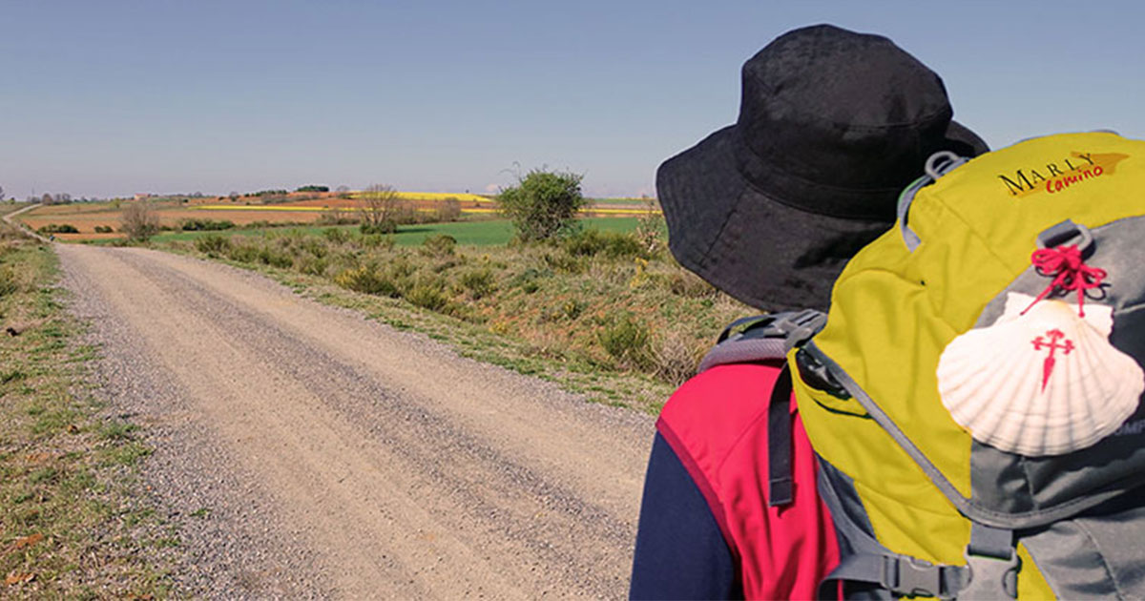
Rucksack Prayer – Part 2

Slide 18
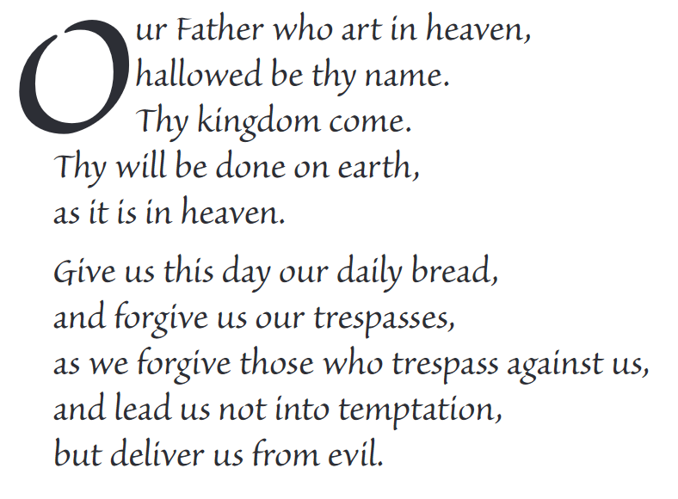
The Lord’s Prayer

Slide 19
Final pilgrim blessing for the week ahead
God of our pilgrimage,
you have given us a desire
to take the questing way
and set out on our journey.
Help us to keep our eyes fixed on Jesus,
that whatever we encounter as we travel,
we may seek to glorify you by the way we live.
You call us, Lord,
to leave familiar things and to leave our “comfort zone”.
May we open our eyes to new experiences,
may we open our ears to hear you speaking to us
and may we open our hearts to your love.
Grant that this time spent on pilgrimage
may help us to see ourselves as we really are
and may we strive to become the people you would have us be. Amen
… continued on next slide

Slide 20
Final pilgrim blessing for the week ahead
Lord, you know our beginning and our end.
Help us to realise we are only pilgrims on this earth
and save us from being too attached to worldly possessions.
May we experience the freedom to wander,
the freedom to hope and the freedom to love as we journey. Amen
Creator God, you are the source of all life and motivation.
May we journey in faith and love, rejoicing and eager to serve you.
Grant us a glimpse of your glory as we seek to follow you –
the Way, the Truth and the Life. Amen
May God the Father who created you, guide your footsteps,
May God the Son who redeemed you, share your journey,
May God the Holy Spirit who sanctifies you, lead you on life’s pilgrimage,
and the blessing of God, Father, Son and Holy Spirit
be with you wherever you may go. Amen.

Slide 21
CAMINO
Making the Journey…
Session 13
Making the journey with the Sacraments

