Slide 1
CAMINO
Making the Journey…
Session 14
Making the journey with Baptism

Slide 2
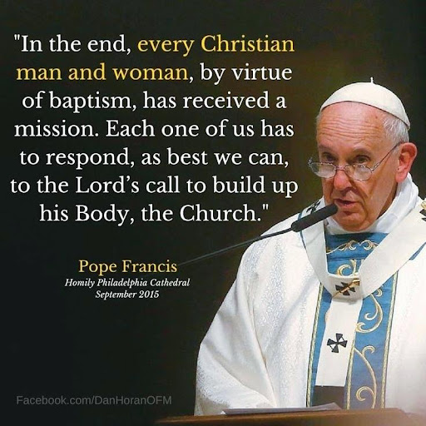
Introduction
Baptism marks out the beginning of our journey in faith by formally welcoming us into the Church. Jesus chose to be baptised, though he did not need to be and by doing so, gave us an example to follow. Baptism reminds us that we are known and loved by God, that we are part of the family of God and have a calling from God. The preparatory and explanatory rites help us to understand this sacrament and show us that it is the gateway to all the other sacraments. It reminds us of the hope that we are given as Christians through following Christ as pilgrims on this earth. Baptism contrasts with a negative view of life that sees it is random and ultimately pointless.

Slide 3
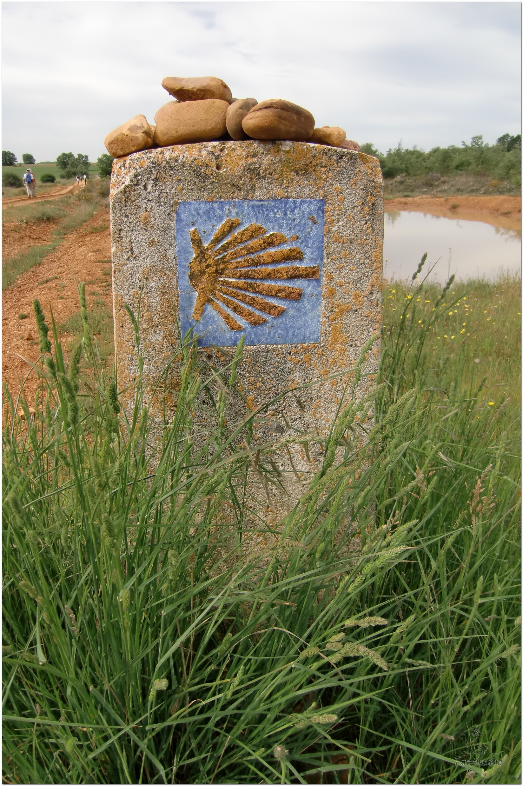
Opening Prayer
The Camino Prayer (adapted)
O God, who brought your servant Abraham out of the land of the Chaldeans, protecting him in his wanderings, who guided the Hebrew people across the desert, we ask that you watch over us, your servants, as we walk in the love of your name.
Be for us our companion on the journey,
Our guide at the crossroads, Our breath in our weariness,
Our protection in danger, our albergue on the Camino,
Our shade in the heat, Our light in the darkness,
Our consolation in our discouragements,
And our strength in our intentions.
So that with your guidance we may arrive safe and sound at the end of the road and enriched with grace and virtue we return safely to our homes filled with joy.
In the name of Jesus Christ our Lord, Amen. Apostle Santiago, pray for us. Santa Maria, pray for us.

Slide 4
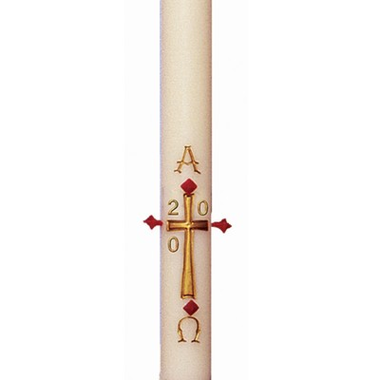
Catholicism in a Hundred Objects
This video is 14 minutes long so watch as much or as little as you like
Paschal Candle

Slide 5
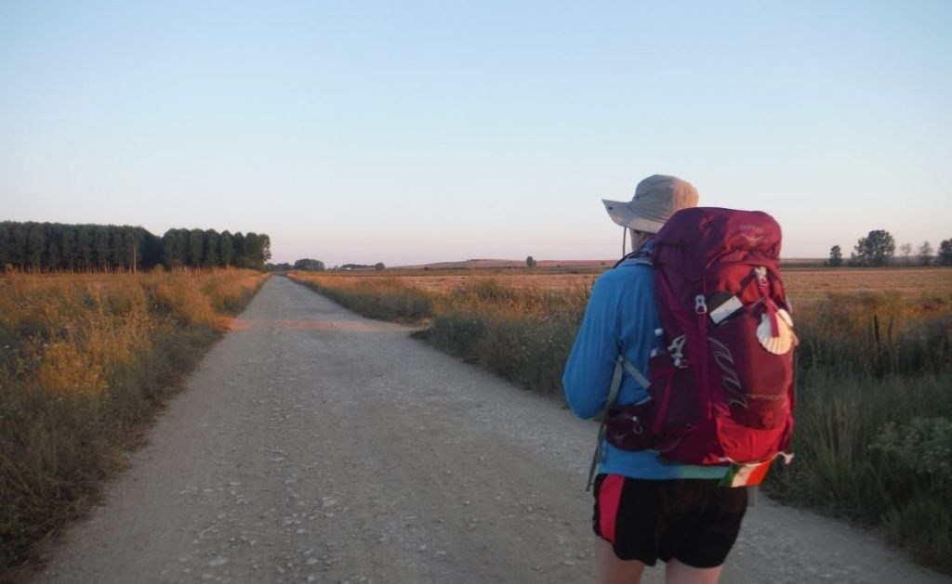
Rucksack Prayer – Part 1

Slide 6
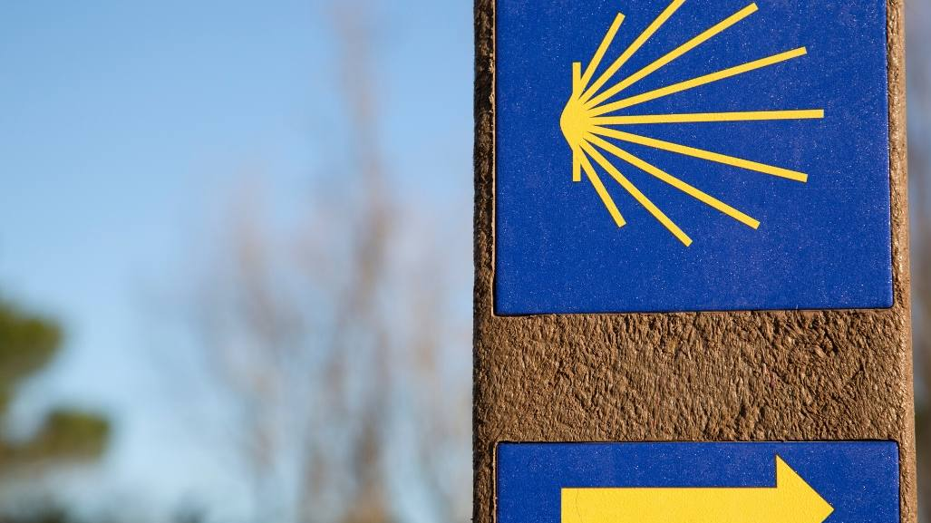
A Journey with Baptism

Slide 7
Scripture Reading – The Baptism of Jesus – Matthew 3 – 13:17
Then Jesus came from Galilee to the Jordan to be baptized by John. But John tried to deter him, saying, “I need to be baptized by you, and do you come to me?”
Jesus replied, “Let it be so now; it is proper for us to do this to fulfil all righteousness.” Then John consented.
As soon as Jesus was baptized, he went up out of the water. At that moment heaven was opened, and he saw the Spirit of God descending like a dove and alighting on him. And a voice from heaven said, “This is my Son, whom I love; with him I am well pleased.”

Slide 8
From what you have heard so far…
…what are your Initial thoughts, reactions, questions that come to mind?
We can discuss these later…

Slide 9
Main Input
“It Was Not You Who Chose Me, but I Who Chose You”
John 15:16

Slide 10
Reflection
“Now in him I live”

Slide 11
Pope Francis on the meaning of Baptism

Slide 12
Catechism of the Catholic Church
315 In the creation of the world and of man, God gave the first and universal witness to his almighty love and his wisdom, the first proclamation of the "plan of his loving goodness", which finds its goal in the new creation in Christ.
316 Though the work of creation is attributed to the Father in particular, it is equally a truth of faith that the Father, Son and Holy Spirit together are the one, indivisible principle of creation.
317 God alone created the universe, freely, directly and without any help.
318 No creature has the infinite power necessary to "create" in the proper sense of the word, that is, to produce and give being to that which had in no way possessed it (to call into existence "out of nothing") (cf DS 3624).
319 God created the world to show forth and communicate his glory. That his creatures should share in his truth, goodness and beauty - this is the glory for which God created them.
320 God created the universe and keeps it in existence by his Word, the Son "upholding the universe by his word of power" (Heb 1:3), and by his Creator Spirit, the giver of life.
323 Divine providence works also through the actions of creatures. To human beings God grants the ability to cooperate freely with his plans.

Slide 13
Question
Why do we baptise?

Slide 14
Discussion
What excites you about the knowledge that you have been baptised or that you might get baptised?
Discuss this is two’s & three’s then feedback to the main group

Slide 15
Internet Corner - Where to find out more…
Sycamore Short - Baptism
faithcafe.org/collections/baptism

Slide 16
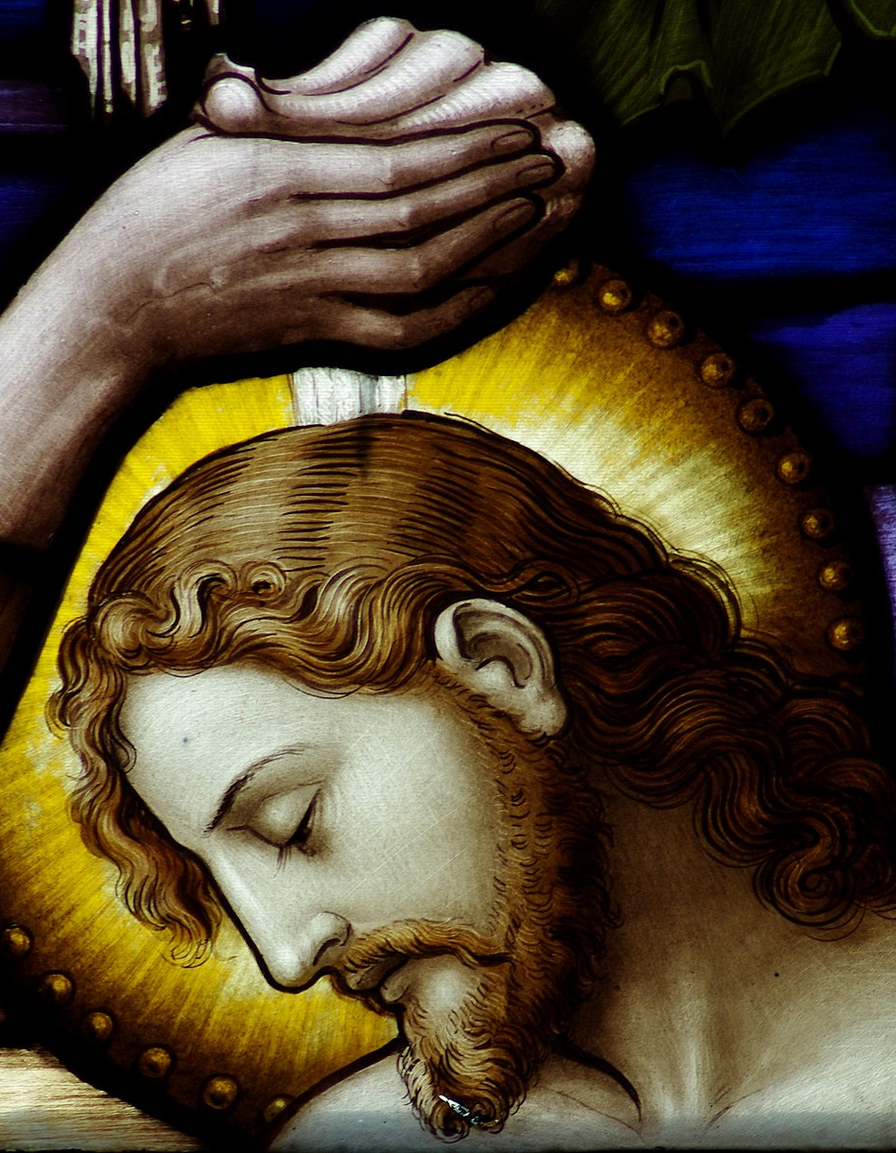
Conversation with Jesus
Focus on this image of Jesus and open your heart to Him now.
Take this opportunity to talk to him in your mind and heart.
Listen and be aware of his presence with you.
You may want to use this hymn to help you pray

Slide 17
Spiritual Journal
You may want to write down what has been important for you during this time together

Slide 18
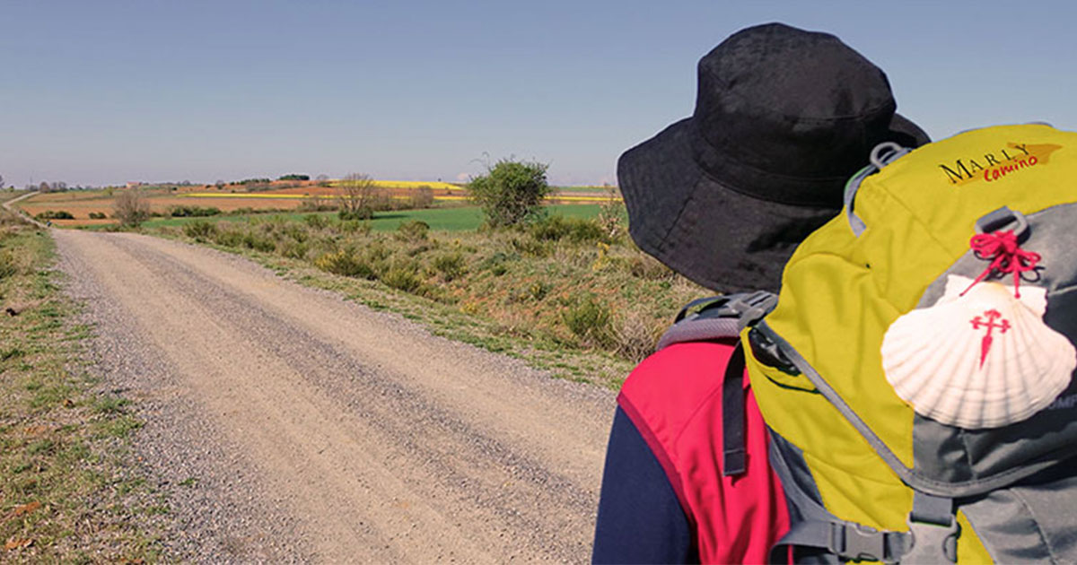
Rucksack Prayer – Part 2

Slide 19
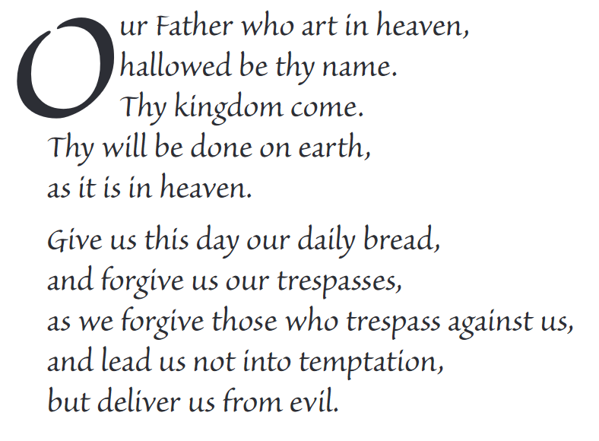
The Lord’s Prayer

Slide 20
Final pilgrim blessing for the week ahead
God of our pilgrimage,
you have given us a desire
to take the questing way
and set out on our journey.
Help us to keep our eyes fixed on Jesus,
that whatever we encounter as we travel,
we may seek to glorify you by the way we live.
You call us, Lord,
to leave familiar things and to leave our “comfort zone”.
May we open our eyes to new experiences,
may we open our ears to hear you speaking to us
and may we open our hearts to your love.
Grant that this time spent on pilgrimage
may help us to see ourselves as we really are
and may we strive to become the people you would have us be. Amen
… continued on next slide

Slide 21
Final pilgrim blessing for the week ahead
Lord, you know our beginning and our end.
Help us to realise we are only pilgrims on this earth
and save us from being too attached to worldly possessions.
May we experience the freedom to wander,
the freedom to hope and the freedom to love as we journey. Amen
Creator God, you are the source of all life and motivation.
May we journey in faith and love, rejoicing and eager to serve you.
Grant us a glimpse of your glory as we seek to follow you –
the Way, the Truth and the Life. Amen
May God the Father who created you, guide your footsteps,
May God the Son who redeemed you, share your journey,
May God the Holy Spirit who sanctifies you, lead you on life’s pilgrimage,
and the blessing of God, Father, Son and Holy Spirit
be with you wherever you may go. Amen.

Slide 22
CAMINO
Making the Journey…
Session 14
Making the journey with Baptism

