Slide 1
CAMINO
Making the Journey…
Session 15
Making the journey with the Mass – The Liturgy of the Word & Eucharist

Slide 2
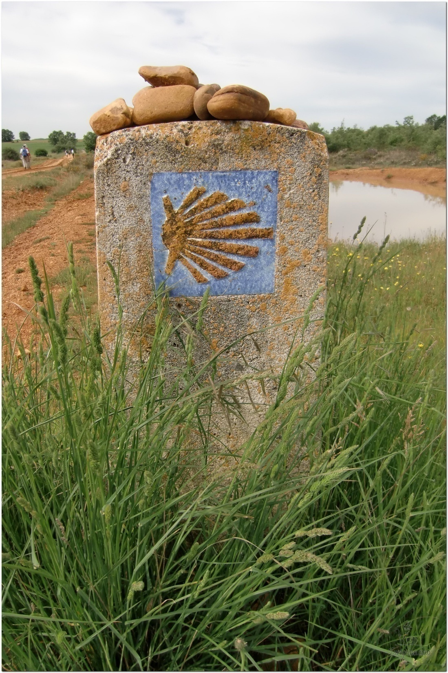
Opening Prayer
The Camino Prayer (adapted)
O God, who brought your servant Abraham out of the land of the Chaldeans, protecting him in his wanderings, who guided the Hebrew people across the desert, we ask that you watch over us, your servants, as we walk in the love of your name.
Be for us our companion on the journey,
Our guide at the crossroads, Our breath in our weariness,
Our protection in danger, our albergue on the Camino,
Our shade in the heat, Our light in the darkness,
Our consolation in our discouragements,
And our strength in our intentions.
So that with your guidance we may arrive safe and sound at the end of the road and enriched with grace and virtue we return safely to our homes filled with joy.
In the name of Jesus Christ our Lord, Amen. Apostle Santiago, pray for us. Santa Maria, pray for us.

Slide 3
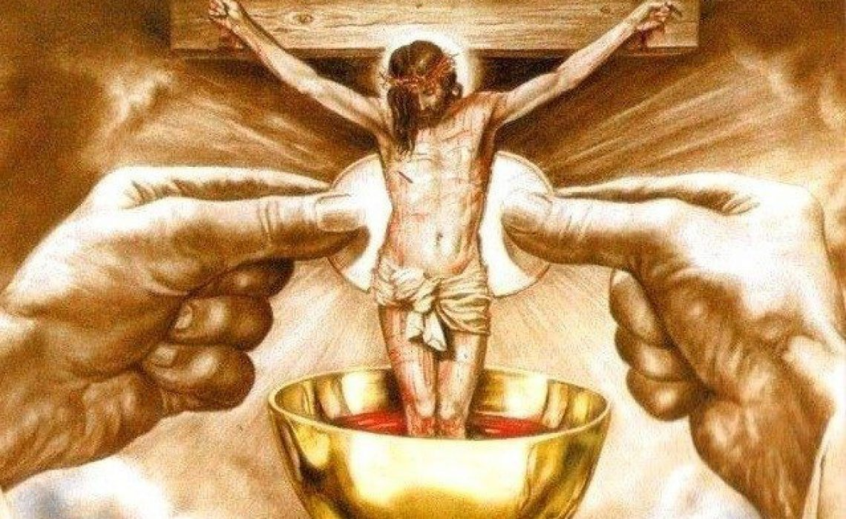
Introduction
In this session we will look at Celebration and Sacrifice of Holy Mass and the Sacrament of the Eucharist.
At the last supper Jesus instituted the Mass and asked us to do this in memory of Him, remembering his Sacrifice for us on the cross.
By the power of the Holy Spirit the elements of Bread and Wine become the Body, Blood, Soul and Divinity of Jesus Christ.
The Mass has two main parts, Liturgy of the Word and the Liturgy of the Eucharist.

Slide 4
What is Mass?

Slide 5
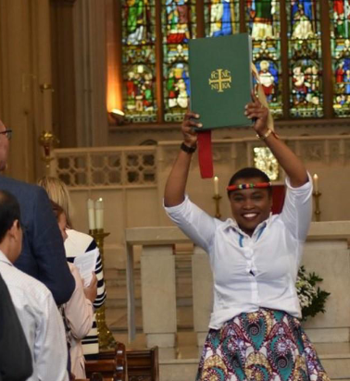
The Liturgy of the Word

Slide 6
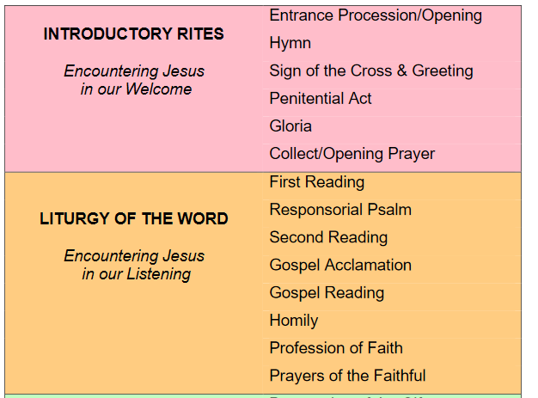
The Liturgy of the Word

Slide 7
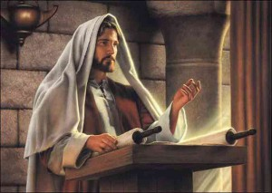
Scripture Reading - Luke 4:17-21
Jesus went to Nazareth, where he had been brought up, and on the Sabbath day he went into the synagogue, as was his custom. He stood up to read, and the scroll of the prophet Isaiah was handed to him. Unrolling it, he found the place where it is written:
“The Spirit of the Lord is on me, because he has anointed me to proclaim good news to the poor. He has sent me to proclaim freedom for the prisoners and recovery of sight for the blind, to set the oppressed free, to proclaim the year of the Lord’s favour.”
Then he rolled up the scroll, gave it back to the attendant and sat down. The eyes of everyone in the synagogue were fastened on him. He began by saying to them, “Today this scripture is fulfilled in your hearing.”

Slide 8
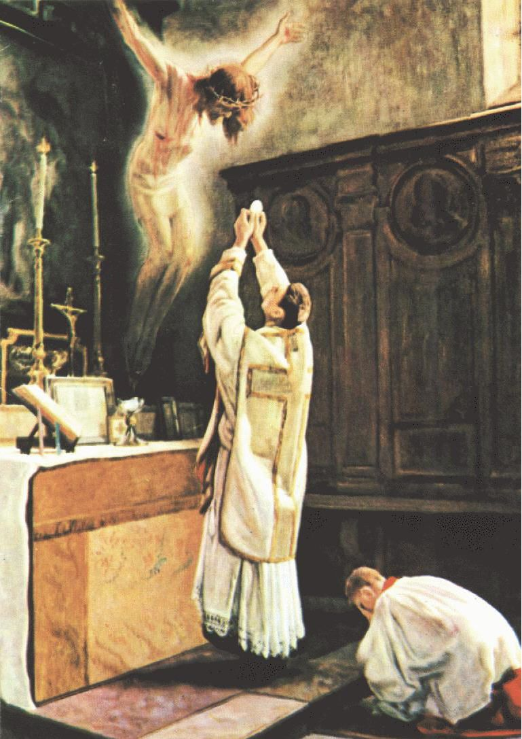
The Liturgy of the Eucharist

Slide 9
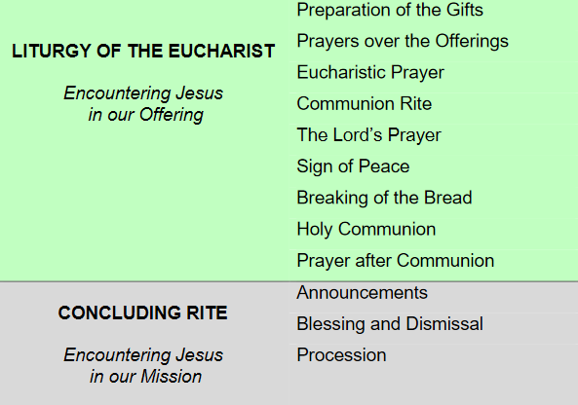
The Liturgy of the Eucharist

Slide 10
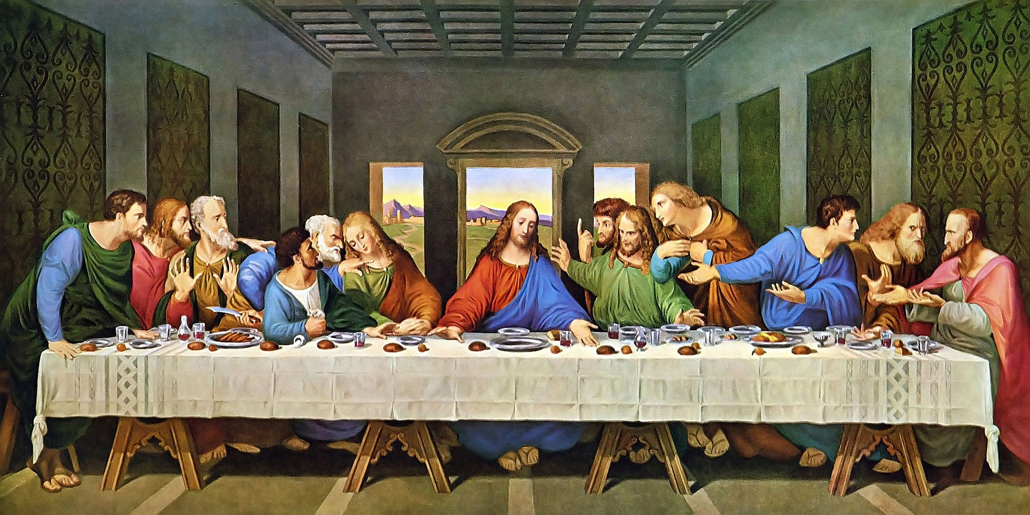
Scripture Reading - 1Cor 11:23-26
For the tradition I received from the Lord and also handed on to you is that on the night he was betrayed, the Lord Jesus took some bread, and after he had given thanks, he broke it, and he said, 'This is my body, which is for you; do this in remembrance of me.‘ And in the same way, with the cup after supper, saying, 'This cup is the new covenant in my blood. Whenever you drink it, do this as a memorial of me.‘ Whenever you eat this bread, then, and drink this cup, you are proclaiming the Lord's death until he comes.

Slide 11
What is Mass?
Key phrases/words
Tradition – handed on Body - blood
Received from the Lord Covenant
Bread – wine Memorial
Gave thanks Proclaim the Lord’s death
Broke

Slide 13
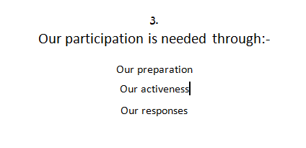

Slide 14
Catechism of the Catholic Church
1356 – 1381 The Mass as Sacrifice, Memorial, Thanksgiving and Presence
Sacrifice: re-presents the same sacrifice of Christ in an un-blooded manner
Memorial – makes present the reality it signifies (not just recalls or re-enacts it)
MASS =
Thanksgiving – praise of God and what He has done (eucharistia – thank you)
Presence – Power of the Word of God & the Holy Spirit – Real Presence of Christ

Slide 15
Catechism of the Catholic Church – The Mass of the Ages
CCC1345 As early as the second century we have the witness of St. Justin Martyr for the basic lines of the order of the Eucharistic celebration. They have stayed the same until our own day for all the great liturgical families. St. Justin wrote to the pagan emperor Antoninus Pius (138-161) around the year 155, explaining what Christians did:
On the day we call the day of the sun, all who dwell in the city or country gather in the same place. The memoirs of the apostles and the writings of the prophets are read, as much as time permits. When the reader has finished, he who presides over those gathered admonishes and challenges them to imitate these beautiful things. Then we all rise together and offer prayers* for ourselves . . .and for all others, wherever they may be, so that we may be found righteous by our life and actions, and faithful to the commandments, so as to obtain eternal salvation. When the prayers are concluded we exchange the kiss. Then someone brings bread and a cup of water and wine mixed together to him who presides over the brethren. He takes them and offers praise and glory to the Father of the universe, through the name of the Son and of the Holy Spirit and for a considerable time he gives thanks (in Greek: eucharistian) that we have been judged worthy of these gifts. When he has concluded the prayers and thanksgivings, all present give voice to an acclamation by saying: 'Amen.' When he who presides has given thanks and the people have responded, those whom we call deacons give to those present the "eucharisted" bread, wine and water and take them to those who are absent.

Slide 16
From what you have heard so far…
…what are your Initial thoughts, reactions, questions that come to mind?
We can discuss these later…

Slide 17
Reflection
What this video to see what is really happening at every Mass if only we could we it.
At the Mass, Heaven touches Earth!

Slide 18
Discussion
How is sacrifice connected to holiness and love ?
Discussion Question
Discuss this is two’s & three’s then feedback to the main group

Slide 19
Discussion
Can you name any of the different elements of the Mass from the 2nd Century account ?
Discussion Question
Discuss this is two’s & three’s then feedback to the main group

Slide 20
Sacrifice
SACRE – HOLY
FICERE – TO Do / To Make
Any SACRIFICE is to do or make something holy
WHY ?
Because it shows LOVE
and GOD IS LOVE
The greater the sacrifice – the greater the love shown
REFLECTION - What application does this have in our lives?

Slide 21
The Parts of the Mass

Slide 22
Mass
PURGATIVE
WAY
Penitential Rite
ILLUMINATIVE
WAY
Liturgy of the Word
UNITIVE
WAY
Communion Rite

Slide 23
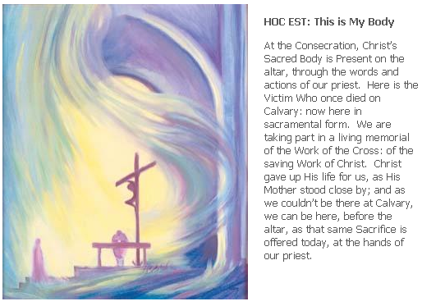
The Mass in Art by Elizabeth Wang

Slide 24
Spiritual Journal
You may want to write down what has been important for you during this time together

Slide 25
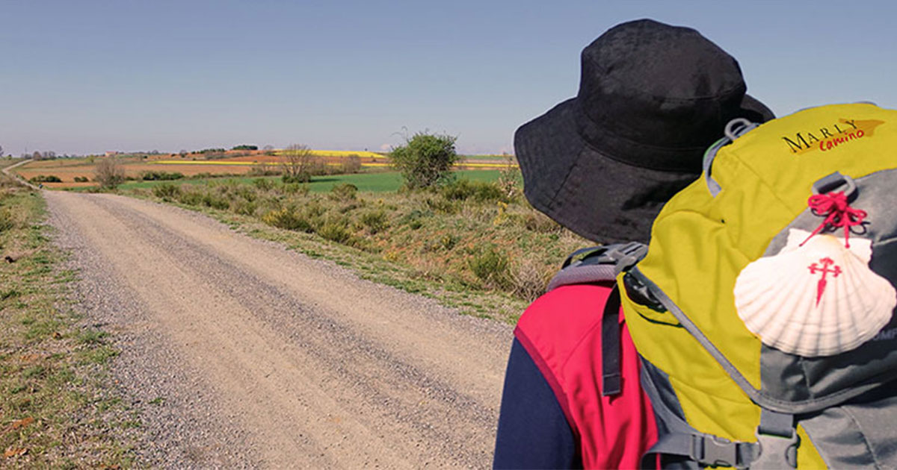
Rucksack Prayer – Part 2

Slide 26
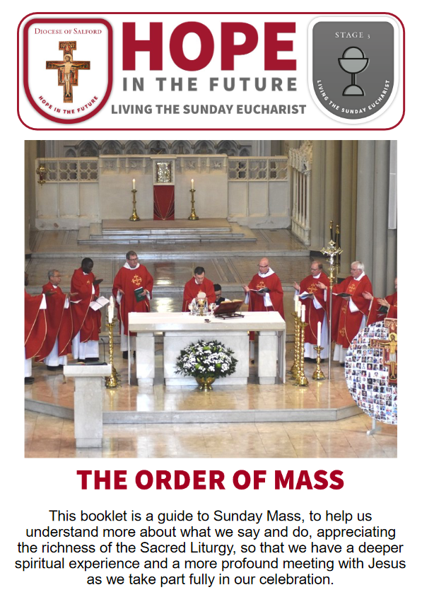
Internet Corner - Where to find out more…
www.dioceseofsalford.org.uk/faith/sacraments/parents-videos/
www.dioceseofsalford.org.uk/wp-content/uploads/Order-of-Mass-Booklet.pdf

Slide 27
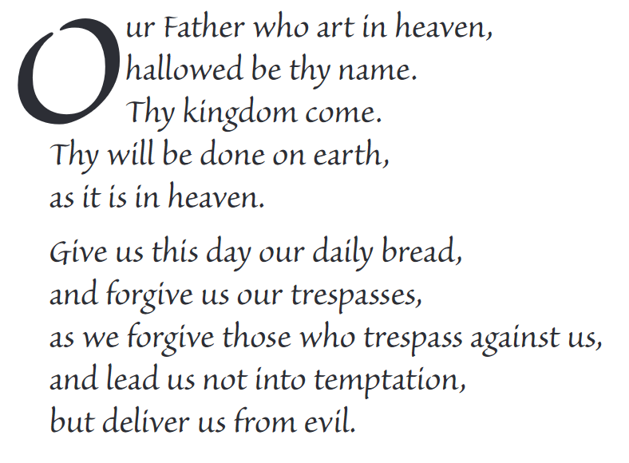
The Lord’s Prayer
You may want to use this hymn to help you pray
© - Bread of life by CJM Music

Slide 28
Final pilgrim blessing for the week ahead
God of our pilgrimage,
you have given us a desire
to take the questing way
and set out on our journey.
Help us to keep our eyes fixed on Jesus,
that whatever we encounter as we travel,
we may seek to glorify you by the way we live.
You call us, Lord,
to leave familiar things and to leave our “comfort zone”.
May we open our eyes to new experiences,
may we open our ears to hear you speaking to us
and may we open our hearts to your love.
Grant that this time spent on pilgrimage
may help us to see ourselves as we really are
and may we strive to become the people you would have us be. Amen
… continued on next slide

Slide 29
Final pilgrim blessing for the week ahead
Lord, you know our beginning and our end.
Help us to realise we are only pilgrims on this earth
and save us from being too attached to worldly possessions.
May we experience the freedom to wander,
the freedom to hope and the freedom to love as we journey. Amen
Creator God, you are the source of all life and motivation.
May we journey in faith and love, rejoicing and eager to serve you.
Grant us a glimpse of your glory as we seek to follow you –
the Way, the Truth and the Life. Amen
May God the Father who created you, guide your footsteps,
May God the Son who redeemed you, share your journey,
May God the Holy Spirit who sanctifies you, lead you on life’s pilgrimage,
and the blessing of God, Father, Son and Holy Spirit
be with you wherever you may go. Amen.

Slide 30
CAMINO
Making the Journey…
Session 15
Making the journey with the Mass – The Liturgy of the Word & Eucharist

