Slide 1
CAMINO
Making the Journey…
Session 16
Making the journey with the Holy Spirit –
Pentecost and Confirmation

Slide 2
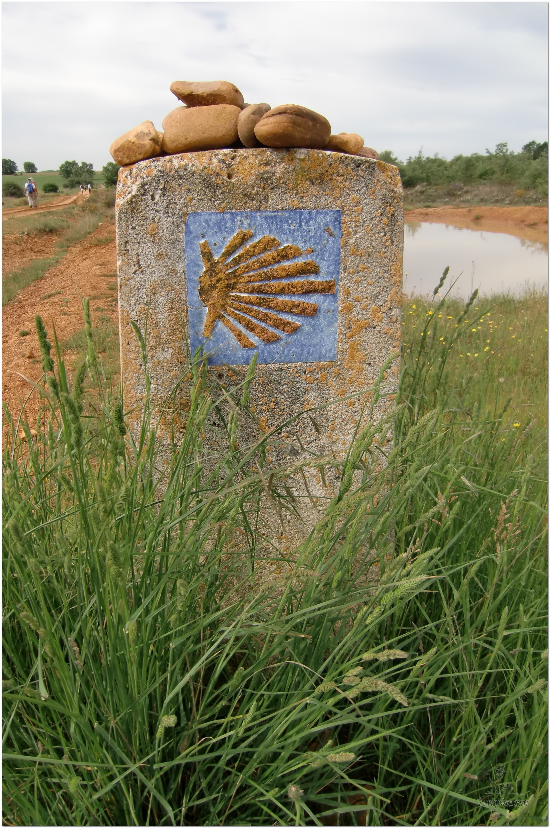
Opening Prayer
The Camino Prayer (adapted)
O God, who brought your servant Abraham out of the land of the Chaldeans, protecting him in his wanderings, who guided the Hebrew people across the desert, we ask that you watch over us, your servants, as we walk in the love of your name.
Be for us our companion on the journey,
Our guide at the crossroads, Our breath in our weariness,
Our protection in danger, our albergue on the Camino,
Our shade in the heat, Our light in the darkness,
Our consolation in our discouragements,
And our strength in our intentions.
So that with your guidance we may arrive safe and sound at the end of the road and enriched with grace and virtue we return safely to our homes filled with joy.
In the name of Jesus Christ our Lord, Amen. Apostle Santiago, pray for us. Santa Maria, pray for us.

Slide 3
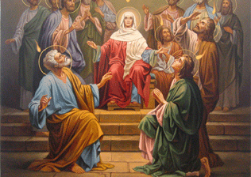
Introduction
In this session, we will help people to recognise the importance of the Holy Spirit on our pilgrim journey. The gifts and the fruits of the Holy Spirit are given to us to make us literally charismatic in a way that will draw other people to Christ. They will also help deepen our relationship with Christ and our understanding of who he truly is and strengthen us for our own faith journey and what God asks of us. The Holy Spirit will help us to know the story of Pentecost and how that transformed the disciples and turned them inside out and into apostles. The Holy Spirit will also help us to understand that in sacred confirmation we receive the Holy Spirit and this, if we are fully open to the Holy Spirit, will transform us too!

Slide 4
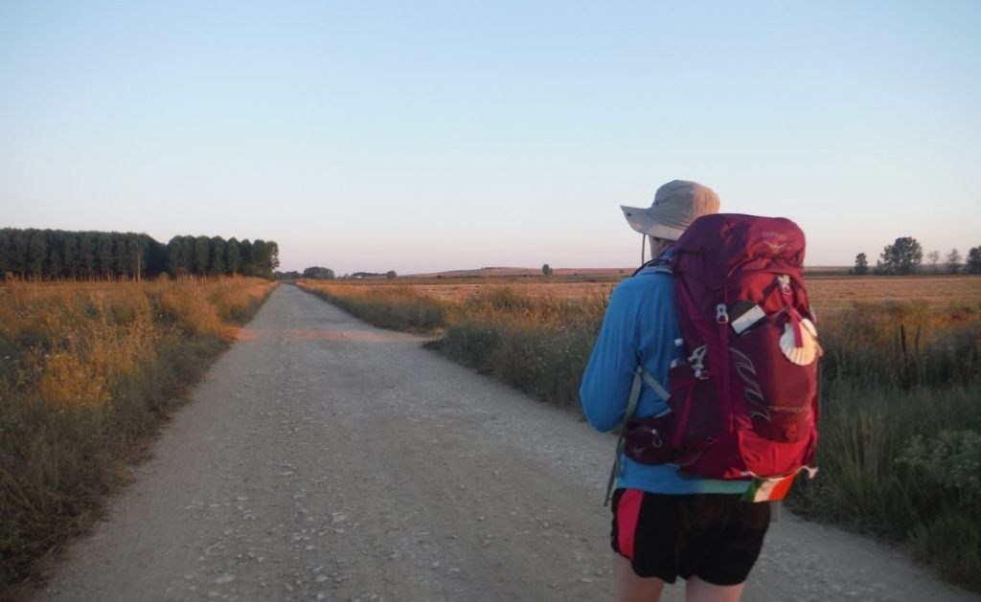
Rucksack Prayer – Part 1

Slide 5
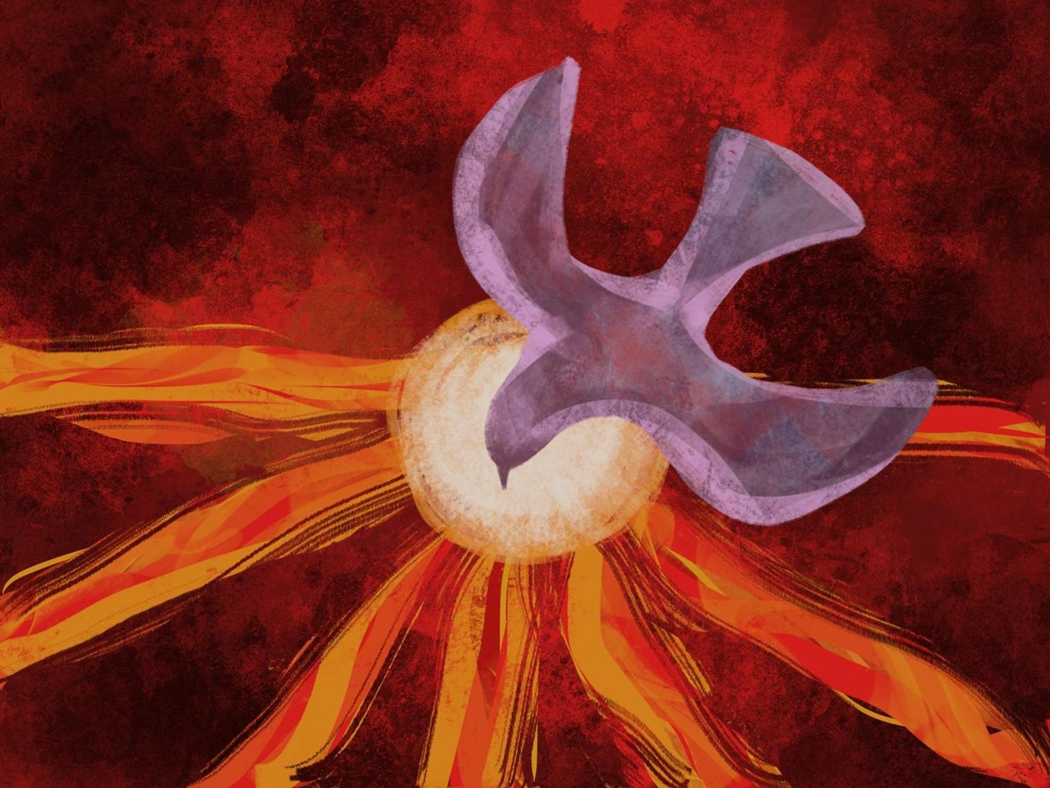
Pentecost and the Sacrament of Confirmation

Slide 6
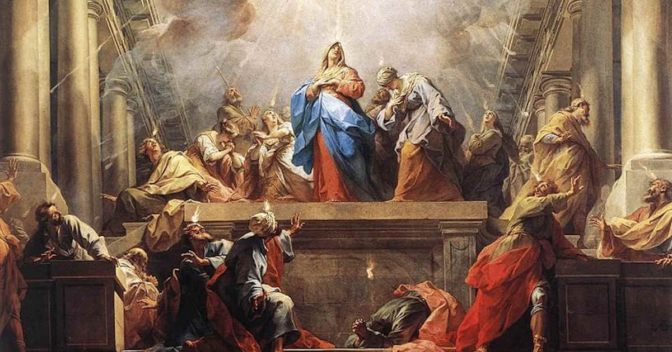
What do you think of when you hear the words;
The Holy Spirit?

Slide 7
Scripture Reading – Acts 2: 1- 12
When Pentecost day came round, they had all met in one room, when suddenly they heard what sounded like a powerful wind from heaven, the noise of which filled the entire house in which they were sitting; and something appeared to them that seemed like tongues of fire; these separated and came to rest on the head of each of them. They were all filled with the Holy Spirit, and began to speak foreign languages as the Spirit gave them the gift of speech.
Now there were devout men living in Jerusalem from every nation under heaven, and at this sound they all assembled, each one bewildered to hear these men speaking his own language. They were amazed and astonished. ‘Surely’ they said ‘all these men speaking are Galileans? How does it happen that each of us hears them in his own native language? Parthians, Medes and Elamites; people from Mesopotamia, Judaea and Cappadocia, Pontus and Asia, Phrygia and Pamphylia, Egypt and the parts of Libya round Cyrene; as well as visitors from Rome – Jews and proselytes alike – Cretans and Arabs; we hear them preaching in our own language about the marvels of God.’

Slide 8
From what you have heard so far…
…what are your Initial thoughts, reactions, questions that come to mind?
We can discuss these later…

Slide 9
How do I know what God wants me to do?

Slide 10
Reflection
How can the Holy Spirit help me?

Slide 11
Catechism of the Catholic Church
742: ‘Because you are the sons, God has sent the Spirit of his Son into our hearts, crying “Abba! Father!” ‘ (Gal 4:6)
743: From the beginning to the end of time, whenever God send his Son, he always sends his Spirit: their mission is conjoined and inseparable.
744: In the fullness of time the Holy Spirit completes in Mary all the preparations for Christ’s coming among the People of Gd. By the actions for the Holy Spirit in her, the Father gives the world Emmanuel, ‘God-with-us’ (Mt 1:23).
745: The Son of God was consecrated as Christ (Messiah) by the anointing of the Holy Spirit at his Incarnation (cf. Ps 2: 6-7).
746: By his death and his Resurrection, Jesus is constituted in glory as Lord and Christ (cf. Acts 2:36). From his fullness, he poured out the Holy Spirit on the apostles and the Church.
747: The Holy Spirit, whom Christ the head pours out on his members, builds, animates and sanctifies the Church. She is the sacrament of the Holy Trinity’s commission with men.

Slide 12
Discussion
How do I know I am walking the right path God wants me to?
Discuss this is two’s & three’s then feedback to the main group

Slide 13
Internet Corner - Where to find out more…
www.dioceseofsalford.org.uk/faith/sacraments/confirmation/
www.wordonfire.org/resources/article/pentecost-and-the-fires-in-our-cities/27588/
alpha.org/
www.sycamore.fm/start/session-guides/

Slide 14
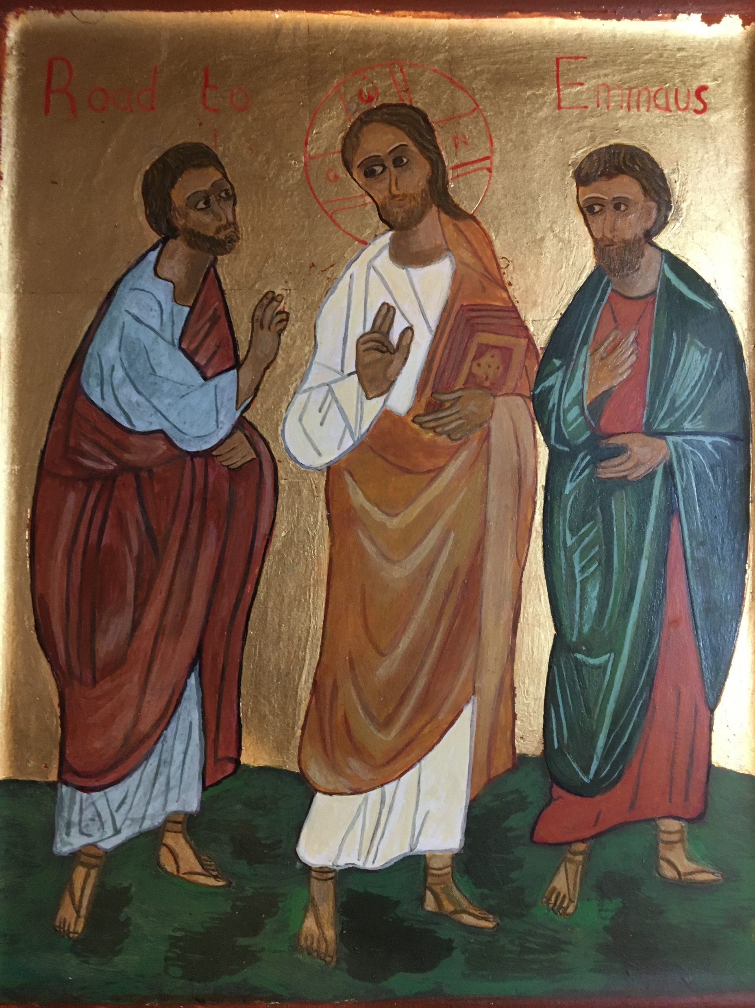
Conversation with Jesus
Focus on this image of Jesus and open your heart to Him now.
Take this opportunity to talk to him in your mind and heart.
Listen and be aware of his presence with you.
You may want to use this hymn to help you pray

Slide 15
Spiritual Journal
You may want to write down what has been important for you during this time together

Slide 16
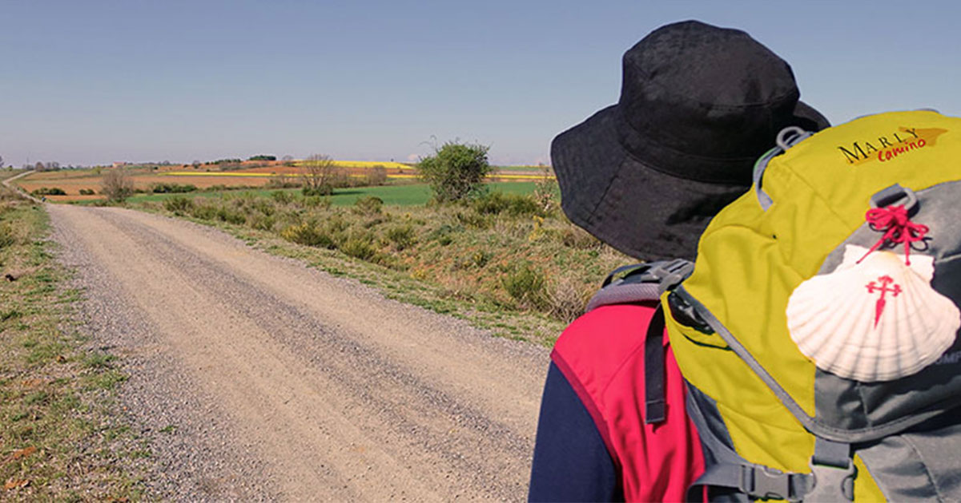
Rucksack Prayer – Part 2

Slide 17
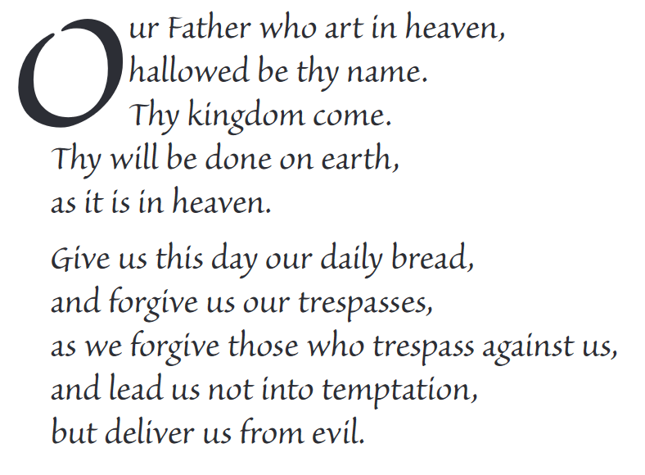
The Lord’s Prayer

Slide 18
Final pilgrim blessing for the week ahead
God of our pilgrimage,
you have given us a desire
to take the questing way
and set out on our journey.
Help us to keep our eyes fixed on Jesus,
that whatever we encounter as we travel,
we may seek to glorify you by the way we live.
You call us, Lord,
to leave familiar things and to leave our “comfort zone”.
May we open our eyes to new experiences,
may we open our ears to hear you speaking to us
and may we open our hearts to your love.
Grant that this time spent on pilgrimage
may help us to see ourselves as we really are
and may we strive to become the people you would have us be. Amen
… continued on next slide

Slide 19
Final pilgrim blessing for the week ahead
Lord, you know our beginning and our end.
Help us to realise we are only pilgrims on this earth
and save us from being too attached to worldly possessions.
May we experience the freedom to wander,
the freedom to hope and the freedom to love as we journey. Amen
Creator God, you are the source of all life and motivation.
May we journey in faith and love, rejoicing and eager to serve you.
Grant us a glimpse of your glory as we seek to follow you –
the Way, the Truth and the Life. Amen
May God the Father who created you, guide your footsteps,
May God the Son who redeemed you, share your journey,
May God the Holy Spirit who sanctifies you, lead you on life’s pilgrimage,
and the blessing of God, Father, Son and Holy Spirit
be with you wherever you may go. Amen.

Slide 20
CAMINO
Making the Journey…
Session 16
Making the journey with the Holy Spirit –
Pentecost and Confirmation

