Slide 1
CAMINO
Making the Journey…
Session 17
Making the journey with forgiveness- Sacrament of Reconciliation

Slide 2
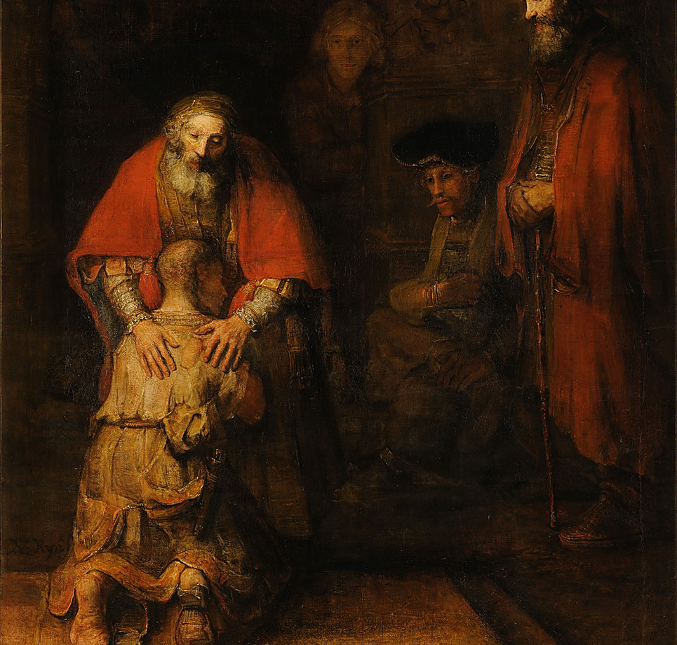
Introduction
Our faith is based on God’s merciful love for us made visible in His Son Jesus Christ.
Salvation is God’s rescue plan that mends what was broken in the world by original sin and what is broken in each one of us by sin. Jesus death on the cross takes away the sins of the world.
A very important part of Jesus ministry was forgiveness and healing and teaching us about God as our loving Father (cf Luke chapter 15).
Sin is a major obstacle on our journey as pilgrims and it is important that we recognise sin and ask for God’s forgiveness and healing. We do this in the beautiful sacrament of reconciliation. Opportunity for people to learn what happens in the sacrament so they will be reassured for when the time comes to experience it for themselves. As it is a sacrament it is Jesus we encounter in the words of absolution.
We need this sacrament to help us keep going on our pilgrimage through life as part of the pilgrim people of God.

Slide 3
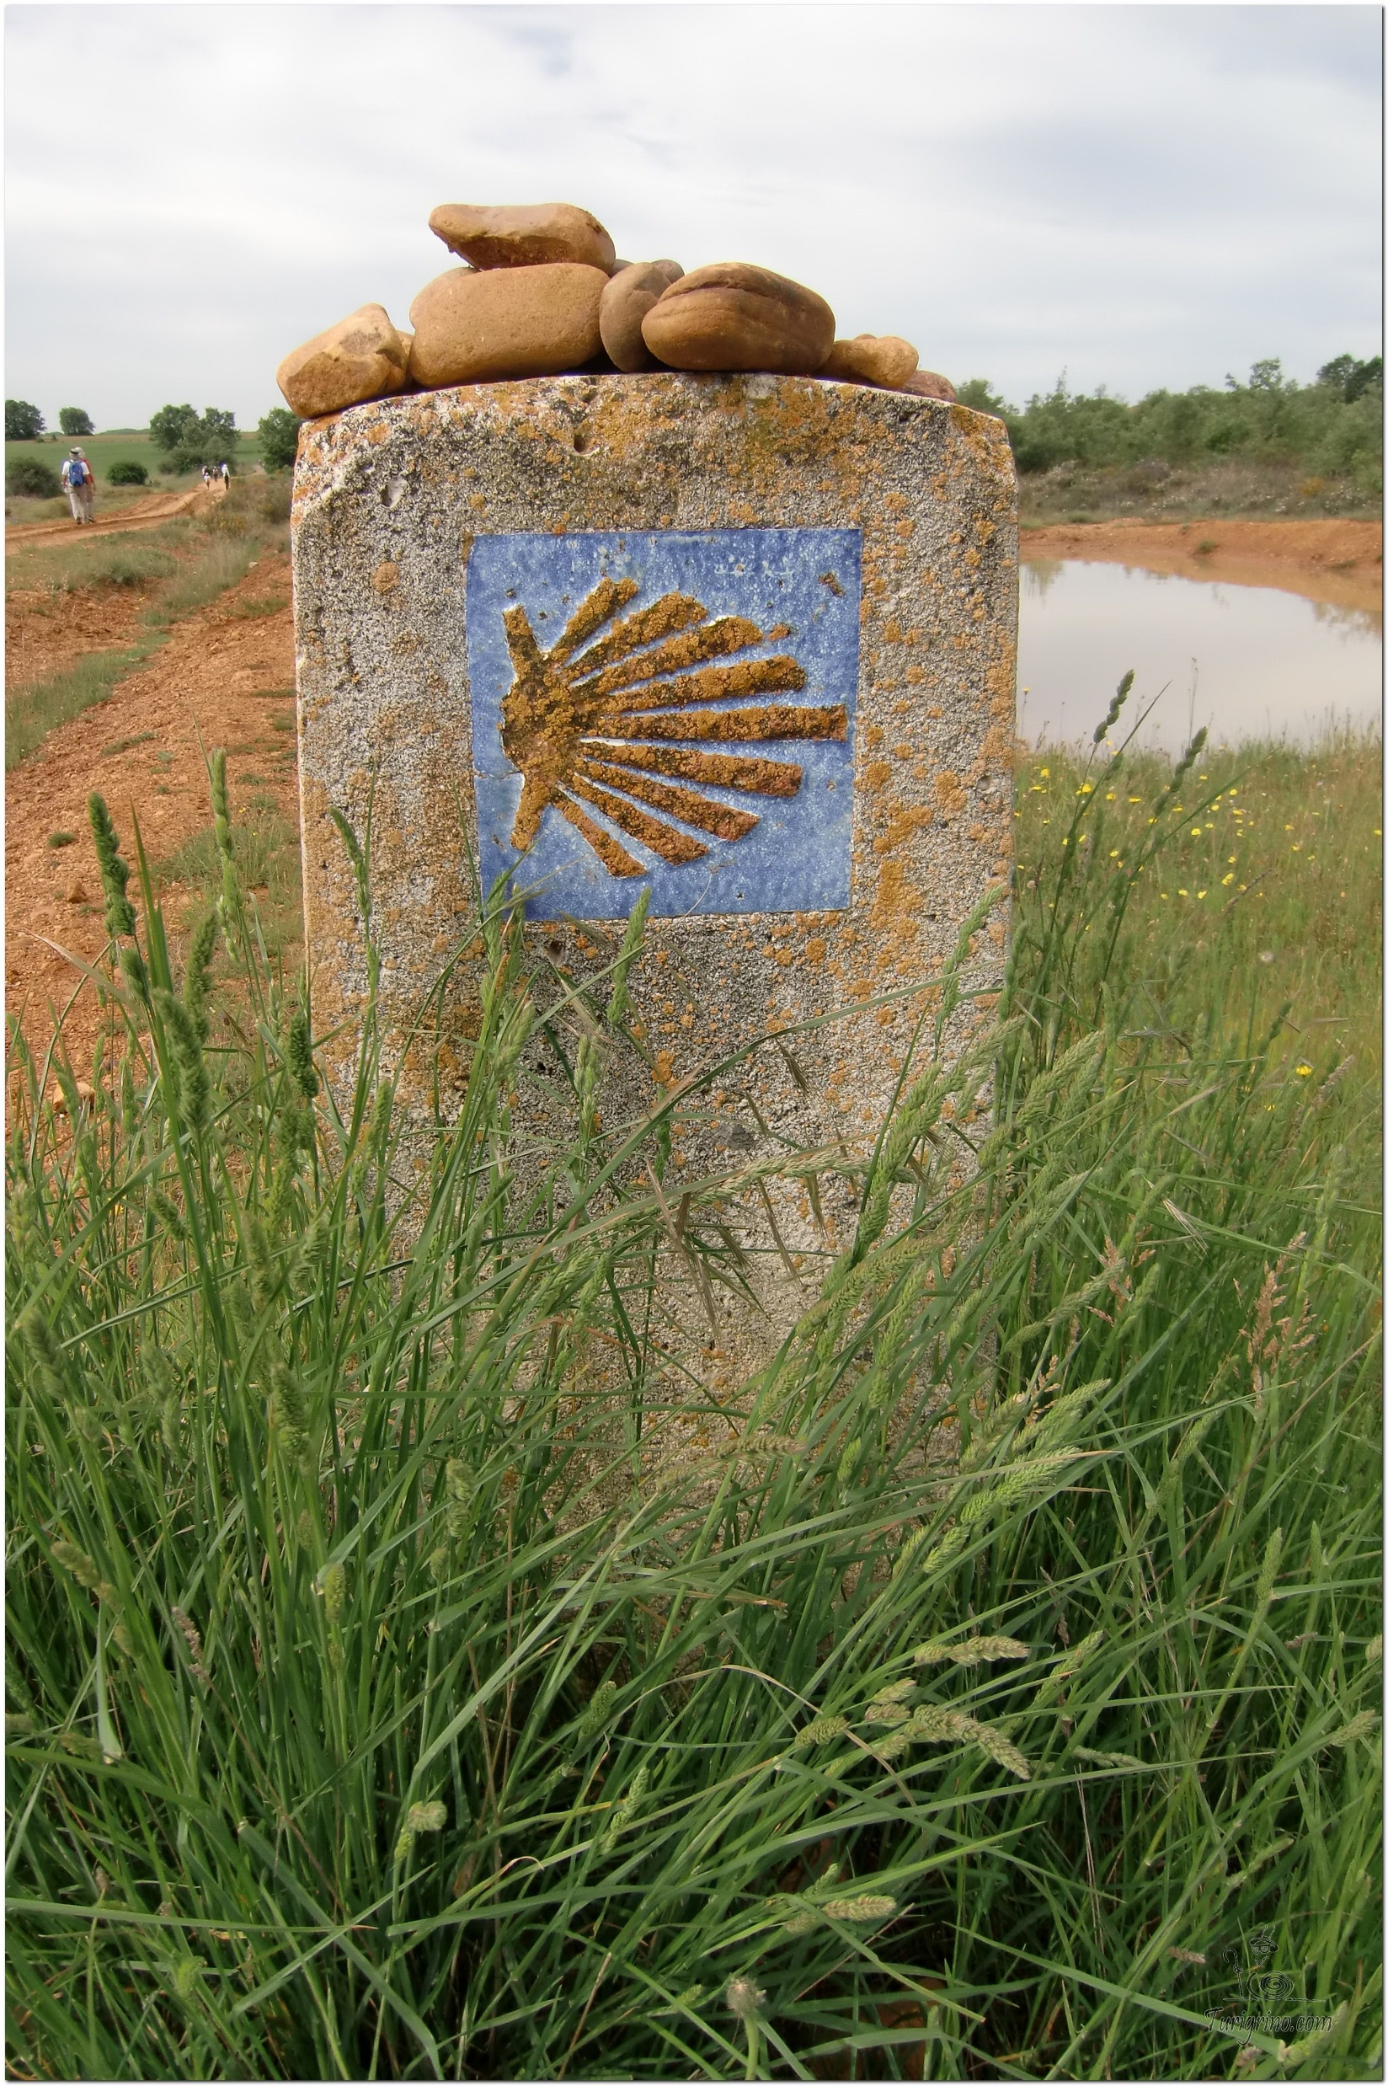
Opening Prayer
The Camino Prayer (adapted)
O God, who brought your servant Abraham out of the land of the Chaldeans, protecting him in his wanderings, who guided the Hebrew people across the desert, we ask that you watch over us, your servants, as we walk in the love of your name.
Be for us our companion on the journey,
Our guide at the crossroads, Our breath in our weariness,
Our protection in danger, our albergue on the Camino,
Our shade in the heat, Our light in the darkness,
Our consolation in our discouragements,
And our strength in our intentions.
So that with your guidance we may arrive safe and sound at the end of the road and enriched with grace and virtue we return safely to our homes filled with joy.
In the name of Jesus Christ our Lord, Amen. Apostle Santiago, pray for us. Santa Maria, pray for us.

Slide 4
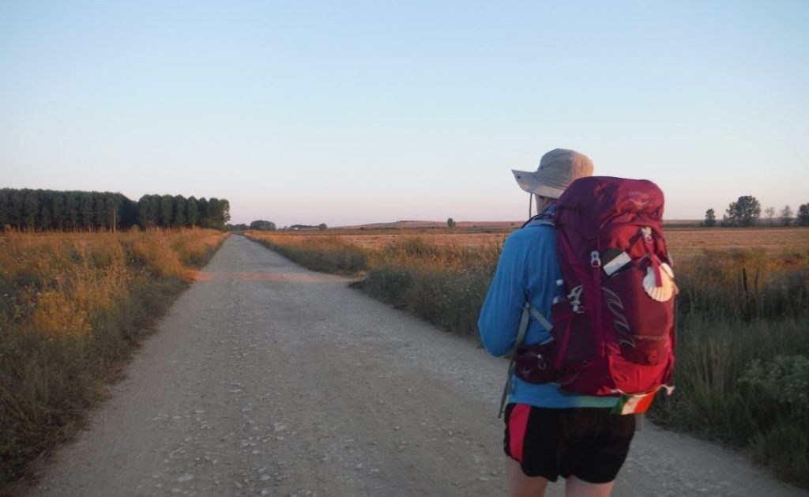
Rucksack Prayer – Part 1

Slide 5
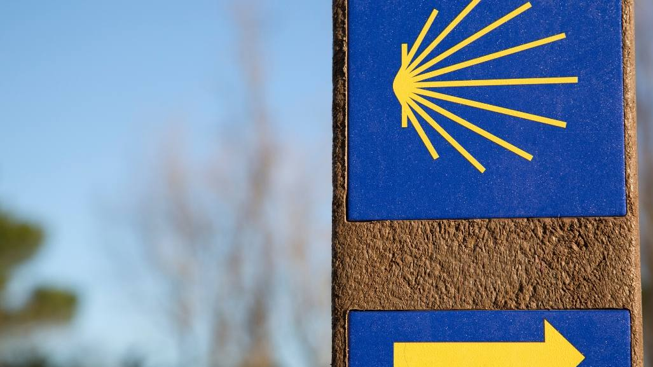
A Journey with Forgiveness
Notes:
https://youtu.be/HL7aUE0W6Dk

Slide 6
Scripture Reading –Luke 15: 11-32
There was a man who had two sons. The younger one said to his father, “Father, let me have the share of the estate that will come to me.” So the father divided the property between them. A few days later, the younger son got together everything he had and left for a distant country where he squandered his money on a life of debauchery.
When he had spent it all, that country experienced a severe famine, and now he began to feel the pinch; so he hired himself out to one of the local inhabitants who put him on his farm to feed the pigs. And he would willingly have filled himself with the husks the pigs were eating but no one would let him have them. Then he came to his senses and said, “How many of my father’s hired men have all the food they want and more, and here am I dying of hunger? I will leave this place and go to my father and say: Father, I have sinned against heaven and against you; I no longer deserve to be called your son; treat me as one of your hired men.” So he left the place and went back to his father.
While he was still a long way off, his father saw him and was moved with pity. He ran to the boy, clasped him in his arms, and kissed him. Then he said, “Father, I have sinned against heaven and against you. I no longer deserve to be called your son.” But the father said to his servants, “Quick! Bring out the best robe and put it on him; put a ring on his finger and sandals on his feet. Bring the calf we have been fattening, and kill it; we will celebrate by having a feast, because this son of mine was dead and has come back to life; he was lost and is found.” And they began to celebrate.
Now the elder son was out in the fields, and on his way back, as he drew near the house, he could hear music and dancing. Calling one of the servants, he asked what it was all about. The servant told him, “Your brother has come and your father has killed the calf we have been fattening because he has got him back safe and sound.” He was angry then and refused to go in, and his father came out and began to urge him to come in; but he retorted to his father, “All these years I have slaved for you and never once disobeyed any orders of yours, yet you never offered as much as a kid for me to celebrate with my friends. But, for this son of yours, after he comes back after swallowing up your property – he and his loose women – you kill the calf we have been fattening.”
The father said, “My son, you are with me always and all I have is yours. But it was only right we should celebrate and rejoice, because your brother here was dead and has come to life; he was lost and is found.”
Notes:
The scripture is taken from the New Jerusalem Bible Luke 15: 11-32

Slide 7
From what you have heard so far…
…what are your Initial thoughts, reactions, questions that come to mind?
We can discuss these later…

Slide 8
Main Input
Notes:
https://youtu.be/eY8CffVn5Sk

Slide 9
Reflection
Notes:
https://youtu.be/3M05YrJ6iiU

Slide 10
Testimony on Reconciliation
Notes:
https://youtu.be/4bxv_wpG2nQ

Slide 11
Catechism of the Catholic Church
1486 The forgiveness of sins committed after Baptism is conferred by a particular sacrament called the sacrament of conversion, confession, Penance or Reconciliation.
1489 To return to communion with God after having lost it through sin is a process born of the grace of God who is rich in mercy and solicitous for the salvation of men. One must ask for this precious gift for oneself and for others.
1491 The sacrament of Penance is a whole consisting in three actions of the penitent and the priest’s absolution. The penitent’s acts are repentance, confession or disclosure of sins to a priest, and the intention to make reparation and do works of reparation.
1492 Repentance (also called contrition) must be inspired by motives that arise from faith. If repentance arises from love of charity for God, it is called ‘perfect’ contrition; if it is founded on other motives, it is called ‘imperfect’.
1493 One who desires to obtain reconciliation with God and with the Church must confess to a priest all the unconfessed grave sins he remembers after carefully examined his conscience.
1495 Only priests who have received the faculty of absolving from the authority of the Church can forgive sins in the name of Christ.
1497 Individual and integral confession of grave sins followed by absolution remains the only ordinary means of reconciliation with God and with the Church.

Slide 12
Questions
Why do I need to go to a priest for confession?
How often should I go to confession?
How do I start my confession?

Slide 13
Discussion
Why do you think it is important to ask God for forgiveness?
Discuss this is two’s & three’s then feedback to the main group
Notes:
Notes for Catechists:
If you forgive others the wrongs they have done to you, your Father in heaven will also forgive you. But if you do not forgive others, then your Father will not forgive the wrongs you have done. (Matthew 6 14-15)
In the parable of the Prodigal Son, the father forgives his son when he returns and welcomes him home. In the same way, God waits for humans to realise what they have done wrong and ask for forgiveness and welcomes them back when they do. It is the willingness to ask for forgiveness and change one's behaviour that is central to the idea of forgiveness.
In the same way that God forgives humans, so humans have to forgive those around them. If people fail to do so, they cannot expect to be forgiven by God.
The Lord's Prayer
This same teaching is reflected in the Lord's Prayer - Forgive us our trespasses as we forgive those who trespass against us. It is also not enough to forgive just once. Jesus says in the Parable of the Unforgiving Servant that it is not enough simply to forgive someone seven times, but seventy time seven (Matthew 18:21-22) which implies as often as is needed.
Forgiving someone when they have caused harm or pain is a difficult thing to do, but in the Gospels Jesus sets an example. Jesus forgave those who crucified him, Jesus said, 'Forgive them, Father! They don't know what they are doing.' (Luke 23:34). This act of forgiveness shows that any act can be forgiven. In John’s Gospel (20:21-23) Jesus tells the apostles that those sins that they forgive are forgiven, and those sins that they do not forgive will not be forgiven.
https://www.bbc.co.uk/bitesize/guides/zwxm97h/revision/8

Slide 14
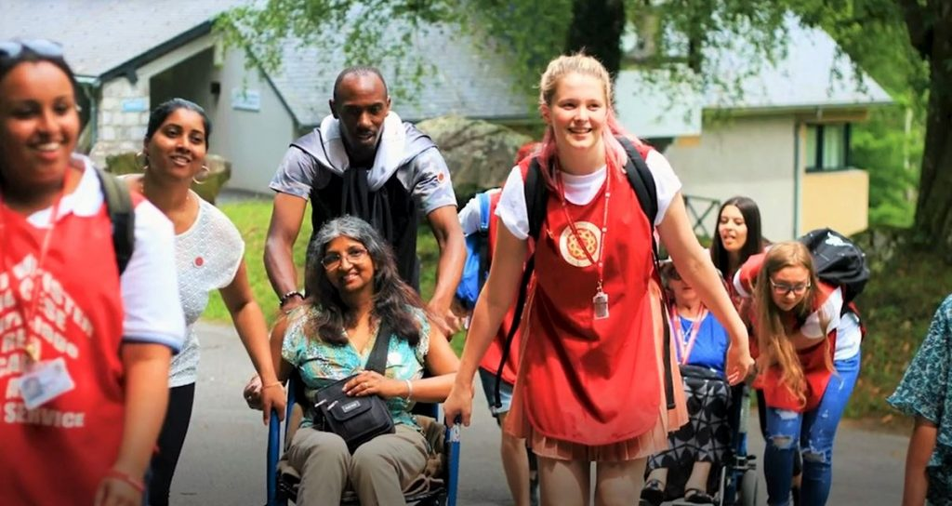
Internet Corner - Where to find out more…
www.universitycatholic.net/resources/how-to-go-to-confession/
www.sycamore.fm/start/session-guides/session-16-forgiveness-healing-and-mission/
www.dioceseofsalford.org.uk/youth/resources-links/

Slide 15
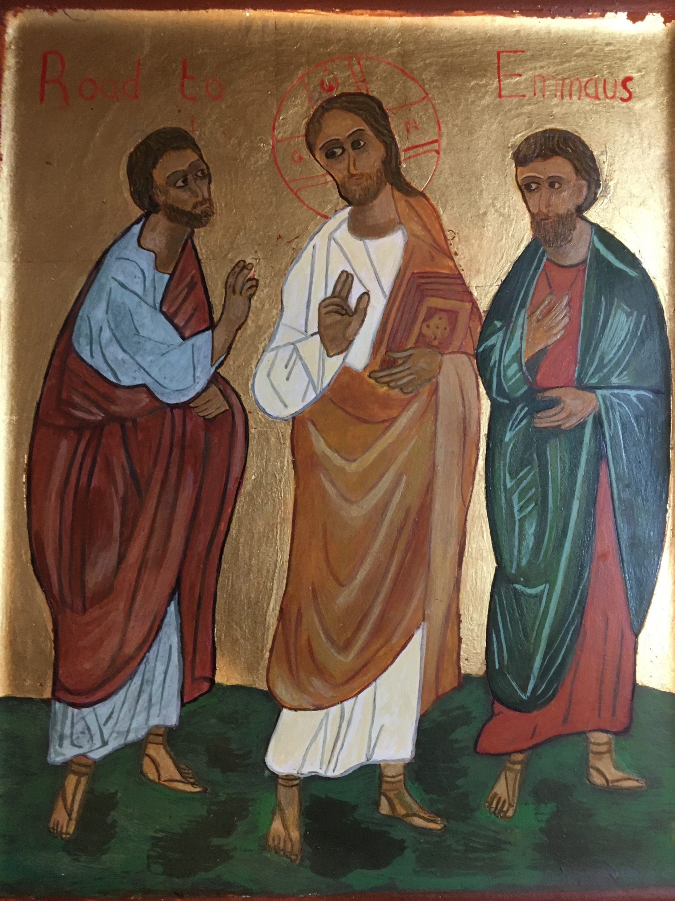
Conversation with Jesus
Focus on this image of Jesus and open your heart to Him now.
Take this opportunity to talk to him in your mind and heart.
Listen and be aware of his presence with you.
You may want to use this hymn to help you pray

Slide 16
Spiritual Journal
You may want to write down what has been important for you during this time together

Slide 17
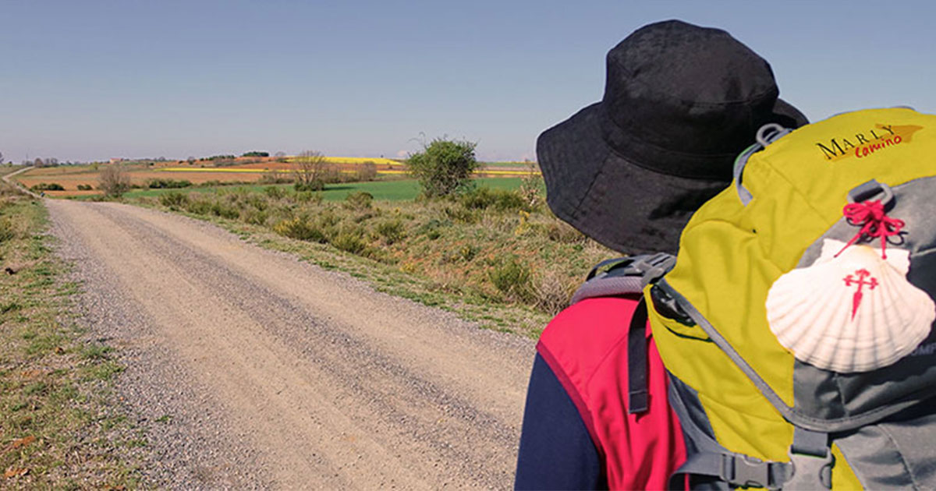
Rucksack Prayer – Part 2

Slide 18
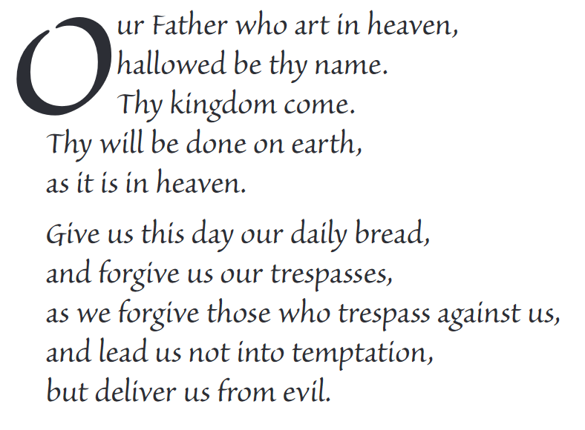
The Lord’s Prayer

Slide 19
Final pilgrim blessing for the week ahead
God of our pilgrimage,
you have given us a desire
to take the questing way
and set out on our journey.
Help us to keep our eyes fixed on Jesus,
that whatever we encounter as we travel,
we may seek to glorify you by the way we live.
You call us, Lord,
to leave familiar things and to leave our “comfort zone”.
May we open our eyes to new experiences,
may we open our ears to hear you speaking to us
and may we open our hearts to your love.
Grant that this time spent on pilgrimage
may help us to see ourselves as we really are
and may we strive to become the people you would have us be. Amen
… continued on next slide

Slide 20
Final pilgrim blessing for the week ahead
Lord, you know our beginning and our end.
Help us to realise we are only pilgrims on this earth
and save us from being too attached to worldly possessions.
May we experience the freedom to wander,
the freedom to hope and the freedom to love as we journey. Amen
Creator God, you are the source of all life and motivation.
May we journey in faith and love, rejoicing and eager to serve you.
Grant us a glimpse of your glory as we seek to follow you –
the Way, the Truth and the Life. Amen
May God the Father who created you, guide your footsteps,
May God the Son who redeemed you, share your journey,
May God the Holy Spirit who sanctifies you, lead you on life’s pilgrimage,
and the blessing of God, Father, Son and Holy Spirit
be with you wherever you may go. Amen.

Slide 21
CAMINO
Making the Journey…
Session 17
Making the journey with forgiveness- Sacrament of Reconciliation

