Slide 1
CAMINO
Making the Journey…
Session 18
Making the journey of life - a moral compass

Slide 2
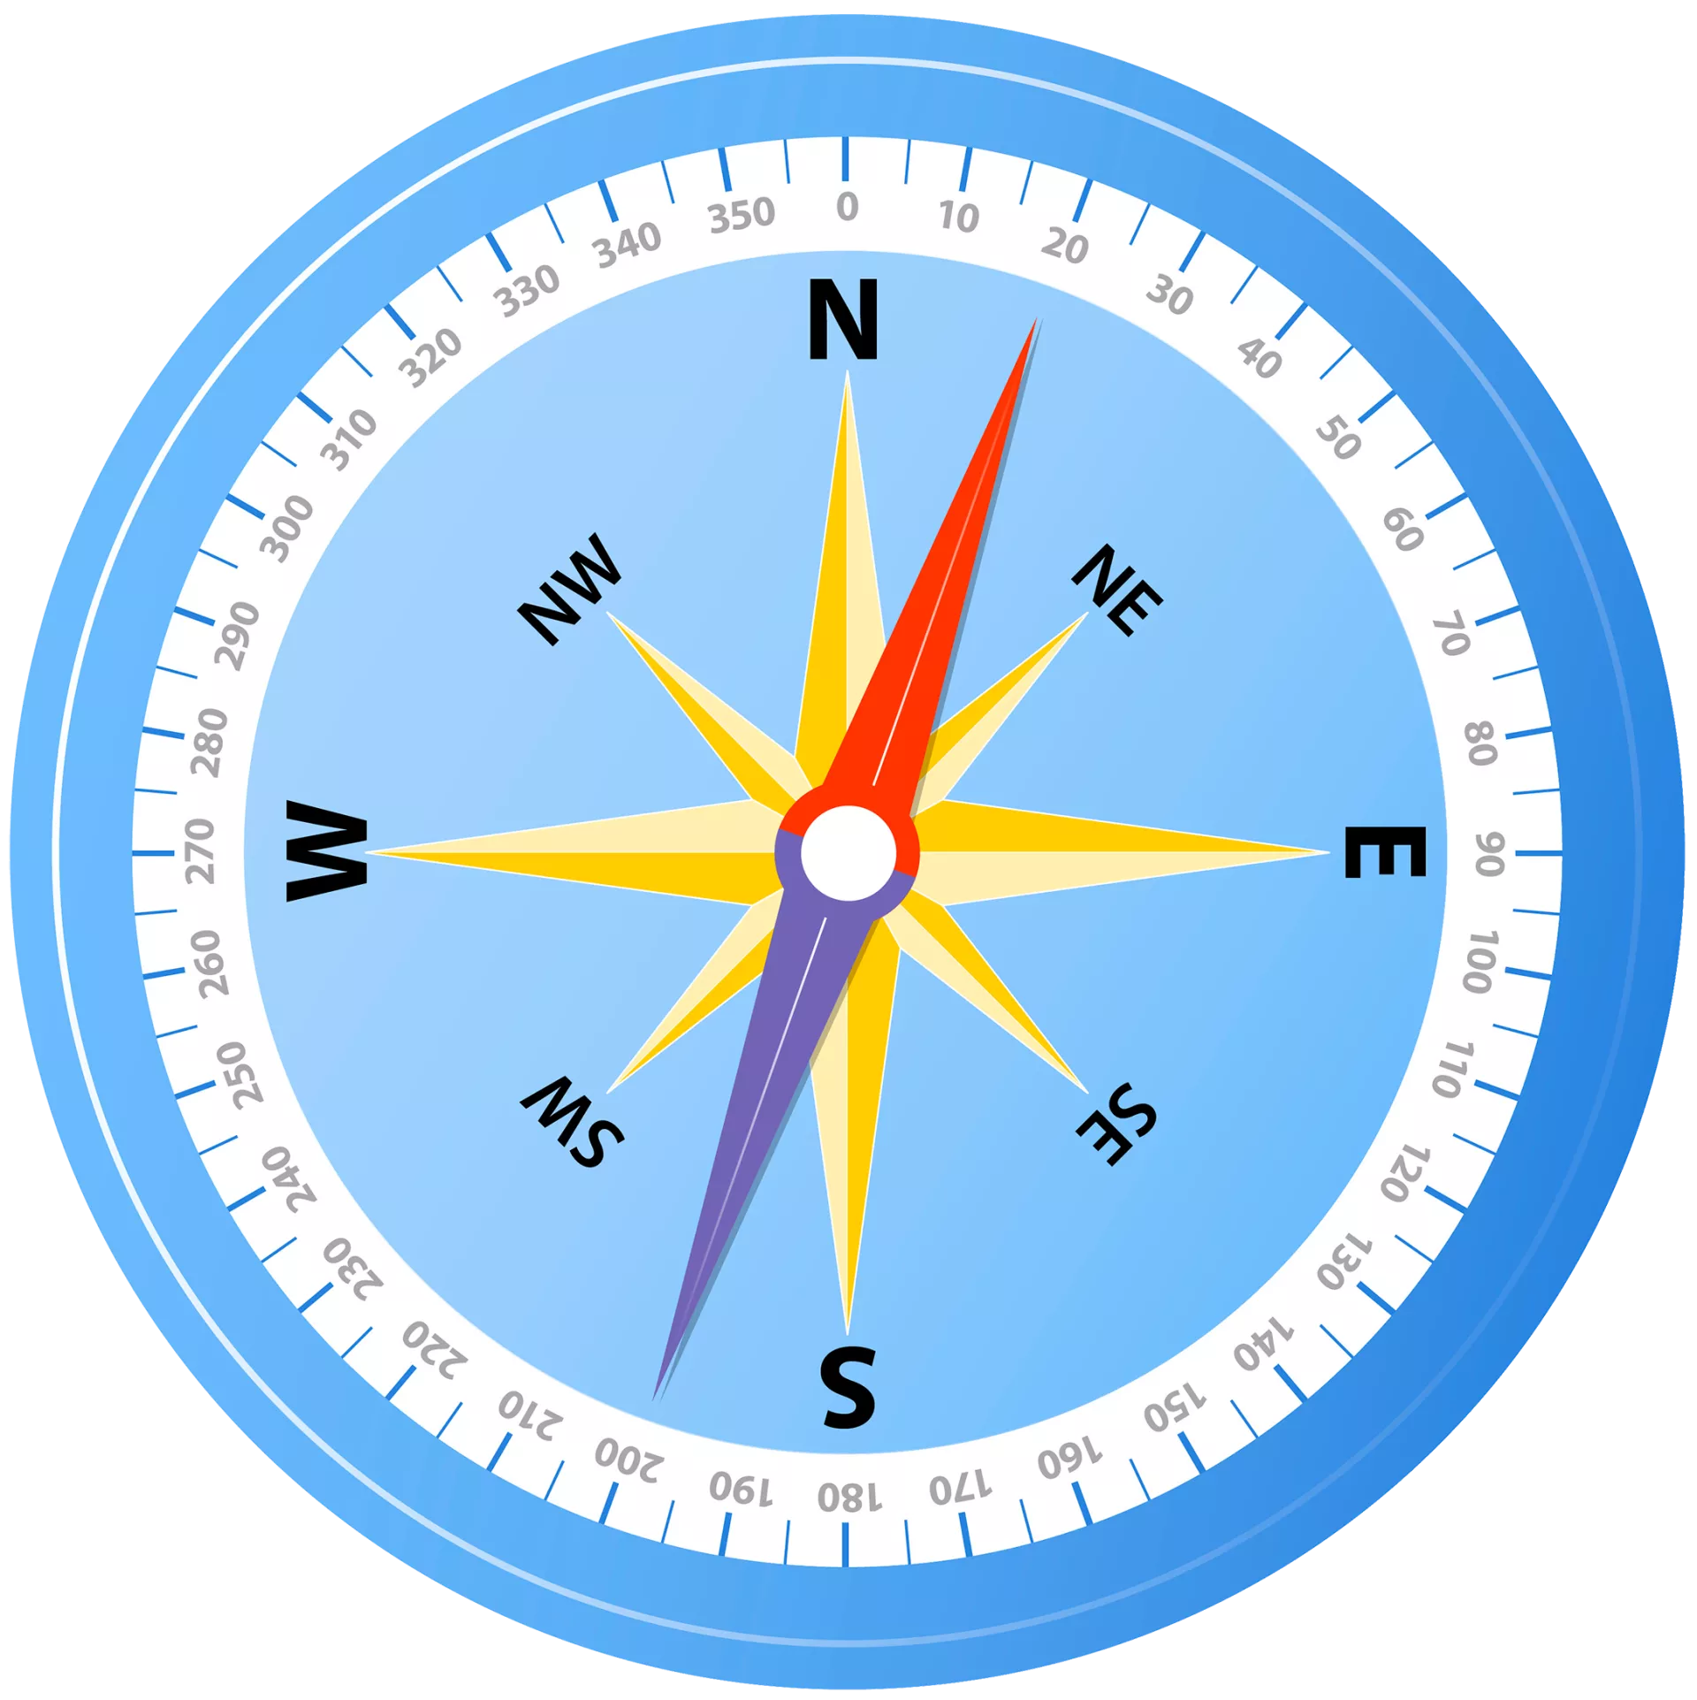
Introduction
Sin makes it very easy for us to get lost on our journey, like getting caught in fog. We need a compass to help us in our moral life so that we do not get lost. Jesus himself teaches us and the Church continues his teaching and applies it to new situations and circumstances. This is an important part of the role of the Church to help us inform our conscience so that we can make the right decisions and therefore be heading in the right direction. Without a moral compass we will be lost and lead others in the wrong direction as well. Here is an opportunity to look at moral teachings of the Church as a way of directing us. Making the right moral decisions helps brings us closer to Christ and welcome him more fully into our lives.

Slide 3
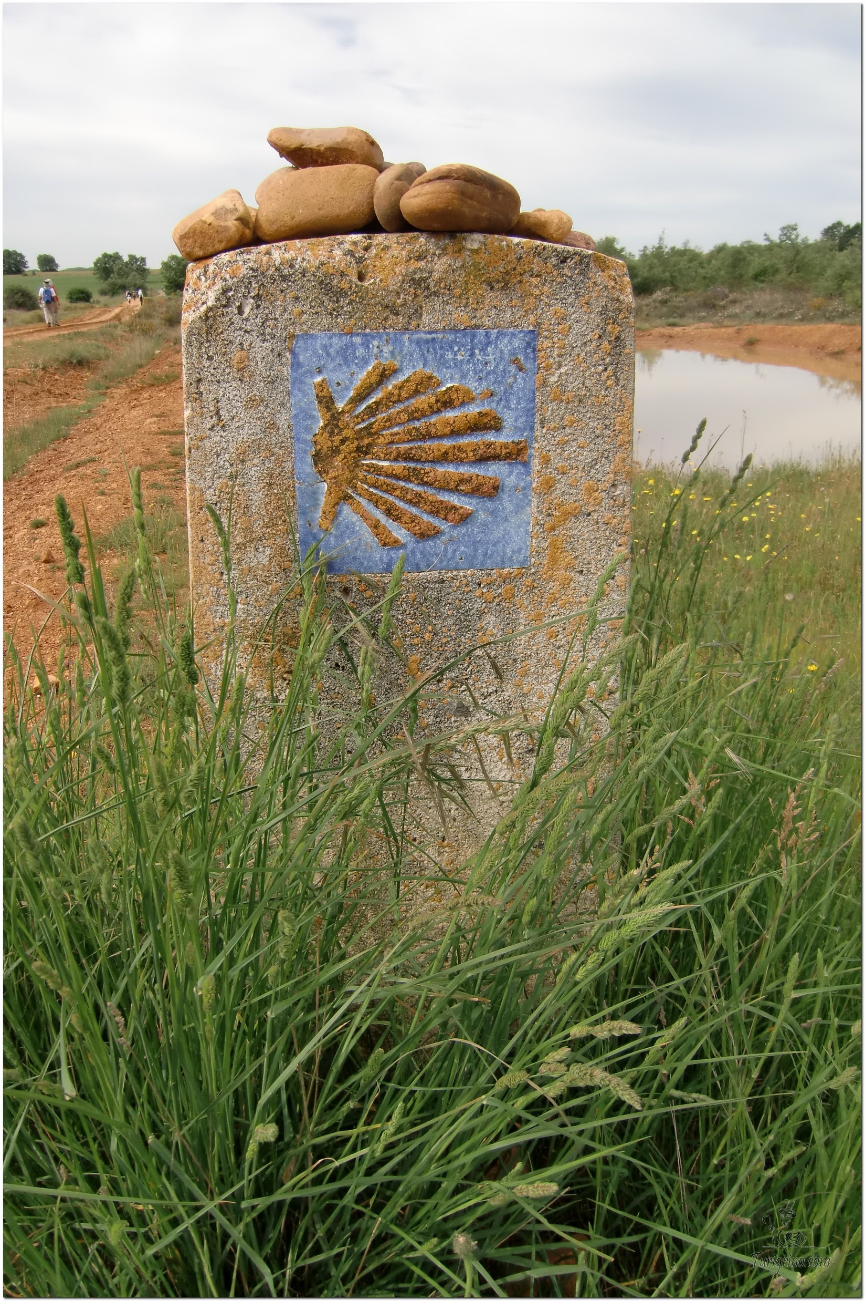
Opening Prayer
The Camino Prayer (adapted)
O God, who brought your servant Abraham out of the land of the Chaldeans, protecting him in his wanderings, who guided the Hebrew people across the desert, we ask that you watch over us, your servants, as we walk in the love of your name.
Be for us our companion on the journey,
Our guide at the crossroads, Our breath in our weariness,
Our protection in danger, our albergue on the Camino,
Our shade in the heat, Our light in the darkness,
Our consolation in our discouragements,
And our strength in our intentions.
So that with your guidance we may arrive safe and sound at the end of the road and enriched with grace and virtue we return safely to our homes filled with joy.
In the name of Jesus Christ our Lord, Amen. Apostle Santiago, pray for us. Santa Maria, pray for us.

Slide 4
Catholicism in a Hundred Objects
The Compass

Slide 5
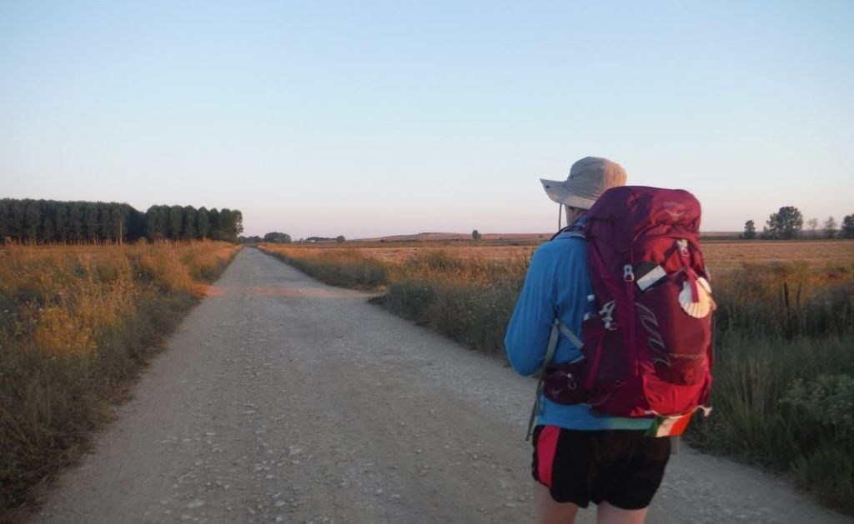
Rucksack Prayer – Part 1

Slide 6
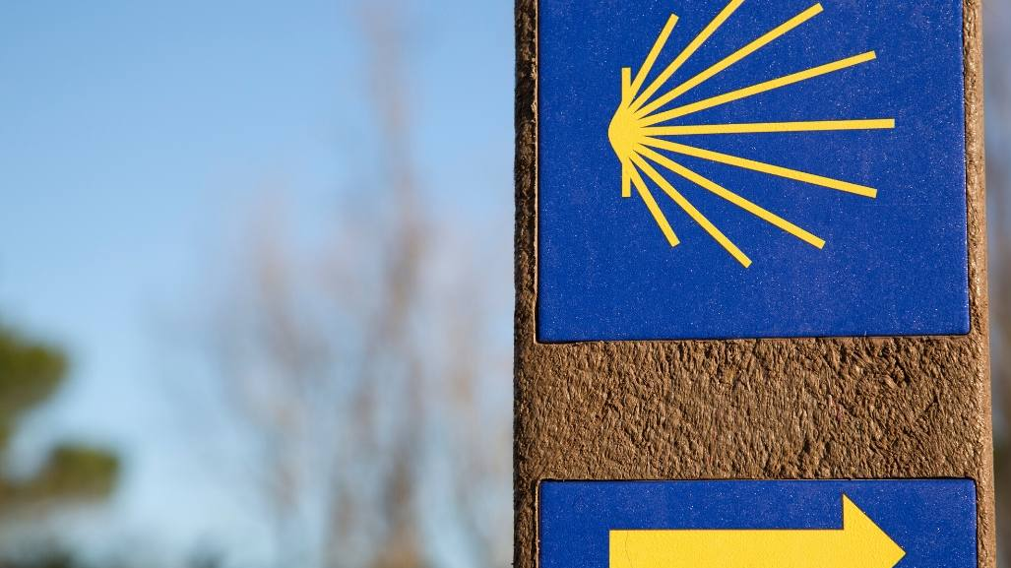
Making the journey of life - a moral compass

Slide 7
Scripture Reading - Matthew 5:1-12
Seeing the crowds, Jesus went up the hill. There he sat down and was joined by his disciples. Then he began to speak. This is what he taught them:
‘How happy are the poor in spirit; theirs is the kingdom of heaven.
Happy the gentle: they shall have the earth for their heritage.
Happy those who mourn: they shall be comforted.
Happy those who hunger and thirst for what is right: they shall be satisfied.
Happy the merciful: they shall have mercy shown them.
Happy the pure in heart: they shall see God.
Happy the peacemakers: they shall be called sons of God.
Happy those who are persecuted in the cause of right: theirs is the kingdom of heaven.
‘Happy are you when people abuse you and persecute you and speak all kinds of calumny against you on my account. Rejoice and be glad, for your reward will be great in heaven.’

Slide 8
From what you have heard so far…
…what are your Initial thoughts, reactions, questions that come to mind?
We can discuss these later…

Slide 9
The Way of Christ: the Christian Moral Life

Slide 10
Input on the Moral Life and Decision Making
“The ones who have a voice must speak for those who are voiceless”
St Oscar Romero

Slide 11
Reflection
Lord I need you, every hour I need you. You’re my one defence, my righteousness, O God how I need you.
Amen

Slide 12
Catechism of the Catholic Church
1795 "Conscience is man's most secret core, and his sanctuary. There he is alone with God whose voice echoes in his depths" (GS 16).
1796 Conscience is a judgment of reason by which the human person recognizes the moral quality of a concrete act.
1797 For the man who has committed evil, the verdict of his conscience remains a pledge of conversion and of hope.
1798 A well-formed conscience is upright and truthful. It formulates its judgments according to reason, in conformity with the true good willed by the wisdom of the Creator. Everyone must avail himself of the means to form his conscience.
1799 Faced with a moral choice, conscience can make either a right judgment in accordance with reason and the divine law or, on the contrary, an erroneous judgment that departs from them.
1800 A human being must always obey the certain judgment of his conscience.
1801 Conscience can remain in ignorance or make erroneous judgments. Such ignorance and errors are not always free of guilt.
1802 The Word of God is a light for our path. We must assimilate it in faith and prayer and put it into practice. This is how moral conscience is formed.

Slide 13
Question

Slide 14
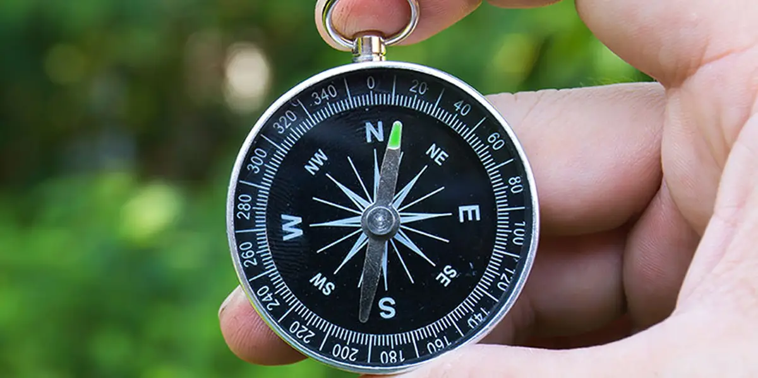
Discussion
Can you remember a time when you got lost?
Discuss this is two’s & three’s then feedback to the main group

Slide 15
Internet Corner - Where to find out more…
Ascension Presents
www.youtube.com/channel/UCVdGX3N-WIJ5nUvklBTNhAw
Catholic Morality 101
www.youtube.com/watch?v=h3NU2mTFhy4

Slide 16
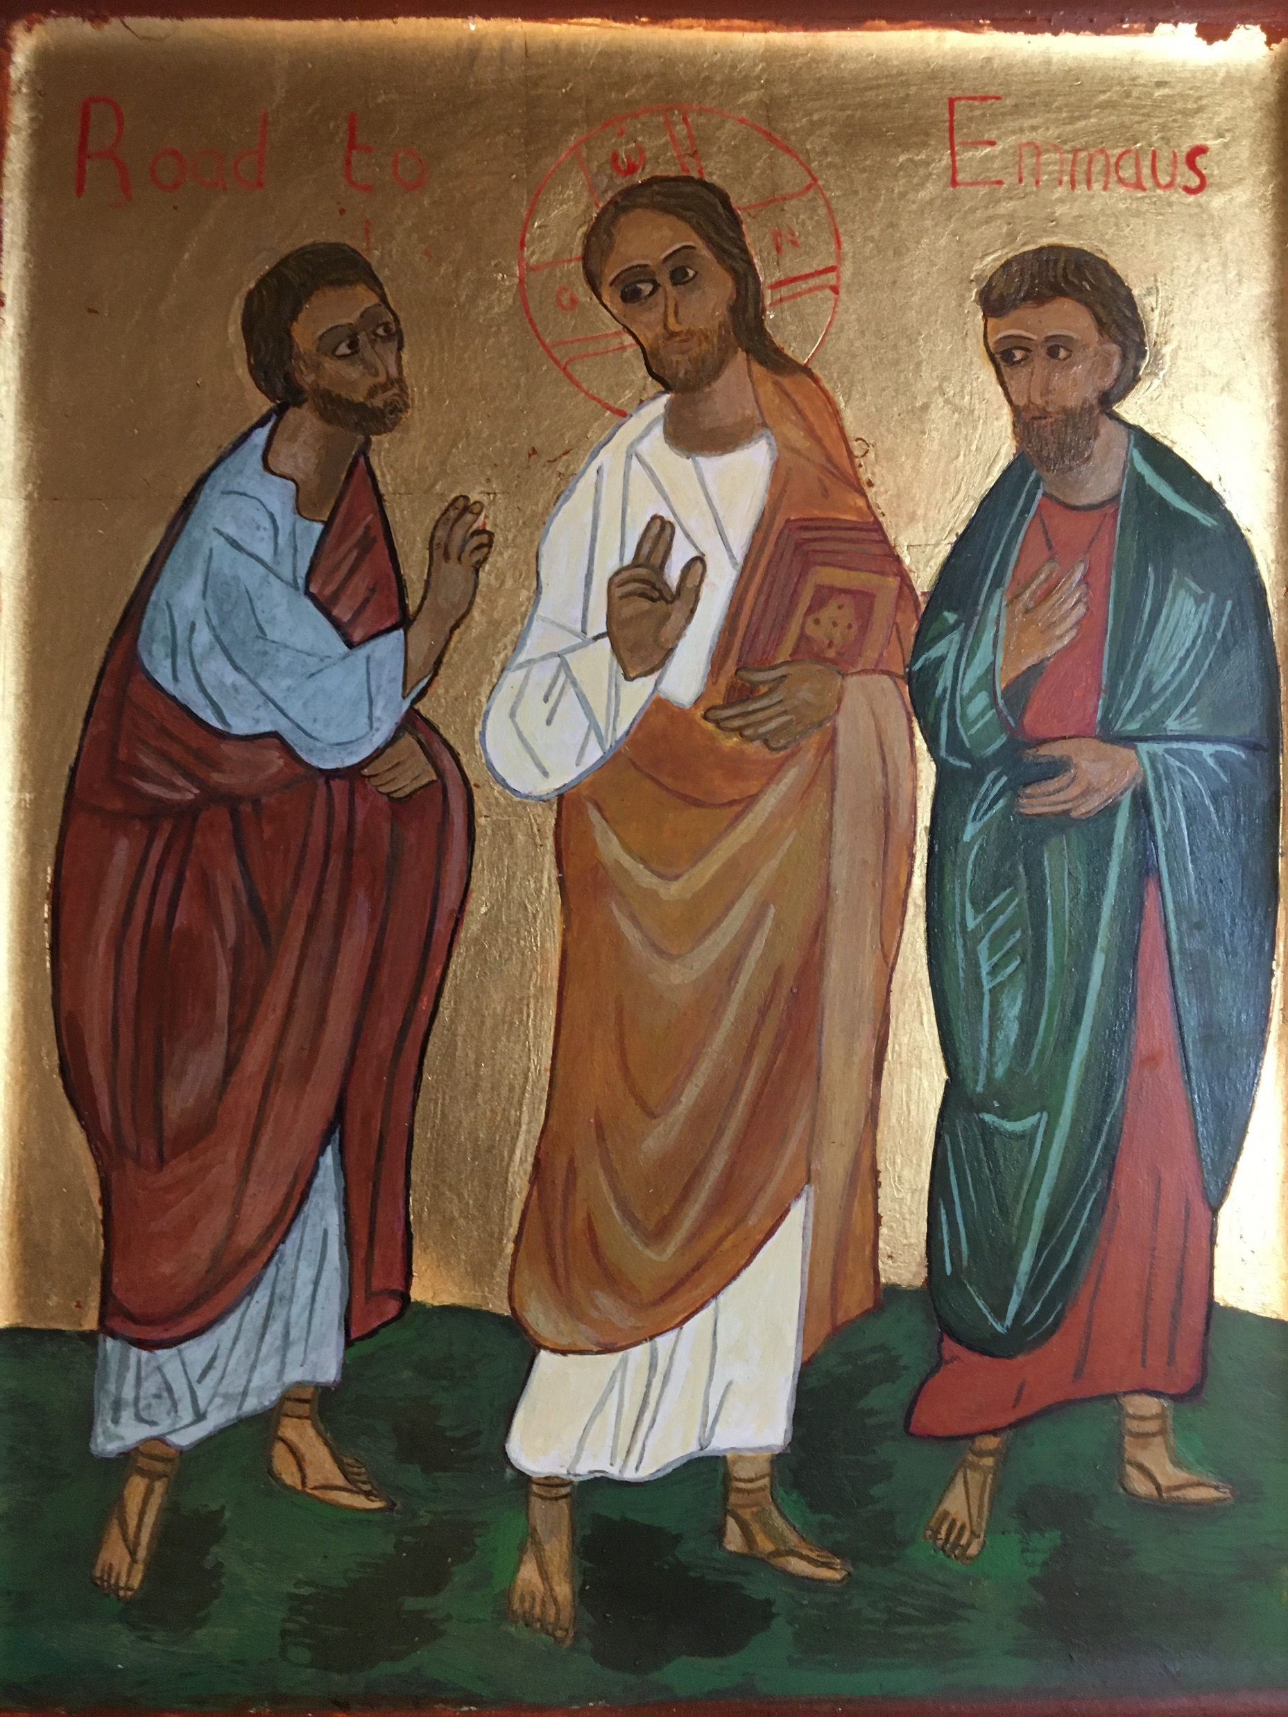
Conversation with Jesus
Focus on this image of Jesus and open your heart to Him now.
Take this opportunity to talk to him in your mind and heart.
Listen and be aware of his presence with you.
You may want to use this hymn to help you pray

Slide 17
Spiritual Journal
You may want to write down what has been important for you during this time together

Slide 18
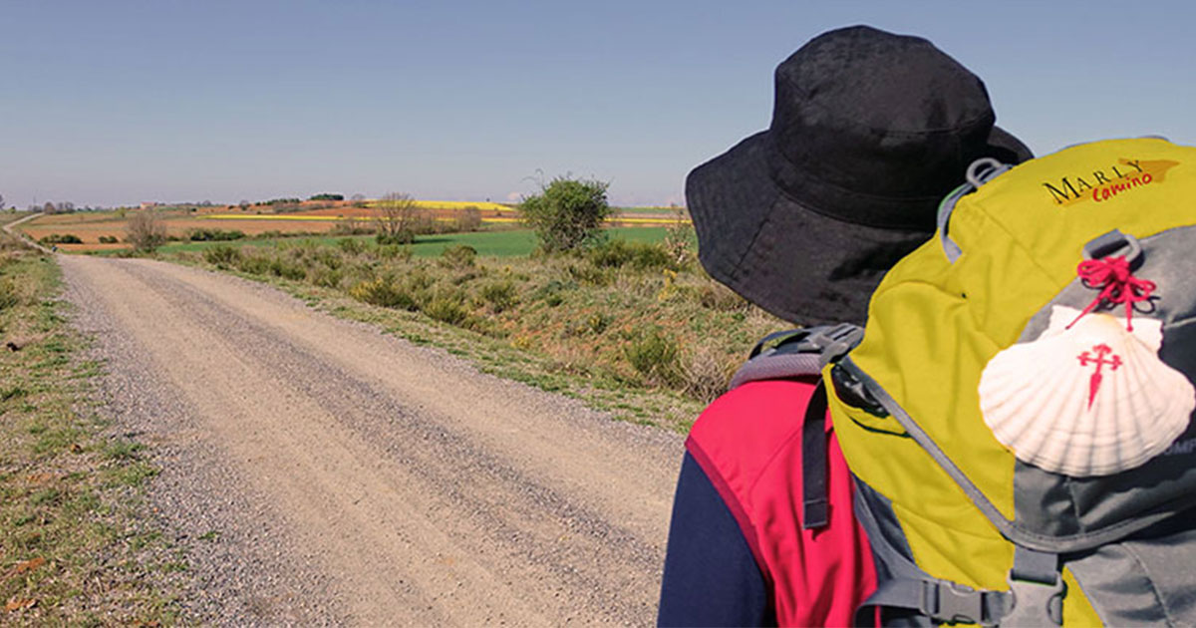
Rucksack Prayer – Part 2

Slide 19
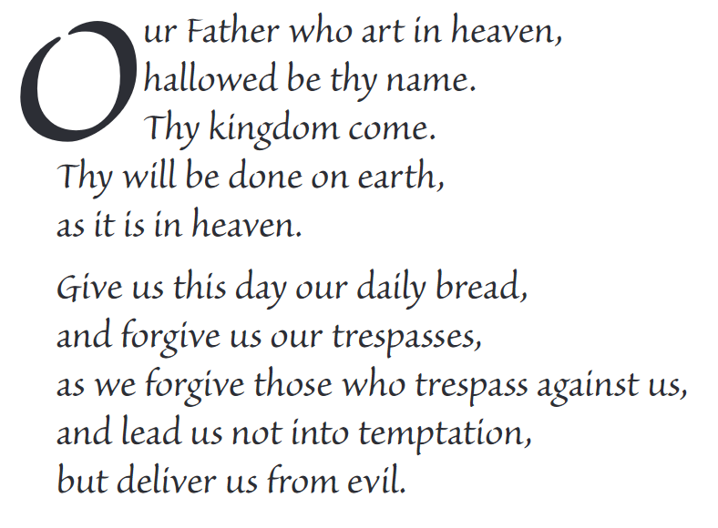
The Lord’s Prayer

Slide 20
Final pilgrim blessing for the week ahead
God of our pilgrimage,
you have given us a desire
to take the questing way
and set out on our journey.
Help us to keep our eyes fixed on Jesus,
that whatever we encounter as we travel,
we may seek to glorify you by the way we live.
You call us, Lord,
to leave familiar things and to leave our “comfort zone”.
May we open our eyes to new experiences,
may we open our ears to hear you speaking to us
and may we open our hearts to your love.
Grant that this time spent on pilgrimage
may help us to see ourselves as we really are
and may we strive to become the people you would have us be. Amen
… continued on next slide

Slide 21
Final pilgrim blessing for the week ahead
Lord, you know our beginning and our end.
Help us to realise we are only pilgrims on this earth
and save us from being too attached to worldly possessions.
May we experience the freedom to wander,
the freedom to hope and the freedom to love as we journey. Amen
Creator God, you are the source of all life and motivation.
May we journey in faith and love, rejoicing and eager to serve you.
Grant us a glimpse of your glory as we seek to follow you –
the Way, the Truth and the Life. Amen
May God the Father who created you, guide your footsteps,
May God the Son who redeemed you, share your journey,
May God the Holy Spirit who sanctifies you, lead you on life’s pilgrimage,
and the blessing of God, Father, Son and Holy Spirit
be with you wherever you may go. Amen.

Slide 22
CAMINO
Making the Journey…
Session 18
Making the journey of life - a moral compass

