Slide 1
CAMINO
Making the Journey…
Session 19
Making the journey with Love

Slide 2
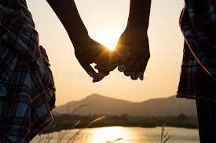
Introduction
We are pilgrims together on this journey and that means that we have a responsibility to help others along the way. Jesus made this clear on many occasions e.g. the parable of the Good Samaritan and the Parable of the Sheep and Goats. The more we allow Jesus to be the centre of our lives, the more we will live inside out at the service of God and those around us. The more that we do, the more our lives will make sense. The Church helps us with corporal and spiritual works of mercy to make this a way of life based on Christ himself. And we must always remember that whenever we encounter someone in need we encounter Jesus himself.

Slide 3
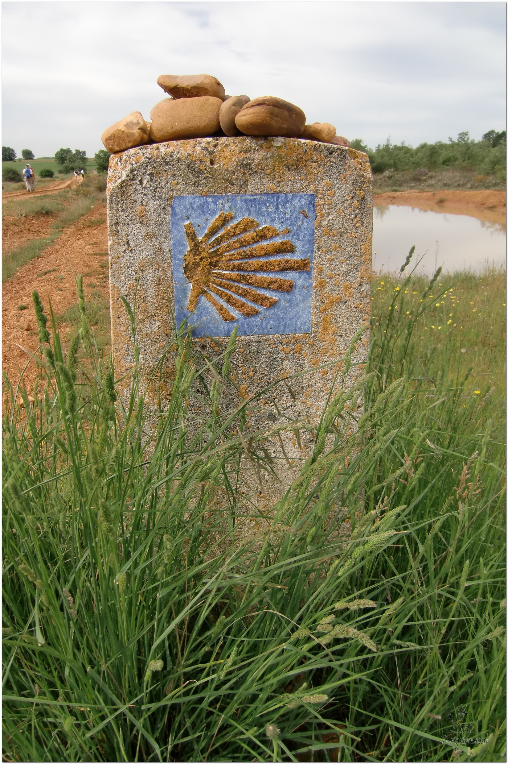
Opening Prayer
The Camino Prayer (adapted)
O God, who brought your servant Abraham out of the land of the Chaldeans, protecting him in his wanderings, who guided the Hebrew people across the desert, we ask that you watch over us, your servants, as we walk in the love of your name.
Be for us our companion on the journey,
Our guide at the crossroads, Our breath in our weariness,
Our protection in danger, our albergue on the Camino,
Our shade in the heat, Our light in the darkness,
Our consolation in our discouragements,
And our strength in our intentions.
So that with your guidance we may arrive safe and sound at the end of the road and enriched with grace and virtue we return safely to our homes filled with joy.
In the name of Jesus Christ our Lord, Amen. Apostle Santiago, pray for us. Santa Maria, pray for us.

Slide 4
What did Jesus mean when he instructed us to love our enemies?

Slide 5
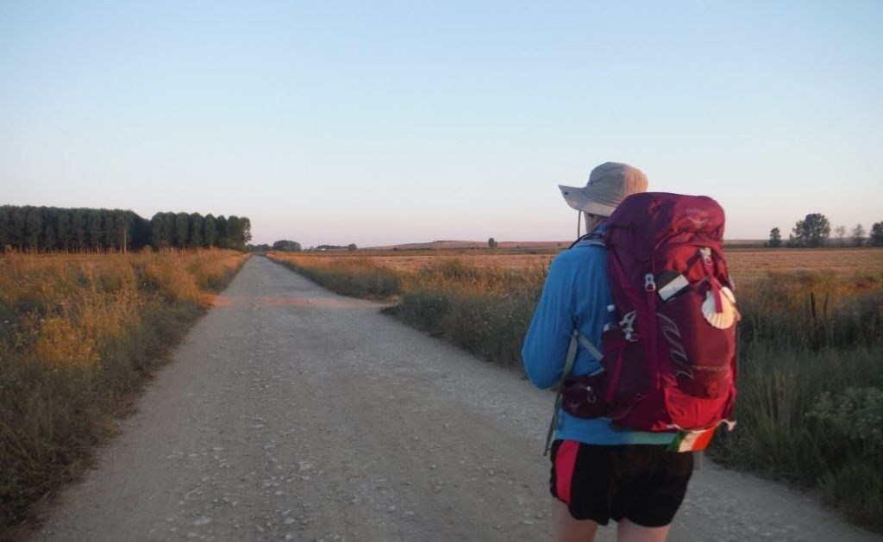
Rucksack Prayer – Part 1

Slide 6
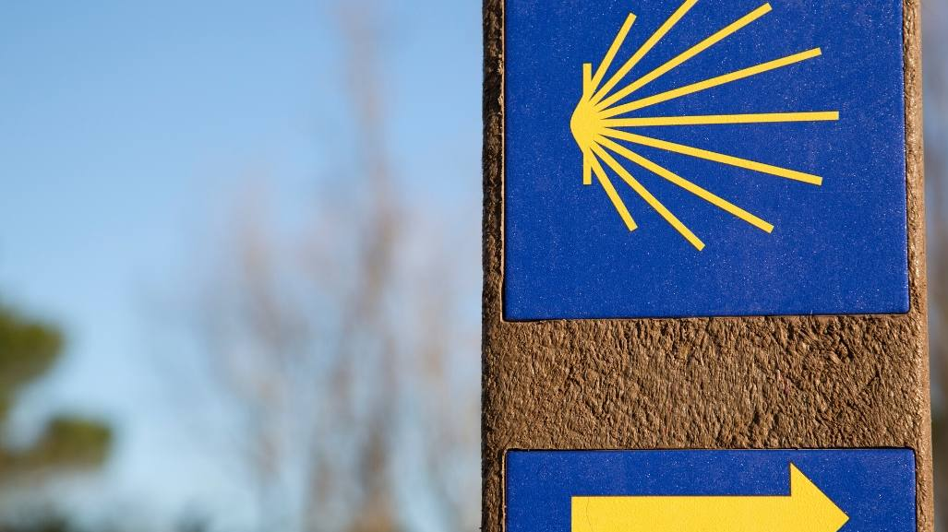
A Journey with…
“When our hearts are open to universal communion this excludes nothing and no one Pope Francis”.
Laudato si #92 Caritas is…Love in action

Slide 7
The Parable of the sheep and goats - Matthew 25:31-46
‘When the Son of Man comes in his glory, escorted by all the angels, then he will take his seat on his throne of glory. All the nations will be assembled before him and he will separate men one from another as the shepherd separates sheep from goats. He will place the sheep on his right hand and the goats on his left. Then the King will say to those on his right hand, Come, you whom my Father has blessed, take for your heritage the kingdom prepared for you since the foundation of the world. For I was hungry and you gave me food; I was thirsty and you gave me drink; I was a stranger and you made me welcome; naked and you clothed me, sick and you visited me, in prison and you came to see me. Then the virtuous will say to him in reply, Lord, when did we see you hungry and feed you; or thirsty and give you drink? When did we see you a stranger and make you welcome; naked and clothe you; sick or in prison and go to see you? And the King will answer, I tell you solemnly, in so far as you did this to one of the least of these brothers of mine, you did it to me.

Slide 8
The Parable of the sheep and goats - Matthew 25:31-46
Next he will say to those on his left hand, Go away from me, with your curse upon you, to the eternal fire prepared for the devil and his angels. For I was hungry and you never gave me food; I was thirsty and you never gave me anything to drink; I was a stranger and you never made me welcome, naked and you never clothed me, sick and in prison and you never visited me. Then it will be their turn to ask, Lord, when did we see you hungry or thirsty, a stranger or naked, sick or in prison, and did not come to your help? Then he will answer, I tell you solemnly, in so far as you neglected to do this to one of the least of these, you neglected to do it to me. And they will go away to eternal punishment, and the virtuous to eternal life.’

Slide 9
From what you have heard so far…
…what are your Initial thoughts, reactions, questions that come to mind?
We can discuss these later…

Slide 10
Main Input
“Therefore welcome one another as Christ has welcomed you, for the glory of God.” Romans 15:7

Slide 11
Reflection
“Praise the Lord all nations Lift Him up all people
For His love to us is great His faithfulness forever”

Slide 12
Testimony
Love must be sincere. Hate what is evil; cling to what is good. Be devoted to one another in love. Romans 12: 9

Slide 13
Catechism of the Catholic Church
The life of man - to know and love God
1 God, infinitely perfect and blessed in himself, in a plan of sheer goodness freely created man to make him share in his own blessed life. For this reason, at every time and in every place, God draws close to man. He calls man to seek him, to know him, to love him with all his strength. He calls together all men, scattered and divided by sin, into the unity of his family, the Church. To accomplish this, when the fullness of time had come, God sent his Son as Redeemer and Saviour. In his Son and through him, he invites men to become, in the Holy Spirit, his adopted children and thus heirs of his blessed life.
2 So that this call should resound throughout the world, Christ sent forth the apostles he had chosen, commissioning them to proclaim the gospel: "Go therefore and make disciples of all nations, baptizing them in the name of the Father and of the Son and of the Holy Spirit, teaching them to observe all that I have commanded you; and lo, I am with you always, to the close of the age." Strengthened by this mission, the apostles "went forth and preached everywhere, while the Lord worked with them and confirmed the message by the signs that attended it."
3 Those who with God's help have welcomed Christ's call and freely responded to it are urged on by love of Christ to proclaim the Good News everywhere in the world. This treasure, received from the apostles, has been faithfully guarded by their successors. All Christ's faithful are called to hand it on from generation to generation, by professing the faith, by living it in fraternal sharing, and by celebrating it in liturgy and prayer.

Slide 14
Question
What does the bible say about love being an action?

Slide 15
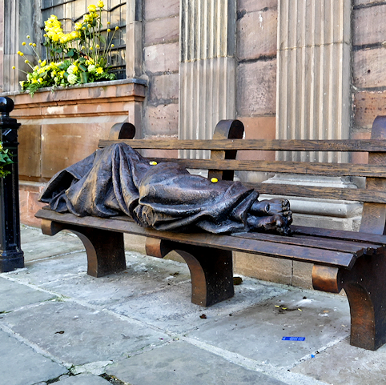
Discussion
Would you sit on this bench?
Discuss this is two’s & three’s then feedback to the main group

Slide 16
Internet Corner - Where to find out more…
www.caritassalford.org.uk/
www.caritaswestminster.org.uk/love-in-action.php
www.stepforwardinlove.org/

Slide 17
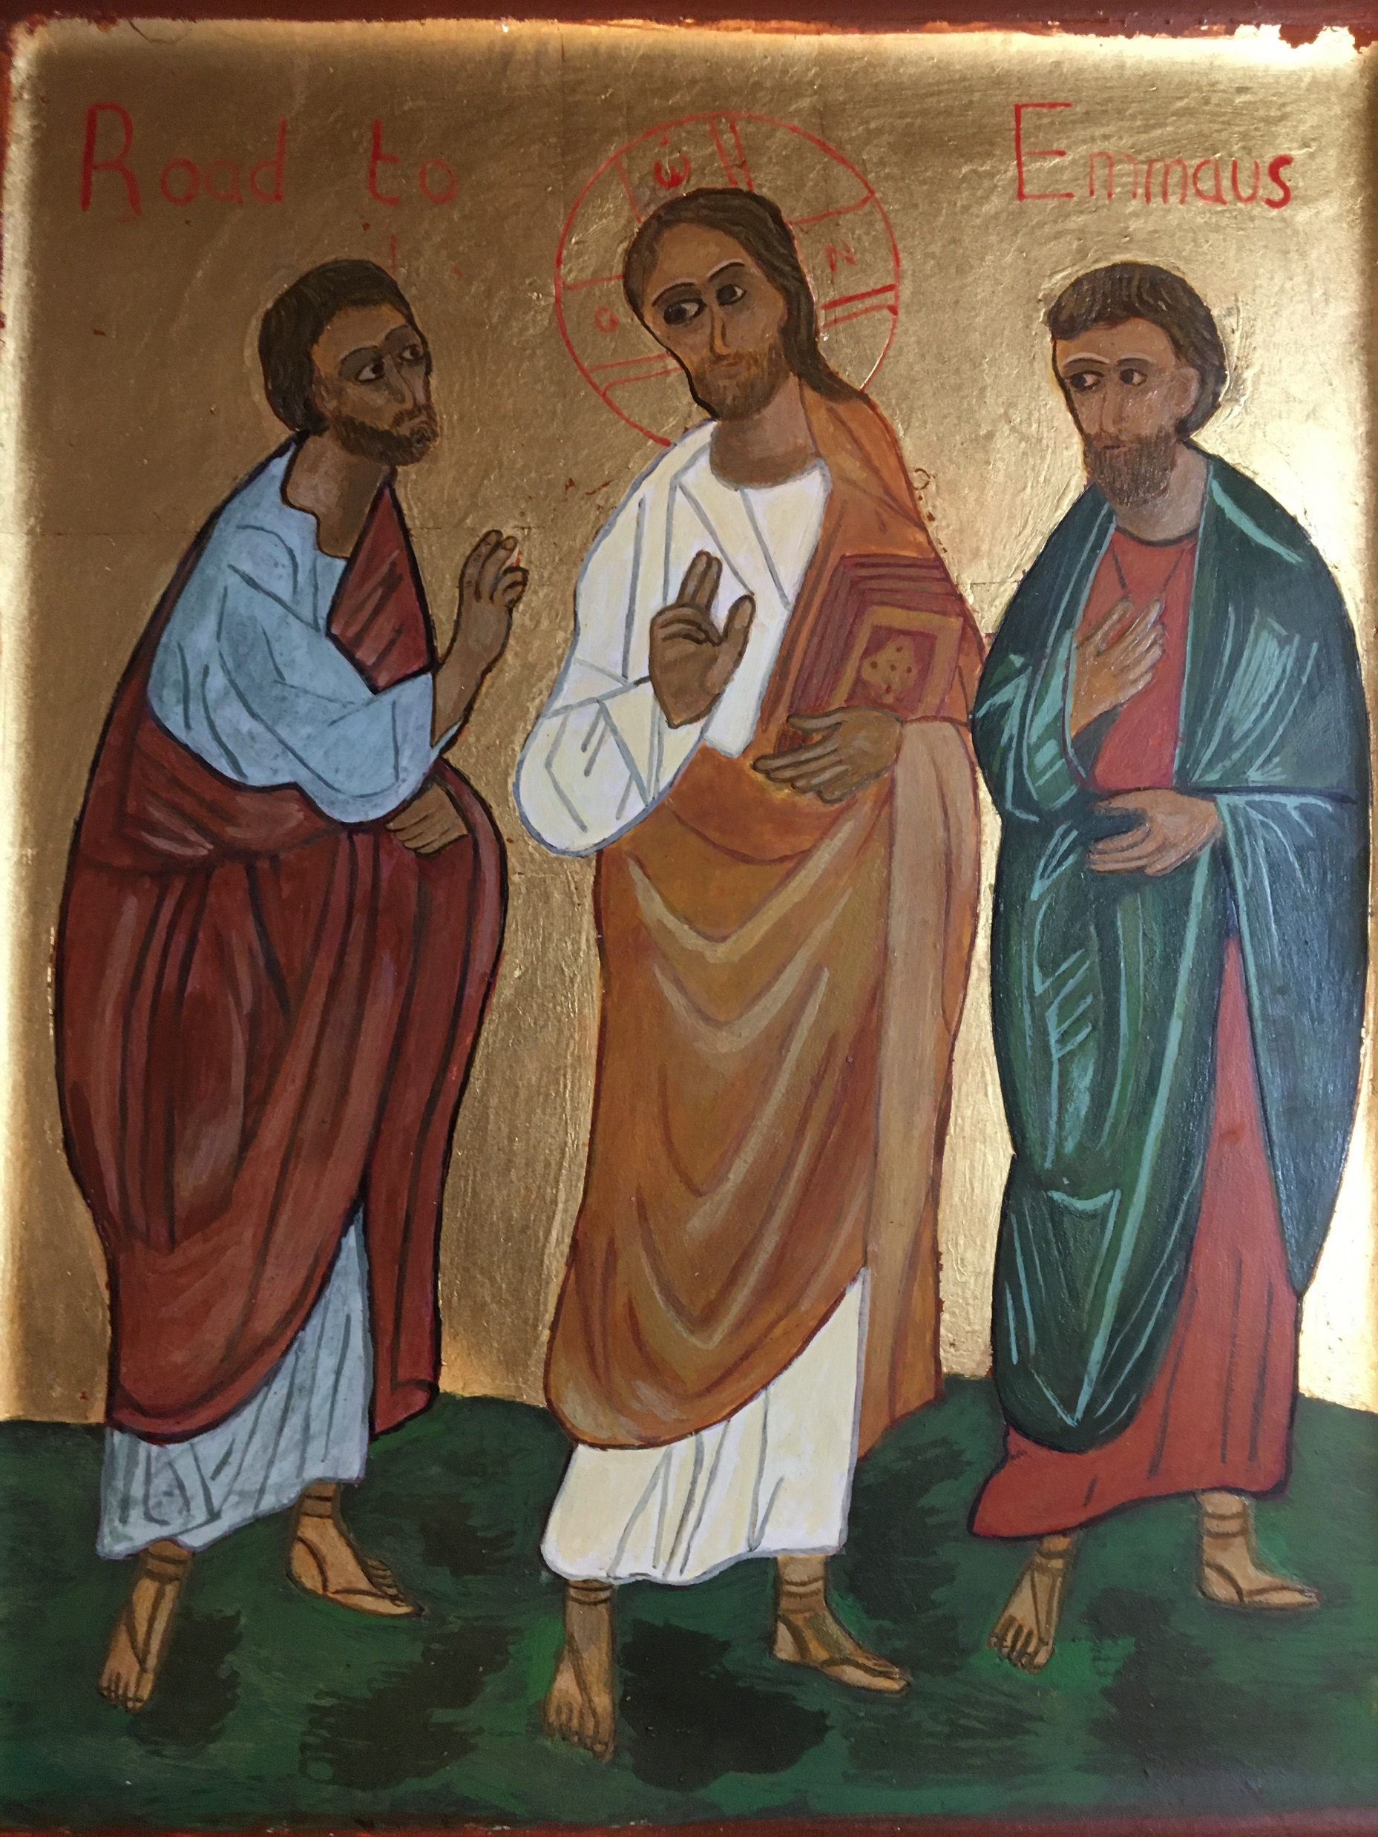
Conversation with Jesus
Focus on this image of Jesus and open your heart to Him now.
Take this opportunity to talk to him in your mind and heart.
Listen and be aware of his presence with you.
You may want to use this hymn to help you pray

Slide 18
Spiritual Journal
You may want to write down what has been important for you during this time together

Slide 19
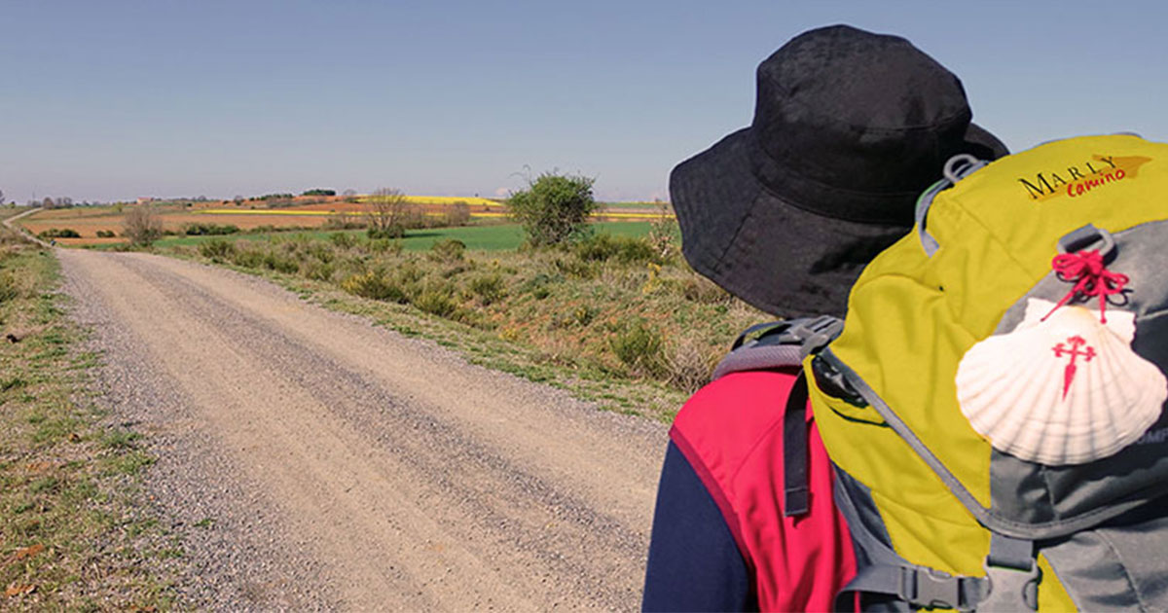
Rucksack Prayer – Part 2

Slide 20
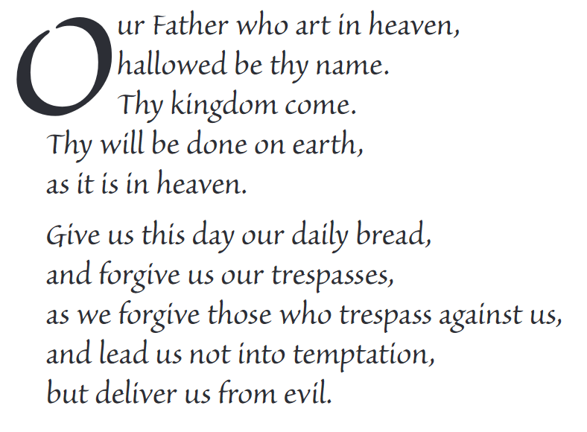
The Lord’s Prayer

Slide 21
Final pilgrim blessing for the week ahead
God of our pilgrimage,
you have given us a desire
to take the questing way
and set out on our journey.
Help us to keep our eyes fixed on Jesus,
that whatever we encounter as we travel,
we may seek to glorify you by the way we live.
You call us, Lord,
to leave familiar things and to leave our “comfort zone”.
May we open our eyes to new experiences,
may we open our ears to hear you speaking to us
and may we open our hearts to your love.
Grant that this time spent on pilgrimage
may help us to see ourselves as we really are
and may we strive to become the people you would have us be. Amen
… continued on next slide

Slide 22
Final pilgrim blessing for the week ahead
Lord, you know our beginning and our end.
Help us to realise we are only pilgrims on this earth
and save us from being too attached to worldly possessions.
May we experience the freedom to wander,
the freedom to hope and the freedom to love as we journey. Amen
Creator God, you are the source of all life and motivation.
May we journey in faith and love, rejoicing and eager to serve you.
Grant us a glimpse of your glory as we seek to follow you –
the Way, the Truth and the Life. Amen
May God the Father who created you, guide your footsteps,
May God the Son who redeemed you, share your journey,
May God the Holy Spirit who sanctifies you, lead you on life’s pilgrimage,
and the blessing of God, Father, Son and Holy Spirit
be with you wherever you may go. Amen.

Slide 23
CAMINO
Making the Journey…
Session 19
Making the journey with Love

