Slide 1
CAMINO
Making the Journey…
Session 2
Making the journey with the People of Israel - Divine Revelation

Slide 2
Introduction
The focus of this part of the journey is to understand how God chose to reveal Himself to the people of Israel and reach out to them in the different covenants of the Old Testament. This is Divine Revelation and distinguishes our faith. Our faith is not a human way of trying to make sense of existence, rather it is a response to God choosing to reveal Himself to us and be in relationship with us. God’s rescue plan reaches it fulfilment in Jesus Christ the new and everlasting Covenant.

Slide 3
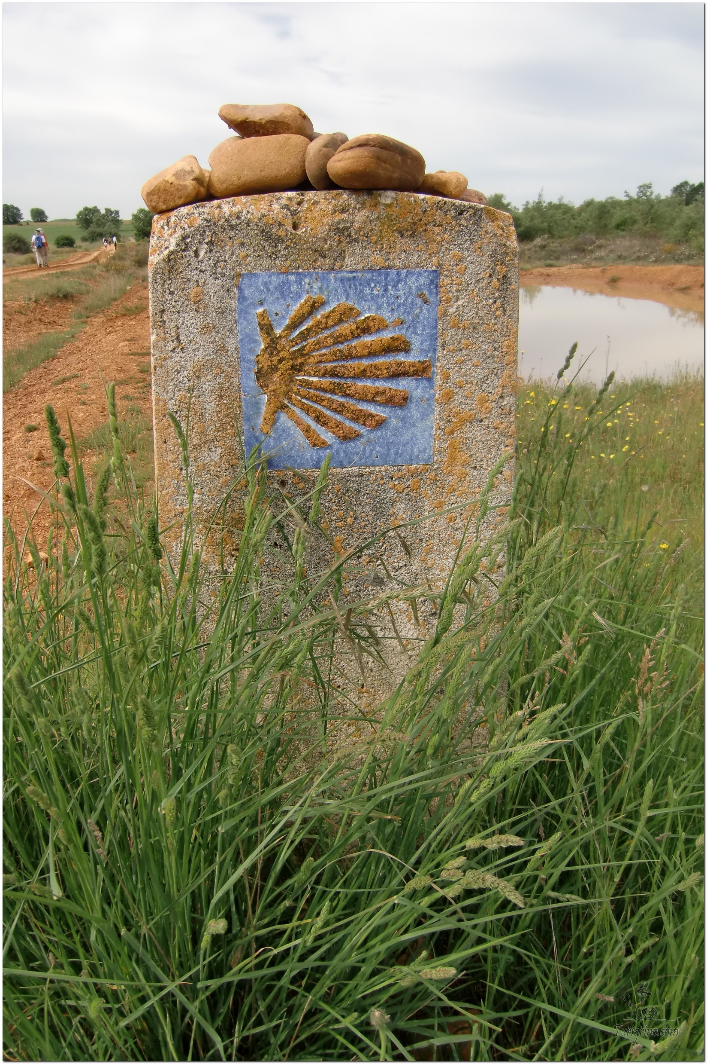
Opening Prayer
The Camino Prayer (adapted)
O God, who brought your servant Abraham out of the land of the Chaldeans, protecting him in his wanderings, who guided the Hebrew people across the desert, we ask that you watch over us, your servants, as we walk in the love of your name.
Be for us our companion on the journey,
Our guide at the crossroads, Our breath in our weariness,
Our protection in danger, our albergue on the Camino,
Our shade in the heat, Our light in the darkness,
Our consolation in our discouragements,
And our strength in our intentions.
So that with your guidance we may arrive safe and sound at the end of the road and enriched with grace and virtue we return safely to our homes filled with joy.
In the name of Jesus Christ our Lord, Amen. Apostle Santiago, pray for us. Santa Maria, pray for us.

Slide 4
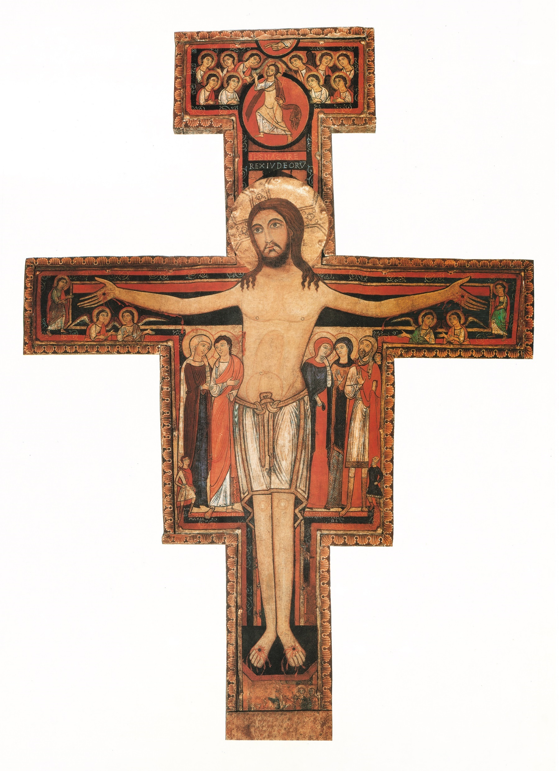
Catholicism in a Hundred Objects
This video is 33 minutes long so watch as much or as little as you like
Object 2 - San Damiano Cross

Slide 5
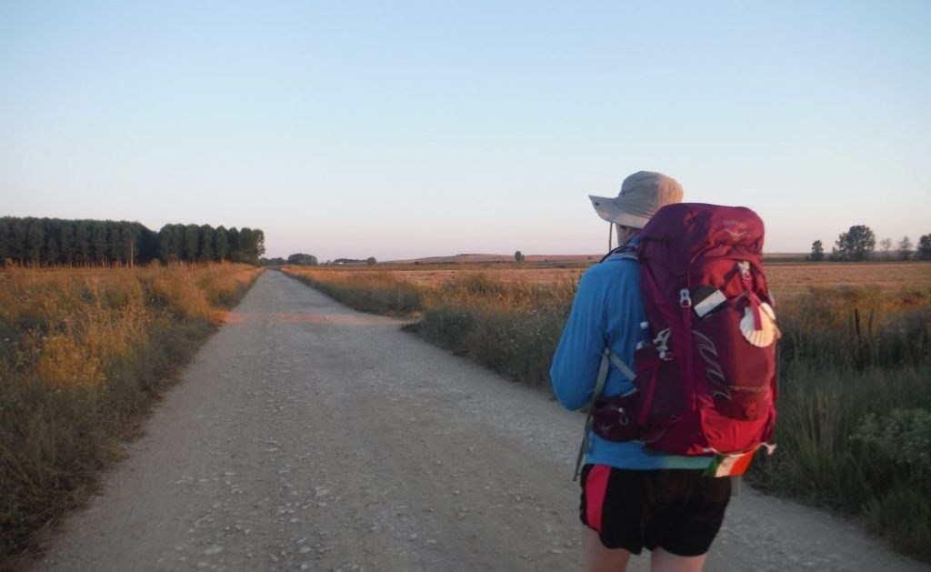
Rucksack Prayer – Part 1

Slide 6
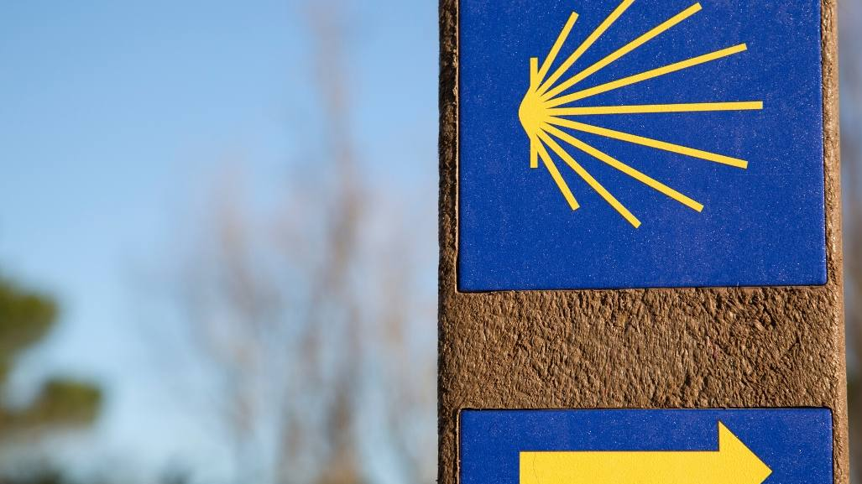
Introduction

Slide 7
Look at this painting from Elizabeth Wang.
What might this be teaching us about the role of Jesus and who he is?

Slide 8
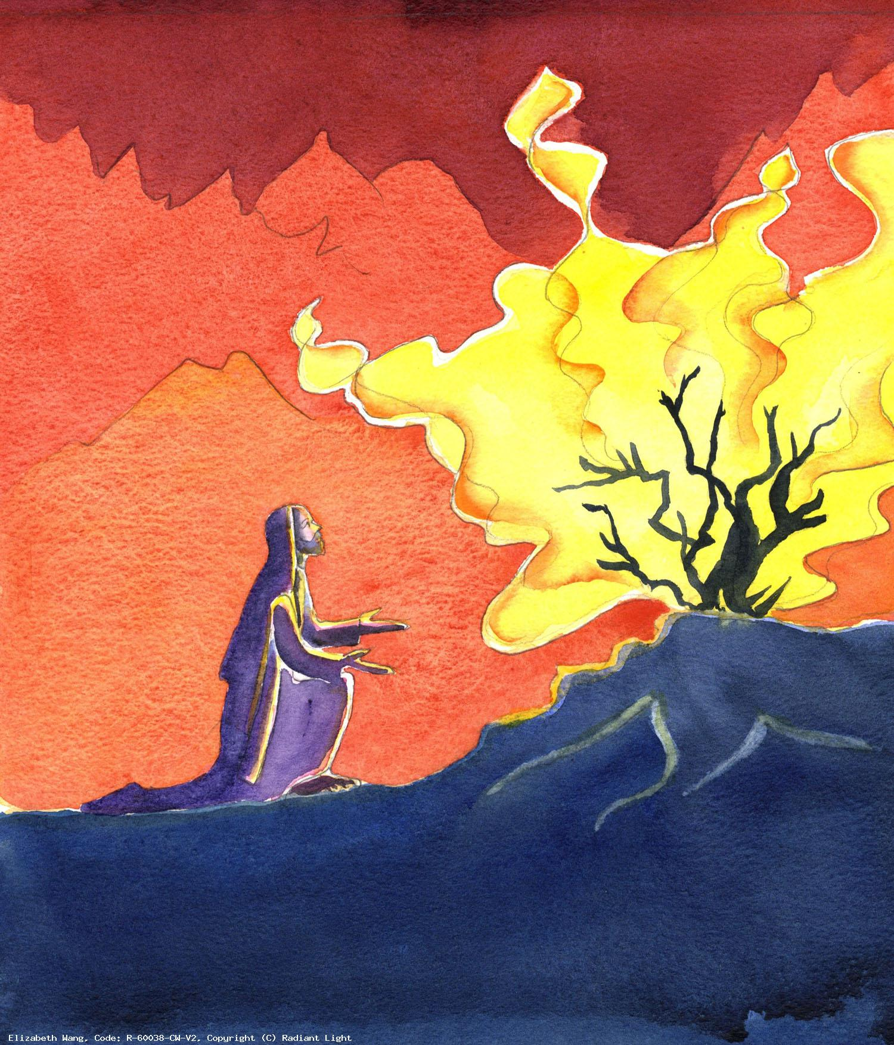
Scripture Reading - Exodus 3:1-8,13-15
Moses was looking after the flock of Jethro, his father-in-law priest of Midian. He led his flock to the far side of the wilderness and came to Horeb, the mountain of God. There the angel of the Lord appeared to him in the shape of a flame of fire, coming from the middle of a bush. Moses looked; there was the bush blazing but it was not being burnt up. ‘I must go and look at this strange sight,’ Moses said, ‘and see why the bush is not burnt.’ Now the Lord saw him go forward to look, and God called to him from the middle of the bush. ‘Moses, Moses!’ he said. ‘Here I am,’ Moses answered. ‘Come no nearer,’ he said. ‘Take off your shoes, for the place on which you stand is holy ground. I am the God of your fathers,’ he said, ‘the God of Abraham, the God of Isaac and the God of Jacob.’ At this Moses covered his face, afraid to look at God.
Then Moses said to God, ‘I am to go, then, to the sons of Israel and say to them, “The God of your fathers has sent me to you.” But if they ask me what his name is, what am I to tell them?’ And God said to Moses,
‘I Am who I Am. This’ he added ‘is what you must say to the sons of Israel: “I Am has sent me to you.”’ And God also said to Moses, ‘You are to say to the sons of Israel: “The Lord, the God of your fathers, the God of Abraham, the God of Isaac, and the God of Jacob, has sent me to you.” This is my name for all time; by this name I shall be invoked for all generations to come.’

Slide 9
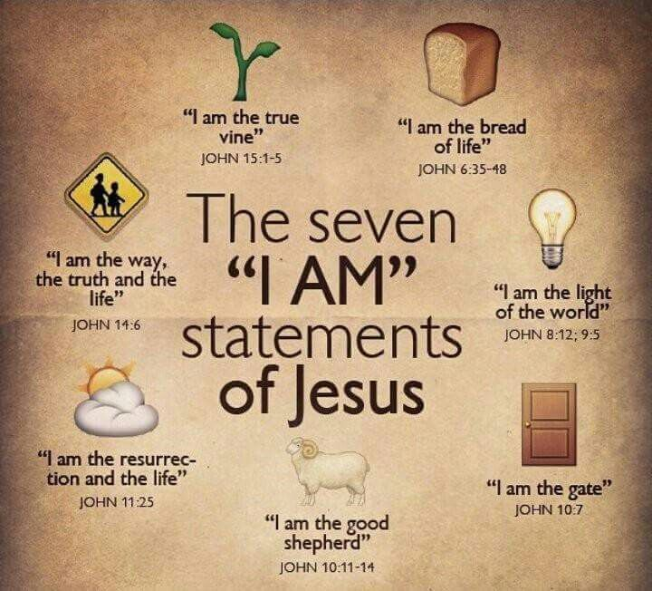
God told Moses His name is
‘I AM’
Jesus continues to tell us who God is in the Gospels
“At various times in the past
and in various different ways,
God spoke to our ancestors through the prophets;
but in our own time, the last days,
he has spoken to us through his Son.”
Hew 1:1-2

Slide 10
From what you have heard so far…
…what are your Initial thoughts, reactions, questions that come to mind?
We can discuss these later…

Slide 11
What is Divine Revelation?
“God revealed Himself in order to have an intimate relationship with us”

Slide 12
Reflection
How do you picture God? God revealed His love and mercy in Jesus –
the face of the Father’s Love & Mercy
“Christ is the visible image of the invisible God. He existed before anything was created and is supreme over all creation”
Colossians 1:15

Slide 13
Testimony
In this video Darrell Tunningley describes his story of coming to faith
in Jesus from a life of drugs and crime.

Slide 14
Catechism of the Catholic Church
68 By love, God has revealed himself and given himself to man. He has thus provided the definitive, superabundant answer to the questions that man asks himself about the meaning and purpose of his life.
69 God has revealed himself to man by gradually communicating his own mystery in deeds and in words.
70 Beyond the witness to himself that God gives in created things, he manifested himself to our first parents, spoke to them and, after the fall, promised them salvation (cf Gen 3:15) and offered them his covenant.
71 God made an everlasting covenant with Noah and with all living beings (cf Gen 9:16). It will remain in force as long as the world lasts.
72 God chose Abraham and made a covenant with him and his descendants. By the covenant God formed his people and revealed his law to them through Moses. Through the prophets, he prepared them to accept the salvation destined for all humanity.
73 God has revealed himself fully by sending his own Son, in whom he has established his covenant for ever. the Son is his Father's definitive Word; so there will be no further Revelation after him.

Slide 15
Discussion - The Jesus Question…
Reflect on this for a moment. Who do YOU say Jesus is?
Discuss this is two’s & three’s then feedback to the main group

Slide 16
Internet Corner - Where to find out more…
Alpha Film Series / Episode 02 // Who is Jesus
Sycamore:
Session 4 –
Who is Jesus

Slide 17
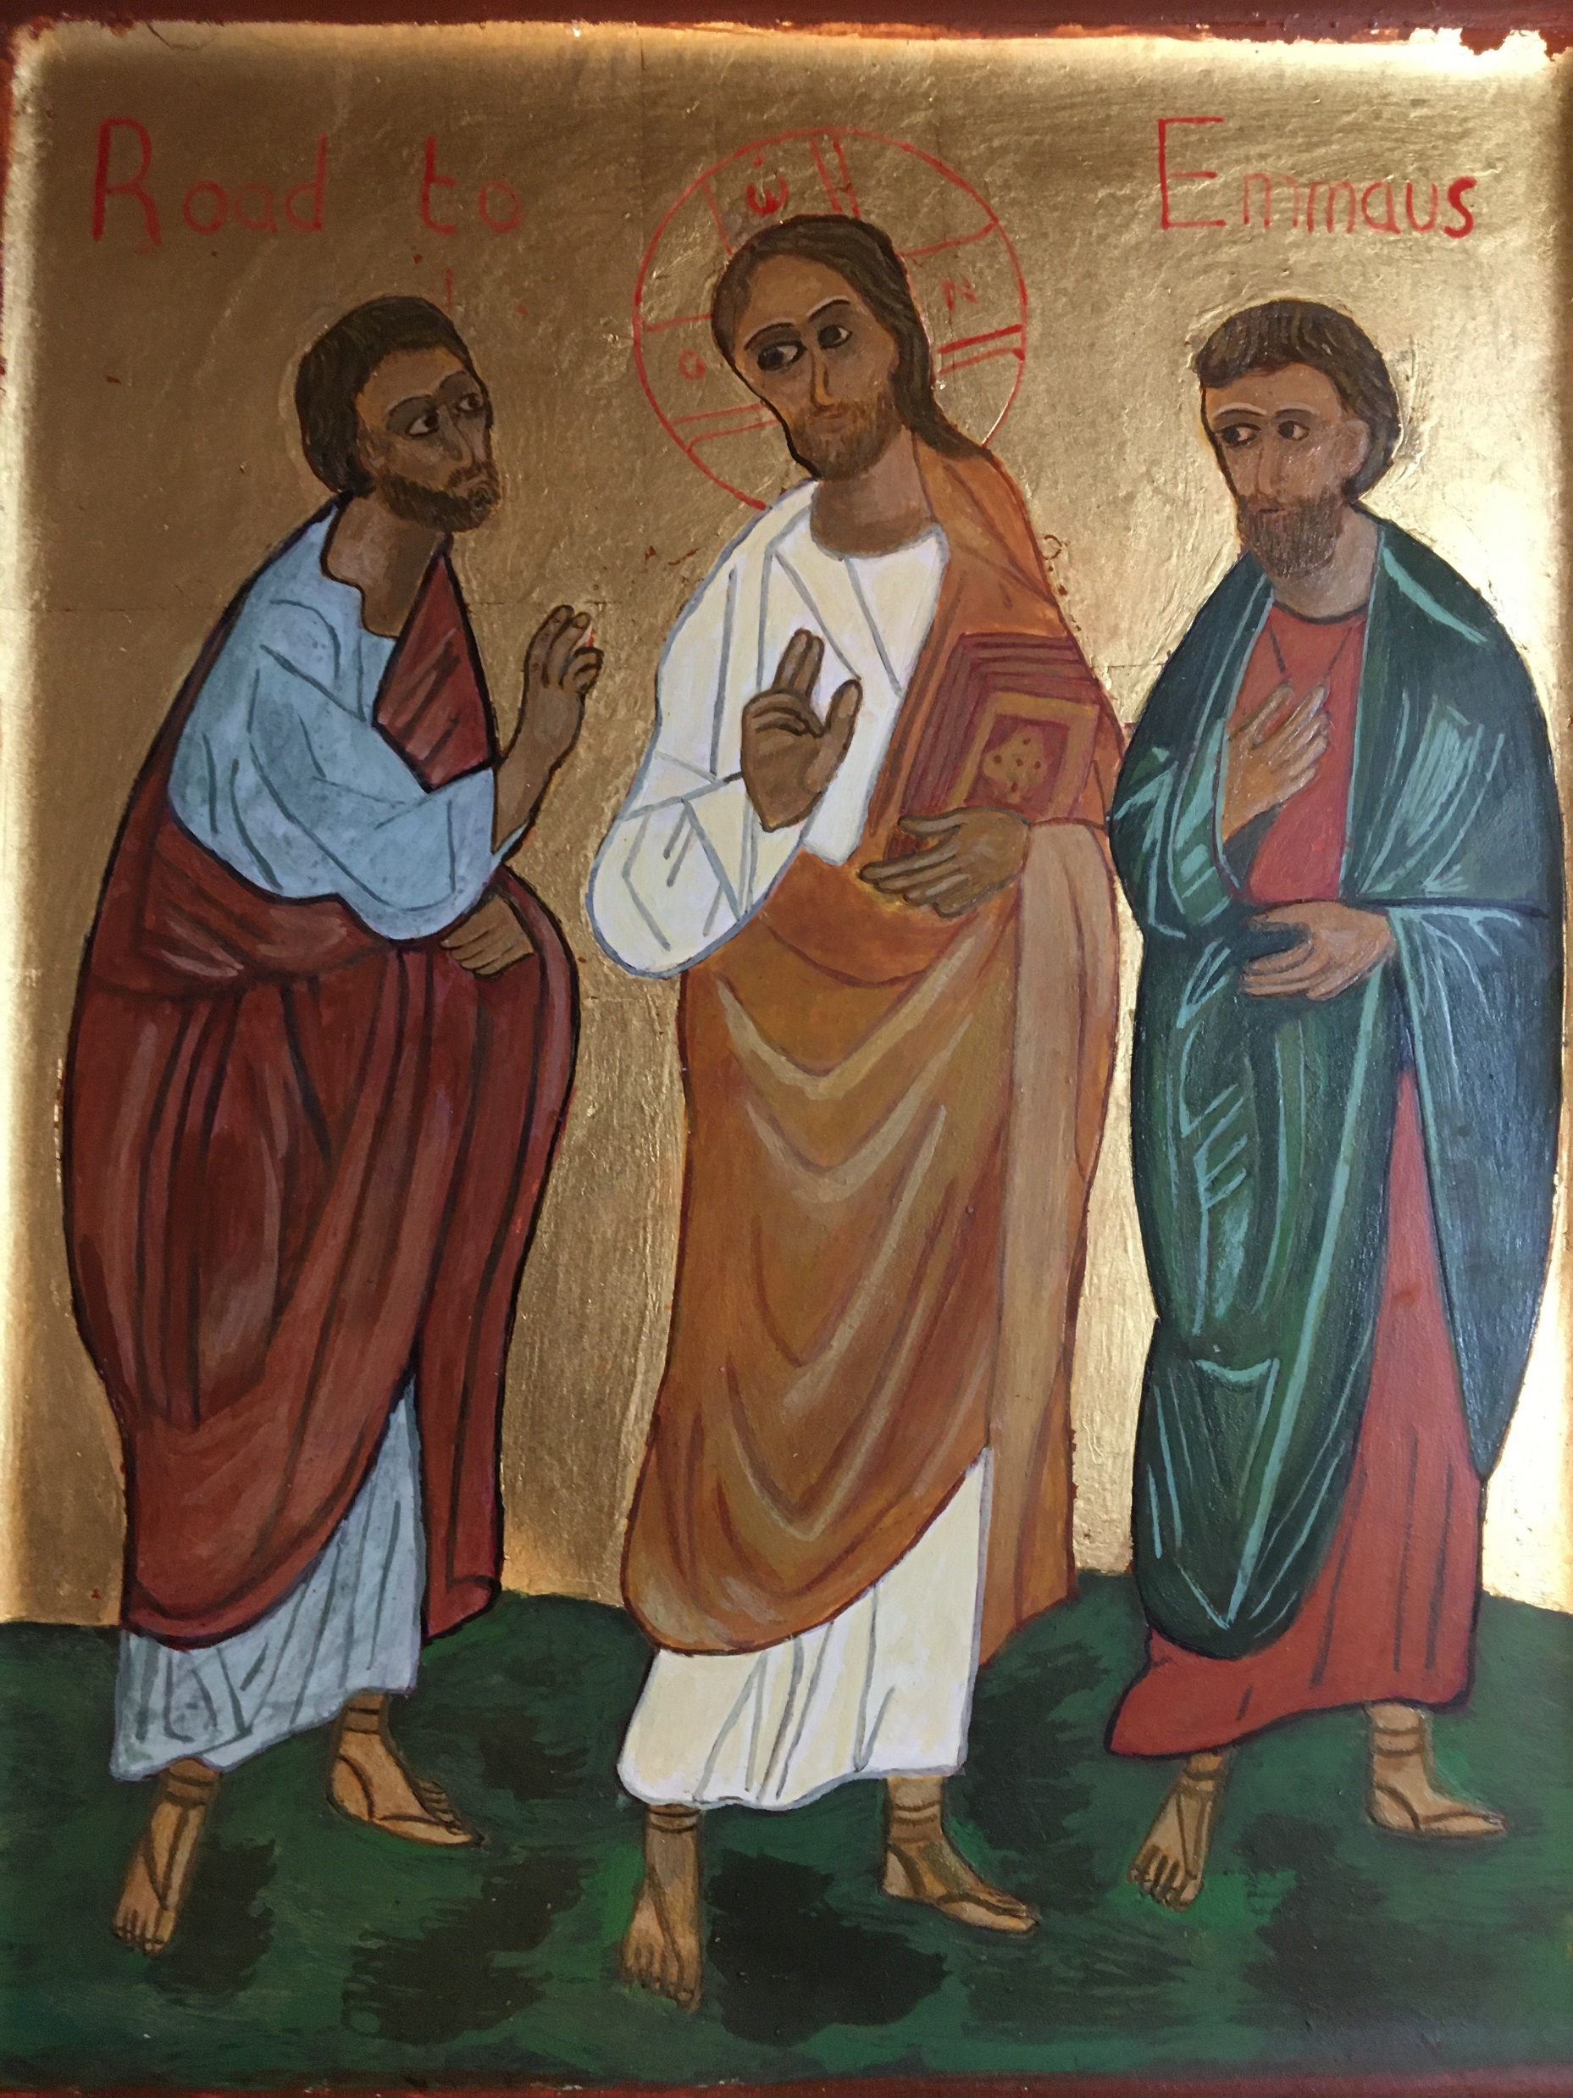
Conversation with Jesus
Focus on this image of Jesus and open your heart to Him now.
Take this opportunity to talk to him in your mind and heart.
Listen and be aware of his presence with you.
You may want to use this hymn to help you pray

Slide 18
Spiritual Journal
You may want to write down what has been important for you during this time together

Slide 19
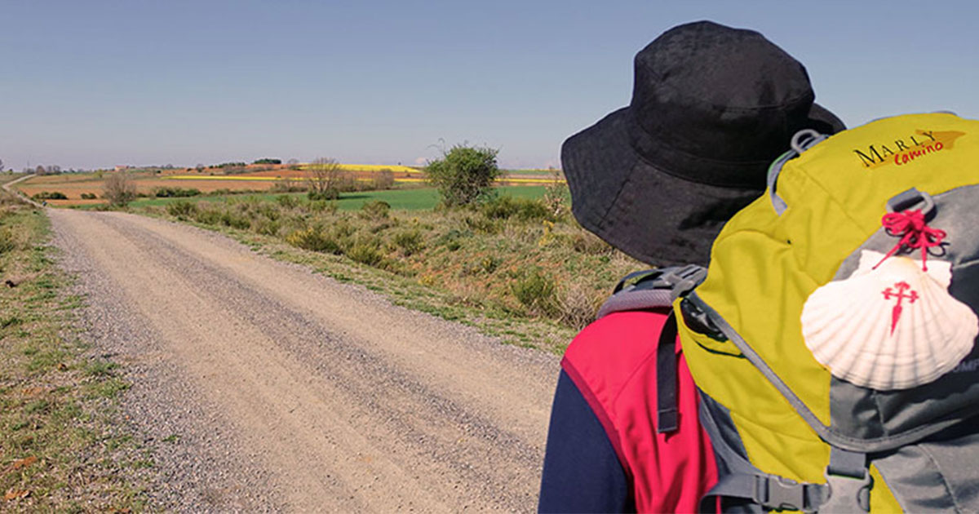
Rucksack Prayer – Part 2

Slide 20
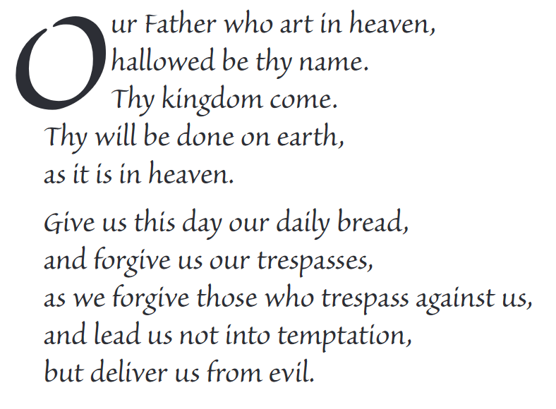
The Lord’s Prayer

Slide 21
Final pilgrim blessing for the week ahead
God of our pilgrimage,
you have given us a desire
to take the questing way
and set out on our journey.
Help us to keep our eyes fixed on Jesus,
that whatever we encounter as we travel,
we may seek to glorify you by the way we live.
You call us, Lord,
to leave familiar things and to leave our “comfort zone”.
May we open our eyes to new experiences,
may we open our ears to hear you speaking to us
and may we open our hearts to your love.
Grant that this time spent on pilgrimage
may help us to see ourselves as we really are
and may we strive to become the people you would have us be. Amen
… continued on next slide

Slide 22
Final pilgrim blessing for the week ahead
Lord, you know our beginning and our end.
Help us to realise we are only pilgrims on this earth
and save us from being too attached to worldly possessions.
May we experience the freedom to wander,
the freedom to hope and the freedom to love as we journey. Amen
Creator God, you are the source of all life and motivation.
May we journey in faith and love, rejoicing and eager to serve you.
Grant us a glimpse of your glory as we seek to follow you –
the Way, the Truth and the Life. Amen
May God the Father who created you, guide your footsteps,
May God the Son who redeemed you, share your journey,
May God the Holy Spirit who sanctifies you, lead you on life’s pilgrimage,
and the blessing of God, Father, Son and Holy Spirit
be with you wherever you may go. Amen.

Slide 23
CAMINO
Making the Journey…
Session 2
Making the journey with the People of Israel - Divine Revelation

