Slide 1
CAMINO
Making the Journey…
Session 20
Making the journey with a purpose - Vocation

Slide 2
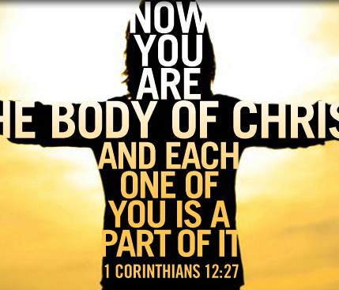
Introduction
All the different steps that we have made together help us realise that we have a vocation, a calling from God.
The call begins by recognising that God has made everything and that we are part of His creation, unique and know by God and part of the family of God.
The more we open our lives to being a disciple the more we are formed by Jesus then we are ‘sent’. Jesus calls, forms and sends his disciples. When we are using the natural gifts and talents that we have been given and the supernatural gifts given to us by the Holy Spirit we are called (vocation) to live our lives to the great glory of God and at the service of others proclaiming the Gospel. When we do this then we help the kingdom of God to break though in to this world as a way to help others be pilgrims on the way.
This gives us a sense of deep purpose and peace in our lives.

Slide 3
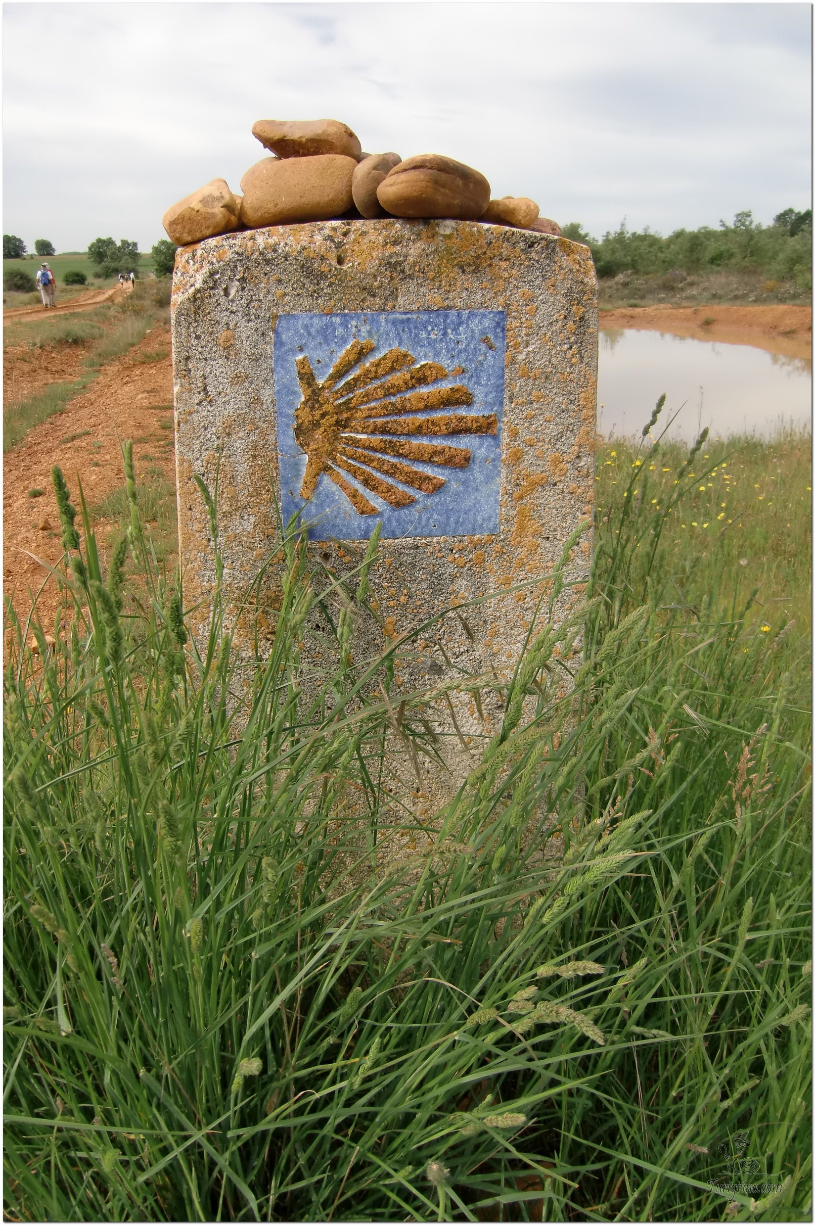
Opening Prayer
The Camino Prayer (adapted)
O God, who brought your servant Abraham out of the land of the Chaldeans, protecting him in his wanderings, who guided the Hebrew people across the desert, we ask that you watch over us, your servants, as we walk in the love of your name.
Be for us our companion on the journey,
Our guide at the crossroads, Our breath in our weariness,
Our protection in danger, our albergue on the Camino,
Our shade in the heat, Our light in the darkness,
Our consolation in our discouragements,
And our strength in our intentions.
So that with your guidance we may arrive safe and sound at the end of the road and enriched with grace and virtue we return safely to our homes filled with joy.
In the name of Jesus Christ our Lord, Amen. Apostle Santiago, pray for us. Santa Maria, pray for us.

Slide 4
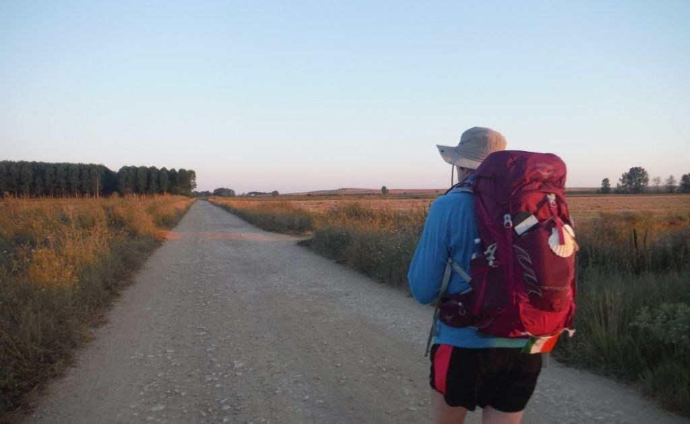
Rucksack Prayer – Part 1

Slide 5
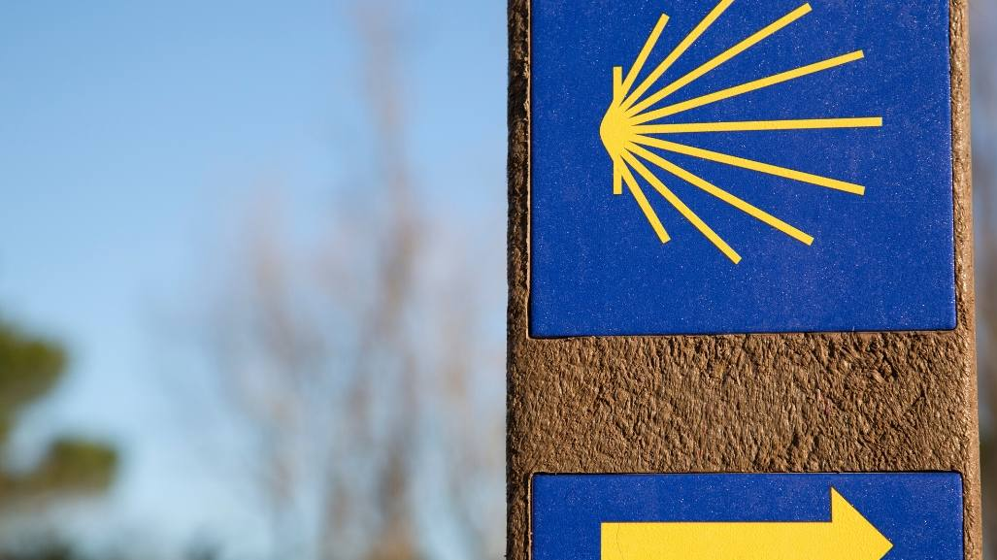
A Journey with a purpose - vocation
Intro video here

Slide 6
Scripture Reading – 1 Corinthians 12: 12 – 27
"For as with the human body which is a unity although it has many parts -- all the parts of the body, though many, still making up one single body -- so it is with Christ. We were baptised into one body in a single Spirit, Jews as well as Greeks, slaves as well as free men, and we were all given the same Spirit to drink. And indeed the body consists not of one member but of many. If the foot were to say, 'I am not a hand and so I do not belong to the body,' it does not belong to the body any the less for that. Or if the ear were to say, 'I am not an eye, and so I do not belong to the body,' that would not stop its belonging to the body. If the whole body were just an eye, how would there be any hearing? If the whole body were hearing, how would there be any smelling? As it is, God has put all the separate parts into the body as he chose. If they were all the same part, how could it be a body? As it is, the parts are many but the body is one. The eye cannot say to the hand, 'I have no need of you,' and nor can the head say to the feet, 'I have no need of you.' What is more, it is precisely the parts of the body that seem to be the weakest which are the indispensable ones. It is the parts of the body which we consider least dignified that we surround with the greatest dignity; and our less presentable parts are given greater presentability which our presentable parts do not need. God has composed the body so that greater dignity is given to the parts which were without it, and so that there may not be disagreements inside the body but each part may be equally concerned for all the others. If one part is hurt, all the parts share its pain. And if one part is honoured, all the parts share its joy.
Now Christ's body is yourselves, each of you with a part to play in the whole."

Slide 7
What is vocation?
Universal Call to Holiness
(We are all called to be Saints)
Priest
Religious Brother or Sister
Married
Single or consecrated
Any job (teacher, care profession, office etc.)
We are all called to holiness, but God may want us to live out that holiness in different states of life. No one vocation is better than another, they are just different ways of giving Glory to God.

Slide 8
From what you have heard so far…
…what are your Initial thoughts, reactions, questions that come to mind?
We can discuss these later…

Slide 9
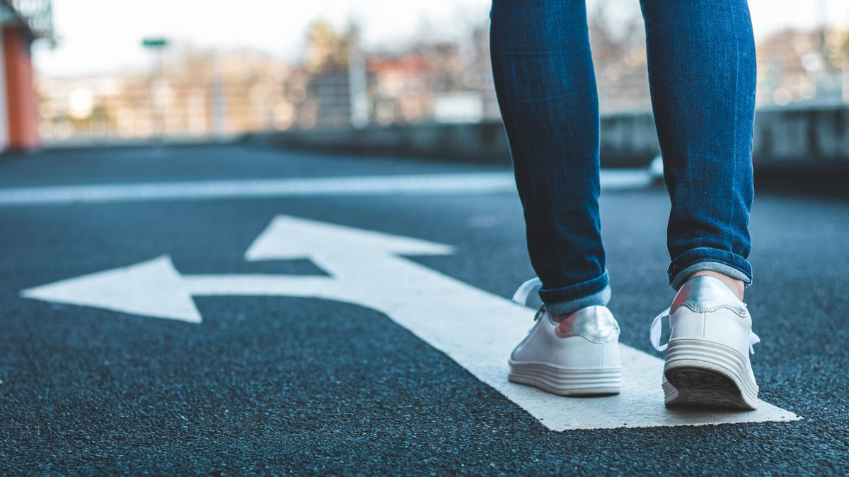
The Holy Spirit can help us discern who God is calling us to be
“Be who God meant you to be and you will set the world on fire!”
St Catherine of Siena

Slide 10
Discerning your Vocation: Prayer

Slide 11
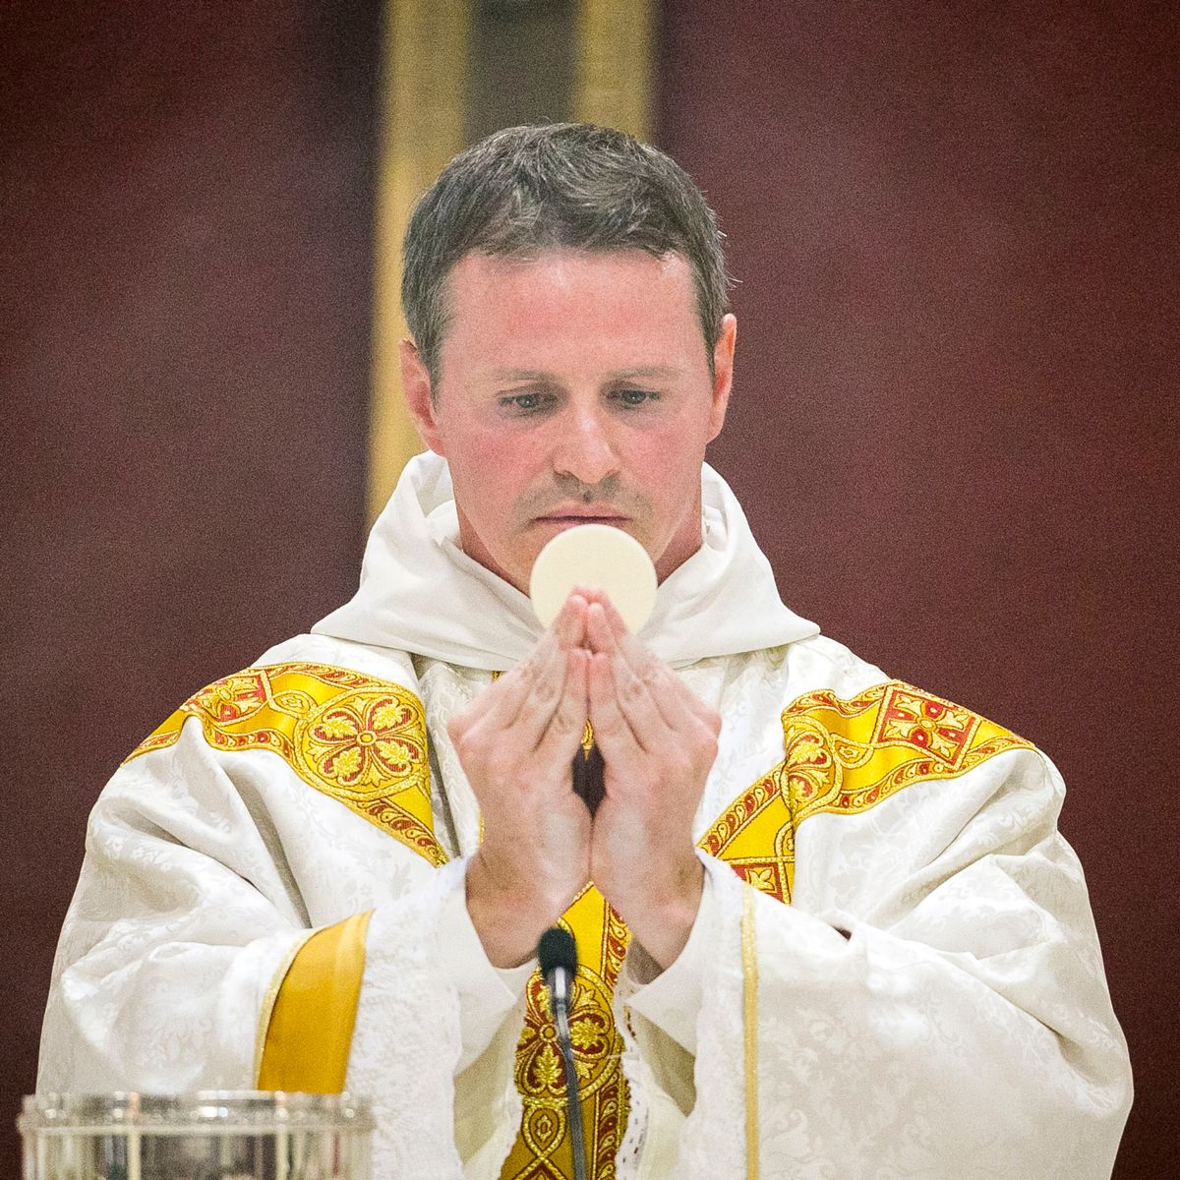
Testimony: From Professional Footballer to Priesthood
Fr Philip Mulryne OP

Slide 12
Reflection: Sr Clare Crockett – A servant of God

Slide 13
Catechism of the Catholic Church
The Beatitudes take up and fulfil God’s promises from Abraham on by ordering them o the Kingdom of heaven. They respond to the desire for happiness that God has placed in the human heart.
The Beatitudes teach us the final end to which God callus us: the kingdom, the vision of God, participation in the divine nature, eternal life, filiation, rest in God.
The beatitude of eternal life is a gratuitous gift of God. It is supernatural, as is the grace that leads us there.
The Beatitudes confront us with decisive choices concerning earthly goods; they purify our hearts in order to teach us to love God above all things.
The beatitude of heaven sets the standards for discernment in the use of earthly goods in keeping with the law of God.

Slide 14
Discussion
What do you think brings true happiness?
Discuss this is two’s & three’s then feedback to the main group

Slide 15
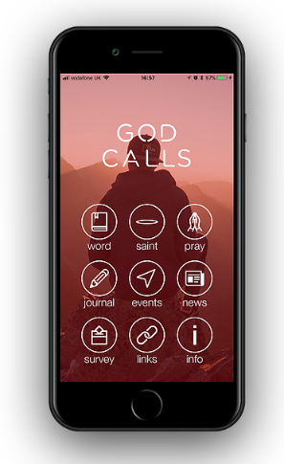
Internet Corner - Where to find out more…
Fr Mike Schmitz (Ascension Presents) on Vocation
www.youtube.com/watch?v=vJz9PbakIzY
Diocese of Salford Vocations Office
www.dioceseofsalford.org.uk/faith/vocations/
God Calls app
www.godcalls.co.uk/
National Vocation Office
www.ukvocation.org/

Slide 16
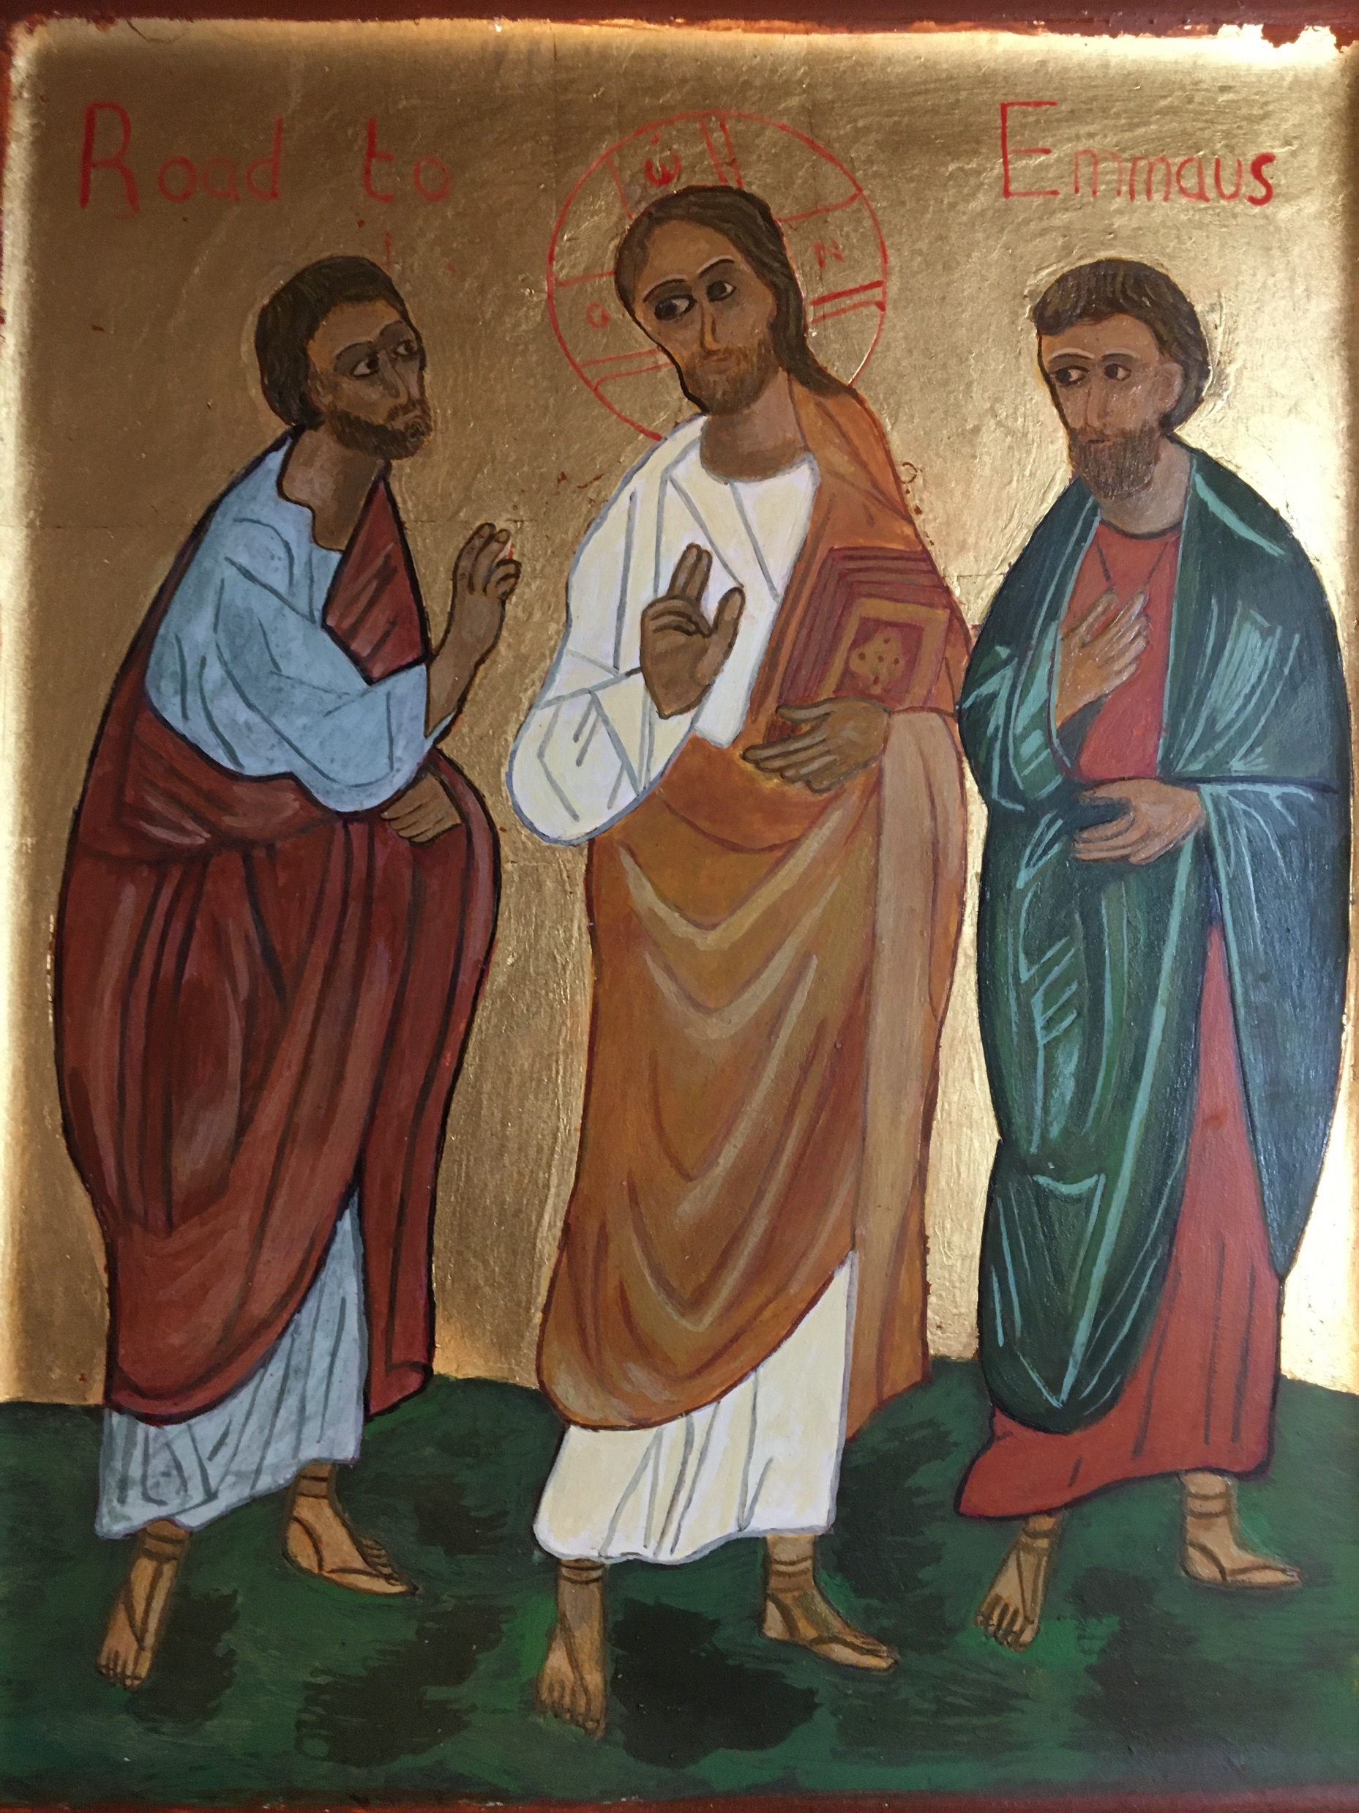
Conversation with Jesus
Focus on this image of Jesus and open your heart to Him now.
Take this opportunity to talk to him in your mind and heart.
Listen and be aware of his presence with you.
You may want to use this hymn to help you pray

Slide 17
Spiritual Journal
You may want to write down what has been important for you during this time together

Slide 18
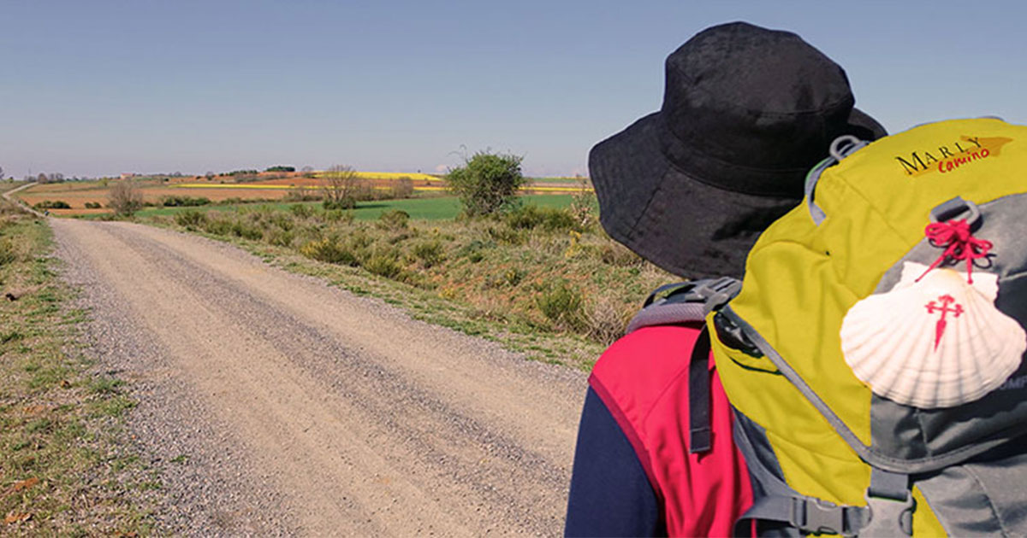
Rucksack Prayer – Part 2

Slide 19
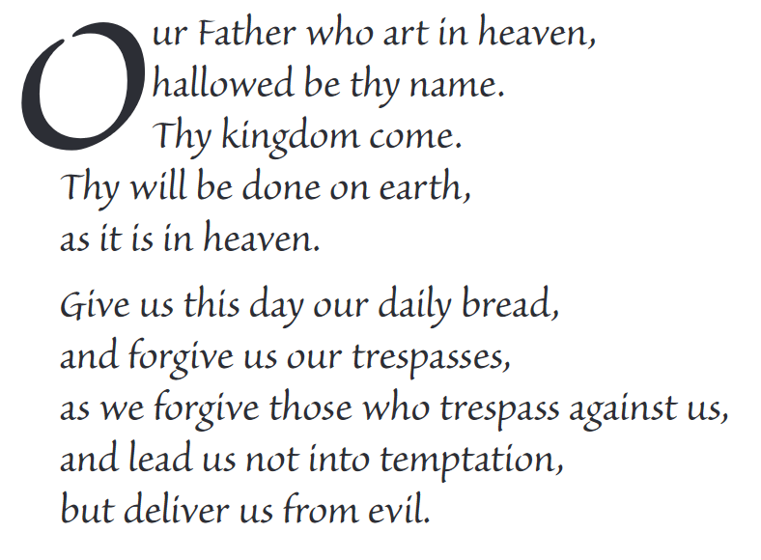
The Lord’s Prayer

Slide 20
Final pilgrim blessing for the week ahead
God of our pilgrimage,
you have given us a desire
to take the questing way
and set out on our journey.
Help us to keep our eyes fixed on Jesus,
that whatever we encounter as we travel,
we may seek to glorify you by the way we live.
You call us, Lord,
to leave familiar things and to leave our “comfort zone”.
May we open our eyes to new experiences,
may we open our ears to hear you speaking to us
and may we open our hearts to your love.
Grant that this time spent on pilgrimage
may help us to see ourselves as we really are
and may we strive to become the people you would have us be. Amen
… continued on next slide

Slide 21
Final pilgrim blessing for the week ahead
Lord, you know our beginning and our end.
Help us to realise we are only pilgrims on this earth
and save us from being too attached to worldly possessions.
May we experience the freedom to wander,
the freedom to hope and the freedom to love as we journey. Amen
Creator God, you are the source of all life and motivation.
May we journey in faith and love, rejoicing and eager to serve you.
Grant us a glimpse of your glory as we seek to follow you –
the Way, the Truth and the Life. Amen
May God the Father who created you, guide your footsteps,
May God the Son who redeemed you, share your journey,
May God the Holy Spirit who sanctifies you, lead you on life’s pilgrimage,
and the blessing of God, Father, Son and Holy Spirit
be with you wherever you may go. Amen.

Slide 22
CAMINO
Making the Journey…
Session 20
Making the journey with a purpose - Vocation

