Slide 1
CAMINO
Making the Journey…
Session 21
Making the journey through Holy Week

Slide 2
Introduction
Every year we are called to make this pilgrimage with Jesus as he enters in to Jerusalem and all that takes place that leads to the Last Supper, the cross and the resurrection. When we do this we go back in time and space. This is called anamnesis (the opposite of amnesia, forgetting) and this is in the tradition of the Jewish people when they celebrate the Passover. When we walk with Jesus it reminds us of the immensity of God’s love for us in the plan of salvation and we walk with Christ so that we are aware that he walks with us on our pilgrim journey and that changes everything. Holy Week gives us the opportunity to be immersed in the liturgies as we follow in the footsteps of Jesus. This is a clear example that we are pilgrims!

Slide 3
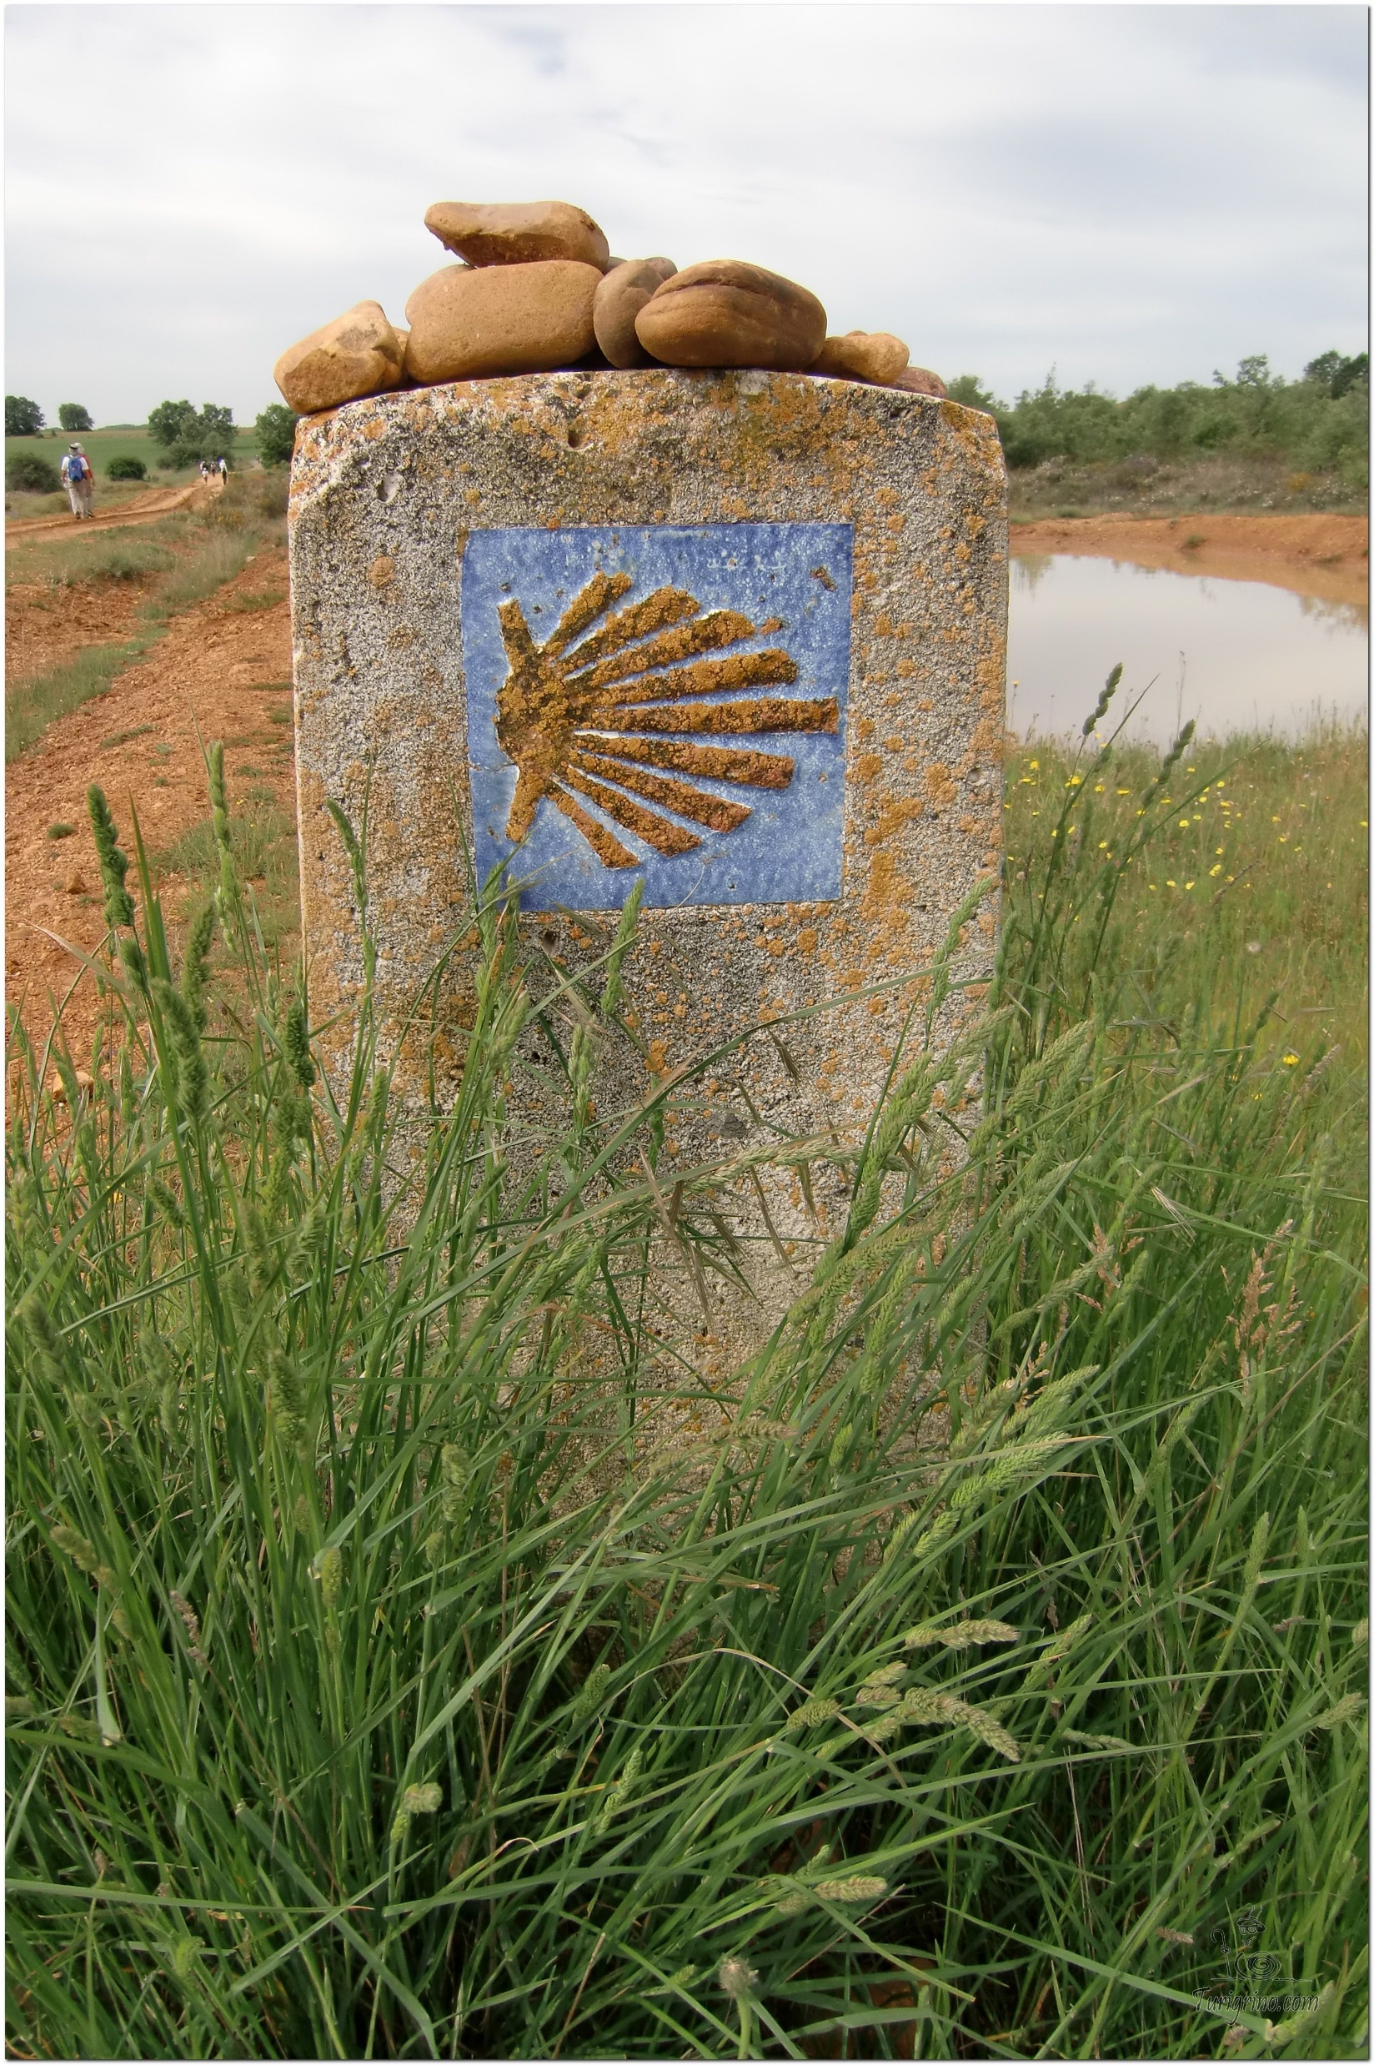
Opening Prayer
The Camino Prayer (adapted)
O God, who brought your servant Abraham out of the land of the Chaldeans, protecting him in his wanderings, who guided the Hebrew people across the desert, we ask that you watch over us, your servants, as we walk in the love of your name.
Be for us our companion on the journey,
Our guide at the crossroads, Our breath in our weariness,
Our protection in danger, our albergue on the Camino,
Our shade in the heat, Our light in the darkness,
Our consolation in our discouragements,
And our strength in our intentions.
So that with your guidance we may arrive safe and sound at the end of the road and enriched with grace and virtue we return safely to our homes filled with joy.
In the name of Jesus Christ our Lord, Amen. Apostle Santiago, pray for us. Santa Maria, pray for us.

Slide 4
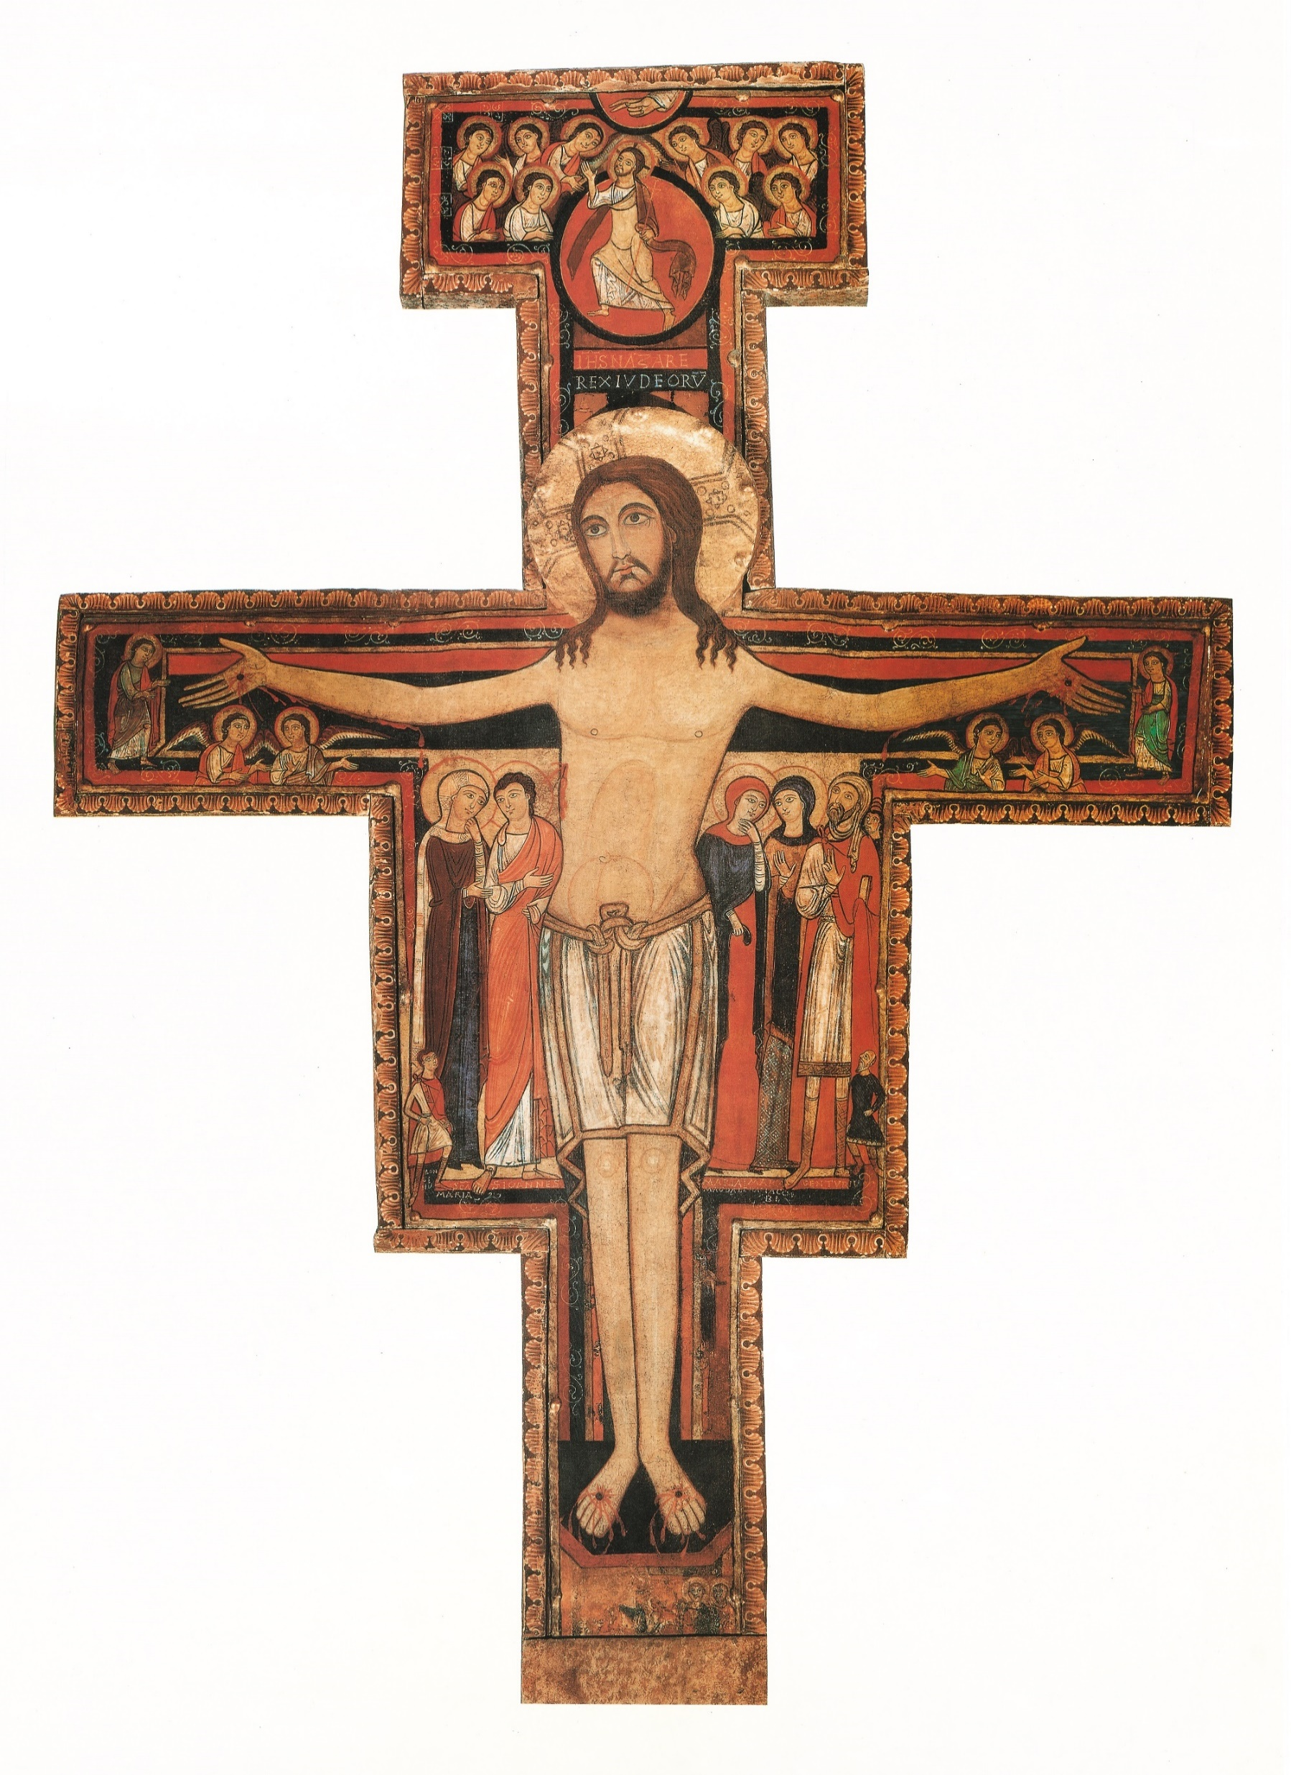
Catholicism in a Hundred Objects
This video is 33 minutes long so watch as much or as little as you like
San Damiano Cross

Slide 5
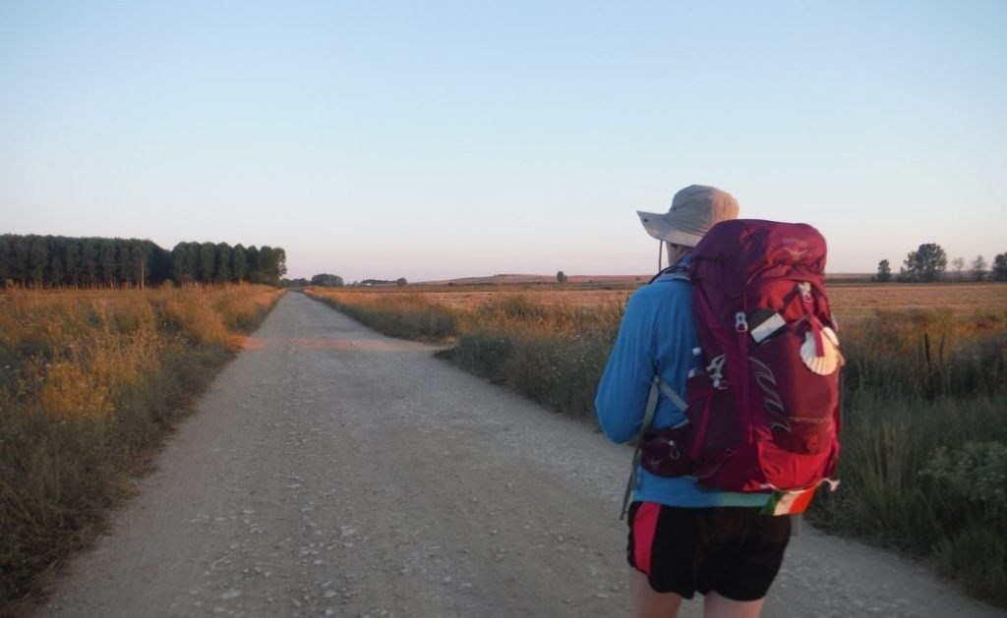
Rucksack Prayer – Part 1

Slide 6
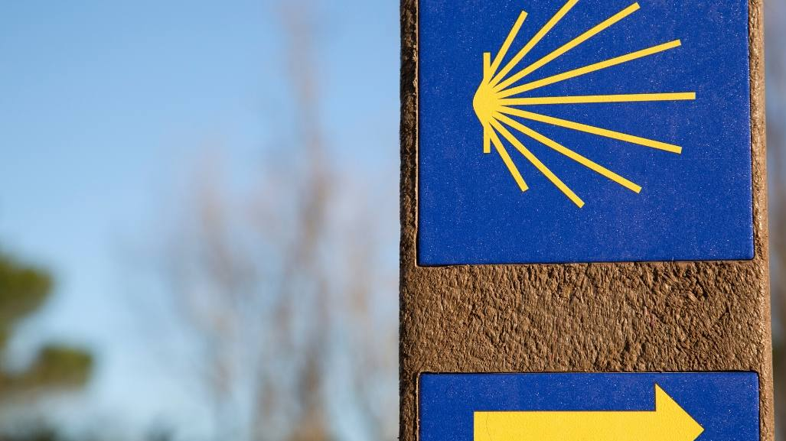
A Journey through
Holy Week

Slide 7
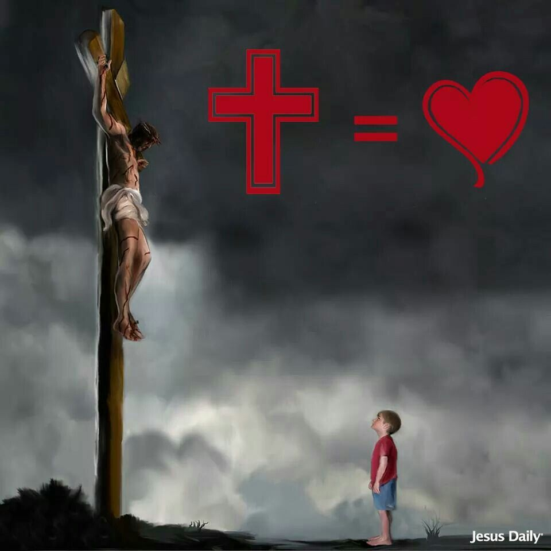
Scripture Reading – John 3:16
For God so loved the world that
he gave his one and only Son,
that whoever believes in him
shall not perish but have eternal life.

Slide 8
From what you have heard so far…
…what are your Initial thoughts, reactions, questions that come to mind?
We can discuss these later…

Slide 10
The Saving Death of Jesus

Slide 12
Catechism of the Catholic Church
619 "Christ died for our sins in accordance with the scriptures" (I Cor 15:3).
620 Our salvation flows from God's initiative of love for us, because "he loved us and sent his Son to be the expiation for our sins" (I Jn 4:10). "God was in Christ reconciling the world to himself" (2 Cor 5:19).
621 Jesus freely offered himself for our salvation. Beforehand, during the Last Supper, he both symbolized this offering and made it really present: "This is my body which is given for you" (Lk 22:19).
622 The redemption won by Christ consists in this, that he came "to give his life as a ransom for many" (Mt 20:28), that is, he "loved [his own] to the end" (Jn 13:1), so that they might be "ransomed from the futile ways inherited from [their] fathers" (I Pt 1:18).
623 By his loving obedience to the Father, "unto death, even death on a cross" (Phil 2:8), Jesus fulfils the atoning mission (cf Is 53:10) of the suffering Servant, who will "make many righteous; and he shall bear their iniquities" (Is 53:11; cf. Rom 5:19).

Slide 13
Question
Why Did Jesus Have to Die the Way He Did?

Slide 14
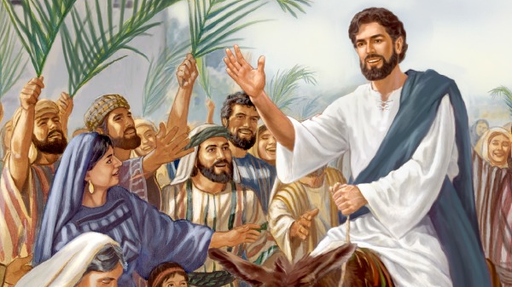
Discussion
Jesus’ triumphant entry in Jerusalem
Will you walk with Him to Calvary?
Discuss this is two’s & three’s then feedback to the main group

Slide 15
Internet Corner - Where to find out more…
Holy Week with Bishop Barron
The Role of Hope in Holy Week

Slide 16
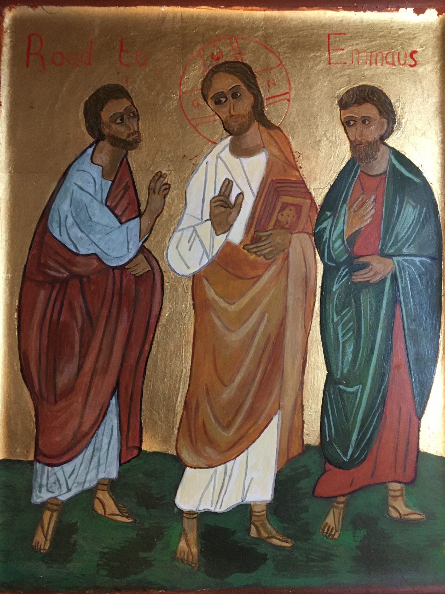
Conversation with Jesus
Focus on this image of Jesus and open your heart to Him now.
Take this opportunity to talk to him in your mind and heart.
Listen and be aware of his presence with you.
You may want to use this hymn to help you pray

Slide 17
Spiritual Journal
You may want to write down what has been important for you during this time together

Slide 18
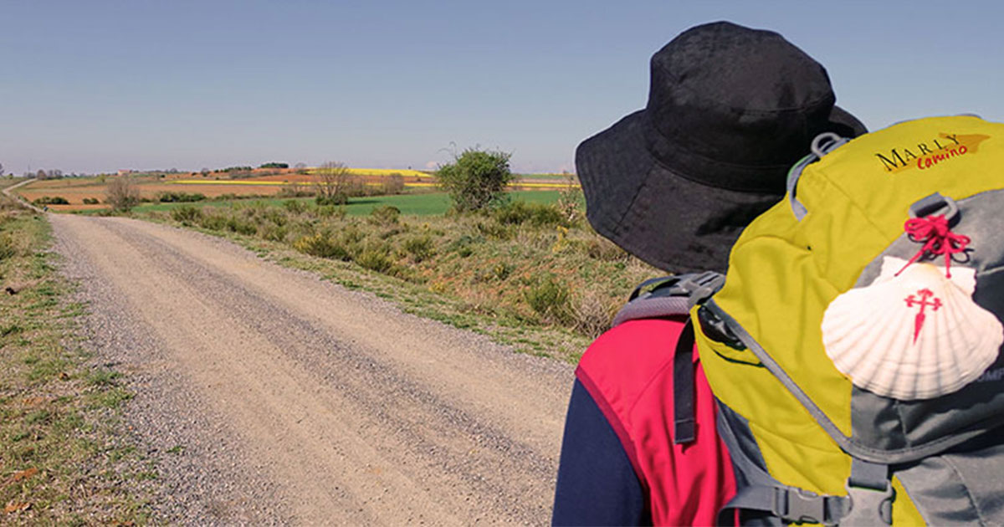
Rucksack Prayer – Part 2

Slide 19
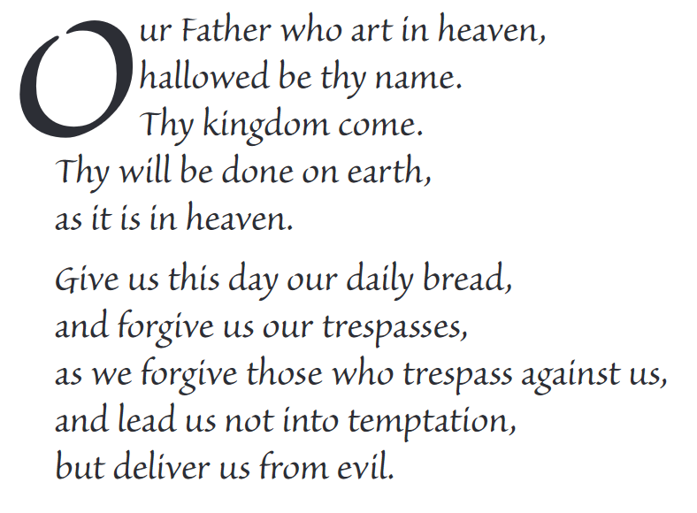
The Lord’s Prayer

Slide 20
Final pilgrim blessing for the week ahead
God of our pilgrimage,
you have given us a desire
to take the questing way
and set out on our journey.
Help us to keep our eyes fixed on Jesus,
that whatever we encounter as we travel,
we may seek to glorify you by the way we live.
You call us, Lord,
to leave familiar things and to leave our “comfort zone”.
May we open our eyes to new experiences,
may we open our ears to hear you speaking to us
and may we open our hearts to your love.
Grant that this time spent on pilgrimage
may help us to see ourselves as we really are
and may we strive to become the people you would have us be. Amen
… continued on next slide

Slide 21
Final pilgrim blessing for the week ahead
Lord, you know our beginning and our end.
Help us to realise we are only pilgrims on this earth
and save us from being too attached to worldly possessions.
May we experience the freedom to wander,
the freedom to hope and the freedom to love as we journey. Amen
Creator God, you are the source of all life and motivation.
May we journey in faith and love, rejoicing and eager to serve you.
Grant us a glimpse of your glory as we seek to follow you –
the Way, the Truth and the Life. Amen
May God the Father who created you, guide your footsteps,
May God the Son who redeemed you, share your journey,
May God the Holy Spirit who sanctifies you, lead you on life’s pilgrimage,
and the blessing of God, Father, Son and Holy Spirit
be with you wherever you may go. Amen.

Slide 22
CAMINO
Making the Journey…
Session 21
Making the journey through Holy Week

