Slide 1
CAMINO
Making the Journey…
Session 3
Making the journey with expectation – the Prophets and John the Baptist

Slide 2
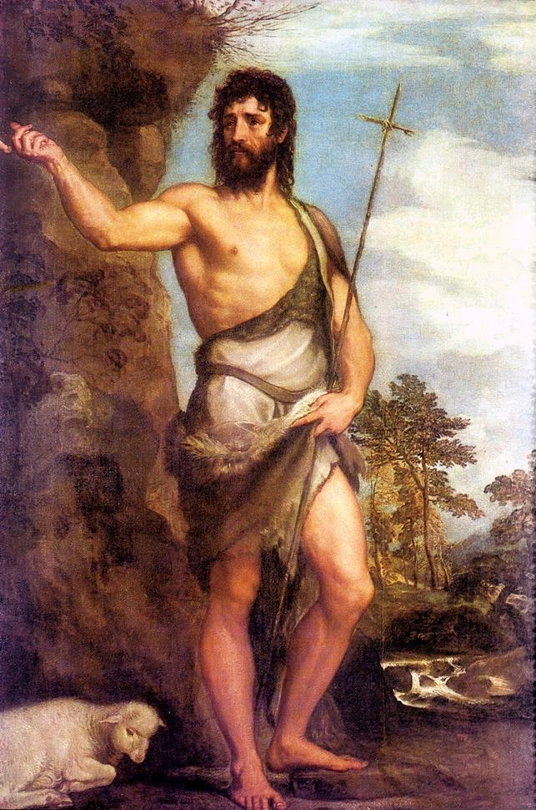
Introduction
In this session we will explore the expectation of a Messiah. The people of Israel were expecting a king or a warrior leader who would restore them and defeat their enemies. The prophets foretold the coming of a messiah e.g., Isaiah, as well as challenging the behaviour of the people when they had lost their way in their relationship with God, calling them back to God. It is in this context that John the Baptist has one foot in the Old Testament and one foot in the New Testament directly preparing the way for Christ (the Greek word for Messiah). Jesus is the messiah but not in the way that the people were expecting but he is the fulfilment of the Law and the Prophets. Jesus is God’s rescue plan personified cf John 3:16.

Slide 3
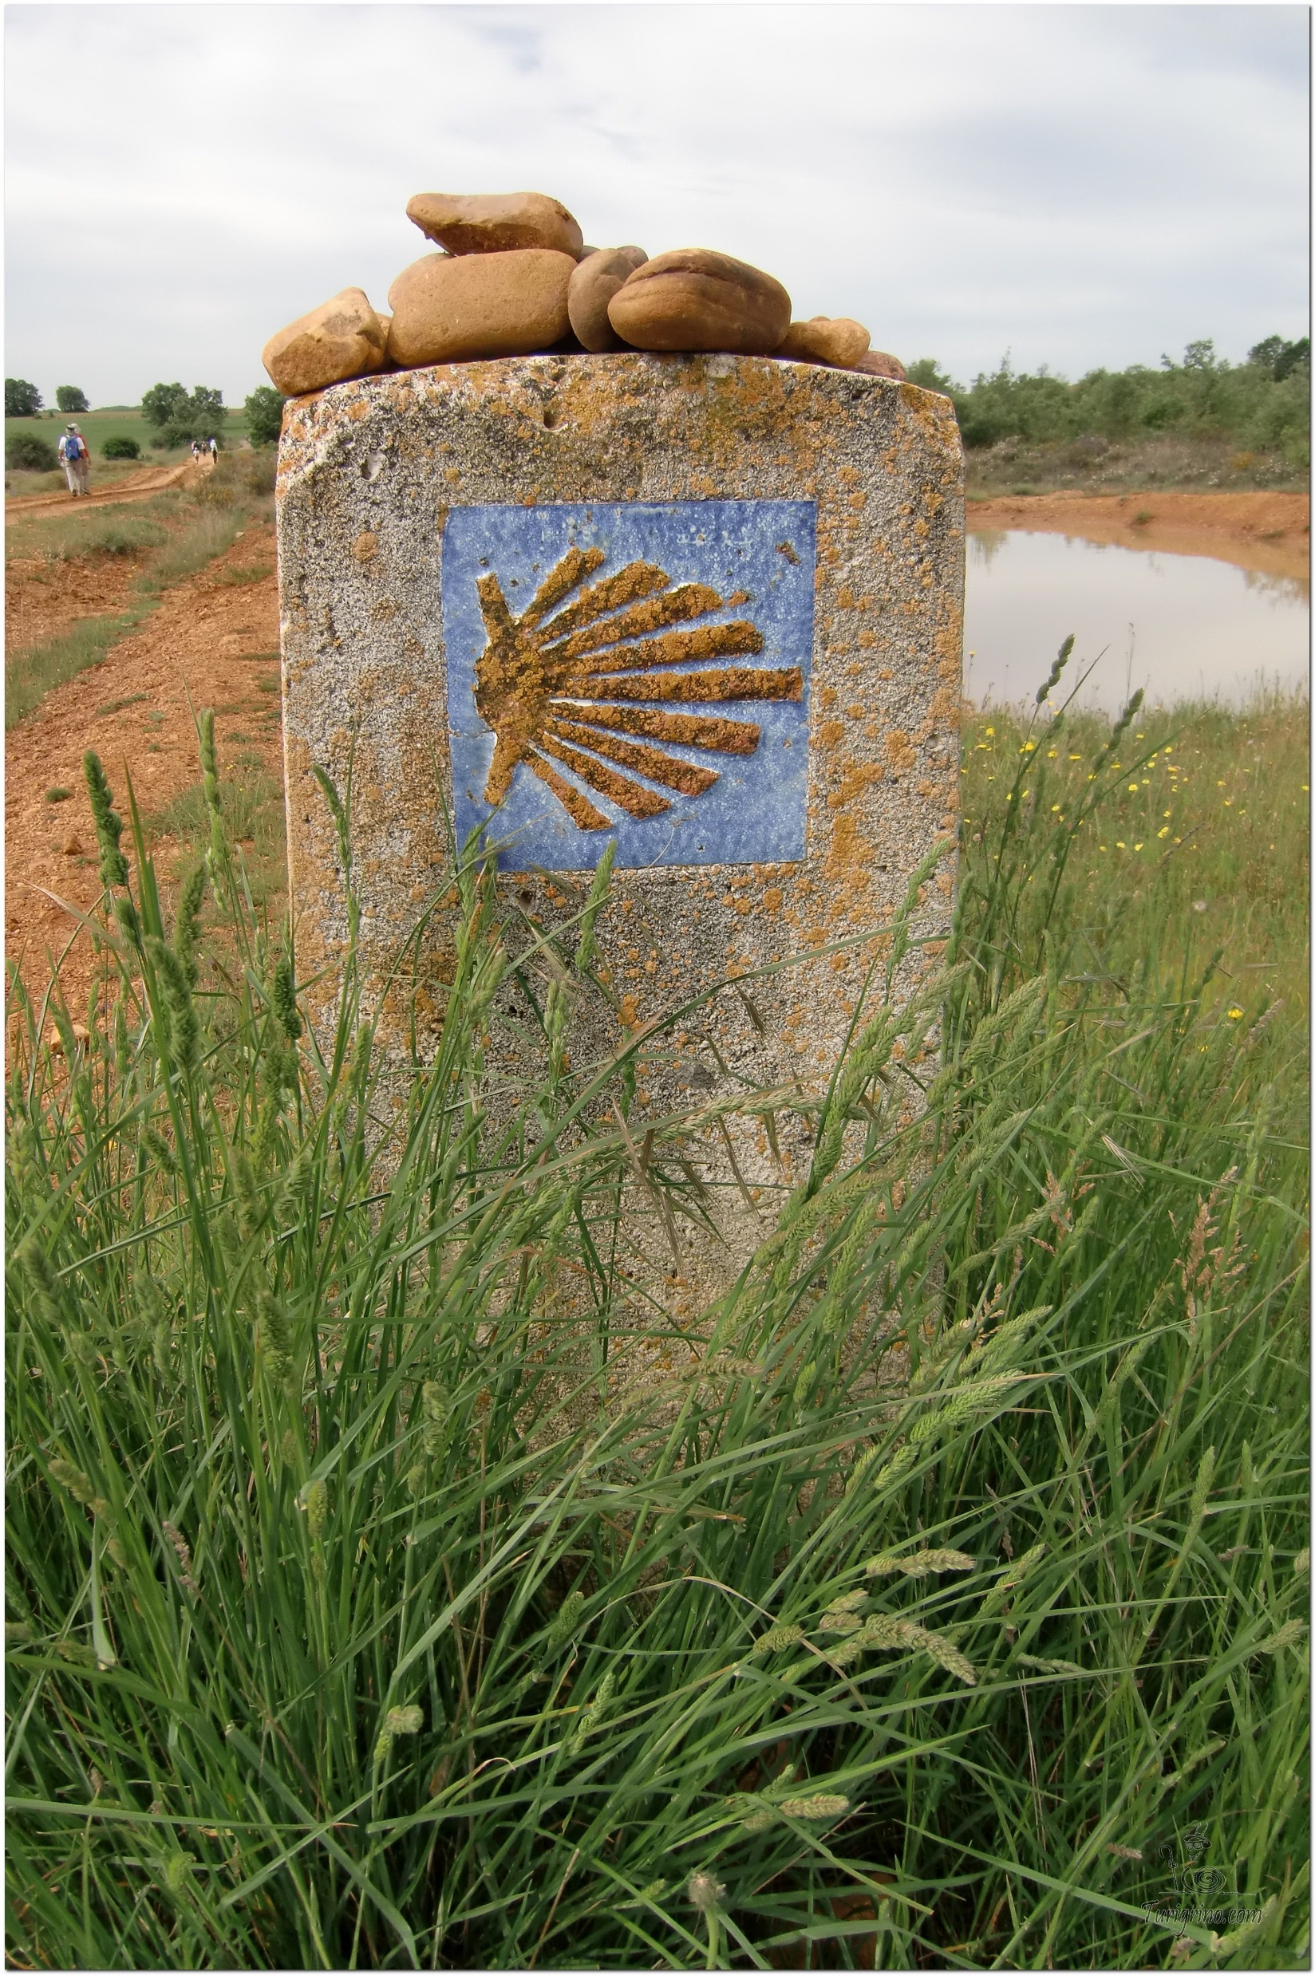
Opening Prayer
The Camino Prayer (adapted)
O God, who brought your servant Abraham out of the land of the Chaldeans, protecting him in his wanderings, who guided the Hebrew people across the desert, we ask that you watch over us, your servants, as we walk in the love of your name.
Be for us our companion on the journey,
Our guide at the crossroads, Our breath in our weariness,
Our protection in danger, our albergue on the Camino,
Our shade in the heat, Our light in the darkness,
Our consolation in our discouragements,
And our strength in our intentions.
So that with your guidance we may arrive safe and sound at the end of the road and enriched with grace and virtue we return safely to our homes filled with joy.
In the name of Jesus Christ our Lord, Amen. Apostle Santiago, pray for us. Santa Maria, pray for us.

Slide 4
Catholicism in a Hundred Objects
This video is 25 minutes long so watch as much or as little as you like
The Book of the Gospels

Slide 5
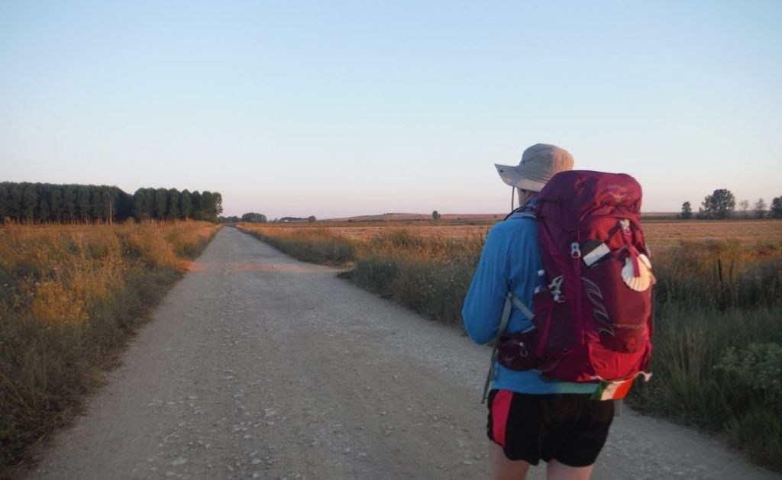
Rucksack Prayer – Part 1

Slide 6
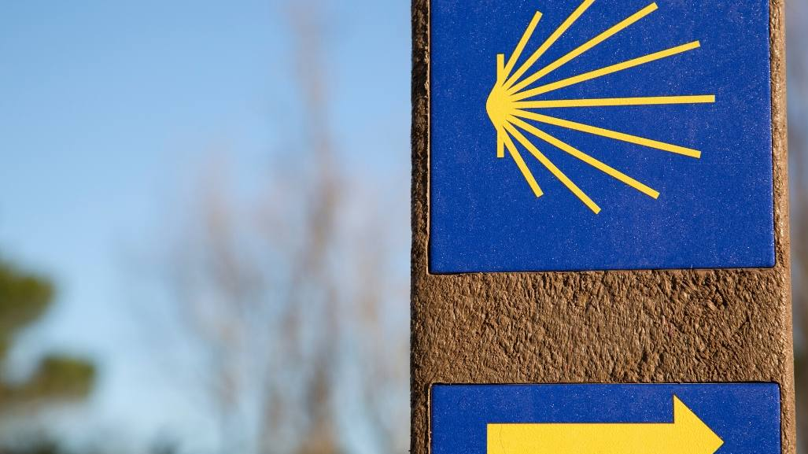
A Journey with…
Intro video here

Slide 7
Scripture Reading – Isaiah 9:2-7
The people walking in darkness have seen a great light;
on those living in the land of deep darkness
a light has dawned. You have enlarged the nation and increased their joy;
they rejoice before you as people rejoice at the harvest, as warriors rejoice when dividing the plunder.
For as in the day of Midian’s defeat,
you have shattered the yoke that burdens them,
the bar across their shoulders, the rod of their oppressor.
Every warrior’s boot used in battle and every garment rolled in blood
will be destined for burning, will be fuel for the fire.
For to us a child is born, to us a son is given, and the government will be on his shoulders.
And he will be called Wonderful Counsellor, Mighty God, Everlasting Father, Prince of Peace.
Of the greatness of his government and peace there will be no end.
He will reign on David’s throne and over his kingdom, establishing and upholding it with j
ustice and righteousness from that time on and forever.
The zeal of the Lord Almighty will accomplish this.

Slide 8
From what you have heard so far…
…what are your Initial thoughts, reactions, questions that come to mind?
We can discuss these later…

Slide 9
Main Input
Fr Mark Mary shares an important message with you – God has a Mission for You

Slide 10
Reflection
How can we be like the Prophets and John the Baptist?
You may like to pray that God will lead you in His love to those around you

Slide 11
Who were the Phrophets?

Slide 12
Catechism of the Catholic Church
61 The patriarchs, prophets and certain other Old Testament figures have been and always will be honoured as saints in all the Church's liturgical traditions.
64 Through the prophets, God forms his people in the hope of salvation, in the expectation of a new and everlasting Covenant intended for all, to be written on their hearts. The prophets proclaim a radical redemption of the People of God, purification from all their infidelities, a salvation which will include all the nations. Above all, the poor and humble of the Lord will bear this hope. Such holy women as Sarah, Rebecca, Rachel, Miriam, Deborah, Hannah, Judith and Esther kept alive the hope of Israel's salvation. The purest figure among them is Mary.
65 "In many and various ways God spoke of old to our fathers by the prophets, but in these last days he has spoken to us by a Son." Christ, the Son of God made man, is the Father's one, perfect and unsurpassable Word. In him he has said everything; there will be no other word than this one. St. John of the Cross, among others, commented strikingly on Hebrews 1:1-2:

Slide 13
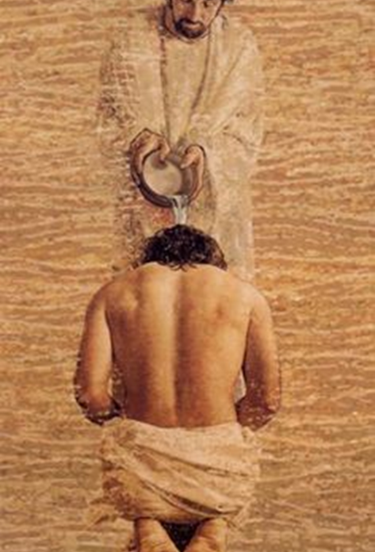
Discussion
How do you think the Old Testament prophets prepare us for the coming of Jesus?
Reflect on this image. What do you think is happening here?
Discuss this is two’s & three’s then feedback to the main group

Slide 14
Internet Corner - Where to find out more…
Salvation History
Sycamore.fm/

Slide 15
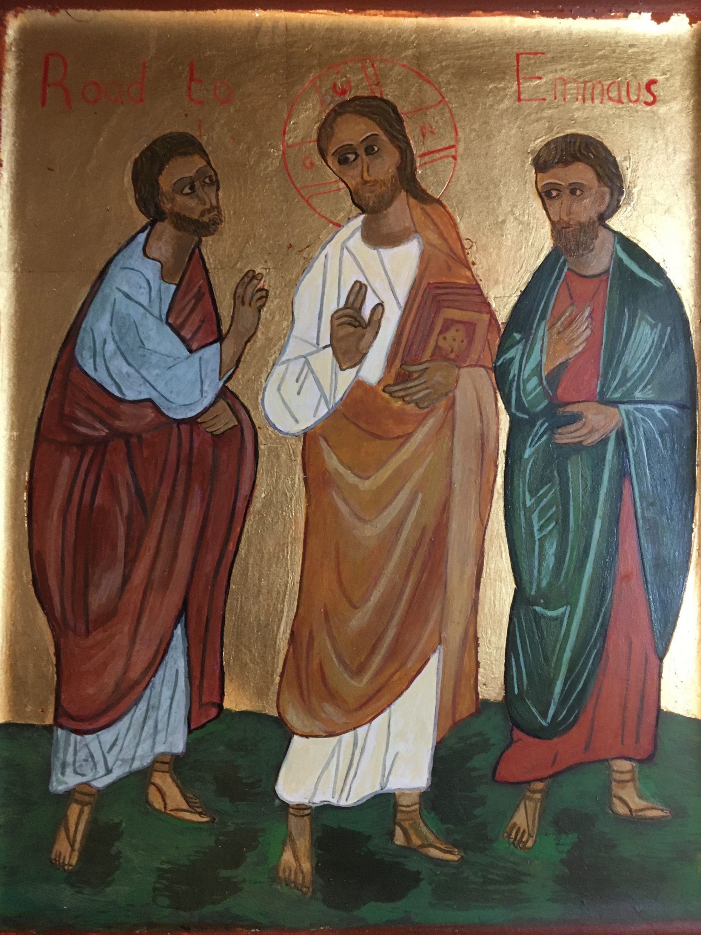
Conversation with Jesus
Focus on this image of Jesus and open your heart to Him now.
Take this opportunity to talk to him in your mind and heart.
Listen and be aware of his presence with you.
You may want to use this hymn to help you pray

Slide 16
Spiritual Journal
You may want to write down what has been important for you during this time together

Slide 17
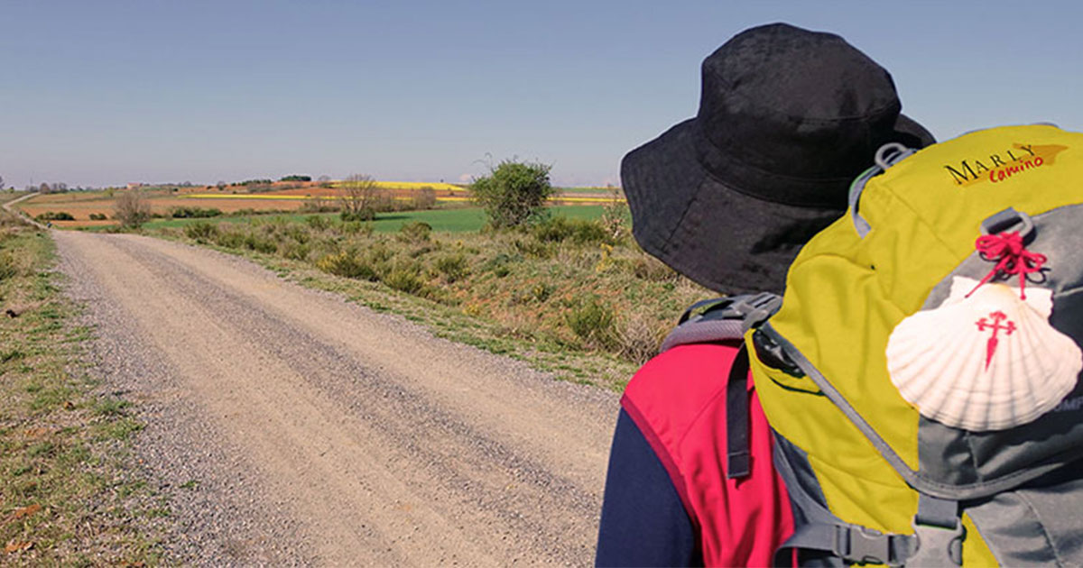
Rucksack Prayer – Part 2

Slide 18
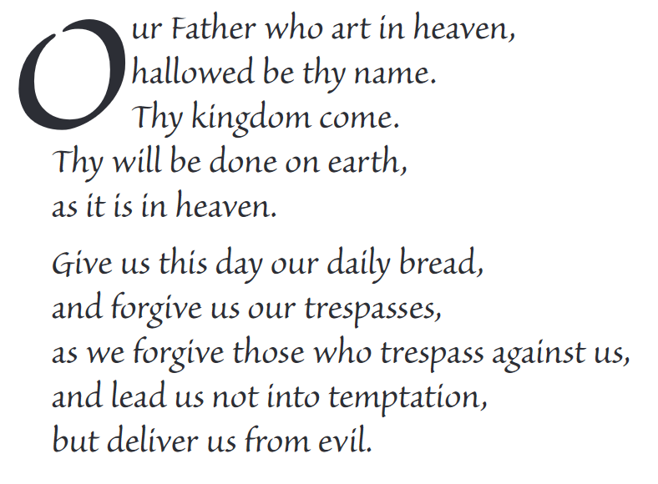
The Lord’s Prayer

Slide 19
Final pilgrim blessing for the week ahead
God of our pilgrimage,
you have given us a desire
to take the questing way
and set out on our journey.
Help us to keep our eyes fixed on Jesus,
that whatever we encounter as we travel,
we may seek to glorify you by the way we live.
You call us, Lord,
to leave familiar things and to leave our “comfort zone”.
May we open our eyes to new experiences,
may we open our ears to hear you speaking to us
and may we open our hearts to your love.
Grant that this time spent on pilgrimage
may help us to see ourselves as we really are
and may we strive to become the people you would have us be. Amen
… continued on next slide

Slide 20
Final pilgrim blessing for the week ahead
Lord, you know our beginning and our end.
Help us to realise we are only pilgrims on this earth
and save us from being too attached to worldly possessions.
May we experience the freedom to wander,
the freedom to hope and the freedom to love as we journey. Amen
Creator God, you are the source of all life and motivation.
May we journey in faith and love, rejoicing and eager to serve you.
Grant us a glimpse of your glory as we seek to follow you –
the Way, the Truth and the Life. Amen
May God the Father who created you, guide your footsteps,
May God the Son who redeemed you, share your journey,
May God the Holy Spirit who sanctifies you, lead you on life’s pilgrimage,
and the blessing of God, Father, Son and Holy Spirit
be with you wherever you may go. Amen.

Slide 21
CAMINO
Making the Journey…
Session 3
Making the journey with expectation – the Prophets and John the Baptist

