Slide 1
CAMINO
Making the Journey…
Session 4
Making the journey with the Disciples – the call to follow Jesus

Slide 2
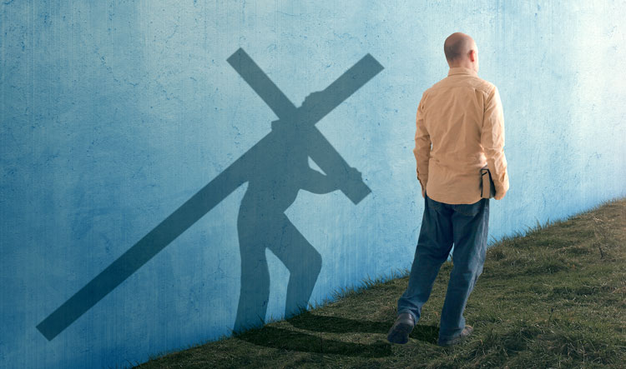
Introduction
The focus of this session is the call to follow Jesus. The disciples were called by Jesus to follow him and they left their old lives behind. They made their lives a pilgrimage following Jesus and allowing themselves to be formed by him. He called them to live a life that was self giving taking up the cross. We are called to follow their example on our own faith journey, Jesus calls each one of us to follow him and to be his life long disciples. It is this way that we will find true meaning and purpose in our lives.

Slide 3
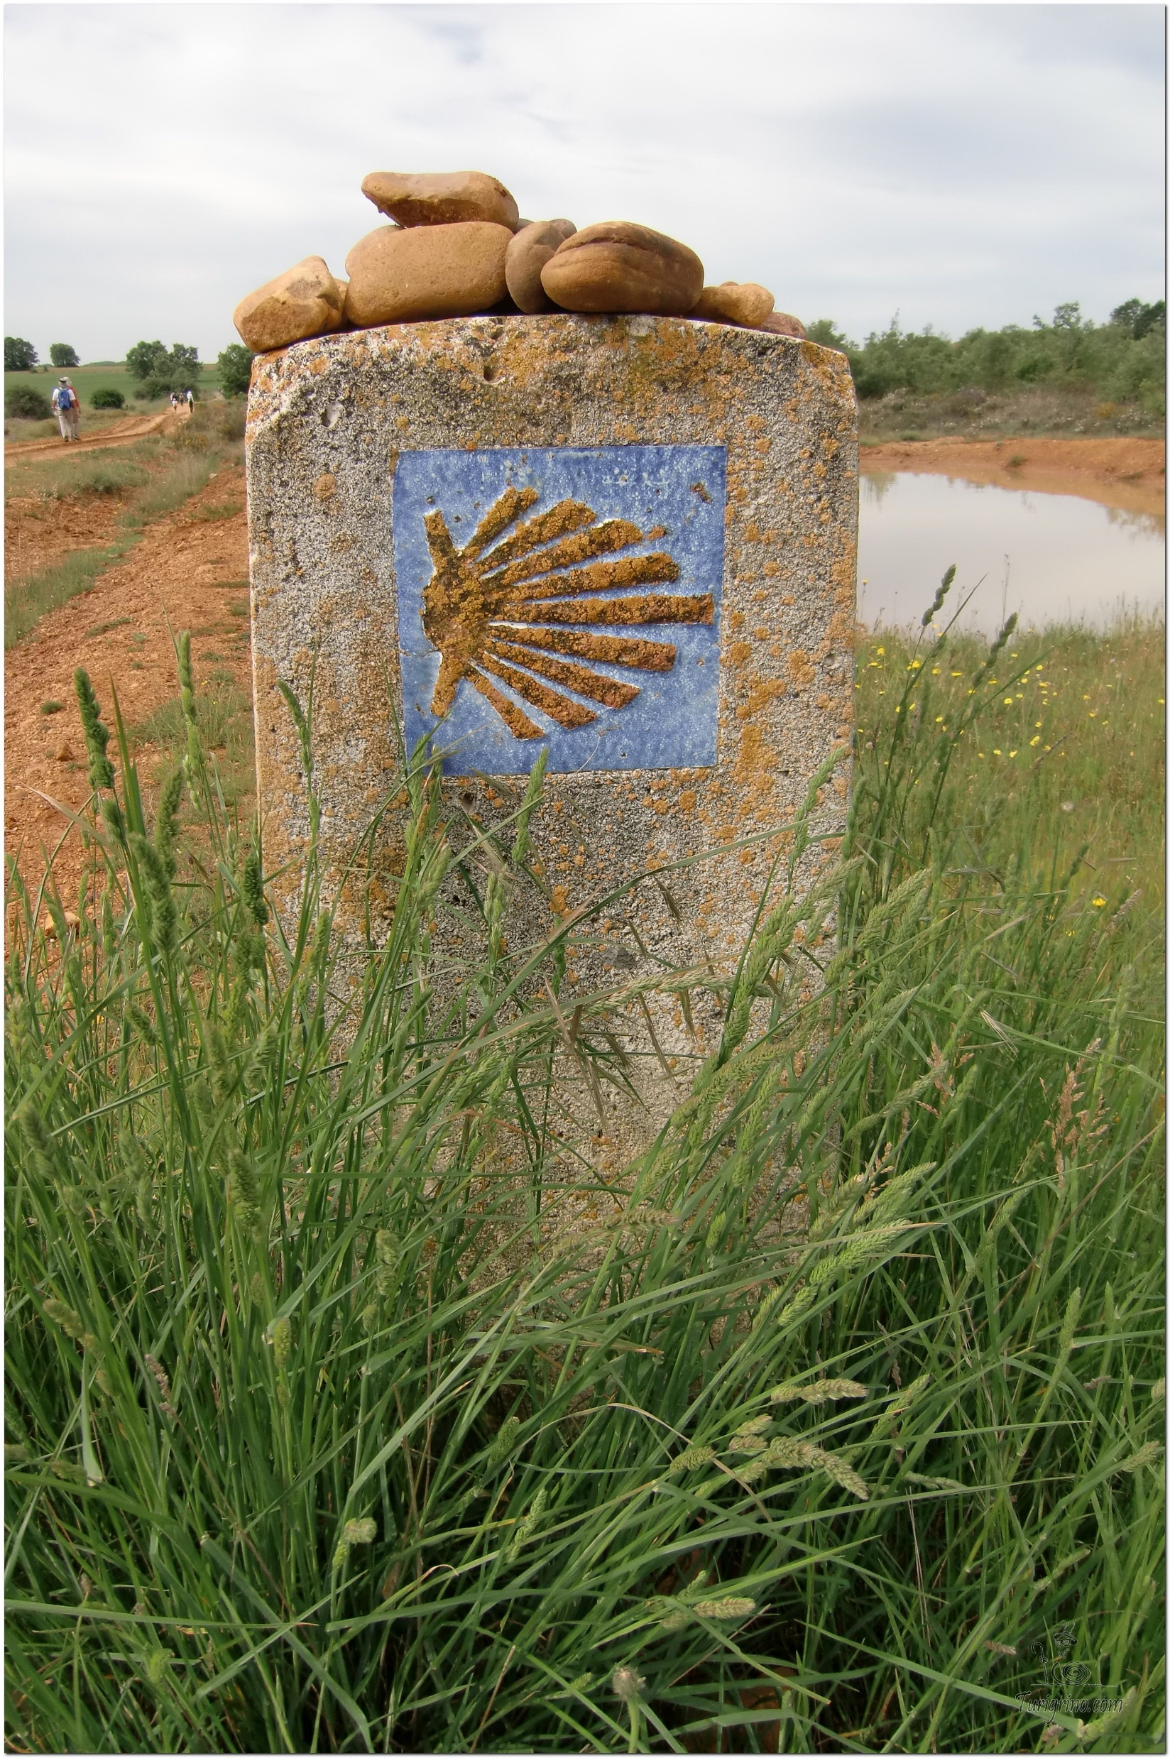
Opening Prayer
The Camino Prayer (adapted)
O God, who brought your servant Abraham out of the land of the Chaldeans, protecting him in his wanderings, who guided the Hebrew people across the desert, we ask that you watch over us, your servants, as we walk in the love of your name.
Be for us our companion on the journey,
Our guide at the crossroads, Our breath in our weariness,
Our protection in danger, our albergue on the Camino,
Our shade in the heat, Our light in the darkness,
Our consolation in our discouragements,
And our strength in our intentions.
So that with your guidance we may arrive safe and sound at the end of the road and enriched with grace and virtue we return safely to our homes filled with joy.
In the name of Jesus Christ our Lord, Amen. Apostle Santiago, pray for us. Santa Maria, pray for us.

Slide 4
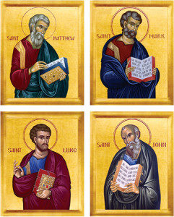
Catholicism in a Hundred Objects
This video is 28 minutes long so watch as much or as little as you like
The Four Gospels

Slide 5
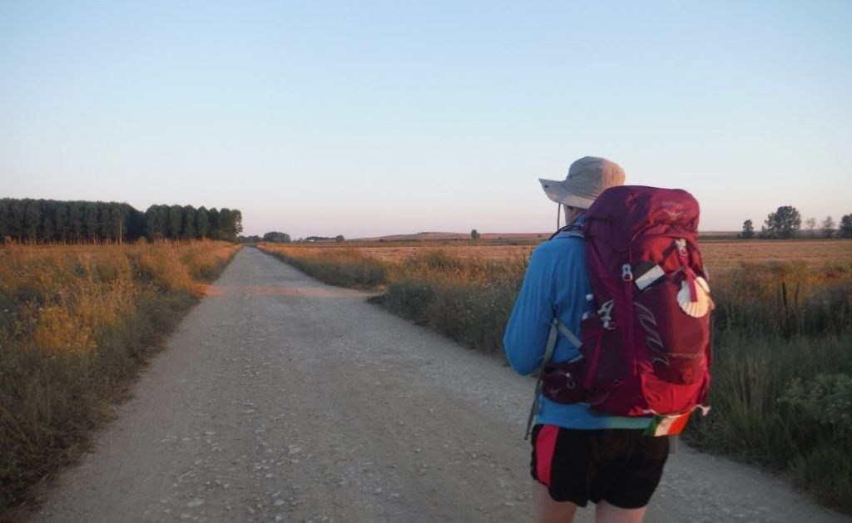
Rucksack Prayer – Part 1

Slide 6
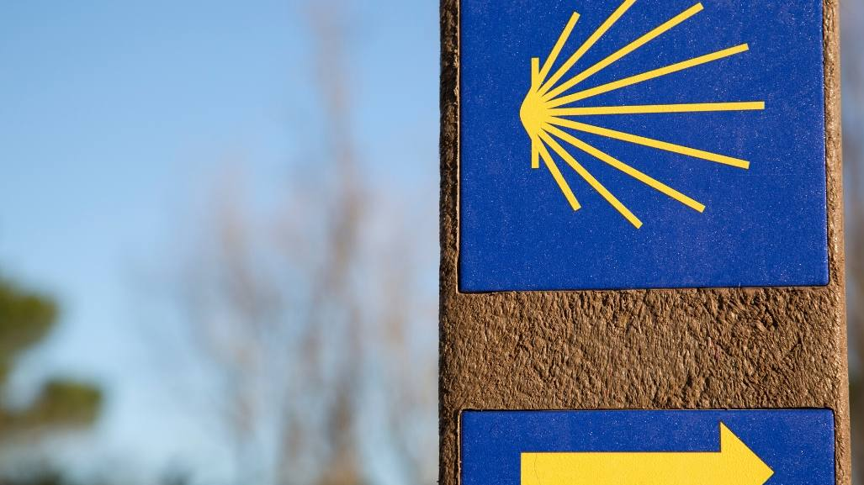
A Journey with…
Intro video here

Slide 7
Scripture Reading - Mark 1:16-20
As Jesus walked beside the Sea of Galilee, he saw Simon and his brother Andrew casting a net into the lake, for they were fishermen.
“Come, follow me,” Jesus said, “and I will send you out to fish for people.”
At once they left their nets and followed him.
When he had gone a little farther, he saw James son of Zebedee and his brother John in a boat, preparing their nets. Without delay he called them, and they left their father Zebedee in the boat with the hired men and followed him.

Slide 8
From what you have heard so far…
…what are your Initial thoughts, reactions, questions that come to mind?
We can discuss these later…

Slide 9
Main Input
Bishop Robert Barron on The Calling of the Disciples

Slide 10
Reflection
As you listen to this hymn think about Jesus calling you as His disciples

Slide 11
Testimony
Jessica shares her Discipleship Testimony

Slide 12
Catechism of the Catholic Church
520 - In all of his life Jesus presents himself as our model. He is "the perfect man", who invites us to become his disciples and follow him. In humbling himself, he has given us an example to imitate, through his prayer he draws us to pray, and by his poverty he calls us to accept freely the privation and persecutions that may come our way.
#546 - Jesus' invitation to enter his kingdom comes in the form of parables, a characteristic feature of his teaching. Through his parables he invites people to the feast of the kingdom, but he also asks for a radical choice: to gain the kingdom, one must give everything. Words are not enough, deeds are required. The parables are like mirrors for man: will he be hard soil or good earth for the word? What use has he made of the talents he has received? Jesus and the presence of the kingdom in this world are secretly at the heart of the parables. One must enter the kingdom, that is, become a disciple of Christ, in order to "know the secrets of the kingdom of heaven". For those who stay "outside", everything remains enigmatic.
618 - He calls his disciples to "take up [their] cross and follow [him]", for "Christ also suffered for [us],
leaving [us] an example so that [we] should follow in his steps." In fact Jesus desires to associate with his
redeeming sacrifice those who were to be its first beneficiaries.

Slide 13
Question
How can I be a Good Disciple of Christ?

Slide 14
Discussion
How do you feel Jesus has called you to be His Disciple?
Discuss this is two’s & three’s then feedback to the main group

Slide 15
Internet Corner - Where to find out more…
catholicmissionarydisciples.com/ news/marks-of-discipleship
alpha.org/
Sycamore.fm/

Slide 16
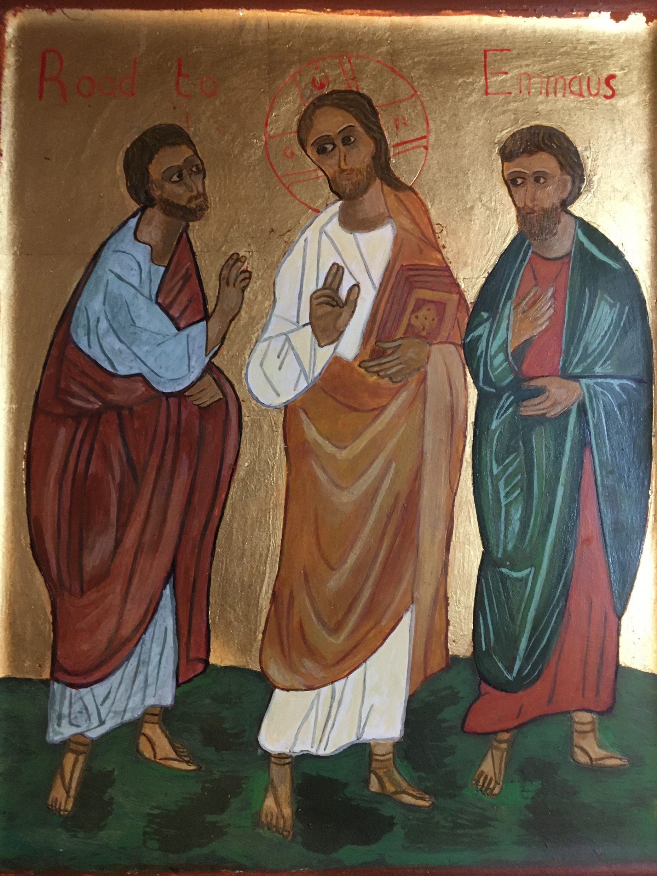
Conversation with Jesus
Focus on this image of Jesus and open your heart to Him now.
Take this opportunity to talk to him in your mind and heart.
Listen and be aware of his presence with you.
You may want to use this hymn to help you pray

Slide 17
Spiritual Journal
You may want to write down what has been important for you during this time together

Slide 18
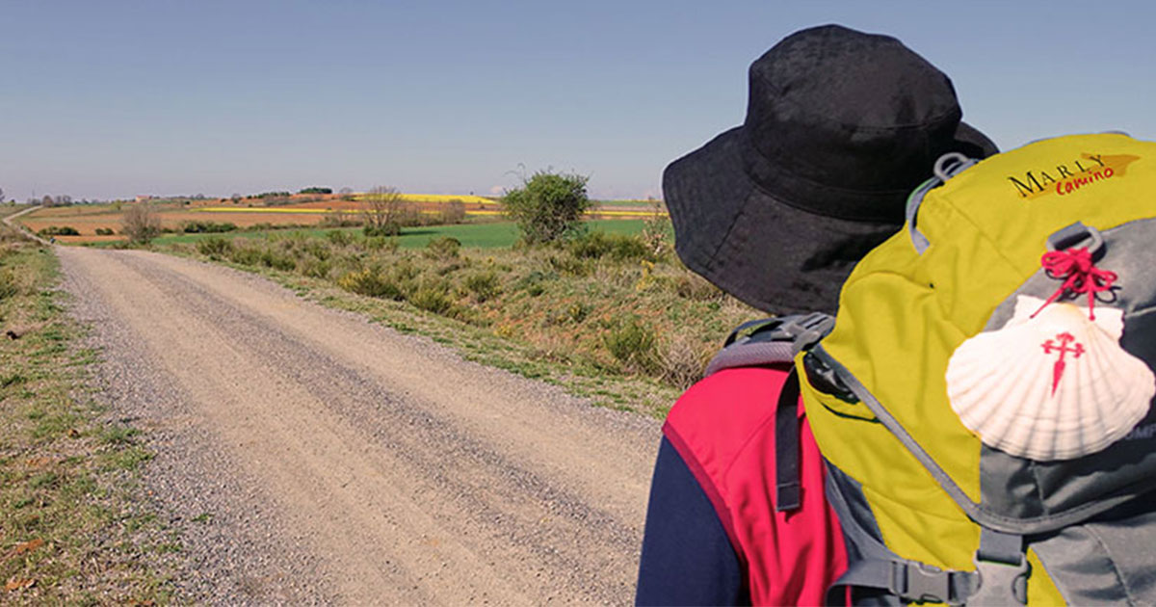
Rucksack Prayer – Part 2

Slide 19
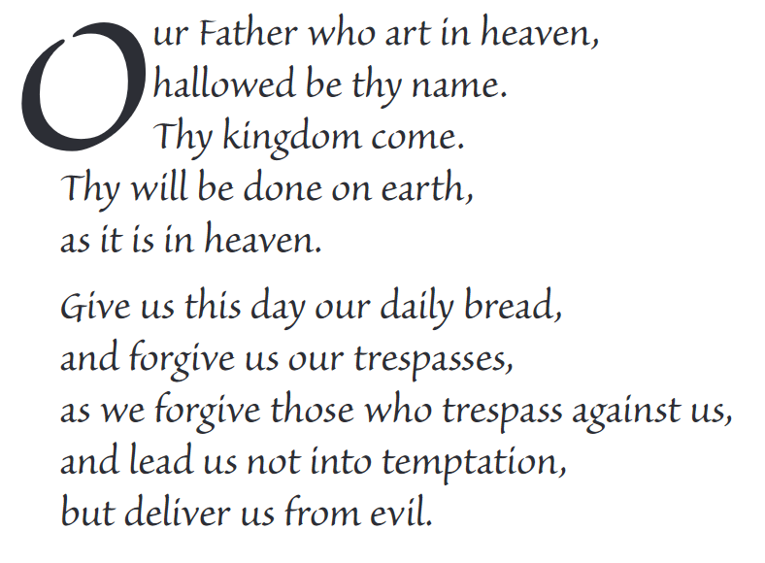
The Lord’s Prayer

Slide 20
Final pilgrim blessing for the week ahead
God of our pilgrimage,
you have given us a desire
to take the questing way
and set out on our journey.
Help us to keep our eyes fixed on Jesus,
that whatever we encounter as we travel,
we may seek to glorify you by the way we live.
You call us, Lord,
to leave familiar things and to leave our “comfort zone”.
May we open our eyes to new experiences,
may we open our ears to hear you speaking to us
and may we open our hearts to your love.
Grant that this time spent on pilgrimage
may help us to see ourselves as we really are
and may we strive to become the people you would have us be. Amen
… continued on next slide

Slide 21
Final pilgrim blessing for the week ahead
Lord, you know our beginning and our end.
Help us to realise we are only pilgrims on this earth
and save us from being too attached to worldly possessions.
May we experience the freedom to wander,
the freedom to hope and the freedom to love as we journey. Amen
Creator God, you are the source of all life and motivation.
May we journey in faith and love, rejoicing and eager to serve you.
Grant us a glimpse of your glory as we seek to follow you –
the Way, the Truth and the Life. Amen
May God the Father who created you, guide your footsteps,
May God the Son who redeemed you, share your journey,
May God the Holy Spirit who sanctifies you, lead you on life’s pilgrimage,
and the blessing of God, Father, Son and Holy Spirit
be with you wherever you may go. Amen.

Slide 22
CAMINO
Making the Journey…
Session 4
Making the journey with the Disciples – the call to follow Jesus

