Slide 1
CAMINO
Making the Journey…
Session 5
Making the journey with the Apostles – the Resurrection

Slide 2
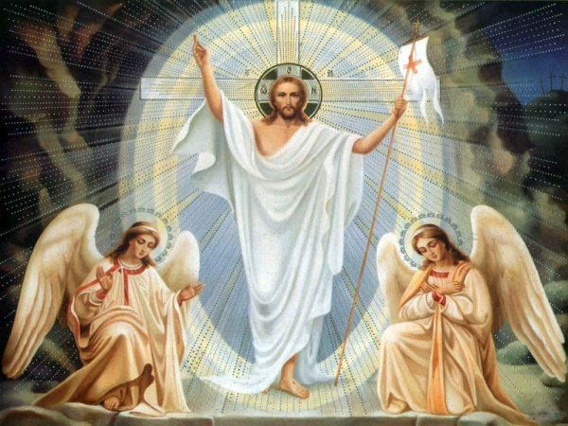
Introduction
In this session we will explore how the resurrection changes everything. The disciples had been called and formed by Jesus and prepared for his death and now they had the momentous news of the Resurrection. This changed their understanding of who Jesus was, it confirmed who he was and this compelled them to share this Good News. The resurrection is central to our faith, without it we are not Christians. It. changes the way that we look at life and death. This faith is given to us because the apostles were ‘sent out’ Greek word apostello to share the Good News. Once we allow the reality of the resurrection and it’s implications to enter deep within us it will radically change our understanding of life and death, help us to understand more full that life is a pilgrimage and compel us to share this meaning with our fellow pilgrims on the Way.

Slide 3
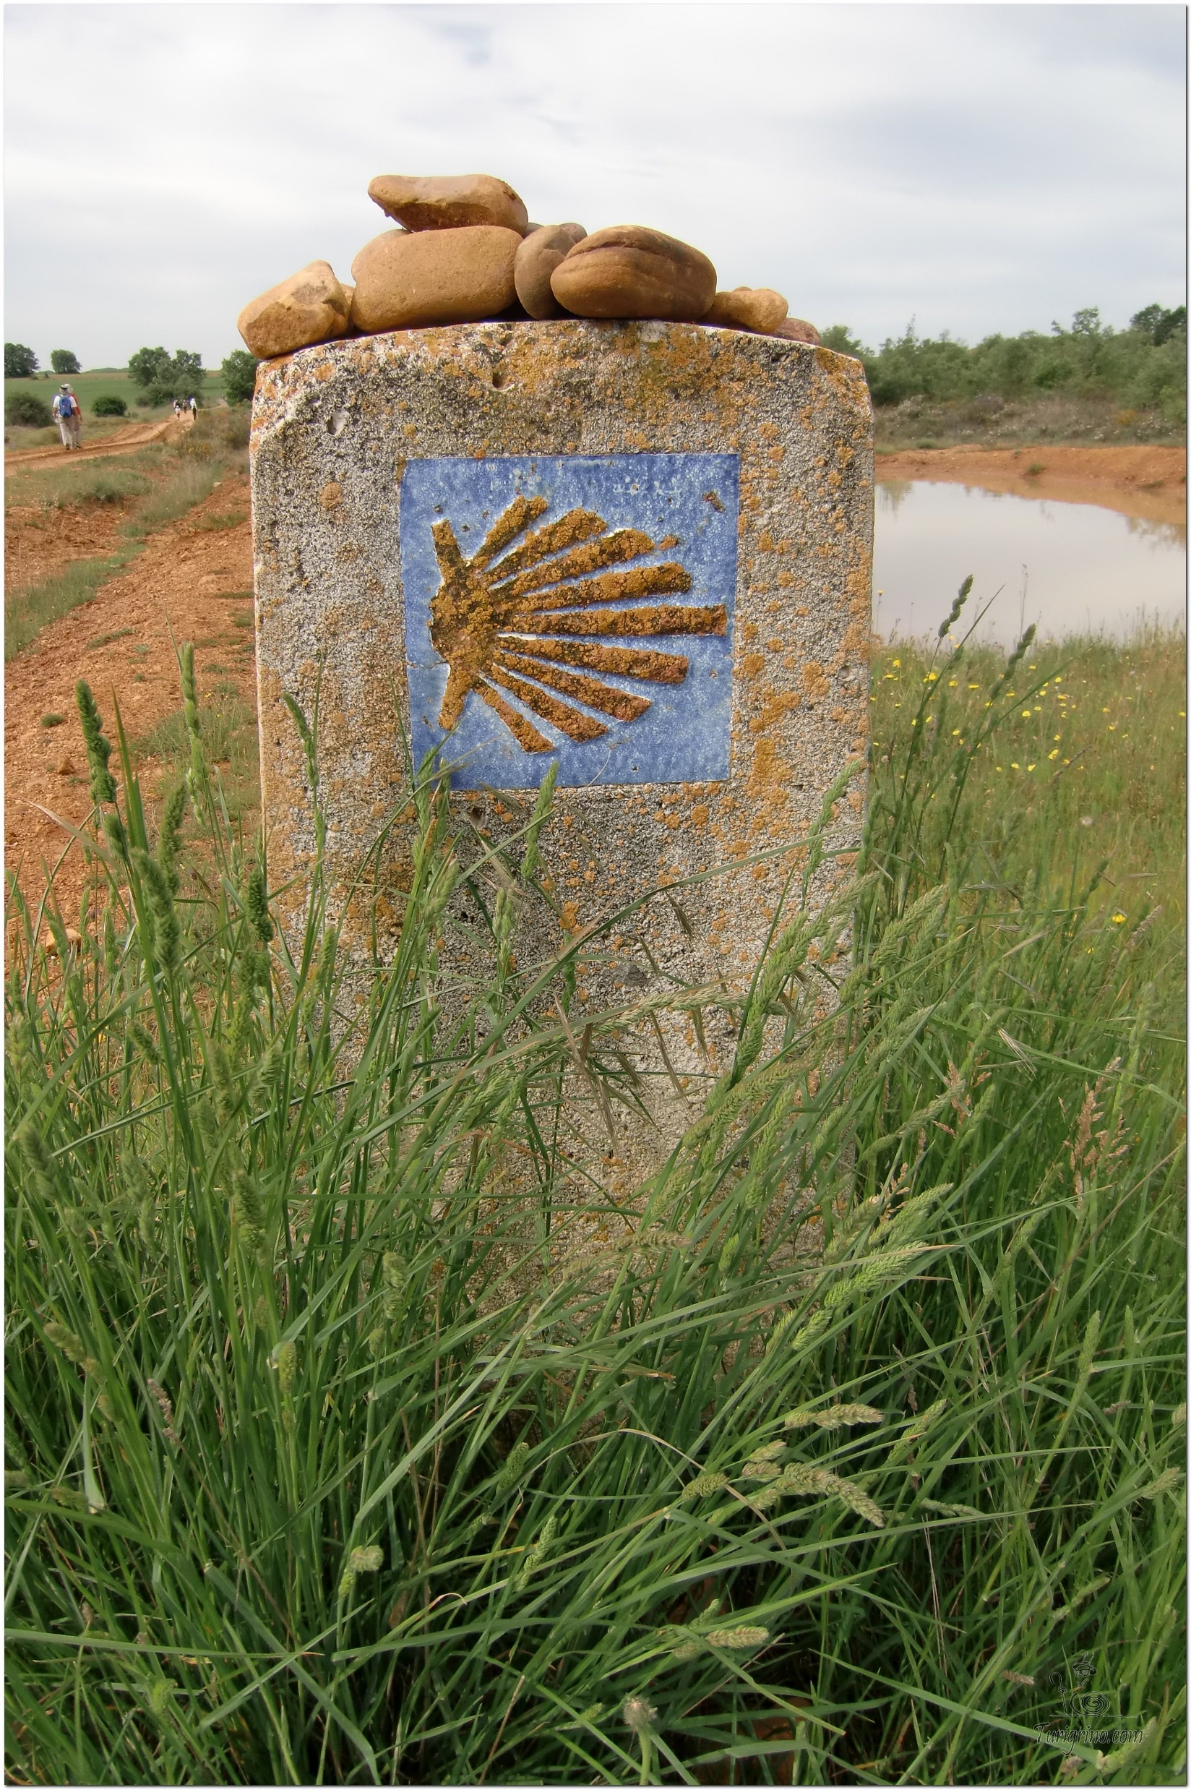
Opening Prayer
The Camino Prayer (adapted)
O God, who brought your servant Abraham out of the land of the Chaldeans, protecting him in his wanderings, who guided the Hebrew people across the desert, we ask that you watch over us, your servants, as we walk in the love of your name.
Be for us our companion on the journey,
Our guide at the crossroads, Our breath in our weariness,
Our protection in danger, our albergue on the Camino,
Our shade in the heat, Our light in the darkness,
Our consolation in our discouragements,
And our strength in our intentions.
So that with your guidance we may arrive safe and sound at the end of the road and enriched with grace and virtue we return safely to our homes filled with joy.
In the name of Jesus Christ our Lord, Amen. Apostle Santiago, pray for us. Santa Maria, pray for us.

Slide 4
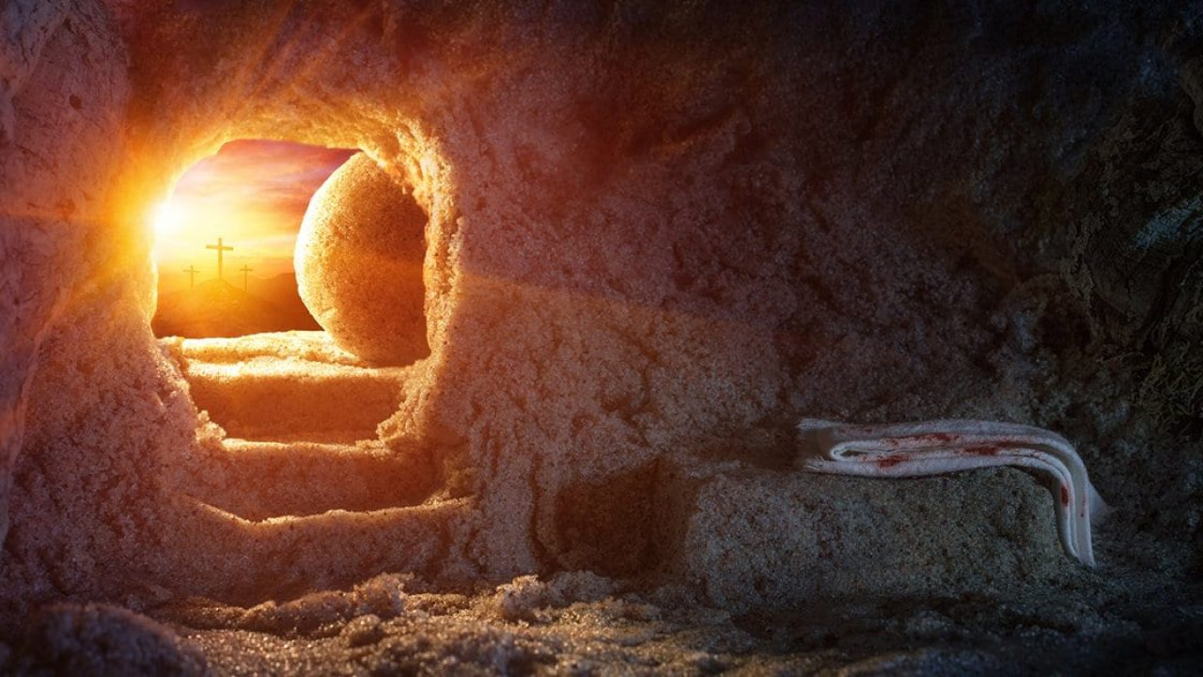
Catholicism in a Hundred Objects
This video is 25 minutes long so watch as much or as little as you like
The empty tomb

Slide 5
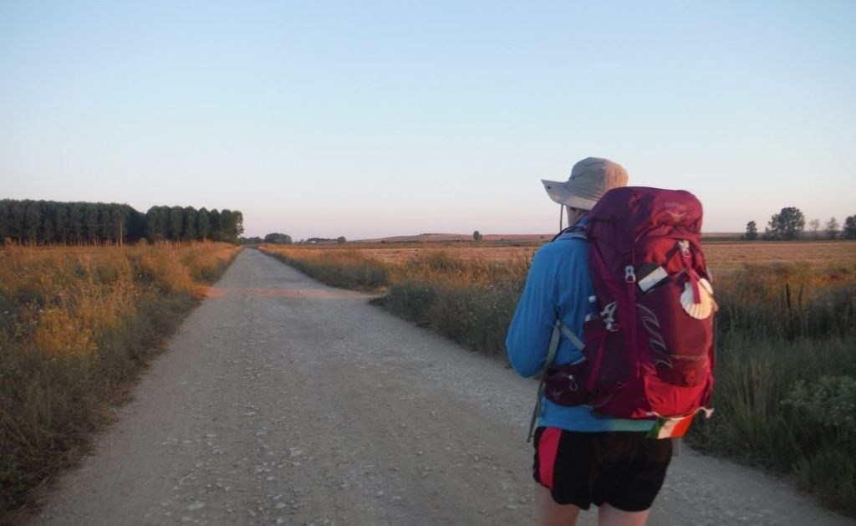
Rucksack Prayer – Part 1

Slide 6
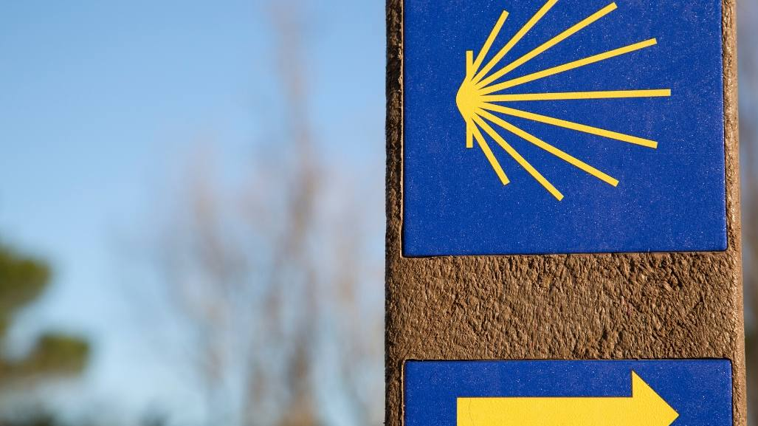
A Journey with
The Apostles
Intro video here

Slide 7
Scripture Reading – John 20:1-9
It was very early on the first day of the week and still dark, when Mary of Magdala came to the tomb. She saw that the stone had been moved away from the tomb and came running to Simon Peter and the other disciple, the one Jesus loved. ‘They have taken the Lord out of the tomb’ she said ‘and we don’t know where they have put him.’
So Peter set out with the other disciple to go to the tomb. They ran together, but the other disciple, running faster than Peter, reached the tomb first; he bent down and saw the linen cloths lying on the ground, but did not go in. Simon Peter who was following now came up, went right into the tomb, saw the linen cloths on the ground, and also the cloth that had been over his head; this was not with the linen cloths but rolled up in a place by itself. Then the other disciple who had reached the tomb first also went in; he saw and he believed. Till this moment they had failed to understand the teaching of scripture, that he must rise from the dead.

Slide 8
From what you have heard so far…
…what are your Initial thoughts, reactions, questions that come to mind?
We can discuss these later…

Slide 9
Main Input
Bishop Barron on How to Preach Like an Apostle

Slide 10
Reflection
As we give thanks to the Risen Lord we listen to this song of praise.

Slide 11
“What’s So Different About These Christians?”
3 Evangelization Hacks You Can Use Today

Slide 12
Catechism of the Catholic Church
75 "Christ the Lord, in whom the entire Revelation of the most high God is summed up, commanded the apostles to preach the Gospel, which had been promised beforehand by the prophets, and which he fulfilled in his own person and promulgated with his own lips. In preaching the Gospel, they were to communicate the gifts of God to all men. This Gospel was to be the source of all saving truth and moral discipline."
In the apostolic preaching. . .
76 In keeping with the Lord's command, the Gospel was handed on in two ways:
- orally "by the apostles who handed on, by the spoken word of their preaching, by the example they gave, by the institutions they established, what they themselves had received - whether from the lips of Christ, from his way of life and his works, or whether they had learned it at the prompting of the Holy Spirit";
- in writing "by those apostles and other men associated with the apostles who, under the inspiration of the same Holy Spirit, committed the message of salvation to writing".
. . . continued in apostolic succession
77 "In order that the full and living Gospel might always be preserved in the Church the apostles left bishops as their successors. They gave them their own position of teaching authority." Indeed, "the apostolic preaching, which is expressed in a special way in the inspired books, was to be preserved in a continuous line of succession until the end of time."
78 This living transmission, accomplished in the Holy Spirit, is called Tradition, since it is distinct from Sacred Scripture, though closely connected to it. Through Tradition, "the Church, in her doctrine, life and worship, perpetuates and transmits to every generation all that she herself is, all that she believes." "The sayings of the holy Fathers are a witness to the life-giving presence of this Tradition, showing how its riches are poured out in the practice and life of the Church, in her belief and her prayer."

Slide 13
Question
Are there any proofs for the Resurrection of Jesus?

Slide 14
Discussion
What difference does this image make to your life?
Discuss this is two’s & three’s then feedback to the main group

Slide 15
Internet Corner - Where to find out more…
Why did Jesus die? - Alpha
The Light of the Resurrection - Sycamore

Slide 16
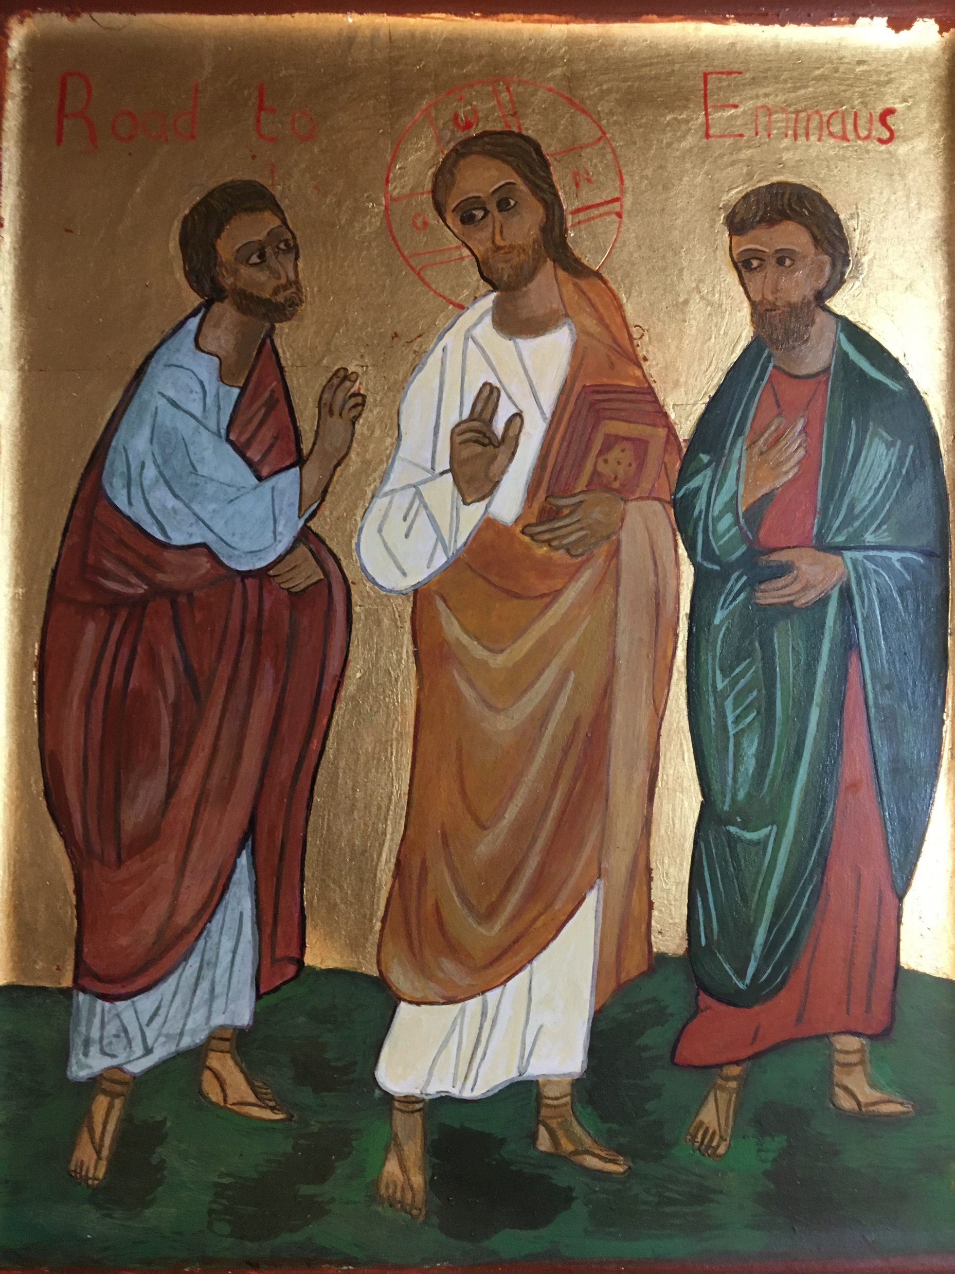
Conversation with Jesus
Focus on this image of Jesus and open your heart to Him now.
Take this opportunity to talk to him in your mind and heart.
Listen and be aware of his presence with you.
You may want to use this hymn to help you pray

Slide 17
Spiritual Journal
You may want to write down what has been important for you during this time together

Slide 18
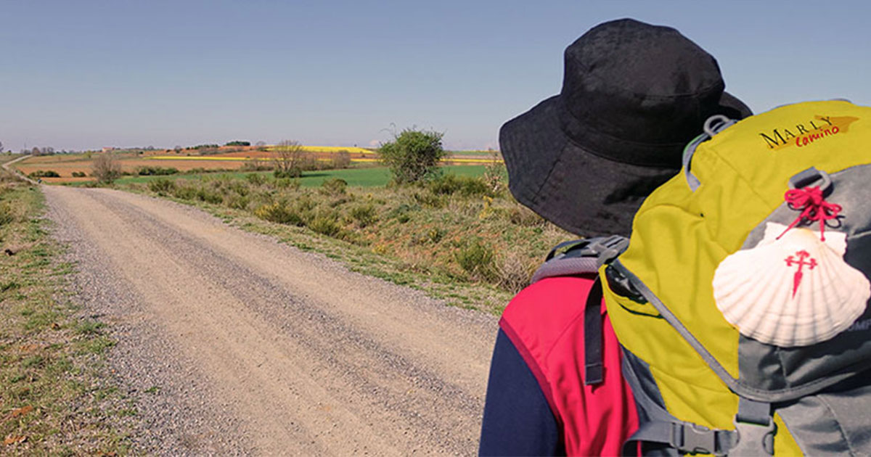
Rucksack Prayer – Part 2

Slide 19
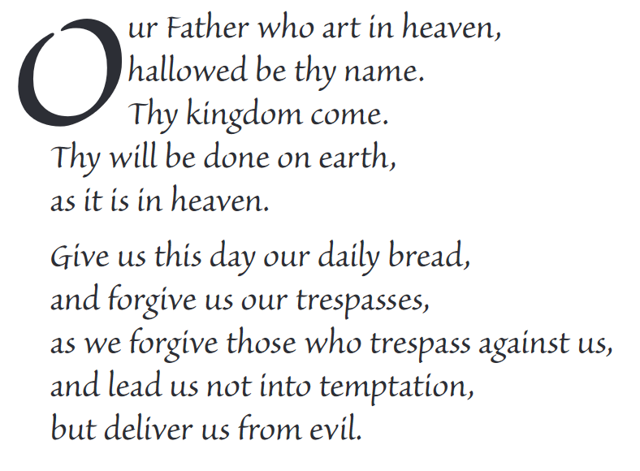
The Lord’s Prayer

Slide 20
Final pilgrim blessing for the week ahead
God of our pilgrimage,
you have given us a desire
to take the questing way
and set out on our journey.
Help us to keep our eyes fixed on Jesus,
that whatever we encounter as we travel,
we may seek to glorify you by the way we live.
You call us, Lord,
to leave familiar things and to leave our “comfort zone”.
May we open our eyes to new experiences,
may we open our ears to hear you speaking to us
and may we open our hearts to your love.
Grant that this time spent on pilgrimage
may help us to see ourselves as we really are
and may we strive to become the people you would have us be. Amen
… continued on next slide

Slide 21
Final pilgrim blessing for the week ahead
Lord, you know our beginning and our end.
Help us to realise we are only pilgrims on this earth
and save us from being too attached to worldly possessions.
May we experience the freedom to wander,
the freedom to hope and the freedom to love as we journey. Amen
Creator God, you are the source of all life and motivation.
May we journey in faith and love, rejoicing and eager to serve you.
Grant us a glimpse of your glory as we seek to follow you –
the Way, the Truth and the Life. Amen
May God the Father who created you, guide your footsteps,
May God the Son who redeemed you, share your journey,
May God the Holy Spirit who sanctifies you, lead you on life’s pilgrimage,
and the blessing of God, Father, Son and Holy Spirit
be with you wherever you may go. Amen.

Slide 22
CAMINO
Making the Journey…
Session 5
Making the journey with the Apostles – the Resurrection

