Slide 1
CAMINO
Making the Journey…
Session 6
Making the journey with the Evangelists

Slide 2
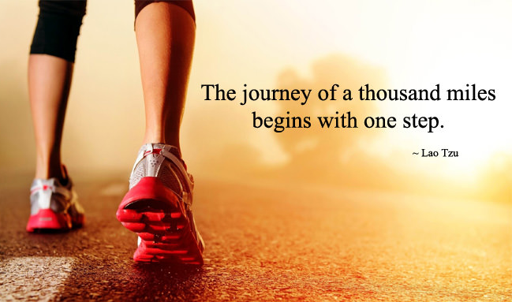
Introduction
In this session we will help people understand the importance of the Gospels as part of our faith because they contain the key stories of Jesus life: his healing and teaching ministry, his suffering death and resurrection. They are a rich treasure for us and when we engage with the Gospels then we engage with Jesus himself. Jesus is the Word made flesh who dwelt amongst us. Encourage people to familiarise themselves with the Gospel narratives as an encounter with Christ that will transform their lives. The Gospels form an important road map for us as pilgrims on the Way.

Slide 3
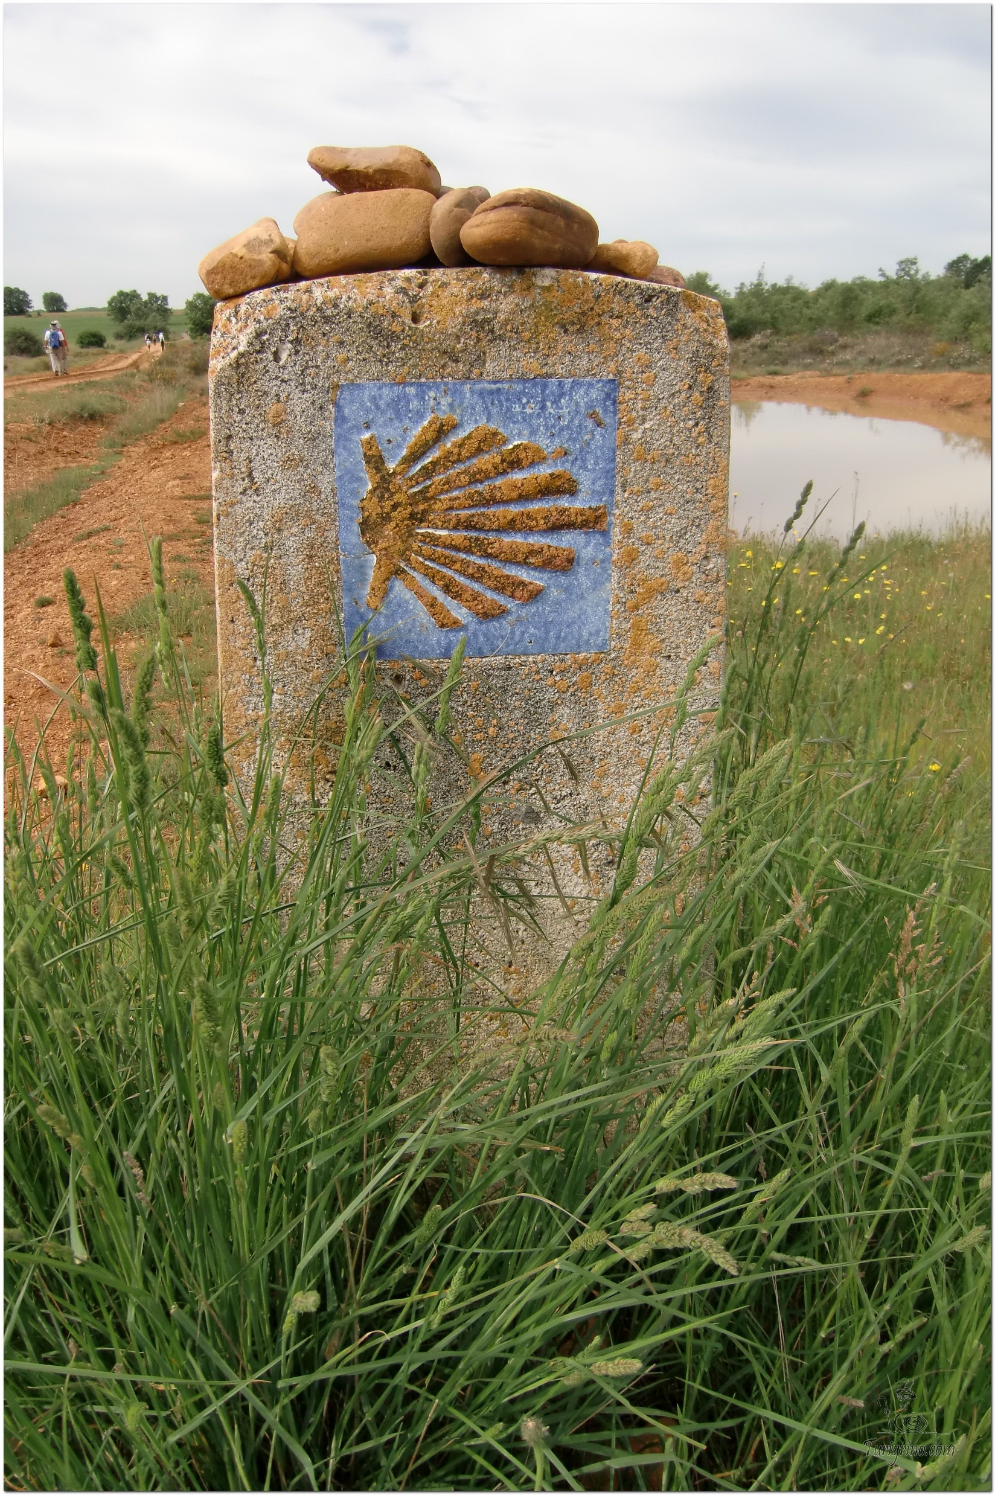
Opening Prayer
The Camino Prayer (adapted)
O God, who brought your servant Abraham out of the land of the Chaldeans, protecting him in his wanderings, who guided the Hebrew people across the desert, we ask that you watch over us, your servants, as we walk in the love of your name.
Be for us our companion on the journey,
Our guide at the crossroads, Our breath in our weariness,
Our protection in danger, our albergue on the Camino,
Our shade in the heat, Our light in the darkness,
Our consolation in our discouragements,
And our strength in our intentions.
So that with your guidance we may arrive safe and sound at the end of the road and enriched with grace and virtue we return safely to our homes filled with joy.
In the name of Jesus Christ our Lord, Amen. Apostle Santiago, pray for us. Santa Maria, pray for us.

Slide 4
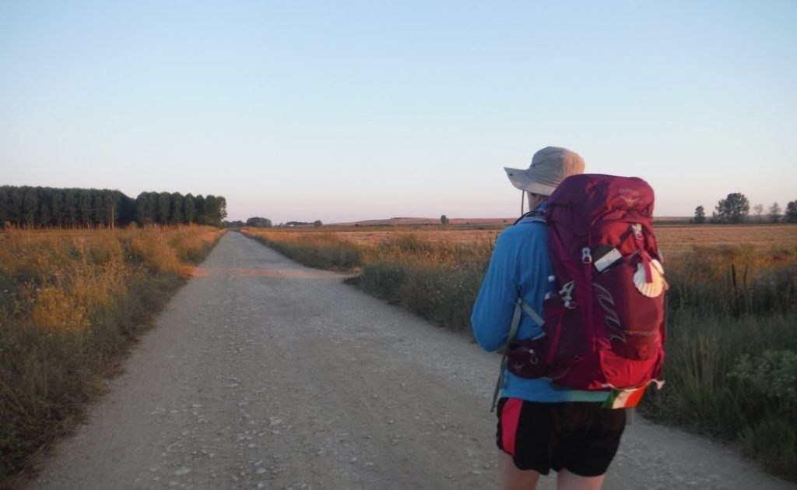
Rucksack Prayer – Part 1

Slide 5
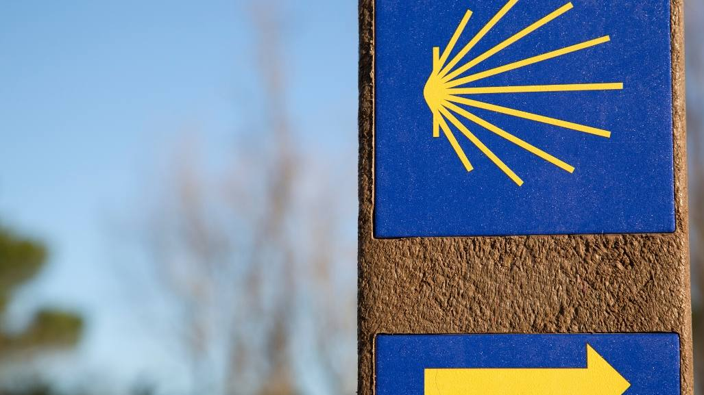
A Journey with…
Intro video here

Slide 6
Scripture Reading -
In the beginning was the Word, and the Word was with God, and the Word was God. This one was in the beginning with God. All things came into being through him, and apart from him not one thing came into being that has come into being. In him was life, and the life was the light of humanity. And the light shines in the darkness, and the darkness did not overcome it.
A man came, sent from God, whose name was John. This one came for a witness, in order that he could testify about the light, so that all would believe through him. That one was not the light, but came in order that he could testify about the light. The true light, who gives light to every person, was coming into the world. He was in the world, and the world came into being through him, and the world did not recognize him. He came to his own things, and his own people did not receive him. But as many as received him—to those who believe in his name—he gave to them authority to become children of God, who were born not of blood, nor of the will of the flesh, nor of the will of a husband, but of God.
And the Word became flesh and took up residence among us, and we saw his glory, glory as of the one and only from the Father, full of grace and truth. John testified about him and cried out, saying, “This one was he about whom I said, ‘The one who comes after me is ahead of me, because he existed before me.’” For from his fullness we have all received, and grace after grace. For the law was given through Moses; grace and truth came about through Jesus Christ.

Slide 7
From what you have heard so far…
…what are your Initial thoughts, reactions, questions that come to mind?
We can discuss these later…

Slide 8
Main Input
Scripture

Slide 9
Reflection

Slide 10
Testimony

Slide 11
Catechism of the Catholic Church
"The Sacred Scriptures contain the Word of God and, because they are inspired, they are truly the Word of God".
God is the author of Sacred Scripture because he inspired its human authors; he acts in them and by means of them. He thus gives assurance that their writings teach without error his saving truth.
Interpretation of the inspired Scripture must be attentive above all to what God wants to reveal through the sacred authors for our salvation. What comes from the Spirit is not fully "understood except by the Spirit's action’.
The Church accepts and venerates as inspired the 46 books of the Old Testament and the 27 books of the New.
The four Gospels occupy a central place because Christ Jesus is their centre.
The unity of the two Testaments proceeds from the unity of God's plan and his Revelation. the Old Testament prepares for the New and the New Testament fulfils the Old; the two shed light on each other; both are true Word of God.
"The Church has always venerated the divine Scriptures as she venerated the Body of the Lord" : both nourish and govern the whole Christian life. "Your word is a lamp to my feet and a light to my path"

Slide 12
Question
Why are these books so important within the Bible?

Slide 13
Discussion
What difference do the Gospels make in my life?
Discuss this is two’s & three’s then feedback to the main group

Slide 14
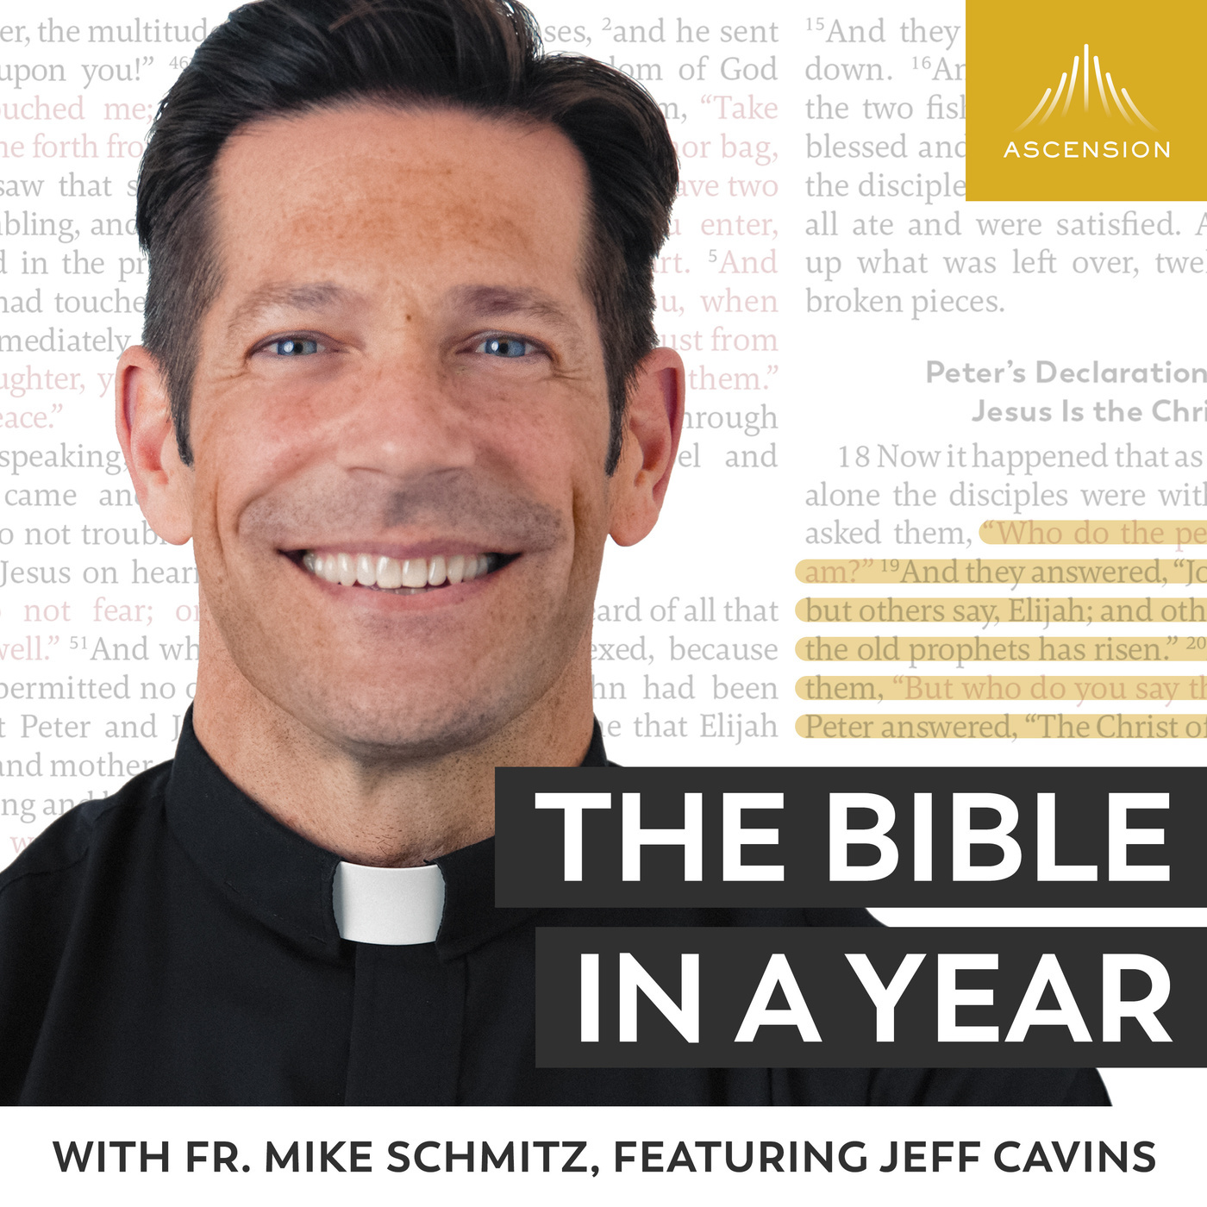
Internet Corner - Where to find out more…
https://bibleinayear.fireside.fm/
alpha.org/
Sycamore.fm/

Slide 15
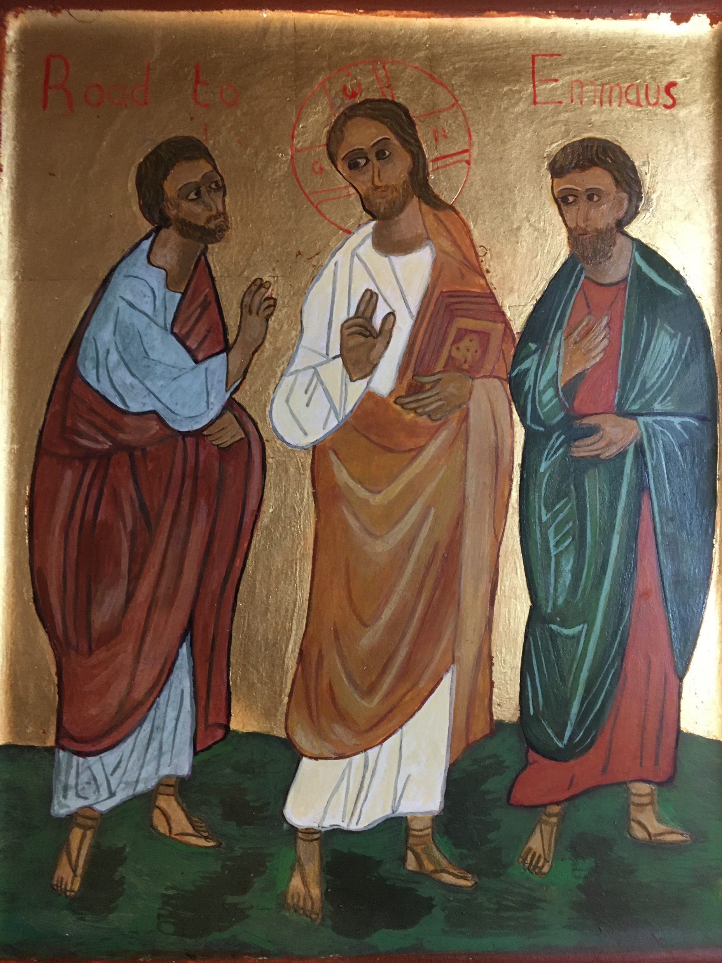
Conversation with Jesus
Focus on this image of Jesus and open your heart to Him now.
Take this opportunity to talk to him in your mind and heart.
Listen and be aware of his presence with you.
You may want to use this hymn to help you pray

Slide 16
Spiritual Journal
You may want to write down what has been important for you during this time together

Slide 17
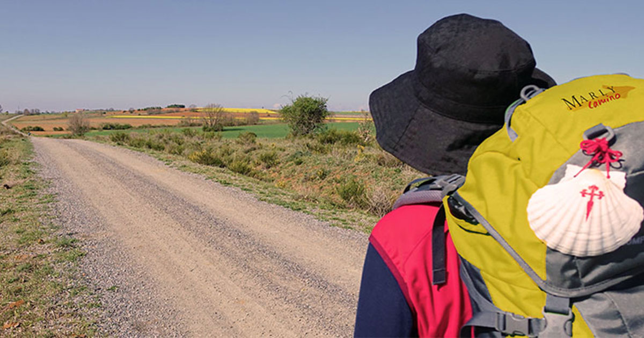
Rucksack Prayer – Part 2

Slide 18
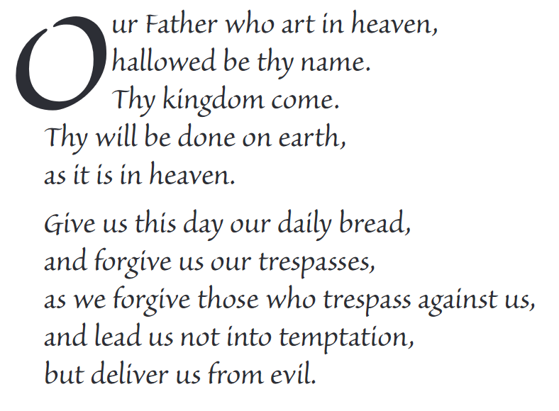
The Lord’s Prayer

Slide 19
Final pilgrim blessing for the week ahead
God of our pilgrimage,
you have given us a desire
to take the questing way
and set out on our journey.
Help us to keep our eyes fixed on Jesus,
that whatever we encounter as we travel,
we may seek to glorify you by the way we live.
You call us, Lord,
to leave familiar things and to leave our “comfort zone”.
May we open our eyes to new experiences,
may we open our ears to hear you speaking to us
and may we open our hearts to your love.
Grant that this time spent on pilgrimage
may help us to see ourselves as we really are
and may we strive to become the people you would have us be. Amen
… continued on next slide

Slide 20
Final pilgrim blessing for the week ahead
Lord, you know our beginning and our end.
Help us to realise we are only pilgrims on this earth
and save us from being too attached to worldly possessions.
May we experience the freedom to wander,
the freedom to hope and the freedom to love as we journey. Amen
Creator God, you are the source of all life and motivation.
May we journey in faith and love, rejoicing and eager to serve you.
Grant us a glimpse of your glory as we seek to follow you –
the Way, the Truth and the Life. Amen
May God the Father who created you, guide your footsteps,
May God the Son who redeemed you, share your journey,
May God the Holy Spirit who sanctifies you, lead you on life’s pilgrimage,
and the blessing of God, Father, Son and Holy Spirit
be with you wherever you may go. Amen.

Slide 21
CAMINO
Making the Journey…
Session 6
Making the journey with the Evangelists

