Slide 1
CAMINO
Making the Journey…
Session 7
Making the journey with the Early Church –
St. Paul and New Testament

Slide 2
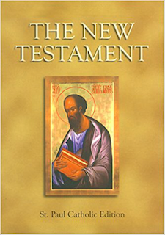
Introduction
This session talks about the journey to help people understand the world of the New Testament scriptures and the missionary nature of our faith. To see how encounter with Christ transformed people, St Paul most radically. St Paul has a key role and is a rich seem for us in our liturgy and our prayer. Help people to understand more the link between scripture and tradition in our faith that we have inherited.

Slide 3
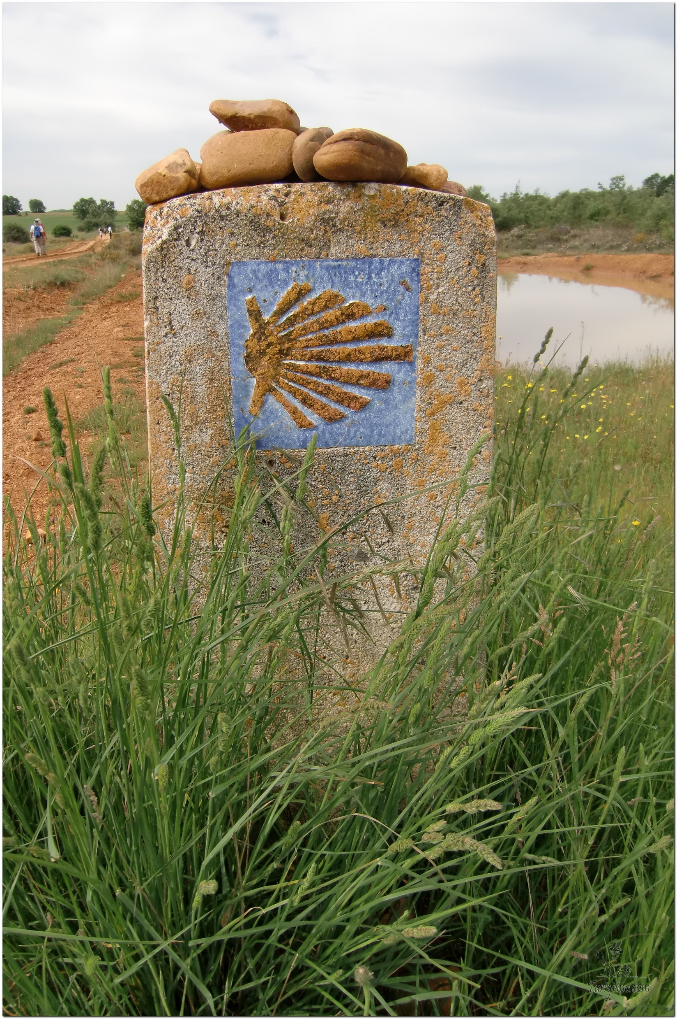
Opening Prayer
The Camino Prayer (adapted)
O God, who brought your servant Abraham out of the land of the Chaldeans, protecting him in his wanderings, who guided the Hebrew people across the desert, we ask that you watch over us, your servants, as we walk in the love of your name.
Be for us our companion on the journey,
Our guide at the crossroads, Our breath in our weariness,
Our protection in danger, our albergue on the Camino,
Our shade in the heat, Our light in the darkness,
Our consolation in our discouragements,
And our strength in our intentions.
So that with your guidance we may arrive safe and sound at the end of the road and enriched with grace and virtue we return safely to our homes filled with joy.
In the name of Jesus Christ our Lord, Amen. Apostle Santiago, pray for us. Santa Maria, pray for us.

Slide 4
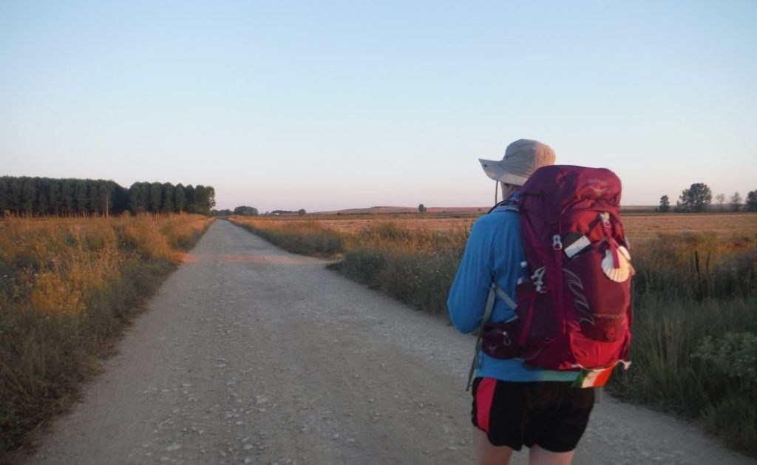
Rucksack Prayer – Part 1

Slide 5
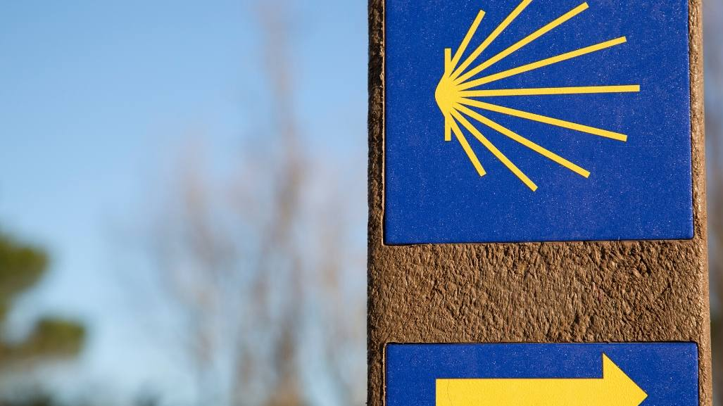
A Journey with…
Intro video here

Slide 6
Scripture Reading – Acts 2:42-47
They devoted themselves to the apostles’ teaching and to fellowship, to the breaking of bread and to prayer. Everyone was filled with awe at the many wonders and signs performed by the apostles. All the believers were together and had everything in common. They sold property and possessions to give to anyone who had need. Every day they continued to meet together in the temple courts. They broke bread in their homes and ate together with glad and sincere hearts, praising God and enjoying the favour of all the people. And the Lord added to their number daily those who were being saved.

Slide 7
From what you have heard so far…
…what are your Initial thoughts, reactions, questions that come to mind?
We can discuss these later…

Slide 8
Main Input
Bishop Barron on St. Paul and the Mission of the Church

Slide 9
Reflection
Before St Paul’s conversion, he killed Christians. Even after his conversion he had his weaknesses and asked God to take them away from him. But God replied, “My grace is sufficient for you, for My power is perfected in weakness.” As we listen to this song, let us reflect on God’s grace working powerfully through us when we are weak.

Slide 10
Testimony
Watch Dez's story of overcoming drug addiction and how his life has changed since finding faith

Slide 11
Catechism of the Catholic Church
It is in the Church, in communion with all the baptized, that the Christian fulfills his vocation. From the Church he receives the Word of God containing the teachings of "the law of Christ." From the Church he receives the grace of the sacraments that sustains him on the "way." From the Church he learns the example of holiness and recognizes its model and source in the all-holy Virgin Mary; he discerns it in the authentic witness of those who live it; he discovers it in the spiritual tradition and long history of the saints who have gone before him and whom the liturgy celebrates in the rhythms of the sanctoral cycle.
The moral life is spiritual worship. We "present (our) bodies as a living sacrifice, holy and acceptable to God," within the Body of Christ that we form and in communion with the offering of his Eucharist. In the liturgy and the celebration of the sacraments, prayer and teaching are conjoined with the grace of Christ to enlighten and nourish Christian activity. As does the whole of the Christian life, the moral life finds its source and summit in the Eucharistic sacrifice.

Slide 12
Question
Why do Catholics use Scripture and Tradition?

Slide 13
Discussion
Has anyone had a similar encounter with God as St Paul did?
Discuss this is two’s & three’s then feedback to the main group

Slide 14
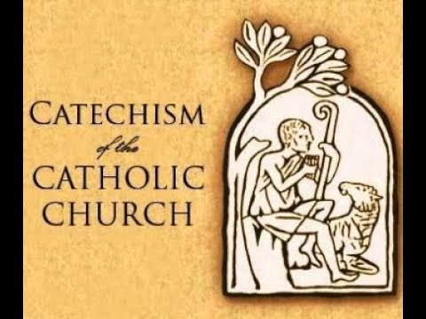
Internet Corner - Where to find out more…
www.vatican.va/archive/ENG0015/_INDEX.HTM
alpha.org/
Sycamore.fm/

Slide 15
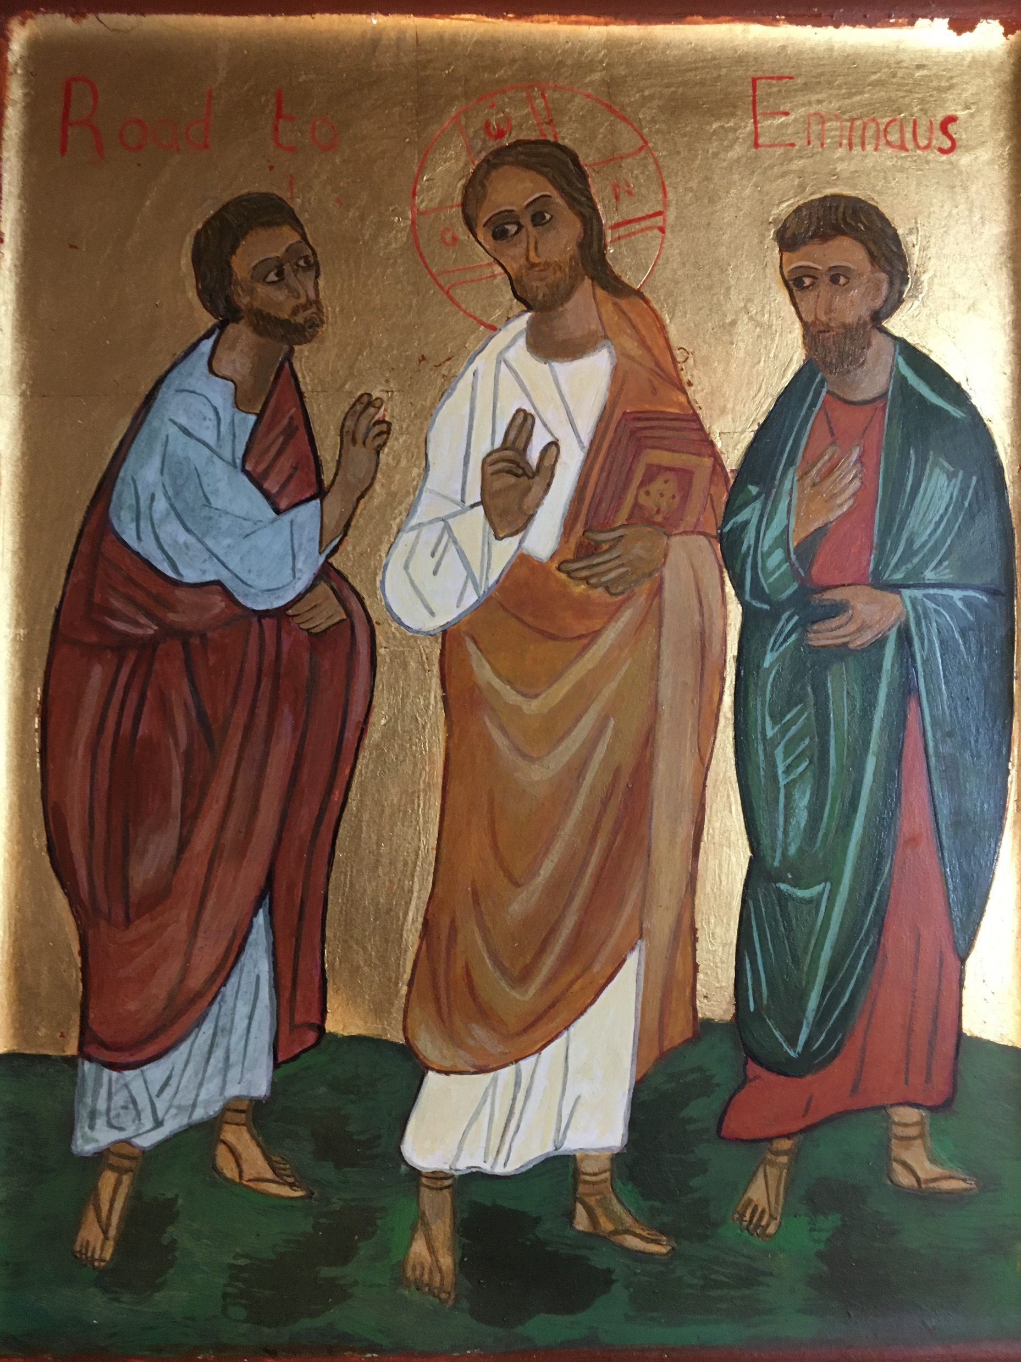
Conversation with Jesus
Focus on this image of Jesus and open your heart to Him now.
Take this opportunity to talk to him in your mind and heart.
Listen and be aware of his presence with you.
You may want to use this hymn to help you pray

Slide 16
Spiritual Journal
You may want to write down what has been important for you during this time together

Slide 17
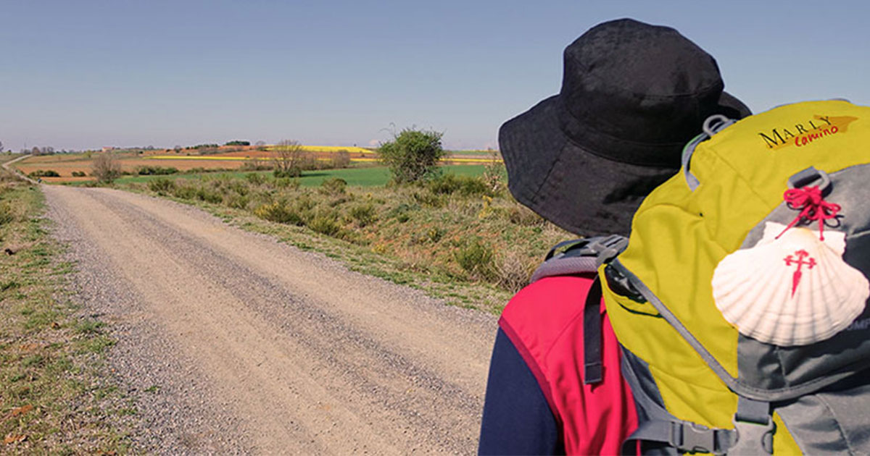
Rucksack Prayer – Part 2

Slide 18
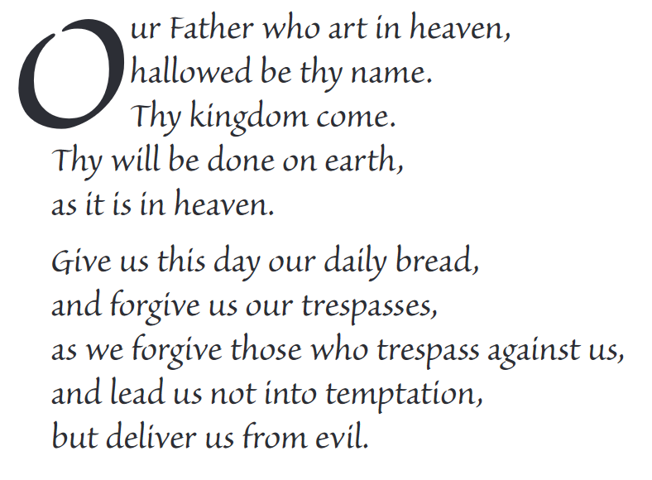
The Lord’s Prayer

Slide 19
Final pilgrim blessing for the week ahead
God of our pilgrimage,
you have given us a desire
to take the questing way
and set out on our journey.
Help us to keep our eyes fixed on Jesus,
that whatever we encounter as we travel,
we may seek to glorify you by the way we live.
You call us, Lord,
to leave familiar things and to leave our “comfort zone”.
May we open our eyes to new experiences,
may we open our ears to hear you speaking to us
and may we open our hearts to your love.
Grant that this time spent on pilgrimage
may help us to see ourselves as we really are
and may we strive to become the people you would have us be. Amen
… continued on next slide

Slide 20
Final pilgrim blessing for the week ahead
Lord, you know our beginning and our end.
Help us to realise we are only pilgrims on this earth
and save us from being too attached to worldly possessions.
May we experience the freedom to wander,
the freedom to hope and the freedom to love as we journey. Amen
Creator God, you are the source of all life and motivation.
May we journey in faith and love, rejoicing and eager to serve you.
Grant us a glimpse of your glory as we seek to follow you –
the Way, the Truth and the Life. Amen
May God the Father who created you, guide your footsteps,
May God the Son who redeemed you, share your journey,
May God the Holy Spirit who sanctifies you, lead you on life’s pilgrimage,
and the blessing of God, Father, Son and Holy Spirit
be with you wherever you may go. Amen.

Slide 21
CAMINO
Making the Journey…
Session 7
Making the journey with the Early Church –
St. Paul and New Testament

