Slide 1
CAMINO
Making the Journey…
Session 8
Making the journey with the Church Fathers

Slide 2
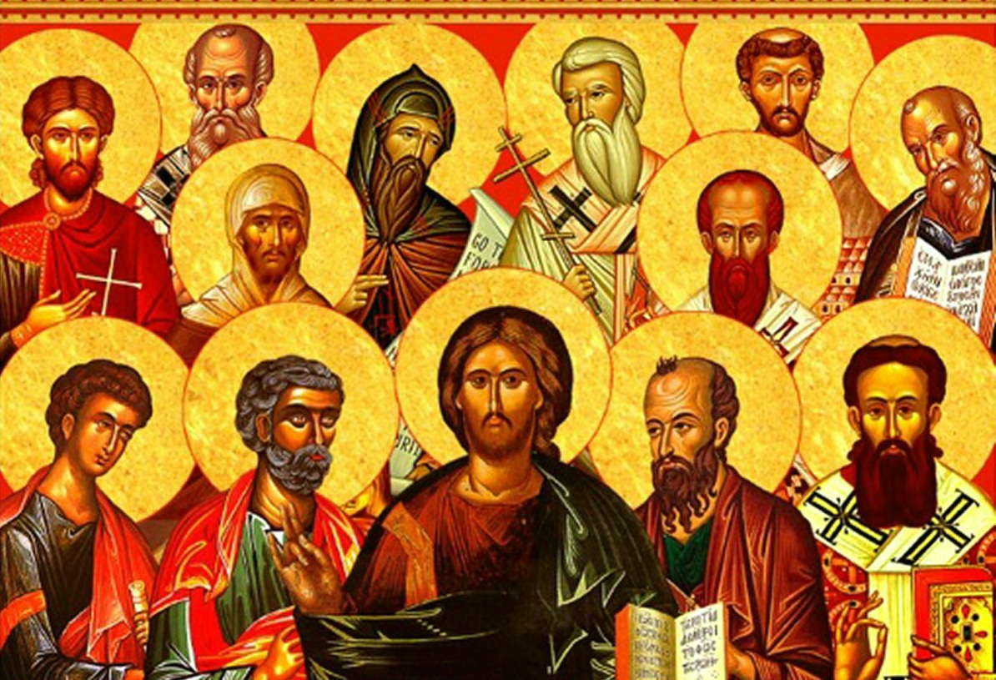
Introduction
In this session we understand who Jesus really is, true God and true man and how this was debated in the early church leading to the ecumenical councils and the Nicene Creed that we say together at mass. Link this with our own faith journey. Jesus is not just another teacher or another prophet he is the Son of God made fully human for us. He is the Way, the Truth and the Life. Each one of us has to answer the question that Jesus asked Peter at Caesarea Philippi: who do you say that I am? Encourage people to stay with this question as very important on our pilgrim journey through life.

Slide 3
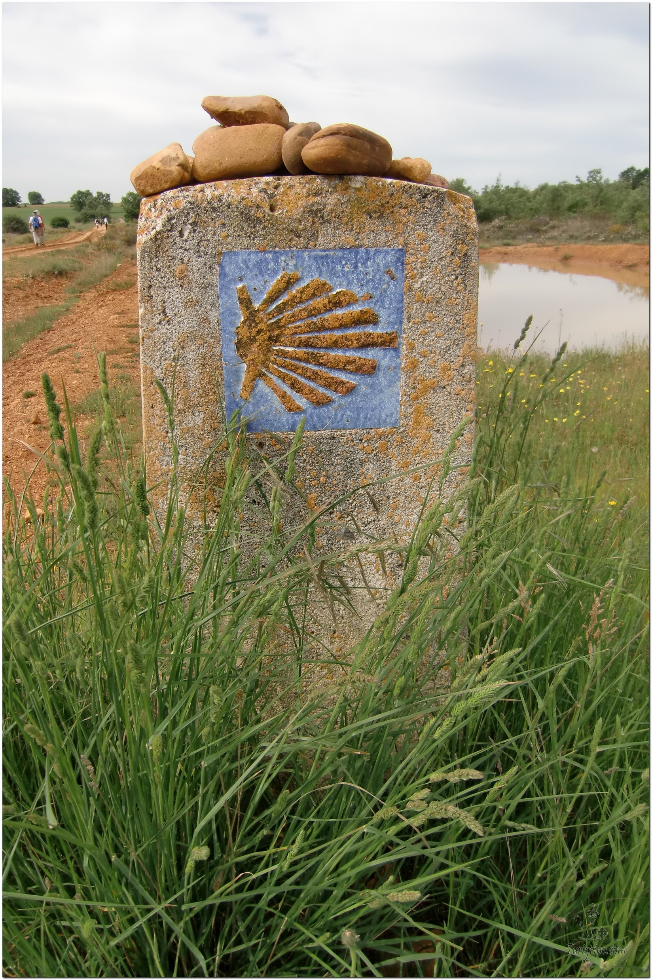
Opening Prayer
The Camino Prayer (adapted)
O God, who brought your servant Abraham out of the land of the Chaldeans, protecting him in his wanderings, who guided the Hebrew people across the desert, we ask that you watch over us, your servants, as we walk in the love of your name.
Be for us our companion on the journey,
Our guide at the crossroads, Our breath in our weariness,
Our protection in danger, our albergue on the Camino,
Our shade in the heat, Our light in the darkness,
Our consolation in our discouragements,
And our strength in our intentions.
So that with your guidance we may arrive safe and sound at the end of the road and enriched with grace and virtue we return safely to our homes filled with joy.
In the name of Jesus Christ our Lord, Amen. Apostle Santiago, pray for us. Santa Maria, pray for us.

Slide 4
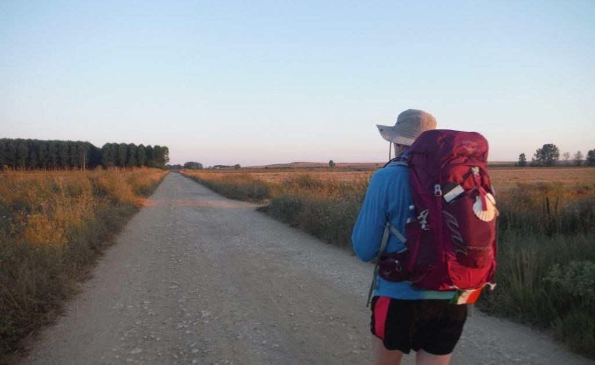
Rucksack Prayer – Part 1

Slide 5
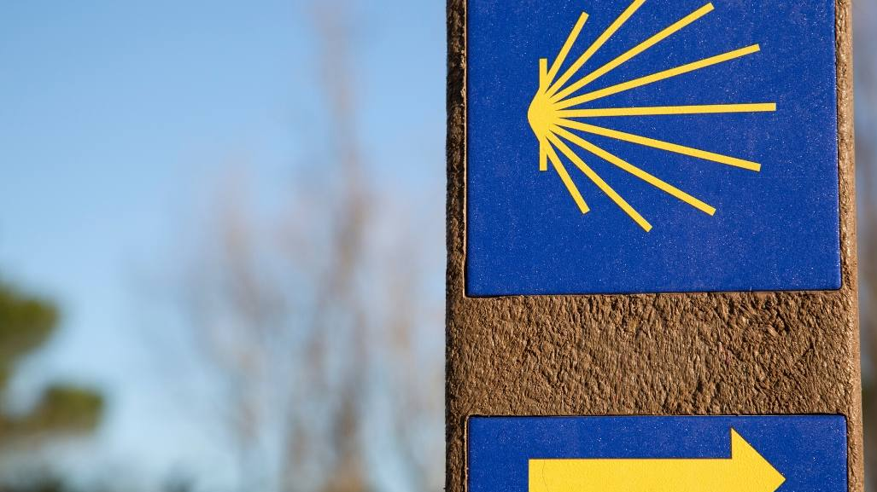
A Journey with The Church Fathers
Intro video here

Slide 6
Scripture Reading – Matthew 16:13-21
When Jesus came to the region of Caesarea Philippi, he asked his disciples, “Who do people say the Son of Man is?”
They replied, “Some say John the Baptist; others say Elijah; and still others, Jeremiah or one of the prophets.”
“But what about you?” he asked. “Who do you say I am?” Simon Peter answered, "You are the Christ, the Son of the living God."
Jesus replied, "Blessed are you, Simon son of Jonah, for this was not revealed to you by man, but by my Father in heaven.
And I tell you that you are Peter, and on this rock I will build my church,
and the gates of Hades will not overcome it.
I will give you the keys of the kingdom of heaven; whatever you bind on earth will be bound in heaven, and whatever you loose on earth will be loosed in heaven."
Then he warned his disciples not to tell anyone that he was the Christ.
From that time on Jesus began to explain to his disciples that he must go to Jerusalem and suffer many things at the hands of the elders, chief priests and teachers of the law, and that he must be killed and on the third day be raised to life.

Slide 7
From what you have heard so far…
…what are your Initial thoughts, reactions, questions that come to mind?
We can discuss these later…

Slide 8
Main Input
Bishop Baron explains who the Church Fathers were

Slide 9
Reflection
On the Rock of Peter, I will build My Church

Slide 10
Testimony
Have a listen to the difference faith made in the lives of Miranda and Ashlyn

Slide 11
Catechism of the Catholic Church
Faith is a personal adherence of the whole man to God who reveals himself. It involves an assent of the intellect and will to the self-revelation God has made through his deeds and words.
"To believe" has thus a twofold reference: to the person, and to the truth: to the truth, by trust in the person who bears witness to it.
We must believe in no one but God: the Father, the Son and the Holy Spirit.
Faith is a supernatural gift from God. In order to believe, man needs the interior helps of the Holy Spirit.
"Believing" is a human act, conscious and free, corresponding to the dignity of the human person.
"Believing" is an ecclesial act. The Church's faith precedes, engenders, supports and nourishes our faith. the Church is the mother of all believers. "No one can have God as Father who does not have the Church as Mother"
We believe all "that which is contained in the word of God, written or handed down, and which the Church proposes for belief as divinely.
Faith is necessary for salvation. the Lord himself affirms: "He who believes and is baptized will be saved; but he who does not believe will be condemned”.

Slide 12
Question
Where did the Nicene Creed come from?

Slide 13
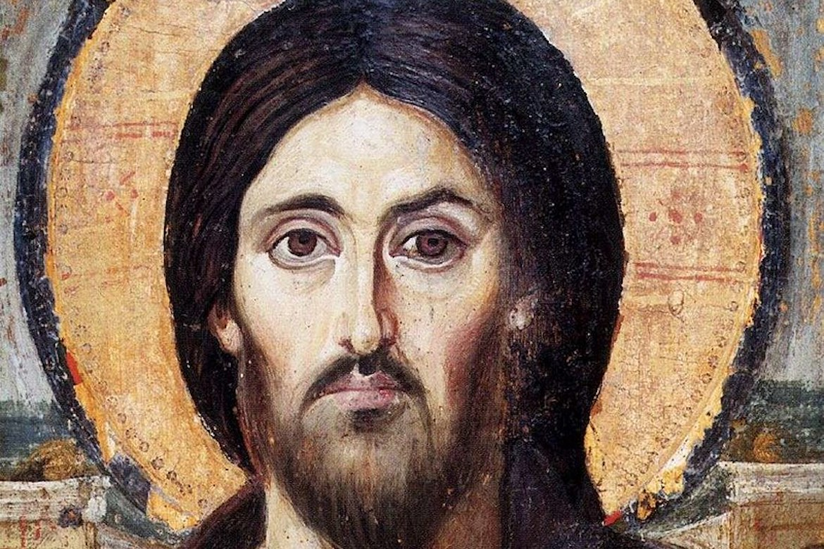
Discussion
What do you notice about this icon? What is it trying to show?
Who is Jesus to you?
Discuss this is two’s & three’s then feedback to the main group

Slide 14
Internet Corner - Where to find out more…
Who is Jesus? - Sycamore
Who is Jesus? - Alpha

Slide 15
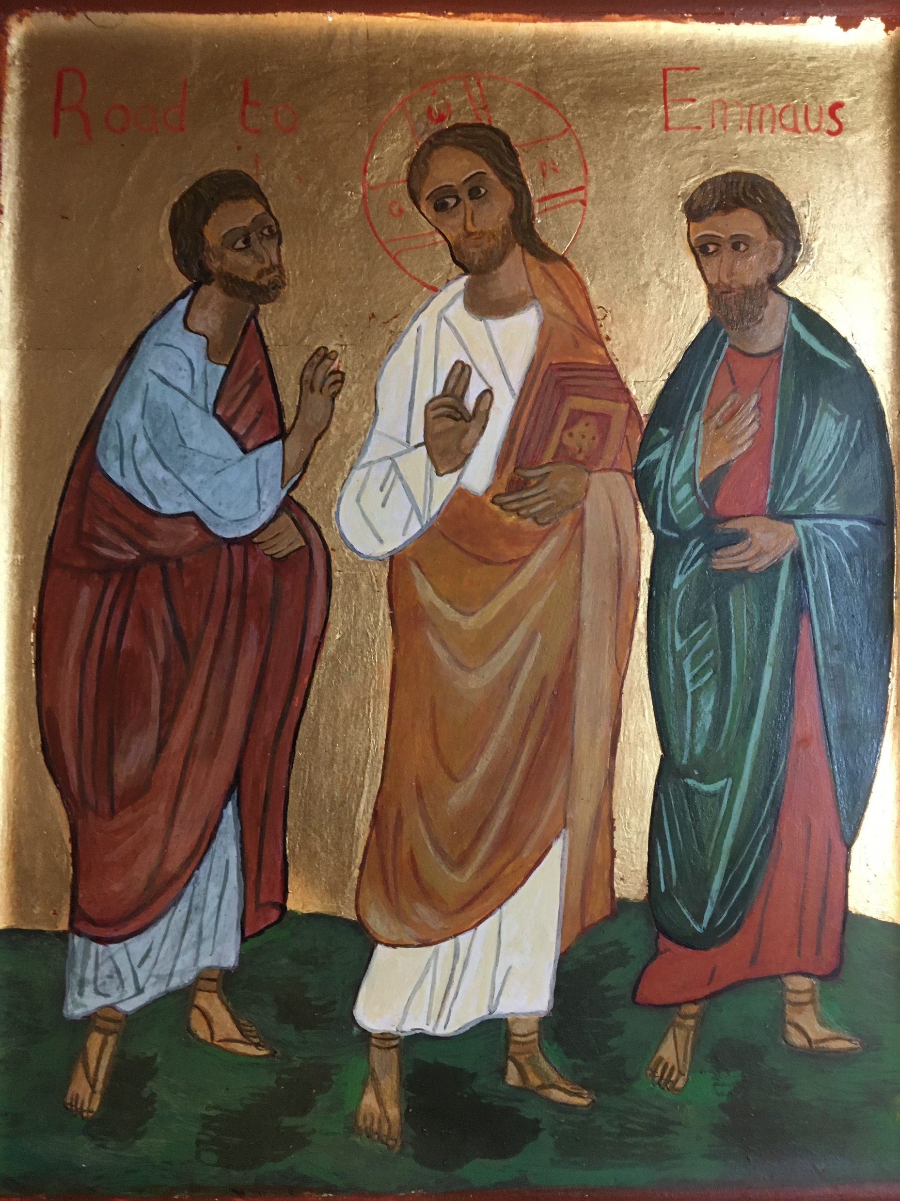
Conversation with Jesus
Focus on this image of Jesus and open your heart to Him now.
Take this opportunity to talk to him in your mind and heart.
Listen and be aware of his presence with you.
You may want to use this hymn to help you pray

Slide 16
Spiritual Journal
You may want to write down what has been important for you during this time together

Slide 17
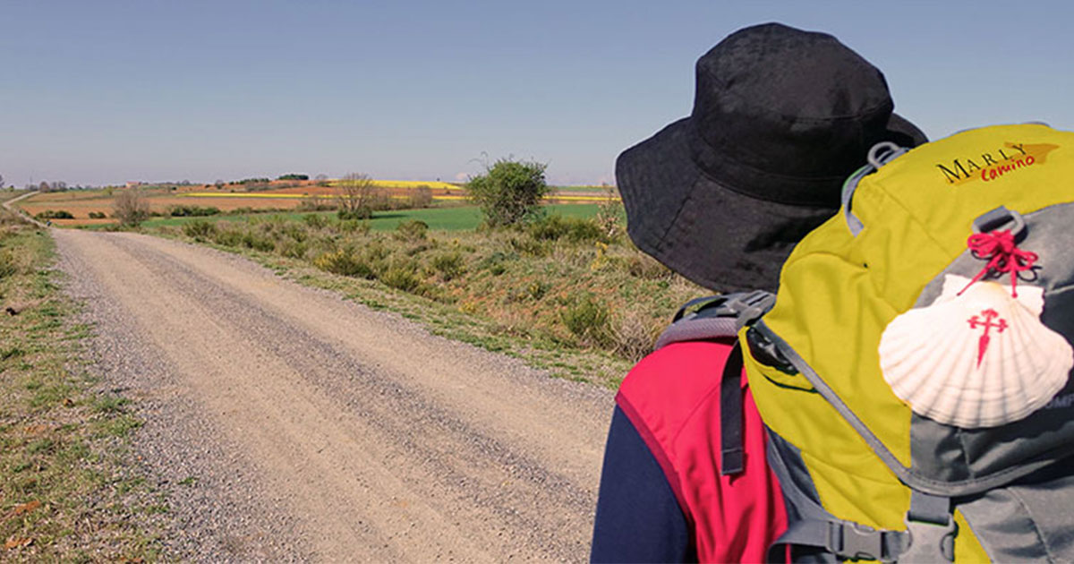
Rucksack Prayer – Part 2

Slide 18
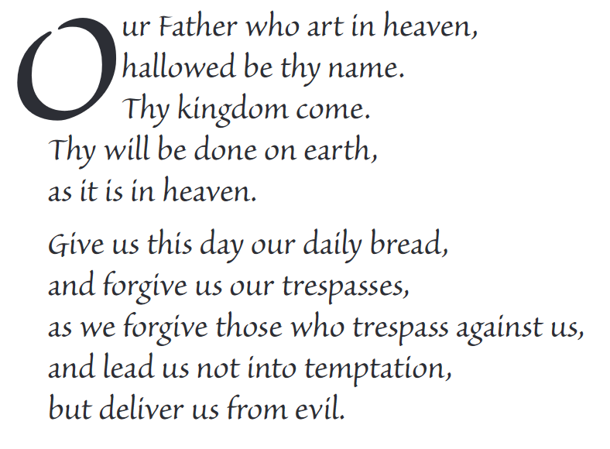
The Lord’s Prayer

Slide 19
Final pilgrim blessing for the week ahead
God of our pilgrimage,
you have given us a desire
to take the questing way
and set out on our journey.
Help us to keep our eyes fixed on Jesus,
that whatever we encounter as we travel,
we may seek to glorify you by the way we live.
You call us, Lord,
to leave familiar things and to leave our “comfort zone”.
May we open our eyes to new experiences,
may we open our ears to hear you speaking to us
and may we open our hearts to your love.
Grant that this time spent on pilgrimage
may help us to see ourselves as we really are
and may we strive to become the people you would have us be. Amen
… continued on next slide

Slide 20
Final pilgrim blessing for the week ahead
Lord, you know our beginning and our end.
Help us to realise we are only pilgrims on this earth
and save us from being too attached to worldly possessions.
May we experience the freedom to wander,
the freedom to hope and the freedom to love as we journey. Amen
Creator God, you are the source of all life and motivation.
May we journey in faith and love, rejoicing and eager to serve you.
Grant us a glimpse of your glory as we seek to follow you –
the Way, the Truth and the Life. Amen
May God the Father who created you, guide your footsteps,
May God the Son who redeemed you, share your journey,
May God the Holy Spirit who sanctifies you, lead you on life’s pilgrimage,
and the blessing of God, Father, Son and Holy Spirit
be with you wherever you may go. Amen.

Slide 21
CAMINO
Making the Journey…
Session 8
Making the journey with the Church Fathers

