Slide 1
CAMINO
Making the Journey…
Session 9
Making the journey with St Joseph, the shepherds and the Magi

Slide 2
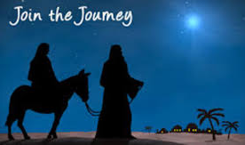
Introduction
A journey to the birth of our Lord and Saviour Jesus Christ gives us a deeper understanding of the importance of Jesus’s birth as part of God’s plan for salvation. There are three different perspectives to help us on our pilgrim journey.
St Joseph was attentive to God and allowed all his plans to be turned upside down.
The Magi literally made a pilgrimage to find the new born king following the star and they were looking to the skies to discern the will of God.
The shepherds were outcasts, who were privileged to be given the news of salvation and the hope that it brings by the angels and that transformed their lives.
They all went home a ‘different way’ transformed by the encounter with the new born baby Jesus and the hope that it brought them.
Can we allow this to happen to us this Christmas?

Slide 3
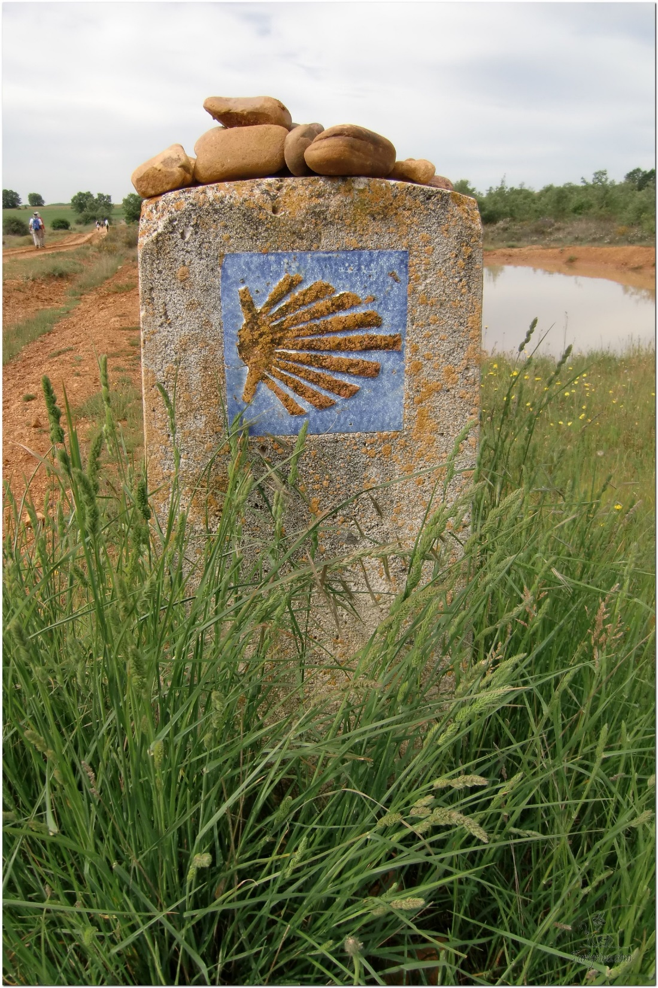
Opening Prayer
The Camino Prayer (adapted)
O God, who brought your servant Abraham out of the land of the Chaldeans, protecting him in his wanderings, who guided the Hebrew people across the desert, we ask that you watch over us, your servants, as we walk in the love of your name.
Be for us our companion on the journey,
Our guide at the crossroads, Our breath in our weariness,
Our protection in danger, our albergue on the Camino,
Our shade in the heat, Our light in the darkness,
Our consolation in our discouragements,
And our strength in our intentions.
So that with your guidance we may arrive safe and sound at the end of the road and enriched with grace and virtue we return safely to our homes filled with joy.
In the name of Jesus Christ our Lord, Amen. Apostle Santiago, pray for us. Santa Maria, pray for us.

Slide 4
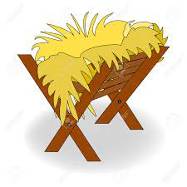
Catholicism in a Hundred Objects
This video is 15 minutes long so watch as much or as little as you like
The Manger

Slide 5
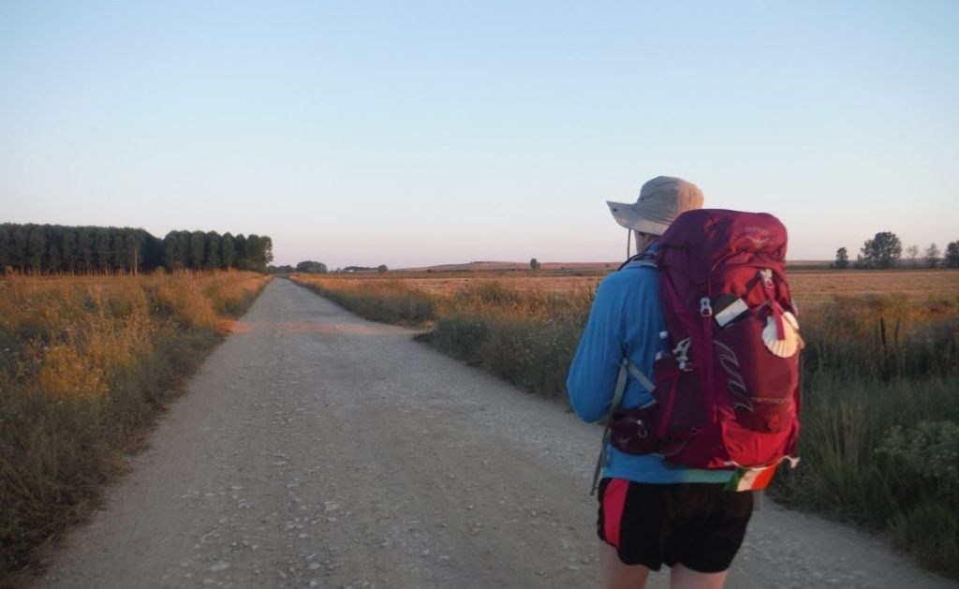
Rucksack Prayer – Part 1

Slide 6
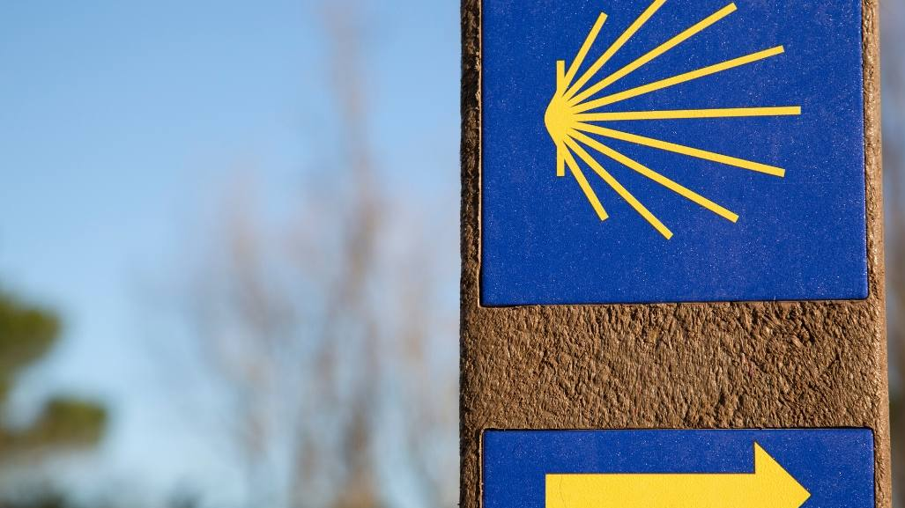
A Journey with Joseph, the shepherds and the Magi…

Slide 7
The Magi visit the Messiah – Matthew 2: 1-12
After Jesus had been born at Bethlehem in Judaea during the reign of King Herod, suddenly some wise men came to Jerusalem from the east.
asking, 'Where is the infant king of the Jews? We saw his star as it rose and have come to do him homage.'
When King Herod heard this he was perturbed, and so was the whole of Jerusalem.
He called together all the chief priests and the scribes of the people, and enquired of them where the Christ was to be born.
They told him, 'At Bethlehem in Judaea, for this is what the prophet wrote:
And you, Bethlehem, in the land of Judah, you are by no means the least among the leaders of Judah, for from you will come a leader who will shepherd my people Israel.'
Then Herod summoned the wise men to see him privately. He asked them the exact date on which the star had appeared
and sent them on to Bethlehem with the words, 'Go and find out all about the child, and when you have found him, let me know, so that I too may go and do him homage.'
Having listened to what the king had to say, they set out. And suddenly the star they had seen rising went forward and halted over the place where the child was.
The sight of the star filled them with delight,
and going into the house they saw the child with his mother Mary, and falling to their knees they did him homage. Then, opening their treasures, they offered him gifts of gold and frankincense and myrrh.
But they were given a warning in a dream not to go back to Herod, and returned to their own country by a different way.

Slide 8
From what you have heard so far…
…what are your Initial thoughts, reactions, questions that come to mind?
We can discuss these later…

Slide 9
Main Input
The Nations shall come to the light of the Lord

Slide 10
Reflection
“As pilgrims of faith, the Wise Men themselves became stars shining in the firmament of history and they show us the way. The saints are God’s true constellations, which light up the nights of this world, serving as our guides. Saint Paul, in his Letter to the Philippians, told his faithful that they must shine like stars in the world.”
Extract from the Homily of His Holiness Benedict XVI

Slide 11
Testimony
Dr Brant Pitre, St Augustine Institute

Slide 12
Catechism of the Catholic Church
430 Jesus means in Hebrew: "God saves." At the annunciation, the angel Gabriel gave him the name Jesus as his proper name, which expresses both his identity and his mission. Since God alone can forgive sins, it is God who, in Jesus his eternal Son made man, "will save his people from their sins". In Jesus, God recapitulates all of his history of salvation on behalf of men.
439 Many Jews and even certain Gentiles who shared their hope recognized in Jesus the fundamental attributes of the messianic "Son of David", promised by God to Israel. Jesus accepted his rightful title of Messiah, though with some reserve because it was understood by some of his contemporaries in too human a sense, as essentially political.
486 The Father's only Son, conceived as man in the womb of the Virgin Mary, is "Christ", that is to say, anointed by the Holy Spirit, from the beginning of his human existence, though the manifestation of this fact takes place only progressively: to the shepherds, to the magi, to John the Baptist, to the disciples. the whole life of Jesus Christ will make manifest "how God anointed Jesus of Nazareth with the Holy Spirit and with power."
528 The Epiphany is the manifestation of Jesus as Messiah of Israel, Son of God and Saviour of the world. The great feast of Epiphany celebrates the adoration of Jesus by the wise men (magi) from the East, together with his baptism in the Jordan and the wedding feast at Cana in Galilee. ²¹² In the magi, representatives of the neighbouring pagan religions, the Gospel sees the first-fruits of the nations, who welcome the good news of salvation through the Incarnation. The magi's coming to Jerusalem in order to pay homage to the king of the Jews shows that they seek in Israel, in the messianic light of the star of David, the one who will be king of the nations. ²¹³ Their coming means that pagans can discover Jesus and worship him as Son of God and Saviour of the world only by turning towards the Jews and receiving from them the messianic promise as contained in the Old Testament. ²¹⁴ The Epiphany shows that "the full number of the nations" now takes its "place in the family of the patriarchs", and acquires Israelitica dignitas ²¹⁵ (is made "worthy of the heritage of Israel").
724 In Mary, the Holy Spirit manifests the Son of the Father, now become the Son of the Virgin. She is the burning bush of the definitive theophany. Filled with the Holy Spirit she makes the Word visible in the humility of his flesh. It is to the poor and the first representatives of the gentiles that she makes him known.

Slide 13
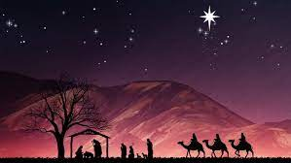
Question
If you were in a nativity, what part did you have. If not, what part would you want to have?

Slide 14
Discussion
What did worshipping Jesus involve for the Magi?
How does this influence your understanding of worship?
Discuss this is two’s & three’s then feedback to the main group

Slide 15
Internet Corner - Where to find out more…
www.catholicdigest.com/faith/spirituality/three-wise-men/
rcdow.org.uk/cardinal/news/the-gifts-of-the-magi/
www.augustineinstitute.org/

Slide 16
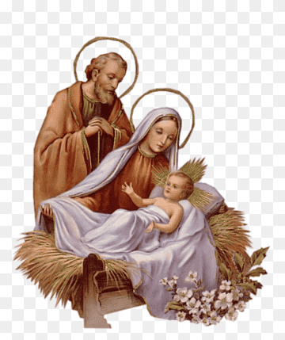
Conversation with Jesus
Focus on this image of Jesus and open your heart to Him now.
Take this opportunity to talk to him in your mind and heart.
Listen and be aware of his presence with you.
You may want to use this hymn to help you pray

Slide 17
Spiritual Journal
You may want to write down what has been important for you during this time together

Slide 18
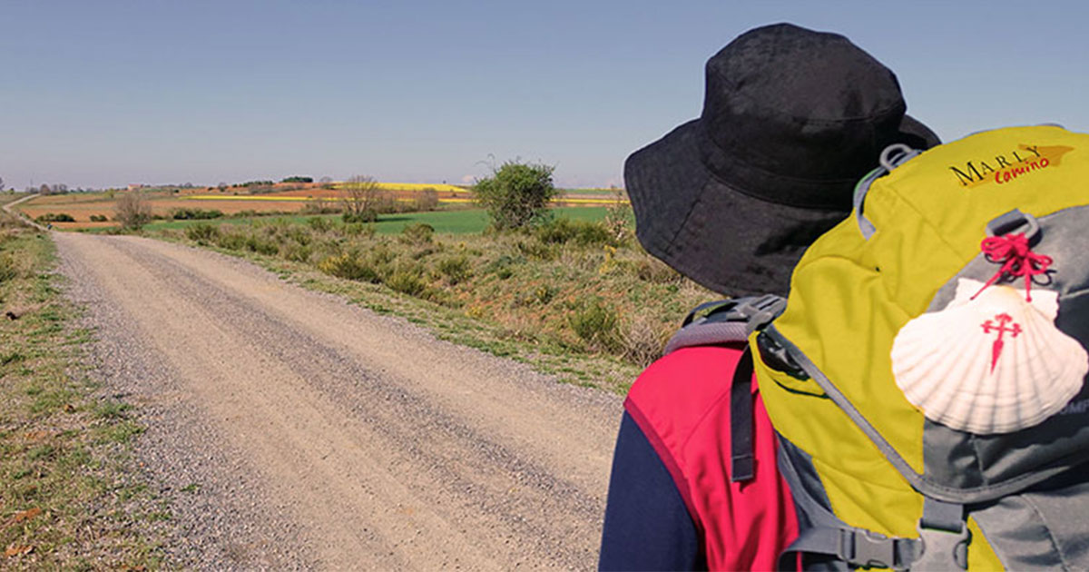
Rucksack Prayer – Part 2

Slide 19
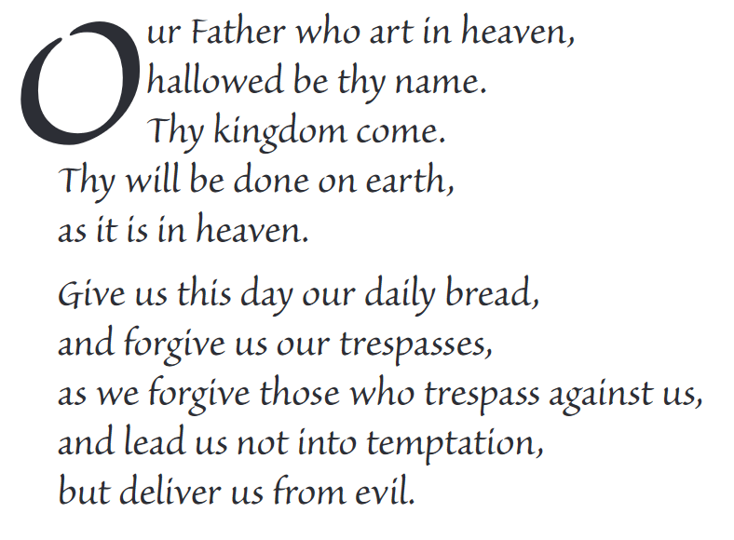
The Lord’s Prayer

Slide 20
Final pilgrim blessing for the week ahead
God of our pilgrimage,
you have given us a desire
to take the questing way
and set out on our journey.
Help us to keep our eyes fixed on Jesus,
that whatever we encounter as we travel,
we may seek to glorify you by the way we live.
You call us, Lord,
to leave familiar things and to leave our “comfort zone”.
May we open our eyes to new experiences,
may we open our ears to hear you speaking to us
and may we open our hearts to your love.
Grant that this time spent on pilgrimage
may help us to see ourselves as we really are
and may we strive to become the people you would have us be. Amen
… continued on next slide

Slide 21
Final pilgrim blessing for the week ahead
Lord, you know our beginning and our end.
Help us to realise we are only pilgrims on this earth
and save us from being too attached to worldly possessions.
May we experience the freedom to wander,
the freedom to hope and the freedom to love as we journey. Amen
Creator God, you are the source of all life and motivation.
May we journey in faith and love, rejoicing and eager to serve you.
Grant us a glimpse of your glory as we seek to follow you –
the Way, the Truth and the Life. Amen
May God the Father who created you, guide your footsteps,
May God the Son who redeemed you, share your journey,
May God the Holy Spirit who sanctifies you, lead you on life’s pilgrimage,
and the blessing of God, Father, Son and Holy Spirit
be with you wherever you may go. Amen.

Slide 22
CAMINO
Making the Journey…
Session 9
Making the journey with St Joseph, the shepherds and the Magi

