Slide 1


Celebrating Gifts & Talents of Children & Young People
St Mary’s Priory, Bamber Bridge, Preston
26th June 2018

Slide 2
www.dioceseofsalford.org.uk/parishes/school-links/
Assembly

Slide 3

Opening Prayer
St Ambrose RC Primary School, Chorlton

Slide 4
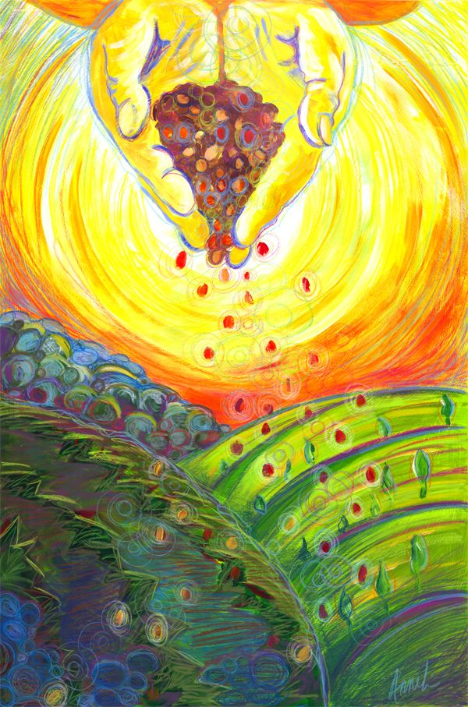

Slide 5

Music Workshop
Debbie Prince

Slide 6
Go Out to the World
Richard Cootes
Go out to the world! Go out to the world!
Go out to the world and proclaim the Good News!
And Know that I am with you
YES, until the end of time.
As you go out to the world and proclaim the Good News.
As you go out to the world and proclaim the Good News.

Slide 7
Our God is Here
Chris Muglia
Here in this time, here in this place,
Here we are standing face to face.
Here in our hearts, here in our lives,
our God is here.
Here for the broken, here for the strong,
Here in this temple we belong.
Here in our hearts, here in our lives,
our God is here. And we cry….

Slide 8
"Holy! Holy! Holy are you!"
and We cry: "Holy! Holy! Holy and true!"
Amen, we do believe our God is here.
Our God is here.

Slide 9







Developing our Parish Communities
7 Steps from School to Parish

Slide 10

Gift Chaplaincy Teams –
Into The Future

Slide 11


Slide 12


Slide 13

Pope Francis

Slide 14
7 Steps into Parish
Each step takes us forward into building up
Our Community

Slide 15
Little steps !
Do one thing well
Then
Move to another step

Slide 16
Today we will seek to discover how to…
Develop the work of our GIFT Chaplaincy teams
Working with our Parish Priest and Catechists
Working with the different parish groups
Discovering new families and friends

Slide 17
Step 1: Linking with the
Parish Community
Christ the King Primary School, Walkden

Slide 18
Step 2: Taking an Active Role
Our Lady of the Rosary Primary School, Davyhulme

Slide 19
You are Holy
Michael W. Smith
I will sing to and worship the King who is worthy
I will love and adore him and I will bow down before him
And I will sing to and worship the King who is worthy
I will love and adore him and I will bow down before him
You’re my Prince of Peace and I will live my life for you

Slide 20
Step 3: Understanding Parish Structures

Slide 21
Understanding the structures of your Parish
Invite the Parish Priest and or the Parish Secretary to explain how the parish is run
Different roles and responsibilities
Mount an exhibition for the Parish in Church
Organise a fun discovery day/BBQ to celebrate all the good work
Invite the leaders of each activity to speak about their work both in school and in the parish
Organise a day in the life of the parish – work shadowing
Mount a careers day in your parish to show all the possibilities of job opportunities
Meet with Bishop John to discuss career pathways and vocations for the diocese.

Slide 22
Step 4: Liturgical Leadership
St Joseph’s Primary School & Thornleigh Salesian College, Bolton

Slide 23
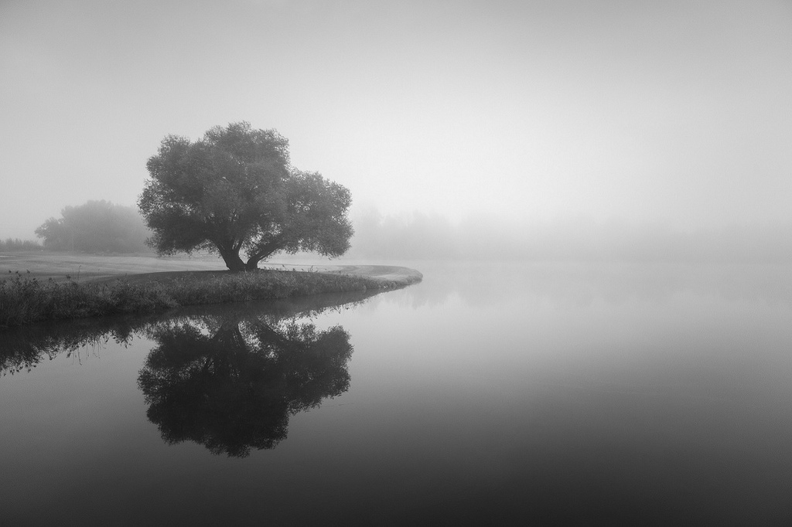
Open our eyes to see

Slide 24
Step 5: Leading Prayer
St Ambrose RC Primary School, Chorlton

Slide 25
Step 6: Fostering Spiritual Growth

Slide 26
Putting our Faith into Action

Slide 27
We have a Hope in Jesus
We have hope in Jesus
We have hope in Jesus
That all things will be well
That all things will be well
That all things will be well
In the Lord

Slide 28

Step 7: Joining the Hope in the Future Team
Fr Chris Gorton

Slide 29

PARISH

Slide 30
SCHOOL

Slide 31
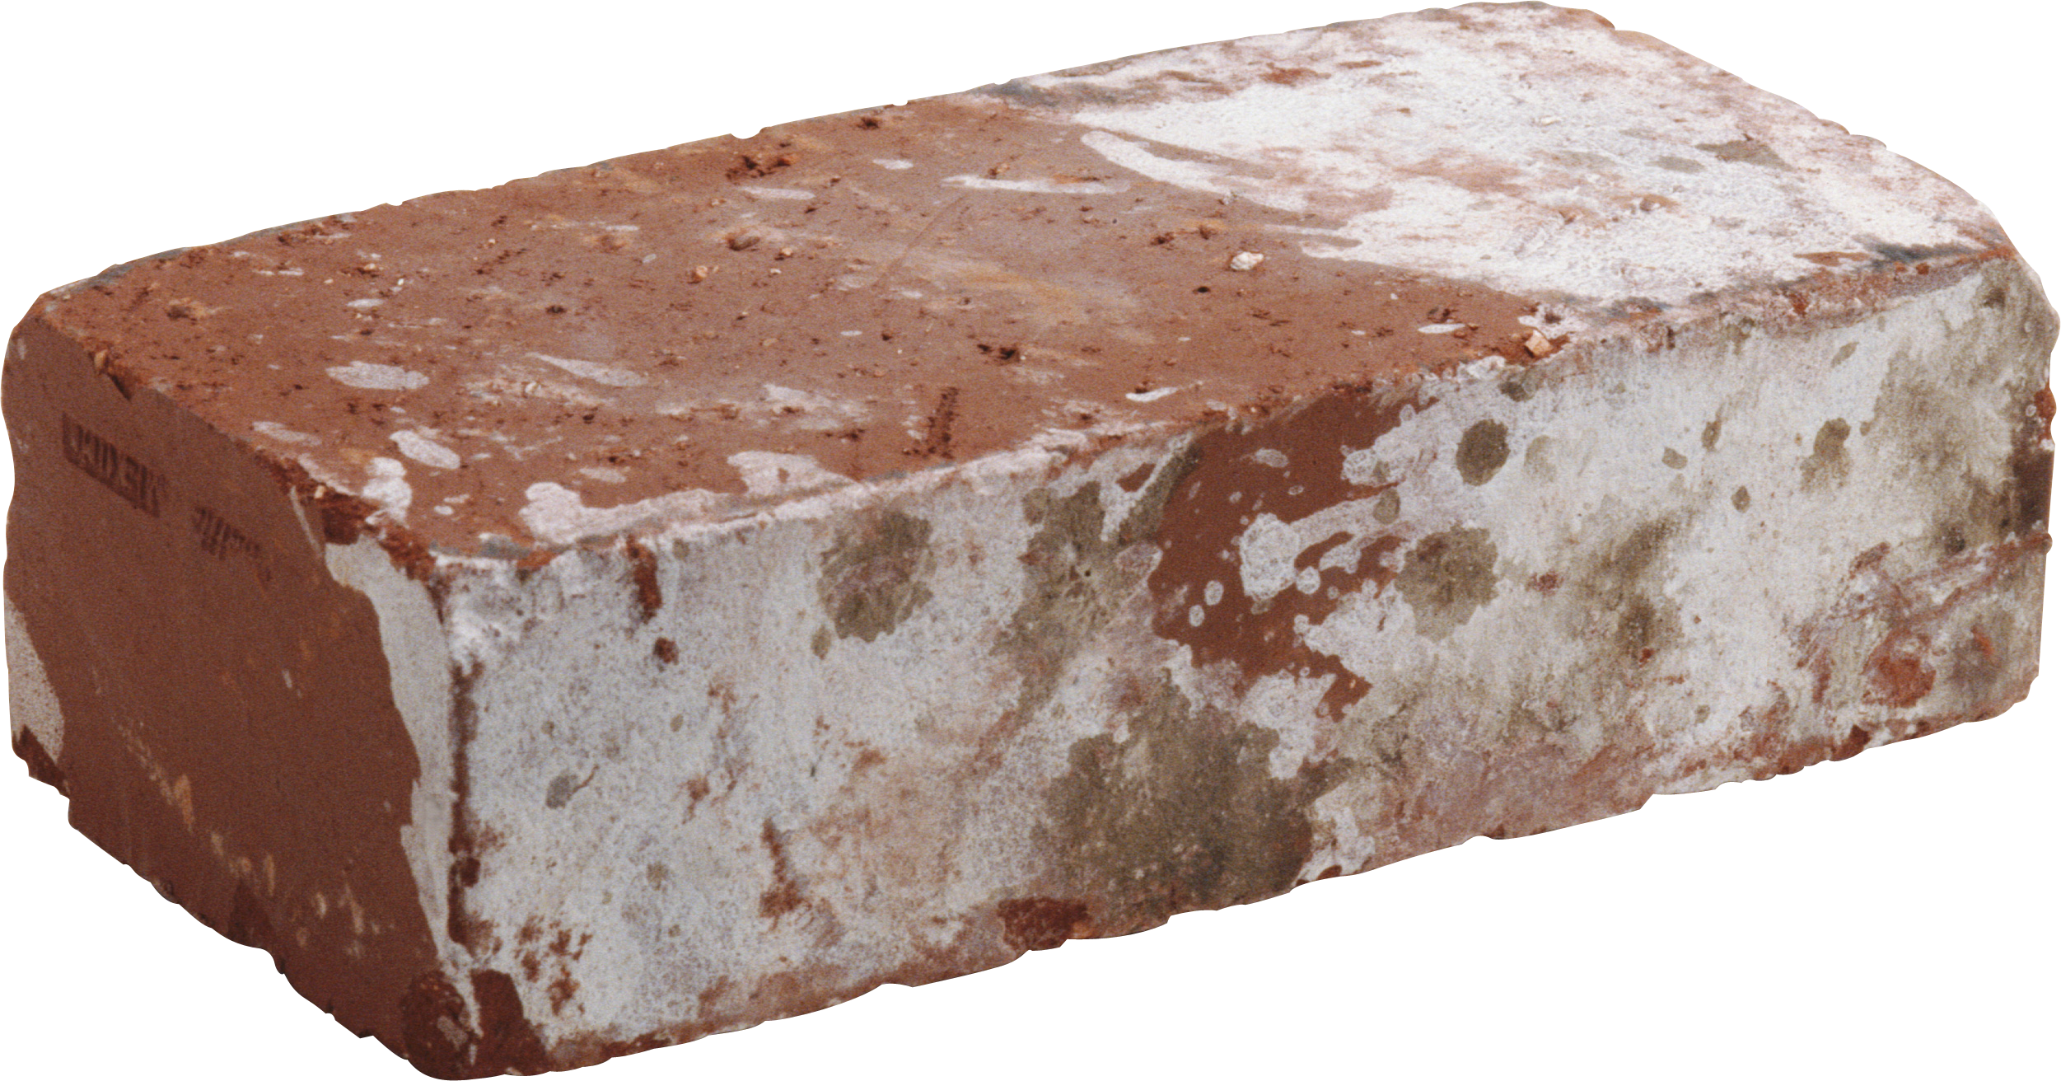

Slide 32
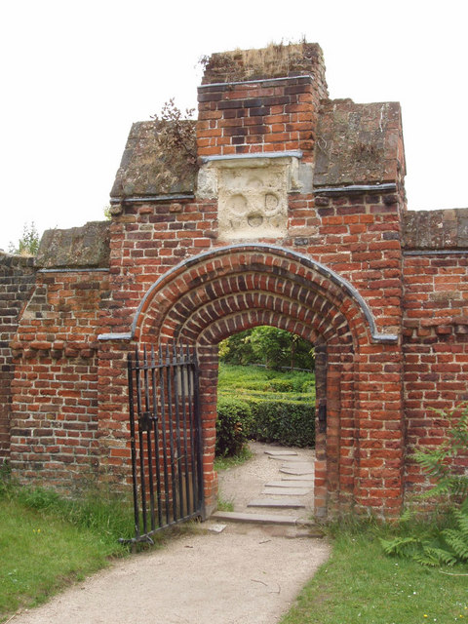
This Photo by Unknown Author is licensed under CC BY

Slide 33
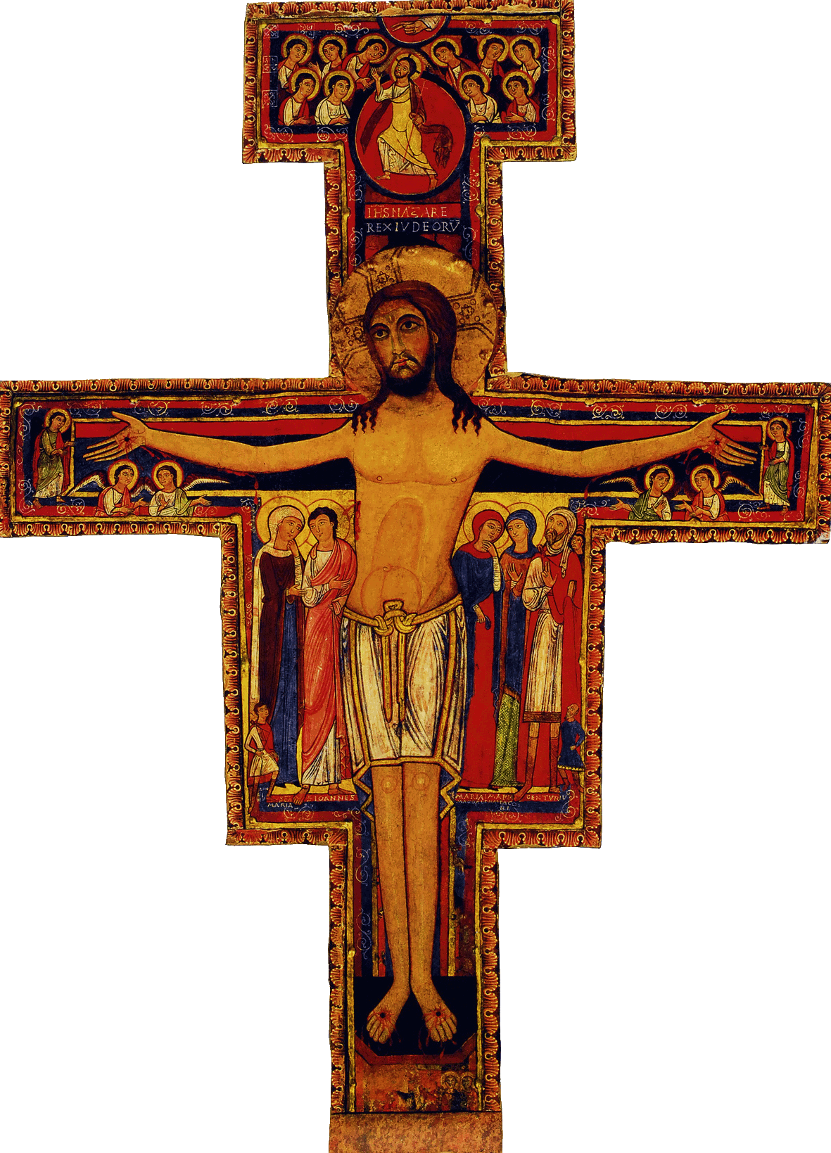
Hope in the Future Hymn
A gift from school to parish
Music and Words by Debbie Prince
Chorus
Holy Spirit Come.
May our hearts be one.

Slide 34
Developing our Parish Communities
7 Steps from School to Parish

Slide 35


Slide 36
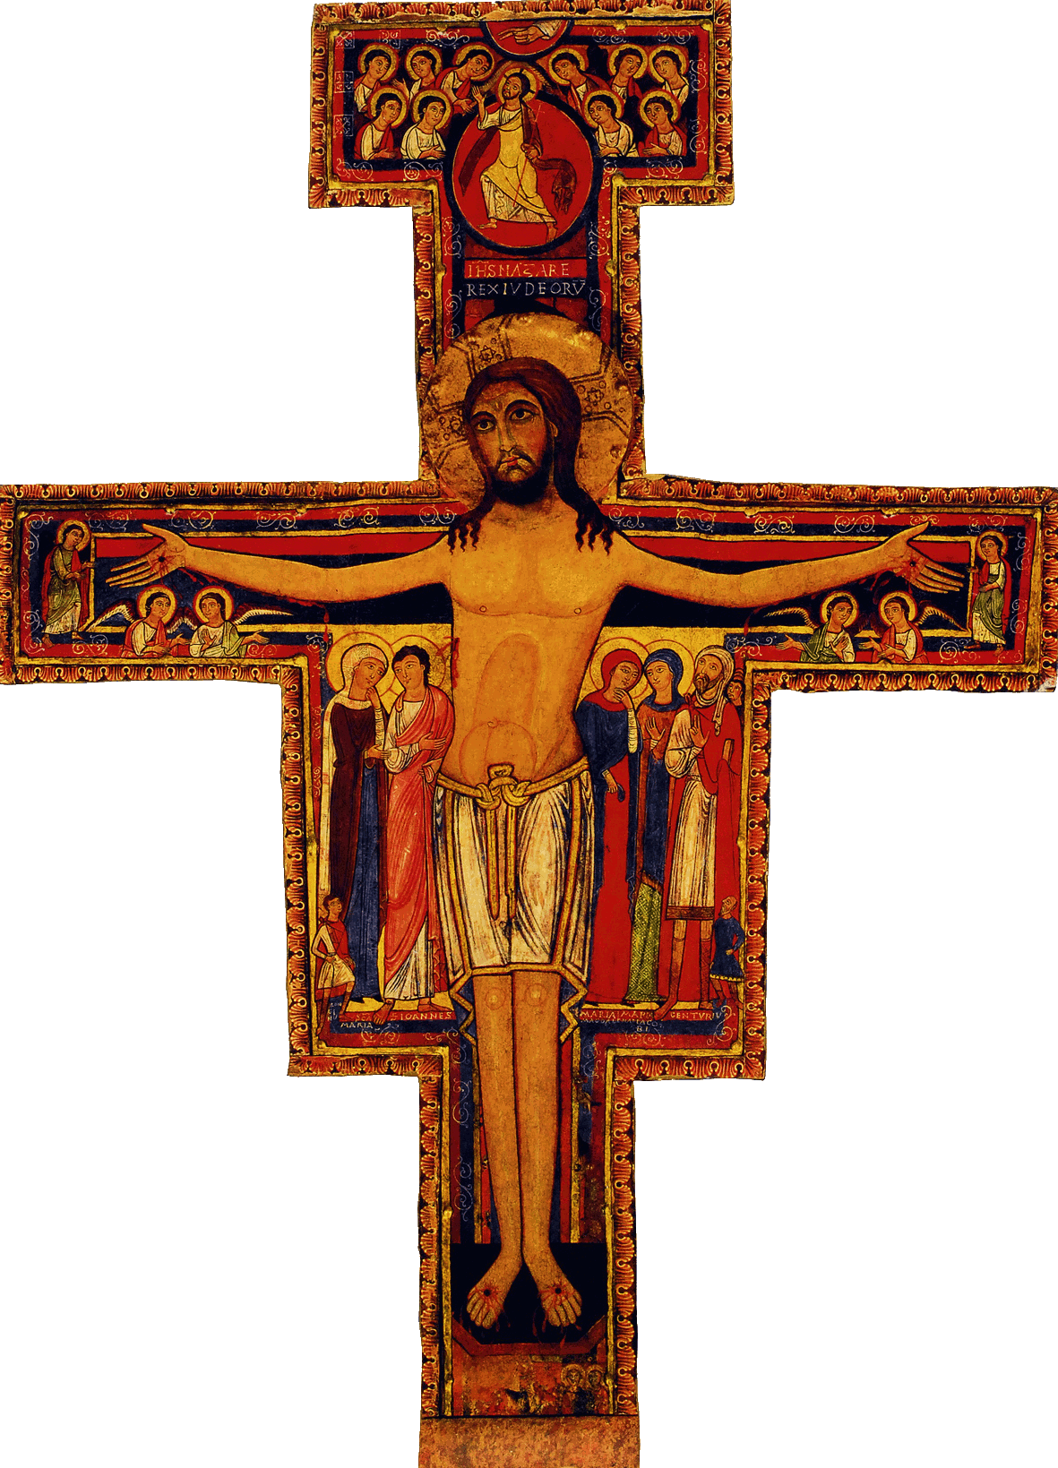

Slide 37
Will You Come and Follow Me
John Bell and Graham Maule
Will you come and follow me
if I but call your name?
Will you go where you don’t know
and never be the same?
Will you let my love be shown,
will you let my name be known,
will you let my life be grown
in you and you in me?

Slide 38
Will you let the blinded see
if I but call your name?
Will you set the prisoners free
and never be the same?
Will you kiss the leper clean
and do such as this unseen,
and admit to what I mean
in you and you in me?

Slide 39
Lord, your summons echoes true
when you but call my name.
Let me turn and follow you
and never be the same.
In your company I’ll go
where your love and footsteps show.
Thus I’ll move and live and grow
in you and you in me.

Slide 40
Knowing You, Jesus
Graham Kendrick
All I once held dear, built my life upon
All this world reveres, and wars to own
All I once thought gain I have counted loss
Spent and worthless now, compared to this
Knowing you, Jesus
Knowing you, there is no greater thing
You're my all, you're the best
You're my joy, my righteousness
And I love you, Lord

Slide 41
Open the Eyes of My Heart
Michael W. Smith
Open the eyes of my heart, Lord
Open the eyes of my heart
I want to see You
I want to see You
To see You high and lifted up
Shining in the light of Your glory
Pour out Your power and love
As we sing holy, holy, holy

Slide 43
Hope in the Future Hymn
Music and Words by Debbie Prince
Show us, lead us, ignite in us a flame
Take us on a journey, help us surrender to your name
And stay with us Lord as we commit to your call
With faith renewed and gratitude.
May your light burn in our souls
And lead us to deep trust in you.

Slide 44
Hope in the Future Hymn
Music and Words by Debbie Prince
Your blessing on us we do seek
Let not our hearts and minds grow weak
Instead, evangelise and speak news of
our glory and salvation
Let is spread to all the nations
Shining out from deep within.
Holy Spirit Come. May our hearts be one.

