Slide 1


Faith in Action Award

Slide 2
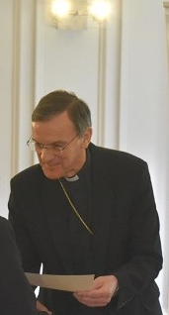
Recognises, rewards and celebrates the active faith and service of
children and young people in their school and parish.

Slide 3


Who is it for?
The Faith in Action Award is for children and young people aged 10-18, Young people undertake the award through their school & parish.
  Schools
  Chaplaincy Teams
  Caritas Ambassadors
  Cafod Group
  Mini Vinnies
  Pupil Leaders
  School Council
  Peer Mentors
  School Choir
  Eco Teams
  Parishes
  Altar Servers
  Readers
  Choir
  Welcomers/Greeters
  Youth Groups

Slide 4




Pin Award: Discovery (20: 10/10)
At this early stage, Children will begin a journey of discovering what it means for faith to be active. (Yr 6) THIS CAN BE DONE AS A WHOLE CLASS
Bronze Award: Service (35: 15/15/5)
Young people at the Bronze Level take the initial steps in responding to their faith, by way of serving others. (Yr 7 onwards)
Silver Award: Leadership (60: 25/25/10)
This level encourages a maturity of faith which is expressed in terms of leadership and initiative. (Yr 8/9 onwards)
Gold Award: Innovation (100: 30/50/20)
The essence of the Gold Award is found in the young people’s desire to develop and establish new ideas in terms of outreach and missionary work on behalf of the Church community.

Slide 5
Pin Award: Discovery
At this early stage, young people will begin a journey of discovering what it means for faith to be active.
20 credits: 10/10 (Each credit is an hour).
Age range: Y6 (age 10-11)
Completed as a group or class
Led by teacher/youth leader/catechist/parish rep.
Examples of service: fundraising; planning an assembly/liturgy; participating in an act of worship, reading at Mass, Altar serving, shoe boxes, leading prayers etc.

Slide 6
Principles of the Award
Faith – Service – Reflection
To celebrate the faith journey of young people. Simple and powerful way of reflecting on active faith
Thank You
Accessible and Inclusive
Raising Aspirations - Acknowledging good work and encouraging young people to do more in particular in the parish/community.
School and Parish base for service.

Slide 7
To Summarise…..
Powerpoint presentation
Registration form
Log hours
Reflection points
Moderator
Award Ceremony

Slide 8
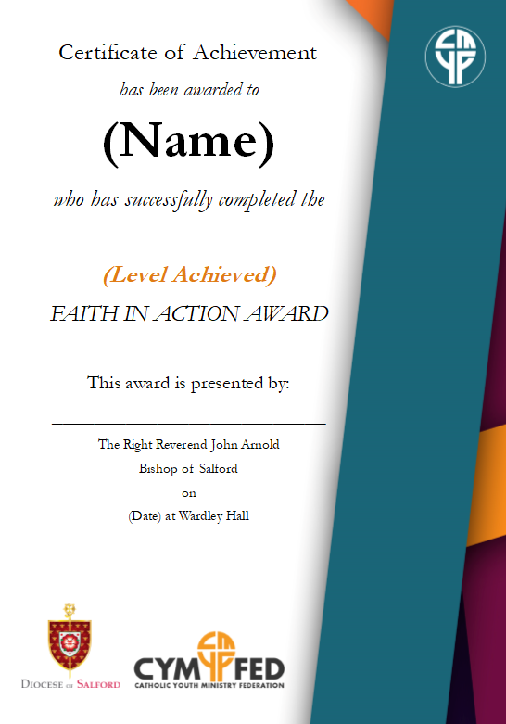
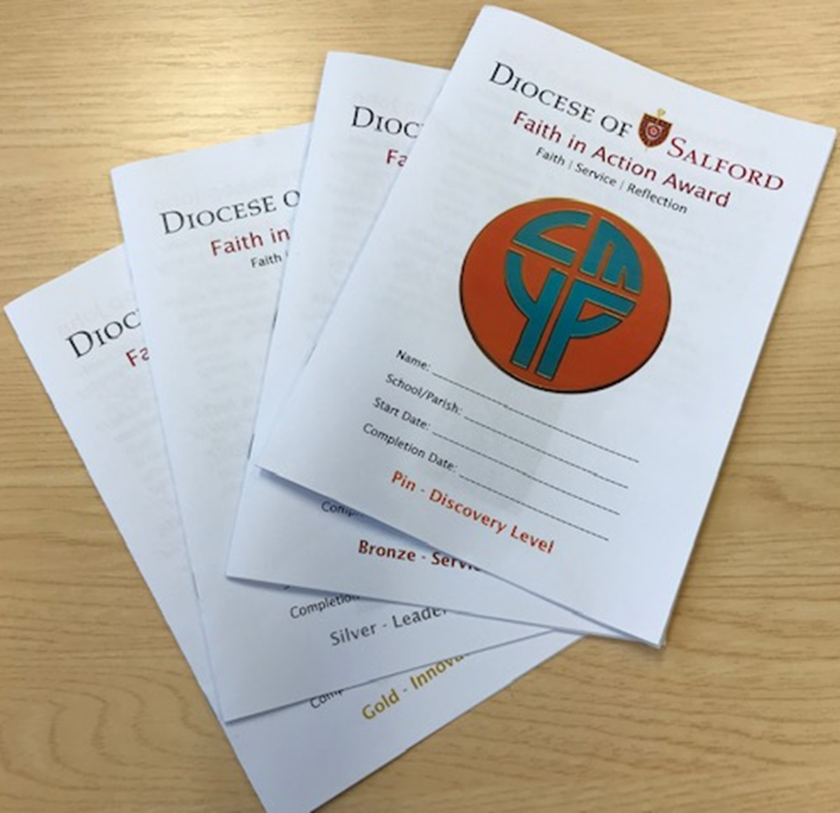
Log Booklets, Badges & Certificates

Slide 9
Frequently Asked Questions
How much does the award cost?
  No cost apart from the badge (£2.50 each)
How long does it take to complete the PIN level?
  It is based on hours and it is just a matter of recording your activities in the log book.
Can a young person achieve all their hours in school?
  We would recommend to do your hours both in the school and parish. HOWEVER, during these challenging times, these hours can be completed in school.
What can I do to achieve the award? www.dioceseofsalford.org.uk/services/youth/faithinaction
How can I register?
E: Lorraine.Leonard@dioceseofsalford.org.uk
Who will deliver the reflection day?
  These are now available on the above website and can be completed within your time scales.
When will the certificate be awarded?
  At this stage, we are looking a school ceremonies. The badges and certificates will be sent to the point of contact at the school directly.

