Slide 1
Notes:
Overview Video of Hope in the Future: Home, School, Parish (8 minutes 34 seconds) - https://www.youtube.com/watch?v=PEnKCICcVFw
This animated video gives an introduction to Hope in the Future, the 5 stages, Bishop John’s vision for Home School Parish partnership and practical ways young people can be Missionary Disciples

Slide 2
Launch Liturgy
October 2021

Slide 3
WELCOME/GATHER
Hope in the Future Anthem
Notes:
As a opening hymn/gathering song you may like to listen to the Hope in the Future anthem embedded into this slide. It is also available on YouTube - https://www.youtube.com/watch?v=axGIyvp2p_I
You may like to process forward your San Damiano Cross and place it at the front.
Sheet music, chords, lyrics and a backing track can all be downloaded here (under resource pack 1) - https://www.dioceseofsalford.org.uk/faith/hope/home-school-parish/

Slide 4
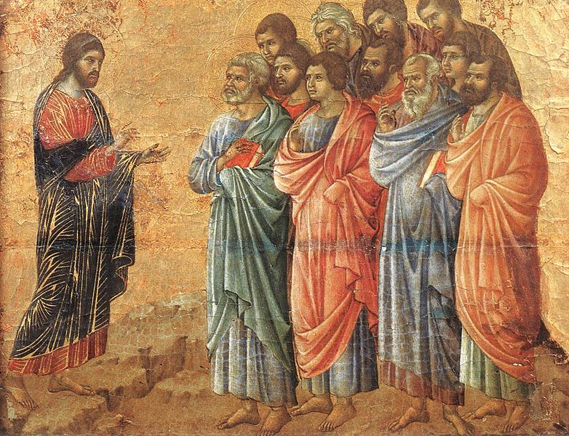
WORD
Scripture - Matthew 28:16-20
A reading from St Matthew’s Gospel
The eleven disciples set out for Galilee, to the mountain where Jesus had arranged to meet them. When they saw him they fell down before him, though some hesitated. Jesus came up and spoke to them.
He said, ‘All authority in heaven and on earth has been given to me. Go, therefore, make disciples of all the nations; baptise them in the name of the Father and of the Son and of the Holy Spirit, and teach them to observe all the commands I gave you. And know that I am with you always; yes, to the end of time.’
The Word of the Lord R/ Thanks be to God

Slide 5
RESPONSE TO THE WORD
The Great Commission
The reading we just heard is known as The Great Commission.
This was the last and most important Mission Jesus gave to His disciples and to us before He ascended back to the Father in Heaven.
Our task as the Church is to help make disciples, baptise people in the name of the Father, Son and Holy Spirit and teach them all that God has taught us through the bible.
We don’t have to do it alone! Jesus promises us He will be with us until the end of time. He sent us the Holy Spirit to equip us for this mission.
Will you accept this mission from Jesus?

Slide 6
WITNESS
How can I be a Missionary Disciple?
There are many ways we can grow in our relationship with God and share Him with others. Here are some suggested ways:
Pray – attend Mass, read scripture, pray a rosary, talk to God.
Learn – find out more about your Faith, watch a Youth Alpha video, read the YOUCAT, read about young saints.
Share – tell your family and friends the difference faith makes in your life.
Serve – Take part in the CYMFED Faith in Action award, support the work of CAFOD, Caritas or other charities and help raise awareness for caring for the environment.
Notes:
For more information visit:
https://www.dioceseofsalford.org.uk/youth/
https://www.dioceseofsalford.org.uk/diocese/environment/
https://www.caritassalford.org.uk/
https://www.dioceseofsalford.org.uk/wp-content/uploads/Alpha-Youth-Alpha.pdf

Slide 7
Prayers of Intercession
Let us pray that we may open our hearts to God's love and awaken us to greater generosity in mission and service.
Lord in your mercy R/ Hear our Prayer
Let us pray for all our Homes, Schools and Parishes, that they may give witness to Christ by lives displaying faith, hope and love.
Lord in your mercy R/ Hear our Prayer

Slide 8
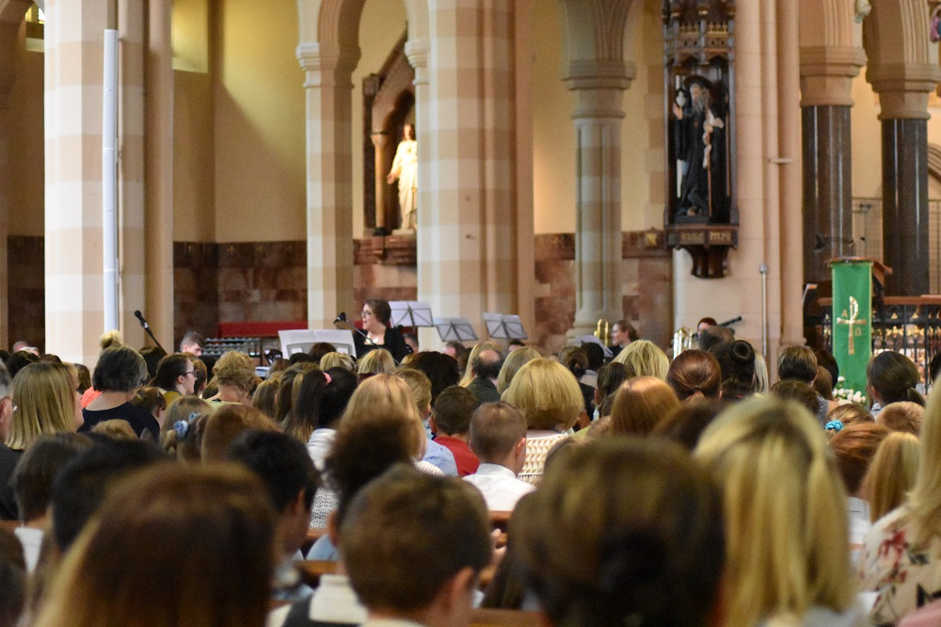
Prayers of Intercession
Let us pray for all of us here today, that we may reach out with compassion and care to those in need.
Lord in your mercy R/ Hear our Prayer
We pray that we may truly be Missionary Disciples. May we be prepared to be outward facing, joyful, courageous ambassadors of Christ bringing his Good News to those around us.
Lord in your mercy R/ Hear our Prayer

Slide 9
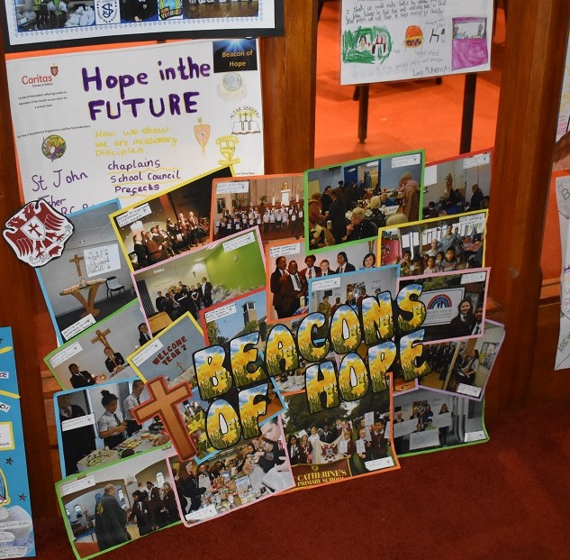
Prayers of Intercession
We offer these prayers and the prayers of all God's people, to the intercession of Mary, Mother of the Church, as we say together,
Hail, Mary, full of grace, the Lord is with thee. Blessed art thou among women and blessed is the fruit of thy womb, Jesus. Holy Mary, Mother of God, pray for us sinners, now and at the hour of our death. Amen.
Stay with us Lord on our Journey.
St Francis of Assisi…Pray for us

Slide 10
Hope in the Future Prayer
God our loving Father, we thank you for blessing our parish and school communities with all that we need to respond to our vocation to be missionary disciples.
We ask you to pour out afresh the gifts of your Spirit upon each one of us, that we may be inspired to serve you in new and creative ways, bringing your light to the world.
We ask your blessing upon us as we journey together in hope through Christ Our Lord, Amen.
Notes:
Prayer cards can be downloaded here - https://www.dioceseofsalford.org.uk/wp-content/uploads/Hope-in-the-Future-Prayer-Card-schools-v2.pdf

Slide 11
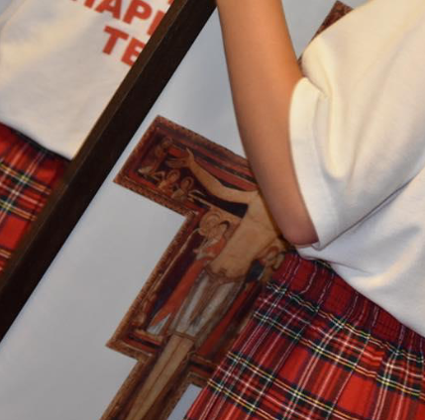
For more information and resources visit:
www.dioceseofsalford.org.uk/faith/hope/home-school-parish/
Notes:
For more information and resources visit:
www.dioceseofsalford.org.uk/faith/hope/home-school-parish/

