Slide 1
Marriage Preparation

Slide 2
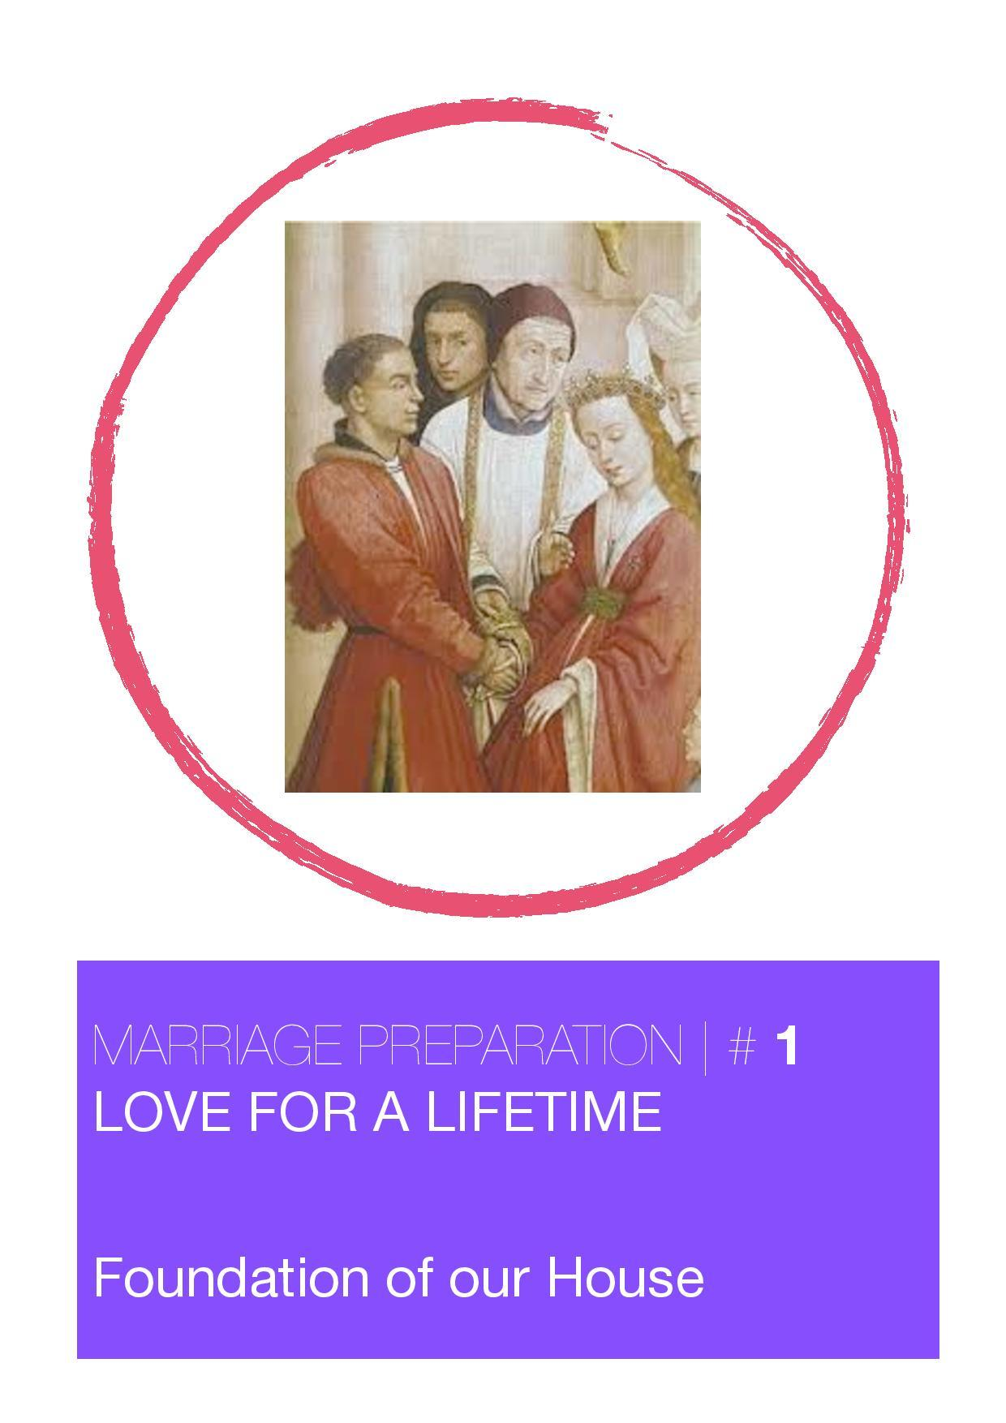

Slide 3
Welcome to...
Love for a Lifetime…
In the Gospel of Luke Jesus compares the wise disciple to
the builder of a house “who dug deeply and laid the
foundation on rock”.The task of marriage is the same. We
want to support each other in building our marriage on a
firm foundation.
Getting married today is something like building a house in
a quake-prone area. We know that there are forces out
there that can pull apart the foundation of any marriage. We
need to know for ourselves, what “materials” we are going
to put into the foundation. They will see us through, even
when we feel as if the ground is shaking beneath you.

Slide 4
“Under Construction”
What am I putting into the foundations of our Marriage?
Are they quality “materials”?
There are twelve gifts listed in your workbook. Choose the
most important three “materials” and share this with your
Fiancé.
Three elements essential to a ‘rock-solid’ foundation for your
marriage:
Communication
Commitment
Complementarity (Vive la Difference!)

Slide 5
Five Love Languages
ONE - Words of Affirmation
We need to be affirmed (this can be written words as well as
spoken ones) to feel built up, complimented and appreciated.
TWO - Quality Time
Making time to give your future spouse undivided attention. 20
minutes of listening, talking and sharing feelings will really show
love to your fiancé.
THREE - Receiving Gifts
Giving is a real symbol of love. Gifts don’t have to be expensive but
do need to be thoughtful. Please be very careful with this one. It is
possible to give gifts as a way of making ourselves feel better
because we aren’t spending enough time with our future spouse.

Slide 6
Five Love Languages
FOUR - Acts of Service
Endeavouring to please our fiancé by doing things that we might
not normally choose to do like washing up or cleaning the car.
FIVE -Physical Touch
Is a very important means by which we can express love. A hug or
a touch can really show we care. Remember touch can be
assumed to be linked to the desire for sex, but it doesn’t have to
be

Slide 7
Five Love Languages
Which do you think your two most important love languages are?
Which do you think your partner’s top most important love
languages are?

Slide 8
Dear Lord Jesus,
grant that we may have a true and understanding love for
each other.
Grant that we may both be filled with faith and trust.
Please give us the grace to live with each other in peace
and harmony,
and may we always bear with one another’s weaknesses
and grow from each other’s strengths.
Help us, Lord,
to forgive one another’s failings
and grant us patience, cheerfulness
and the spirit of placing
the well-being of one another before our own.
May the love that brought us together grow and mature
with each passing day and may it bring us both ever closer
to you through our love for each other.
In our Covenant of Marriage,
let our love grow to perfection. Amen.

Slide 9
Five Love Languages
Which do you think your two most important love languages are?
Which do you think your partner’s top most important love
languages are?

Slide 10
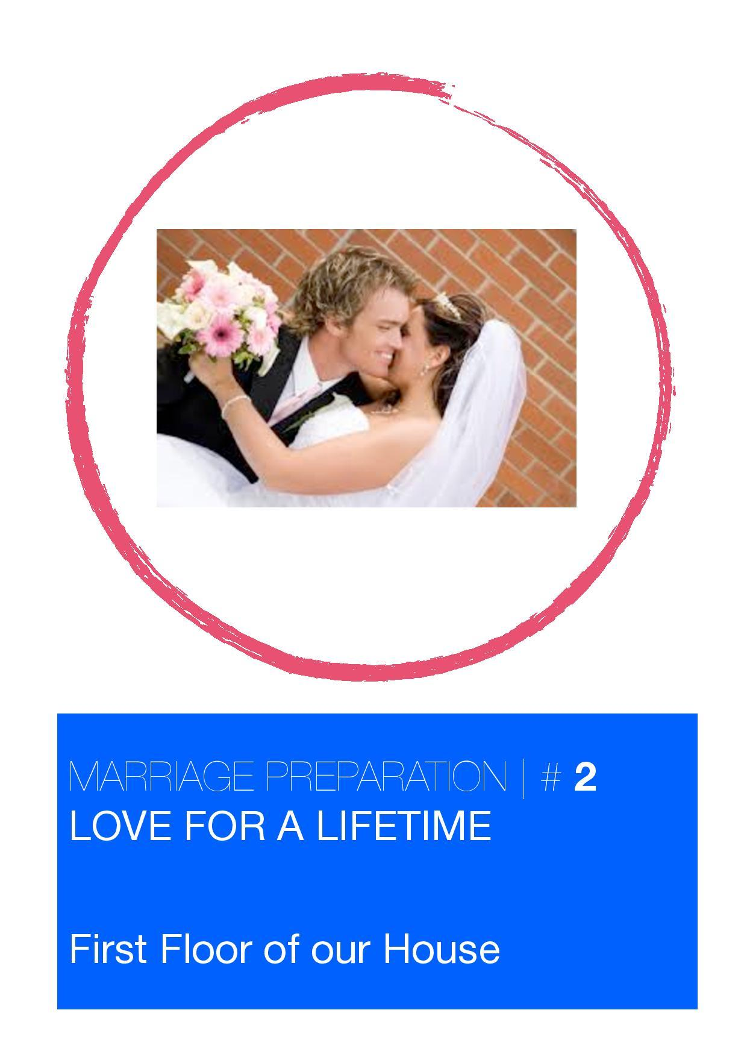

Slide 11
Love for a Lifetime
First Floor of our House
Experience of Home
As you strive to create this new identity as a married couple
you need to know who you are and how you have been
formed by your own families of origin. Look at the activity in
your workbook and take time to fill in your response and
compare with your fiancé

Slide 12
Family of Origin
When two people marry they bring together two distinct
personalities, ways of thinking and acting, expectations
about negotiating emotional closeness, and styles of
resolving conflict. Many of these factors are a result of our
experiences at home with our own families. The task of a
newly married couple is to blend and integrate these many
factors into a style that they can call their own.
A Wedding of Stories
Becoming married is a wedding of many stories. The legacy
from our families of origin is kept alive by many stories.
They are the foundation for our future.

Slide 13
Reflecting Together
What is there about your family of origin that you want to be
sure to include in the new family you are forming?
What is there about your family of origin that you would not
like to continue in your new family?
“My Invisible Suitcase”
Please write your answers to the following questions in your
workbook

Slide 14
Family Rituals
What are “Family Rituals”?
Family Rituals are those family routines, the consistent and
predictable ways of behaving, that give special meaning to
couples and families.
Rituals are a highly condensed expression of family
feelings, thoughts and values. Family rituals range from
‘family celebrations” (celebration days, religious days, rites
of passage)
to less formal, less culturally defined “family traditions”
(birthdays, holidays, visits to extended family),
to the most individually defined and consciously
constructed “family interactions” (bedtime or mealtime
routines).

Slide 15
Family Rituals
Reflecting Together…
What are your memories of family rituals?
What were your family celebrations and family traditions?
How did your family members interact?
What would you like to take with you into your marriage and home?

Slide 16
Dear Lord Jesus,
grant that we may have a true
and understanding love for each other.
Grant that we may both
be filled with faith and trust.
Please give us the grace
to live with each other in peace and harmony,
and may we always bear
with one another’s weaknesses
and grow from each other’s strengths.
Help us, Lord,
to forgive one another’s failings
and grant us patience, cheerfulness
and the spirit of placing
the well-being of one another before our own.
May the love that brought us together grow and mature
with each passing day and may it bring us both ever closer
to you through our love for each other.
In our Covenant of Marriage,
let our love grow to perfection. Amen.

Slide 17
Dear Lord Jesus,
grant that we may have a true
and understanding love for each other.
Grant that we may both
be filled with faith and trust.
Please give us the grace
to live with each other in peace and harmony,
and may we always bear
with one another’s weaknesses
and grow from each other’s strengths.
Help us, Lord,
to forgive one another’s failings
and grant us patience, cheerfulness
and the spirit of placing
the well-being of one another before our own.
May the love that brought us together grow and mature
with each passing day and may it bring us both ever closer
to you through our love for each other.
In our Covenant of Marriage,
let our love grow to perfection. Amen.

Slide 18
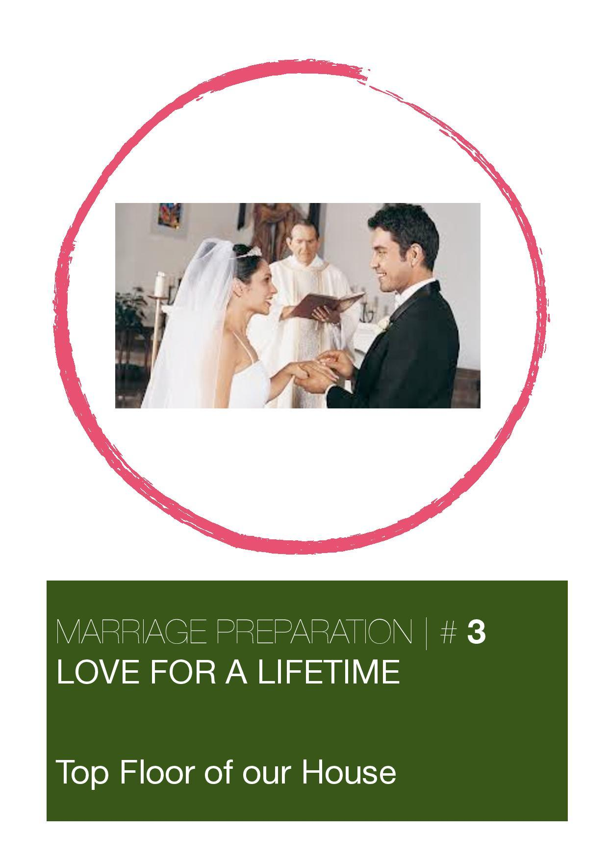

Slide 19
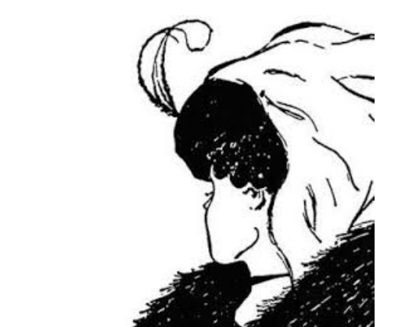
Top Floor of Our House Shared Vision
What do you see? Share with your partner

Slide 20
Top Floor of Our House Shared Vision
Twenty Questions
In the game in your workbook find out how much you know
about what is going on in your partner’s life. Choose ten
numbers each . Find out how many you get right?

Slide 21
Top Floor of Our House Shared Vision
The notion of ‘Love Maps’ is about measuring how much
time and effort do I give to know what is going on in my
partner’s life. How much is their life ‘on my mind’?
Twenty Questions
In the game in your workbook find out how much you know
about what is going on in your partner’s life. Choose ten
numbers each . Find out how many you get right.

Slide 22
Top Floor of Our House Shared Vision
Faith in Marriage
How important is Faith to me and to you?
Look at the ‘Religious Values’ in your workbook.
If you have a response which is two categories different
from your Fiancée, then that is a small indication that you
should talk about this further.

Slide 23
Top Floor of Our House Shared Vision
Created for Love – ‘Gospel of the Body’
On the Foundation level we talked about the languages of
Love. St John Paul II talked about our bodies being a
language which tell the story of God’s plan of love. When
we consider marriage as the gift of husband and wife to
each other we have a deeper understanding of our own
bodies. The spousal meaning of our bodies becomes a
‘gospel’ revealing God’s vision and plan for creation. We are
created for love.

Slide 24
Top Floor of Our House Shared Vision
Love
In order for people to love one another properly, they
must first desire what is good for the other person.
Authentic love is not self-seeking, it is always self-
giving. In other words Christian love defined:
Giving versus using.
Love as attraction: recognising the good, the mystery, the
uniqueness of another person; seeing the inner and outer
beauty of another person.

Slide 25
Top Floor of Our House Shared Vision
Love
Love as desire: wanting this good for yourself, to be made
whole, to be made complete; desiring goodness and
happiness.
Love as goodwill: wanting the good and well-being of
another person before your own.

Slide 26
Top Floor of Our House Shared Vision
Prayer for one another
Dear Lord Jesus, grant that we may have a true and
understanding love for each other. Grant that we may both
be filled with faith and trust. Please give us the grace to live
with each other in peace and harmony, and may we always
bear with one another’s weaknesses and grow from each
other’s strengths.
Help us, Lord, to forgive one another’s failings and grant us
patience, cheerfulness and the spirit of placing the well-
being of one another before our own.
May the love that brought us together grow and mature
with each passing day and may it bring us both ever closer
to you through our love for each other. In our Covenant of
Marriage, let our love grow to perfection. Amen..

Slide 27
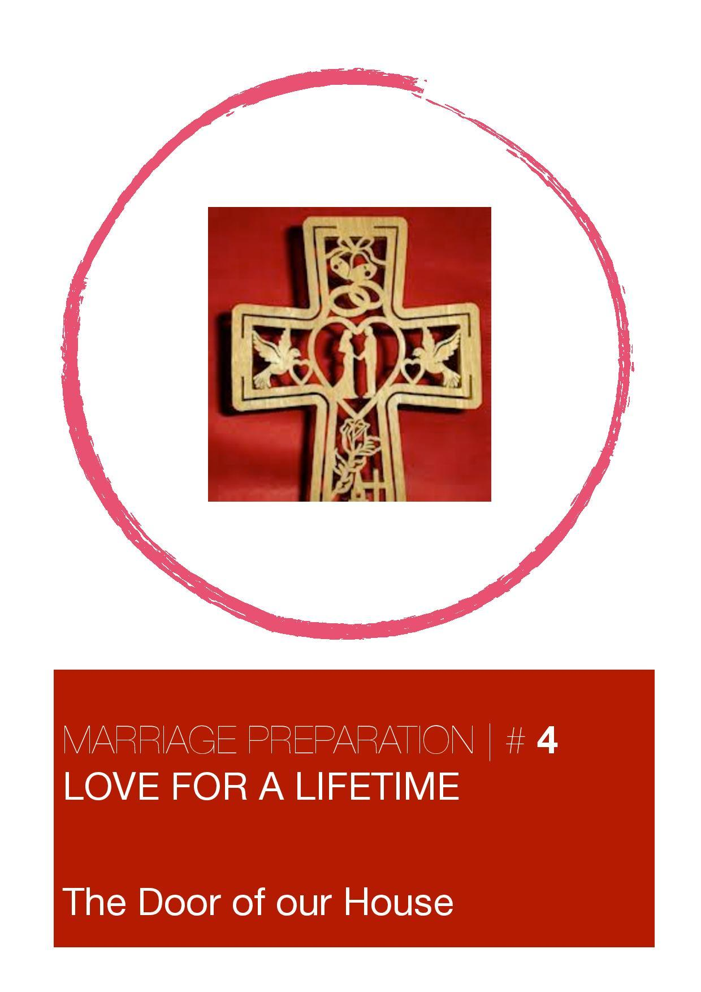

Slide 28
The Door of our House - Sacrament of Marriage
God is behind our Love
God has entered our lives in a new way. We have found our
partner and our future husband or wife. Through this our
relationship to God has changed.
God is the Third Person in our Covenant
God wants us to be together. This gives our love a Divine Light,
a Divine Strength, a Divine Nearness, God is the Third Person,
the Third Partner in our Marriage
Our Marriage Sacrament
God created us for love. We have an endless source of love
within us. Knowing that God’s love carries and strengthens us
is the meaning and aim of the Sacrament of Marriage.

Slide 29
The Door of our House - Sacrament of Marriage
Planning your Wedding
Some things are planned in the long term. Many things are
actual on the days running up to your wedding
Some important things to think about:
What kind of Service?
There are two kinds of service in the Catholic Church.
One is a ‘Wedding service with Nuptial Mass’.
The other is a ‘Wedding Service without Mass’
Sacrament of Reconciliation
A beautiful way to prepare for your Wedding Day is to go to confession.

Slide 30
The Door of our House - Sacrament of Marriage
Readers
There will be readings from the scriptures. You might like to ask some of your guests to read for you. You can discuss with the priest marrying you what readings you would like
Witnesses
You must choose to adults to witness your wedding by signing the register. They don’t have to be Catholics
Music and Flowers
Your choice of music can transform the ceremony, A gift of the beauty of flowers can highlight the day.

Slide 31
The Door of our House - Sacrament of Marriage
Photography
The taking of photos and video recordings needs to be discussed with your priest beforehand.
Register of Marriages, and Donations
Go to your Registrar Office, up to twelve months before your Wedding, not less than fifteen days - Application for a Wedding Certificate
Donations
Catholic Churches usually do not have “fees” for a Wedding.
However, a donation for the Church is always welcome

Slide 32
The Door of our House - Sacrament of Marriage
A Shared Blessing
Priest:
In the name of the Father, and of the Son +, and of the
Holy Spirit. Amen.
Father in heaven, we come before you tonight to ask for
your Blessing. We ask you to bless in your love all the
couples that are going to be married soon. Keep all
harm away from them and may they always know how
close you are to them in this time of preparation. We
thank you for our Preparation Meetings together and
for the thoughts and experiences we could share. Bless
us all now and bless those who we carry in our own
hearts. We ask this through Christ our Lord.
All:
Amen.
Speaker:
These are words that give us strength and confidence:
“Love is always patient and kind. It is never jealous;
love is never boastful or conceited; it is never rude or
selfish; it does not take offence, and is not resentful.
Love takes no pleasure in other people’s sins, but
delights in the truth; it is always ready to excuse, to
trust, to hope and to endure whatever comes.”

Slide 33
The Door of our House - Sacrament of Marriage
A Shared Blessing
Couples pray together:
I rejoice that I have chosen you in the Sacrament of Marriage…
I rejoice that you have chosen me…
Together we belong for always…
Accept me as I am…
with my limitations and my talents... with my hopes and with
my future... Wherever you go, I will go
where you live, I will live…
Together we will build the House of our Marriage... A House
built on the Rock of Jesus Christ...
(Blessing of the Couples)
Priest:
God, Eternal Father, bless and consecrate these couples in
their love for each other. May the Preparations for their
Wedding Day be blessed and filled with peace and joy. Draw
them always closer to you and protect them from any troubles
or worries. We ask you this through Christ our Lord. Amen.
And may Almighty God bless you in the Name of the Father,
and of the Son + and of the Holy Spirit. Amen.

