Slide 1
Diocese of Salford
Achievement and impact in RE
Creative ways forward
Lat Blaylock, RE Today
Spiritual, thoughtful and creative RE for every pupil
A day to stimulate your own RE work

Slide 2
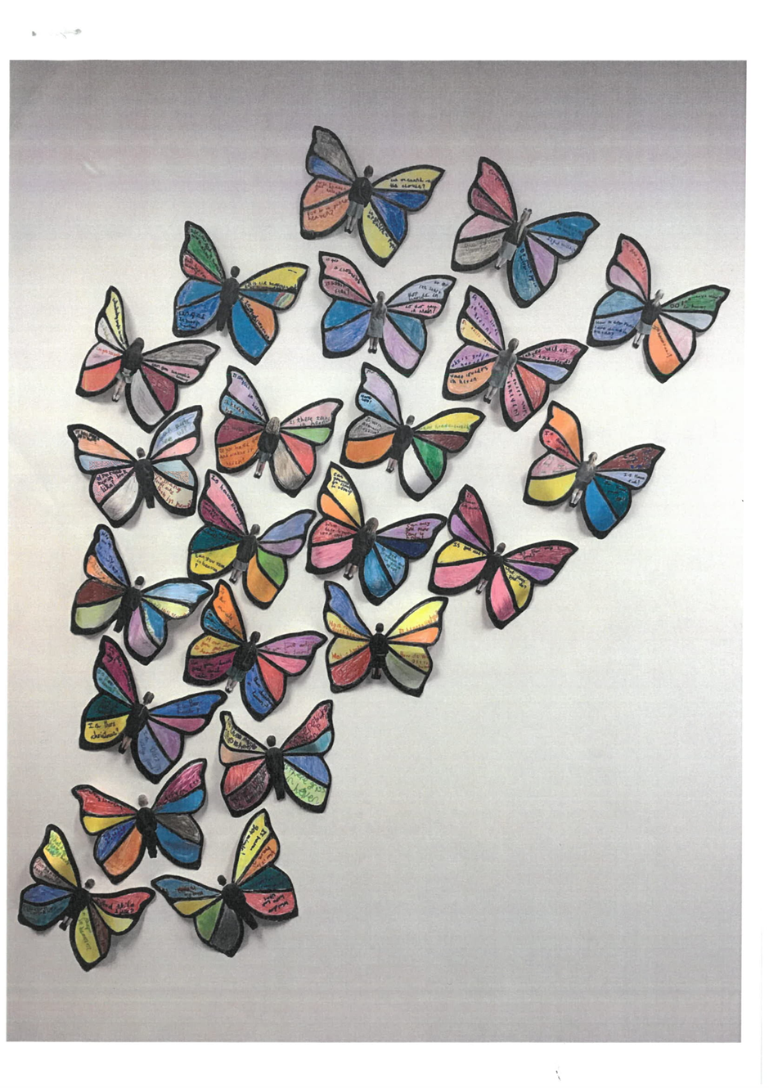
Class Entry Year 2 Art in Heaven. Berwick St Mary's First School Butterflies
Teacher: “Things that are mysteries or are puzzles can be within what we know and beyond, so we chose wings to show this. We started to ask questions about heaven and beyond the world we know. For our artwork we made ourselves as butterflies with our questions on each part of the wing.”
Pupils: (7YOs)
“We went outside to inspire us to ask questions about God's creation”
“We saw a butterfly and decided their wings reminded us of angels going up to heaven.”
“Doing this work made me think about God. God is in this world but also looks after people or animals in heaven.”
“We talked about the mystery of heaven. Some people in our class have lost someone who is no longer with us.”

Slide 3
Saint Paul wrote, in the Bible:
“A person’s body has more than one part. It has many parts. ¹⁵ The foot might say, “I am not a hand. So I am not part of the body.” But saying this would not stop the foot from being a part of the body. ¹⁶ The ear might say, “I am not an eye. So I am not part of the body.” But saying this would not make the ear stop being a part of the body. ¹⁷ If the whole body were an eye, the body would not be able to hear. If the whole body were an ear, the body would not be able to smell anything…
Truly God put the parts in the body as he wanted them. He made a place for each one of them. ²⁰ And so there are many parts, but only one body.
The eye cannot say to the hand, “I don’t need you!” And the head cannot say to the foot, “I don’t need you!” ²² No! Those parts of the body that seem to be weaker are really very important… God wanted the different parts to care the same for each other. ²⁶ If one part of the body suffers, then all the other parts suffer with it.
²⁷ All of you together are the body of Christ. Each one of you is a part of that body.”
1 Corinthians 12

Slide 4
Team church
Team A: Here’s the church... Build a cardboard box church. Provide the children with a huge box, and tell them it is going to be turned into a church. Talk a lot before this starts! | Team B: Here’s the steeple... A Tower and a bell This team are also going to do some big scale box modelling. Get them to look at some pictures of a church tower or spire, and tell them their challenge is to make one
Team C: Lego furniture Talk to this team about the things they find inside church. There might need to be an altar for the sacrament, and a font to welcome new babies, some images and statues of saints or of the Blessed Virgin Mary | Team D: Making Windows from stories of Jesus Give the team members an outline on paper of a blank church window, and tell them that we are making some windows for our class’s team built church. Ask what pictures
Team E: Open the door and here’s all the people Tell this team that their challenge is to create the congregation for the church. | Team F: All around the church Ask this team to decide how the whole model church can be put into a churchyard or garden.

Slide 5
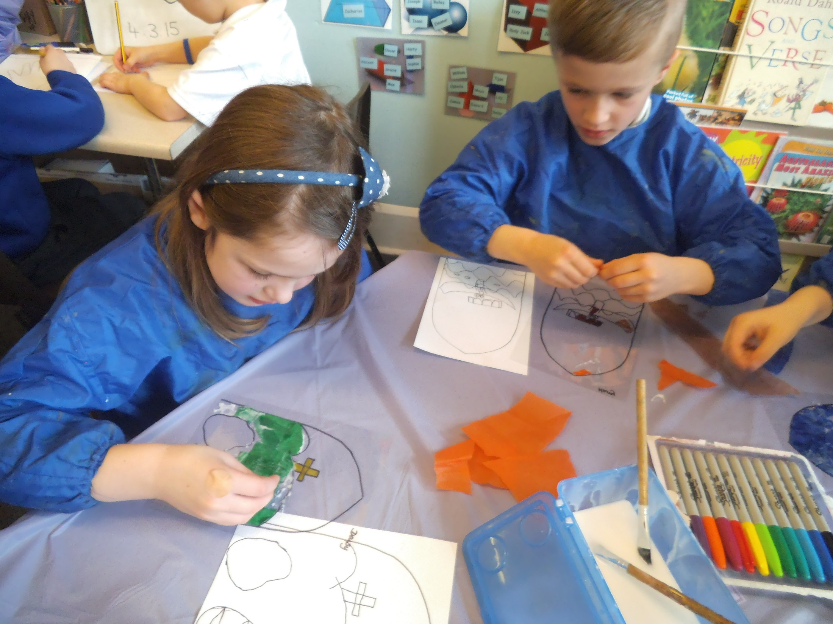
Worth taking time and trouble with the stained glass pictures.

Slide 6
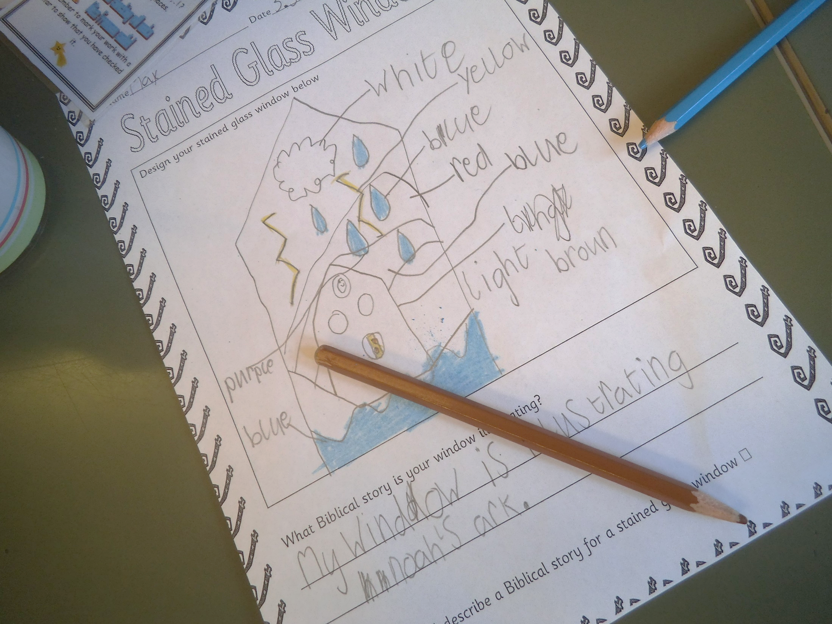

Slide 7
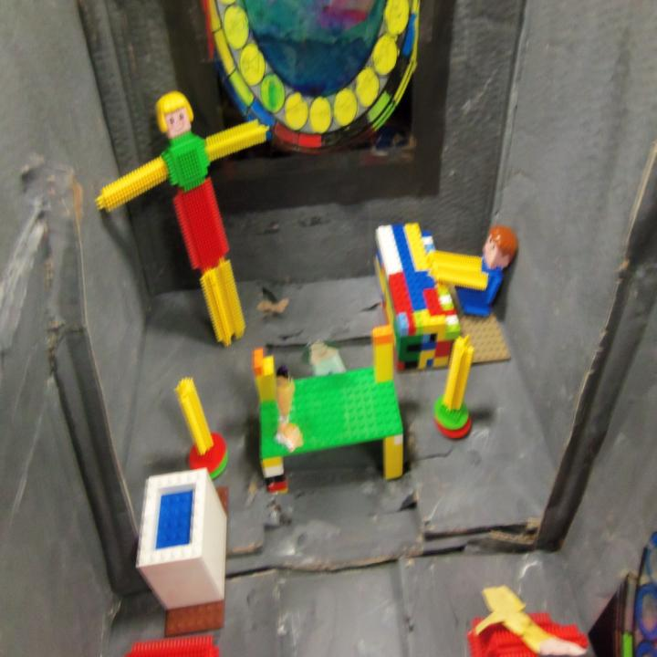
Here you can see an acetate stained glass window, a stickle brick crucifix, two candles, an altar, font and organ. What will it look like if you move the camera up a bit?
Notes:
Children might learn some key words: altar, font, church, crucifix, stained glass, and use these in their work.

Slide 8
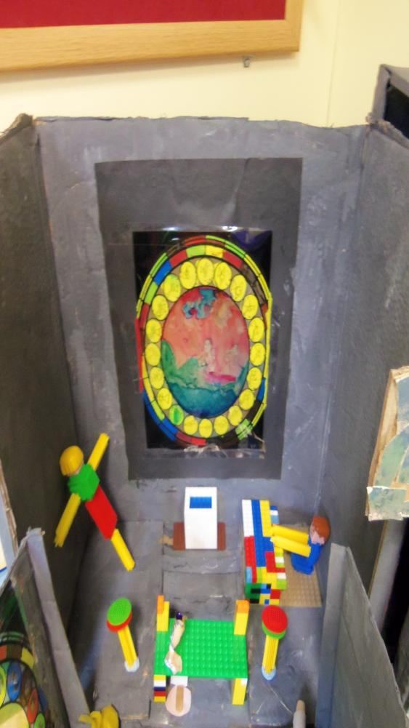
The stained glass window was done with sharpie pens. It works better to do the windows on plain paper, then photocopy them onto acetate.
Imagine what you see when you turn around and look down the church.
Notes:
You might give your pupils a particular story to illustrate in their stained glass pictures: the Lost Sheep, or Jesus Birth?

Slide 9
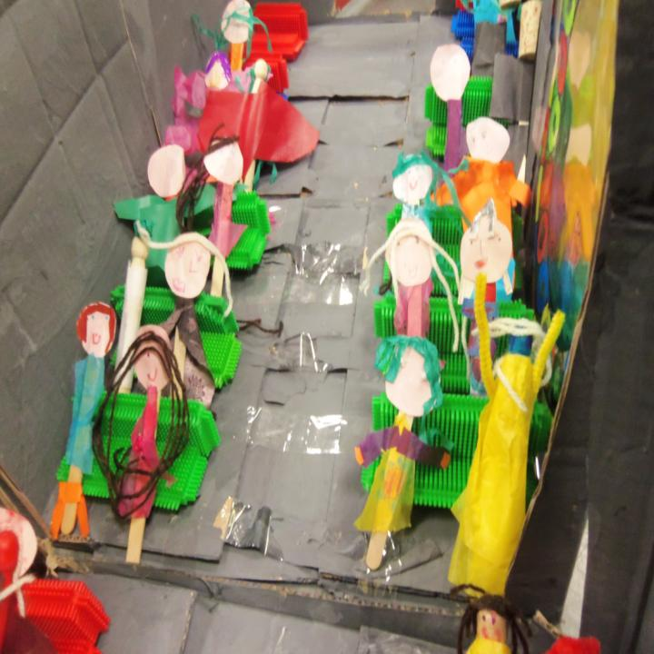
“Open the doors and here’s all the people”
What will it look like if you move the camera back to see the whole church?
Notes:
These little people were made from lolly sticks dressed in tissue, with individual cardboard faces. The team made nearly twenty of them.

Slide 10
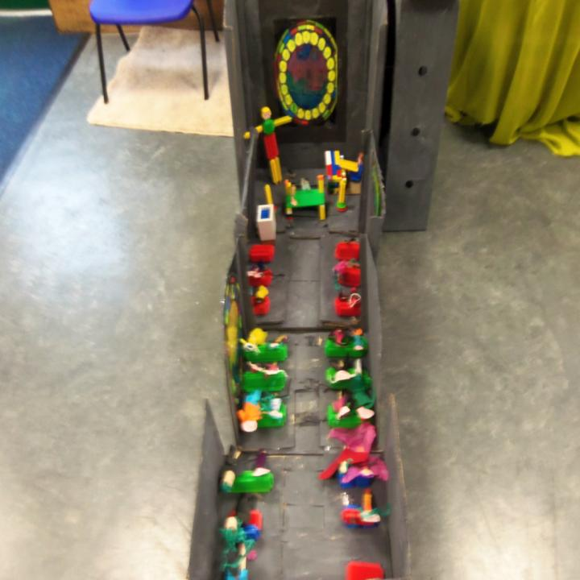
The tower building team did a fine job.
Can children write about their work, using, for example, labels, lists and captions?
Notes:
This class did not have a team to make a church yard – a big piece of green cloth is a good start, but a walk in the school grounds for twigs to be trees and stones to be rocks is good.

Slide 11
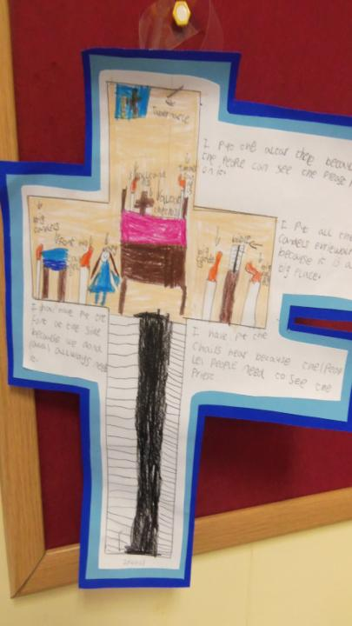
Julie got her pupils to make a plan of the church and draw some of the things they had learned about in their plan.
Some pupils wrote about the drawings as well.
Notes:
This follow up work linked well to literacy objectives and cemented the learning effectively.

Slide 12
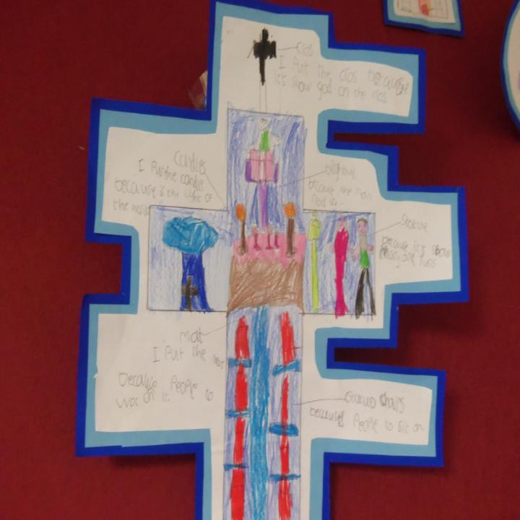
It’s good thinking and creative energy that makes this team task into good RE
I put the cross because I saw Jesus or God on the cross
I put a candle because Jesus is the light of the world
Notes:
This child is beginning to make sense of the symbols of the church.

Slide 13
Get each team to share its work with the others.
Tell children that the Bible compares the church to a body, where the hands do one thing and the feet another, the tummy matters and so does the tongue.
Tell the children that their teamwork is like the church itself, in one way. Christians believe God is pleased when we all co-operate, when we all do our bit.
Ask the children to make up some prayers or meditations, and to practice a song for the ‘opening’ of the church, and have a little ceremony.
Can some of your writers make a poster inviting people to come?
Ask children to take and use photos of the teams working to show how the church is built. Link community and activity together as a way to learn what it means to belong to the church.

Slide 14
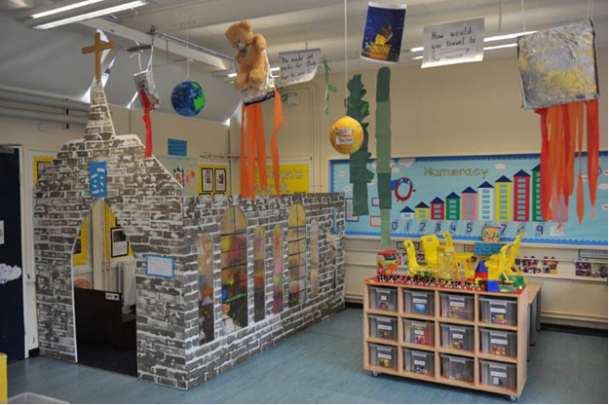
Hallsville School in Newham used similar ideas with the Reception class, creating a church in their classroom for children to play inside.
What do you think the inside looks like?

Slide 15
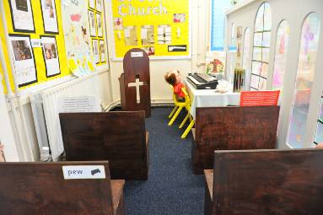
Lots of work for the TA here, but lots of experiential and fun learning for the 4-5 year olds.
What if you adapted the ideas for older pupils?

Slide 16
Team Church for 7-11s
Older pupils might try…
Designing and making two faith community buildings, from different religions, and considering similarities and differences. They could invite the 4-6 year olds to come and see their work
Developing ideas for a ‘shared sacred space’ – e.g. a chapel for an airport, hospital, prison or shopping centre: how could this be made to work for Christians, Jews, Muslims and Hindus? What about non-religious people?
Notes:
Making this task more thoughtful is the focus of these ideas: it is RE, not just design or technology.

Slide 17
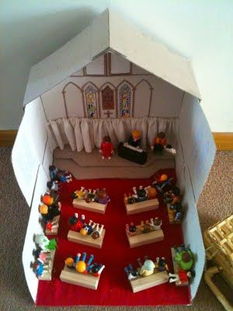

Slide 18
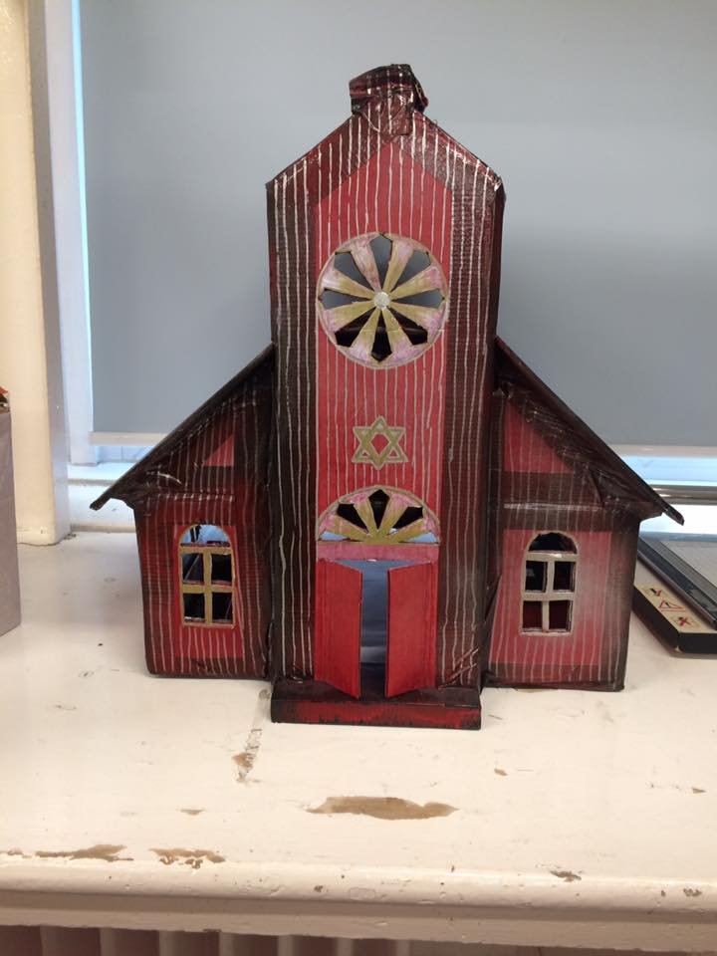
Ruth Wajchendler teaches Year 4. One of her pupils made this box model synagogue.

Slide 19
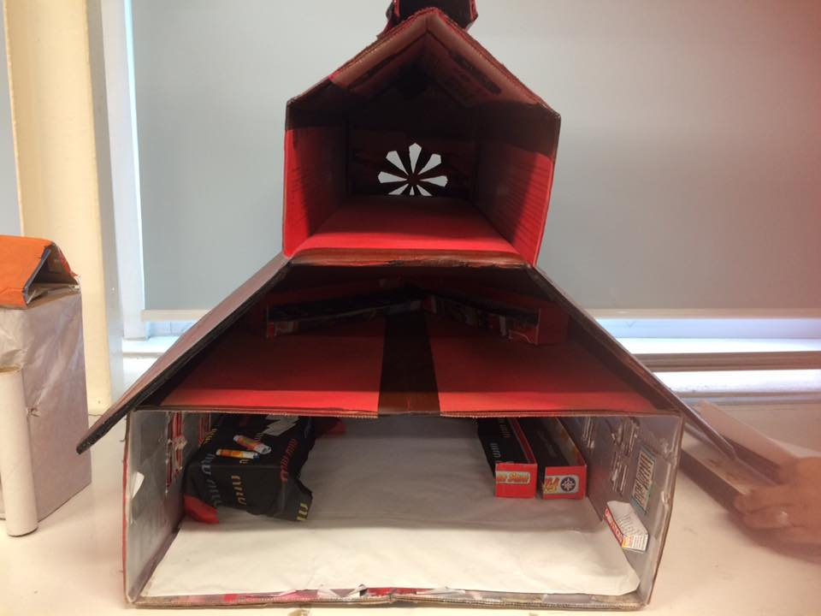
See the use of Jewish symbols and the synagogue interior with ark, scrolls, two seating areas and the bimah (if you look carefully).

Slide 21
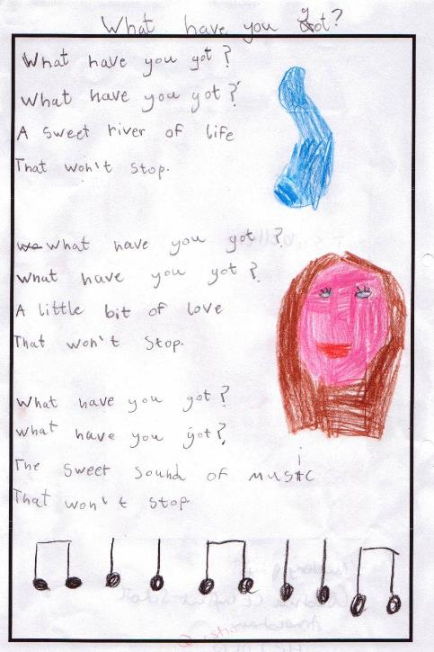
Spirited Poetry
Deep ideas
Big thoughts
Expressed views

Slide 22
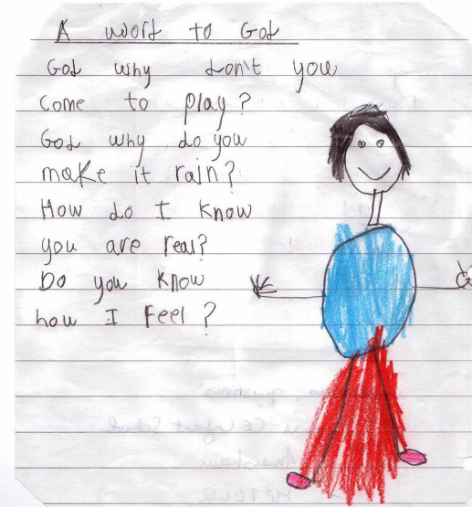
God rhymes
Taylor Richardson, Age 7
Where is God?
God is in the flowers
Using his powers
Where is God?
God is in the cloud
Watching
Feeling proud
Where is God?
God is in the sun
Warming everyone
Where is God?
God is in the ground
Hearing every sound

Slide 23
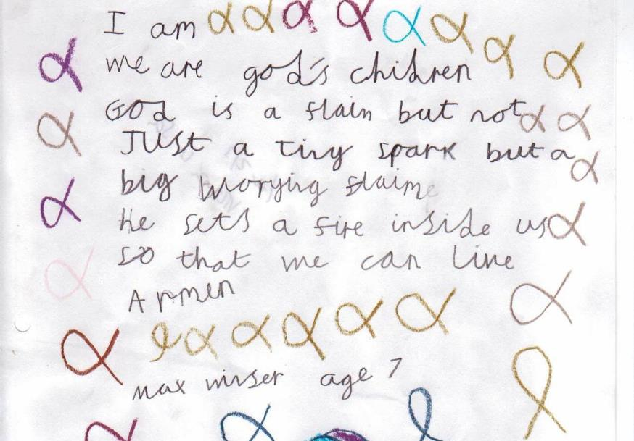

Slide 24
Jill Merlini, 7,
Boxgrove Primary School
God is a runner
and a racer and fast.
God is a swimmer,
fast and not last.
God is in heaven
and air with the sky.
God is someone
who seems to fly.
God is overhanging
like a willow tree.
So if it rains
he is a shelter for me.
Where is God?
Elizabeth Thompson, Age 9
Where is God?
He’s everywhere all around, in the air.
In the meow of a cat
And in the picnic spot where you sat.
He’s in the sun which comes out every day
And in your voice when you say come and play.
He’s in the highest mountain
And the smallest crumb.
He’s in the good deeds of everyone.
He’s in your heart and in your soul,
He’s with you when you score that great goal.
Where is God?
He’s easily found, just look around.

Slide 25
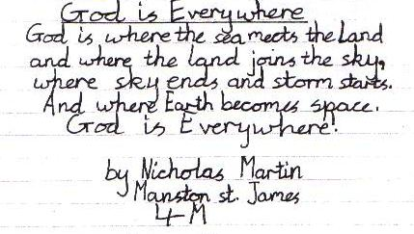
Nicholas is 8

Slide 26
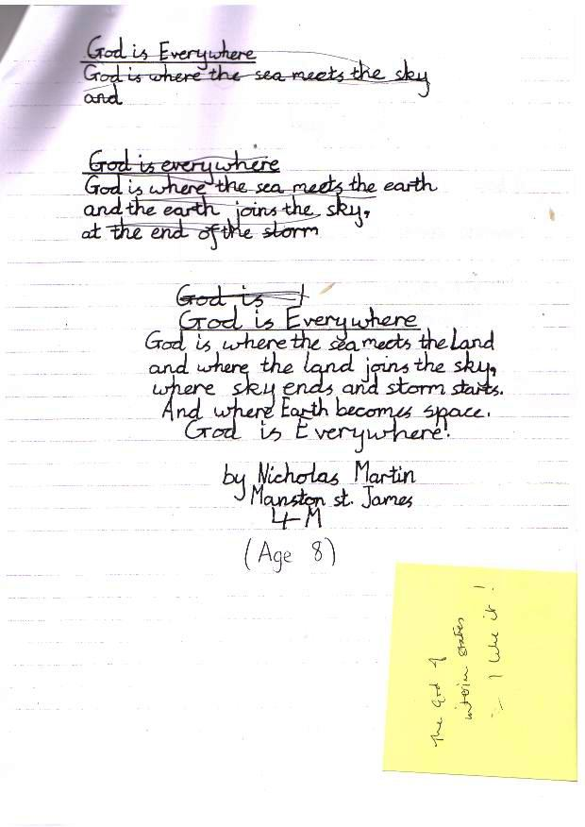

Slide 27
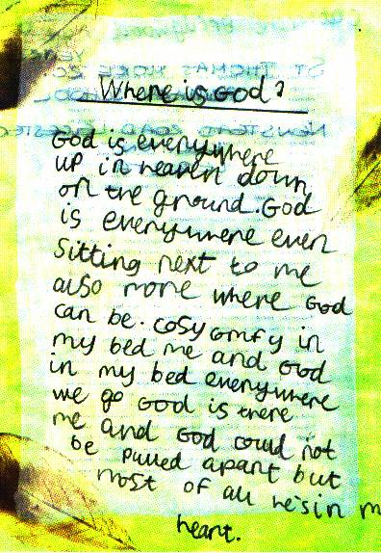

Slide 28
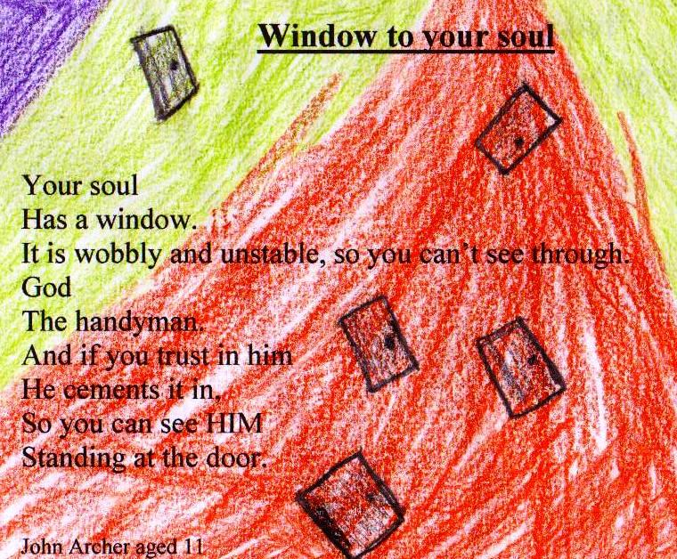

Slide 29
Take six poems...
Arrange them in age order and read them together
What do you like about them? (I hope you like them)
What do the older children typically do?
What do the younger children typically do?
What do these poems show about progression in children’s thinking about fait hand belief?

Slide 30
Is God like any of these things in any way? Think carefully!
Puzzle
Tree
Shadow
Torch
Parent
Notes:
The key ideas here: Is God like a tree, a puzzle, a shadow, a parent, a torchlight? Again, give the pupils a short time for perhaps paired talk and answers, but move along fairly smartly. It may be good to have a TA record the ideas they come up with.

Slide 31
Talking about God: What is God like?
Some Christian ideas
Tell the children that Christians believe God does lots of different things. Can they make some suggestions about what they think God does (some may say ‘nothing’)? Can the class make a list of ten or more ideas?
Using a poem to learn what Christians think God does.
Tell the children that Christians believe God has lots of different roles. Use the ‘kenning’ poem on the next slide to start this work. Read it to the pupils, and ask them what or who they think it is about. The poem actually has two three line stanzas each about God the Father, Jesus and the Holy Spirit, so it is a simple way to help children think about Christian ideas about God.
Put the lines of the poem on the whiteboard or make a big copy on some cards to use in circle time.
Ask the pupils if they can see why each line is something to do with what Christians say about God. Any lines they don’t understand? Maybe someone else in the class can explain? Maybe the teacher can?
Ask the children to take one line (i.e. 2 words!) of the poem each, and draw a picture to show what it means. If two children do a picture for each of the lines, then a class book could be made of the results.
Notes:
Use this sequence of lessons as part of the St Albans Unit for Year 1 or 2 called ‘Talking About God’. This could for an introduction to the unit.

Slide 32
Who?
Time starter
Space maker
Earth shaper
Mud modeller
Garden planter
Fruit grower
Stable sleeper
Miracle maker
Eye opener
Cross carrier
Devil crusher
Grave buster
Promise keeper
Hand holder
Heart warmer
Cheerer upper
Energy booster
Life giver
Notes:
This poem, in the form of a ‘kenning’ is usable alongside literacy activities, where they are connected to list poems or to ‘patterns on the page. The poem uses two verses to say things which Christians believe about God the Father, two verses about Jesus and two about the Holy Spirit. Children who understand this poem will know a lot about Christian beliefs about God. It is quite fun to chant the poem: in circle time set up a rhythm by clapping their hands on their legs. The teacher then says each line of the poem and the pupils all reply together, in the rhythm. This will familiarise them with the language.

Slide 33
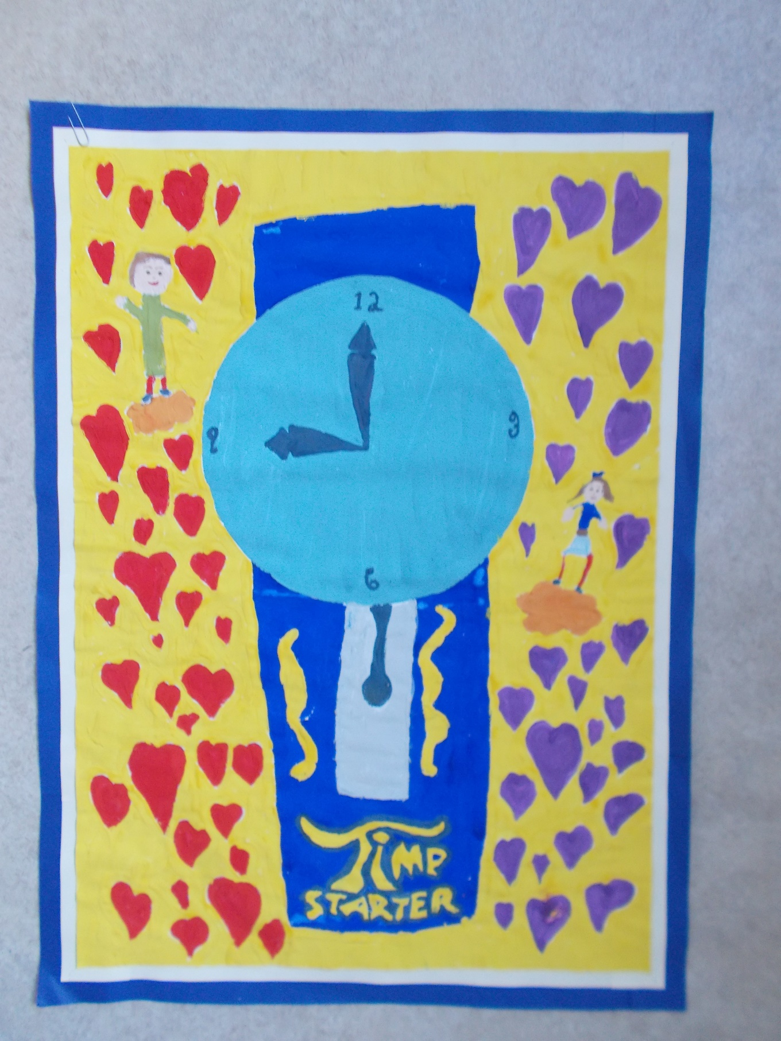
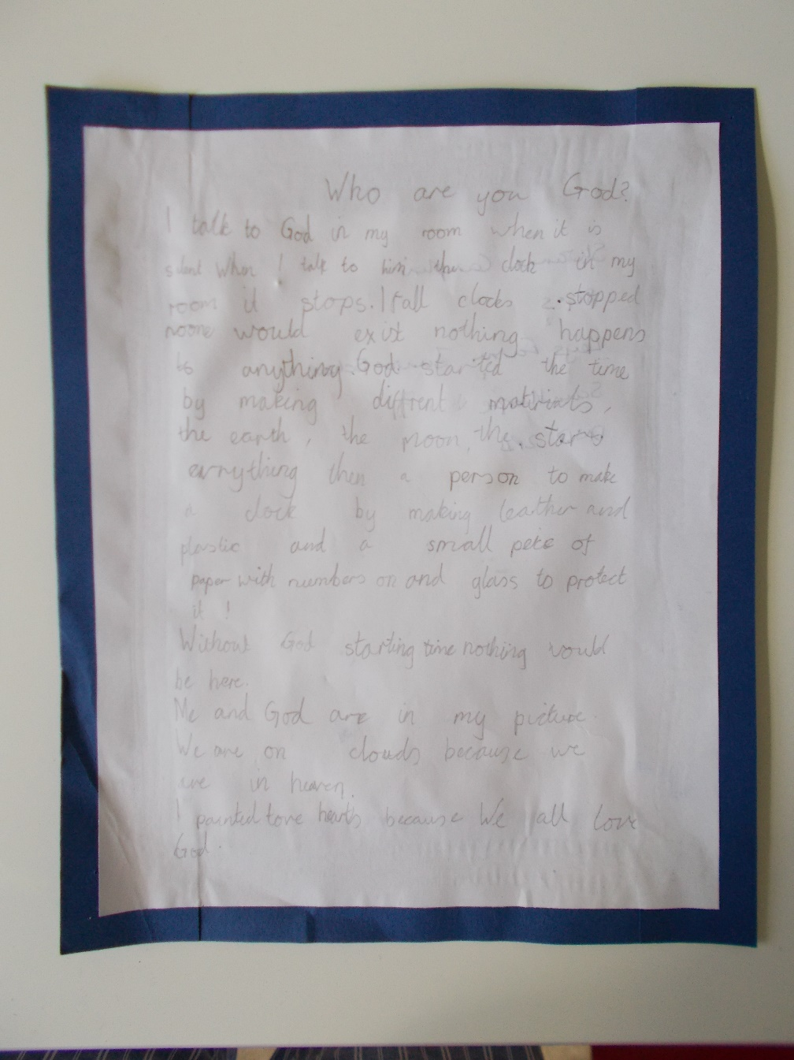

Slide 34
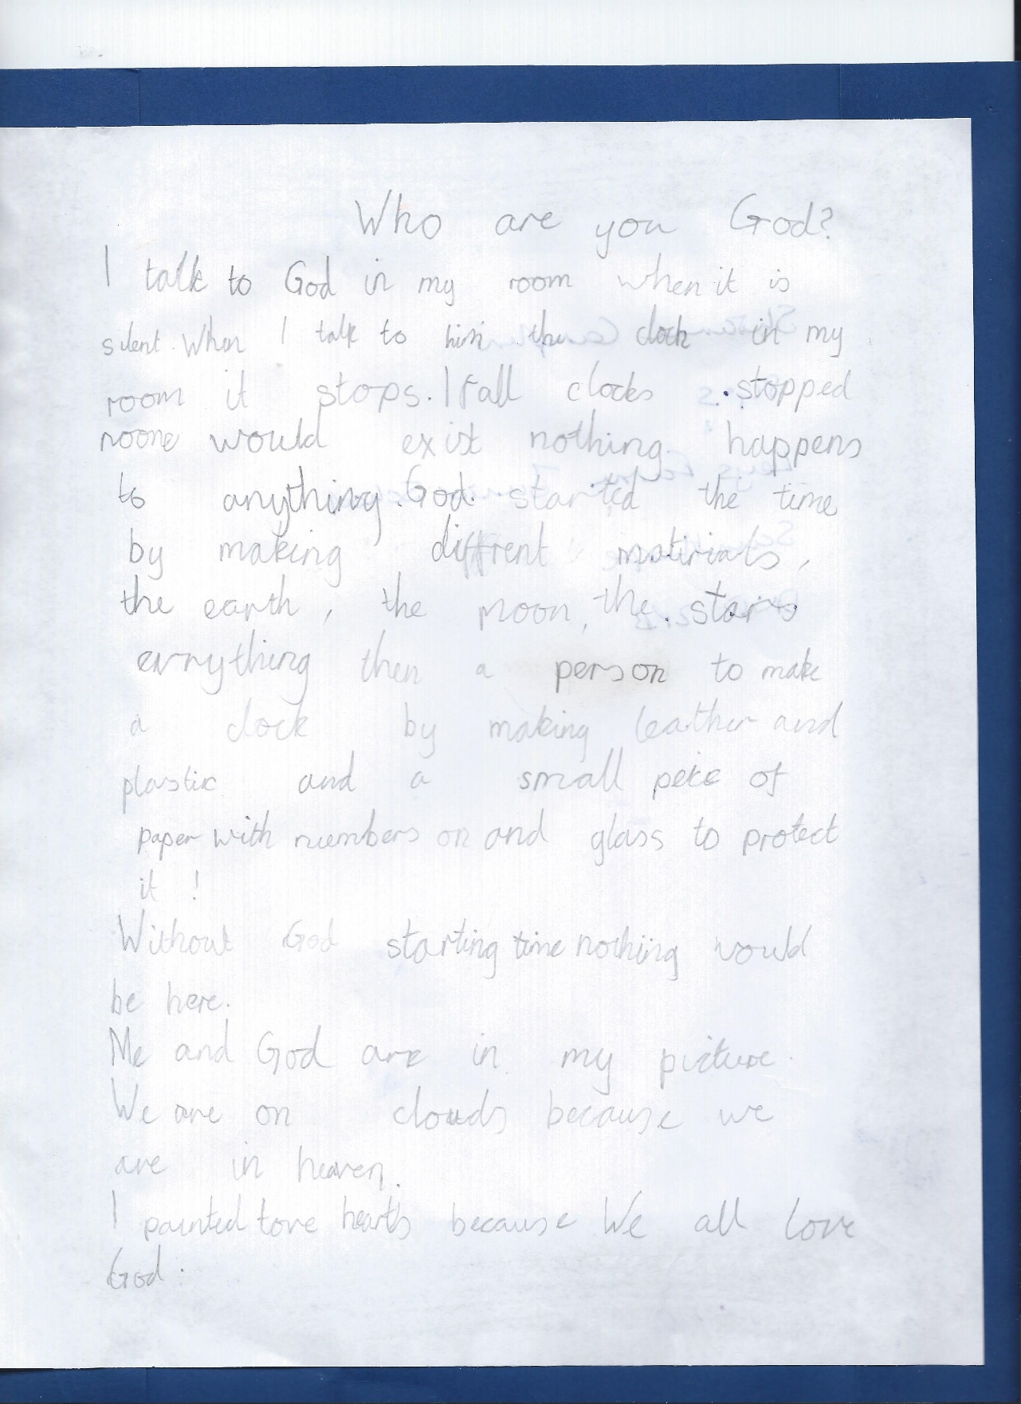

Who are you God?
“I talk to God in my room when it is silent. When I talk to him, the clock in my room, it stops. If all clocks stopped, no one would exist, nothing happens to anything. God started off the time by making different materials: the earth, the moon, the stars, everything. Then a person to make a clock small piece of paper with numbers n it and a glass to protect it. Without God starting time, nothing would be here.”

Slide 35
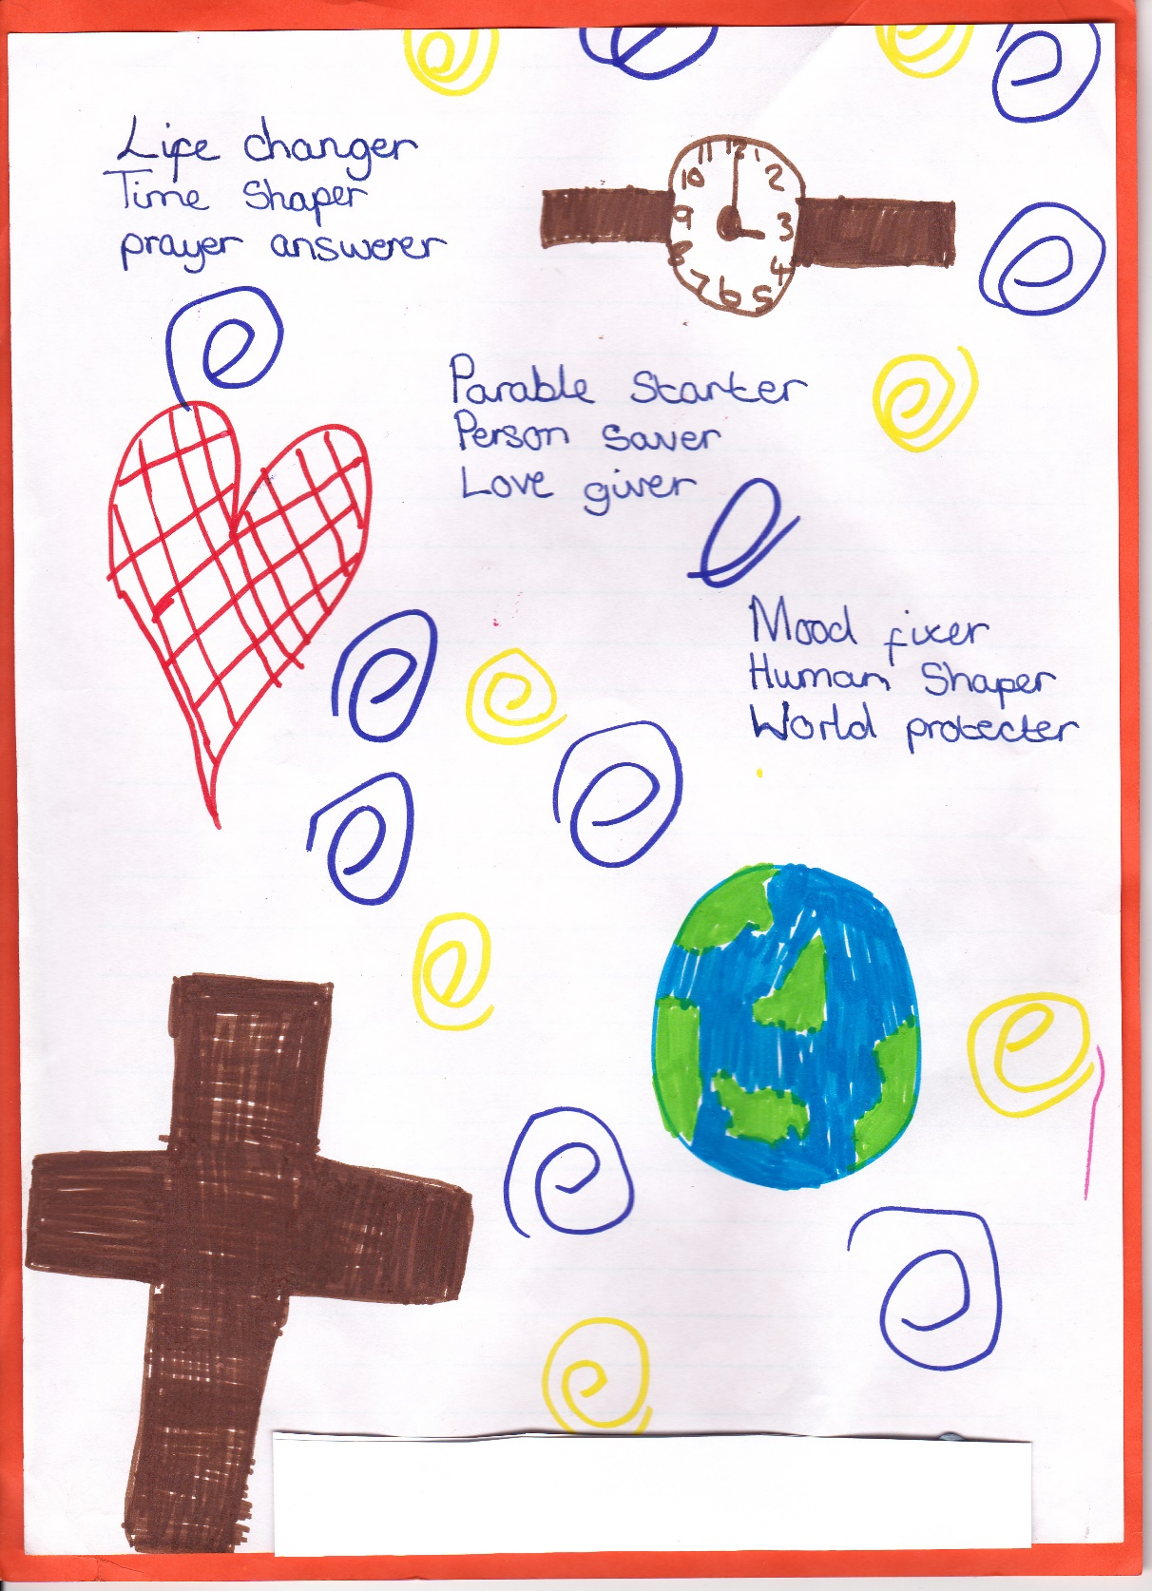

Slide 36
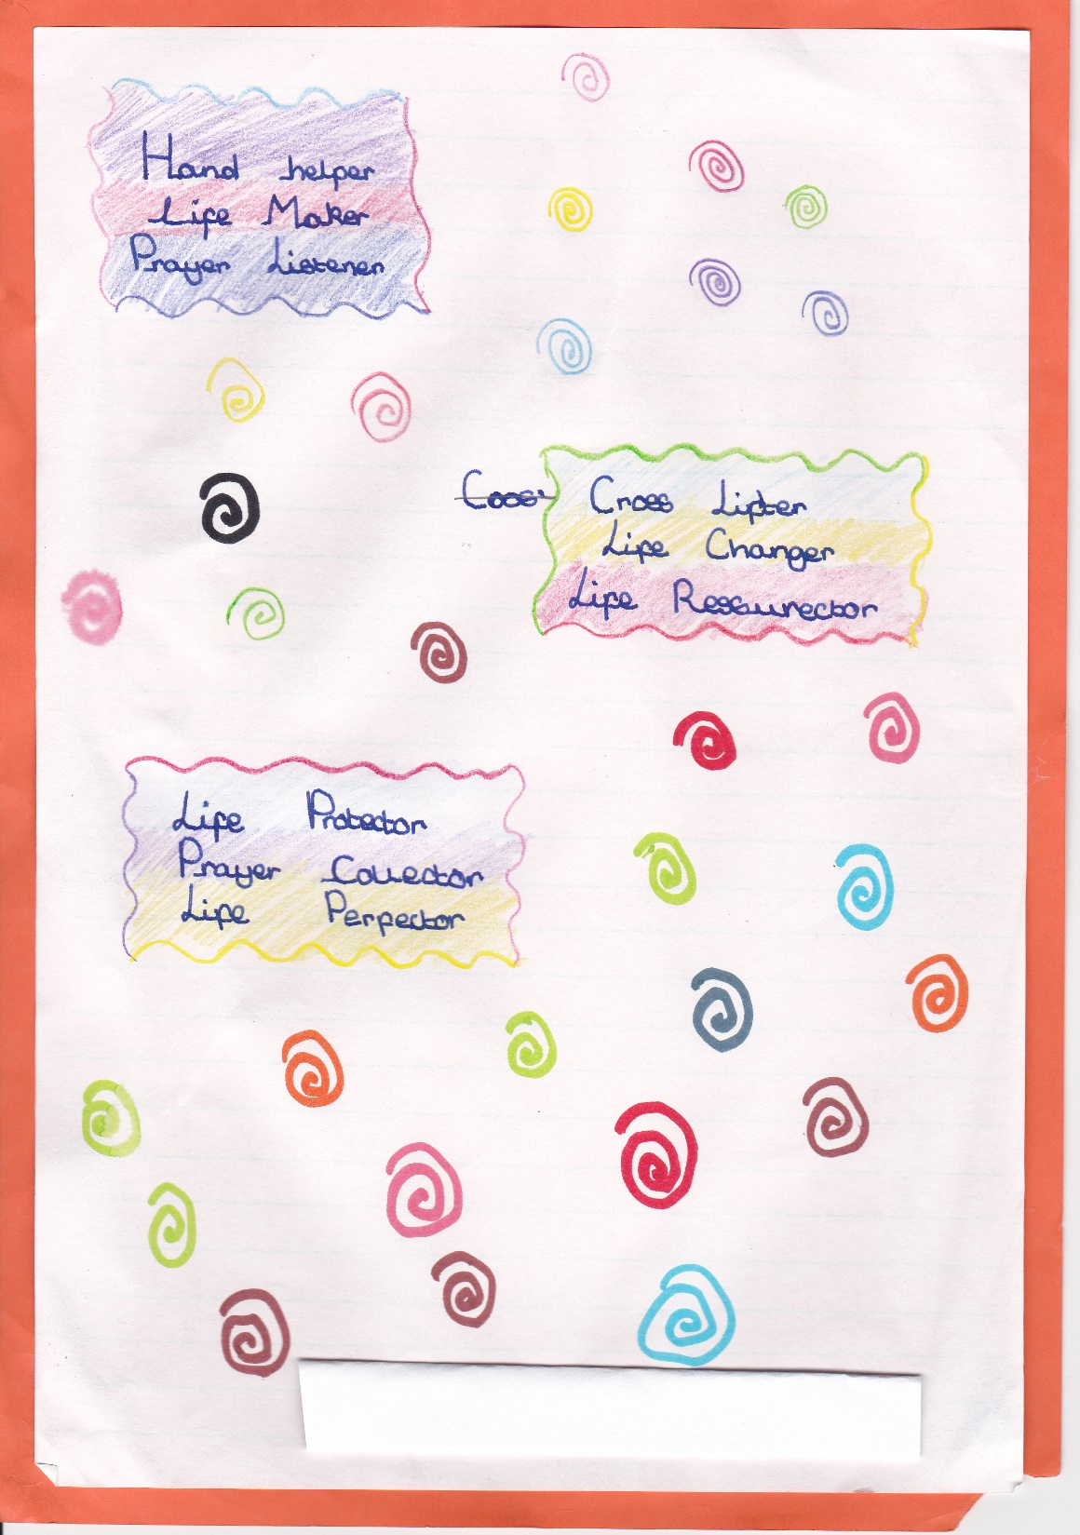

Slide 37
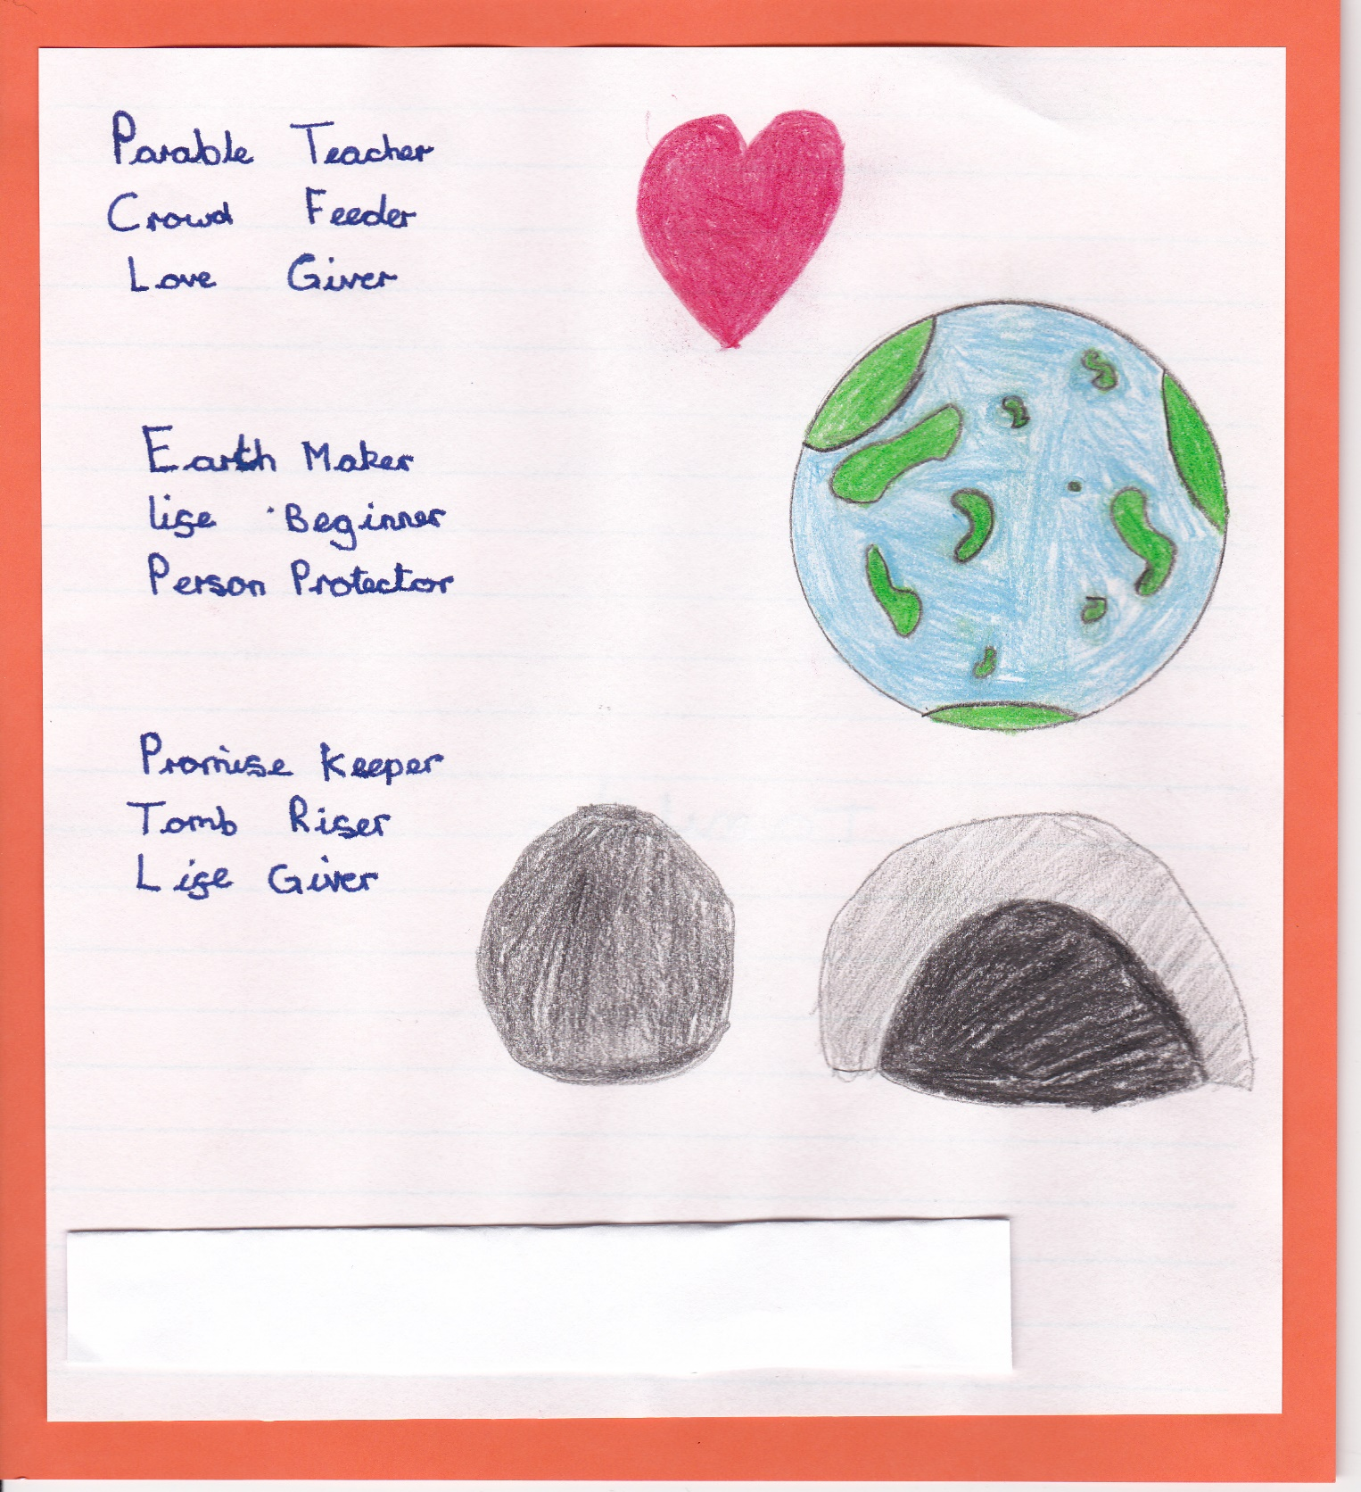

Slide 38
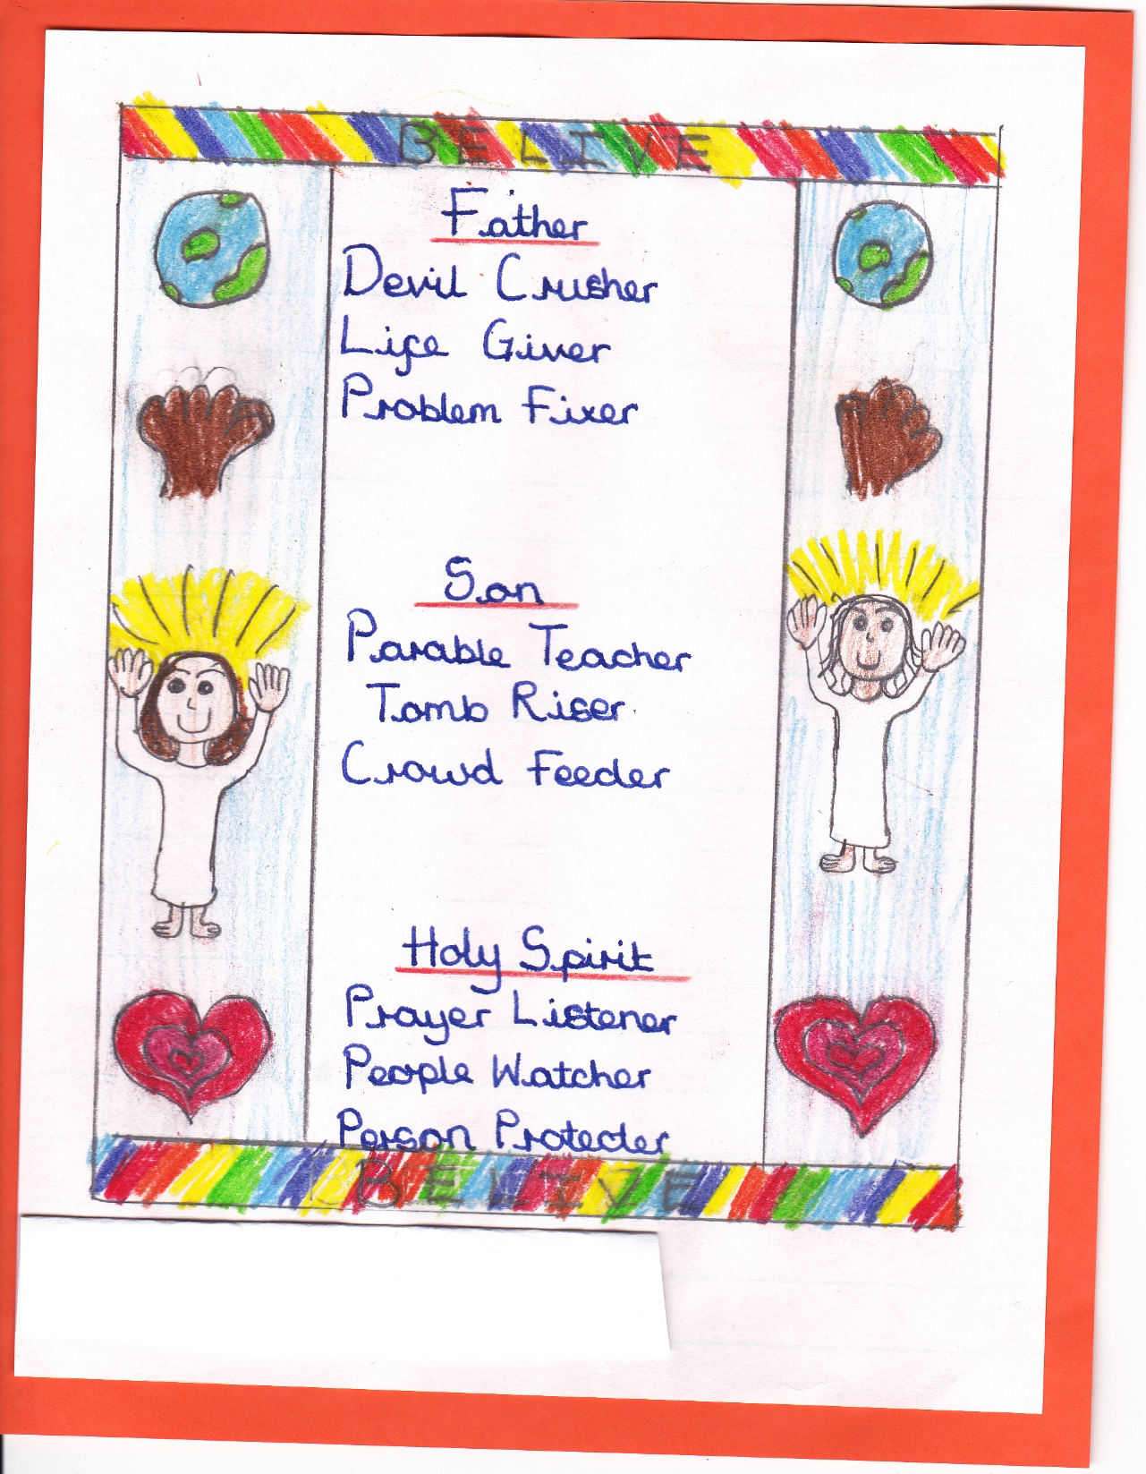

Slide 39
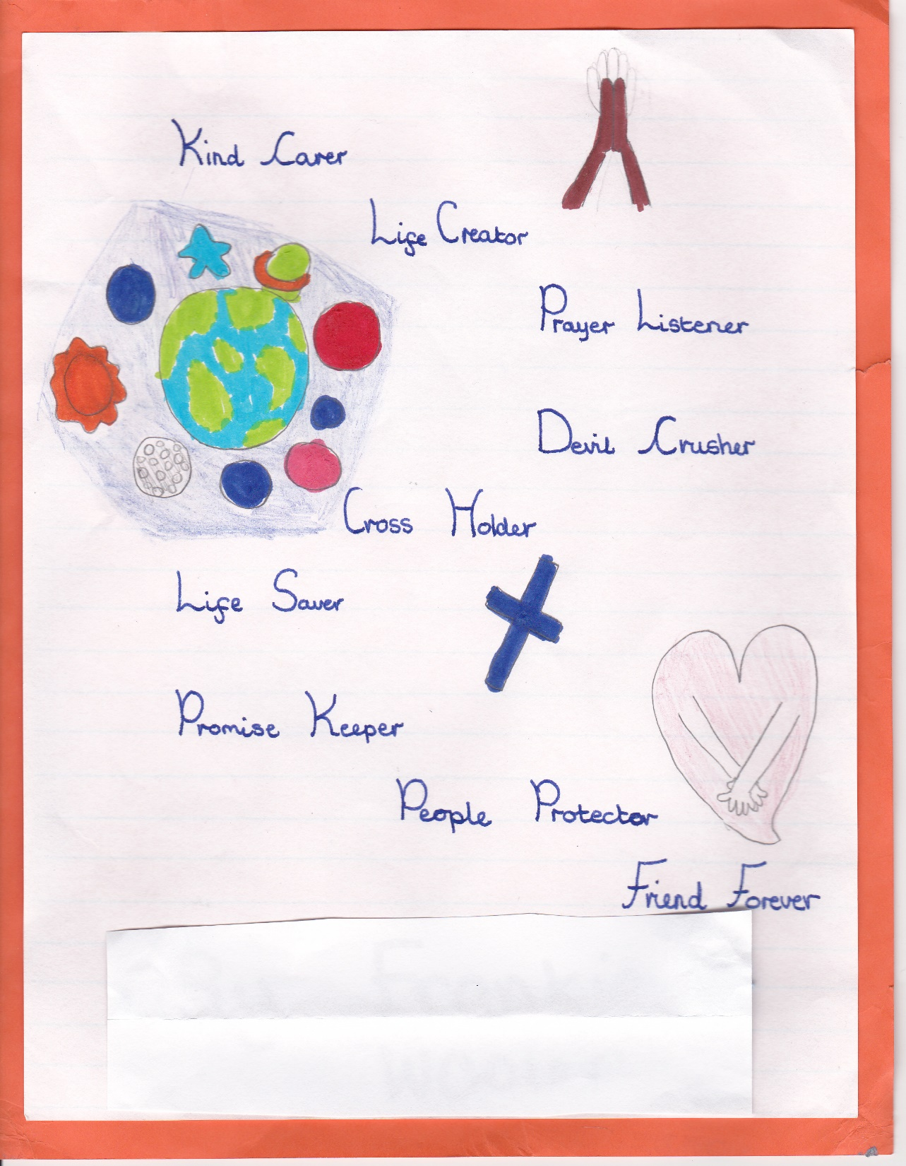

Slide 40
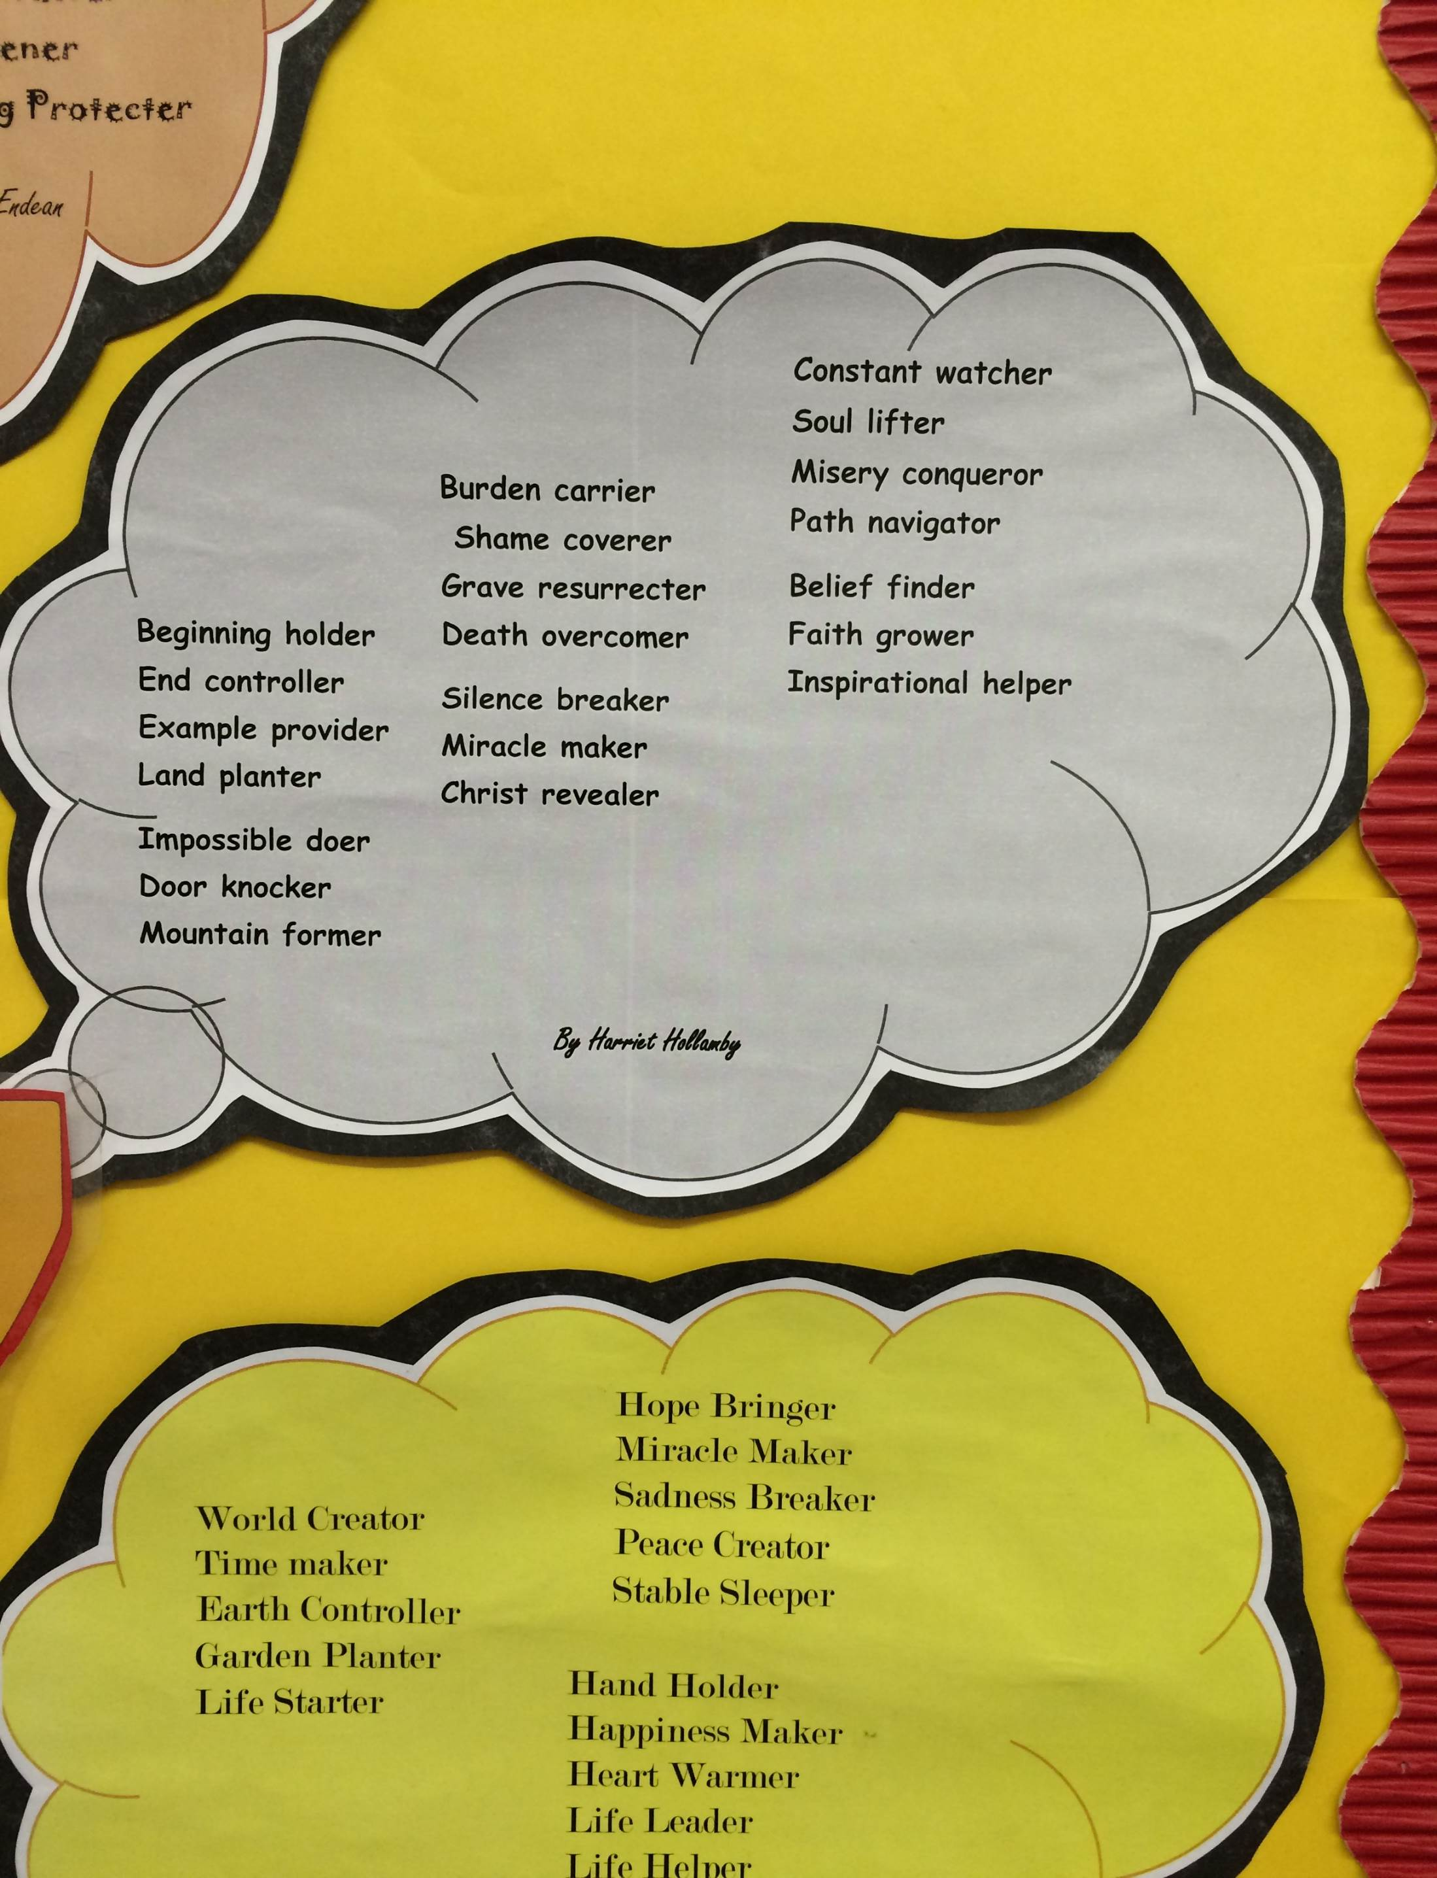

Slide 42
God is like...
Different people have different ideas about what God is like. What are your ideas?
You are going to discover five ideas about God from Christian people. Do you think they are good ideas?
Notes:
This simple slide is important because it launches enquiry with questions. Take a few minutes to hear some childrens’ ideas about these two questions, but move on fairly smartly.

Slide 43
Is God like any of these things in any way? Think carefully!
Puzzle
Tree
Shadow
Torch
Parent
Notes:
The key ideas here: Is God like a tree, a puzzle, a shadow, a parent, a torchlight? Again, give the pupils a short time for perhaps paired talk and answers, but move along fairly smartly. It may be good to have a TA record the ideas they come up with.

Slide 44
5 Christian comments about God:
“I think God is big and strong.”
“I think God can light up your life”
“I think God is puzzling and mysterious”
“I believe God is like your mum or your dad,
but even better.”
“My idea is that God is always really close to us,
but hard to see sometimes”
Can you choose a picture to go with each of the 5 ideas?
Notes:
Read these aloud and ask pupils if they can remember the five pictures, and see any links to them. The next slide will make those links clear to everyone, but some children may get there ahead of the class.

Slide 45
5 Christian comments about God: which picture?
“I think God is big and strong.”
“I think God can light up your life”
“I think God is puzzling and mysterious”
“I believe God is like your mum or your dad,
but even better.”
“My idea is that God is always really close to us, but hard to see sometimes”
Notes:
This time, ask some of the children who may be slower to understand these ideas to say why each of the pictures goes with the sentnece. Involving a high proportion of the class in speaking and listening actively is good RE and good literacy.

Slide 46
Christians think God is...
Like a tree because...
Like a torch because...
Like mums or dads because...
Like your shadow because...
Like a jigsaw because...
Notes:
You could at this point ask pupils to pair and share their ways of completing these sentences, then ask for some to give their ideas to the whole class. If you are working in Year 2, then you could ask for written answers as well.

Slide 47
The next 4 slides are art work from pupils who have been thinking about God. Look and learn, then make one of your own, using your own ideas about God
Notes:
Ask the children to think as they watch these pictures about the picture they would paint to show what God is like. Suggest that they might not paint a picture of God, but instead a painting of what reminds them of God, or what Christians think about God. Emphasise that they are invited to choose, and point out that there are many, many different beliefs about God. If your class has a mixture of pupils from different religions, take time to be affirming about all the faiths represented.

Slide 48
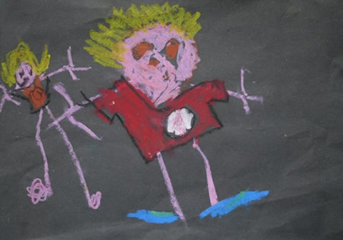
“God Is In Me and
In My Brother”
Anna Walker, Age 5
“Where is God? God lives in my little brother. And God lives in me”.
Notes:
You could ask children what they like about Anna’s picture. Ask them what they think as well: Is God in us? Is God in our brothers and sisters? Is God in every person? Varied answers are welcome of course.

Slide 49
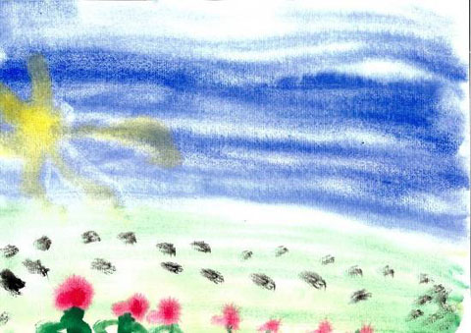
God's Footprints
Thomas Moore (5)
“In my picture I have painted the sky and the sun, then I added grass and flowers. Next I painted God’s footprints because although you can’t see God, I think you can see that He has been everywhere.”
Notes:
Ask children if they prefer Thomas’s picture to Anna’s and why. Talk about the idea that some Christians believe ‘God’s footprints’ are seen in the world of nature. Do they like this idea? What other ideas have they got about ‘God’s footprints’?

Slide 50
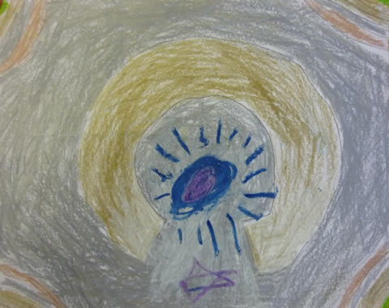
Who Is God? Joe, Age 7
“I think God is hope. Hope might look like a halo with lovely things around it.
I have drawn the halo with the sun shining in the middle. There is rainbow light coming out around the edges. He is also Spirit and human at the same time.
One of my friends said my picture looked a bit like a keyhole. That made me think that God is the key to heaven. So God is hope. He is the key to heaven.”
Notes:
There is a bit more to read here, so instead of getting the children to read it aloud, the teacher should do this. The ideas are more complex too, from 7-year-old Joao. Ask them first if they can see what he describes – the rainbow outline, the keyhole. Then read the text, and ask them what they don’t understand. Explain the ideas simply.

Slide 51
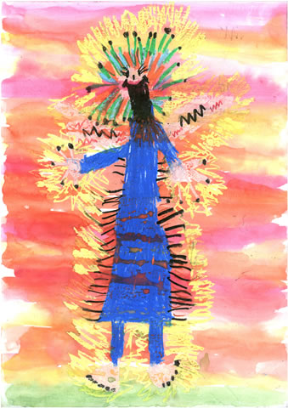
Amazing, Fabulous God. Samuel (6)
“This is my picture of God. He is showing us that he is amazing and fabulous!”
Notes:
Samuel is the only child to draw a picture of God. Tell children that some people think we cannot draw God because they believe he is invisible, and no one knows what he looks like. But what is good about Samuel’s picture? Do they like it better than the others?

Slide 52
My favourite picture is...
Because...
Notes:
Use this slide to get the children to say which one they like best, and which one they agree with most. Ask the children to make a work of art of their own showing their own answer to the question ‘Where is God?’

Slide 53
Expanding the work for different age groups
A preliminary activity might include children choosing an object / objects that is a ‘reminder of God’ This may be a found object from a school grounds walk, for example.
Use circle time to get children to explain their choices. If children are working outdoors (in EYFS for example) items from outdoors could also be included. They might also refer to the wind, trees, leaves, stones, water, sun, sky...
The paintings could be given to the children without the captions. Children could work together in pairs, small groups to talk about possible ideas of God the artist may have had. Then the caption could be given out...and discussed further.
Thanks to Angela Driscoll for these two excellent ideas.

Slide 54
The work in action: Angela Driscoll reports:
“I was at St Andrew’s C of E Infant School in Coventry this morning piloting the above materials with some reception age children. There were 15 lower ability children. Thank You to Mrs Sonja Parker, the class teacher, who very kindly agreed to me working with her class.
I have copied Sonja into this email so that, if you wished, you could ask her any further specific questions that you might have and if Sonja also wanted to add any other comments into the ‘mix’.
Preparation for the activity included a letter to parents/carers asking the children to bring in an object/photo of something that reminded the children of what God is like…
It was evident that the response/support from home was fantastic. Some parents had clearly talked with their child about the reasons for their choices. This helped the children with their responses in terms of the language they used and the confidence they had during the circle time session. The activity lasted approximately an hour and fell into two main parts:
Sharing of artefacts during a circle time session. Children placing their object onto a cloth in the middle of the circle so that we could all see the items.
Use of art (painting/drawing using wax crayons and pencils) to express their responses in a different way. Excellent activity for lower ability for language development (CLL), particularly speaking and listening.”

Slide 55
“Artefacts gave the children something concrete/personal that not only was valued, but effective as a prompt for expressing their thoughts and allowing the teacher to tailor questions accordingly;
Teacher able to summarise this part of the session by relating the 5 ideas about God (one girl brought in a torch, whilst a boy brought in some leaves) to the children’s ideas. This was received well by the children.
The second part could/should be a follow up session at another time or a ‘stand alone’ session. This particular group/ability found the art examples quite complex and clearly their art abilities were much less advanced. However, the children had a go and their oral responses were much more relevant and very interesting. (we will send these onto you, along with some photographs).
Other Thoughts: A group ‘collage’ – collection of photographs/catalogue/magazine cuttings/etc to create a group ‘God is like…’ Display of photographs of the objects children brought in and their responses (these were collated by a TA during the session) Activity repeated whilst working in the outdoor classroom. Children could be asked if they could see anything outdoors that reminded them of God…take photographs Weave in this type of activity at opportune moments, e.g. if using a torch in a science investigation, discuss the properties of light and of God being light; or if discovering ones shadow they can be asked to think about God being like a shadow..
We both thoroughly enjoyed being part of this session and felt that it would work well with other 4 and 5 year olds. The card sorting/reading/poem aspects of the resources, we would be recommended for older young children (Y2?).”
Angela Driscoll

Slide 56
“Do to all people as you would wish to have done to you; and reject for others what you would reject for yourself.” Muslim, Hadith of Abu Dawud | The Greatest Commandment: ‘Love the Lord your God with all your heart and with all your soul. Love him with all your strength and with all your mind. And, ‘Love your neighbour as you love yourself.’ Christian, Luke 10:28 | “I am a stranger to no one, and no one is a stranger to me. Indeed, I am a friend to all.” Sikh, Guru Granth Sahib 1299
“What is hateful to you, do not do to your fellow human” Jewish, Talmud: Shabbat 31a | “No one of you is a believer until he loves for his brother what he loves for himself.” Muslim, Forty Hadith of an-Nawawi,13 | “This is the sum of duty; do naught onto others what you would not have them do unto you.” Hindu, Mahabharata 5,1517
“A person should treat all creatures as he himself would be treated.” Jain religion, Sutrakritanga1.11.33 | “Strong one, make me strong May all beings look on me with the eye of a friend May I look on all beings with the eye of a friend May we look on one another with the eye of a friend” Hindu. Yajur Veda 36.18 | “Grant that we may not so much seek To be consoled as to console To be understood as to understand To be loved as to love.” Christian, St Francis of Assisi (1181-1226)
“Blessed is he who prefers his brother before himself.” The Baha’I faith, Tablets of Bah’a’ullah, 71 | “That nature only is good when it shall not do unto another whatever is not good for its own self.” Zoroastrian, Dadistan-i-Dinik, 94,5 | “Hurt not others in ways that you yourself would find hurtful.” Buddhist, Udana-Varga 5,1

Slide 57
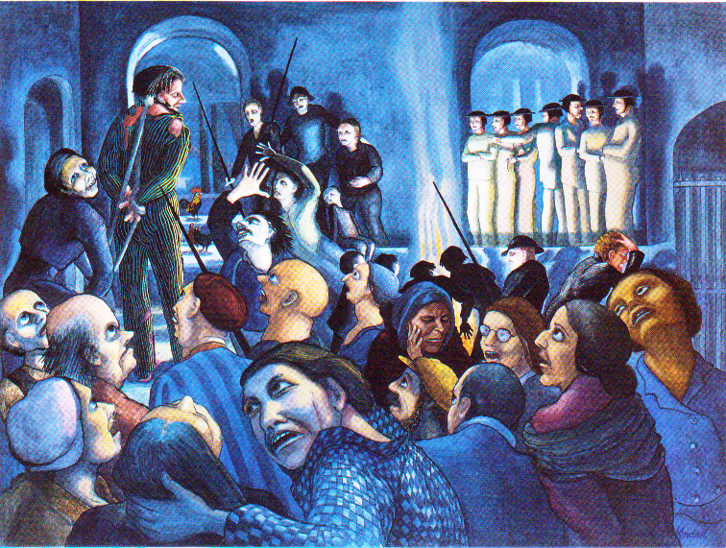
What might the rest of this picture show us?
How might a British artist from Sheffield show the story of Peter’s denial?

Slide 58
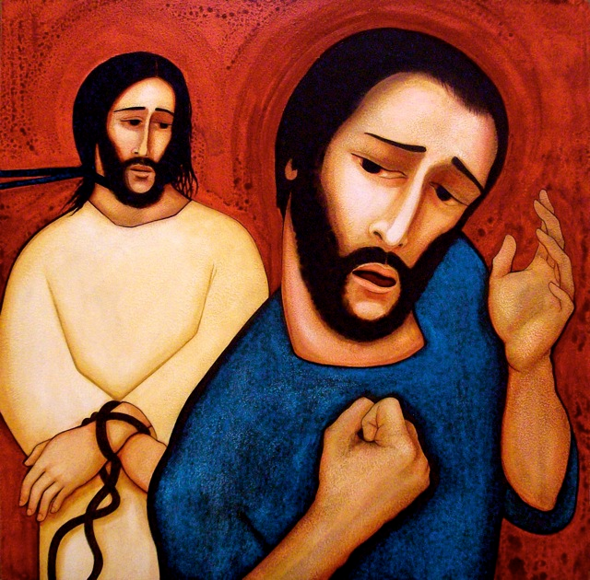
What might this artist show us –
the fist of Peter, the tied hands of Jesus?
Imagine what else you will see in a moment.

Slide 59
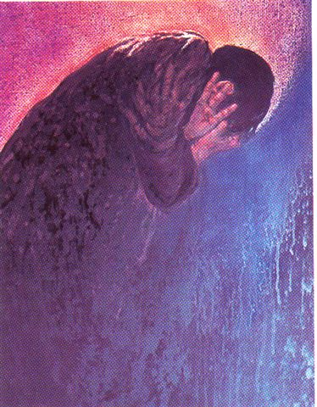
Frank Wesley is an Indian Christian artist
He uses two colours here.
What will you see from his painting about despair?

Slide 60
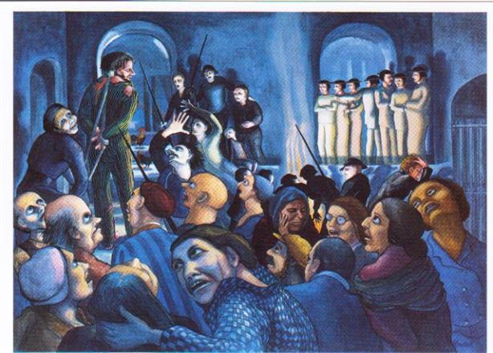


What is good about each picture?
Which is best, and why?
If you pictured Peter’s denial, how would you show it?
Notes:
Discuss

Slide 61
Stronger By Stephen Fischbacher
What do you do when you trip up
what do you do when you stumble
do you stay down on the ground
or get back on your feet again?
What do you do when you fall down
what do you do when you tumble
do you stay down on the ground
or get back on your feet again?
Stronger, (you’ll be stronger)
Stronger, (you’ll be stronger)
every time you get back
every time you get back up
What do you do when you fail it
what do you do when you lose it
do you stay down on the ground
or get back on your feet again?
What do you do when you miss it
what do you do when you blow it
do you stay down on the ground
or get back on your feet again?
Notes:
Show symbol movie
Play and sing

Slide 62
Lucy Chapman, class teacher:
“I thought I would share the outcomes of an RE lesson taught today to our Year Three/Four Class. They have had an RE focus week on Easter and have been taught by our NQT.
This lesson's learning objective was to explore Peter's actions and how these and his emotions could be represented through art. The class were shown a variety of artist's impressions of Peter's denial and the children tried described the colours and clues to explain his actions and convey meaning, before creating their own artwork.
The pupils were asked to describe the symbolism they had tried to include.”

Slide 63
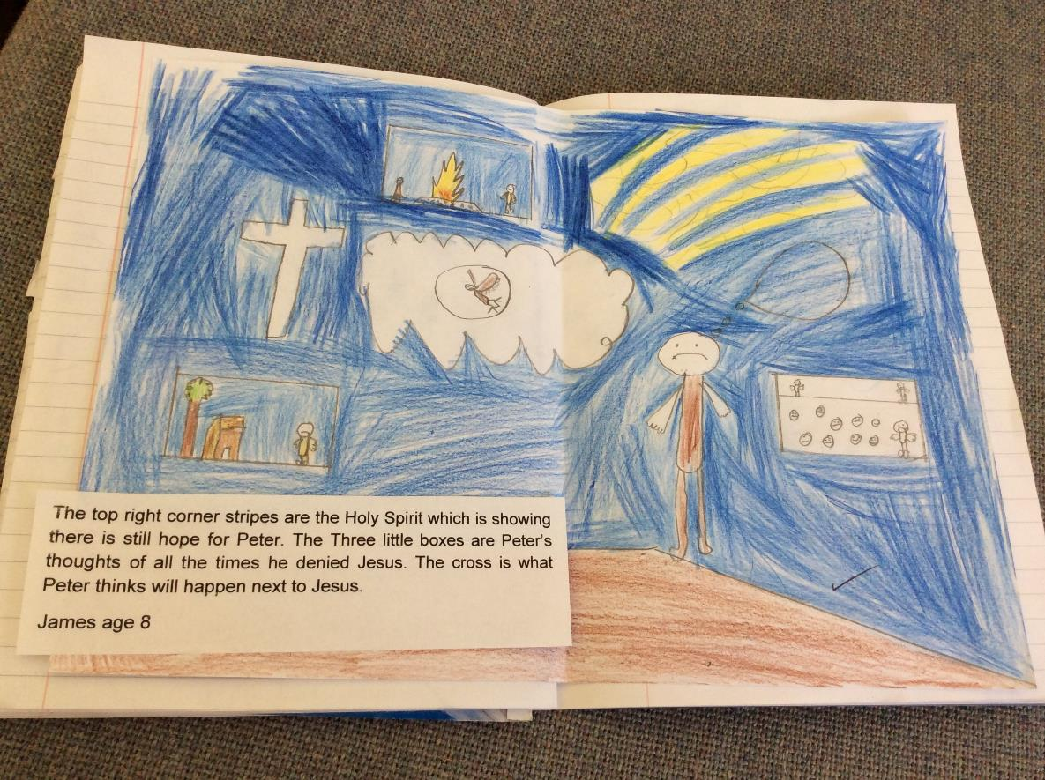

Slide 64
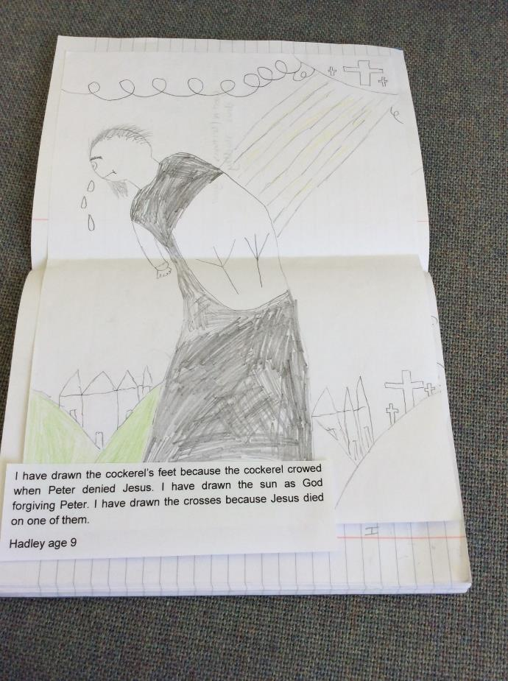

Slide 65
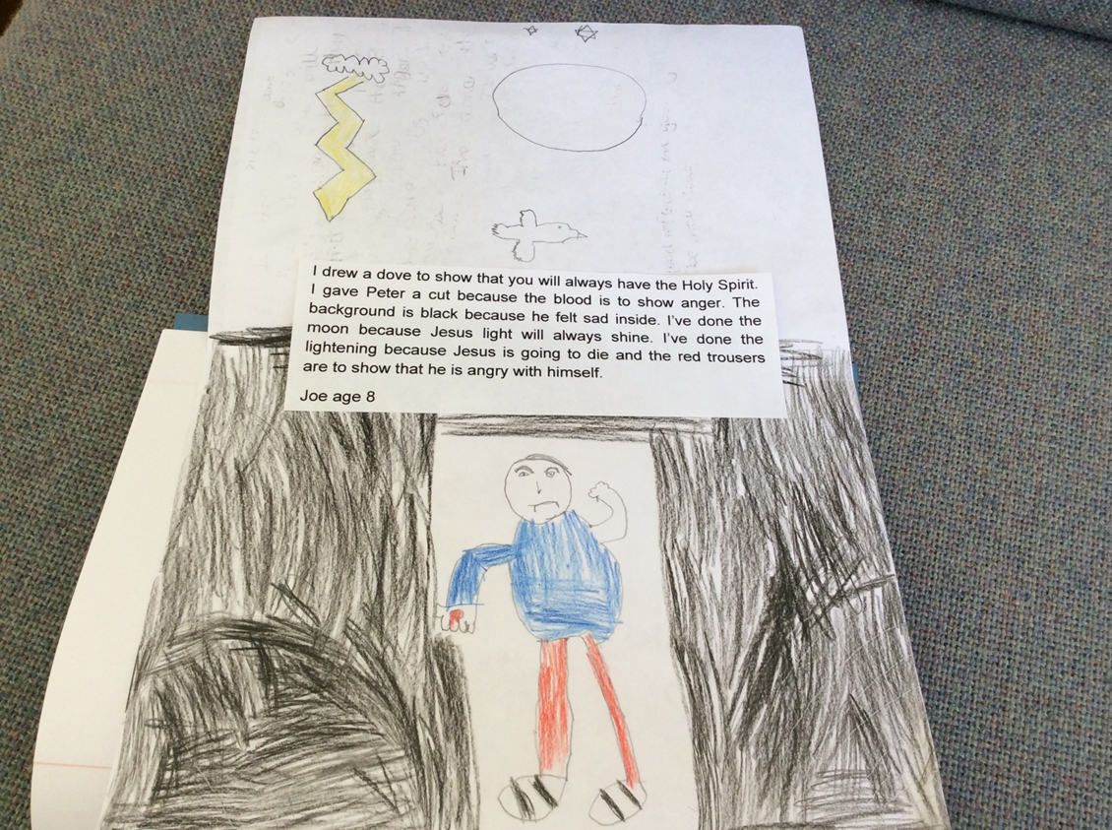

Slide 66
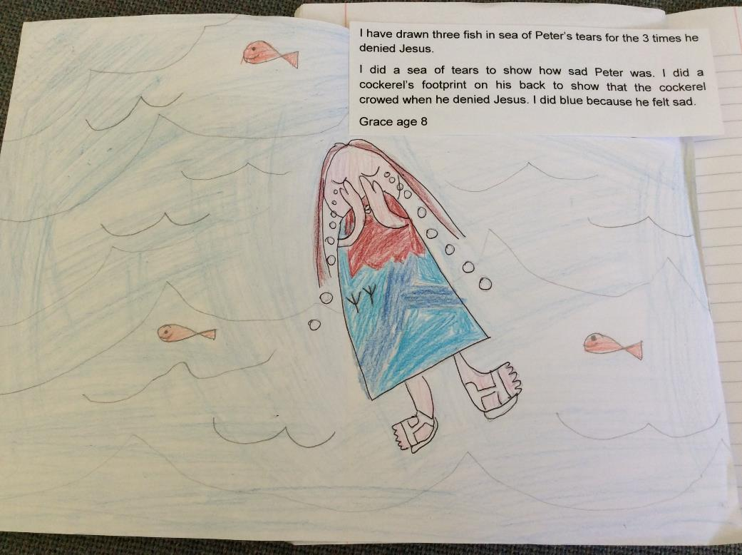

Slide 67
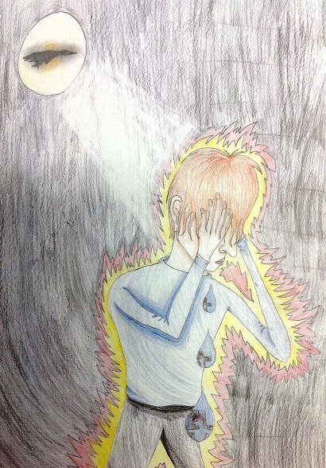
Peter’s Denial
Song: Stronger
Katie’s picture:
Forgive
She is 11

Slide 68

Forgive – Katie Holland age 11
The theme of my artwork is despair. The picture shows Peter after the three times he denied knowing Jesus. Also pictured in the drawing is the feeling that the light and love of God will always be with you; even if you have done wrong, the Lord will guide you back towards the right path. Peter has made a mistake but Jesus was still willing to forgive.
This is a spiritual picture. I’ve hidden some images in it. The three tear drops flowing from Peter’s eyes represent sorrow. The sun shines over the black background to symbolize the light still left in his soul. There is a silhouette of a dove in front of the sun, showing that the peace and love of God will always stay with him, even in his darkest times.
The background is black to represent dark sin. Peter is surrounded by yellow to show that he is scared for Jesus, and the red shows that he is angry with himself. Peter is wearing quite modern clothing to show that people today can still make mistakes, but they can be forgiven too. I did a modern style for the hair. The main point of the image is the brightness of the sun, which is a contrast to Peter’s action, but also the light of God’s love, leading him back towards the light.

Slide 69
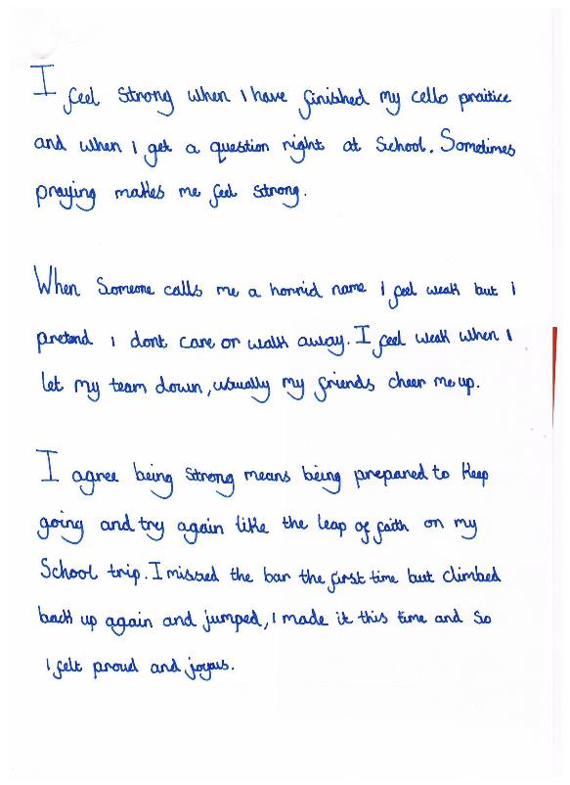
This example by Francesca, 10, shows that she can express many good ideas arising from thinking about the song and connecting it to her own ideas and experience.

Slide 70
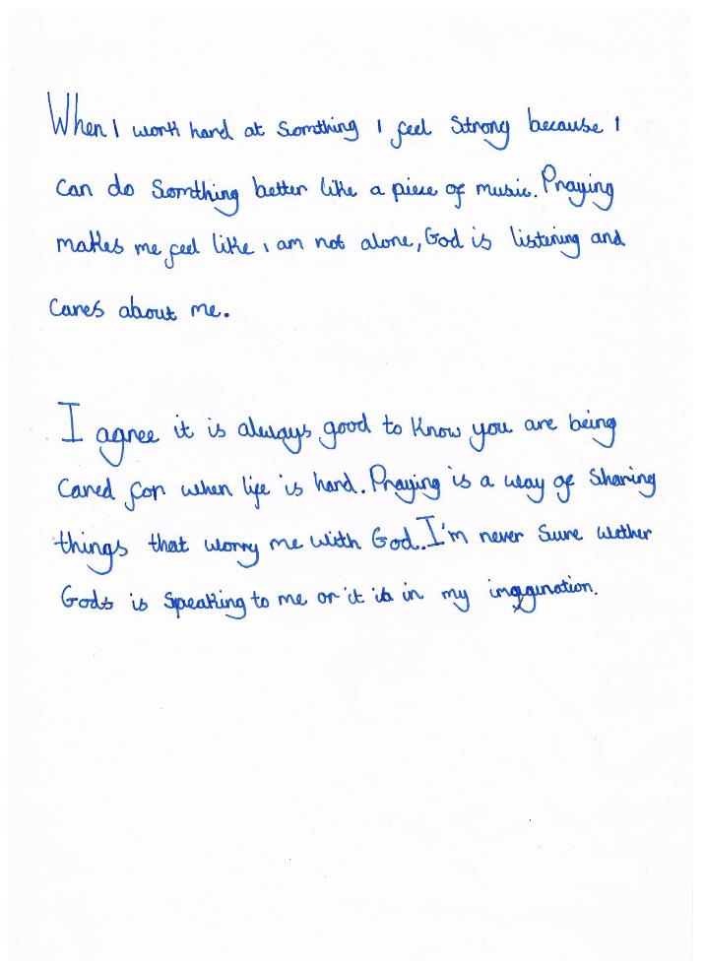
Francesca develops two of her ideas and raises a question about whether we can hear God. This work perhaps shows that it is worth encouraging pupils to deepen their answers in steps or by returning to them after further discussion.

Slide 71
Personal resilience?
Penitence?
Reconciliation?
The aims were to enable pupils…
To interpret the Biblical narrative of Peter’s denial for themselves
To consider questions about forgiveness, failure and recovery
To explore and apply ideas about symbolism for themselves

Slide 72
What does it mean to say a building is ‘for the glory of God?’
Unit L2.5 – Why do Christians call the day Jesus died ‘Good’ Friday?
Unit 3.6: Incarnation – Why do Christians believe Jesus was God on earth?
Teach Holy Week, worship, Easter and the resurrection from 4 ‘Cathedrals’

Slide 73
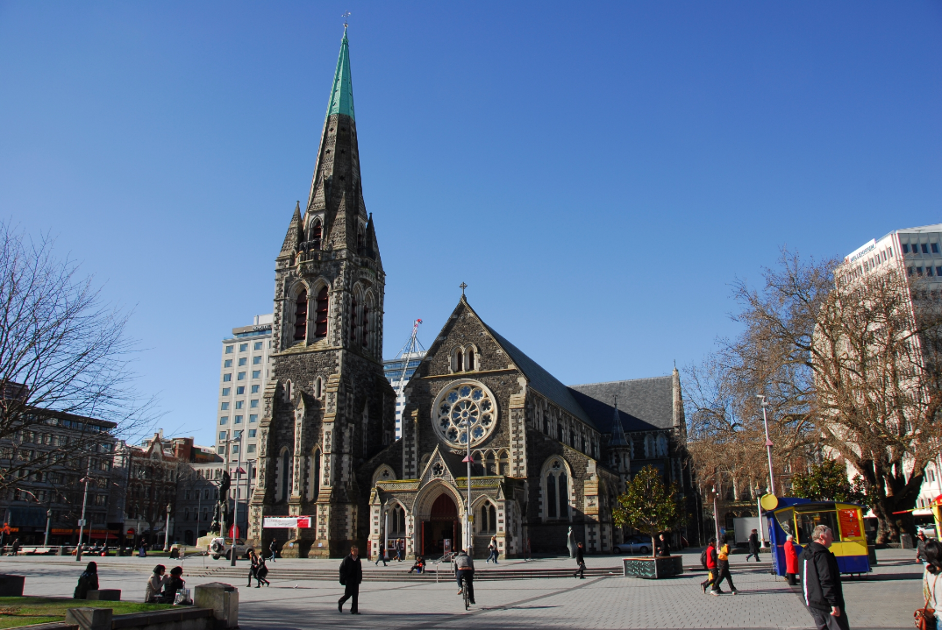

Slide 74
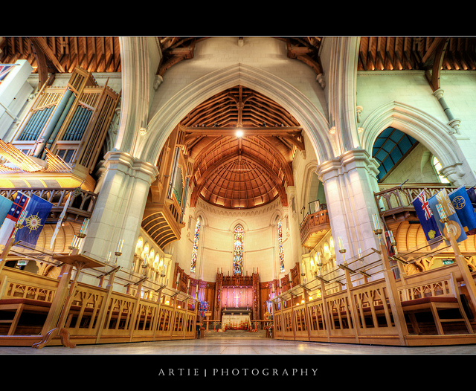

Slide 75
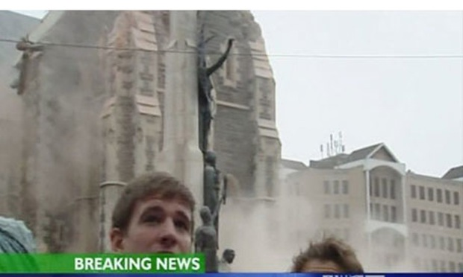
Earthquakes in Christchurch, NZ in September 2010 and February 2011 killed 185 people.
The iconic Cathedral was destroyed.
This is probably the last photo of the tower before it fell.
The young people pictured were safe.

Slide 76
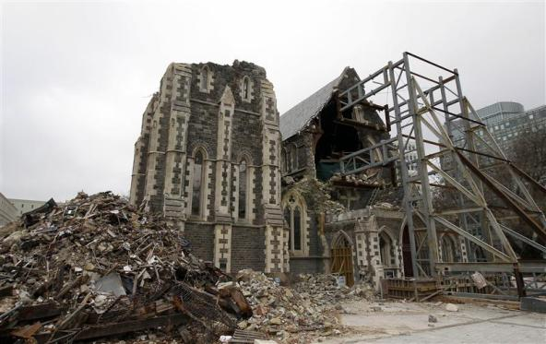
The Cathedral was beyond saving, and had to be pulled down. The Anglican Bishop of Christchurch, Rev Victoria Matthews, said:
“God did not cause the earthquakes. The earth moved because in this part of the world that is what the earth does. The acts of God were the loving selfless, even sacrificial, actions of many people who worked around the clock to free people from the rubble, remove the tonnes of liquid lava and serve water and food to those who had lost everything. That’s an act of God.”

Slide 77
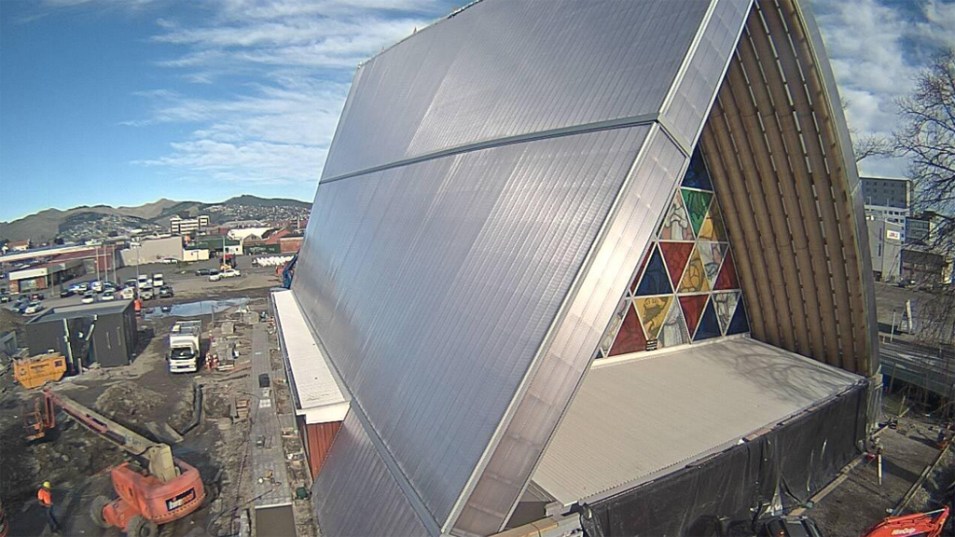
The new ‘Cardboard Cathedral’ opened in Christchurch last year. It is the most ecologically careful cathedral in the world and is – as near as can be – earthquake proof.

Slide 78

‘Cardboard Cathedral’ does indeed use recycled cardboard as the main raw material.
How does this new cathedral show that the Christian concept of resurrection can be ‘incarnated’ in a building? Does it express the Christian ideas of salvation? Life after death?

Slide 79

Lectern, cross and candle sticks saved from the earthquake carry the old into the new.
How does architecture express belief here?
“Like Christ himself, our Cathedral has risen from the dead, to the glory of God.”

Slide 80

Salvation, Incarnation.
Saint Paul says, in the Bible:
“I told you the most important part of the message exactly as it was told to me. That part is: Christ died for our sins, as the Scriptures say. He was buried, and three days later he was raised to life…
The bodies we now have are weak and can die. But they will be changed into bodies that are eternal. Then the Scriptures will come true:
“Death has lost the battle!
Where is its victory?
Where is its sting?”
Thank God for letting our Lord Jesus Christ give us the victory!”
How do these words from the Bible connect to the story of Christchurch Cathedral?

Slide 81

King’s College Cambridge Chapel
3pm 24th December
9 lessons and carols
Broadcast annually since 1928
The most popular service of Anglican worship ever?

Slide 82

Next to the motorway, the Milton Keynes Tree Cathedral was planted 30 years ago to the groundplan of Norwich Cathedral.

Slide 83

What questions does this raise?

Slide 84




Four Christian buildings:
In what ways is each one ‘to the glory of God?’

Slide 85
Some shallow learning
Christian worship: many forms, global;
Cathedral: a seat for a Bishop;
One for each diocese – 44 Anglican and 21 Catholic in the UK;
Earthquakes in Christchurch, NZ, 2010;
BBC: ‘9 lessons and carols’, King’s Cambridge;
The tree Cathedral ~ what is it?
Concept of resurrection – what does the word mean?

Slide 86
Some deeper learning: add loads more information, perspective and concepts to explore debates and dilemmas: do these cathedrals ‘glorify God’, as Christians seek? What does that mean? What would be a good trend in 21st century cathedral design? How do these ideas connect to scripture? Should these cathedrals be sold to help the poor? What critiques are available?
“God is glorified where human hearts are filled with love. Sell the buildings! Give to the starving!”
“In Christianity’s green future, cathedrals will have to be cheaper and so more natural”
“Ancient buildings which have been the space for God’s glory for centuries are treasures held in trust for the future. Love these buildings.”
“It is never the building that glorifies God, but the heart of a worshipper – but the buildings create spiritual space for the heart to respond.”

Slide 87
Join NATRE Today
1000+ free downloads
96 page mag, termly
3 new books every year
Discounts on RE Today and NATRE stuff
£75 the year (£6.25 the month, cash/card/school)
Art in Heaven comp: £1000 in prizes
Have a free 32 page showcase

Slide 88

The legend of the three trees

Slide 89
Once there were three young trees growing in the woods. They were all good, strong trees, and they were all excited about the future.
One day they were discussing their hopes and dreams when the first tree said, "Someday I hope to be a treasure chest. I could be filled with gold, silver and covered in precious jewels. I could be decorated with intricate carving and everyone would see the beauty. I’d love it if my wood was made into a treasure chest."

Slide 90


Slide 91
Then the second tree thought about how she would like to end up. She had a different idea.
She said, "Someday I will be a mighty ship’s mast. I will hold the sails that catch the wind to take kings and queens across the waters and sail to the corners of the world. Everyone will feel safe in my ship because of the strength of my wood and the mast I make."

Slide 92


Slide 93
After a lot of thinking, the third tree said, "I want to grow for many years and be one of the tallest and straightest trees in the forest. I don’t think I want to be cut down and made into anything. I’d like to stand here, on the hill, and point people to God.”
The trees grew quietly. Each one was strong, and beautiful. The three trees hoped and prayed that their dreams and ambitions might become true: a treasure chest, a ship’s mast, a signpost to God.

Slide 94


Slide 95
Then one day a group of woodsmen came into the forest and chose these three trees to cut down for their wood.
When one came to the first tree he said, "This looks like a strong tree, I think I should be able to sell the wood to a carpenter"; and he began cutting it down. The tree was anxious, but also happy, because he knew that the carpenter would perhaps make him into a treasure chest.

Slide 96
At the second tree a woodsman said, "This looks like a strong tree, I should be able to sell it to the shipyard." The second tree was a bit alarmed, but she was also happy because she knew she might be on the way to becoming a mighty ship’s mast.

Slide 97
When the woodsmen came upon the third tree, the tree was frightened because he knew that his dreams might not come true. The woodsmen said, "I like the look of this one. I’ll take the wood to the city.” And he cut it down.
The tree fell, and the wood was taken to a wood yard in the city. The third tree knew that his ambition would have to change.

Slide 98

When the first tree arrived at the carpenters, he was made into a feed box for animals. He was then placed in a barn and filled with hay. This was not at all what he had prayed for.

Slide 99


The second tree was cut and made into a small fishing boat. She floated on a lake, and smelled of rotten fish. Her dreams of being a mighty ship’s mast and carrying the Kings and Queens to all parts of the world had come to an end. This was not the future she had prayed for.

Slide 100
The third tree was cut into large pieces and left alone in storage.
Years passed by.
More years went by, and the trees forgot about their dreams.

Slide 101
Then one day, a man and a young woman came to the barn where the wood of the first tree served as a cattle trough full of hay. By the light of the stars, the young woman gave birth to a child and the man placed the baby in the hay in the feed box that was made from the first tree.
The man wished that he could have made a crib for the baby, but all he said was ‘this manger will have to do, Mary’.
The tree could feel the baby lying in the manger. The manger held a treasure greater than all gold and all jewels. The greatest treasure of all time.

Slide 102
Years later, a group of men got in the fishing boat made from the second tree. One of them was tired and went to sleep. While they were out on the water, a great storm arose and the tree didn't think it was strong enough to keep the men safe. The sails whipped in the wind, and the mast was near to breaking.
The men woke the sleeping man, and he stood and said, "Peace!" and the storm stopped.
The tree could hear the words of the young man, calling the waves and wind to peace. At this moment, the tree knew that it was the King of Kings who slept in the smelly fishing boat.

Slide 103

Another year went by. In the city, a soldier came and took two beams from the wood of the third tree. One was laid on the back of a young man, and carried through the crowded streets. People mocked the man who was carrying it, laughing at his pain. When they came to a stop, the man was nailed to the tree and raised in the air to die at the top of a hill.
When Sunday came, the third tree remembered its old dream: to be a signpost to God on a hill top.
The tree realized that it had become a strange kind of signpost because Jesus had been crucified on it.

Slide 104


Slide 105
If you were a tree, what would you like to be made into?
Did the trees get what they wanted?
What Bible stories does this story link up to? How? Why?
If you plan the future, but don’t get it, what then?
Is it important to have dreams and ambitions?
Was Jesus’ manger more important than a treasure chest?
Does money matter most, or do other things matter more?
Is a king more important than a poor person, or does everyone matter the same?
“We don't always know what God's plans are for us. We just know that His ways are not our ways, but His ways are always best.” What do you think of this? Do you agree?

Slide 106
The legend of the three trees

Slide 107

Adam is 6. He lives with his family – his brother David is 13 and his sister Hannah is 10

Slide 108

Why not try using a simple writing frame to capture learning for Year 2 pupils?
Holly, 7, heard a story from Adam and asked some questions. The class were very excited by the persona doll activity (a first for them). She remembers and records what caught her attention from the story.

Slide 109

Tony, in Year 2, heard a story about Moses from Adam and asked some questions. The class were very interested in what happens when Adam and his big brother fall out! Tony remembers and records three things, one personal, one from the story, and something else Adam ‘said’ about wearing a Kippah and remembering God.

Slide 110

Why not try telling stories where Jewish or Sikh children’s lives are religiously different, but in other ways – football for example – similar to the children in your class? (Julia’s Jewish doll is called Avi, but he does look a bit like Lat’s persona doll, who is called Adam)

Slide 111

James is 6, and he lives with his mum and dad and his sister Ella. She is 9.

Slide 112

James has been watching a movie about Jesus.

Slide 113


Slide 114
Steps to successful doll work
Look at your class
Look at the gaps and missing features
Find / buy and accessorise your doll
As a staff discuss the issues to explore and create your persona
Record the details
Introduce the doll
Avoid...
...always using negative issues
...too many sensitive issues
...stereotyping
...allowing the doll to be played with outside the specific situations you set up

Slide 115
Why not try plugging the ‘gaps’ in your school or locality with a persona doll?
Adam is 6. He lives with his family – his brother David is 13 and his sister Hannah is 10. sometimes they fall out. On Shabbat they go to Synagogue.

Slide 116


David, 13, has a special ‘Britiish Jewish Kippah’

