Slide 1
Launch Liturgy

Slide 2
Opening Hymn
WELCOME/GATHER
To start our time of prayer we pause and ask the Holy Spirit to fill and guide us. © Holy Spirit Living Breath of God - Keith & Kristyn Getty

Slide 3
Opening Prayer
WELCOME/GATHER
In the name of the Father, and of the Son, and of the Holy Spirit. R/ Amen
Come Holy Spirit, fill the hearts of your faithful and kindle in them the fire of your love. Send forth your Spirit and they shall be created.
R/ And You shall renew the face of the earth.
O, God, who by the light of the Holy Spirit, did instruct the hearts of the faithful, grant that by the same Holy Spirit we may be truly wise and ever enjoy His consolations, Through Christ Our Lord,
R/ Amen.

Slide 4
Scripture - Luke 24:13-35
WORD
Two of the disciples of Jesus were on their way to a village called Emmaus, seven miles from Jerusalem, and they were talking together about all that had happened. Now as they talked this over, Jesus himself came up and walked by their side; but something prevented them from recognising him. He said to them, ‘What matters are you discussing as you walk along?’ They stopped short, their faces downcast.
Then one of them, called Cleopas, answered him, ‘You must be the only person staying in Jerusalem who does not know the things that have been happening there these last few days.’ ‘What things?’ he asked. ‘All about Jesus of Nazareth’ they answered ‘who proved he was a great prophet by the things he said and did in the sight of God and of the whole people; and how our chief priests and our leaders handed him over to be sentenced to death, and had him crucified. Our own hope had been that he would be the one to set Israel free. And this is not all: two whole days have gone by since it all happened; and some women from our group have astounded us: they went to the tomb in the early morning, and when they did not find the body, they came back to tell us they had seen a vision of angels who declared he was alive. Some of our friends went to the tomb and found everything exactly as the women had reported, but of him they saw nothing.’

Slide 5
Scripture - Luke 24:13-35
WORD
Then he said to them, ‘You foolish men! So slow to believe the full message of the prophets! Was it not ordained that the Christ should suffer and so enter into his glory?’ Then, starting with Moses and going through all the prophets, he explained to them the passages throughout the scriptures that were about himself.
When they drew near to the village to which they were going, he made as if to go on; but they pressed him to stay with them. ‘It is nearly evening’ they said ‘and the day is almost over.’ So he went in to stay with them. Now while he was with them at table, he took the bread and said the blessing; then he broke it and handed it to them. And their eyes were opened and they recognised him; but he had vanished from their sight. Then they said to each other, ‘Did not our hearts burn within us as he talked to us on the road and explained the scriptures to us?’
They set out that instant and returned to Jerusalem. There they found the Eleven assembled together with their companions, who said to them, ‘Yes, it is true. The Lord has risen and has appeared to Simon.’ Then they told their story of what had happened on the road and how they had recognised him at the breaking of bread.
The Word of the Lord R/ Thanks be to God

Slide 6
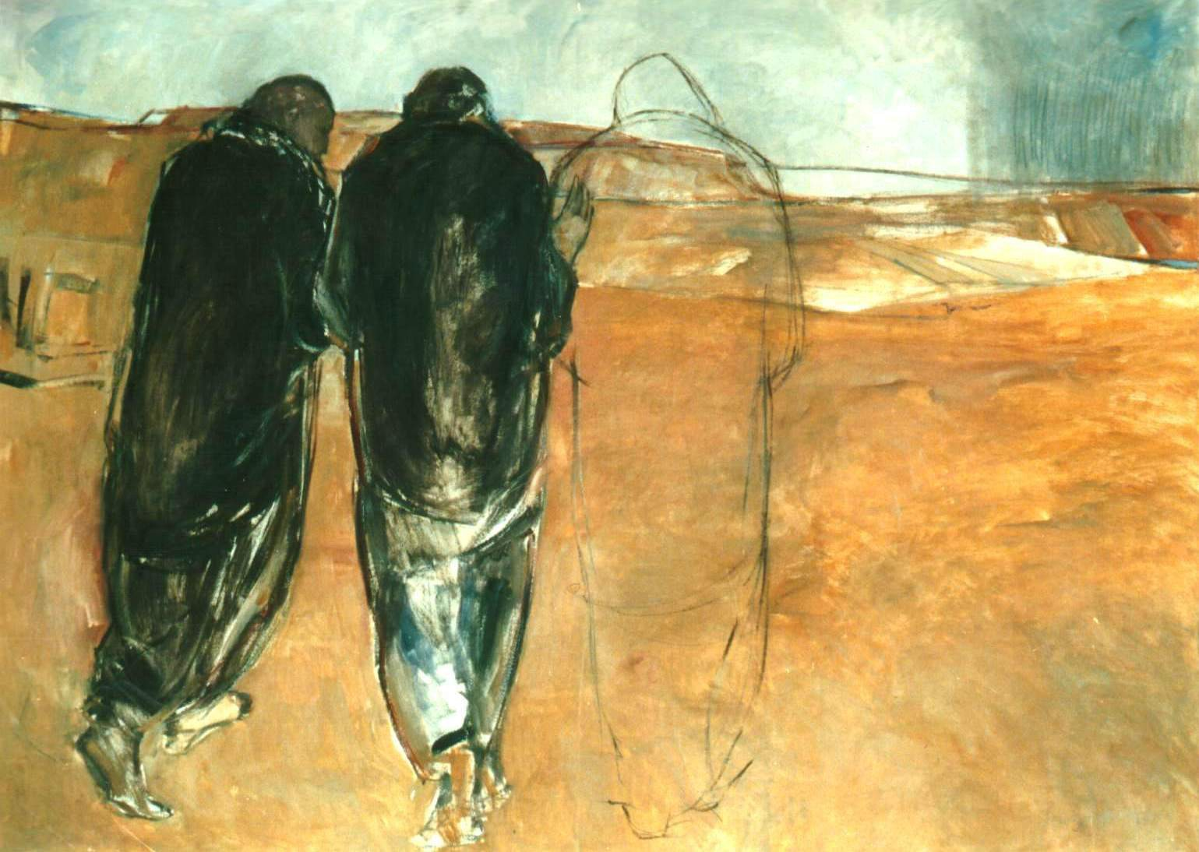
Reflection
RESPONSE TO THE WORD
The Gospel we have just heard is known as ‘The Road to Emmaus’.
It is a story we often hear in the season of Easter.
What stands out to you from the story?
What do you think is happening here?

Slide 7
Reflection
RESPONSE TO THE WORD
In the story, we hear how the disciples are so upset about the death of Jesus, that they don’t even notice him walking alongside them.
Jesus walks on the road with them. He listens to their story and shares in their suffering. He then explains Scripture to them.
Jesus walks with us too on the road of life and shares in our sufferings and joys. Let’s ask him to guide us as we together discern the way forward for the Church…
Stay with us Lord, on our Journey.

Slide 8
Taking part in the Synod
WITNESS
There are many ways you can support the Synod. Here are just some:
PRAY – Please pray for the Universal Synod, asking the Holy Spirit to guide the entire People of God in their discernment. We pray especially for Bishop John and Pope Francis and all those who will take part in the Synod of Bishops in 2023.
RESPOND – After prayer and discernment, make a response online to the ‘Synod Survey for Young People’ and encourage family and friends to do the same. There is a survey for adults too.
GET INVOLVED – The themes for the Synod are Communion, Participation, and Mission. Find out more about how you can support your parish community. There are many ways you can support the Mission of the Church by taking an active role in the Catholic Life of your school community through prayer and helping others.

Slide 9
Closing Prayer
Adsumus, Sancte Spiritus – St. Isidore of Seville – used before each session at Vatican II
We stand before You, Holy Spirit, as we gather together in Your name.
With You alone to guide us, make Yourself at home in our hearts;
Teach us the way we must go and how we are to pursue it.
We are weak and sinful; do not let us promote disorder.
Do not let ignorance lead us down the wrong path nor partiality influence our actions.
Let us find in You our unity so that we may journey together to eternal life and not stray from the way of truth and what is right.
All this we ask of You, who are at work in every place and time, in the communion of the Father and the Son, forever and ever. Amen.

Slide 10
Launch Liturgy

